Slide 1

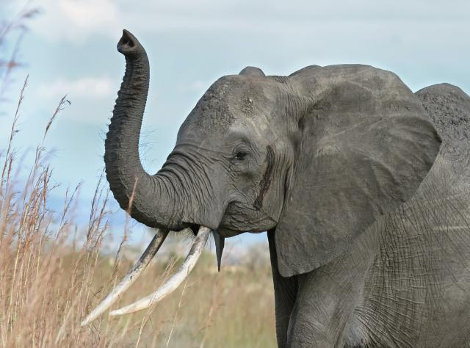
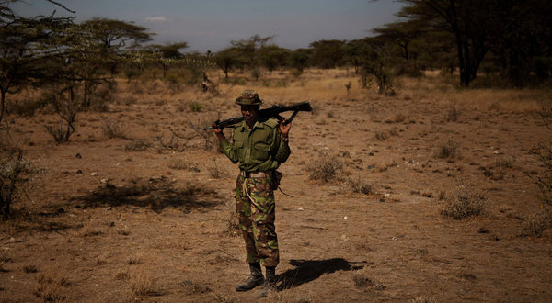
Kenya’s Conservation Militia:
An Interdisciplinary Case Study
Notes:
The case study we are going to look today is a controversial one. It’s about Kenya’s growing conservation militia, which is a movement at the intersection of ecotourism, endangered species conservation, and armed wildlife rangers.
The point is to draw out why people are participating in the conservation militia. And like many issues that grow out of societies in flux, we’ll have to take an integrated approach to understand their motivations and the reasons for their motivations. In other words, we are going to take an interdisciplinary approach to analyze a case study.

Slide 2
A Poacher's Redemption
... look for values

Slide 3
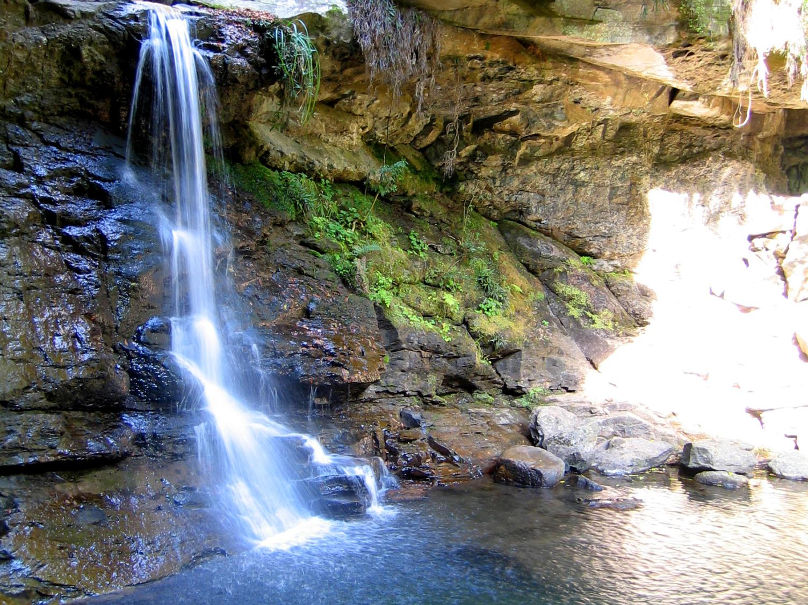
Normative Ethics
(1) Virtue Ethics
Virtue ethics is concerned with the character traits of a person as the object of moral inquiry.
Can you think of an example from the video?
Notes:
“normative” just means a value based statement, as in one *ought* to not litter, or one *should* not cheat

Slide 4

Normative Ethics
(2) Deontology
Deontology is concerned with the sense of duty or obligation of a person as the object of moral inquiry.
What is an example from video?
Notes:
Deon is Greek for duty, therefore deontology is the study of duties

Slide 5

Normative Ethics
(3) Consequentialism
Consequentialism is concerned with the outcome of a person’s decision as the object of moral inquiry.
What’s an example you can think of from the video?
Notes:
Consequentialism is treated as utilitarianism in society – be aware of this

Slide 6
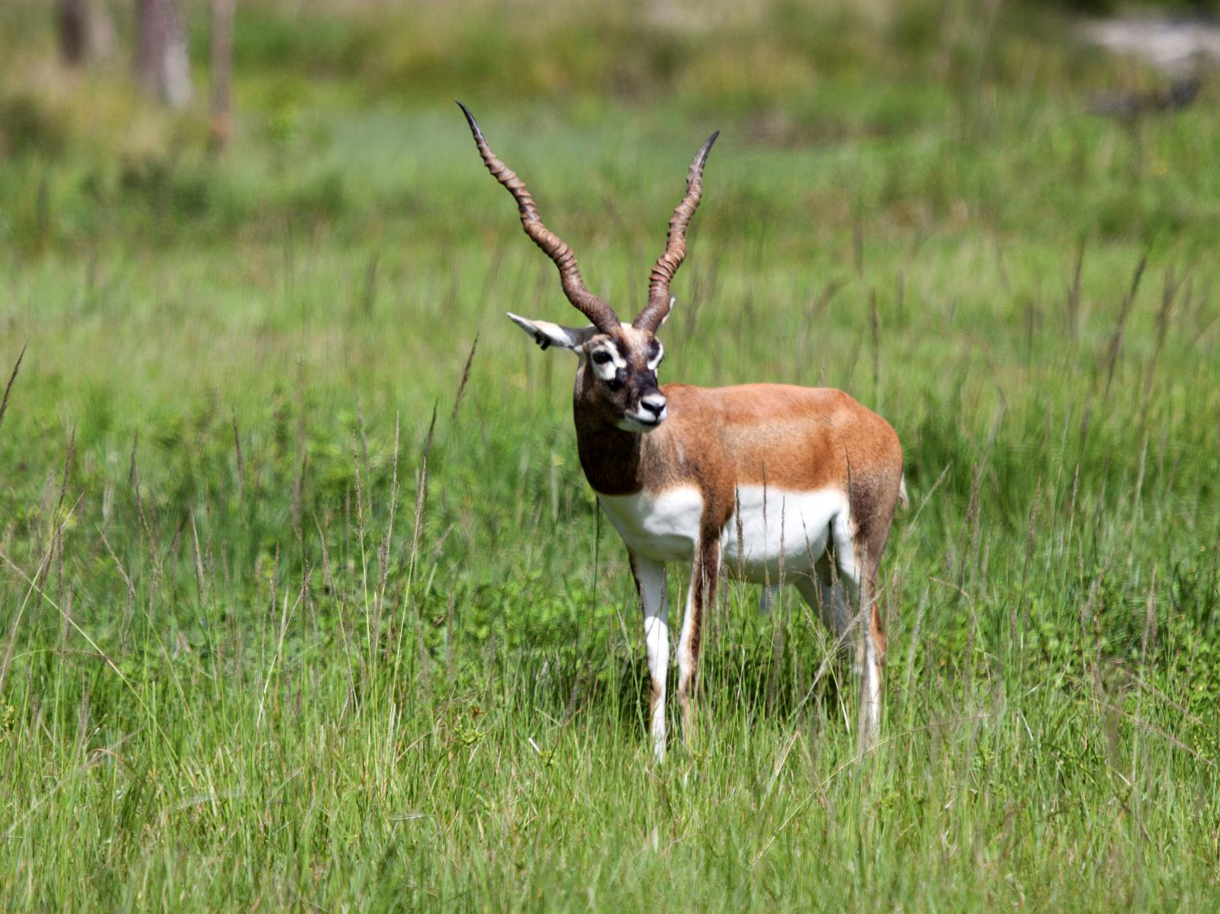
Environmental Ethics
Natural entities
Realm of moral considerability
Instrumental values
Intrinsic values
Anthropocentrism
Nonanthropocentrism
Notes:
See teacher’s notes for help explaining these concepts – students should either be familiar or have done the readings

Slide 7
Read your handout
Look and identify what is ethically relevant
Class discussion follows about:
1) Describe the conflicting environmental ethics that a poacher who turns into a ranger goes through.
2) How do the conflicting environmental ethics fit into virtue ethics versus deontological ethics versus consequentialism? Into anthropocentric versus nonanthropocentric environmental ethics?
3) Do you think the decision to kill poachers to save elephants is justified? Why?

