Slide 1

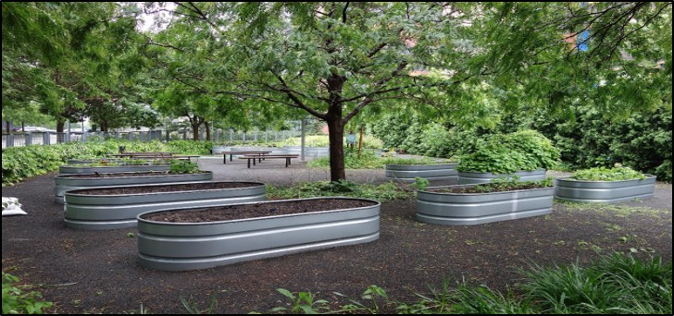
Community Gardens:
Justice, Safety, and Climate Solutions
Community Garden, Queens West Sports Field, Hunters Point, Queens. Photo by Tdorante10 via Wikimedia Commons, 4.0.
Notes:
Notes for Instructor: What are some advantages and disadvantages to having raised container beds for garden spaces vs. in-ground gardens?

Slide 2

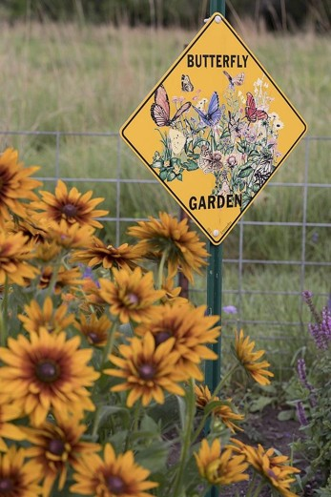
The Underutilized Role of Community Gardens in Improving Cities’ Adaptation to Climate Change: A Review
Clarke et al. 2019: https://doi.org/10.3351/ppp.2019.3396732665
Green Infrastructure
Dispersal of the urban heat island effect
Rainwater absorption and filtering
Pollinator food and habitat
Carbon sequestration from trees, shrubs, and annuals
Climate change resilience: both proactive and reactive
Notes:
Notes for Instructor: Clarke et al. especially underscore proactive climate change resilience as a benefit of cities that actively promote community garden planning, investment, and implementation. In cities with more gardens, resilience and recovery (both social and ecological) from natural disasters is quicker because of the ecological and social supports the gardens provide.

Slide 3
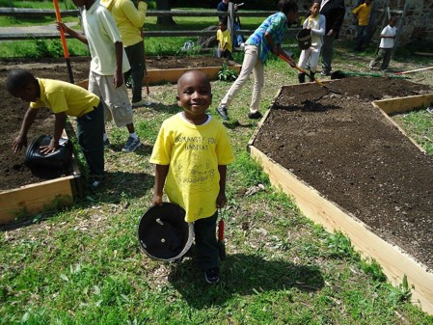
Community Gardens Role Provide Community Services
Clarke et al. 2019: https://doi.org/10.3351/ppp.2019.3396732665
Community Services:
Fruits and vegetables to supplement limited diets
Reduced carbon emissions and energy reliance
Physical and mental health benefits from working outdoors
Community cohesion, cooperation, and exchange of knowledge, food, and planning for the future
Proactive resilience in the event of climate change stressors and disasters
Aesthetic benefits, especially when gardens replace brownscapes and hardscapes
Public Domain Image
Notes:
Notes for Instructor: How do community gardens alleviate some downward pressure on disadvantaged communities, including poverty, poor nutrition, lack of access to fresh food, fear of crime, and social dysfunction? What are the benefits to this child of spending his day this way?

Slide 4
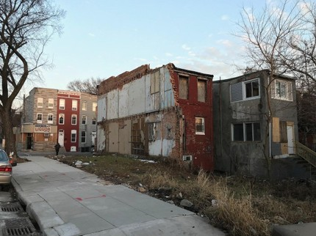
Community Gardens as Contested Spaces
Clarke et al. 2019: https://doi.org/10.3351/ppp.2019.3396732665
Contested Spaces:
Both private and public sectors debate the right to use vacant lots for their economic advantages.
Gardens are political spaces that provide a unique opportunity for residents to assert their rights to the city and alter the urban landscape to suit their needs.
Historically community gardens have expanded during times of political, social, and environmental upheaval.
Governance of gardens is often decentralized and grassroots, but city support is critical to building strategic and proactive climate change resilience.
Notes:
Notes for Instructor: Baltimore, a city with high poverty and abandoned lots, but also a rich history of grassroots community gardens, shows its struggling side in this picture. These boundary spaces might be appropriated for community garden enrichment, given adequate city support and planning.

Slide 5
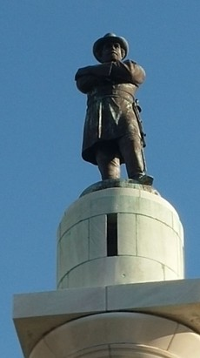
Urban Gardens and Environmental Injustices
Malone 2022: https://doi.org/10.1007/s10460-021-10236-8
Critical Physical Geography:
Landscape conditions – both social and physical – are relics of unequal power relations, colonial histories, and gender and race disparities.
These historic sociological conditions are as fundamental to the land’s condition as hydrology and ecology.
Exposure to contaminants in community gardens is, in part, due to larger structural inequalities that users have no control over.
Social justice and urban garden scholarship rarely consider toxicology or the social elements of exposure in community gardens, despite frequent engagement with toxic exposures for marginalized groups in urban air, water, and buildings.
Notes:
Notes for Instructor: This image of a Robert E. Lee statue in New Orleans typifies the cultures of oppression and historic inequality faced by BIPOC Americans. 20th century “white flight” to the suburbs, redlining, and disinvestment in urban communities during a time of mass incarceration have all contributed to the enduring inequalities of income, education, and quality of life in marginalized communities.

Slide 6
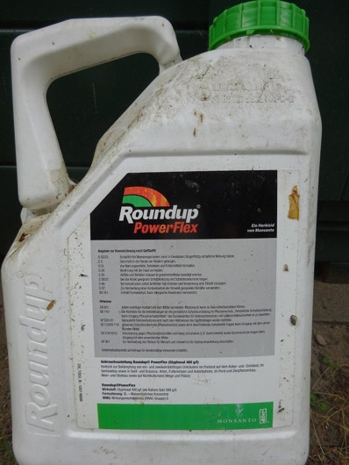
Urban Gardens and Environmental Injustices, Continued
Malone 2022: https://doi.org/10.1007/s10460-021-10236-8
Soil Toxicology: Common Contaminants:
PCBs from legacy industrial uses
Glyphosate (Roundup) from legacy herbicide regimens and food residues in compost
Heavy metals from legacy industry and traffic pollution
Contaminants can be introduced through compost, wood chips, and grass clippings, as well as through the air, water, and previous land uses.
The existence of contamination does not necessarily outweigh the benefits of community gardens.
Soil testing, remediation, and planting flower and fungus species to neutralize toxins helps alleviate legacy issues.
Notes:
Notes for Instructor: There may also be emerging contaminants that affect soil health, including PFAS or “forever” chemicals.

Slide 7
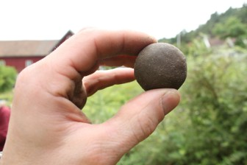
Urban Gardens and Environmental
Injustices, Concluded
Malone 2022: https://doi.org/10.1007/s10460-021-10236-8
Environmental Justice in Community Gardens:
Government funding for soil testing, standards, and federal guidance (EPA) on toxic contaminant safe levels
Racial equity toolkit (Seattle) analyzes equity impacts of policies, programs, and initiatives to target the neediest
Citizen and participant governance builds trust, cooperation, and consensus—balanced with municipal, state, and federal guidance and funding
Secondary benefits of community gardens: youth education and immersion, alignment of diverse populations including immigrants behind a common resource and benefit
Challenge: fuse social benefits and challenges with large scale climate change adaptation and resilience building
Notes:
Notes for Instructor: Once garden spaces are established, governed, tested, and remediated, there may be fewer toxic concerns about using the space in the future. Though external sources of contamination from roadways, air, and rainfall may continue, the initial task of converting a space from a legacy industrial brownscape to a garden may present the greatest challenges in terms of toxicology, governance, domain, and participation.

