Slide 1

Landscape Design Contest:
Three Landscapes

Slide 2
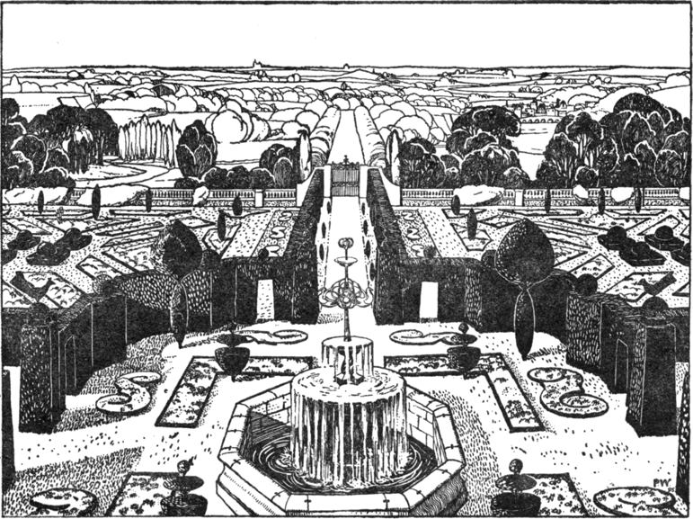
Perspective View of Garden in Plan Following by John Dando Sedding (1902).
Public Domain via Wikimedia Commons.

Slide 3
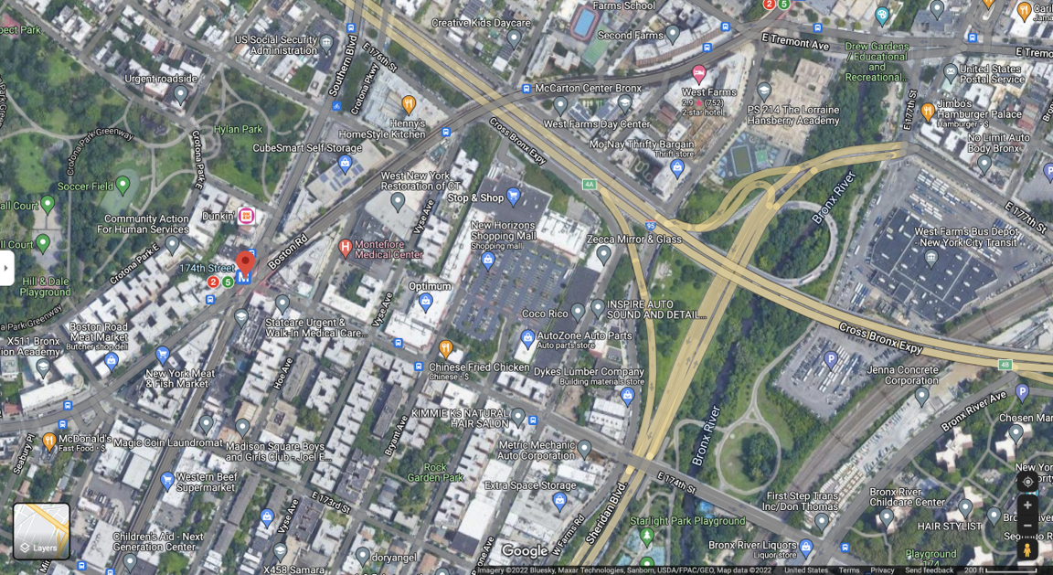
Urban Landscape: The Bronx, New York

Slide 4
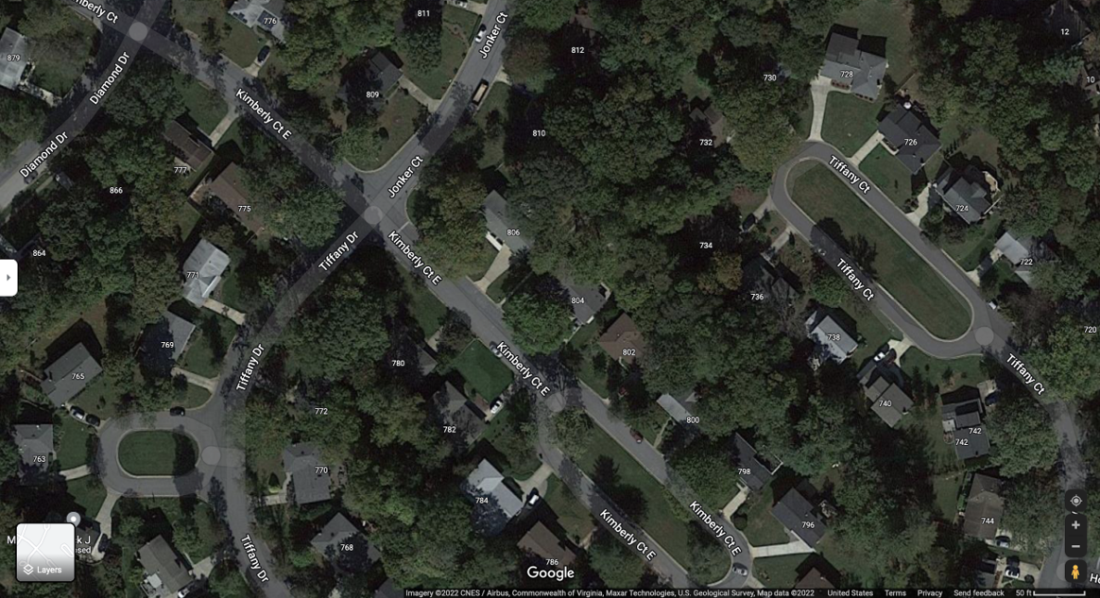
Suburban Landscape: Gaithersburg, Maryland

