Slide 1

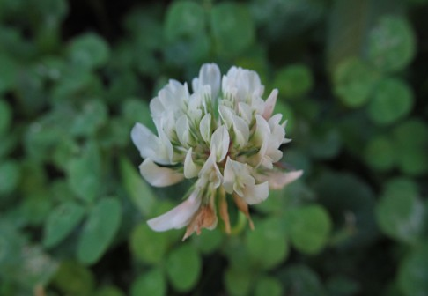
Control or Embrace Non-Native Species?

Slide 2

Non-Native vs. Invasive Species
Non-native species are species that occur outside of their historical range.
Some non-native species were introduced on purpose for their usefulness as food, medicine, pollination, or landscaping.
Many non-natives have a functional and mutualistic roles with native species in their introduced ecosystem.
Invasive species are non-native species that cause harm.
Invasive species are characterized by competitive behavior and rapid population growth.
They can cause natives to go extinct and push historical ecosystems into an alternative state.
Only some non-native species are invasive.

Slide 3
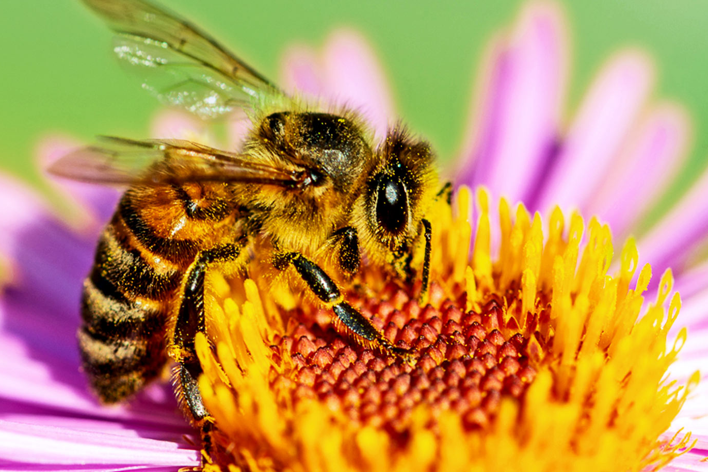
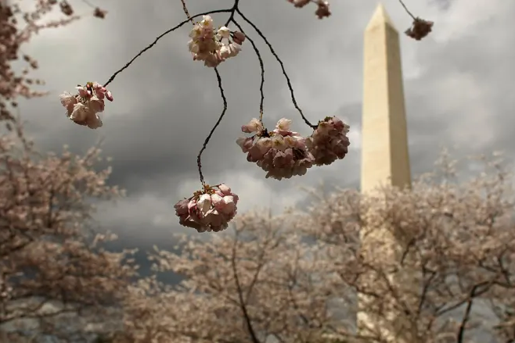
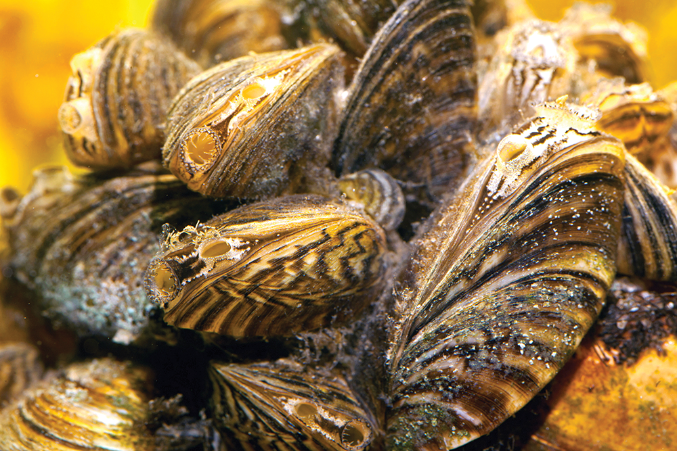
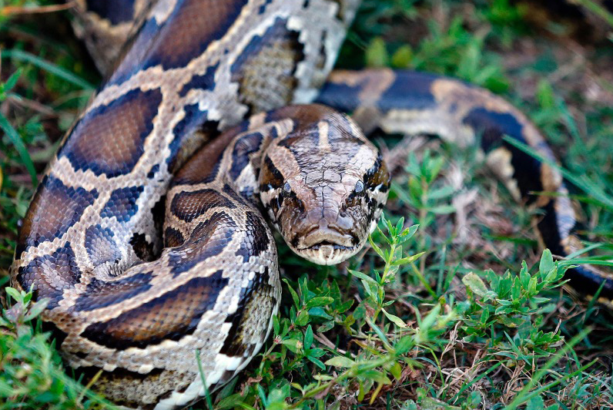
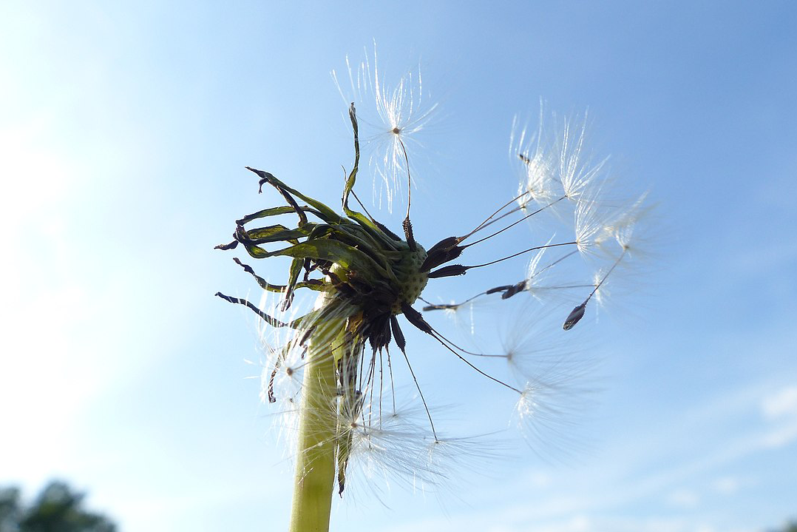
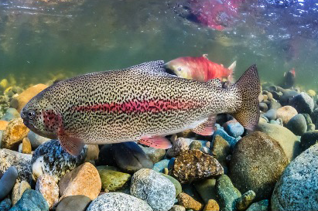
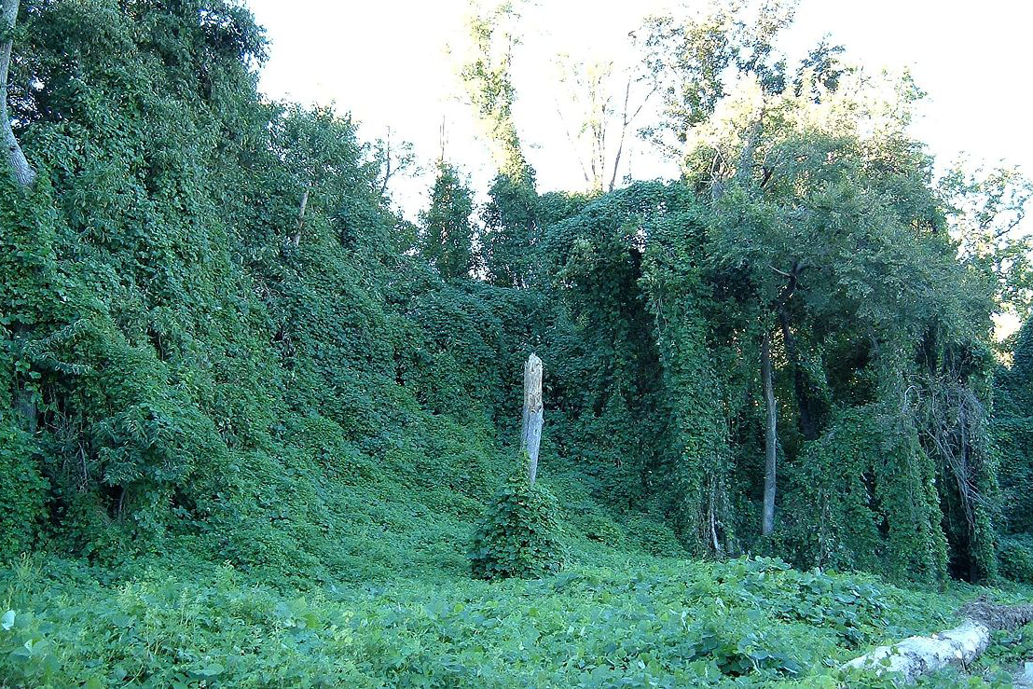
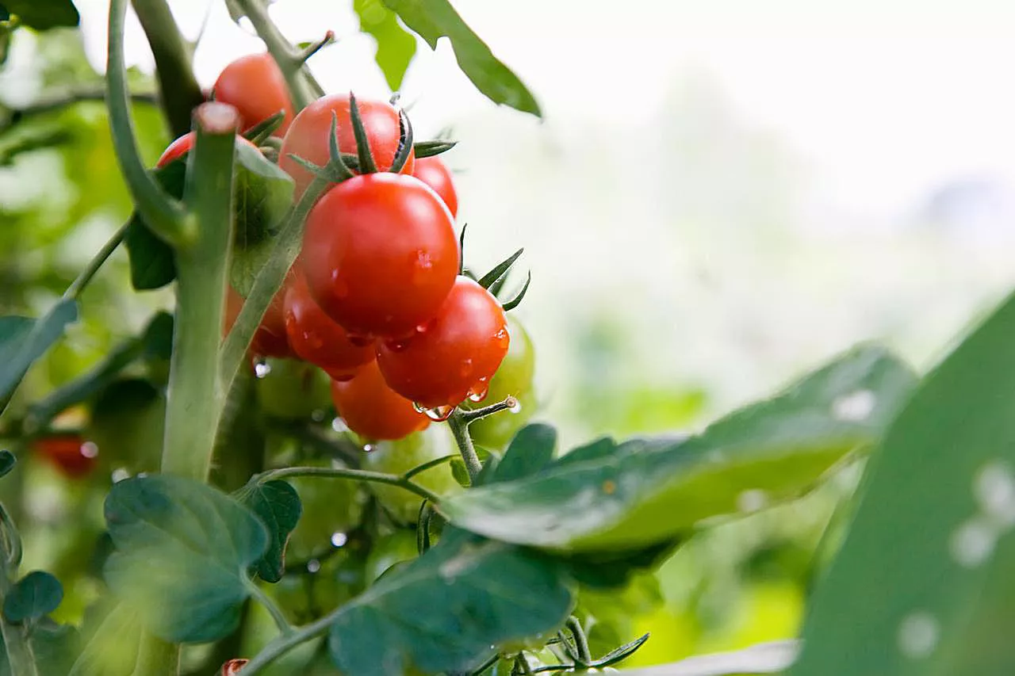
Spotting the Difference
Which are non-native and which are invasive species?

Slide 4
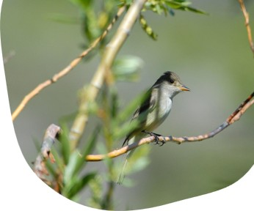
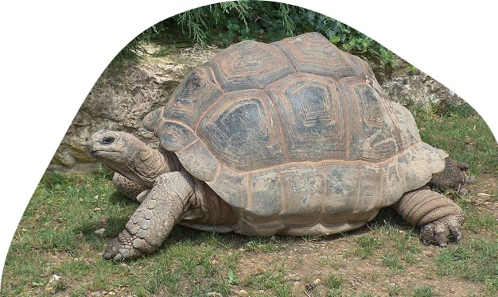
Ecosystem Services from Non-Natives
Shelter and Food for Native Species:
The Southwestern Willow Flycatcher nests on non-native Tamarisk (multiple introductions from arid regions) up to 75% of the time, with similar fledgling success to the birds who nest on native biota.
Potential Catalysts for Restoration:
Non-Natives can increase the structural complexity and support increases in species richness: the opposite of the assumption that invasives outcompete natives.
In Puerto Rico, the presence of non-native plantation trees enabled the re-wilding of deforested land with twenty
native woody species.
Substitute for Extinct Taxa:
Where extinction has caused a rift in community
function, non-natives like the Aldabra giant tortoise
can substitute for the ecological role and renew
ecosystem function.

Slide 5
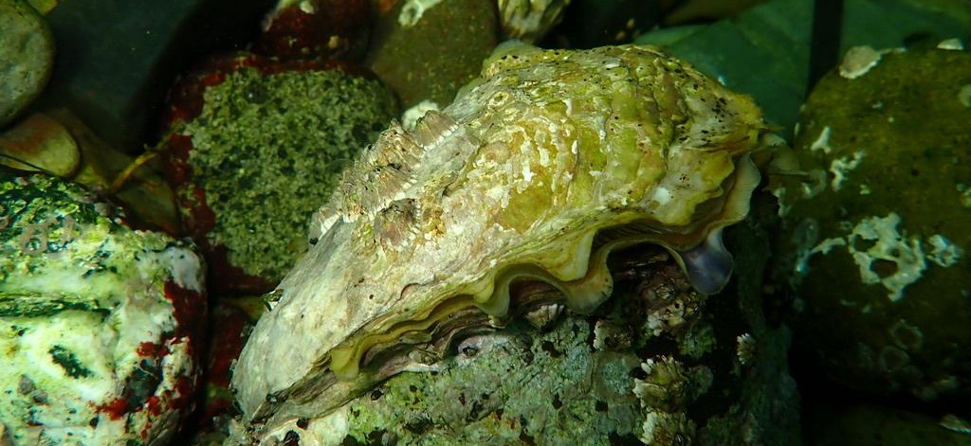
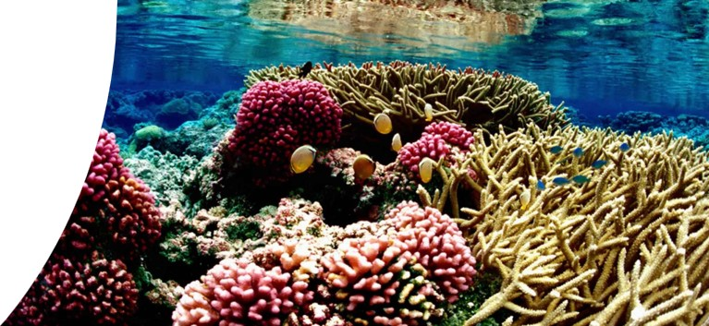
Ecosystem Services from Non-Natives, Continued
Ecosystem Engineers:
Non-native birds in Hawaii substitute for extinct natives by dispersing seeds of native flora. Pacific oysters form hard reefs that support the native invertebrate community.
Ecosystem Services:
The Pacific oyster (from Japan) provides water filtration services in U.S. waters where anthropogenic nutrient forcing causes overgrowth of phytoplankton.
Community Preservation through Climate Change:
Non-natives can be transplanted to island ecosystems or poleward to secure ecosystems stressed by climate change. Preserving coral
reefs may depend on relocating them to cooler waters than now exist in their historic range.

Slide 6
Ecosystem Disservices from Invasives
Invasive species can cause some of the following ecosystem disservices:
Predation, Competition, and Introduction of Disease
Invasive species have caused ~ 20% of species extinctions across the planet since ~1600 C.E.; they have caused many more extirpations.
They carry disease—for example, the East Asian tiger beetle (in Maryland now) is a potential vector of encephalitis, dengue (all four serotypes), yellow fever, dog heartworm, and West Nile virus.
Re-Shaping or Damaging of the Structure of Ecosystems and Human Property
Zebra mussels have clogged pipes and attached and overwhelmed docks and vessels; cogongrass spreading across the U.S. Southeast led to more damaging fires.
Economic Losses Due to Reduced Productivity
Invasive species’ grazing of agricultural and forestry crops have led to huge economic losses—including, for example, gypsy moth caterpillars on 300+ species of trees and shrubs.

Slide 7
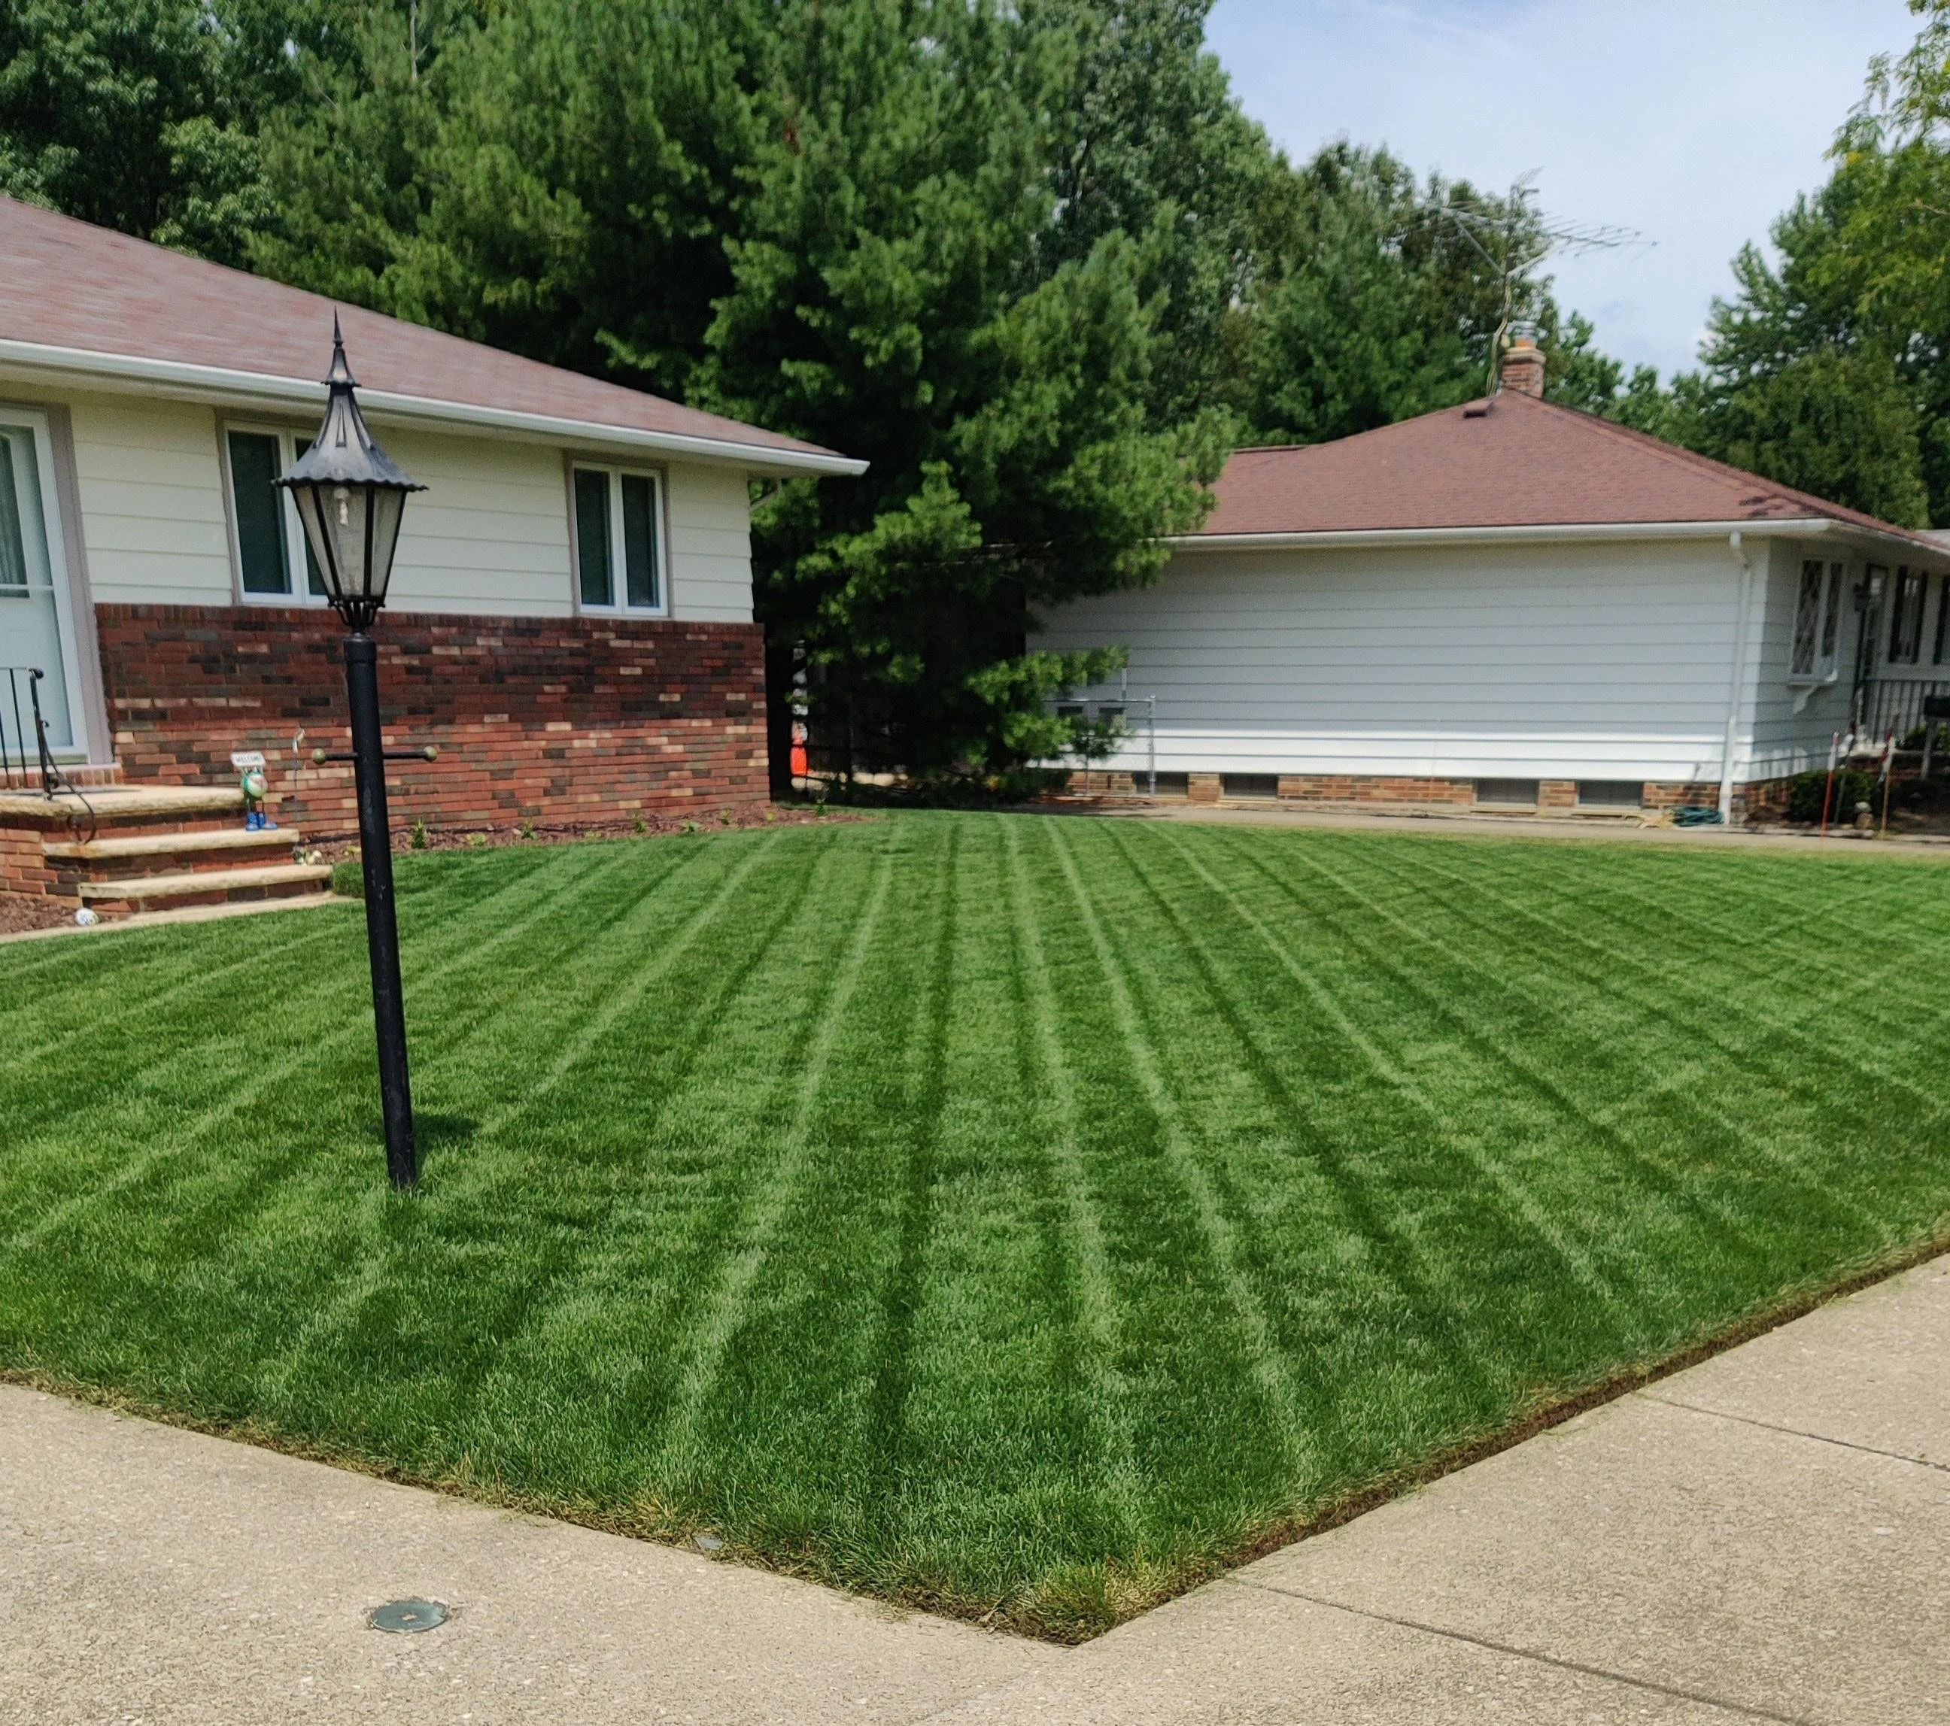
Costs of Non-Native Species
But aren’t there costs associated with attempting to extirpate non-native species?
Example: Monoculture lawns (based on non-native Kentucky bluegrass) have caused the steep economic and ecological costs of broadleaf herbicides to kill dandelions, clover, plantains.
What social and cultural drivers were at work to make this an acceptable behavior? Should we re-frame our view of species richness to accept native diversity in lawns and other aesthetic spaces?

