Slide 1

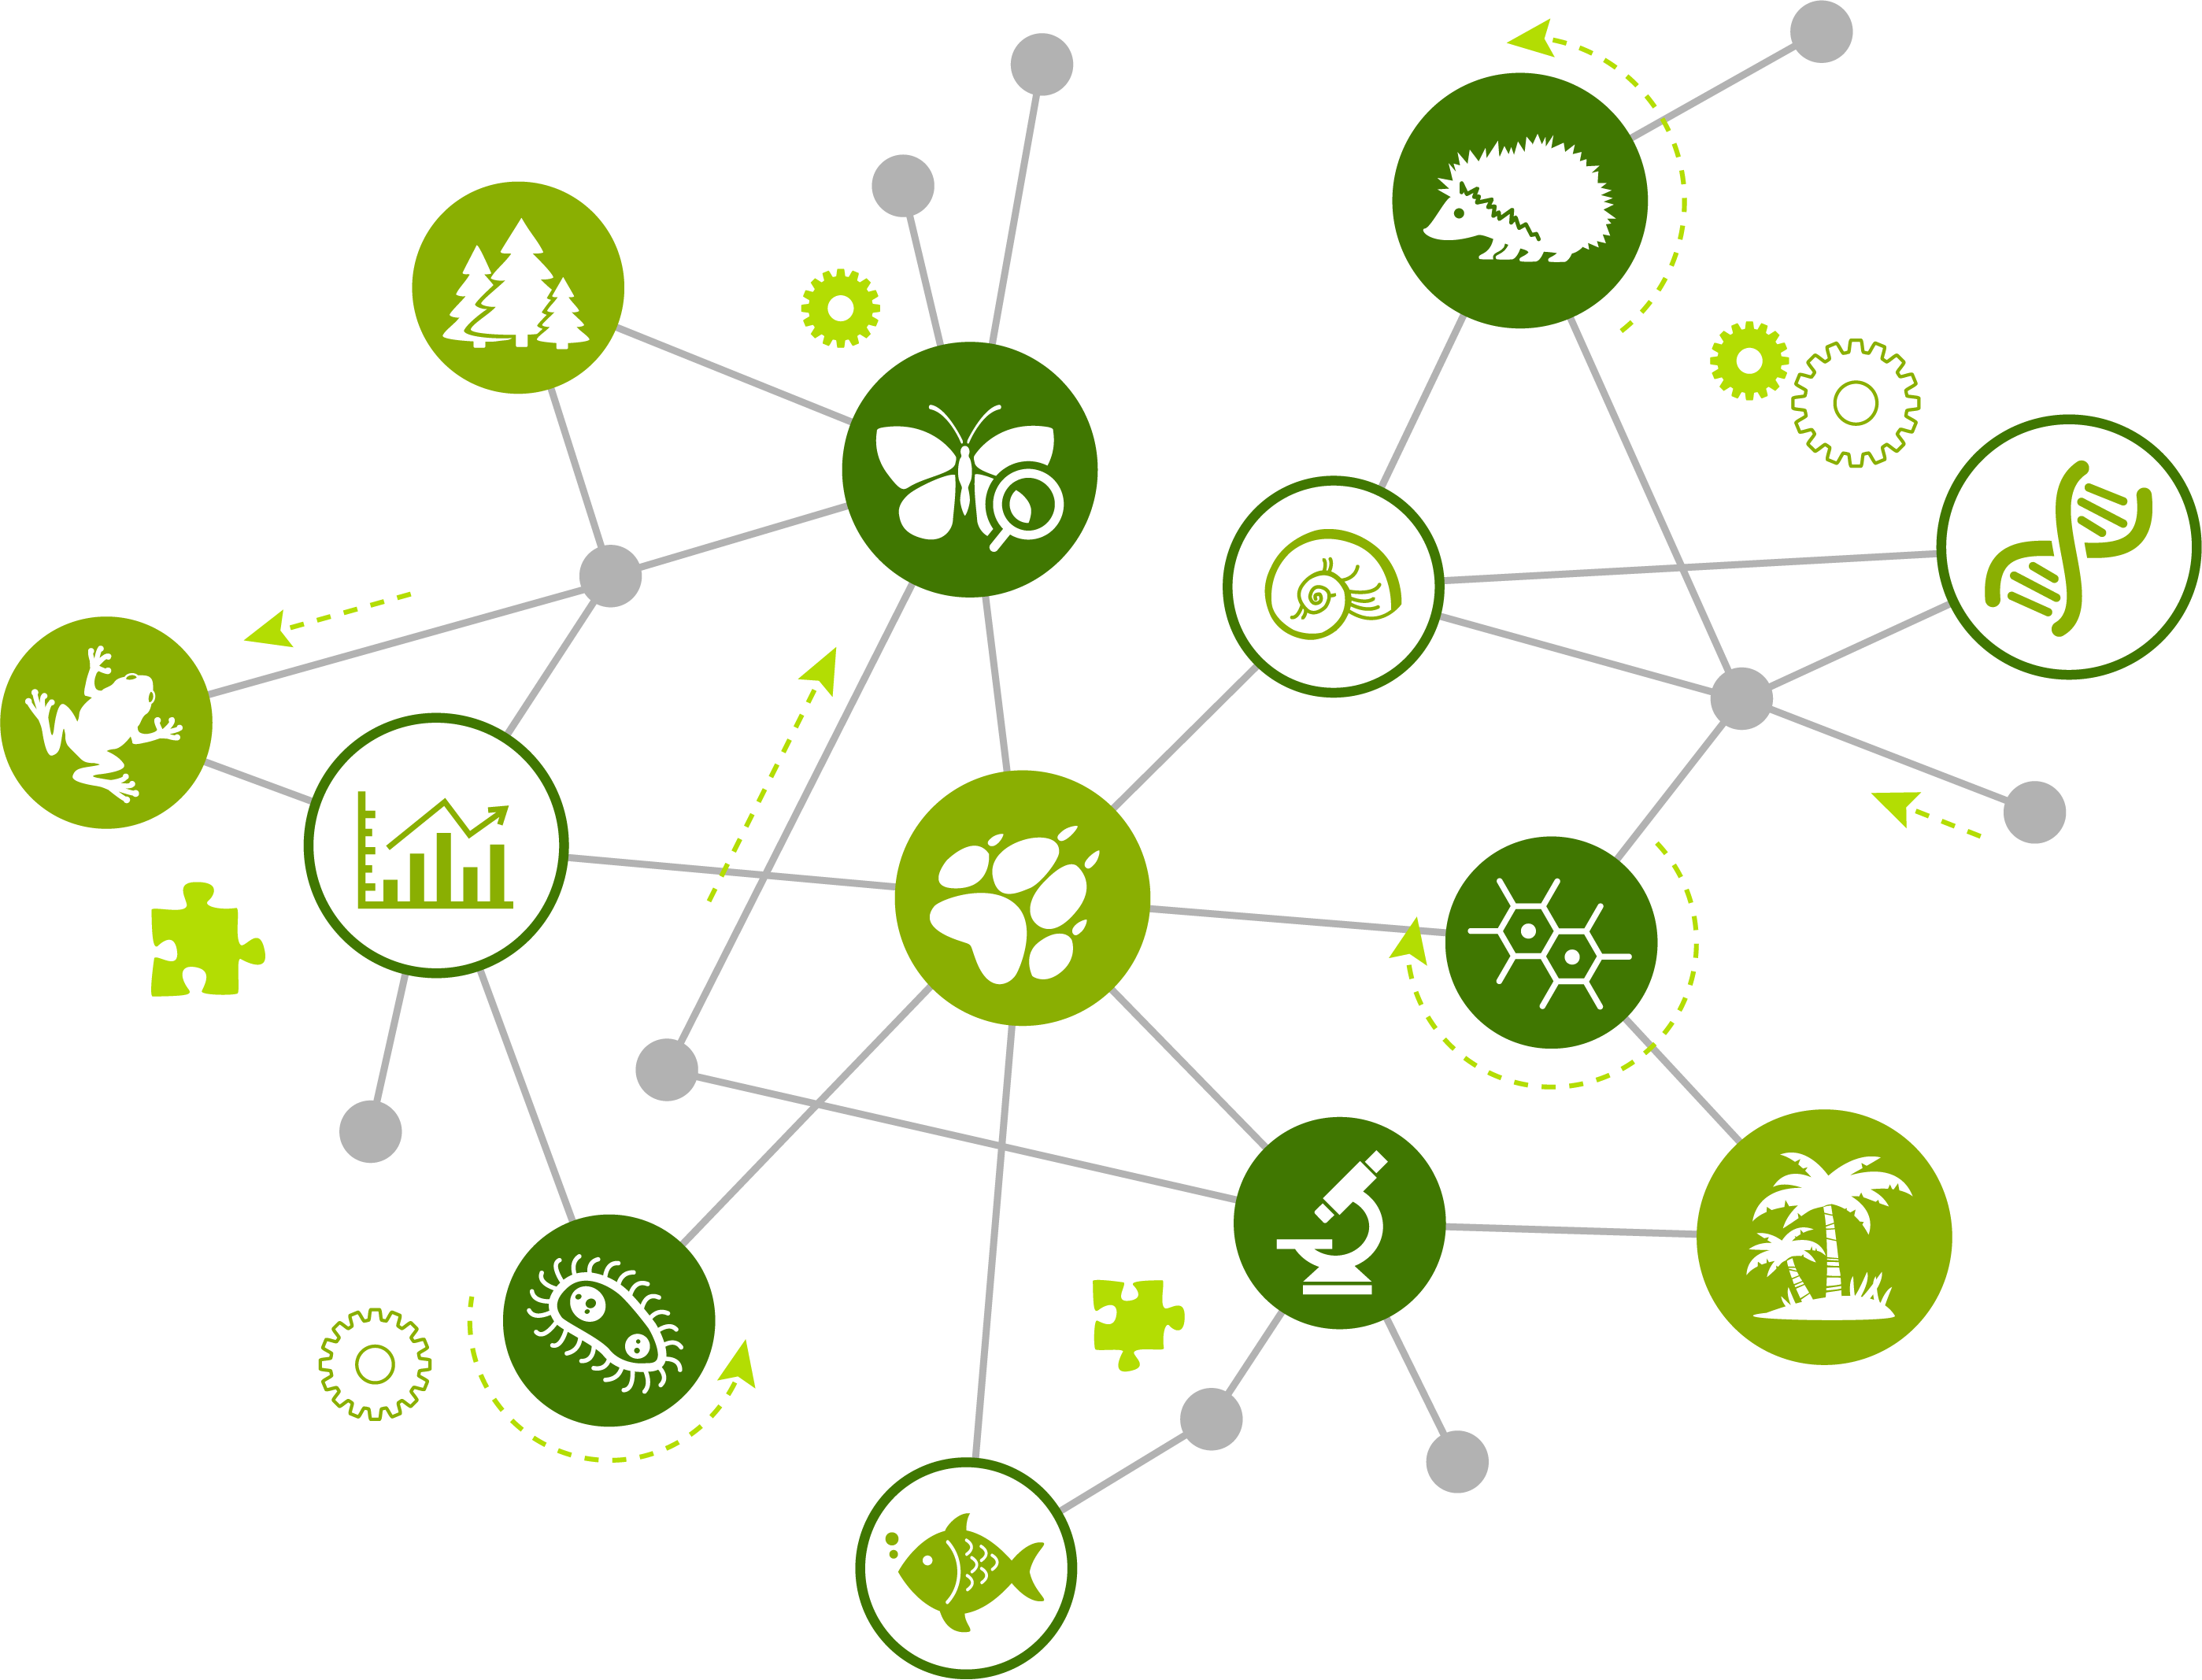
Introduction to Socio-
Environmental
Systems (SESs)

Slide 2

A SES Based on Its Structure
interaction
Socio-Environmental System
component
Regional
Regional
cross-scale interaction
system
boundary
Local
Local
sub-system
Social
Environmental
Notes:
Notes for Instructor: You can add animations to this slide to define the parts of an S-E system over time. Having all the terms up at once can be overwhelming to learners who are new to systems thinking. Feedback loops and emergent behavior are brought up in a later slide since they require more explanation. Tell the learners that this is only one way to depict a system, and it stems from system science, including ecosystems modeling and many other fields. The next few slides will illustrate how different systems can look, as well as the types of components they have and how they are included.

Slide 3
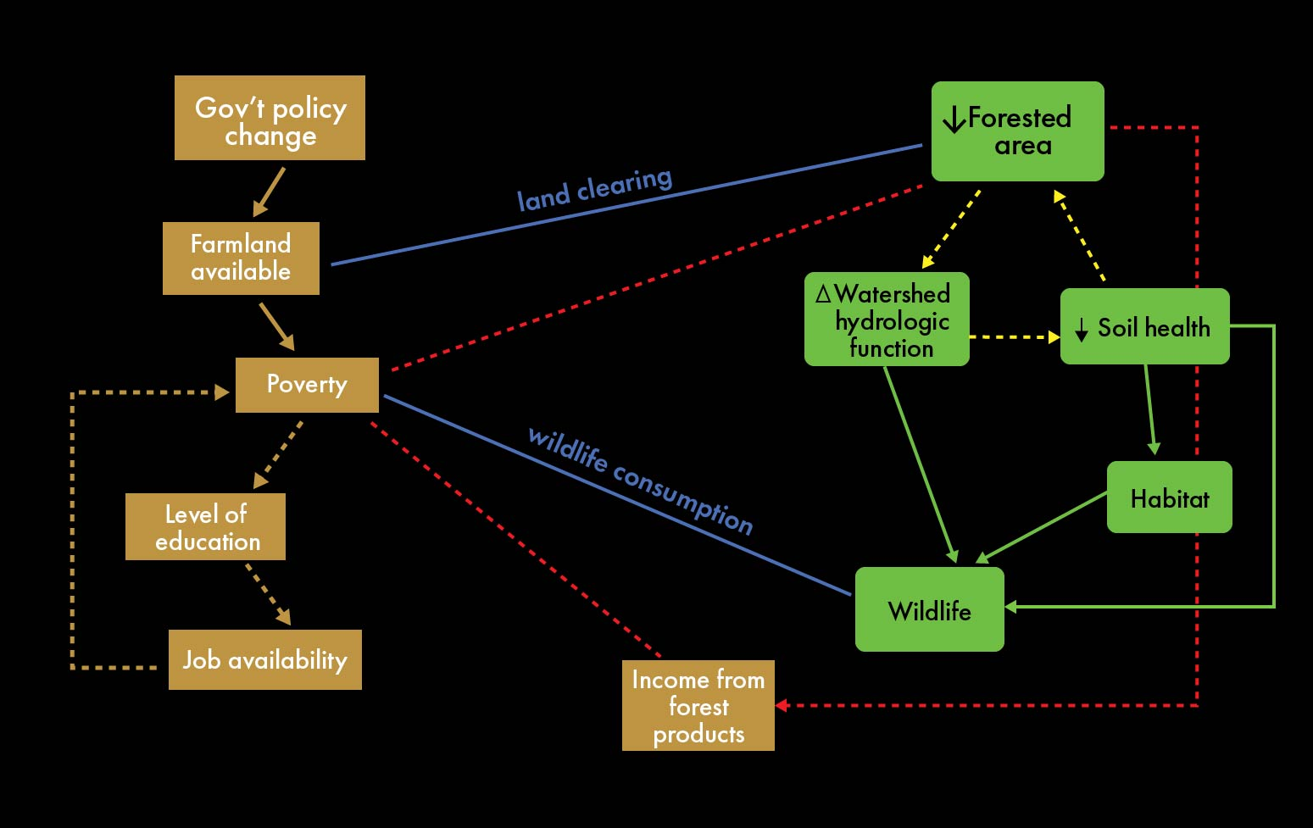
SES Example #1
Notes:
Notes for Instructor: The above image is a diagram that is explained in the 16 min. video “Understanding Environmental Problems Through a Socio-Environmental Lens,” at time 11:48 (https://youtu.be/MMAdOrW6I48?si=xUUHGQjb16UKCxa5). This video is part of the lesson, but if you wish to provide context now, this diagram represents an Indonesian village in which a change in a government policy led to less farmland being available to villagers who then began clearing land—which, in turn, led to a series of events that kept them trapped in poverty. The diagram is used to illustrate feedback loops—one of which is shown in red here.

Slide 4
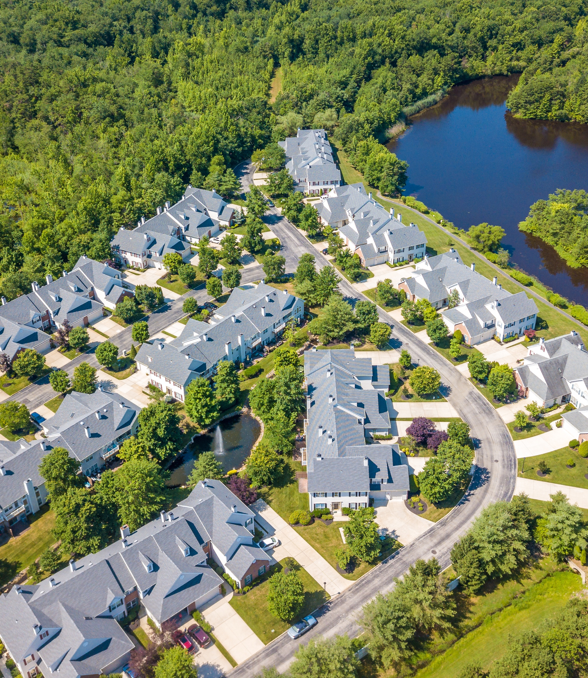
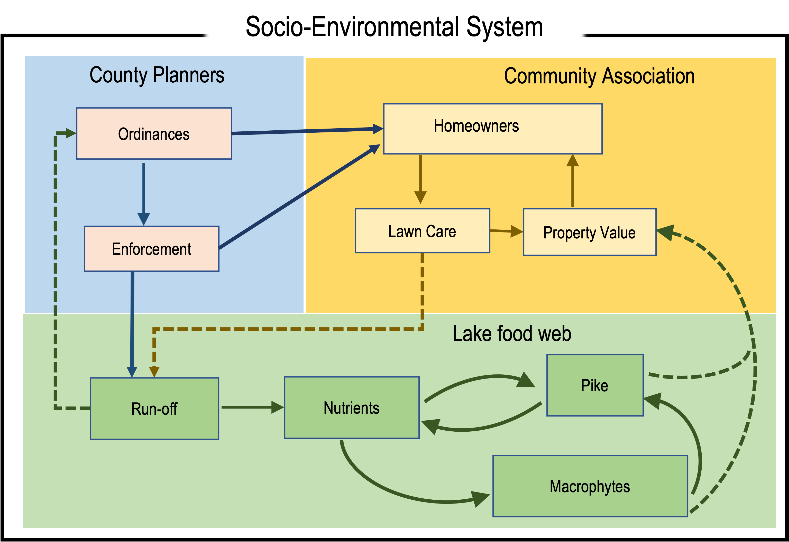
SES Example #2
Notes:
Notes for Instructor: This is a fictional but realistic example of an S-E system that depicts how homeowners’ decisions to fertilize for enhanced lawns influence their property value. The homeowners’ associations requires a certain level of lawn maintenance (e.g., well-cut lawns) to help keep property values up. County ordinances (and the extent to which they are enforced) also influence what the association can do, as well as how much uncontrolled runoff is allowed. Close-cut lawns, combined with high fertilization rates, lead to changes in the lake food web that can result in collapse of fish (pike), and this along with macrophyte filled water can reduce the value of property.

Slide 5
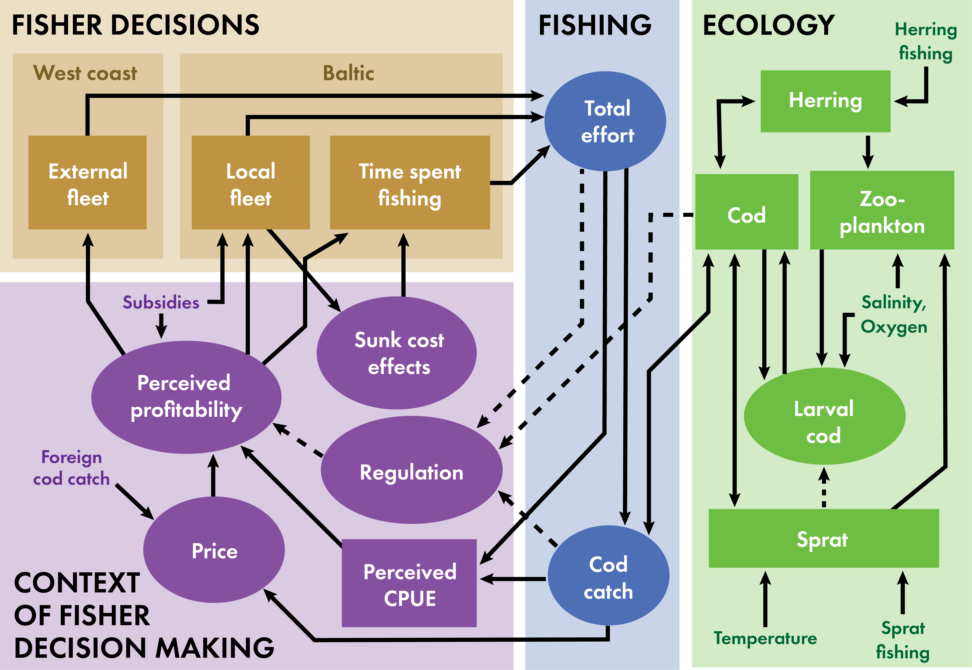
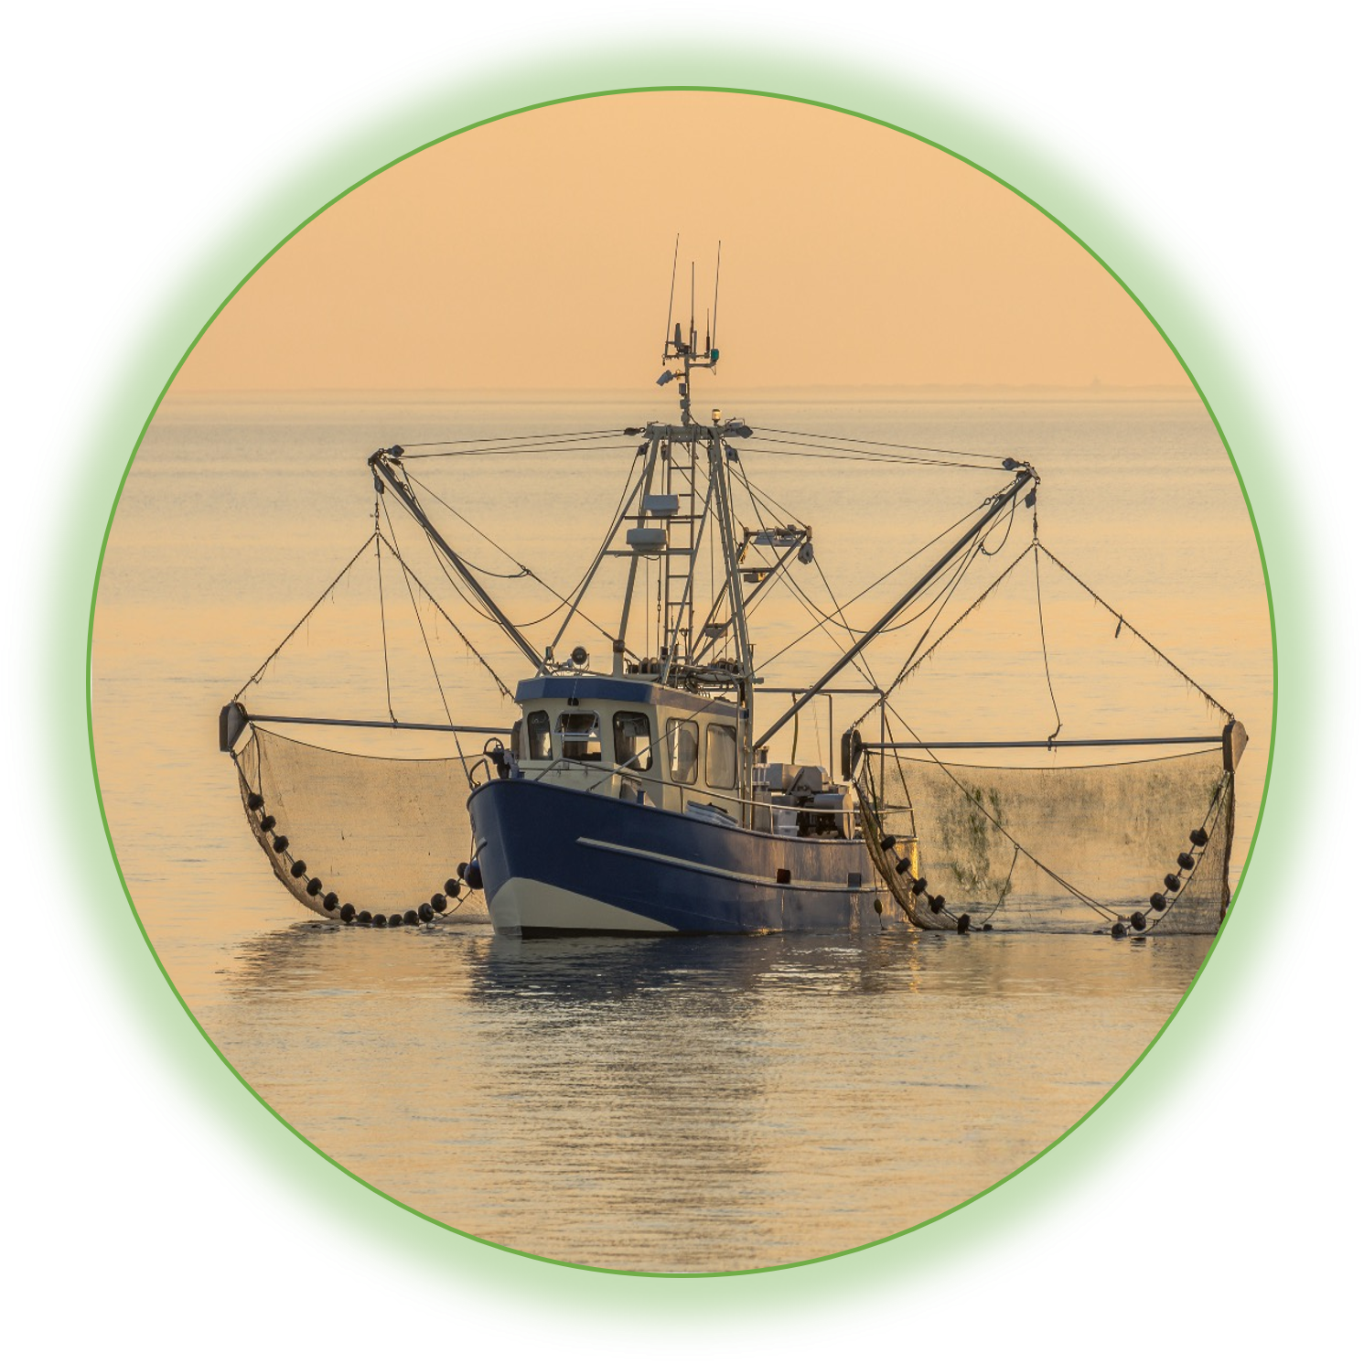
SES Example #3
Notes:
Notes for Instructor: This is a diagram that is explained fully in the 16 min. video “Understanding Environmental Problems Through a Socio-Environmental Lens.” https://youtu.be/MMAdOrW6I48?si=xUUHGQjb16UKCxa5

Slide 6
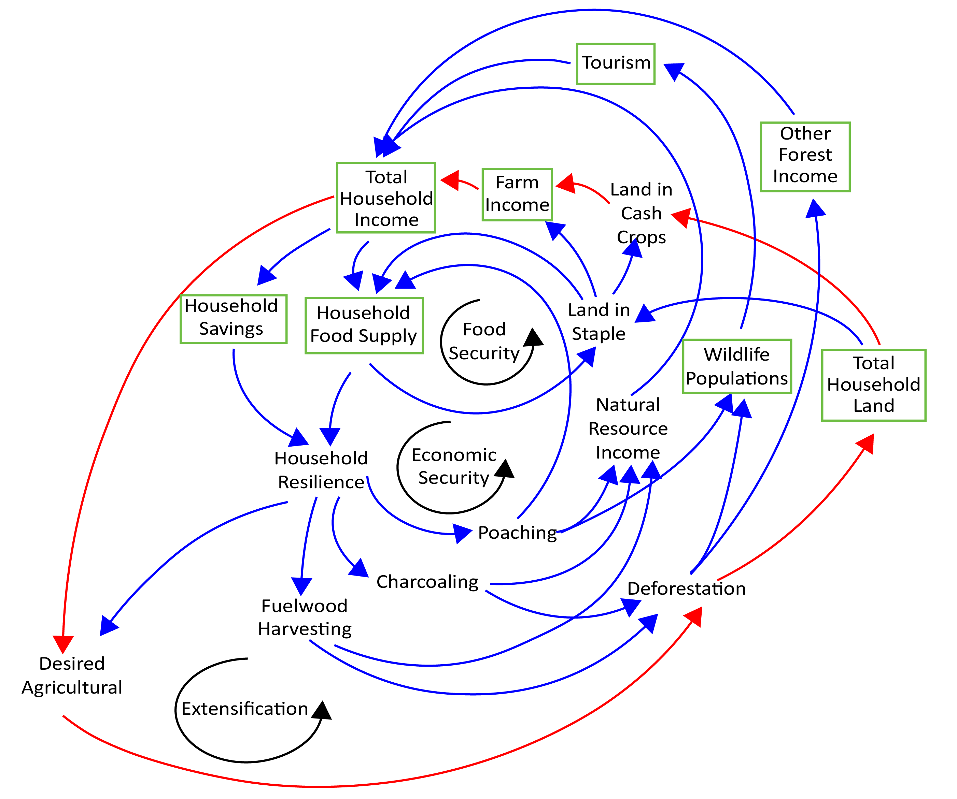
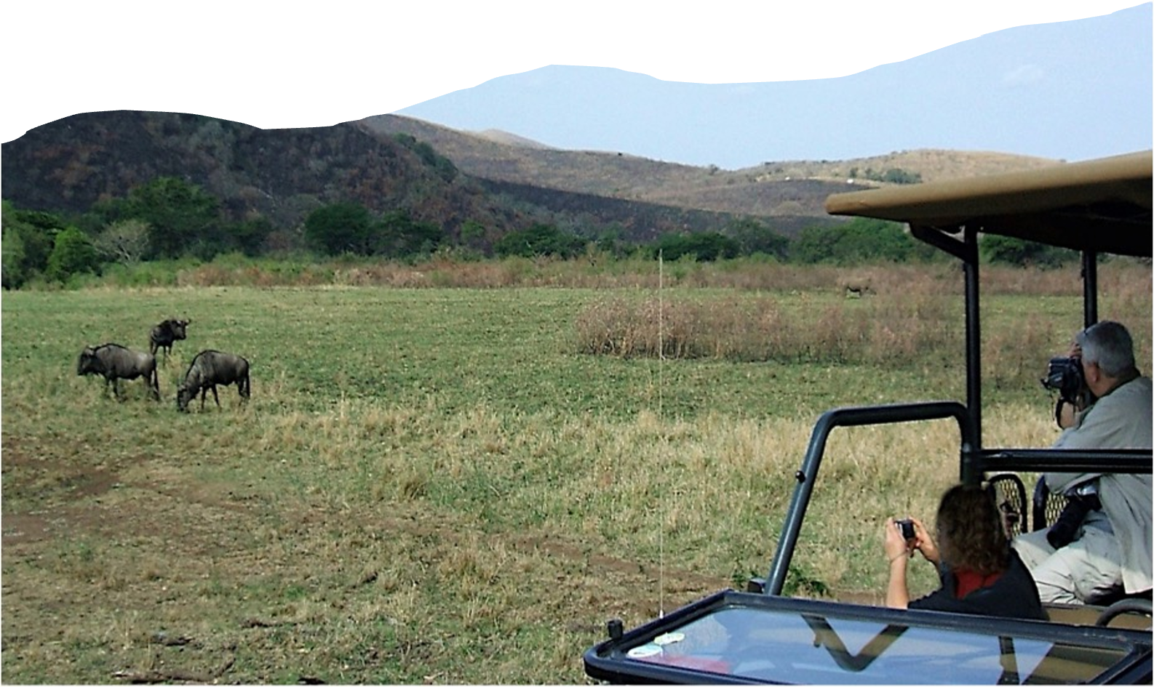
SES
Example #4
Photo by Pierre Andre Ledercq, Wikimedia Commons, 4.0
Notes:
Notes for Instructor: The above image is an example of a causal diagramming approach to depicting an SES and its relationships, including which directions they go in. With this lesson, you will probably not want to fully explain this. If you wish to have a lesson on causal diagramming, one is available at: https://www.sesync.org/resources/causal-approach-actionable-research-design

Slide 7

SES Based on Analysis
To evaluate, design, or reform policy, we must have a systematic way to analyze existing arrangements and to generate and compare alternatives, and thus, the…
Ostrom IAD Framework
(Institutional Analysis & Development)
Institutions shape
choices & consequences
decomposing the institutional context
A systematic method for organizing policy analysis activities
a very different way to think about an S-E system
Elinor Ostrom
1933 – 2012

Slide 8
Ostrom IAD Framework
(Institutional Analysis & Design)
Institutions shape choices
and consequences
decomposing the institutional context
developing context-specific policy
Context
Biophysical conditions
Action arena
Interactions
Characteristics of the community
Actors
Information flow
Learning conditions
Action
Situations
Evaluative criteria
Rules-in-Use
Outcomes
Notes:
Notes for Instructor: This is a very different way to conceptualize a socio-environmental system. It comes from the Nobel Prize-winning economist, Elinor Ostrom. She won the prize based on her work on governance of the commons. So, with her focus on governance, she thinks immediately of the “rules-in-use” (i.e., the governance)—how the actors are influenced, which depends on their characteristics and how information moves among actors
The IAD Framework is designed to facilitate the process of analysis by directing the researcher’s attention to the full range of factors that will need to be considered to fully understand the relevant institutional context.
Action arena is where behavior occurs. It includes groups (actors) who are typically involved in a particular situation (issue with decision at hand).
Context includes the three areas in which factors influence the decisions/behaviors
Interactions are where researchers look to see patterns of interactions that are associated with the behaviors and then what results (outcomes) occur from those interactions.
Note that use of the framework requires interdisciplinary information, or you could consider it transdisciplinary, with policy makers involves. You probably won’t want to go into detail on this here, and instead you may want go to the SESYNC lesson on governance. But for more information and definitions:
Governance – The norms, institutions and processes that determine how power and responsibilities over resources are exercised, how decisions are made, and how different people participate in these processes. They may be formal or informal.
Actor – An actor can be a person, groups, institutions, etc.
Institution – Though defined in different ways, institutions are not real entities. Instead, they are widely understood rules, norms, or strategies that create incentives for behavior in repetitive situations. Institutions:
Provide mechanisms for adjusting behavior in a situation that requires coordination among two or more individuals or groups of individuals
Involve shared concepts that people participate in when making a decision
Structure information and provide incentives for social behavior to be in a certain way or not
Generate patterns of interaction, which produce “policy” outcomes.

Slide 9
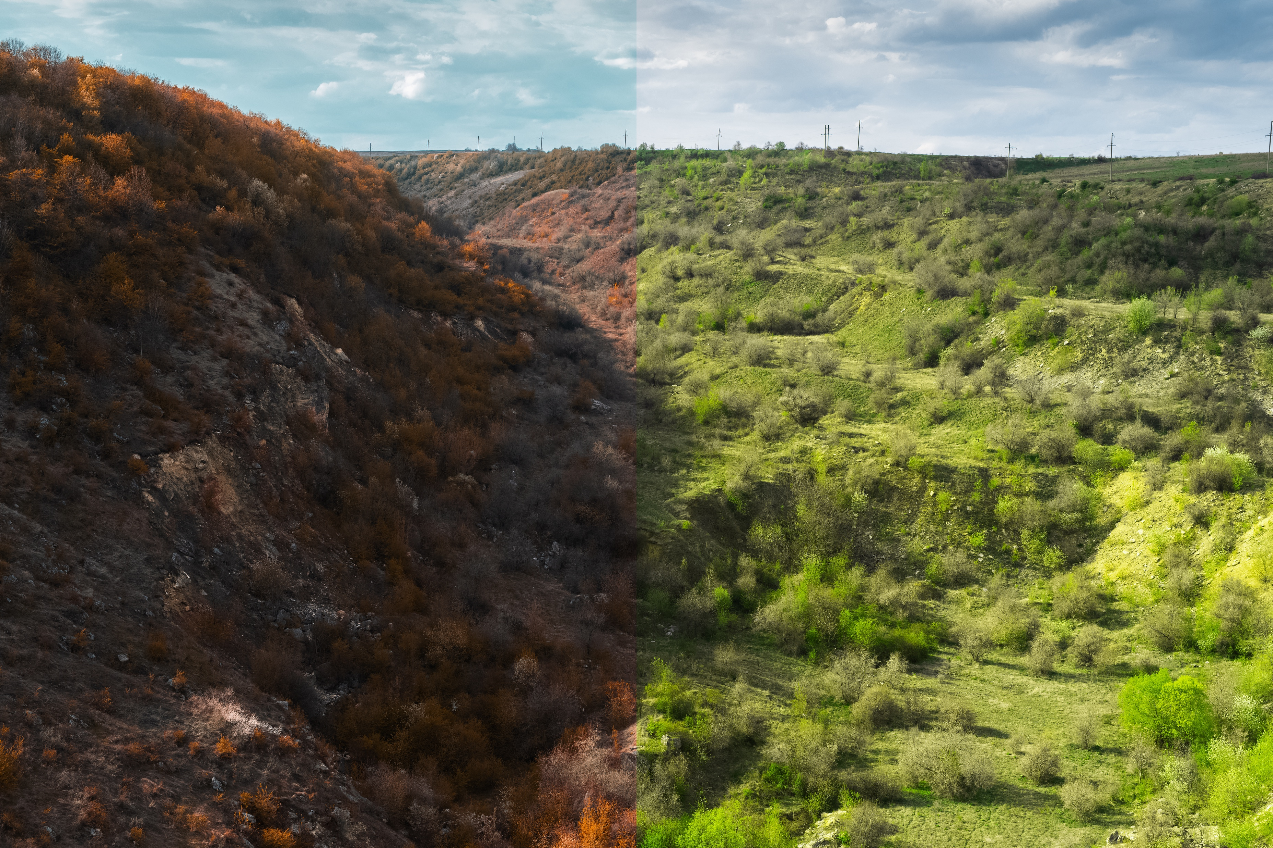

Watch the Video Tutorial
Building the Basics Part 1: Socio-Environmental Systems as Complex Adaptive Systems
  Key Terms:
  System boundaries, subsystems
  Components, interactions, feedbacks (positive & negative)
  Actors (agents) and their multiple forms
  Scale – temporal and spatial
  Dynamics’ emergent behavior
  System state, regime shift

Slide 10
Group Topics for Drawing an S-E System Diagram
  Climate Change and Food
  Changing climate patterns are worsening in parts of the world as existing food security is affected by climate-related disasters, such as drought and flooding. Agricultural land and crops can be decimated by wind and water or may go dr. People go hungry or may be forced to migrate to poor urban areas to seek employment.
  Agricultural Pests and Food
  The spread of agricultural pests is increasing in many parts of the world due to increases in global trade and increasing temperatures due to climate change. This has devastating effects on ecosystems including many agroecosystems (farms). The social impacts are economic which increases food insecurity for many people because higher prices are passed to the consumer.
  Urban Food
  Inner cities in many developed countries have significant populations who experience food insecurity due related to both availability and affordability of nutritious foods and little land suitable for gardens. Many of the affected people feel trapped in urban regions with few options for other sources of food.

Slide 11
Group Topics for Drawing an S-E System Diagram (continued)
  War and Food
  Since Russia invaded Ukraine, 6.3 million people (as of 26 June 2023) have become refugees. For many, their homes and adjacent land have been decimated. Some people were walking on roads for a long time and often had to take shelter in temporary housing where there was little food.
  Dam Construction and Food
  For many developing countries, the construction of dams is touted as helping to increase food security. While it can, there are also many examples where it actually results in increasing food insecurity. By 2023, dam building in Ethiopia has displaced many people where the land was flooded and there is now a reservoir. Many lost their cultivable and grazing land and had to migrate once they lost their income and source of homegrown food.
Instructions: Include and label the following items:
Key components incl. environmental & social (actors, agents)
Interactions
System boundary
At least two scales (e.g., global, country level, regional, family, etc.)
At least one feedback, indicate if it is positive (reinforcing) or negative (balancing).

