Slide 1

Society’s Engagement with the Environment
(Excerpted)
By: Dr. Dana R. Fisher

Slide 2

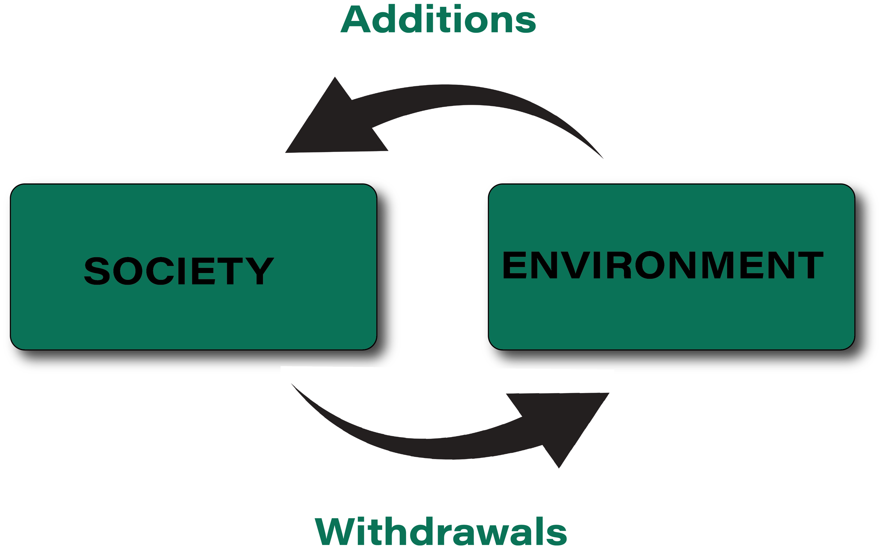
Treadmill of Production
There's an Enduring Conflict between economic growth and Environmental
Quality
Focus on the speeding up of society
  Industrialization drives further
  industrialization
Goal of the Treadmill:
  To expand production and ecological
  extraction (additions and withdrawals)
Competition drives the Treadmill

Slide 3
Overshoot
Based on the notion that humans have sustained society (and populations growth) through consuming more than their carry capacity.
Takeover Method
  Stealing elsewhere
Drawdown Method
  Stealing elsewhen
Phantom Carrying Capacity
  “That portion of the population that cannot be permanently supported when temporally available resources become unavailable” (44-5).
The Die-Off

Slide 4
Reflexive Modernization/
Risk Society
It is "a radicalization of modernity, which breaks up the premises and contours of industrial society and opens paths to another modernity" (Beck 1994: 3).
Risk Society is first (the step after industrial society).
    "Developmental phase of modern society in which the social, political, economic and individual risks increasingly tend to escape the institutions for monitoring and protection in industrial society" (1994: 5).
"Developmental phase of modern society in which the social, political, economic and individual risks increasingly tend to escape the institutions for monitoring and protection in industrial society" (1994: 5).
Conflicts over good turn to conflicts over bad.
Reflexive modernization is society's "self-confrontation with the effects of risk society that cannot be dealt with and assimilated in the system of industrial society-as measured by the latter's institutionalized standards" (1994: 6).

Slide 5
Ecological Modernization
Focus on super-industrialization driven by hybrid arrangements among state, market, and civil society actors.
An ecological switchover is a "logical, necessary, and inevitable next stage in the development of the industrial system" (Spaargaren & Mol 1992: 336).
Argues that continued economic growth increases both technological advancement and environmental governance, which serve as the basis to mediate the environmental outcomes of development over time (Mol 2001).

Slide 6
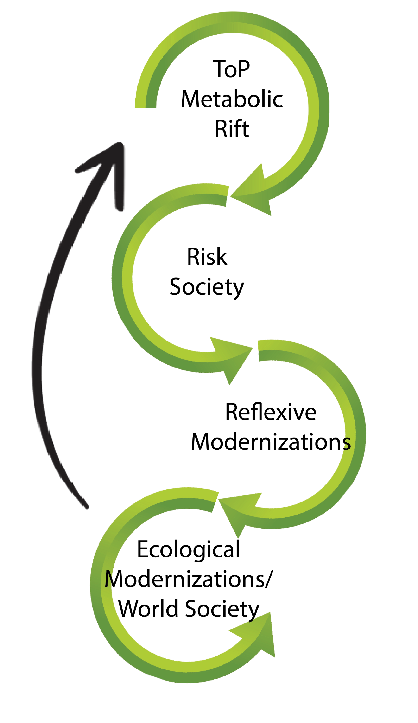
A Continuum of
Society-Environment Relationships
Leads to accumulation of wealth
Leads to accumulation of “additions and withdrawals”
Arrives on cat’s paws
Opens path to modernity
Success of capitalism
Conflicts over goods turn into conflicts over bad
Opens path to modernity
Ecological switch in industrialization process
Focus on new coalitions

