Slide 1

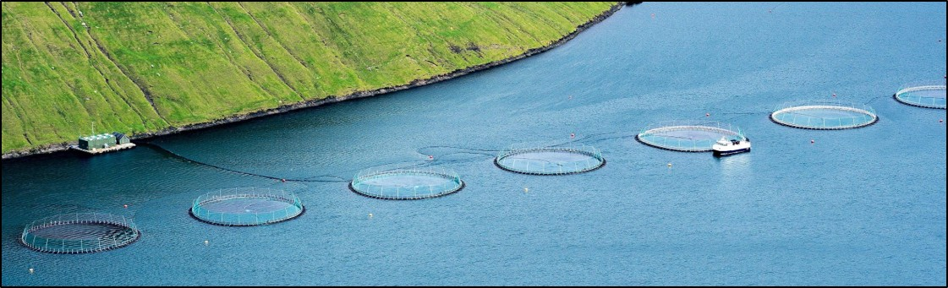
Sustainable Agriculture:
Aquaculture Scenarios
Salmon aquaculture in Klaksvic, Faroe Islands, Denmark. Unaltered photo by Ekrem Canli via Wikimedia Commons, 4.0.
Notes:
Notes for Instructor: Detailed case studies from Gephart et al. 2021 appear in these notes for each of the following slides.

Slide 2
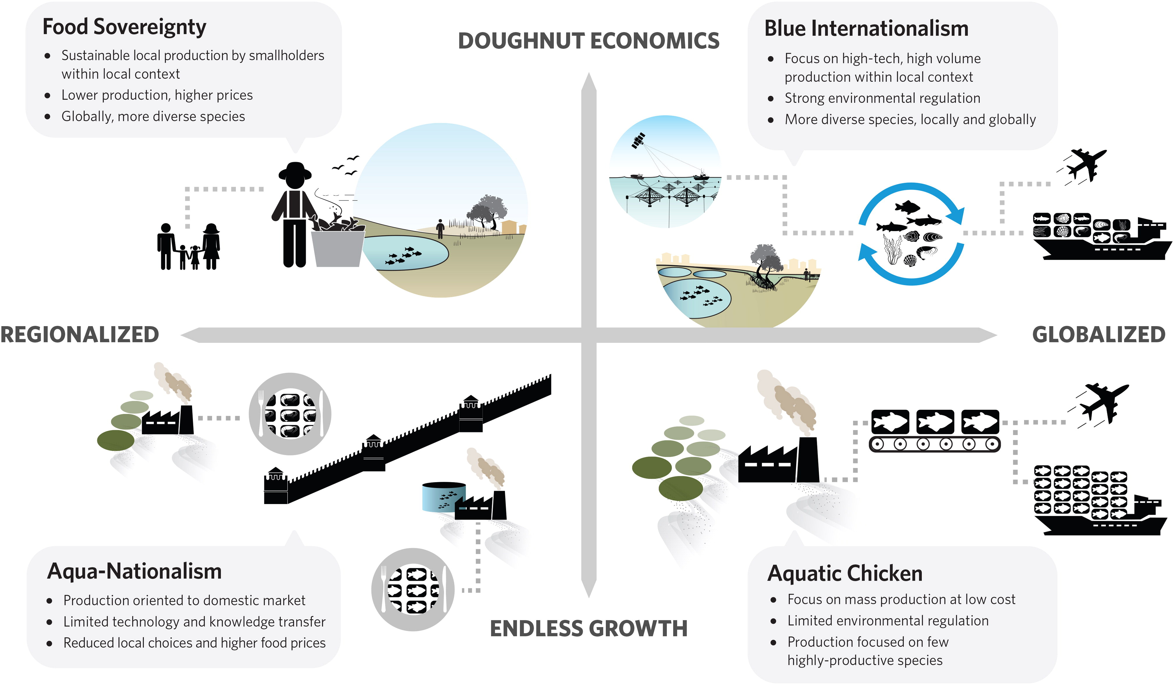
Scenarios for Global Aquaculture and Its Role in Human Nutrition
Gephart et al. 2021: https://doi.org/10.1080/23308249.2020.1782342
Notes:
Notes for Instructor: From the Gephart et al. 2021 paper: “The two axes relating to the degree of globalization and the economic growth philosophy create four quadrants, each representing a distinct future scenario, named: Aquatic Chicken, Aqua-Nationalism, Food Sovereignty, and Blue Internationalism (Figure 1).” In the paper, a qualitative narrative and discussion of the opportunity space for nutrition-sensitive aquaculture and a current aquaculture system exemplifying the scenario is provided for each scenario. The next four slides examine each scenario in more detail

Slide 3

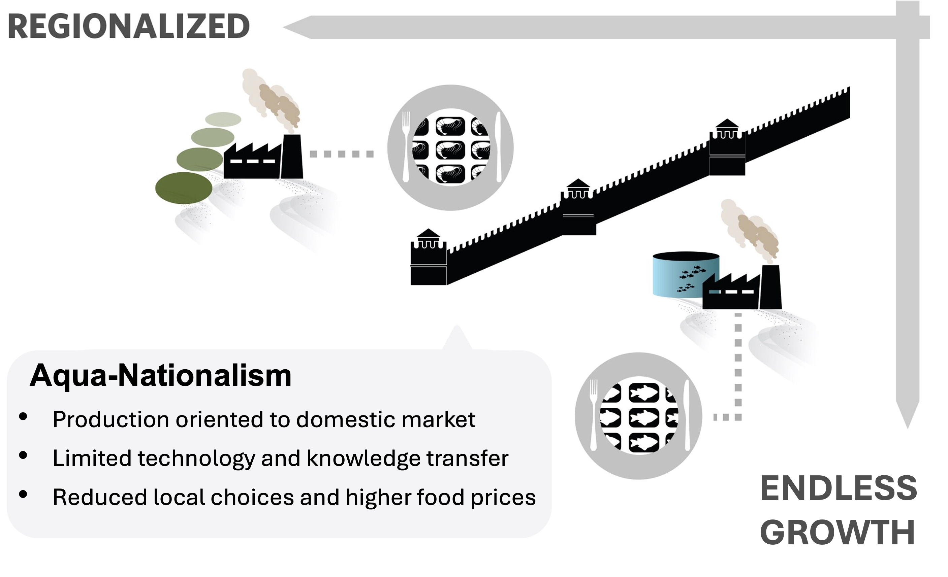
Aqua-Nationalism
Gephart et al. 2021: https://doi.org/10.1080/23308249.2020.1782342
Regional and Growth-Oriented
  Production is for the domestic market
  Limited technology and knowledge transfer
  Fewer food choices and higher food prices
  Underdeveloped regulation and
  import barriers
  High prices reduce access for the poor and vulnerable
  Total global production lower than other scenarios
  May collectively exceed environmental impact targets
Notes:
Notes for Instructor: Gephart et al. Case Study discussion: “Myanmar provides a good example of what an aqua-nationalism scenario looks like. Prior to the onset of political and economic reforms in 2011, the “closed” nature of the economy discouraged inward investment, while economic sanctions severely restricted access to export markets. Government policy during the 1990s and 2000s encouraged industrial-scale aquaculture by allocating land concessions for development by Myanmar companies. Expansion of aquaculture occurred without concern of social or environmental impacts and resulted in displacement of rural households from their land and conversion of large areas of biodiversity rich wetland habitat to fish-ponds (Mark and Belton 2020). These farms produce a very limited diversity of fish species. A single carp species – rohu (Labeo rohita) – accounts for around 70% of total production (Tezzo et al. 2018). Most farms use unsophisticated production technologies that generate low yields. Until recently, a single company maintained a virtual monopoly in domestic aqua-feed production, resulting in high feed prices and low rates of feed use. The high price of feeds contributed to low productivity and limited diversity of species farmed. Domestically sourced feed ingredients are insufficient to meet the needs of the industry, also contributing to high feed prices.”

Slide 4
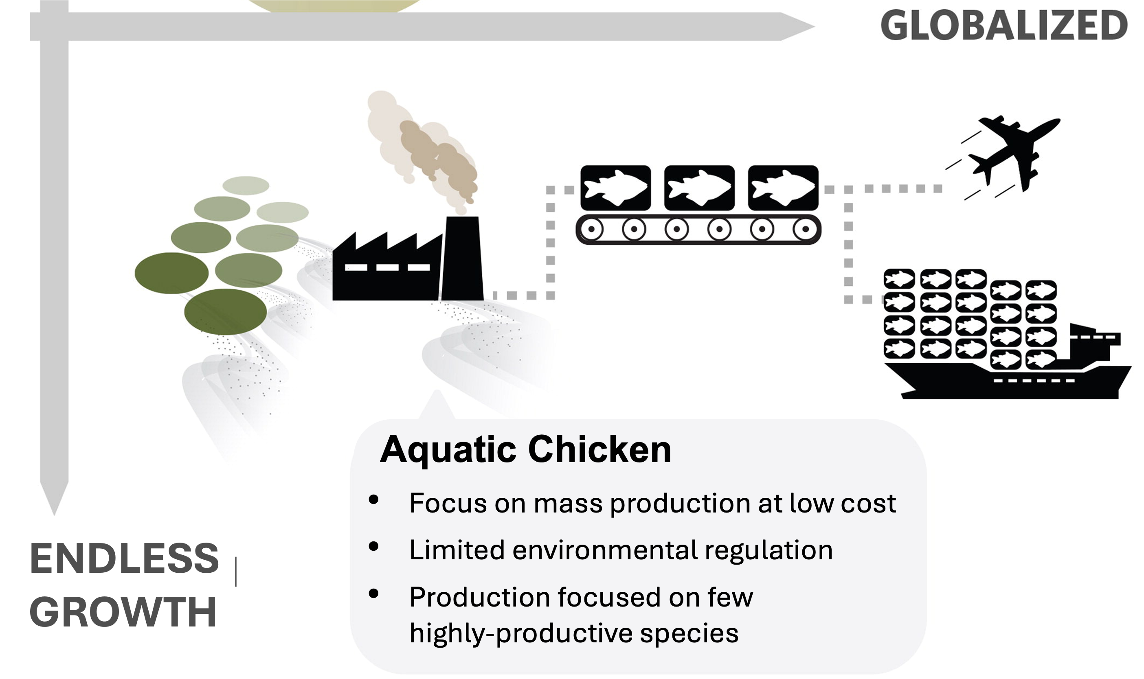
Aquatic Chicken
Gephart et al. 2021: https://doi.org/10.1080/23308249.2020.1782342
Global and Growth-Oriented
Possibility of production of the largest quantity at the lowest prices; variety is limited
Large corporate consolidation of the market reduces access for small-scale growers
Reliance on cold-storage supply chains
Access by poor and vulnerable groups may require policy intervention over free markets
Negative environmental impacts not considered
Notes:
Notes for Instructor: Gephart et al. Case Study discussion: “The development history of Atlantic salmon (Salmo salar) provides a good example of this. In the early years, local pollution and use of antibiotics and different chemicals increased even faster than the salmon production, not dissimilar to what one has observed for chicken. In addition, use of marine ingredients in salmon feeds presents a unique environmental challenge. With increased knowledge and governance systems providing incentives, these challenges can be addressed such as by using vaccines instead of antibiotics (Asche 2008) and alternative terrestrial (e.g. soy for protein) or high technology-based (e.g., microalgae and genetically modified rapeseed for omega-3 fatty acids) feeds ingredients (Klinger and Naylor 2012; Cottrell et al. 2020). While there are still environmental challenges associated with salmon production that vary with the production practices in different countries, the total environmental impact is now less than many alternatives (Froehlich, Runge, et al. 2018).”

Slide 5
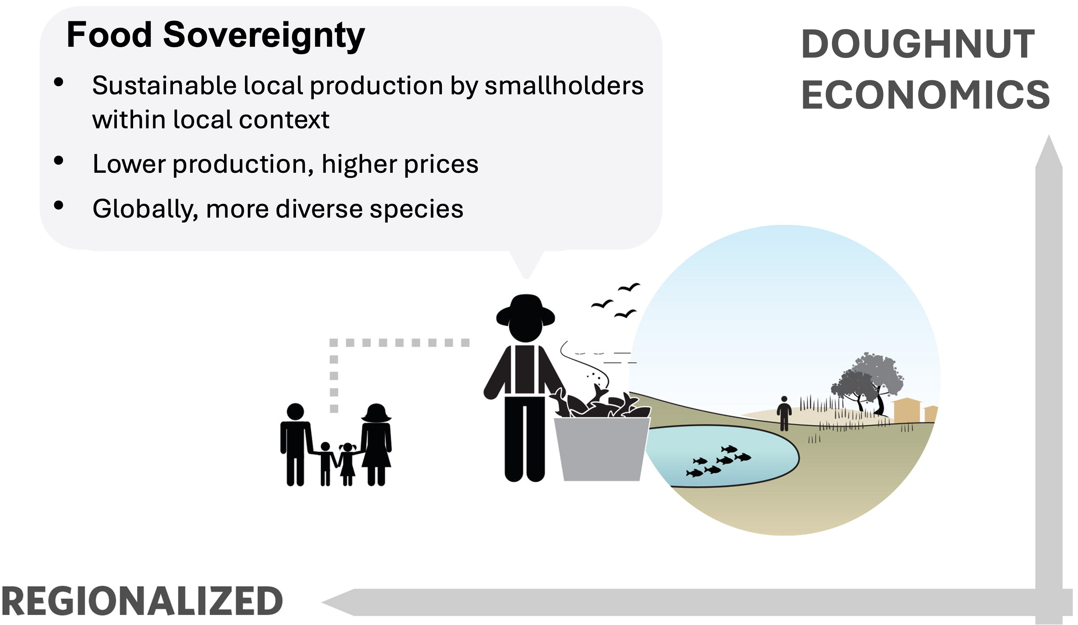
Food Sovereignty
Gephart et al. 2021: https://doi.org/10.1080/23308249.2020.1782342
Local Production and Slow-
Growth Economics
  Less global production and higher prices
  Large variety of species globally; limited regional access to variety
  Sustainable production in local communities
  Women likely to play a key role in production, which increases access by vulnerable groups
  Fits well in urban settings alongside urban gardens
Notes:
Notes for Instructor: Gephart et al. Case Study Discussion: “A current example analogous to the former situation is found in South and Southeast Asia, where millions of rural households maintain small ponds in homesteads and rice fields. These are often stocked with hatchery-produced seed species such as Indian and Chinese major carps, and tilapia and also tend to attract wild self-recruiting fish species from the surrounding environment (Edwards et al. 2002). Such ponds are usually managed extensively or semi-intensively, receiving relatively low levels of feeds and inputs such as rice bran, oil cake, and fertilizers. Ponds managed in this way produce correspondingly low yields of fish and generate limited negative environmental externalities, though there is some evidence that intensification is taking place in Bangladesh through greater use of pelleted feeds (Jahan et al.2015; Hernandez et al. 2018). Depending on household preferences, fish produced in this way may be eaten by household members or sold. Most ponds generate a small surplus of fish that is sold in markets local to the area where the farm is located, as well as contributing to home consumption needs (Belton 2013). The location of such ponds close to home compounds means that they are often managed by women, even in South Asia where cultural norms that restrict the mobility of women sometimes limit their participation in other forms of aquaculture. NGO-led extension projects in Bangladesh and India have successfully introduced micronutrient rich small indigenous species such as mola into carp-based homestead pond polycultures (Thilsted et al. 2016). Including small indigenous species in polycultures has been demonstrated to increase intakes of micronutrient-rich small fish by women and children (Castine et al.2017), and to cost-effectively reduce the burden of micronutrient malnutrition (Fiedler et al. 2016). Unfortunately, these ways of farming no longer contribute a large share of total fish production."

Slide 6
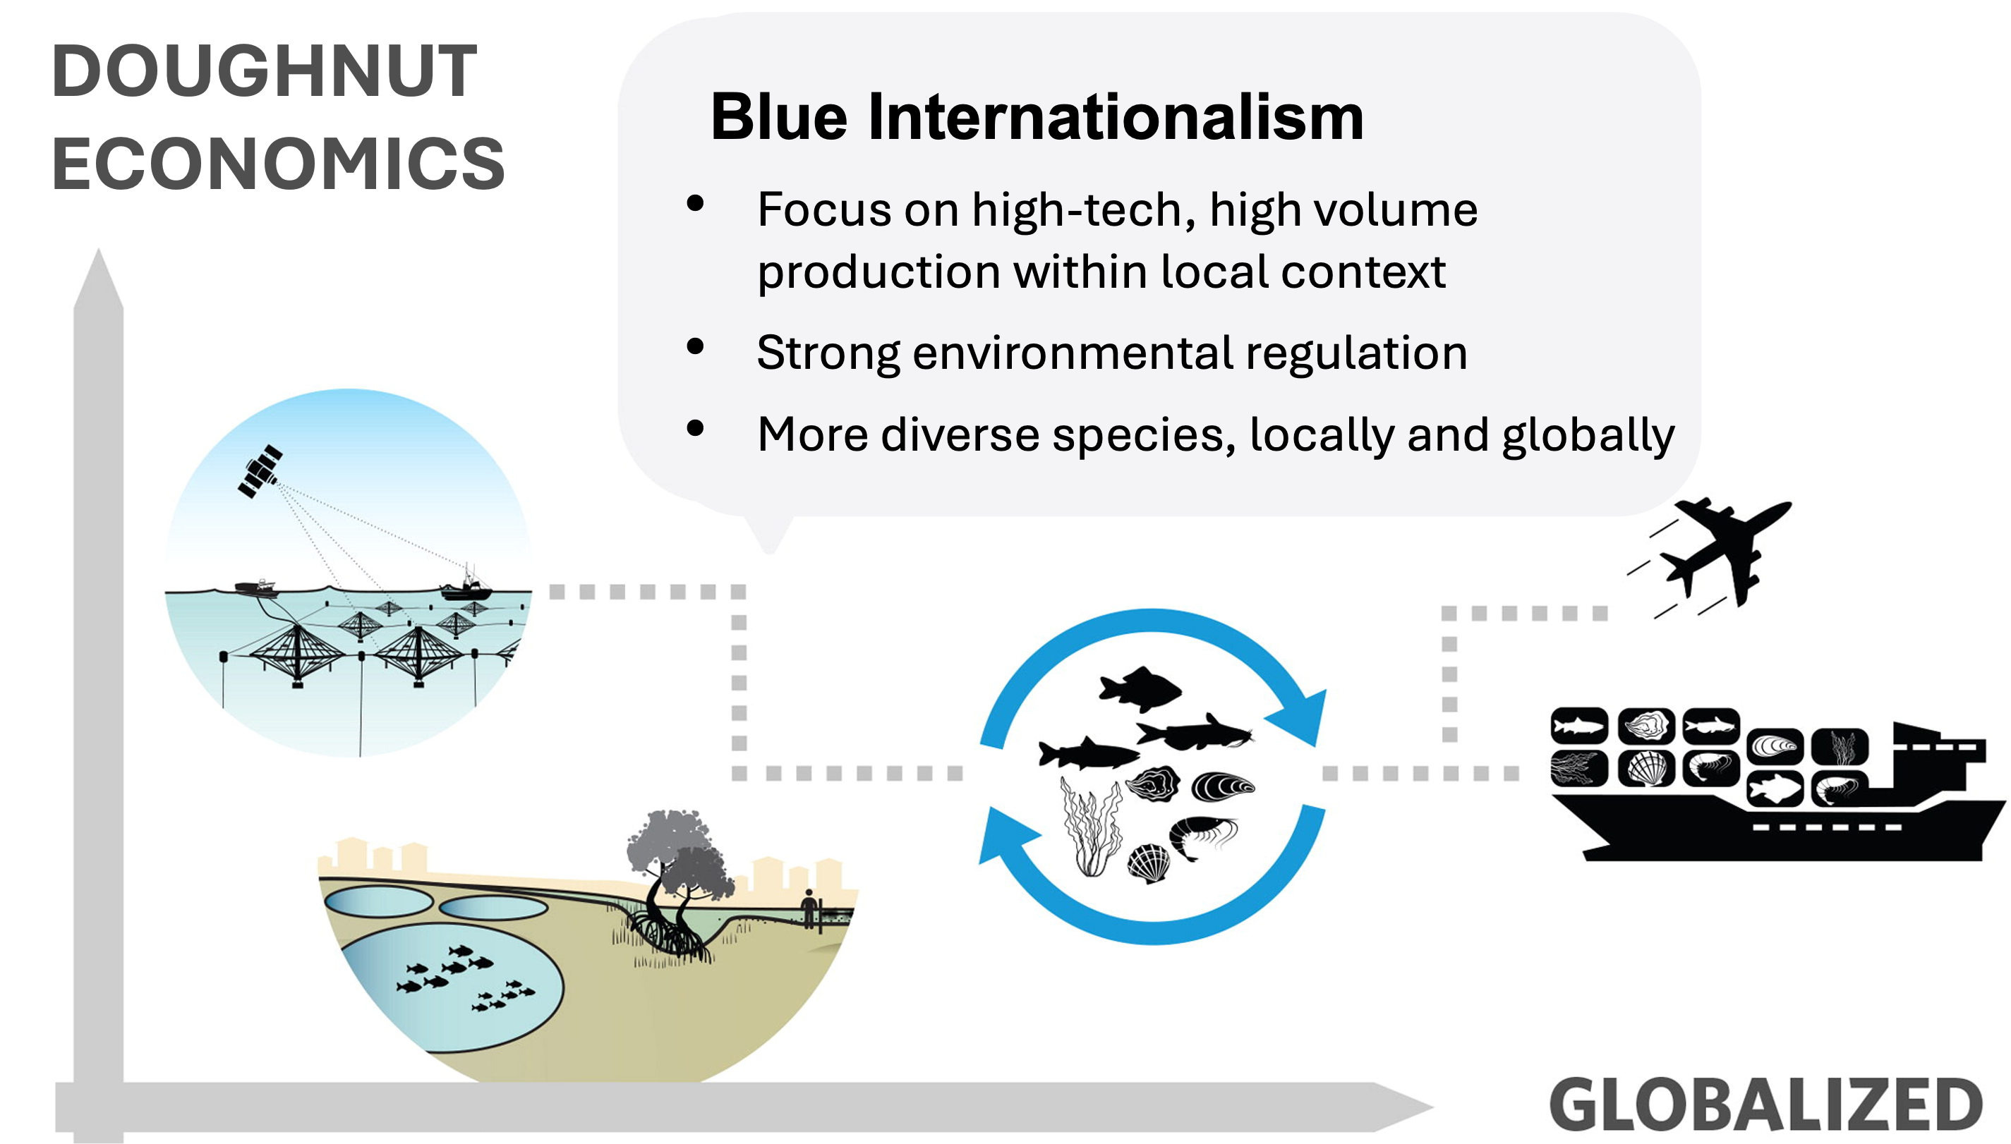
Blue Internationalism
Gephart et al. 2021: https://doi.org/10.1080/23308249.2020.1782342
Global Reach and Slow-Growth Economics
  Business incentives to produce a diversity of species at a range of price points
  High level of industry regulation to meet nutrition, economic, and environmental benchmarks
  Small companies supported by inputs from national and international supply companies produce higher volumes of seafood
  Regulation directs inexpensive seafood to vulnerable populations
Notes:
Notes for Instructor: Gephart et al. Case Study discussion: “The aquaculture sector in the Netherlands exhibits many of the characteristics associated with Blue Internationalism, despite its relatively low total production. Blue mussels (Mytilus edulis) make up the majority of production (86% by tonnage in 2017), but other bivalves and finfish are produced, including north African catfish (Clarias gariepinus, 5%), cupped oysters (Crassostrea gigas, 5%), European eel (Anguilla anguilla, 3%), and several other species (1%; FAO 2016). Production systems in the Netherlands range from extensive, capture-based production of blue mussels to highly intensive recirculating systems for yellowtail (Seriola lalandi). In capture-based blue mussel systems, farmers dredge natural mussel beds or use suspended seed collectors to capture wild juveniles and then transfer them to protected plots for grow-out (Bostock et al. 2016). Farmed blue mussel production in the Netherlands has decreased by about 50% since highs in the late 1990s due to contraction of permitted sea-bottom grow-out area as a result of competition from other users, including environmental conservation, and periodic recruitment decreases. Collection of wild seed is regulated (Wijsman et al. 2019). Recirculating systems for yellowtail and other finfish utilize hatchery produced fingerlings, manufactured feeds, on-land tanks, and high stocking densities (Sicuro and Luzzana 2016). The Dutch aquaculture sector is composed mostly of small companies, but the sector is supported by inputs supplied by regional and international supply-chain companies.”

