Slide 1

Qualitative Methods for Actionable Sustainability Science:
Appreciative Inquiries and Learning Journeys

Slide 2
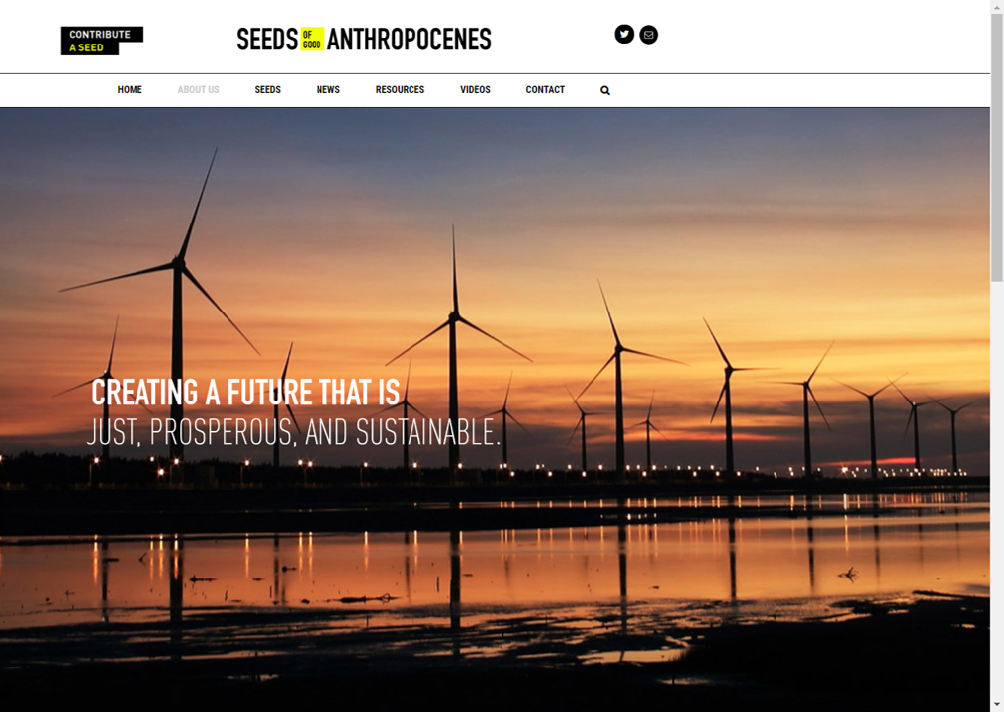
Seeds of
Good
Anthropocenes
Website

Slide 3

What Are Good Seeds?
Good seeds are stories or initiatives—proposed or already in existence—that suggest a more sustainable future but are not currently dominant in our world.
They can be social, technological, economic, or ecological ways of thinking or doing, or case studies, that can contribute to creating a Good Anthropocene.

Slide 4

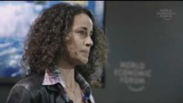
An Explanation & Example
In the video below, Dr. Elena Bennet, of McGill University, provides an explanation and example of initiatives that contribute to a better Anthropocene.
“Identifying successful socio-ecological initiatives that could produce a better Anthropocene”
www.youtube.com/watch?v=3iVaZ7qkku4&t=69s

Slide 5
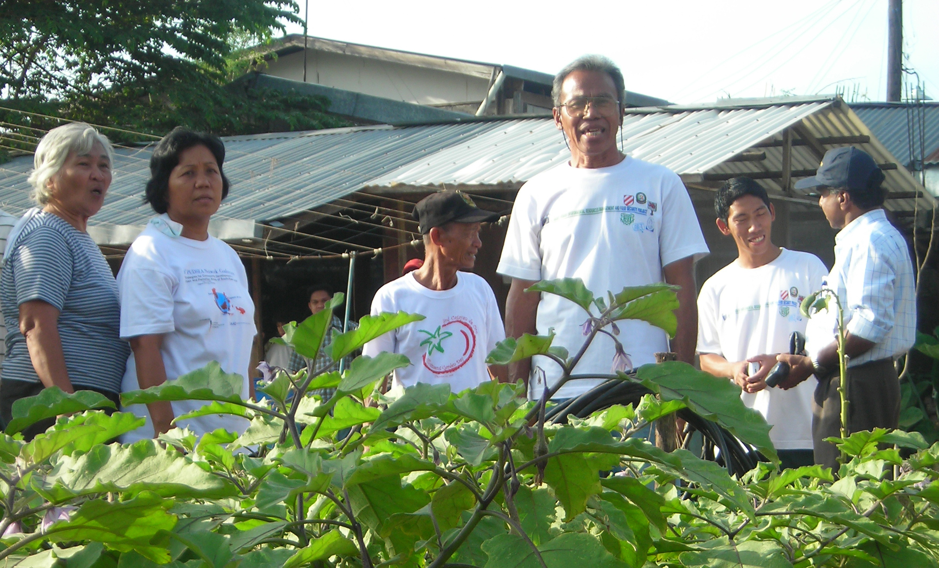
What Is Appreciative Inquiry?
A qualitative method that provides an alternative to solving sustainability problems
An actionable scholarly method
Seeks to identify a good practice or initiative to extend existing community strengths
Focuses the research process on what works, rather than trying to fix what does not
A collaborative and participatory approach
Relies on discussion, exchange of ideas

Slide 6
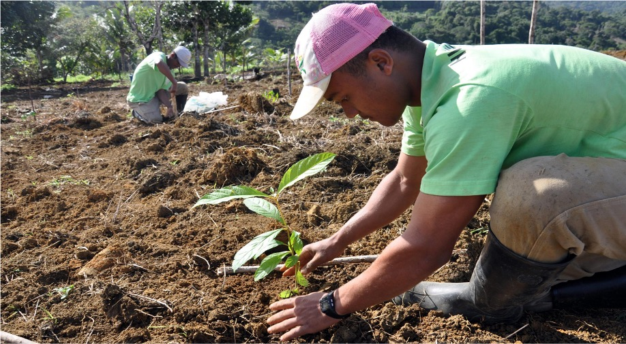
What Is a Learning Journey?
A method for producing knowledge and effecting change
Learning through group experiences in the real world rather than from behind a desk (e.g., to field sites, farms, museums, etc.)
Learning through discussions or writing during or after visits

