Slide 1

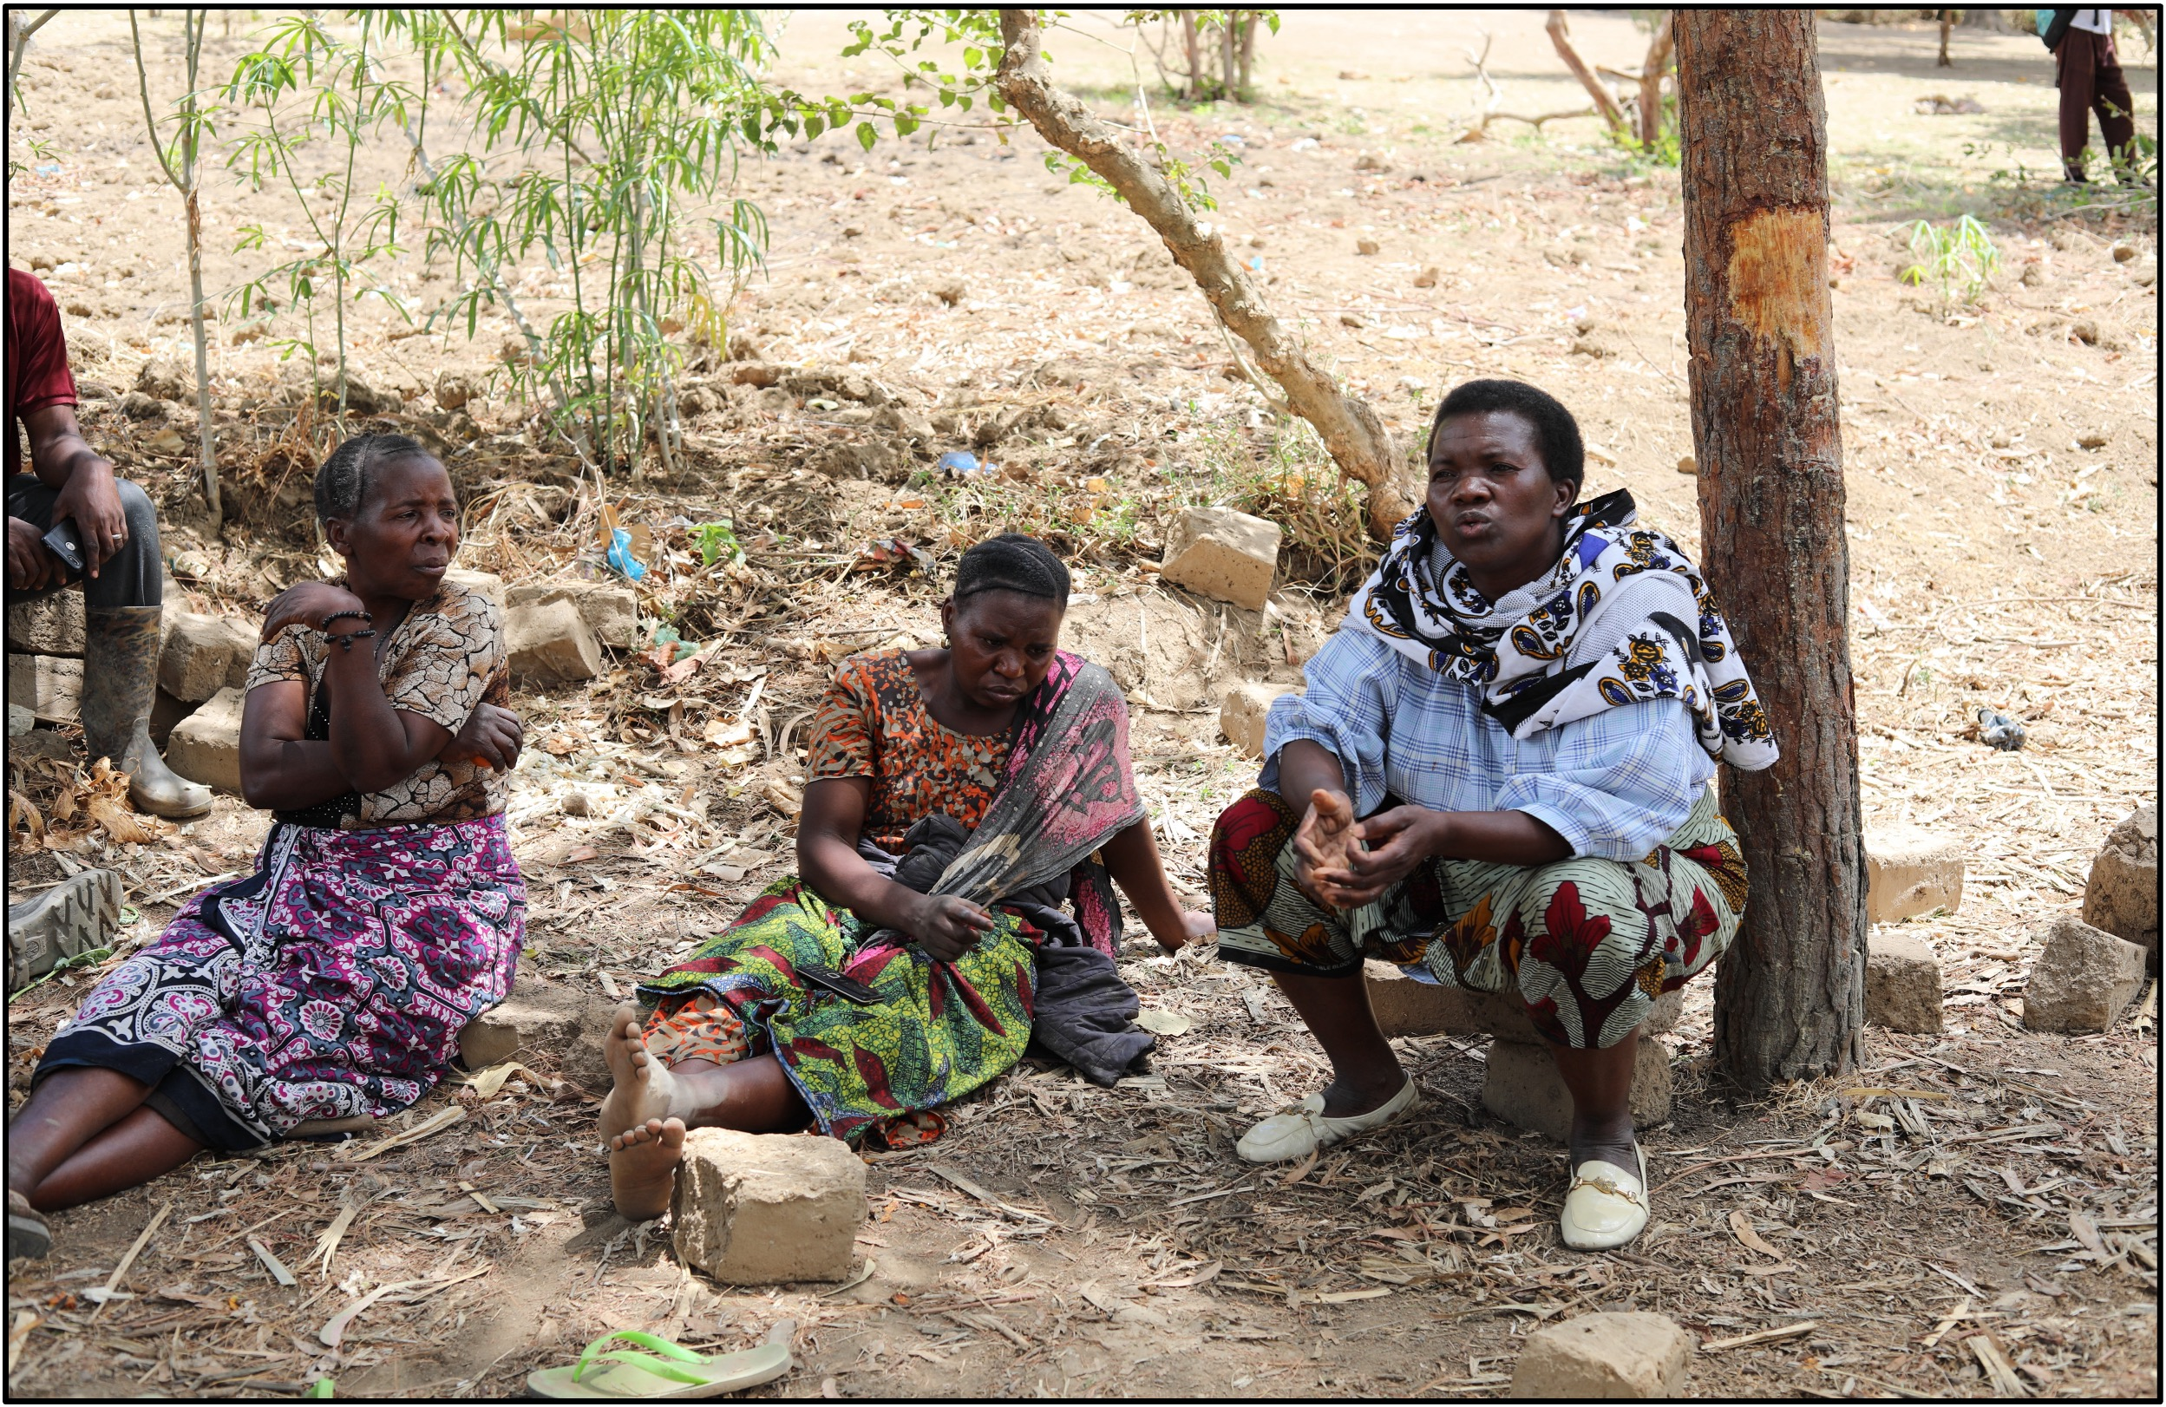
Ethnographic Methods
These co-op farmers in rural Tanzania share with international aid workers the challenges they have encountered with soil fertility, pests, and market rates for their produce. Photo by Heidi Scott.

Slide 2

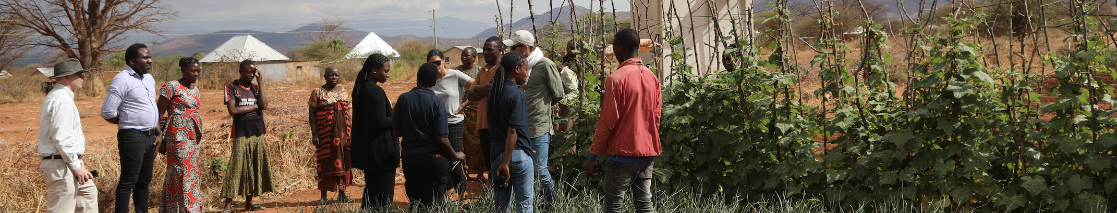
What Is Ethnography?
Ethnography is the scientific study of norms and customs within a specific culture.
Ethnographic methods help socio-environmental (S-E) researchers better understand how culture affects environmental perceptions, values, and impacts.
International aid workers consult with local farmers on climate and soil fertility conditions near Dodoma, Tanzania. Photo by Heidi Scott.
Notes:
Notes for Instructor: It’s important to emphasize that ethnography helps Western science avoid past mistakes that might reinscribe abusive histories of colonization, appropriation, and erasure. Ethnography helps outside researchers and policymakers better understand the needs and norms of target communities so that any “aid” or intervention is well-designed to help the local community on its terms.

Slide 3
What Is Ethnography? Continued
Ethnographic methods include:
        Conducting structured interviews with individuals in a culture of interest
        Doing long-term fieldwork within a community
        Using a historical lens to examine how certain cultural values and notable events result in the exploitation or protection of natural resources, human cultures, and non-human lifeforms.
Ethnography helps scientists create and tailor appropriate research and implementation plans that will benefit the local community.
Notes:
Notes for Instructor: It’s important to emphasize that ethnography helps western science avoid past mistakes that might reinscribe abusive histories of colonization, appropriation, and erasure. Ethnography helps outside researchers and policymakers better understand the needs and norms of target communities, so that any “aid” or intervention is well-designed to help the local community on their own terms.

Slide 4

Cultural Sensitivity
Photo by Heidi Scott
Ethnography is often conducted by Western Scientists studying less materially wealthy cultures, including:
    The Global South
    Indigenous Communities
    Disadvantaged communities within the scientist’s native country.
This discrepancy of experience and access to resources is a major incentive for good ethnography: to build understanding between people who don’t share a common experience.
Notes:
Notes for Instructor: Ask students how they think ethnographers should approach these two situations differently: 1) an outside country with a colonial history of resource extraction vs. 2) a domestic community that has long suffered racial and class discrimination. How is the positionality of the researcher different in these two scenarios?

Slide 5
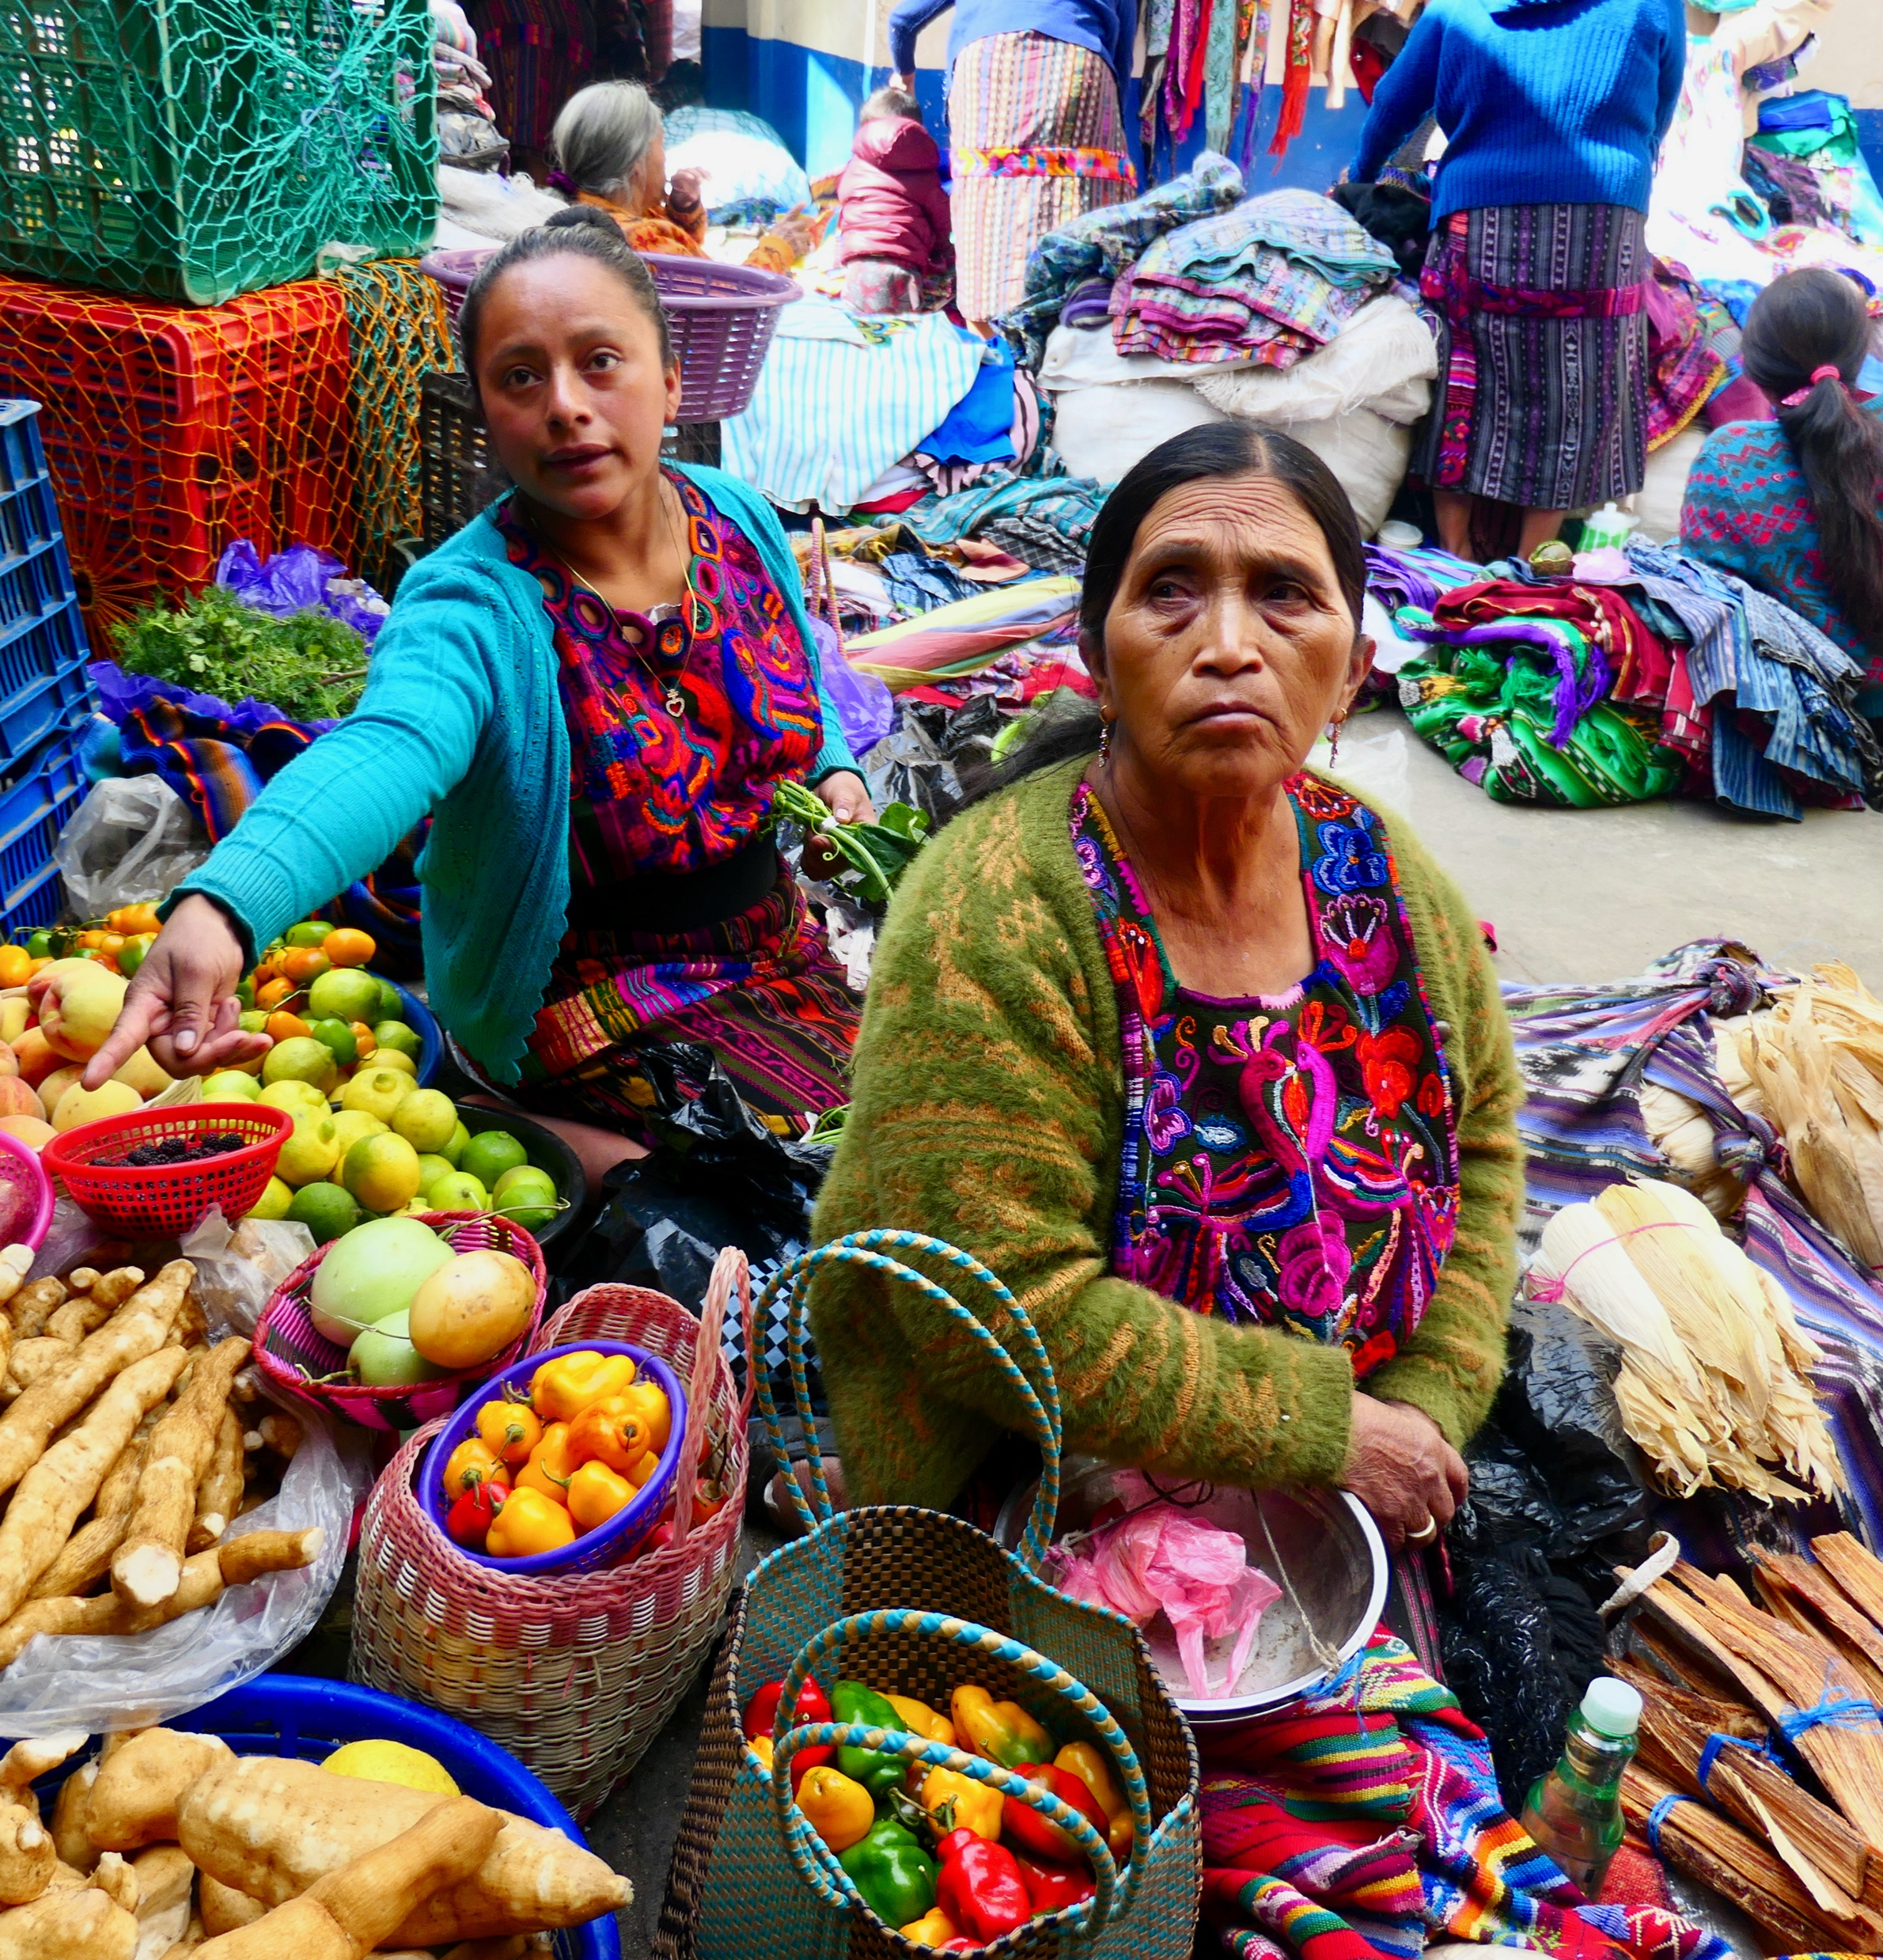
Cultural Sensitivity Cont’d
Two vendors at the Chichicastenango market in Guatemala. Photos by Bruno Rijsman via Wikimedia, Creative Commons Attribution-Share Alike 2.0 Generic
Ethnographers must be aware of their positionality and practice cultural relativism and non-judgement as they ask target communities to share their norms and customs.
They should also ensure that their work does not cause new problems, such as conflict for funds that the ethnographer offers as incentives.
Ethnography should strengthen bonds and opportunities within a target culture, rather than undermine longstanding norms or serve an outside agenda.
Notes:
Notes for Instructor: Ask students how they think ethnographers should approach these two situations differently: 1) an outside country with a colonial history of resource extraction vs. 2) a domestic community that has long suffered racial and class discrimination. How is the positionality of the researcher different in these two scenarios?

Slide 6
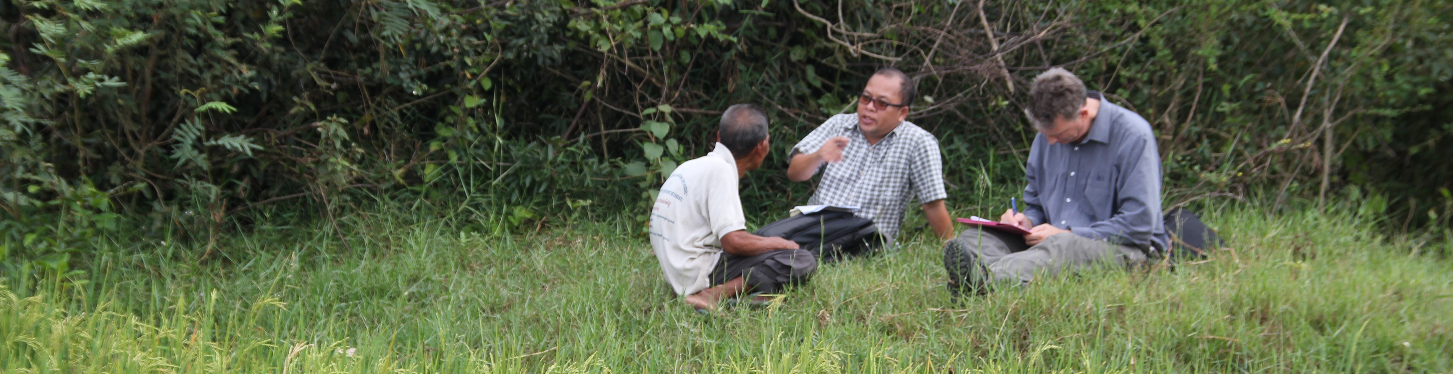
Ethnographic Method: Structured Interviews
Interviewing a Cambodian rice farmer. Photo by Australia Department of Foreign Affairs and Trade via Wikimedia Commons Creative Commons Attribution 2.0 Generic License
Researchers recruit individuals from a community and ask structured, consistent questions to better understand the local culture and ecology. Researchers might tailor their questions to cover areas of limited outside understanding, such as:
          The history of land use including colonial and local tribal histories
          How land tenure systems affect agricultural practices
          Species community or climactic changes witnessed through time
          The specific needs and challenges that a community is facing
          Distinctions of age, gender, and social class in cultural needs and perceptions.
Notes:
Notes for Instructor: Learners may find it interesting to consider how these guidelines relate to conversations about “consent.” When Western Science desires access to Indigenous lands to conduct research, scientists must ask consent for their inquiry and design their approach around Indigenous practices, priorities, and future benefit.

Slide 7
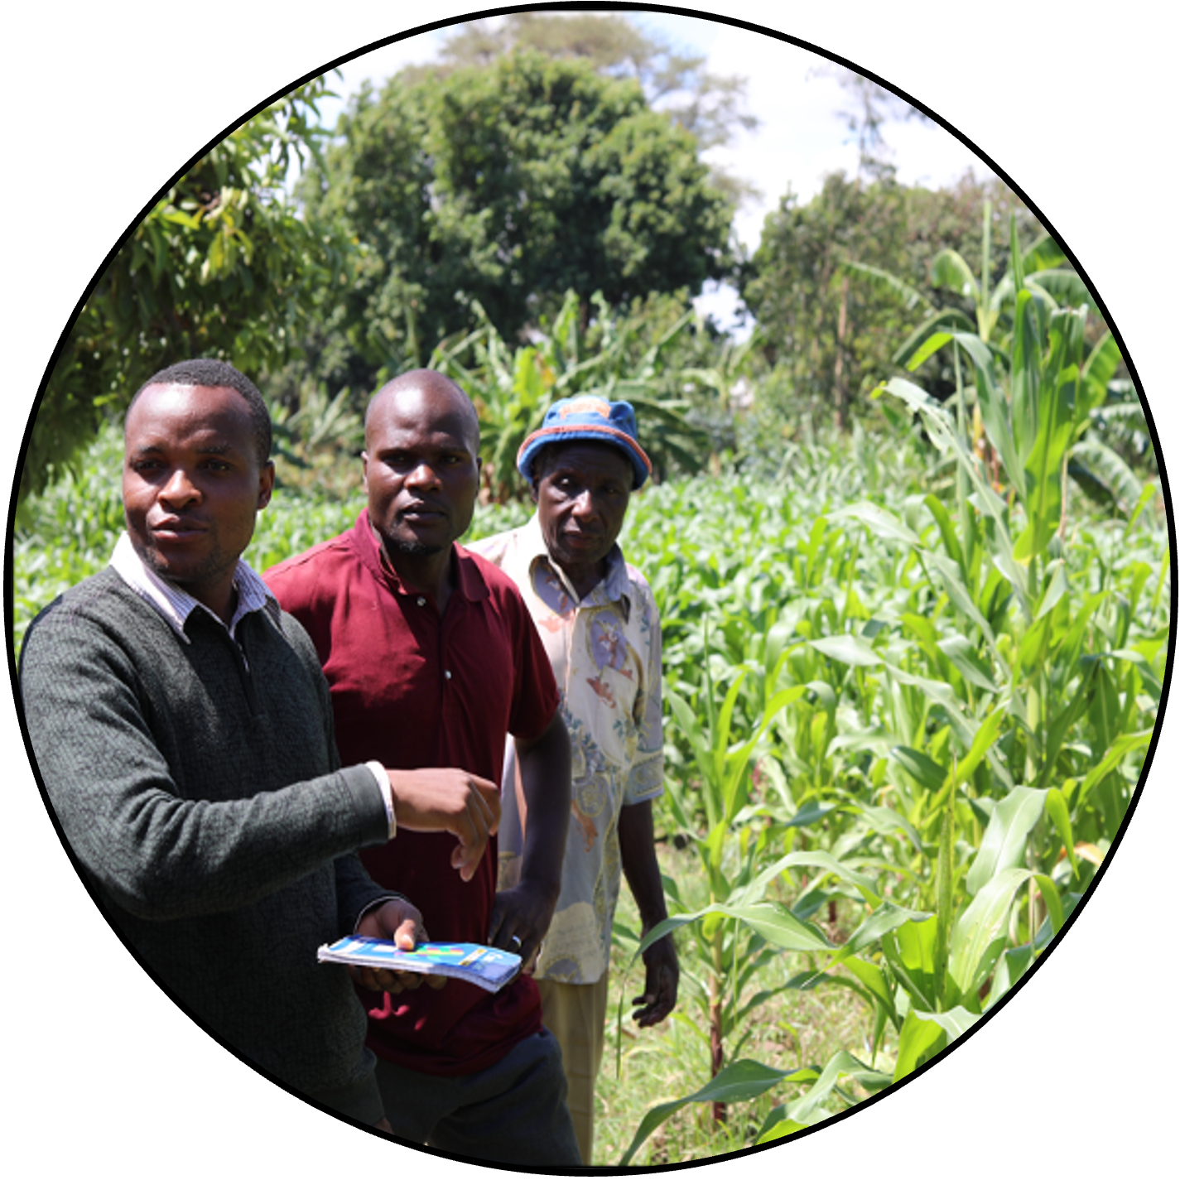
Ethnographic Method: Dialogues
    With dialogues, community members may expect equal participation in knowledge sharing, and they may be empowered to ask outside researchers about their norms and perceptions.
    A dialogue brings participants onto an equal footing rather than dividing the power of inquiry from the burden of response.
    In both cases, researchers may achieve more by offering a small financial incentive to participants.
Co-op farmers in Tanzania share their challenges with outside aid workers. Ethnography often requires a local guide and translator, here, a Swahili interpreter. Photo by Heidi Scott.
Notes:
Notes for Instructor: Learners may find it interesting to consider how these guidelines relate to conversations about “consent.” When Western Science desires access to Indigenous lands to conduct research, scientists must ask consent for their inquiry and design their approach around Indigenous practices, priorities, and future benefit.

Slide 8
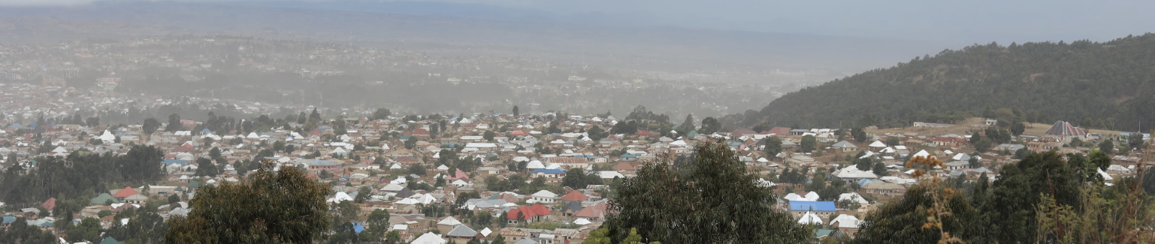
Ethnographic Method: Long-Term Field Work within a Community
Mbeya, Tanzania, is the country’s “food basket,” yet malnutrition rates are high.
How can ethnography help? Photo by Heidi Scott.
With origins in Anthropology, long-term fieldwork means that a researcher will live in a community for an extended period, often several years. This deeper commitment to understanding a culture can result in:
Greater comprehension of the subtleties of language and cultural norms
Rituals of food provision, preparation, and service through many seasons
Spiritual aspects of culture that may influence pro-environmental behavior
Distinct experiences according to gender, age, and place in the community
Histories between local cultures or colonial-era influences on present behavior in the community.
Notes:
Notes for Instructor: Learners may find it interesting to consider how guidelines for ethnography relate to conversations about “consent.” When Western Scientists seek access to ethnic lands to conduct research, scientists must ask consent for their inquiry and design their approach around local practices, priorities, and future benefit.

