Slide 1

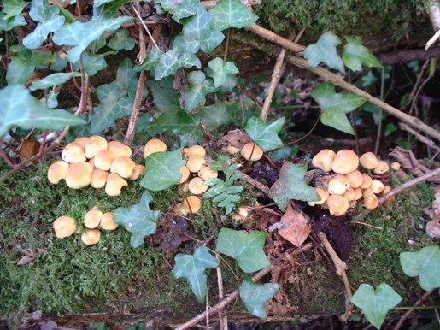
Urban Forest Patches Lesson 1:
Ecological Dynamics

Slide 2

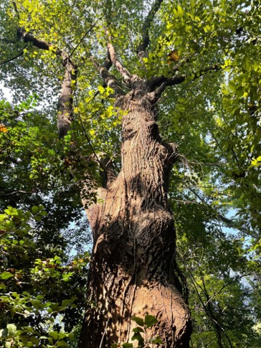
What Is a Novel Ecosystem?
Novel Ecosystems are ecological community assemblages that are unique to a location.
Several factors can affect novel communities:
Histories of human use and disturbance
Presence of non-native or invasive species
Pollution (air, water, noise, light, trash)
Water run-off from city hardscapes
Imbalances of fauna: grazers like deer that no longer have natural predators
These ecosystems display invasions, emergent mutualisms, and community evolution through states of succession.
Notes:
Notes for Instructor: Ask learners whether they’re familiar with the debate in Invasion Biology between “historical restorers” and “novel stewards,” which is both philosophical and ecological. The debate centers on the value of protecting or restoring “historical ecosystems” versus cultivating value in “novel ecosystems.” Historical ecosystems are community assemblages that have long existed without extensive human disturbance but may now require specific governance and restoration mandates to remove non-native species or to protect against climate and hydrological shifts. Whereas novel ecosystems are communities that exist as the byproduct of human disturbance including climate change or the introduction of non-natives.
Those who argue for the value of Novel Ecosystems argue that we must dispense with the idea of restoring communities to their historical assemblage, and they note that preserving historical ecosystems may be seen as a losing battle from a climate change perspective. Adaptation, resistance, resilience, and evolution’s creative potential to craft mutualistic communities in times of disturbance are all positive factors for embracing novel ecosystems. On the other hand, Invasion Biologists have developed many tools aimed at preserving the integrity of native landscapes from physical removal of invasive species to the genetic alteration of breeding pairs (male neutering) to limit the proliferation of invasive species.

Slide 3
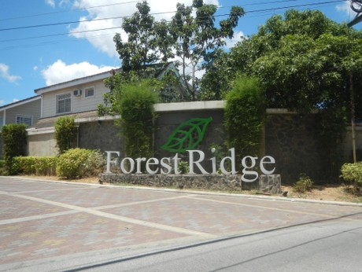
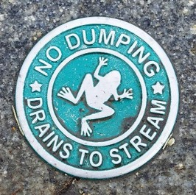
Biophysical Factors in Urban Forest Patches (UFFPs)
Edge Effects: Exposure to outside conditions: wind, urban heat, sunlight, trampling, dumping, higher levels of proximate pollution than large forested areas.
Disturbance: Histories of human use and the plant and animal species compositions in the UFP ecosystem affect states of ecological succession.
Forest Patch Condition:
Multi-dimensional factors:
species composition;
soil biochemistry;
tree age and health;
layered structure including herbaceous, shrub, understory, and overstory
governance and local economic conditions.
Wikimedia Commons, Public Domain
Notes:
Notes for Instructor: Edge effects are easily understood through the basic idea of the surface area to volume ratio: small UFPs have extremely high surface area (edges) compared with their volumes (interiors). Though this may be a useful ratio for digestion in our intestines, it can be highly disruptive of ecological community dynamics.
Advise learners to think vertically as well as laterally: a lot of forest health and habitat quality is about the vertical distribution of biomass, shelter, water, and sunlight.

Slide 4
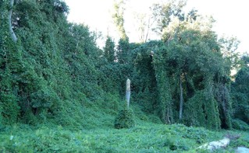
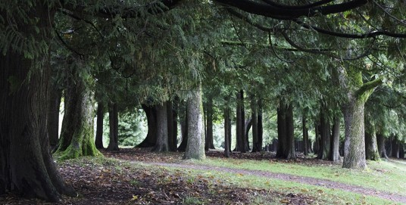
Aesthetic Factors and UFP Valuation
UFPs can display conditions of neglect, invasion, and disinvestment that make them seem ugly, useless, or even dangerous.
Alternatively, UFPs can serve as havens for biodiversity and habitat for endemic, rare, and migrating species, as well as urban humans.
UFPs can evolve community assemblages that provide ecosystem services and form networks of resilience against urban stressors and climate change.
Kudzu chokes trees in Atlanta, GA, USA, Wikimedia Commons, Public Domain
Urban Forest, Vancouver BC, Canada. Photo by Rod Raglin, Share-Alike 2.0
Notes:
Notes for Instructor: Biologists may look to aesthetics as merely human sensual cues to evaluate ecosystem health; sensual displeasure often results from unstable states, chemical pollution, or other forms of disturbance. But human aesthetic enjoyment is also a potent way to yoke the biophilia we feel for healthy ecosystems to the governance, economic, and community support necessary to maintain healthy UFPs. Sensual pleasure also provides human services like ecopsychology, exercise, curiosity, and attraction: all elements of biophilia.

