Slide 1

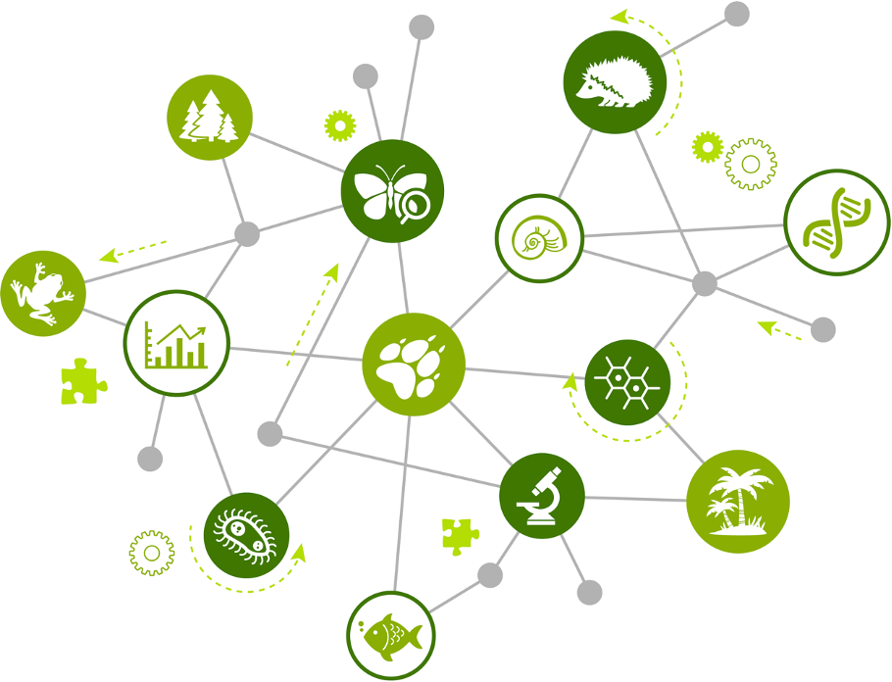
Network Methods to Understand Complex Systems Part 2: Social

Slide 2

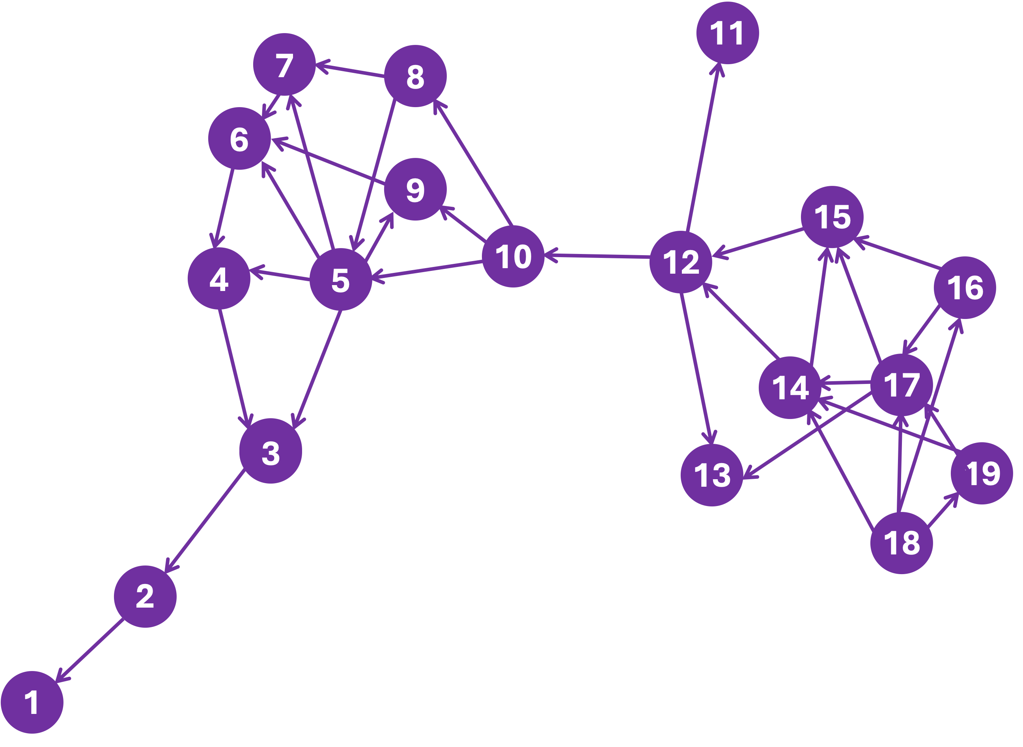
Centrality Network Analysis in Social Systems

Slide 3
Network Centrality Metrics
What are they and why are they useful?
Characterize aspects of a node’s position in a network
Useful in identifying most influential actor* (node)
  *actor = person, institution, group
  How is an actor’s influence in a network assessed?
Number of relationships?
Speed of influence?
Ability to connect others?
There’s a centrality metric for each…
Notes:
Notes for Instructor: Slides are animated, so you can first prompt the participants to answer the questions and then bring up answers.

Slide 4
Centrality Metrics
Node Degree
node linked to the
most other nodes
(reflects # of relationships)
Closeness
has shortest average mean distance to all other nodes
(reflects ability to influence
others “quickly”)
Betweenness
falls on the shortest paths the most times
(reflects bridging between parts of network)
Notes:
Notes for Instructor:
Node Degree Method: Count the number of links for each node and compare among nodes.
Closeness Method: For a node, determine the number of links away it is to every other node; add these numbers up, then divide by the total number of nodes and you have the average closeness for that node. Do this for every node, and the one with the shortest average closeness value is where the network’s closeness centrality is the greatest.
Betweenness Method: Count the umber of times a node lies on the shortest path between two other nodes in the network. (I.e., It bridges nodes and removing it severs parts of the network; it controls the flow of information between nodes and groups of nodes.
The NEXT 3 slides include the purple network image. Ask participants to identify the highest node degree; best closeness; and best betweenness. Animation click brings up the answer.

Slide 5
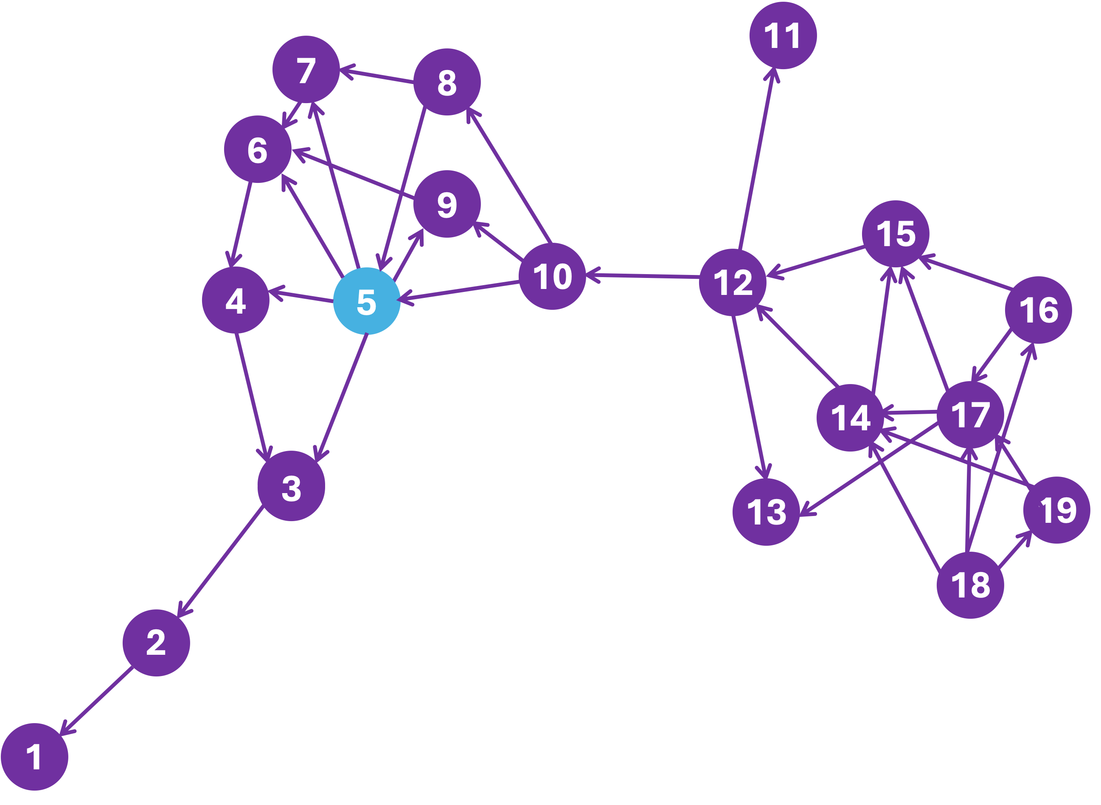
Node Degree

Slide 6
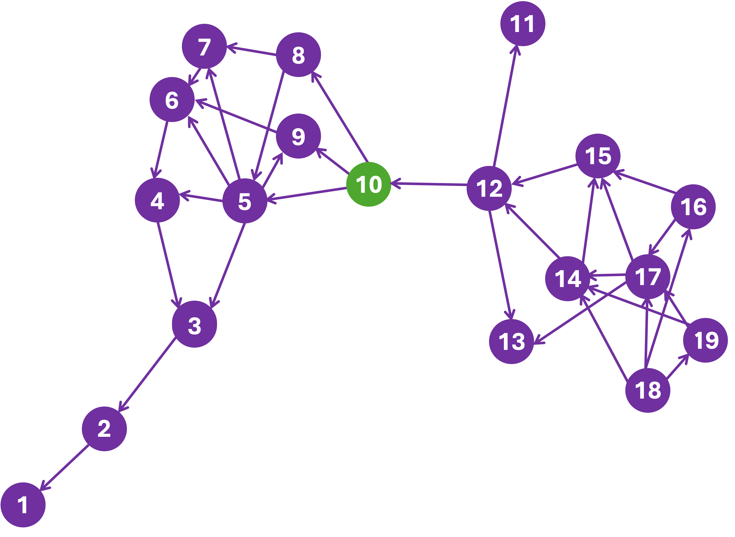
Closeness Centrality

Slide 7
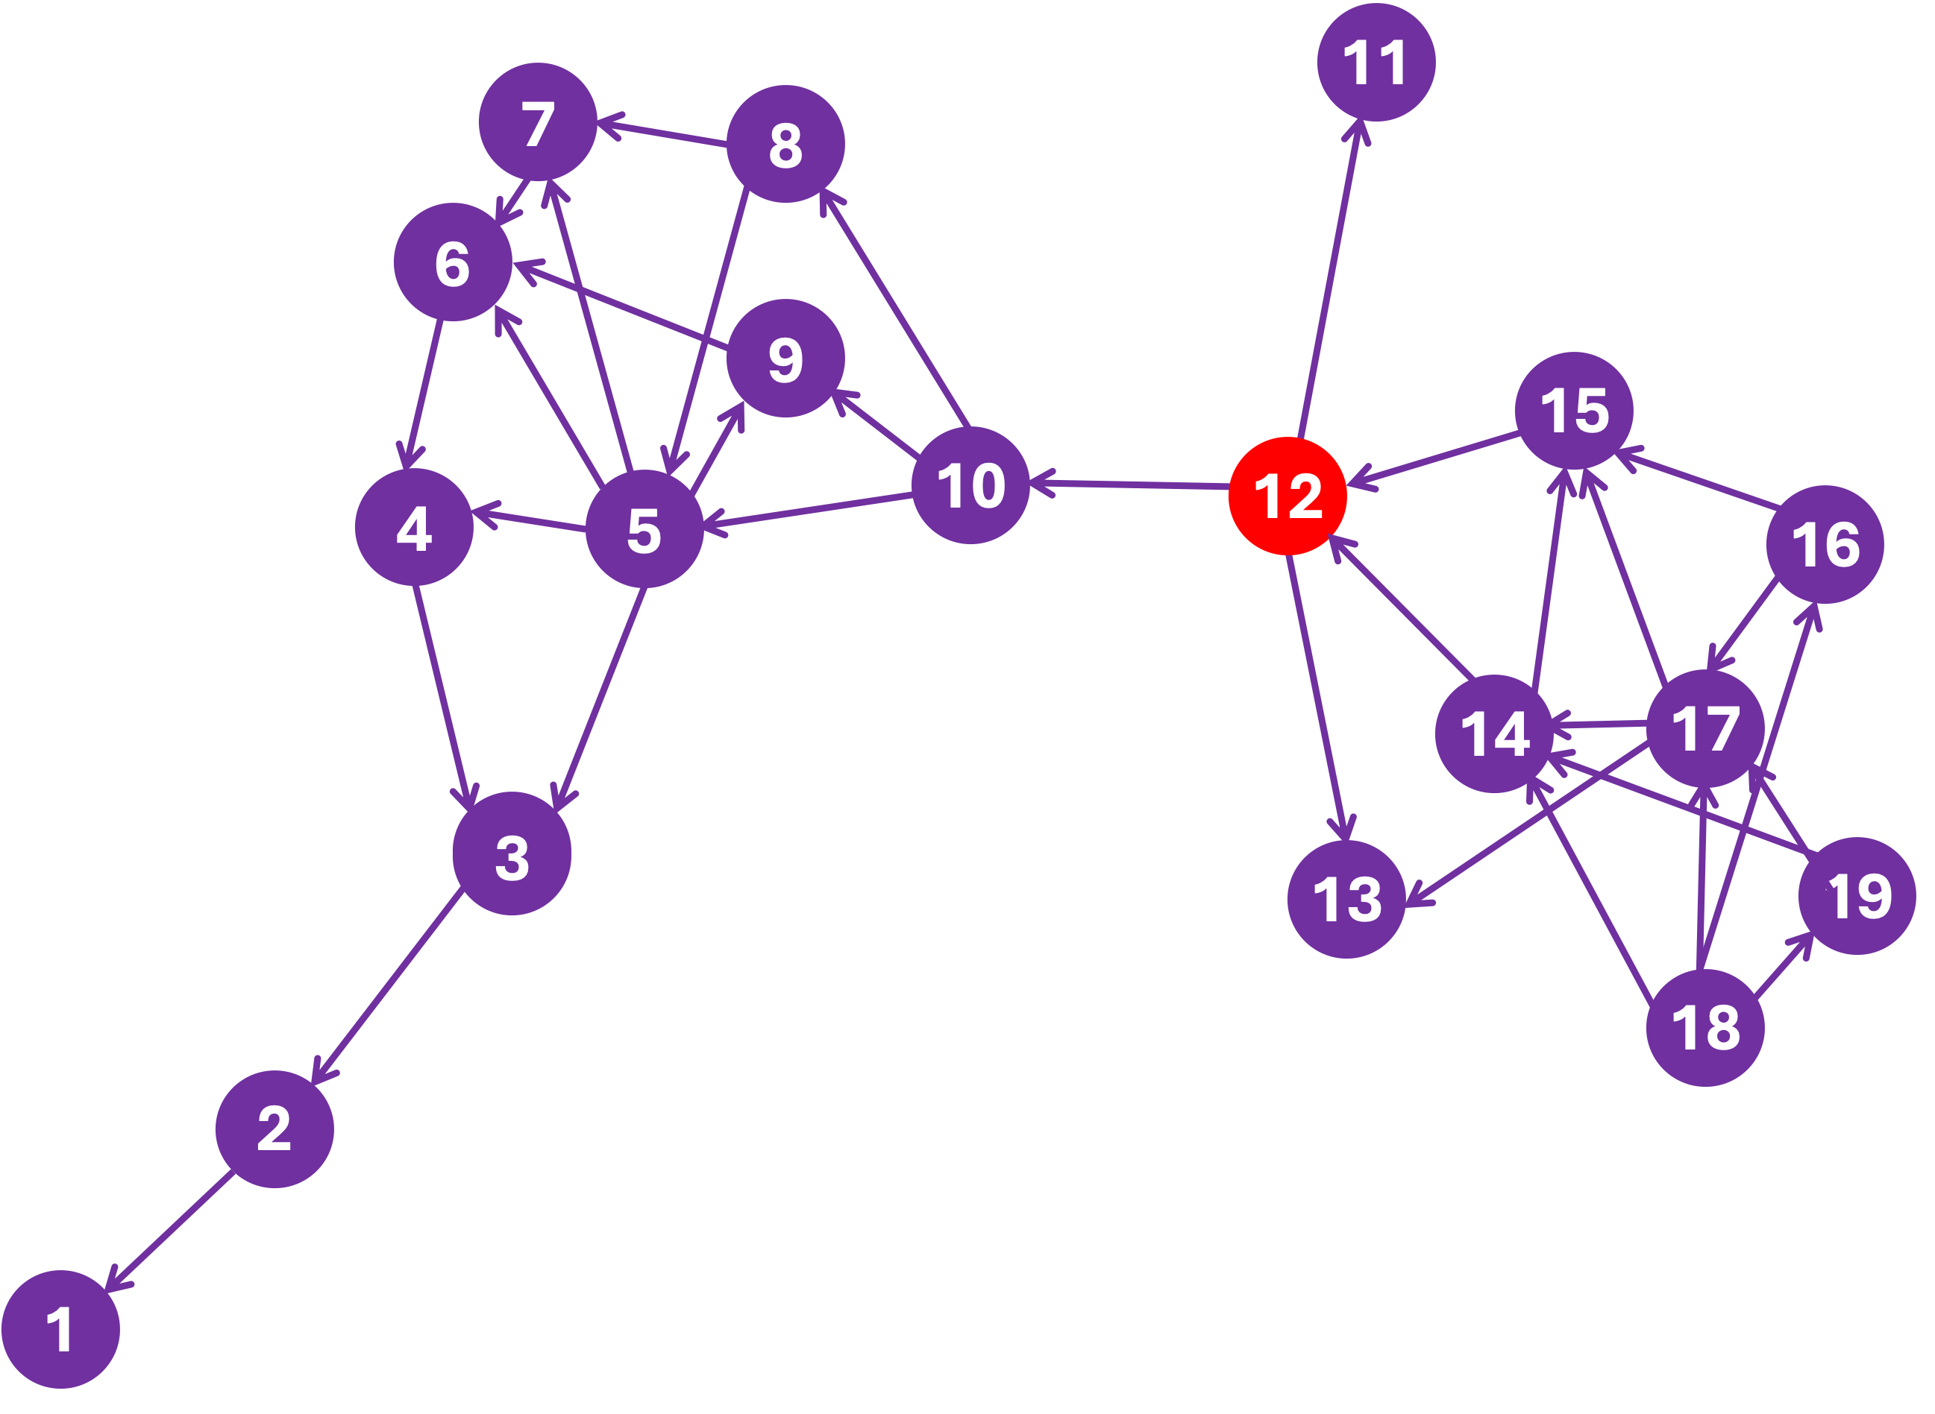
Betweenness Centrality

Slide 8
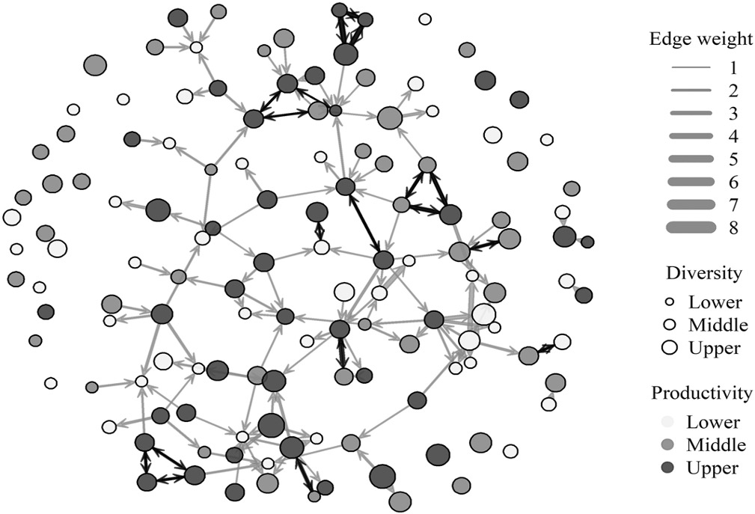
Example: Aniak Food-Sharing
Network
Source: Figure 2 from Scaggs et al. 2021. Linking subsistence harvest diversity and productivity to adaptive capacity in an Alaskan food-sharing network.
Notes:
Notes for Instructor:
In this figure, “edge” is synonymous with “links.”
Node diameter is scaled by household's harvest diversity.
Node shading indicates productivity.
The direction of links is indicated by arrows.
Black links represent instances of reciprocity.
The thickest links have heavier weights (i.e., the transfer of multiple resource types between two households).

