Slide 1

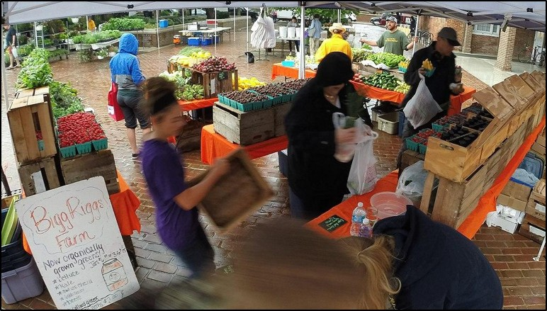
Sustainable Development: Urban Agrobiodiversity
A farmer’s market in Alexandria, VA, just outside of Washington, DC, via Wikimedia Commons, Public Domain.
Notes:
Notes for Instructor: Look at the variety of foods provided by local growers in Virginia. How does this variety and locality compare with a standard grocery store? What social, health, and environmental benefits come out of this style of food retailing? How accessible do you think this food is to low-income residents, in terms of price points, market location, and community outreach?

Slide 2


The UN’s 17 Sustainable Development Goals (SDGs)
Notes:
Notes for Instructor: Learners will review these SDGs and identify which ones are supported by the specific agrobiodiversity linkages identified in Zimmerer et al. 2021. Learners may enjoy discussing how many of the human-centered goals rely on the support and innovation of sustainable environmental practices. For example, how can gender equality be achieved without equal access to clean water, nutritious food, and safe living spaces? How does global poverty affect access to clean energy? Which of the SDGs seem most clearly related to urban agrobiodiversity in the United States?

Slide 3
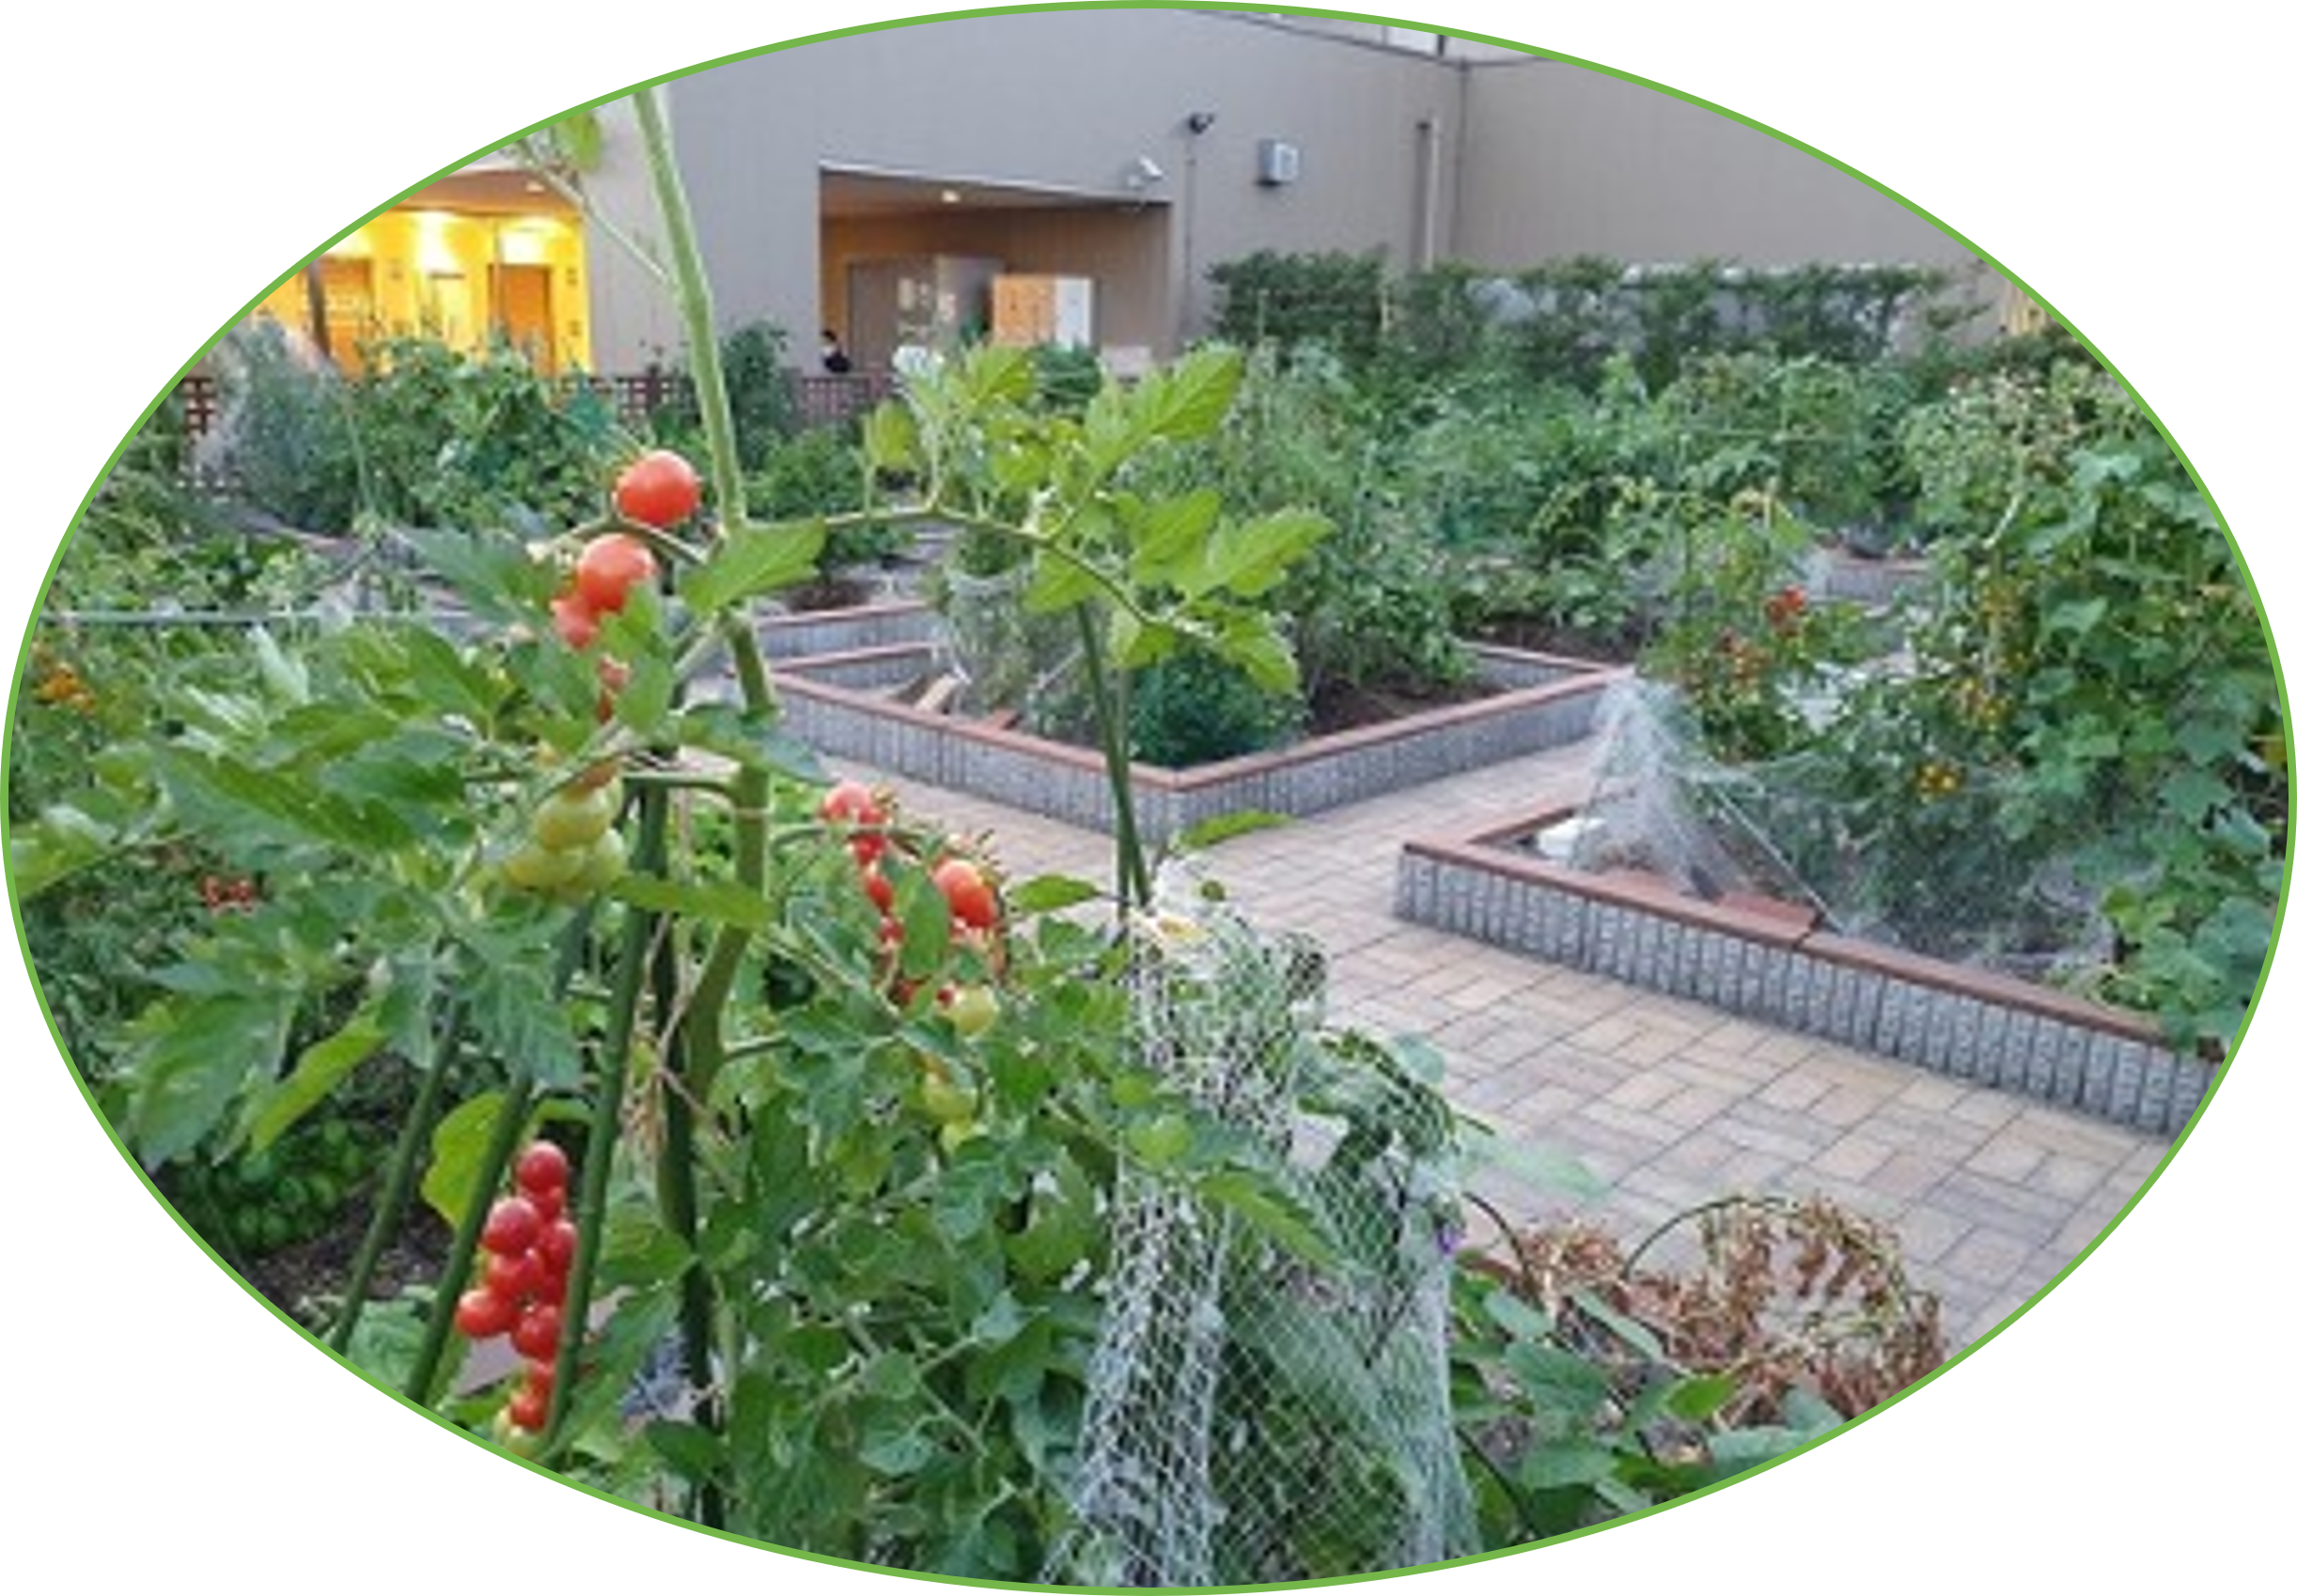
Urbanization and Agrobiodiversity: Leveraging a Key Nexus for Sustainable Development
Zimmerer et al. 2021: https://doi.org/10.1016/j.oneear.2021.10.012
Agrobiodiversity: Umbrella term referring to biodiversity in food production and consumption, as well as in food-producing agroecosystems.
Zimmerer et al. identify four key
linkages:
Urban and peri-urban land use
Urban food supply chains
Urban food access
Urban food retailing
Notes:
Notes for Instructor: As cities develop, modernize, and infill in the 21st century, what opportunities to develop urban food production and distribution emerge? What specific examples can learners share?

Slide 4
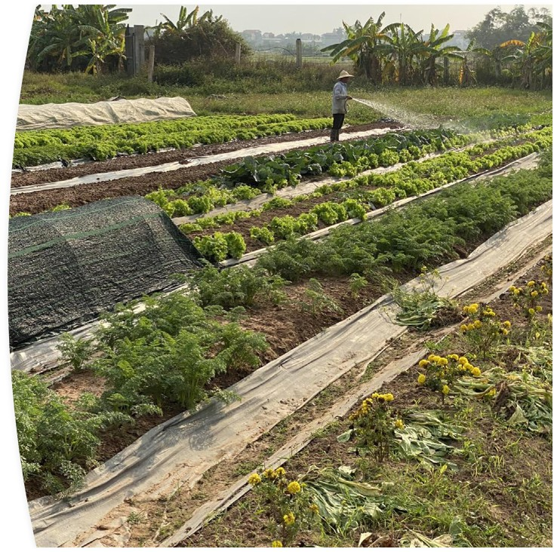
Urban & Peri-Urban Land Use
Zimmerer et al. 2021: https://doi.org/10.1016/j.oneear.2021.10.012
Surveys and sensing of urban fringe croplands show great capacity for dynamic sustainable food production.
Incorporates diverse species, local and global, ideally adapted to local food needs and climate change futures.
Case study in Hanoi, Vietnam shows its capacity to grow up to 83% of vegetables and “significant” meat (1561).
Developed countries like the U.S. and Australia have shown an ability to cultivate up to 34% of overall food, including vegetables, fruits, eggs, and milk (1560).
Hanoi, Vietnam peri-urban farmer
Photo by Karl S. Zimmerer
Notes:
Notes for Instructor: In the United States since 1950, much of the peri-urban land has been sacrificed to suburban development, which includes roads, lawns, and large houses. How might this petroculture landscape be retrofitted to integrate sustainable food production, including varied, nutritious foods and economic and social opportunities for local people?

Slide 5
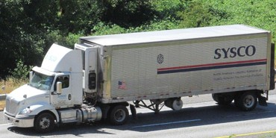
Urban Food Supply Chains
Zimmerer et al. 2021: https://doi.org/10.1016/j.oneear.2021.10.012
Medium- and long-distance food supply chains include national and international sources.
They increase the volume, diversity, and seasonal availability of food in cities, including among the urban poor.
Some ethnic and exotic foodstuffs rely on long-distance suppliers because local agriculture lacks the means, markets, or climate to provision them.
Unaltered photo by Ewkada
via Wikimedia Commons, 3.0
Supply chains drive standardized and homogenized crops and livestock but do not always suppress local agrobiodiversity (1560).
“Food miles” and industrial-style agriculture exacerbate climate change.
Notes:
Notes for Instructor: Corporate food suppliers like Sysco and U.S. Foods dominate the markets for restaurant food supply. Large grocery store chains rely on long-haul supplies to provide a variety of foods throughout the year at affordable prices. What negative effects does this style of provision have on climate change, agrarian health, and social connections to food cultures?

Slide 6
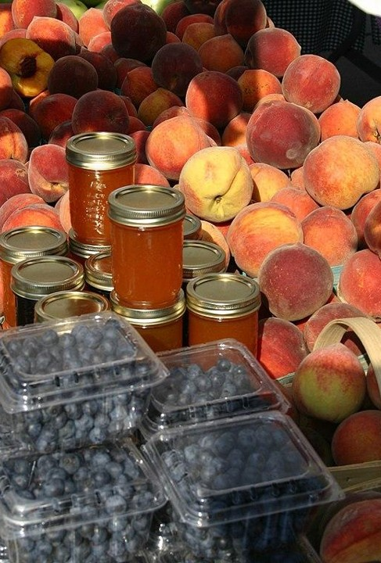
Urban Food Access
Zimmerer et al. 2021: https://doi.org/10.1016/j.oneear.2021.10.012
1/3 of the global population, including the urban poor, suffers from low dietary diversity (1560).
Contrastingly, urban “foodie” cultures display extensive diversity and supply for the wealthy.
Gentrification diminishes low-income urban populations’ access to affordable and varied diets.
Diverse urban sociocultural groups can support food diversification, even at the production level with linkages to urban and peri-urban farms.
Notes:
Notes for Instructor: How do food assistance programs like the U.S. Supplemental Nutrition Assistance Program (SNAP) aim to supplement not just calorie supply to low-income people but also the quality and diversity of their diet? https://www.fns.usda.gov/snap/supplemental-nutrition-assistance-program
In what ways do price points at urban retailers, including groceries and restaurants, actually impose different realities upon city dwellers, according to their incomes?

Slide 7
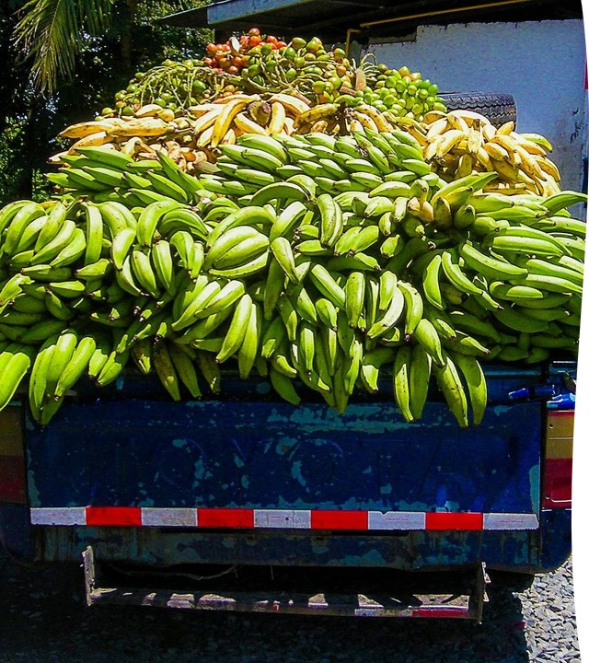
Urban Food Retailing
A variety of retail options increases food diversity.
Outlets include grocery and corner stores, farmer’s markets, CSAs, street vendors, and restaurants.
The quality, diversity, and affordability of food varies greatly among these retail options, but more options tend to result in higher nutrition and participation in urban agrobiodiversity (1561).
Poverty-affected urban populations stand to gain the most from development of these four key linkages in agrobiodiversity.
A banana truck at a local market.
Photo by Fran Hogan via Wikimedia Commons,
4.0.
Notes:
Notes for Instructor: The urban poor can benefit from low-cost, open-air (flea) markets, which may not have the same marketing or style of fashionable farmer’s markets but can effectively recover ripe and slightly damaged produce for consumption. What other programs exist to reduce food waste by redirecting imperfect or oversupplied goods to lower price markets?

Slide 8
Table: Hypothesized Urbanization-Agrobiodiversity Linkages (UAL), Assumptions, & Methods
Zimmerer et al. 2021: https://doi.org/10.1016/j.oneear.2021.10.012
Hypothesized UAL | Assumed Processes in the Urbanization Driver | Assumed Agrobiodiversity Impact | Methods
(1) Changes in food-producing land use in urban and peri-urban spaces | urban expansion includes physical and resource footprints as well as diversified farming | moderate to high agrobiodiversity in urban and peri-urban agriculture | land-use and resource change analysis integrated with agrobiodiversity science and agroecology applied to diversified farming
(2) Urban-directed food supply chains | urbanization drives distinct mixtures of food chains (national, international, local) | certain mixes of food chains result in higher agrobiodiversity | economics, policy, and food-systems analysis of supply chains combined with agrobiodiversity science and agroecology in source areas
(3) Food access and foodways of urban populations | urbanization drives demographic and cultural trends that include “foodies,” immigrants, and other sub-populations | “foodie” and immigrant groups associated with notably higher food biodiversity | cultural, food-system, and sociological analysis of food practices combined with agrobiodiversity science; these approaches need to focus on access and quality of diverse diets of food- and nutrition-insecure populations
(4) Range of urban food retail types and sub-types | urbanization differences lead to distinct food retailing and to influences of surrounding infrastructure (e.g., transport accessibility of food markets) | mix of food market types (e.g., greengrocer prevalence) and infrastructure influences food biodiversity | economics and retail analysis through diverse approaches such as business and infrastructure assessment combined with agrobiodiversity science

