Slide 1

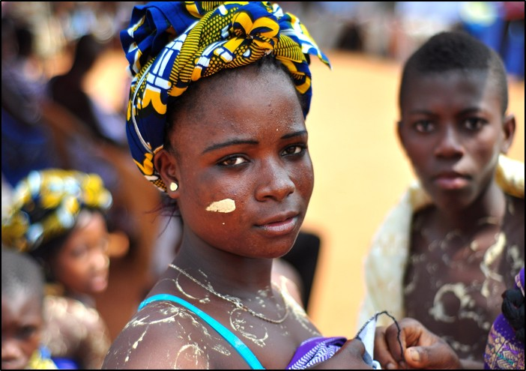
Advancing Sustainable Development Goals:
Gender Equality & Environmental Health
A woman in Ghana at a USAID event.
Public Domain courtesy of USAID.

Slide 2

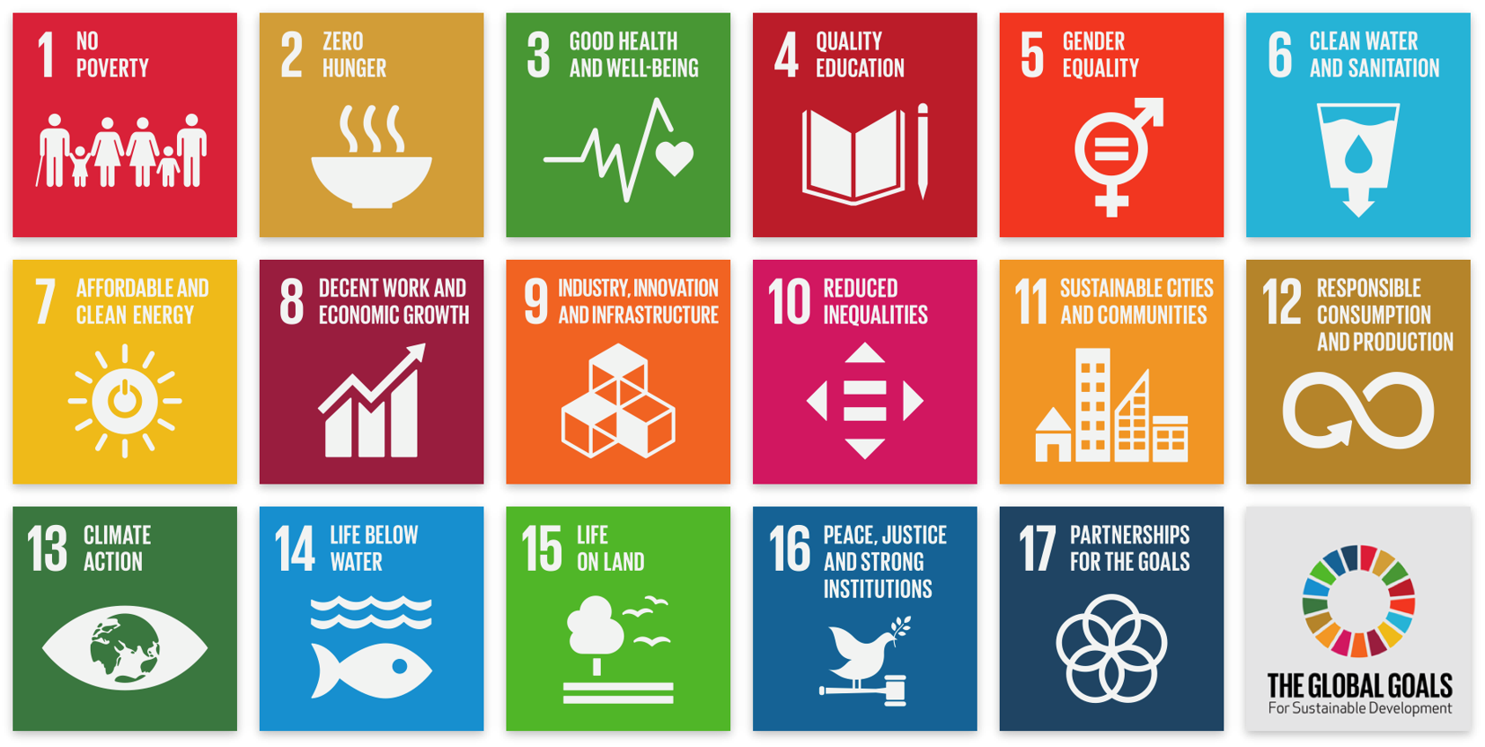
The UN’s 17 Sustainable
Development Goals (SDGs)
Notes:
Notes for Instructor: This lesson focusses on SDG #5. Learners may benefit from briefly considering how the other goals would support or depend upon our success in implementing Gender Equality. For example, how does #5 inherently overlap with #1, #2, #3, and #4? How do the environmental goals of #6, #7, #11, #12, #13, #14, and #15 resonate with Gender Equality? What’s the role of strong institutions (#16) and partnerships (#17) in making gains on gender equality in the developing world?

Slide 3
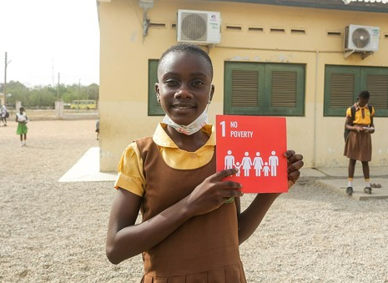
Gendered Vulnerability & Sustainable Livelihood Interventions in Era of Climate Change
Call & Sellers 2019: https://doi.org/10.1088/1748-9326/ab2f57
Women’s Inequality:
Problems:
Discrimination; stereotypes
Domestic violence
Poverty; poor nutrition
Lack of education & family planning
Intersectionality
Patriarchy; colonial history
Solutions:
Gender equality education
Rebalanced gender duties
Contraceptives and family planning support
Financing for women’s entrepreneurship
Governance roles for women
School girl in Ghana holds an SDG placard.
Photo by Fquasie via Wikimedia Commons, 4.0.
Notes:
Notes for Instructor: Many of these challenges may be interesting to discuss in more depth with learners. They might consider how deeply seeded cultural inequalities have been reinforced by patriarchal and colonial histories. Marked successes result from girls’ education and access to birth control, as a starting point. Educating boys and men about gender equality is an important companion to empowering girls. And intersectionality is a fascinating multi-identity social dynamic that may help reveal how women experience inequality differently from one another.

Slide 4
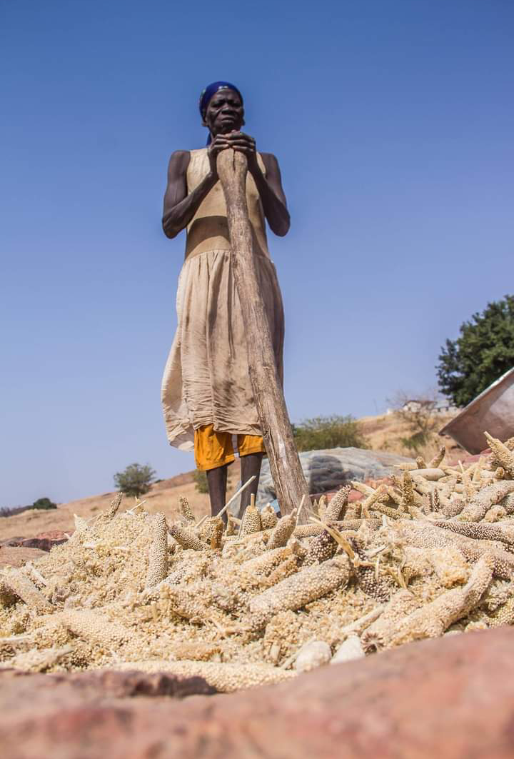
Agriculture Solutions
Call & Sellers 2019: https://doi.org/10.1088/1748-9326/ab2f57
Climate-Smart Agriculture: No-till planting, intercropping, biodiverse vegetated strips, soil bunds, landscaping to reduce runoff, climate adapted crops
Agricultural Technology: Advanced seeds, fertilizer, methods and education for best practices
Ownership Opportunities: Land access, ownership, and financing for women
Leadership Opportunities: Farmers’ organizations with dedicated leadership and governance roles for women
Woman pounding sorghum in Ghana.
Photo by Ibn Shiraz via Wikimedia
Commons, 4.0.
Notes:
Notes for Instructor: How do some of these technologies help women prepare for a climate changed present and future? How might some technology actually exacerbate environmental impacts?

Slide 5
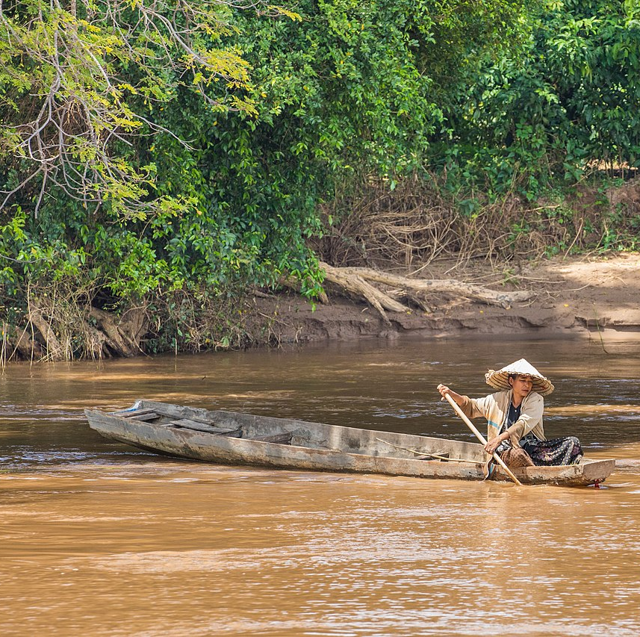
Fishing & Aquaculture Solutions
Call & Sellers 2019:
https://doi.org/10.1088/1748-9326/ab2f57
Marine Protected Areas: Equality of access and women’s governance
Aquaculture: Women-targeted training, financing, technical support
Aquaculture Design: Species that work with local, small-scale operations
Leadership Opportunities: Opportunities for women in fishery and aquaculture organizations
Woman fishing in the Mekong, Don Det, Laos.
Picture by Basile Moran via Wikimedia Commons, 4.0
Notes:
Notes for Instructor: Note that local, small-scale aquaculture run by women with domestic duties can measurably improve the nutrition in a household as well as its income. In all three sectors, changes in the gender balance of leadership and governance are priorities that have the potential to make a difference in women’s empowerment. How can communities work to include women in important roles, and how will that impact the potential of girls who are in danger of becoming pregnant or child brides?

Slide 6
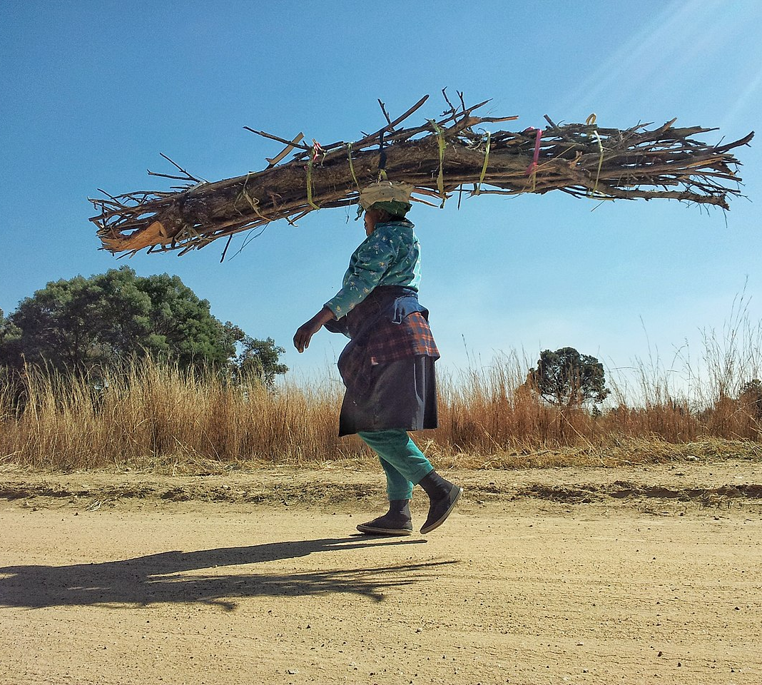
Forestry Solutions
Call & Sellers 2019:
https://doi.org/10.1088/1748-9326/ab2f57
Enhanced Support and Profitability for Traditional Women’s Roles: Gathering food and fuel
Challenging Status Quo: Challenging gendered exclusion from profitable timber and hunting roles
Forest Governance: Achieving a critical mass of women participants and leaders
Pay-to-Preserve Ecosystem Services: Educate and empower women to preserve forests and reduce emissions
A woman in South Africa gathers firewood.
Photo by Mindseed Design via Wikimedia Commons, 4.0.
Notes:
Notes for Instructor: Gender stereotypes endure and delimit women’s ability to work outside the home. What are some methods to change a patriarchal culture to greater value women as equal workers in many occupations? How can men be taught to feel good about gender equality?

