Slide 1

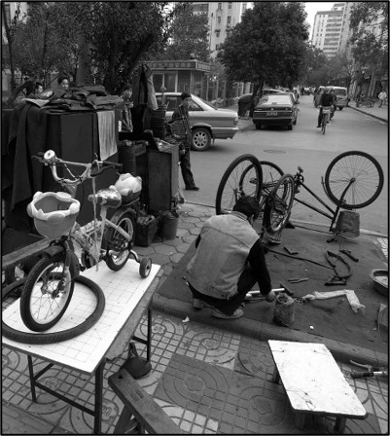
Advancing Sustainable Development Goals: Systemic Change to Reduce Consumer Impact
An open-air community bike repair shop in Nanjing, China.
Unaltered image by Stougard via Wikimedia Commons, Attribution 4.0
Notes:
Notes for Instructor: How does this bike repair store support sustainable transportation, economic well-being, and community cohesion?

Slide 2

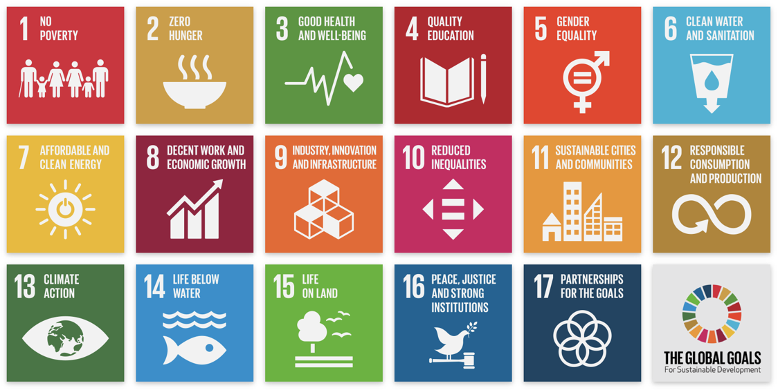
The UN’s 17 Sustainable Development Goals (SDGs)
Notes:
Notes for Instructor: This lesson focuses on SDG #12. Learners may benefit from briefly considering how the other goals would support or depend upon our success in implementing Responsible Consumption and Production. For example, how can #12 be synergetic or at odds with #8, Decent Work and Economic Growth and #11 Sustainable Cities and Communities? How does #12 impact the environmental goals in #6, #7, #13, #14, and #15?

Slide 3

Transforming Systems of Consumption and Production for Achieving the Sustainable Development Goals
Bengtsson et al. 2018: https://doi.org/10.1007/s11625-018-0582-1
Efficiency versus Systemic Change
Bengtsson et al. note a bias toward “efficiency” in research and implementation of SD goal #12:
More efficient production methods
Technological advances
Better informed consumers
But these efficiencies do not tackle systemic change:
Volumes of elective consumption
Global distribution of consumer goods (wealth bias)
Social and institutional changes that reduce consumption levels
Cropped photo by Jonathan McIntosh
via Wikimedia Commons, Attribution 2.0.
Notes:
Notes for Instructor: What are some ways learners can approach reducing the volume of the goods they consume? What existing resources are available to support cultures of shared goods, and second hand and upcycling retail?

Slide 4
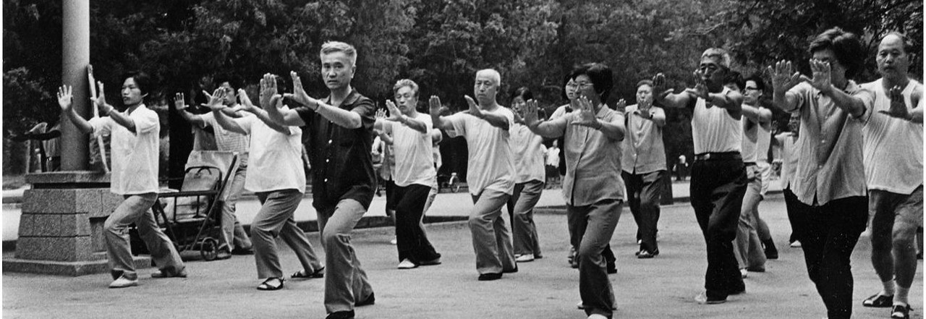
Critical Action Areas to Achieve Systemic Change (p.1543)
Community Tai Chi practice in Beijing. Unaltered photo by Lars Mongs via Wikimedia Commons, Attribution 4.0
Bengtsson et al. 2018: https://doi.org/10.1007/s11625-018-0582-1
Curtailed paid labor
Good quality public services
Support for cooperatives, worker-owned companies, community ownership, and small-scale businesses rooted in communities
Spurring health benefits
Notes:
Notes for Instructor: Do learners wish to contribute any additional systemic change ideas however radical they may seem to today’s status quo? What sectors of service are particularly in need of reform?

Slide 5

Curtailed Paid Labor
Bengtsson et al. 2018 p. 1543: https://doi.org/10.1007/s11625-018-0582-1
Enhanced labor productivity due to work culture and technology
tests ecological limits.
Overwork culture causes stress and burnout, as well as less
opportunity for underemployed individuals.
Improvements in labor productivity could be used to free up time for other activities.
Shorter working hours can improve mental and physical health.
Time for other activities can enhance community cohesion and shared goals, like local food production, craft and repair shops, exercise, and meditation.
Notes:
Notes for Instructor: How have learners already experienced cultures of workaholism in service of corporate profits, versus a reformed culture that achieves a work-life balance as a form of human rights?

Slide 6
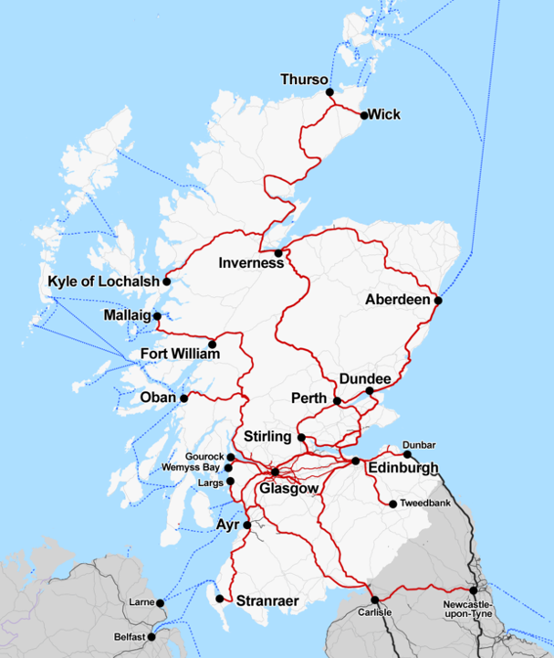
Good Quality Public Services
Bengtsson et al. 2018 p. 1543: https://doi.org/10.1007/s11625-018-0582-1
Public services are inclusive, support well-being, and limit the need for private consumption.
Services can be in the form of facilities, like libraries, public parks, gyms, repair centers, and fairs.
Services can also include education, welfare, public transportation, food assistance, and universal health insurance systems.
These public services reduce inequality and cultures of elitism that fuel unsustainable consumption and mass global inequality.
They synergize social progress with ecological sustainability.
A map showing Scotland’s ScotRail route of operation.
CnbrbOpenStreetMap contributors, CC0, via Wikimedia Commons
Notes:
Notes for Instructor: What public service is most lacking in your region? How do government and community investment versus private and corporate management make a difference in the landscape of public services?

Slide 7
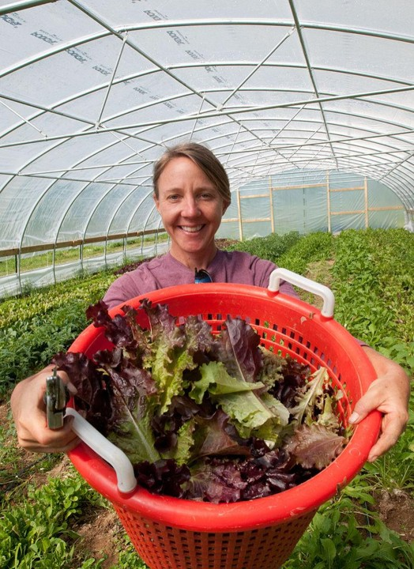
Support for: Cooperatives; Worker-Owned Companies; Community Ownership, and Small-Scale Businesses Rooted in Communities
Bengtsson et al. 2018 p. 1543: https://doi.org/10.1007/s11625-018-0582-1
Unlike the profit-driven status quo, cooperatives benefit community members rather than anonymous investors and corporate owners.
Co-ops support multiple goals: good livelihoods, strong community bonds and trust, reduced need for transportation, and greater responsibility for local environmental impacts.
Positive examples abound when governments support local businesses.
Notes:
Notes for Instructor: Have any learners ever worked for co-ops, reaping their benefits in barter, food, or other tangible goods, rather than all of their work being reduced to an exchange in the money economy?

Slide 8

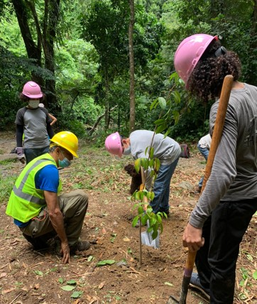
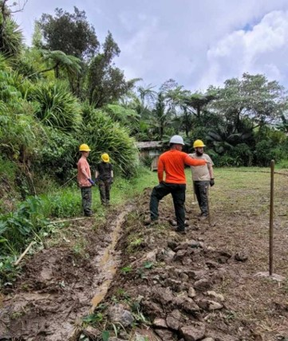
Spurring Health Benefits
Bengtsson et al. 2018 p. 1544: https://doi.org/10.1007/s11625-018-0582-1
Liberation of labor from long sedentary work hours enables the move toward active lifestyles and occupations
Diversified food and local food production provide dietary benefits.
There are findings of mental health and social benefits from work within a community that has shared goals.
Volunteer restoration efforts in El Yunque National Forest
Photos: U.S. Forest Service
Notes:
Notes for Instructor: Physical activity has benefits for the body and mind, and cooperative labor enables social cohesion and a shared identity and goals. How can we reform our social goals to value these benefits rather than reduce all jobs to the value of monetary pay? How does a culture obsessed by achieving the upper echelons of pay grades effectively diminish other personal, community, and environmental benefits?

Slide 9

Conclusion
Bengtsson et al. 2018 p. 1544: https://doi.org/10.1007/s11625-018-0582-1
A new social order beyond consumerism and ecological bankruptcy may require:
Private philanthropy that supports responsible capitalism
“Just transitions” supported by partnerships among academics, environmental justice advocates, community organizers, labor rights
Cities as incubators of scalable and transferrable innovations that support citizen-led transformations
Notes:
Notes for Instructor: Institutional revolutions are bound to be resisted by those who already benefit from the status quo—elites in both the Global North and South. How can synergies between social and ecological progress overcome this structural resistance? What other forms of political and social reform, civil disobedience, and public demonstration have shown the power of the people? What forces, such as mounting climate change disaster, populist uprising, climate migration, and food insecurity, might spur structural changes in global production and consumption?

