Slide 1

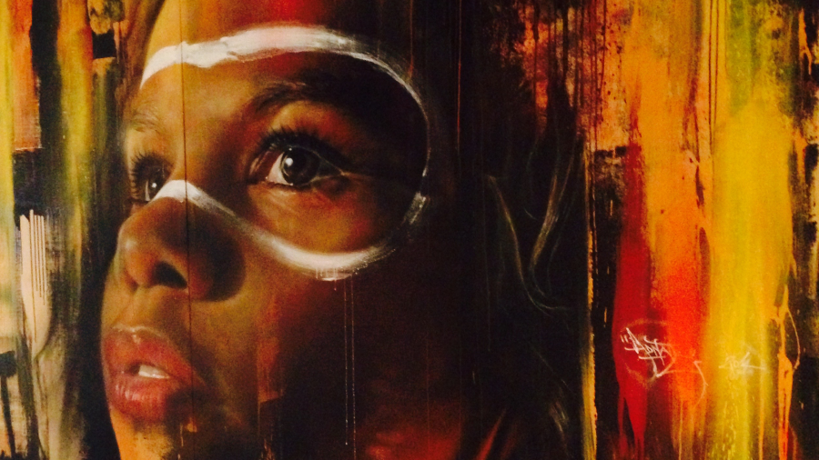
Practicing Reflexivity and
Appreciating Diverse Perspectives
Wikimedia Commons “Mural in Thoughtworks Melbourne Office”

Slide 2

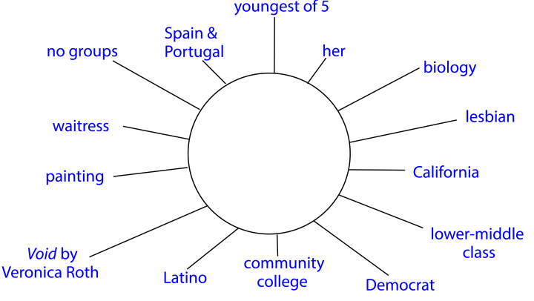
Categories for Self-Identities Diagrams
Number in family and birth order
Political leaning
Religion
Potential college major
Any group(s) belonged to
Last book read that was not assigned
Travel experience (e.g., international, local)
Where they grew up
Introvert/extrovert
Past jobs
Talents
Race/ethnicity
Citizenship
Sexual orientation
Gender identity
Physical or mental limitations
Family social class
Education level of parents
Hobby
Body image (+/-)

Slide 3
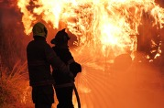
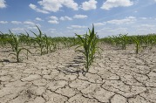


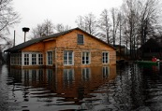
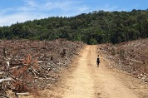
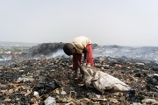
Complete the Following Sentences
Reducing [list one environmental problem] requires [list at least two actions].
The biggest social issue associated with this problem is [list one social issue].
This social problem is largely due to [list two responses].

