Slide 1

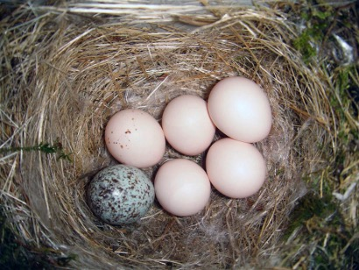
Lesson: How Can Human Societies Evolve from Parasitism to Mutualism with Earth?
This nest of the eastern phoebe has one brown-headed cowbird egg. The phoebe has been parasitized. Image by Galawebdesign, 3.0.
Notes:
Notes for Instructor: How could this beautiful speckled egg be a parasite? Have learners briefly discuss the benefit to the cowbird, which is a parasitism for the phoebe.

Slide 2

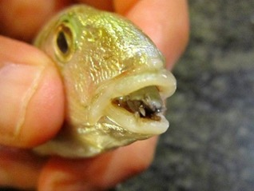
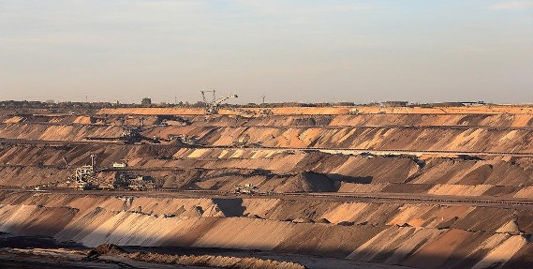
What Are Parasites?
Parasites are predators that weaken their host by feeding on the host’s body or by sapping the host’s resources. In the image to the left, a parasitic crustacean has entered a host fish’s body and attached to the tongue. The parasite feeds on the tongue and eventually other parts of the host, until the host dies.
Image by Marco Vinci via Wikimedia 3.0.
Now consider this image (right) of a surface mine that produces lignite, a form of soft brown coal. This image shows its devastating impacts on local ecosystems and implies its global impacts in contributing to climate change. Is this human activity parasitic to our host?
Image by Martin Falbisoner via Wikimedia, 4.0.
Notes:
Notes for Instructor: This comparison of human activities to parasites is meant to be provocative, even controversial, among your students. Anticipate some resistance and indignation and use that energy to have learners inquire more deeply about the effects of industrial humans on our local and global environments. But it is important not to call humans themselves parasites—only our cultural activities cause parasitic and weakening effects in our host planet.

Slide 3
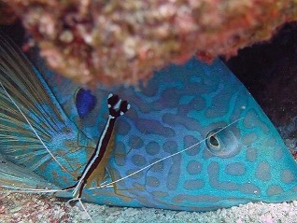
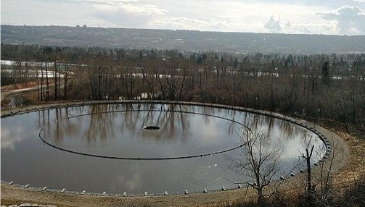
What Are Mutualists?
Image is public domain via NOAA.
Mutualists are symbiotic species that have co-evolved for mutual benefit. In the image to the left, a yellowstripe coris receives beneficial grooming from a scarlet cleaner shrimp and the shrimp gets a meal.
Image by Oceanflynn via Wikimedia Commons, 4.0.
Now consider this image (right) of a restored gravel pit site in Calgary Olympic Park. The degraded site now absorbs and filters stormwater in coordination with the adjacent stream and meadow, and it provides a public art piece for contemplation. Is this human activity mutualistic with our host?
Notes:
Notes for Instructor: Note how both these mutualisms involve cleaning services. Many of the mutualistic activities that learners will identify involve the restoration of ecosystems previously degraded by human activities. Once again, the lesson is about how our actions have tended toward parasitism or mutualism, with the understanding that humans historically have played both roles in relation to Earth. Our cultural values and norms are the most significant factors in assessing whether human activities are damaging to Earth’s support systems.

Slide 4
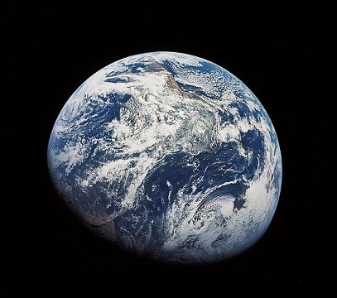
Earth as Host, Earth as Organism
Our home planet is an evolving, delicately balanced complex of interlocking systems.
We can understand these systems in isolation, as the geosphere, the biosphere, and the atmosphere.
But we can also understand them in synergy as physical conditions affect biological life and vice versa.
An obvious example is how mining the geosphere liberates ancient carbon, which we burn, and alters the chemical composition of the atmosphere, which has complicated and emergent effects on biological life across the planet.
Public domain image courtesy of NASA.
Notes:
Notes for Instructor: Have learners quickly name a few of Earth’s physical cycles that might be called elements of homeostasis. For example: the Gulf Stream in the Atlantic Ocean; the rainforests around the equatorial regions; the glaciers and icecaps in the poles. How are each of these homeostatic systems affected by current human activities?

Slide 5
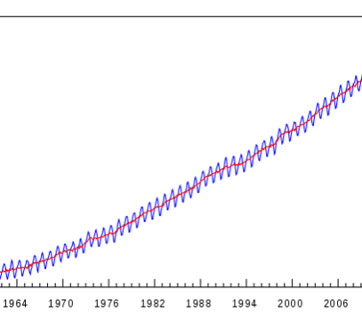
Earth as Host, Earth as Organism
(Continued)
Many find the Gaia hypothesis to be a useful metaphor for considering how Earth’s interlocking systems work as a kind of homeostasis in the global “body.”
Certain ecosystems, like the Amazon rainforest and deciduous forests, act as “lungs” that oxygenate the global atmosphere.
We can see each annual “breath” taken by the planet in the annual zigzags of the Keeling Curve.
The long-term trend toward higher carbon dioxide concentrations is a central element of human-caused imbalance in the atmosphere, which has increasing, malignant effects across Earth systems.
The Keeling Curve. Public domain image.
Notes:
Notes for Instructor: Ask learners how this use of metaphor and imagination in the Gaia hypothesis may enrich their emotions and sympathies for natural processes that are hard for us to experience directly (such as the “breath” of the deciduous forests). Science purports to be a rational and evidence-based approach to knowledge, but the impact of its findings can be greatly enhanced by using human emotion, empathy, hope, and even shame, to direct public attention.

Slide 6
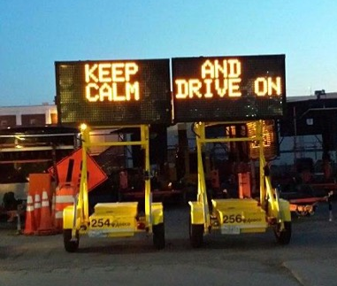
How Dare You? I’m Not a Parasite!
We may resent feeling blamed for environmental degradation because many degrading activities are simply related to survival: eating, drinking, acquiring resources, and having a cozy place to live.
This lesson challenges us to consider not how individuals, but cultures and their values, prescribe certain relations with the non-human world.
These relations may be extractive and wasteful (parasitic) or restorative and sustainable (mutualistic).
Our cultural identity influences what behavior we think is normal, virtuous, or malignant. Different cultures may perceive the same activity very differently.
Public domain image from MassDOT via Wikimedia Commons.
Notes:
Notes for Instructor: Ask learners to name a single human activity that different cultures would perceive differently. For example: timber extraction. From a normative American perspective, timber is seen as an economic resource; it provides jobs, and it yields the raw materials we use to build our structures. From an Indigenous perspective, clear-cutting forests might be seen as an outrage against fellow community members—not just the trees but all the species that rely on the forest habitat. Many examples of this kind show how an economic growth model is at the heart of Western, industrial values and that a simple financial profit is often all that’s needed to justify the degradation of Earth’s systems.

Slide 7
Areas of Inquiry for this Lesson
Your challenge:
To research, dream, and redesign a parasitic activity so that it becomes a
mutualism that benefits Earth.
Infrastructure: Gray Petroculture to Green Community Culture
Agriculture: Monocrop Soil Extraction to Regenerative Polyculture
Waste: Mountains of Plastic to Marvelous Circularity
Communication: Greenwashing to Creative “Righting” and Useful Dreaming
Fragmented Ecosystems: Invasive Eyesores to Novel Communities and Eco-Social Resources
Sociology and Psychology: Inequality and Nature Deficit to Inclusion and Immersion
Notes:
Notes for Instructor: The lesson itself contains many more specifics on these areas of inquiry.

