Slide 1

Novel Ecosystem Case Study:
Open Space near Denver

Slide 2
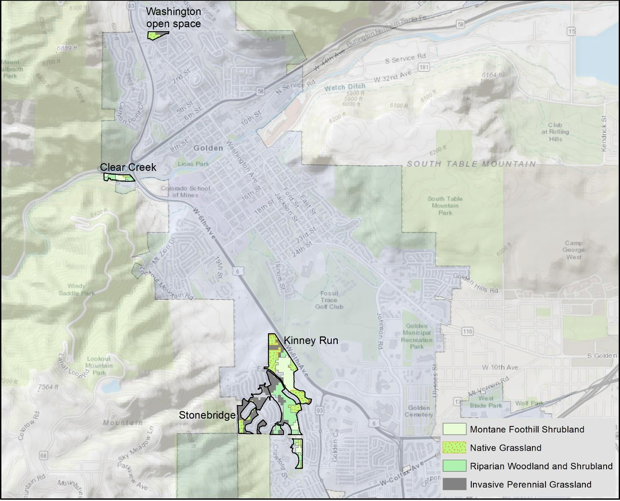
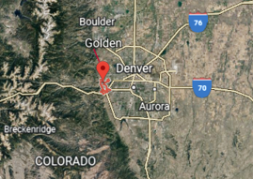
Open-Space Parcels
Golden, CO

Slide 3
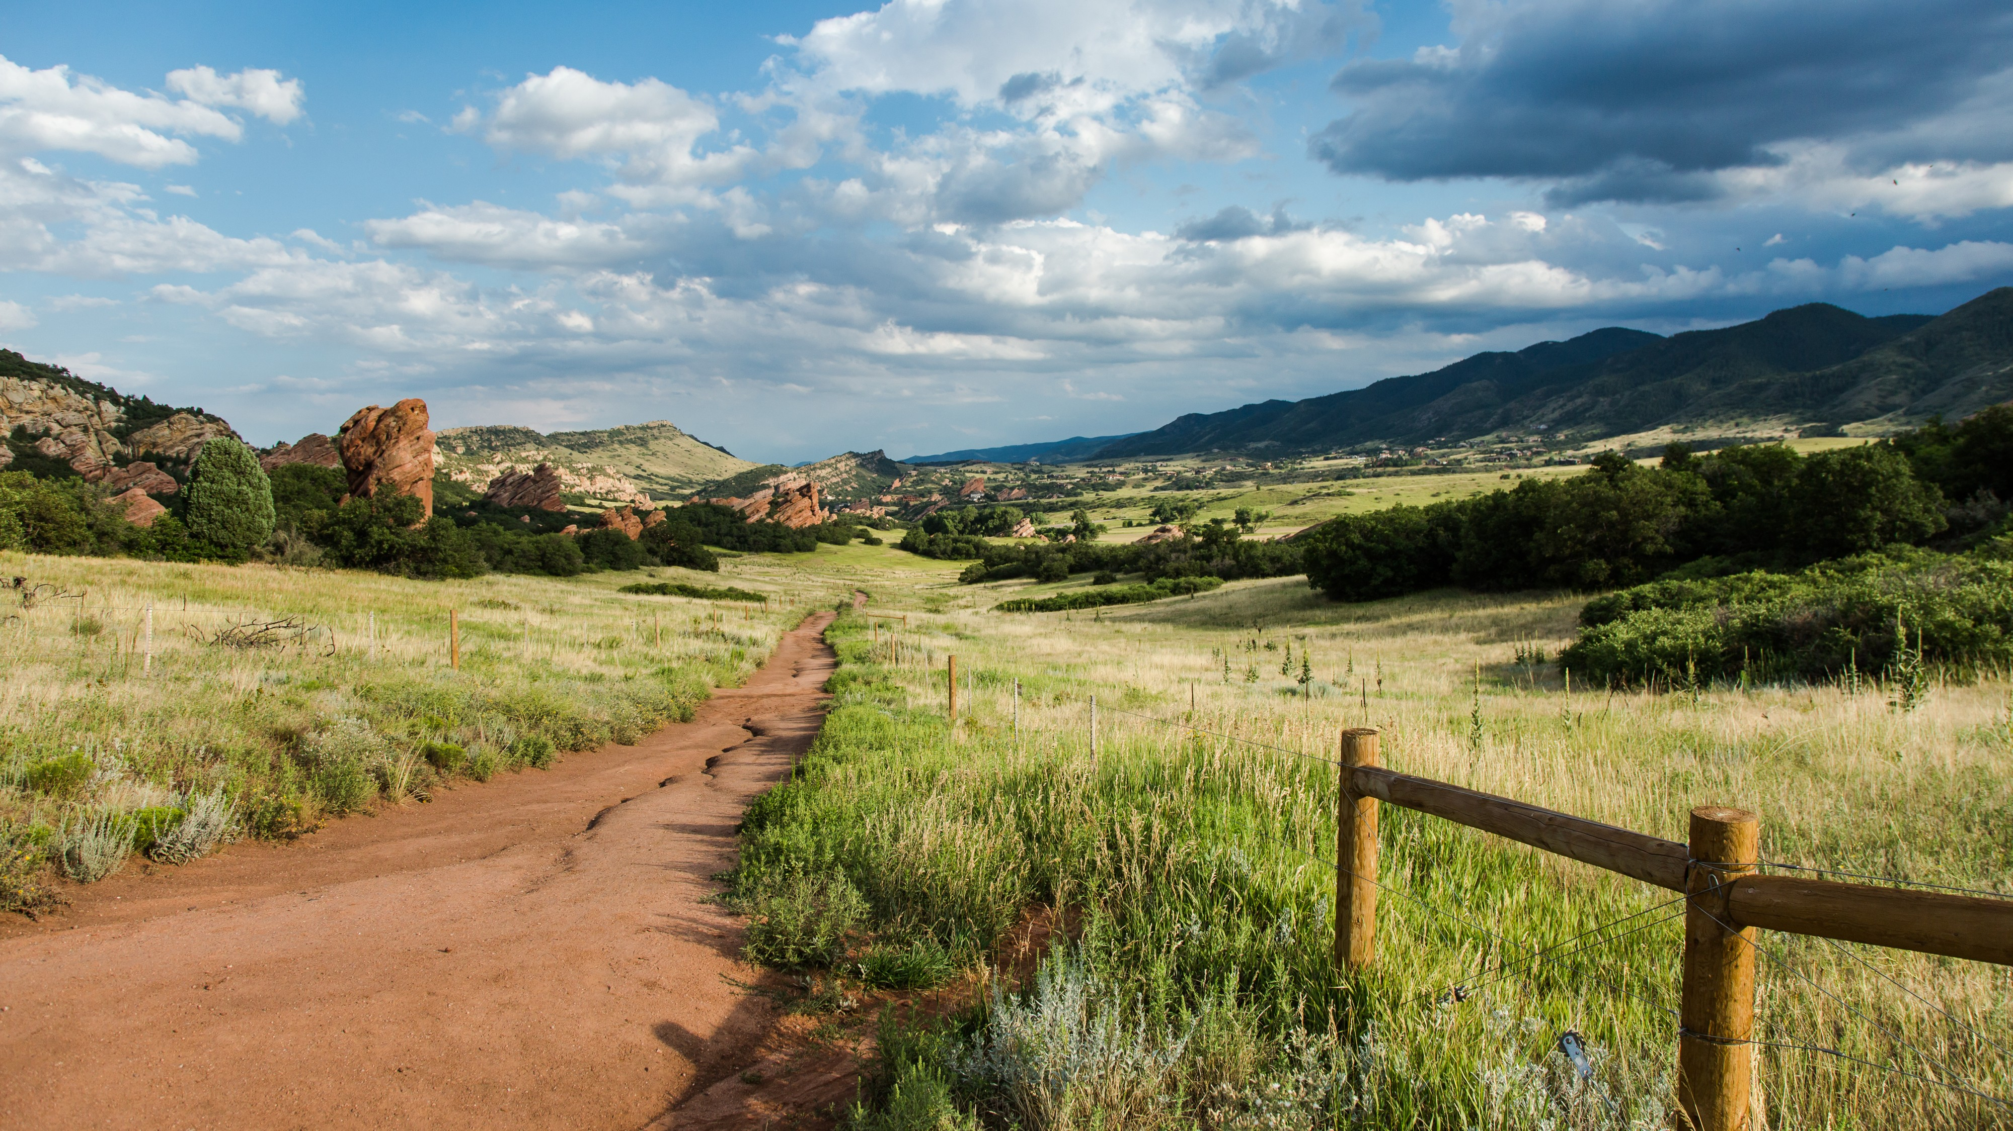
Hiking and Biking Trail

Slide 4
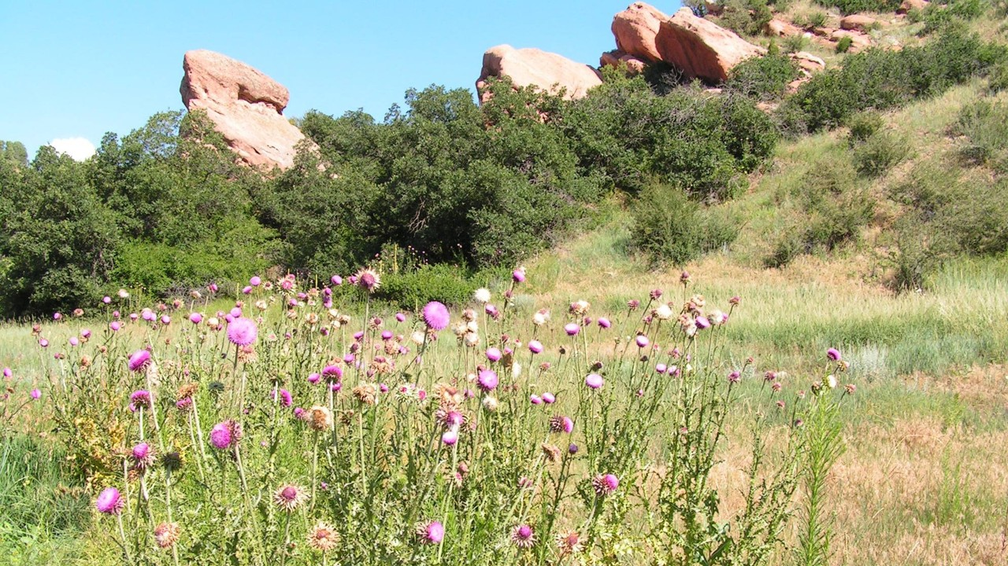
Mixtures of Native & Non-Native Species

Slide 5
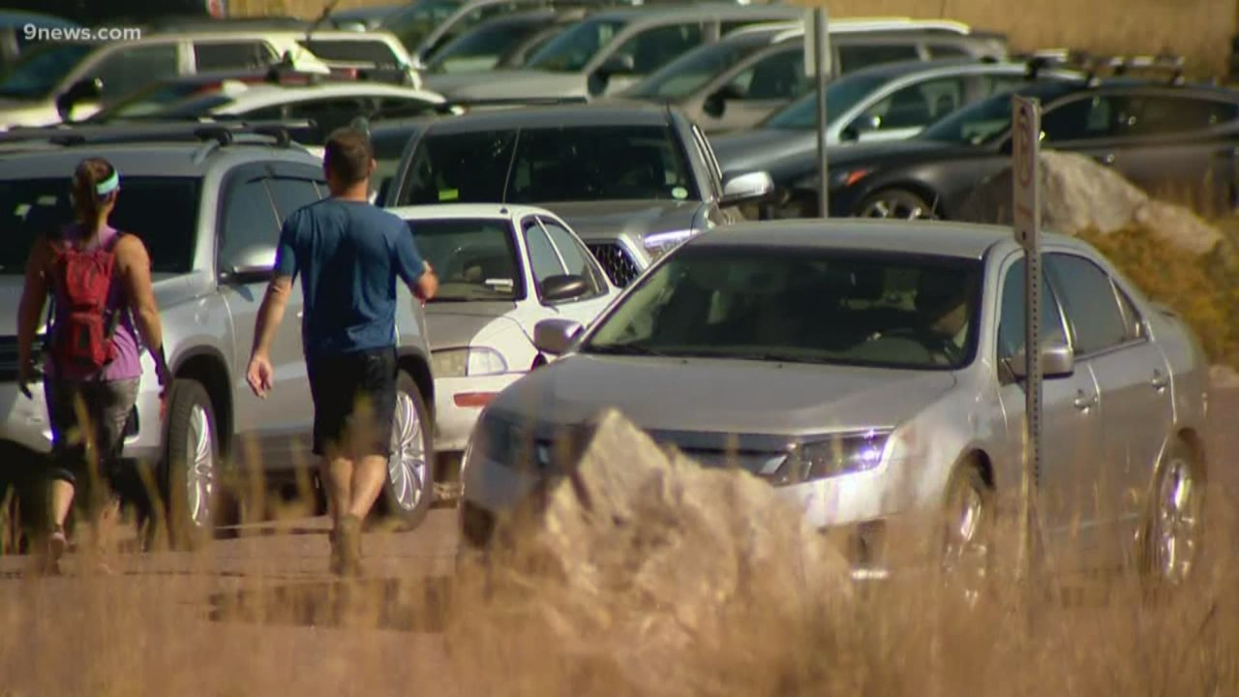
Park Lots Can Be at Capacity

Slide 6
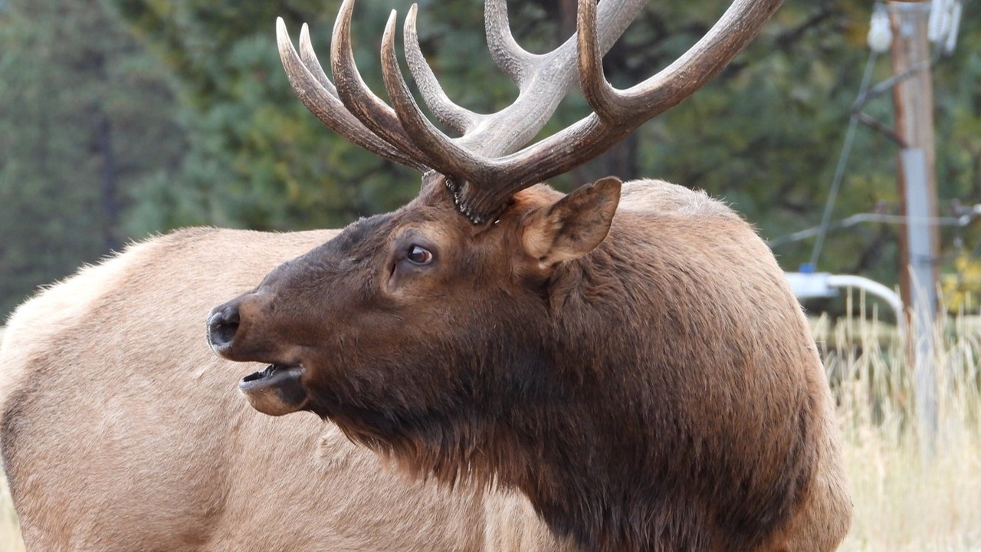
Elk Viewing and Hunting

