Slide 1

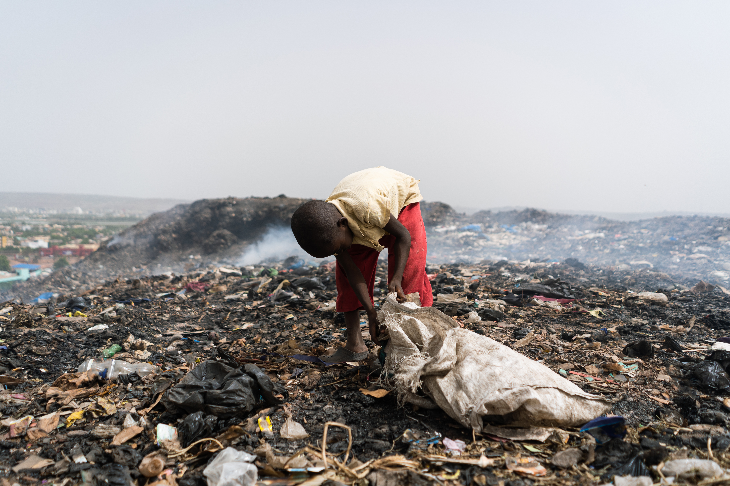
Socio-Environmental Problems:
They Are All Social and Wicked

Slide 2

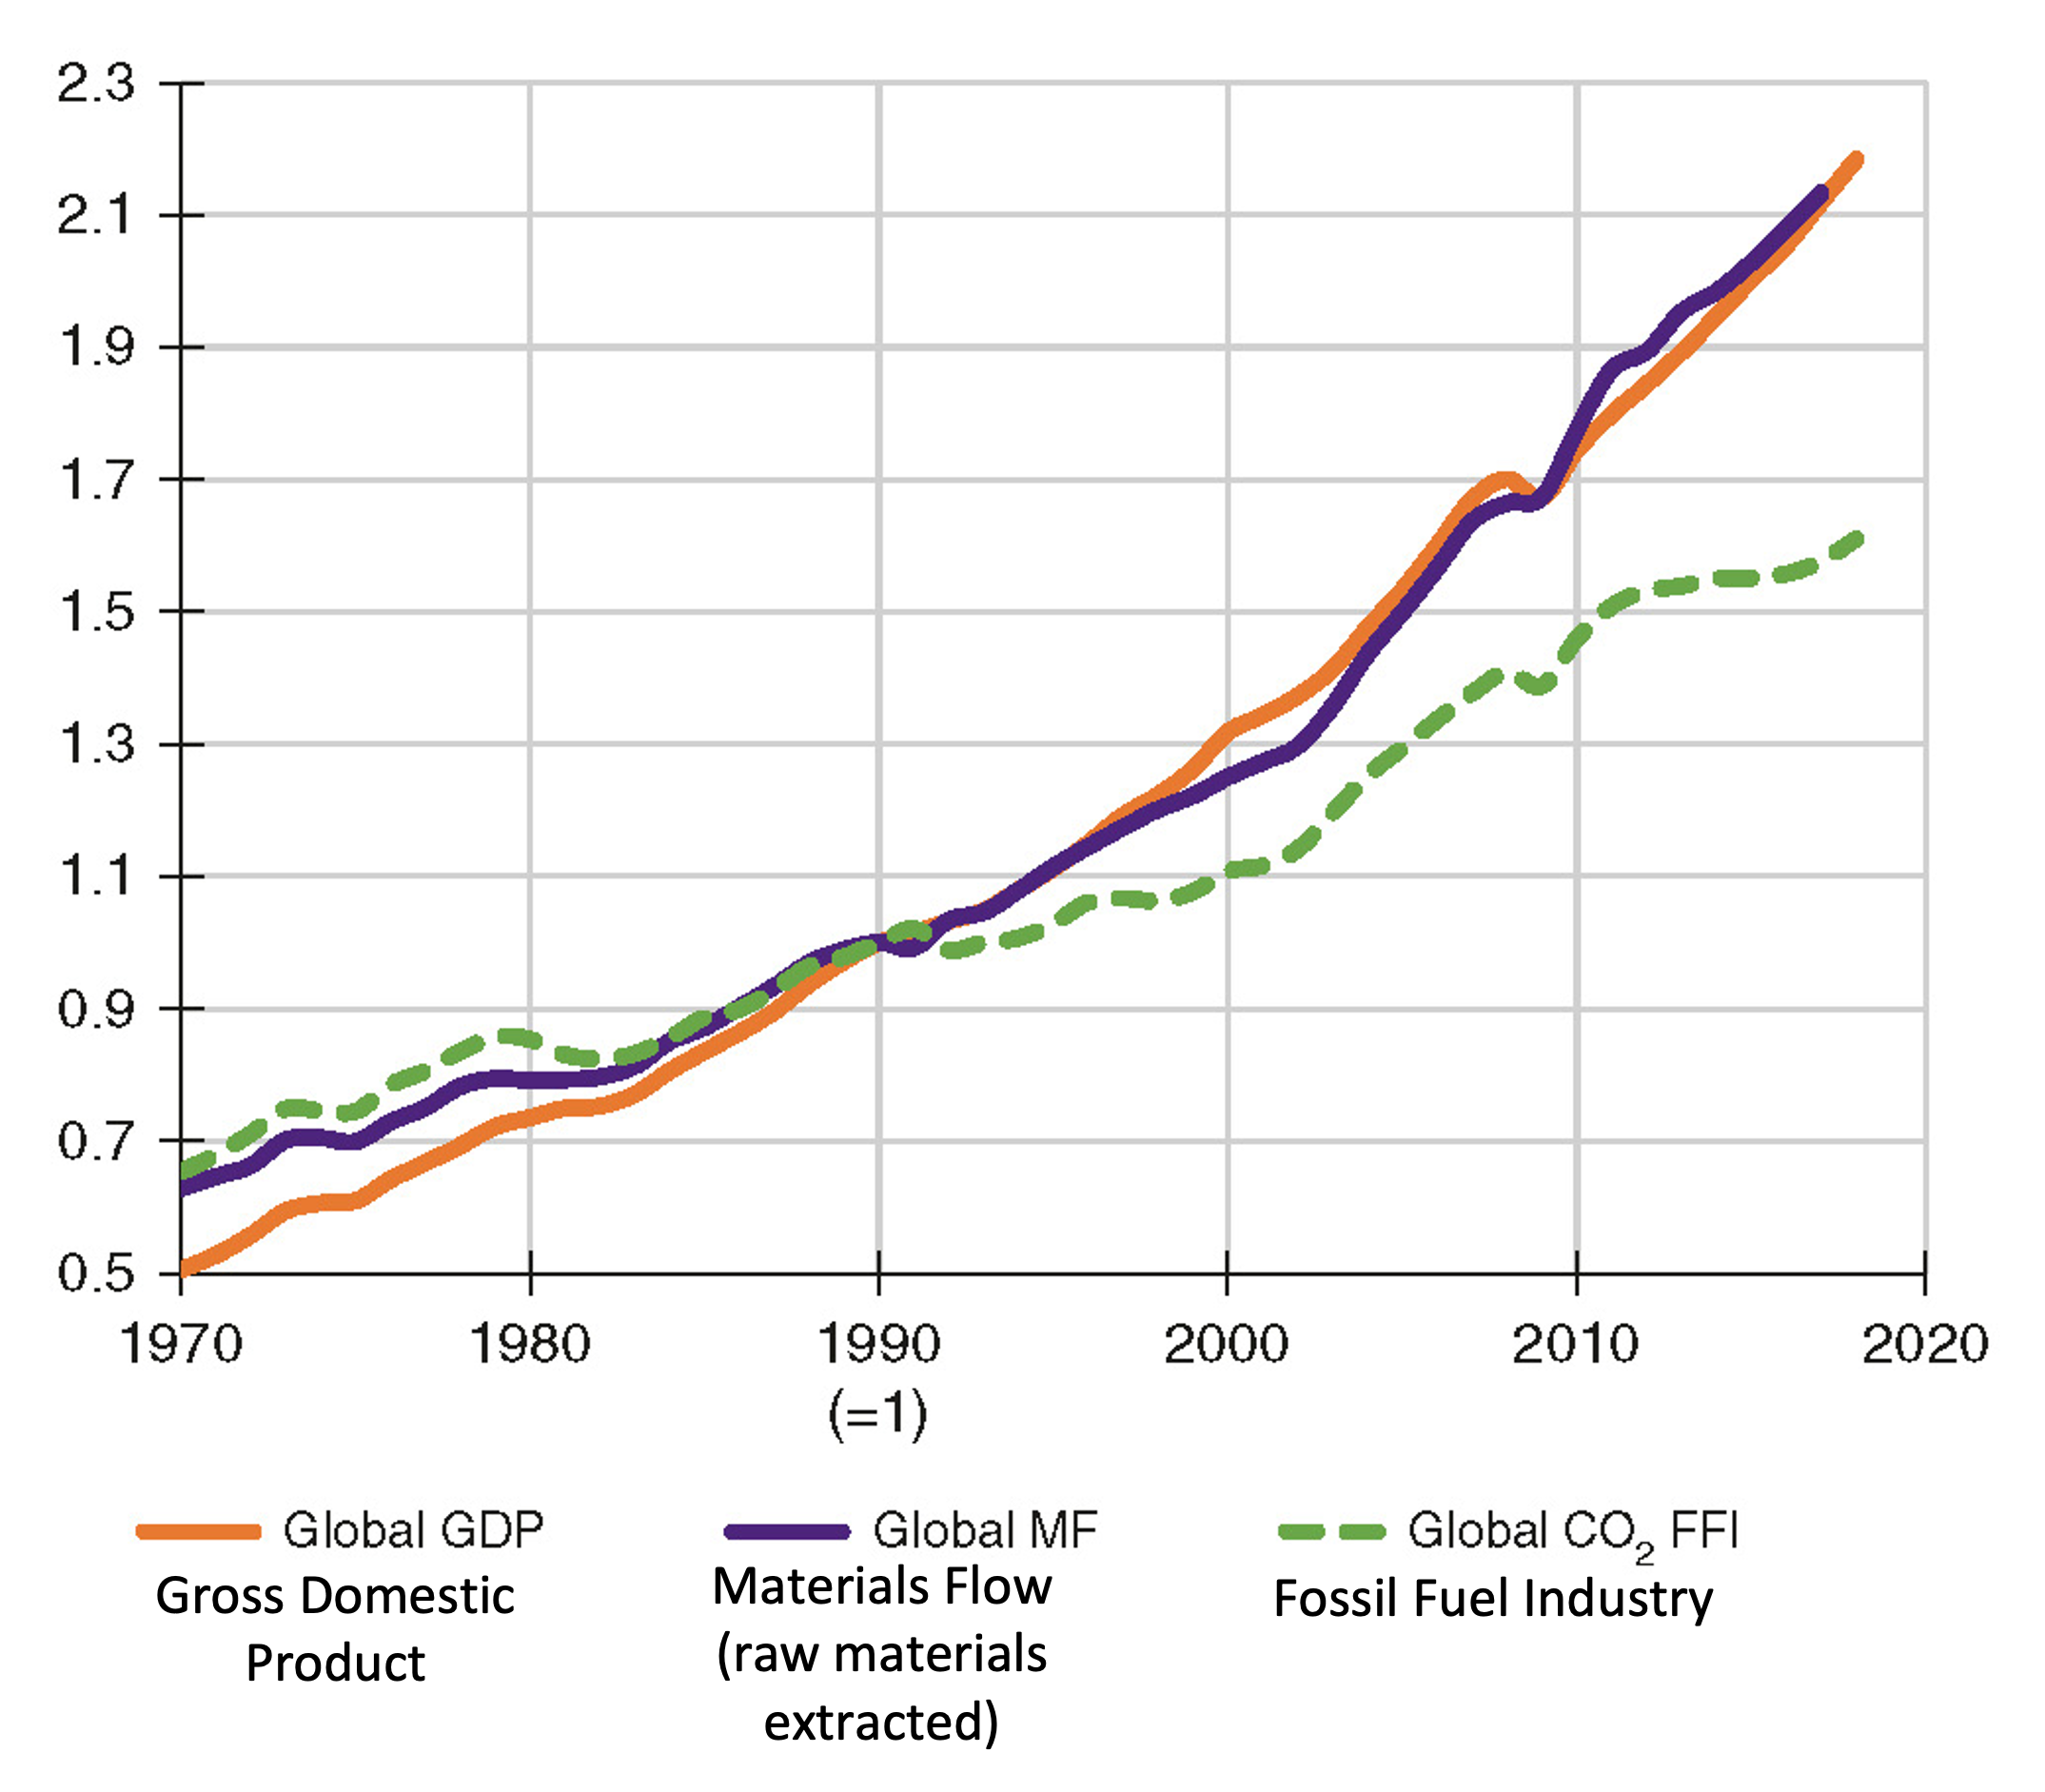
Why are GDP, CO₂ emissions, and raw-material use related statistically?
Source: Wiedmann et al. 2020: https://www.nature.com/articles/s41467-020-16941-y. Open access article Creative Commons 4.0 License
Notes:
Notes for Instructor: First, query the learners on what GDP is and why it continues to go up globally. They should be aware that CO₂ has been rising steadily but will likely not know what “material flows” (MF) means, thus it is defined on the slides. Second, ask them if technology is reducing emissions.

Slide 3
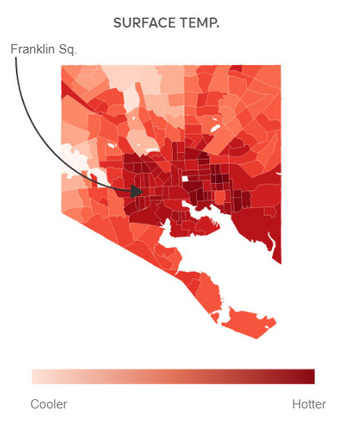
What might be driving the geographic distribution of the hottest temperatures in Baltimore?
https://www.npr.org/2019/09/03/754044732

Slide 4
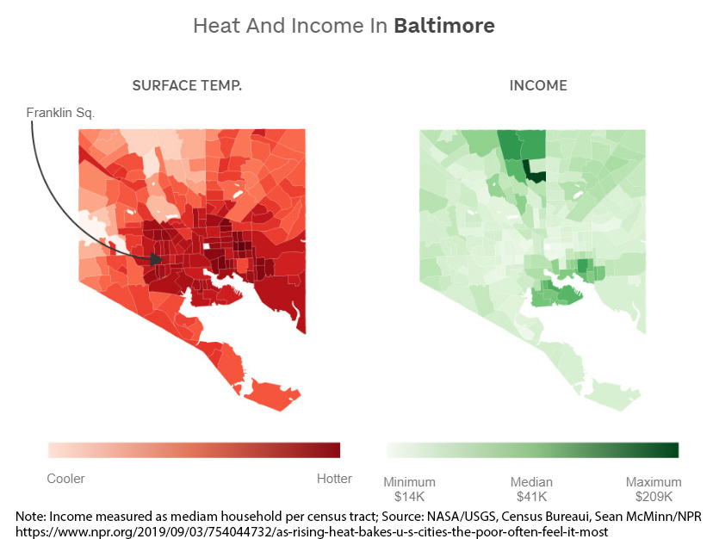
Yes, income, but why? And what else?
Note: Income measured as median household per census tract; Source: NASA/USGS, Census Bureau, Sean McMinn/NPR
https://www.npr.org/2019/09/03/754044732/as-rising-heat-bakes-u-s-cities-the-poor-often-feel-it-most

Slide 5
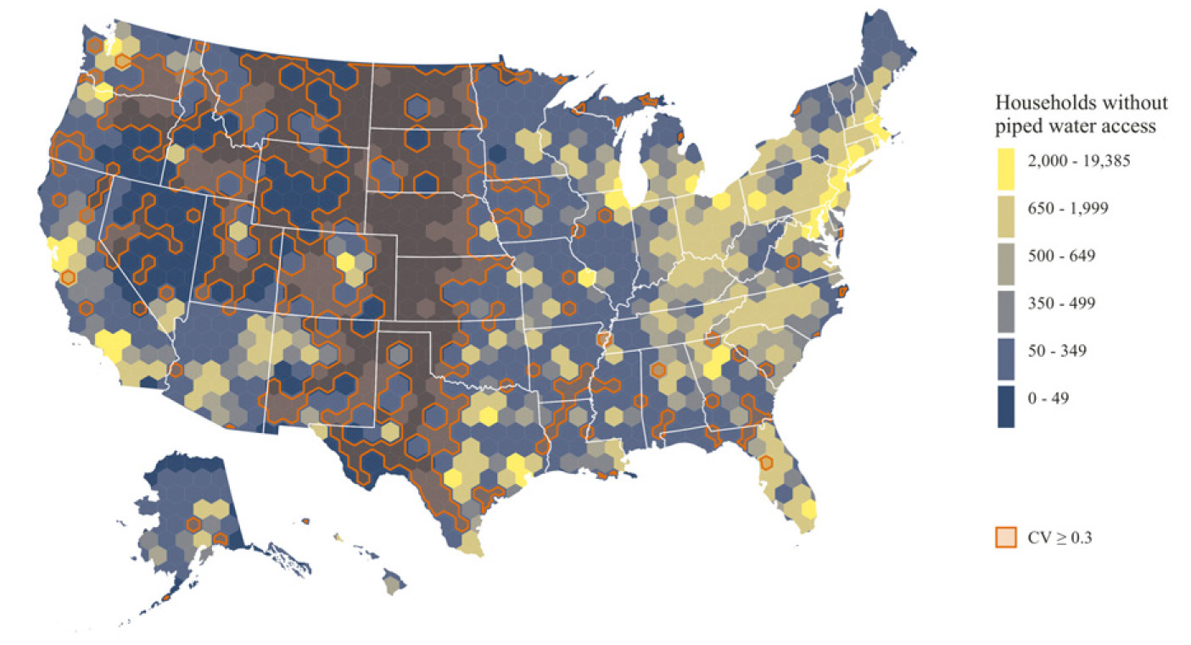
What factors do you think best correlate with high rates of unplumbed households?
Meehan et al. 2020: https://doi.org/10.1073/pnas.2007361117
Notes:
Notes for Instructor: Ask the students to study the map in Figure 1 from "Geographies of insecure water access and the housing–water nexus in US cities" by Meehan et al. and speculate on what factors best correlate to areas with high rates of unplumbed households. https://doi.org/10.1073/pnas.2007361117

Slide 6
Characteristics of urban U.S. households without piped water
Table 2. Characteristics of urban U.S. households without piped water
 | All households | Households without piped water
People of color | 39.3% (±0/1%) | 52.9% (±1.3%)
Median household income | $65,014 (±$180) | $33,152 (±$1,412)
Cost burdened | 36.2% (±0.1%) | 48.2% (±1.4%)
Mobile home | 2.6% (±0%) | 5.2% (±0.6%)
Renter | 39.8% (±0.1%) | 61.4% (±1.5%)
Meehan et al. 2020: https://doi.org/10.1073/pnas.2007361117
Percentages include all households (n = 54,435,664) and households without piped water
(n = 220,267) in the 50 largest U.S. metropolitan areas. Data source: U.S. Census Bureau.

Slide 7
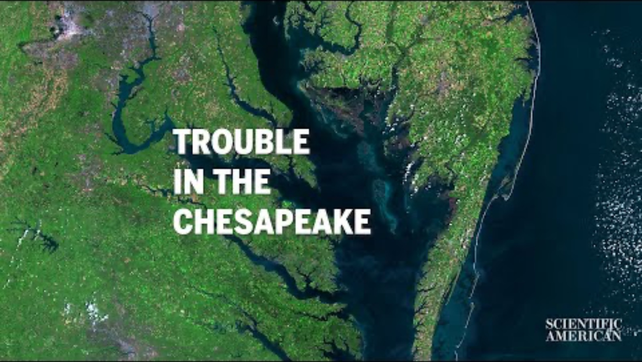
Will the Chesapeake Bay Become a Dead Zone?
MAY 3, 2023
The country’s largest estuary is under critical threat from pollution and climate change. The question is: Can it be saved?
A film by D.L. Tu and S. Tuinder for Scientific American
https://www.scientificamerican.com/video/will-the-chesapeake-bay-become-a-dead-zone/

Slide 8
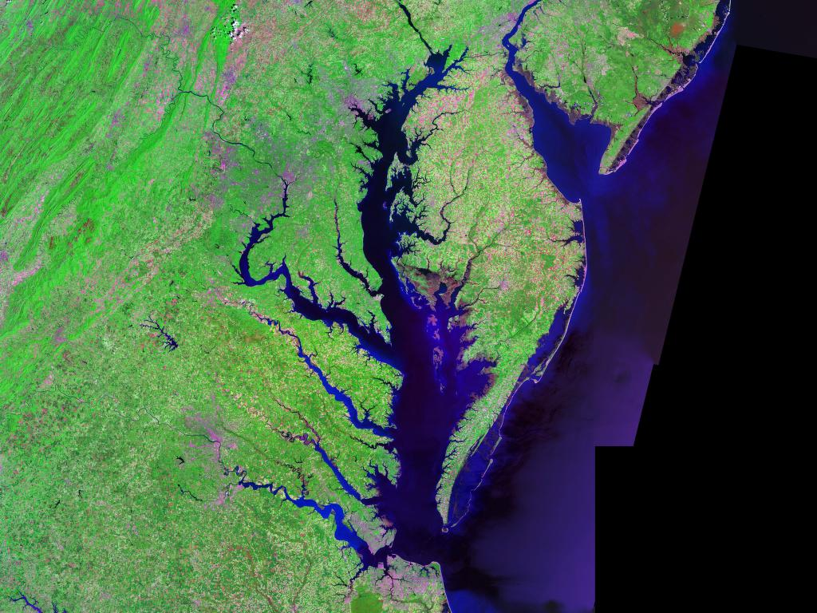
Socio-Ecological Analysis of the Eutrophication in Chesapeake Bay
Ollivier et al. 2023: https://doi.org/10.3389/fmars.2023.1237493
Abstract: This study is a social-ecological analysis of eutrophication in the Chesapeake Bay, United States of America (USA). It uses an expanded DPSIR framework (Drivers/Pressures/State/ Impacts/Responses) methodology to analyze the issue. In addition, a typology of the social actors and stakeholders in the socio-economic part of the system is identified. These stakeholders include residents, agriculturists, fishers, real estate developers, tourism operators, scientific researchers, and state and federal regulators. The framework results found that the Drivers are food security, housing, economic development, recreation pursuits, a sense of belonging, and population growth.
Photo via NASA, Wikimedia Commons

Slide 9
Socio-Ecological Analysis of the Eutrophication in Chesapeake Bay Abstract Part 2
Ollivier et al. 2023: https://doi.org/10.3389/fmars.2023.1237493
Abstract Continued: These result in human Activities such as land and coastal change for development, coastline changes for fisheries, urban or suburban development, burning fossil fuels, and agricultural fertilization. The activities exert Pressures such as wastewater discharge, runoff from cleared land, atmospheric deposition (NOx), nutrient input, decreased tidal vegetation, and overfishing of filter feeders. These alterations change the State of the environment and its resilience by increasing the duration and areal extent of hypoxia, turbidity, and change in nutrient ratios. This also causes ecosystem changes, such as a decrease in wildlife diversity, and affects ecosystem services, such as decreasing nutrient buffering. The health of Chesapeake Bay benefits all stakeholders and wildlife, so the reduction of ecosystem services results in Impacts on society’s welfare and well-being, the economy, and environmental justice. Examples are decreased fishery yields and poorer water quality, affecting aesthetics, tourism, and ultimately human health.

Slide 10
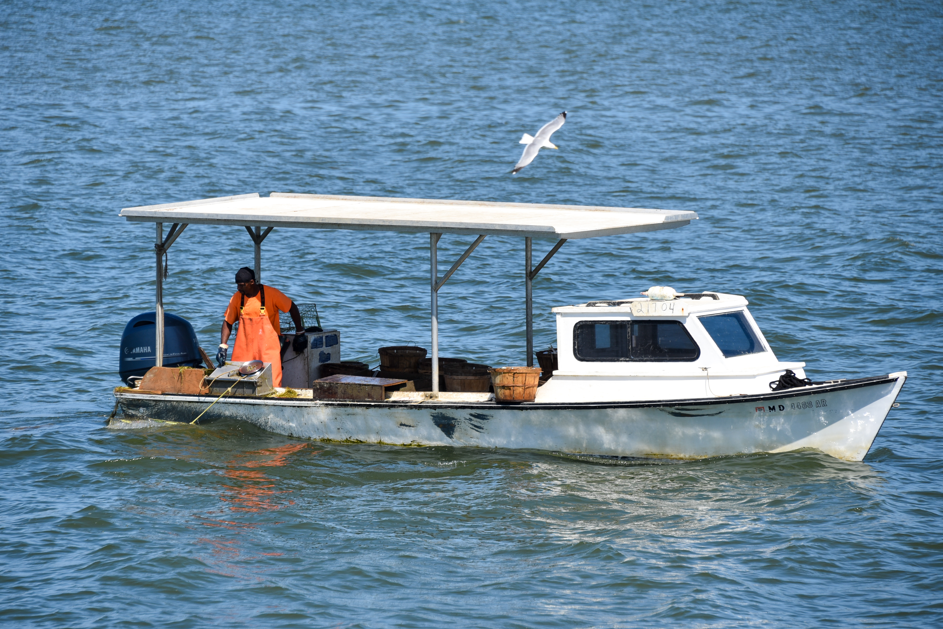
Socio-Ecological Analysis of the Eutrophication in Chesapeake Bay Abstract Part 3
Ollivier et al. 2023: https://doi.org/10.3389/fmars.2023.1237493
Abstract Continued: The governance Response to the degradation of the Chesapeake Bay and main management Measures has been the formation of the Chesapeake Bay Program, which has developed several agreements to improve water quality. The Chesapeake Bay Foundation, Chesapeake Progress, and Report Cards are accountability tools to observe and communicate the management project results or enforce state laws. The current management shows promising results, but further efforts are required to required to improve the water quality. Using various management options may bridge this gap to benefit all stakeholders. The main conclusion is that, although eutrophication is a complex problem, there is a scientific knowledge-base and a range of management options to restore the Chesapeake Bay.
Gordon Leggett / Wikimedia Commons / CC BY-SA 4.0

Slide 11
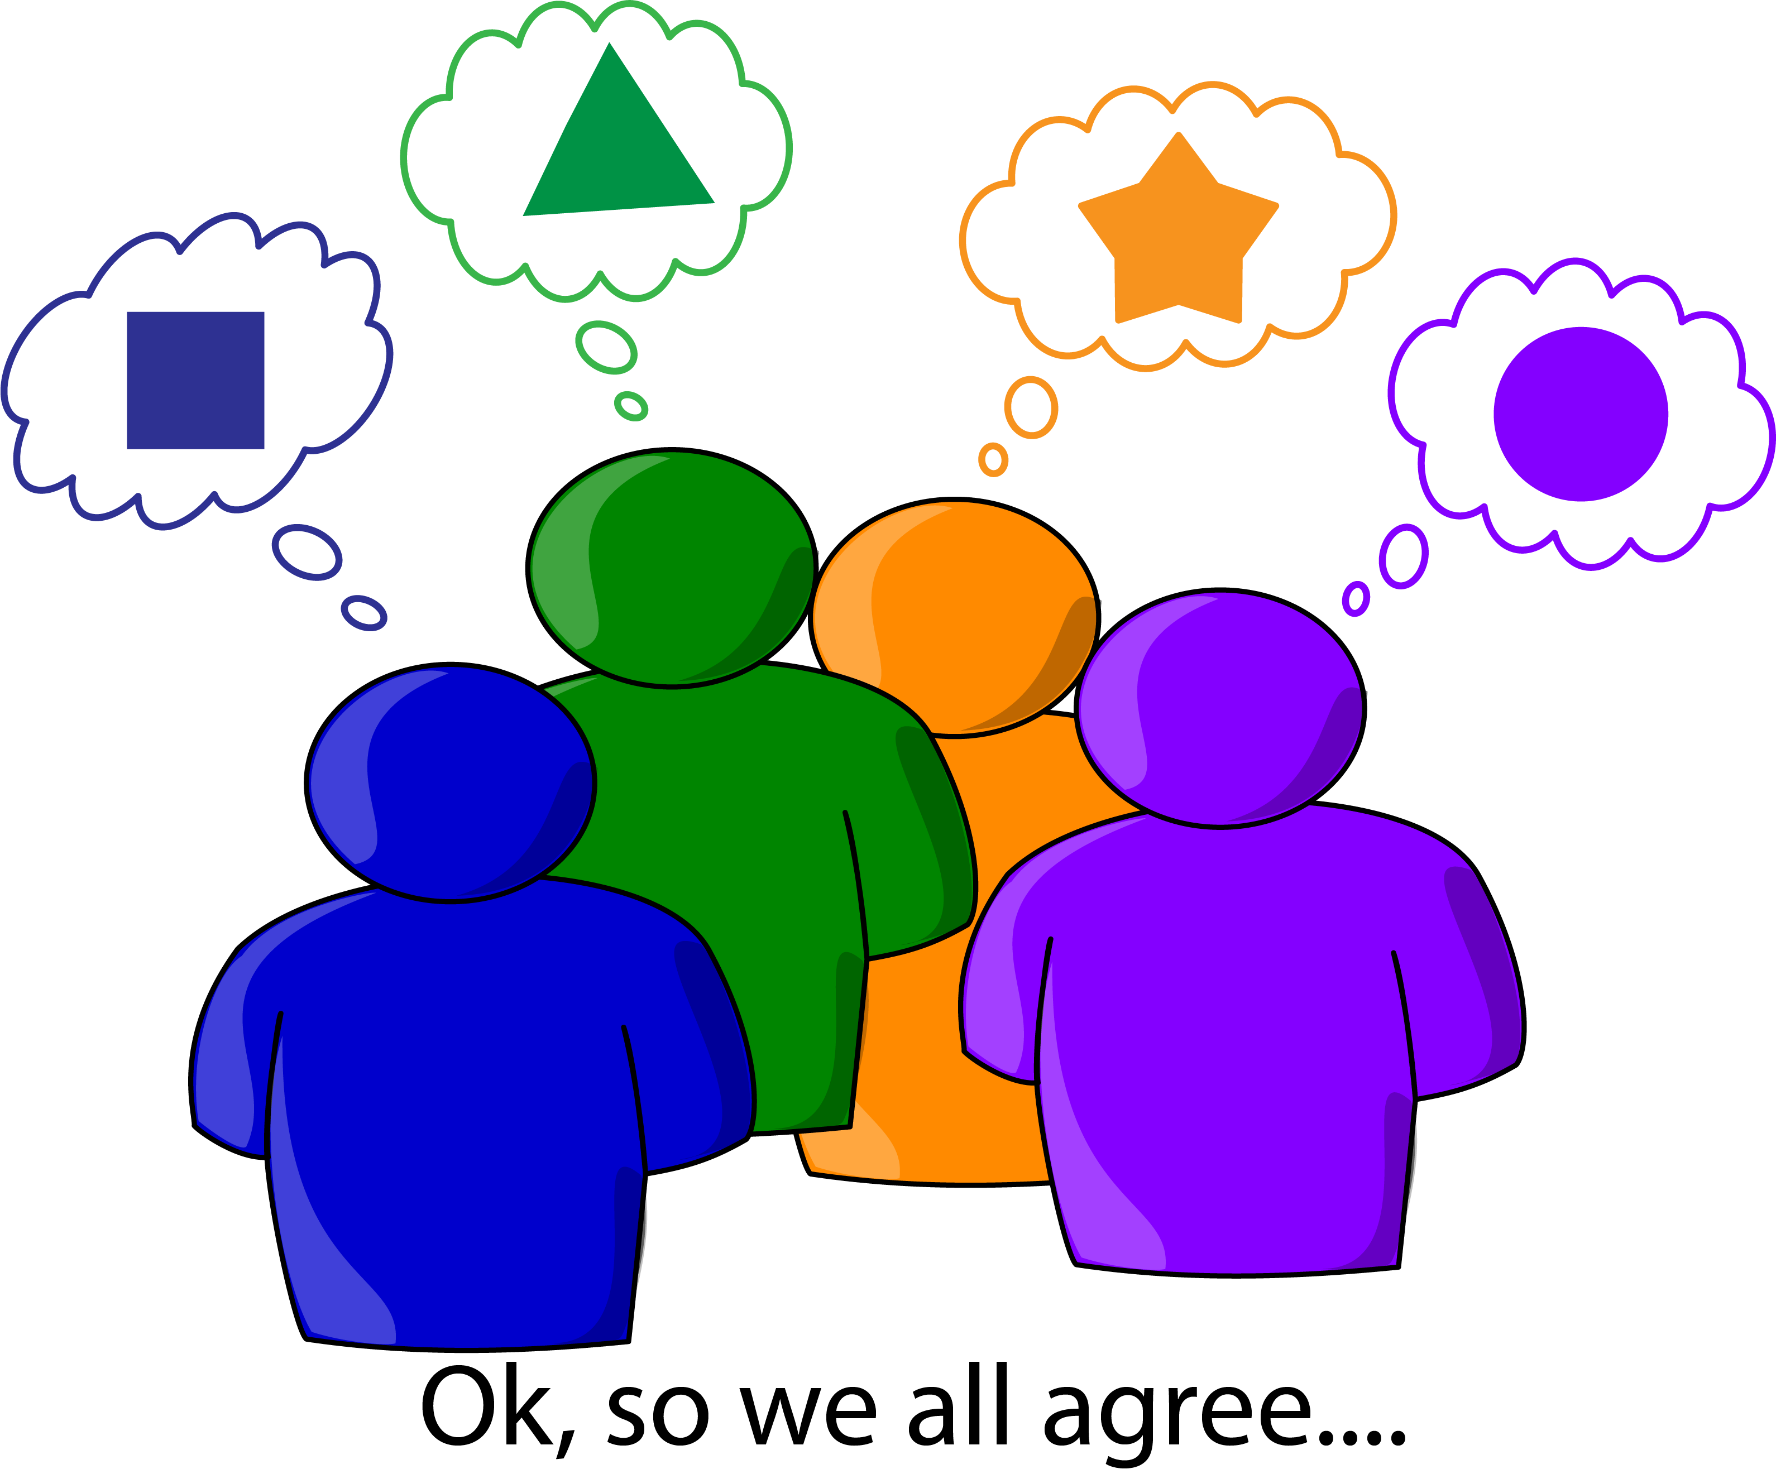
Wicked Problems: Characteristics
Complex
Hard to define
Can be described as symptoms of other problems
Value-laden
Change over time and/or space
No “solution” and potential ones may benefit some, harm others
Cannot study the problem experimentally (testing)
Notes:
Notes for Instructor: There are many articles and open access web resources that describe the characteristics of wicked problems. Make sure you discuss what “complex” means in this context, i.e., many parts that are interrelated as in a complex system. Additionally, discuss why they are hard to define in relation to peoples’ values and their changing dynamics. Give examples of how harm can come to some and benefits to others given various solutions. E.g., companies benefit financially by not having to pay the costs to clean up environmental externalities. Finally, explore the ethics of studies that include human subjects.

Slide 12
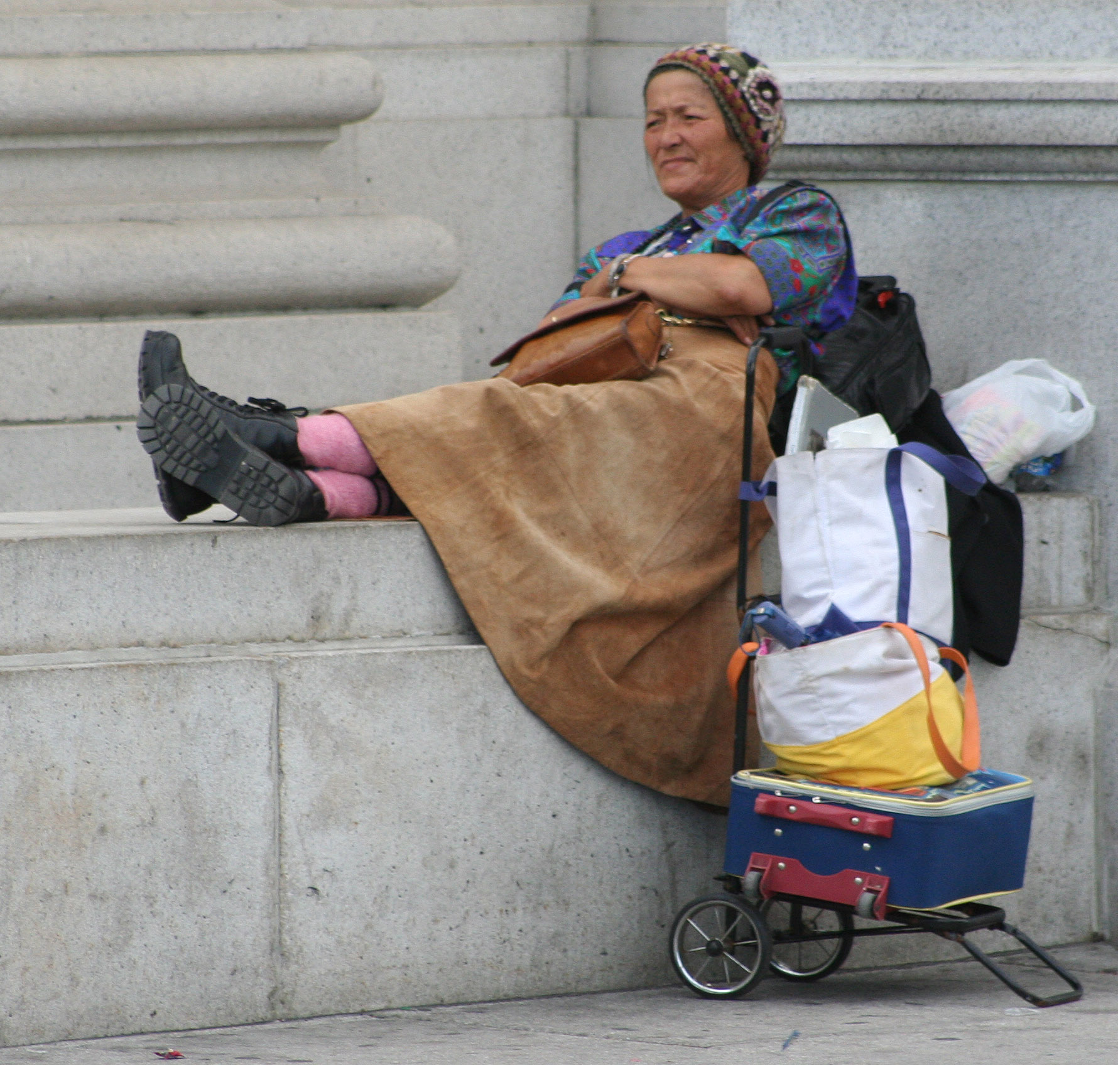
Which of the following are wicked problems and why?
Climate change
Homelessness
Fuel-efficient cars
Financial crisis
Malaria vaccine
Health care
Obesity epidemic
Malaria vaccine
Photo via: Wikimedia Commons
Notes:
Notes for Instructor: Make sure learners understand that tame problems can be complex, but they are also ones for which logic and testing can be applied. Some of the examples listed are related to wicked problems but are not wicked as stated. E.g., the geographic distribution of malaria and even reducing it without a vaccine is a wicked problem because issues like poverty, use of water, and other factors influence its incidence and eradication. Similarity, we know that diets and even newer medications can reduce obesity, but the epidemic is tied to social factors like food availability, income, cultural norms, education, etc.

