Slide 1

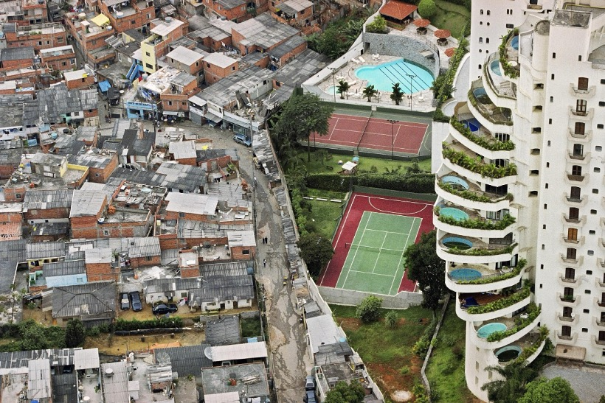
What Is Political Ecology?
Poverty and wealth separated by a wall in Brazil.
(Photo permission granted from Tuca Vieira)
Notes:
Notes for Instructor: Ask the students what they see in the photo.

Slide 2

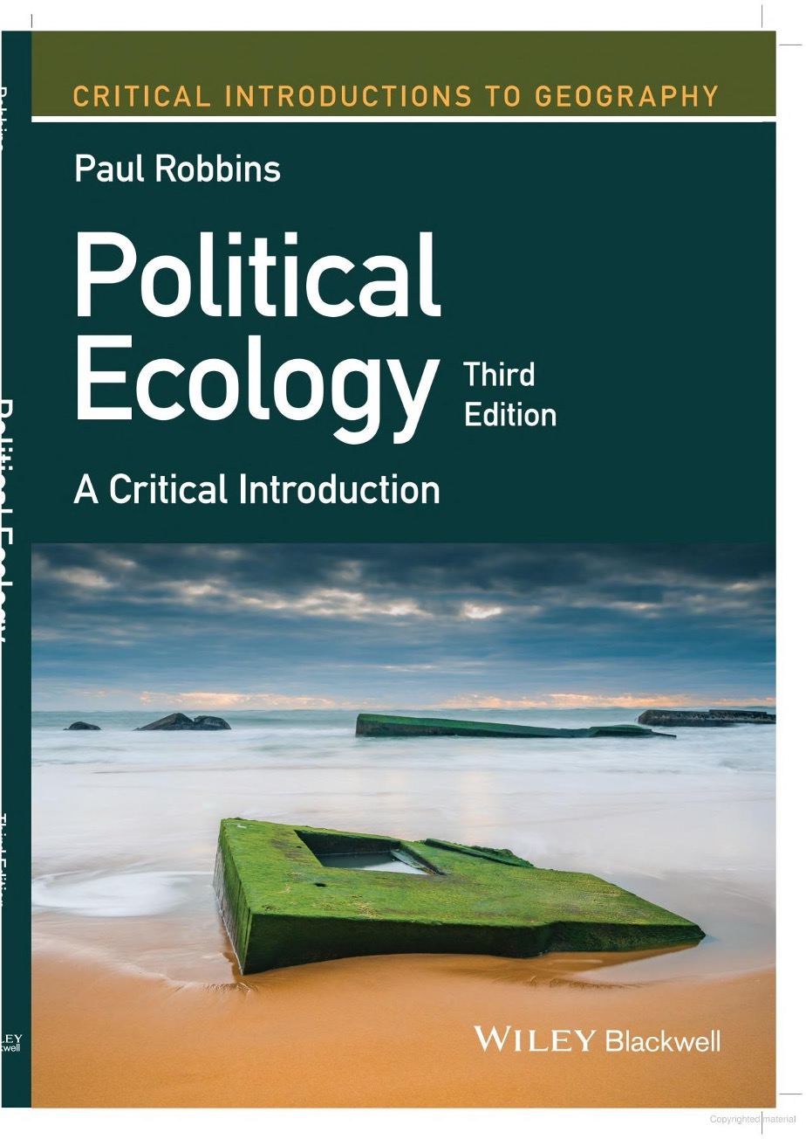
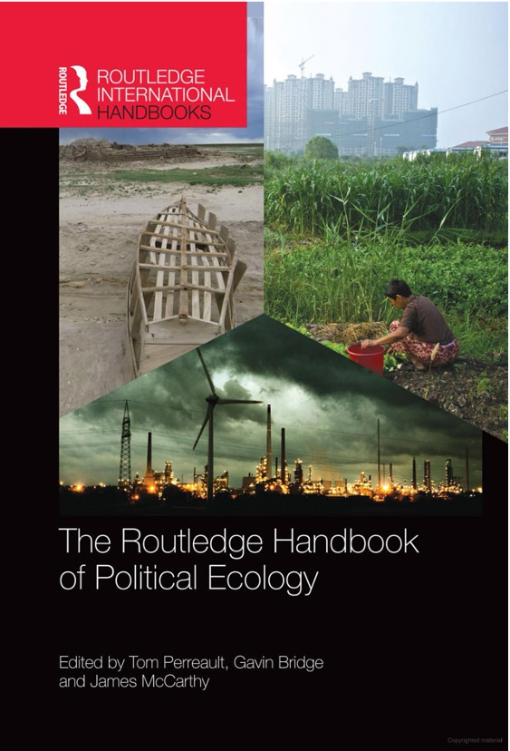
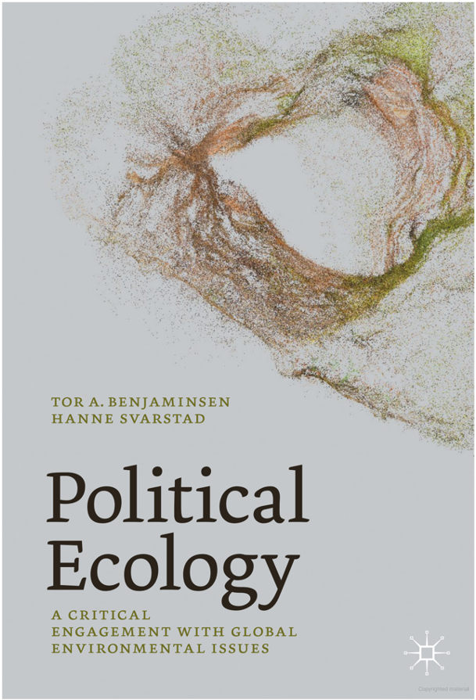
Political Ecology…
Is something you do—not a body of scholarship
Notes:
Notes for Instructor: Above are examples of a few useful texts.

Slide 3
Some Argue that Political Ecology Is:
A community of practice ¹
What does this mean?
An epistemological project ²
  What is/are the epistemologies of your discipline?
An effort to shatter comfortable & simplistic “truths” about the relationship between society & its natural environment ²
What is meant by “truths” here?
¹ Robbins, P. (2019). Political versus apolitical ecologies. In Political Ecology: A Critical Introduction, (3rd ed., pp. 11-24). Wiley.
² Perreault, T., Bridge, G., & McCarthy, J. (Eds). (2015). The Routledge Handbook of Political Ecology. Routledge, Taylor & Francis Group.

Slide 4
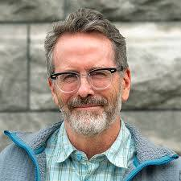
Characterizing Political Ecology
Tom Perreault argues:
“It is best characterized not by a research topic … the field’s coherence derives from a set of commitments held in common.”
He describes four commitments:
A theoretical commitment to critical social theory
A theoretical commitment to a post-positivism understanding of nature
A methodological commitment to in-depth, direct observation involving qualitative research often in combination with quantitative methods and/or document analysis
A normative political commitment to social justice and structural political change
Tom Perreault, Syracuse University
Notes:
Notes for Instructor: Perreault’s quote: “research topic” here is referring to things like deforestation, resource governance, etc.

Slide 5
Commitment #1
A theoretical commitment to critical social theory
What do YOU think critical social theory is?
How do scholars of this theory describe it?
Notes:
Notes for Instructor: Have students first write down or say what they think critical social theory is; THEN present them with a scholarly definition (to clear up misconceptions) as on the next slide.

Slide 6
Critical Social Theory
…from a scholar’s point of view
An approach to social inquiry that goes beneath the surface appearance by critically engaging with prevailing conceptualizations of the social world ¹
A perspective that focuses on reflective assessment of social systems to identify, evaluate, and challenge systems of power ²
An umbrella term for theories advocating social justice and sharing a set of assumptions that recognize the impacts of systemic oppression on all members of society…it posits that theory cannot be separated from practice because people enact their understanding of the world (e.g., a person who believes the world is inherently just and fair may deny that systemic problems exist and may act in ways that perpetuate injustice) ³
¹ Harvey, L. (2022). Critical social research: re-examining quality. Quality in Higher Education, 28(2). https://doi.org/10.1080/13538322.2022.2037762
² Curtis, M.G. et al. (2022). Quantitative criticalism: Guidelines for conducting transformative quantitative family science research. Journal of Family Theory & Review, 14(3). https://doi.org/10.1111/jftr.12449
³ Brennan, C. et al. (2022). Building a critically transformative community of inquiry in an online undergraduate program. The Internet and Higher Education, 52. https://doi.org/10.1016/j.iheduc.2021.100830
Notes:
Notes for Instructor: These three descriptions by different scholars invite a rich discussion by participants in the group.

Slide 7
Commitment #2
A theoretical commitment to a post-positivism understanding of nature
What is post-positivism?
What are examples of research fields in which scholars typically adopt this and fields that have traditionally shunned such?
Notes:
Notes for Instructor: Have the learners first write down a definition and example in response to the two questions, then open the floor for sharing.

Slide 8
Commitment #3
A methodological commitment to in-depth, direct observation involving qualitative research often in combination with quantitative methods and/or document analysis
What are examples of qualitative research methods?
How can qualitative and quantitative data be used together?
Notes:
Notes for Instructor:
The first question posed to the learners: you could have them answered it directly or you could have them do quick, 3-minute searches. Another option is to have them watch SESYNC’s short video on “Qualitative Data” (https://youtu.be/aj81nfyj8pA?si=B_P_bmgI7bIGf4y7). Examples might be: interviews/ethnographic approaches, surveys, etc.
For the second question, the instructor could discuss how survey data can be converted to quantitative data if the survey responses are associated with a Likert scale (e.g., ‘agree’ [with this statement], ‘agree a little’ etc.) or you could mention the use of Qualitative Comparative Analysis (which combines qualitative and quantitative research).
But qualitative data is also excellent when used in a Mixed Methods design in which, for example, the qualitative data helps explain/interpret quantitative results, provides context, etc.. Especially because as Perreault points out: “Some understanding of the place-based, historically sedimented social relations of production and exchange, and environmental practices is crucial for political ecological analysis.” The instructor could also refer to Mysha Clark’s SESYNC lecture on the use of mixed methods titled: “The Human Dimensions of Natural Resource Management: What is the Role of Mixed Methods Approaches” (https://www.youtube.com/watch?v=BtzGnQ9sJko)

Slide 9
Commitment #4
A normative political commitment to social justice and structural political change
In what way might your own work involve normative aspects?
Notes:
Notes for Instructor: Have the students think about the following statement: “Often ecologists have normative views on biodiversity but never question them, e.g., biodiversity is always a good thing.:
Instructor follow up: Perreault expands on this commitment as follows:
“Political ecology is an explicitly normative intellectual project, which has from its beginning highlighted the struggles, interests, and plight of marginalized populations: peasants, indigenous peoples, ethnic and religious minorities, women, the poor. In this sense, and in contrast to many other approaches to social and environmental analysis (e.g., cultural ecology, land use/land cover change analyses, etc.), political ecology is explicitly normative in its approach. Political ecologists thus seek not just to explain social and environmental processes, but to construct an alternative understanding of them, with an orientation toward social justice and radical politics.”

Slide 10
History of Political Ecology:
Early Focus
Environmental degradation is huge, and the impacts fall disproportionately on those with little power.
What are some examples of disproportionate impacts on groups during the 1970s to late 1980s?
Has the disproportionality of environmental impacts decreased over time? Does this vary geographically?
Notes:
Notes for Instructor: Guide the students from historical to recent times. Ask them, “Who wins and who loses from environmental externalities?”

Slide 11
History of Political Ecology:
Later Focus
The focus shifts away from biophysical degradation toward the “politics” side.
There is a major focus on the politics and economics of the environment and how power plays out.
What are some sources of power?
Where do power differentials play out? Provide examples.
Notes:
Notes for Instructor: During this time period, and even up until today, many believe that the ecology has been lost from political ecology. (See article by Turner et al. 2016 who argue that there is still an important role for political ecology as a mode for engaging with ecologists and ecological science. DOI: 10.1177/0309132515577025)
Have students think about power, what it is and how it plays out:
*SOURCES of POWER: gender, income, sexuality identity, geographic region of origin, family status, etc.
*Theaters in which power differentials play out:
Push them to go beyond income status. E.g., Power plays out in terms of being able to afford something (like a home in an uncontaminated area).
Others might include:
Who is at the “table” when zoning laws are set, who provides input into new legislation into where environmental remediation and restoration projects are completed, etc.
Who has a voice, i.e., you may be at the table, but your input is rarely acknowledged or acted upon. Have learners brainstorm examples, ideally from their own experience
Power differentials also play out:
in relationships (especially gender is important here)
in jobs (e.g., director vs. staff member, owner vs. maid, etc.)
in settings in which ‘prestige’ is an issue (e.g., doctor vs. patient, clergy vs. parishioner, police vs. citizen, etc.) .

Slide 12
History of Political Ecology:
Today
Many would argue that political ecology is still just about politics and power…but it is much more.
It also asks researchers to think about positionality and assumptions underlying one’s work and about how socio-environmental systems are studied/framed, and who is involved.
What is meant by positionality in the context of research?
What assumptions are you making in your work?
Notes:
Notes for Instructor: This is often a very difficult topic for natural scientists—i.e., for them to think about their own positionality. Do they bring Western or American assumptions to the table? What is accepted in the U.S. may be very different in other cultures. E.g., what we see as an unacceptable use of natural resources may be very different in other cultures. Ask the participants to challenge one another on their assumptions.

Slide 13
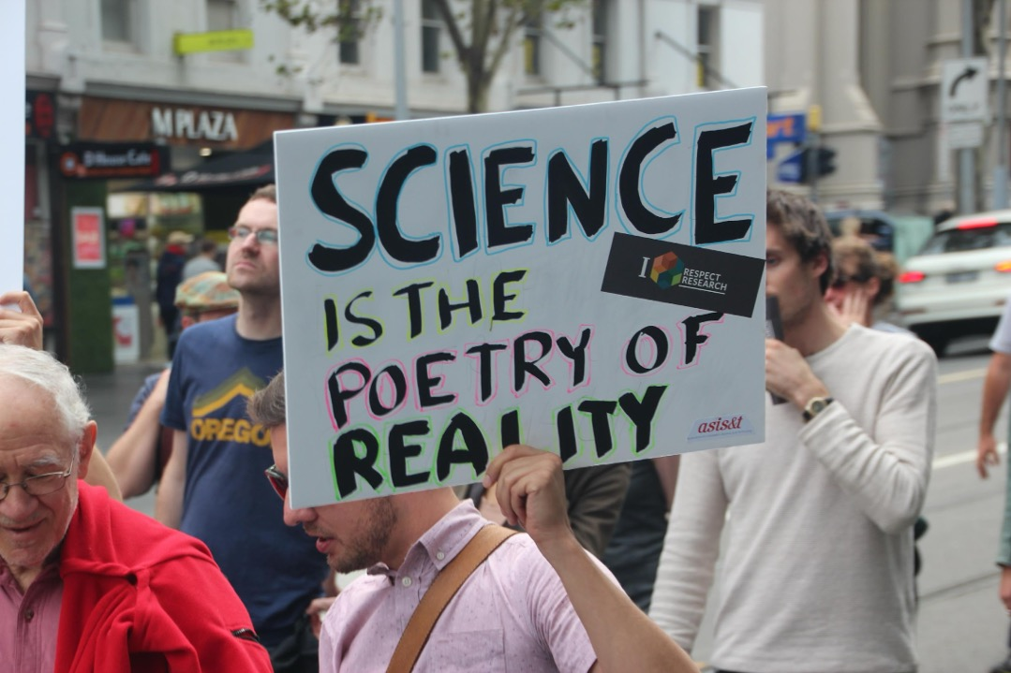
History of Political Ecology:
Today (continued)
Also, for many it is about merging scholarship with activism.
Is this consistent with your views about the role of scholars?
Has this become more acceptable over the last 10 years? What ‘forces’ make this more/less acceptable?
Notes:
Notes for Instructor: Instructor may want to show clip from (https://www.youtube.com/watch?v=gj3E7SMLRoA) where Christina Hicks talks about this. Have the students reflect on this. Allied topics include how they define advocacy? Is this the same as actionable science? (See SESYNC materials on this topic)? Is there basic and applied research…a clear demarcation?

