Slide 1

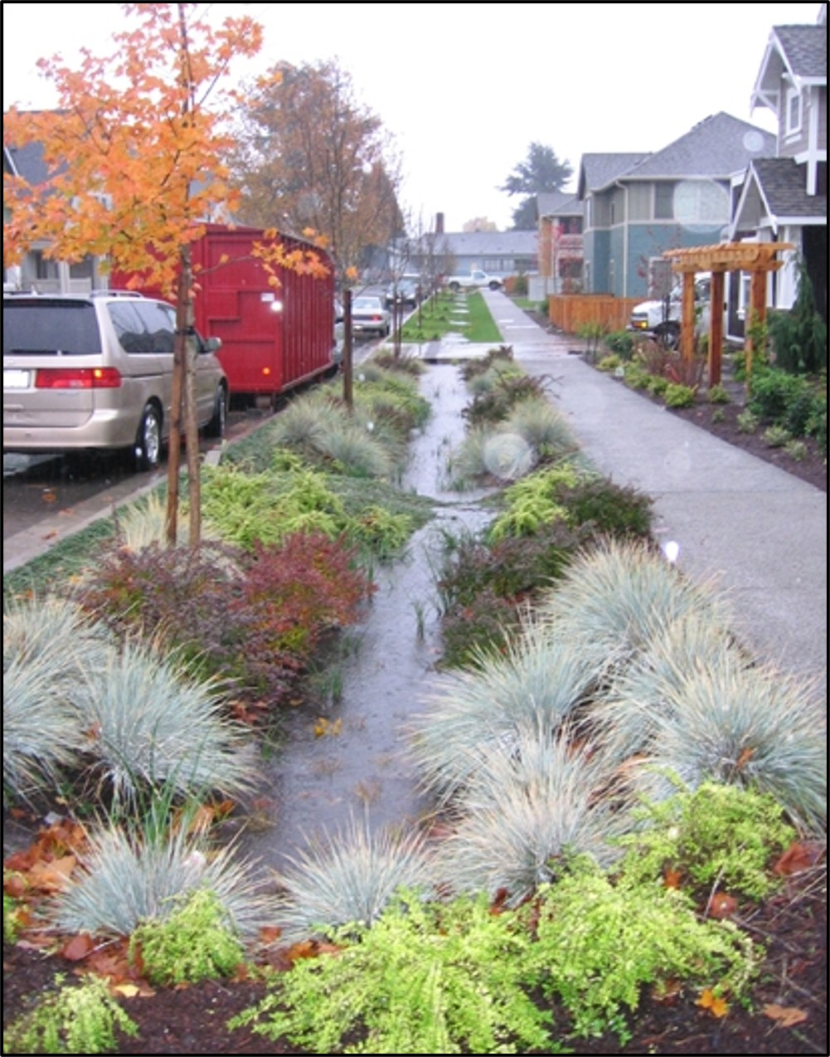
Green Infrastructure (GI): Urban Storm Water, Policy, and Justice
Notes:
Notes for Instructor: Ask learners: How do you view the aesthetics and functionality of this GI intervention? What might this neighborhood look like in 20 years, versus neighborhoods that use only traditional gray infrastructure of curbs and sewers?

Slide 2

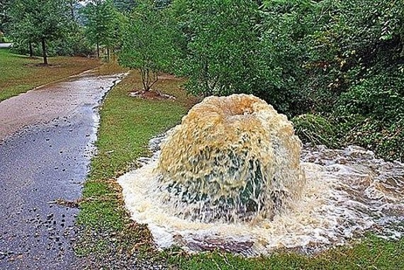
Influence of Governance Structure on Green Stormwater Infrastructure Investment
Hopkins et al. 2018: https://doi.org/10.1016/j.envsci.2018.03.008
Combined Sewer Overflow (CSO): When linked, stormwater and wastewater systems in aging gray infrastructure cannot handle the volume of a large rain event; the system releases untreated sewage into local waterways.
EPA Policy: Federal Permits require an 85% reduction in CSO events from historic baselines. A 2007 document supports the integration of GI to alleviate CSO problems.
Grey to Green: The transition from funding exclusively gray infrastructure projects to integrating small-scale green infrastructure is underway. Hopkins et al. profiled 25 cities’ policy documents to review their investments in green infrastructure.
Notes:
Notes for Instructor: This image from “the hook” may serve as a good time for learners to share their ideas of three human and three environmental impacts of CSO events.

Slide 3
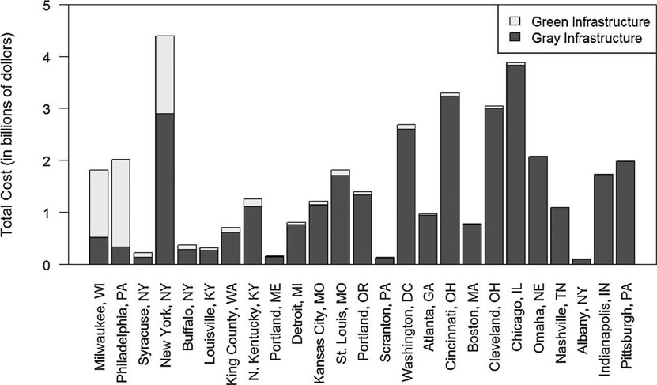
Green Leader Communities
Hopkins et al. 2018: https://doi.org/10.1016/j.envsci.2018.03.008
“Green Leader” communities: Buffalo, Milwaukee, New York, Syracuse, & Philadelphia devoted at least 20% of their control plan budget to green stormwater infrastructure.
Fig. 2. Investments in green and gray infrastructure in each city’s most recent control plan. Cities are ranked from left to right in descending order based on the proportion of total control plan cost to be invested in green infrastructure.
Notes:
Notes for Instructor: Note that only five cities—Buffalo, Milwaukee, New York, Philadelphia, and Syracuse—devote 20+% of their stormwater control plans to green infrastructure. The cities on the right side of the figure entirely fail to mention these interventions and rely completely on investments in grey infrastructure. Have learners discuss how the creativity and progressive thinking of the cities on the left side of the graph may change their habitability and sustainability along a different trajectory from cities on the right-hand side. Does any learner wish to share an experience or anecdote from any of these cities?

Slide 4
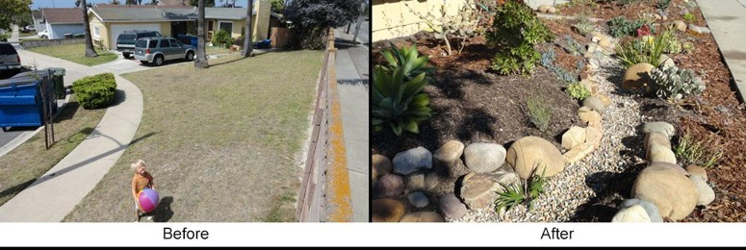
Hopkins Study Conclusions
Hopkins et al. 2018: https://doi.org/10.1016/j.envsci.2018.03.008
Lip Service vs. Community Services: Discussion of GI in plans did not always correlate with investment in GI (e.g., Omaha, NE).
Green Leader Cities: (e.g., Philadelphia, Milwaukee): Prior investment in gray infrastructure freed them to focus on next-phase green projects
Policy Push: Federal policy from EPA to regulate CSO runoff and prioritize green infrastructure projects (2007) created a critical policy window for Green Leader cities to invest in GI.
Notes:
Notes for Instructor: It’s slightly counterintuitive, so ask learners: Why might prior investments in gray infrastructure actually strengthen green infrastructure investments? Does robust gray infrastructure need to be a precursor to creating the opportunity for integrative, biomimicry designs? Since the two types of infrastructure are more cooperative than competitive, how might that mutualism aid in city planners finding a sustainable middle ground?

Slide 5
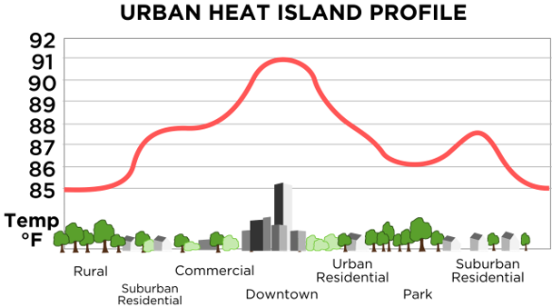
Environmental Justice Implications of
Siting Criteria in Urban Green Infrastructure
Hoover et al. 2021: https://doi.org/10.1080/1523908X.2021.1945916
A review of planning documents from 19 cities shows an emphasis of Technological over Social Criteria:
Technical siting criteria for GI focus on stormwater and economic implications.
These technical criteria have social justice implications, which are unexplored in policy papers.
Environmental Justice (EJ) accounted for only 1.2–2% of cited criteria.
GI plan development should include EJ community priorities and guard against Green Gentrification.
Graph courtesy of NOAA, Public Domain
Notes:
Notes for Instructor: Ask: why does policy that favors technical solutions for economic outcomes tend to ignore the social effects on marginalized groups? How can economic goals better serve all city residents, rather than simply fulfilling benchmarks for the city budget or quarterly report?

Slide 6
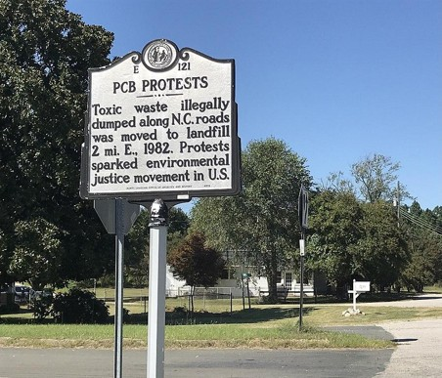
Hoover Study Conclusions
Hoover et al. 2021: https://doi.org/10.1080/1523908X.2021.1945916
  Planning documents should prioritize GI in communities that seek this investment and view GI as an integrative solution to social challenges.
  Trust among stakeholders and empowerment of community members is essential to just policy.
  Documents should have methods and criteria that match explicitly stated justice goals.
  Plans should be implemented alongside policy that directly addresses systemic racism, particularly to resist Green Gentrification.
Historical marker celebrates activists in Warren County NC in 1982 at the origins of the Environmental Justice movement.
Source: Wikimedia Commons, Public Domain
Notes:
Notes for Instructor: Ask learners if they are knowledgeable about the Warren County, North Carolina PCB protests in 1982, or the work of Robert Bullard. If so, they may want to discuss how the origin of EJ in public protest has evolved into the governance realm integrating EJ into policy, public hearings, and both state and federal funding to focus on resolving environmental injustice. What forms of EJ activism and success do learners imagine may be in place by mid-century?

