Slide 1

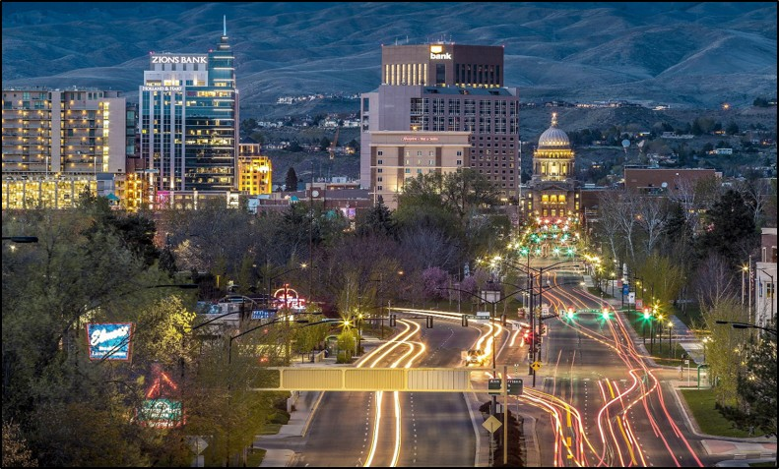
Green Infrastructure:
Urban Metabolism and Smart Cities
Flows of energy and matter in Boise, Idaho, USA, via Wikimedia Commons, Public Domain.

Slide 2

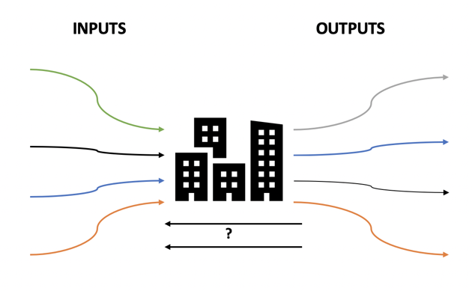
Challenges in Urban Metabolism: Sustainability and Well-Being in Cities
Ulgiati & Zucaro 2019: https://doi.org/10.3389/frsc.2019.00001
Metabolism and Homeostasis are physiological terms that can also apply to planet Earth (Gaia Hypothesis) and to cities.
What are some resource inputs to cities?
What are some waste outputs from cities?
How can we close the loop to make cities more sustainable and equitable?
Notes:
Notes for Instructor: This image from “the hook” may serve as a good time for learners to share their ideas of four inputs (resources), four outputs (wastes), and ideas for how to make “waste” into a new resource.

Slide 3
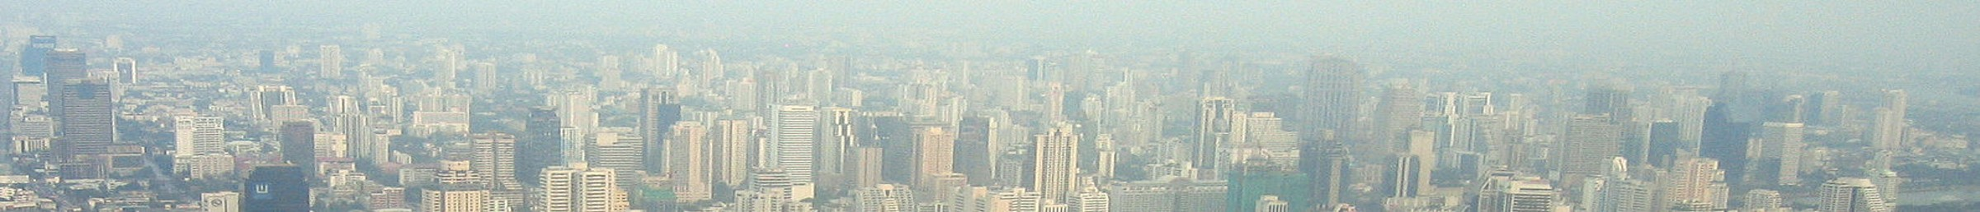
Urban Metabolism
Ulgiati & Zucaro 2019: https://doi.org/10.3389/frsc.2019.00001
Cities cover 2% of Earth’s surface but consume 78% of all the energy produced for human needs (Ulgiati et al. 2019, p. 1).
Cities provide economic and social opportunities, but they are hard to measure as energy and material flows.
How can we value these human services while amplifying cities’ potential to provide ecosystem services (clean air, water, habitat, exercise)?
In terms of efficiency, how can monitoring inflows and outflows provide information about populations, resource availability, and urban carrying capacity?
In terms of equality, how can resource and waste management benefit disadvantaged groups?
Bangkok, Thailand, via Wikimedia Commons, Public Domain
Notes:
Notes for Instructor: For now, these questions may be posed as the complex challenges facing city planners and managers. Invite learners to suggest ways that we can solve multiple problems with urban sustainability and equality with single solutions. For example, how would a zero-waste and closed-loop city provide job opportunities or better habitat for the city’s disadvantaged population?

Slide 4

Shift in Values
Ulgiati & Zucaro 2019: https://doi.org/10.3389/frsc.2019.00001
Cities cannot achieve an efficient metabolism without a shift in values:
Reduce outputs wherever possible; re-envision waste as a resource that can be recycled back into the urban “body.”
Prioritize the well-being of all citizens, not input measures of wealth or material consumption. This is qualitative well-being over quantitative consumption.
Emphasize services, education, leisure, healthcare, and environmental quality to achieve well-being, stability, fairness, and respect.
Reduce city consumption and waste burdens on surrounding rural and wilderness areas.
Wikimedia Commons, Public Domain
Notes:
Notes for Instructor: Ask learners what features of a city would attract them. Is it about infrastructure, economics, or social and personal opportunity? How does one category affect the others? What are some challenges to implementing qualitative well-being over quantitative consumption, especially in our current economic paradigm of growth and technology?

Slide 5
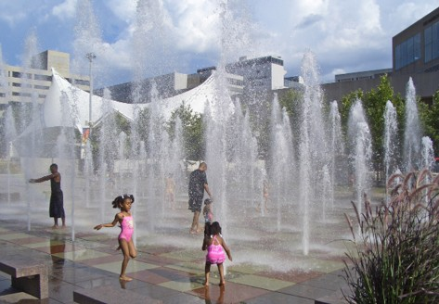
What Makes a City ‘Smart’ in the Anthropocene? A Critical Review of Smart Cities under Climate Change
Obringer & Nateghi 2021: https://doi.org/10.1016/j.scs.2021.103278
Smart city: Definitions are biased toward technological monitoring of traffic and energy flows.
  The authors support the integration of infrastructure with human capital: “This integration of physical and social systems will be critical for climate change adaptation and mitigation, which ultimately involves preparing our physical infrastructure for higher temperatures and more extreme weather, while also protecting people and building adaptive capacity” (p. 3).
  Key aspects of urban resilience to climate change:
  Infrastructure
  Public health & well-being
  Accessibility & equity
  Sustainable systems
  Governance
Crown Center Square Fountain, Kansas City MO, by Charvex, via Wikimedia Commons, Public Domain.
Notes:
Notes for Instructor: What is the difference between climate change mitigation and resilience? Why might cities more often invest in mitigation efforts rather than building infrastructural and social resilience? What kinds of incentives might encourage city planners to implement proactive resilience?

Slide 6
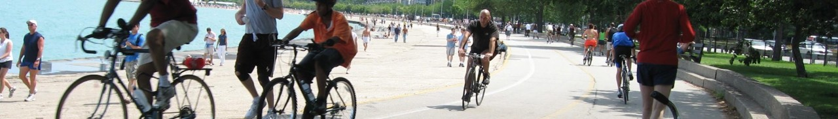
Study Conclusions Part 1
Obringer & Nateghi 2021: https://doi.org/10.1016/j.scs.2021.103278
Study Conclusions:
Decarbonizing the energy system, using smart transportation to reduce emissions, and water resource monitoring are mitigation tactics, but not all are resilience-building.
Links between smart technology and public well-being are sparse and deserve more development, esp. as relates to mitigating heat islands and air pollution.
Few smart city plans explicitly state environmental justice goals; improving equity will aid in both mitigation and adaptation to ensure no undue burdens on a disadvantaged group.
Chicago Lakefront Trail, USA. Unaltered photo by katjung via Wikimedia Commons, 2.0.
Notes:
Notes for Instructor: What are some of the encouraging flows, behaviors, and opportunities on display in this image of Chicago?

Slide 7
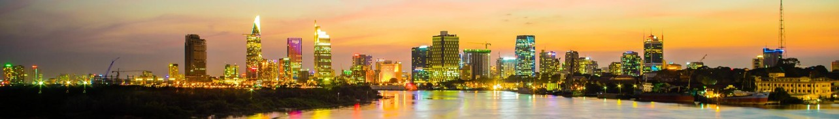
Study Conclusions Part 2
Obringer & Nateghi 2021: https://doi.org/10.1016/j.scs.2021.103278
Study Conclusions:
Governance of smart cities should be linked to current and future climate action plans.
Smart cities use big data with energy-intensive servers, which are vulnerable to cyber attacks.
Decentralized smart grids and local renewable energy systems may reduce cities’ vulnerability to blackouts and extreme weather and assist in the adoption of electric vehicles.
Panorama of Ho Chi Mihn City, Vietnam. Unaltered photo by Hieucd via Wikimedia Commons, 4.0.
Notes:
Notes for Instructor: What technologies exist to convert cities into energy generators rather than consumers? What impacts might these local, small-scale generation efforts have on the city’s resilience, economy, quality of environment, and job opportunities?

