Slide 1

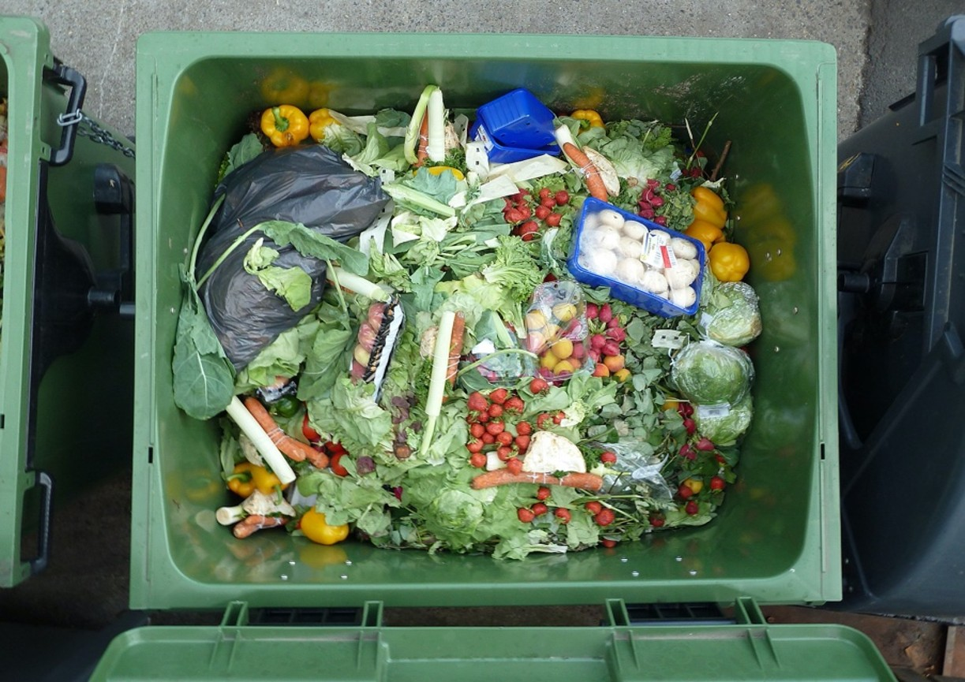
Sustainable Agriculture Lesson 2:
Strategic Reductions in Food Waste
Notes:
Notes for Instructor: Ask learners: What’s the environmental difference between throwing waste food in the trash versus the compost? Note: the largest input to landfills, an estimated 25% by weight, is food waste, which causes the release of the powerful GHG methane.

Slide 2


Assessing the Environmental Impacts of Halving Food Loss and Waste along the Food Supply Chain
Read et al. 2020: https://doi.org/10.1016/j.scitotenv.2019.136255
Conclusions:
16–18% of the total environmental impact of the U.S. food system is linked to food that is ultimately lost or wasted.
Impacts include energy use, eutrophication, greenhouse gas (GHG) warming, land use, and water use.
Reducing food loss and waste by 50% in six supply line sectors would reduce the total environmental footprint of the food system by 8-10%.
Best points to reduce waste are in food service, food processing, and household consumption.
Unaltered image by Liz West via Wikimedia Commons, 2.0
Notes:
Notes for Instructor: Note that there are other food sectors that waste resources but reducing their waste by 50% does not offer as much reduction in environmental impacts. These are Farms, Retail, and Institutional Foodservice (schools and other public services). Learners should keep these sectors in mind as alternate foci of food waste reduction. Also note the several categories of environmental impact reduction: energy, eutrophication, GHG emissions, land use and degradation, and water use and depletion. We will focus on GHG reductions in this lesson, but other sectors also deserve attention (for example, water use in regions like CA experiencing drought).

Slide 3
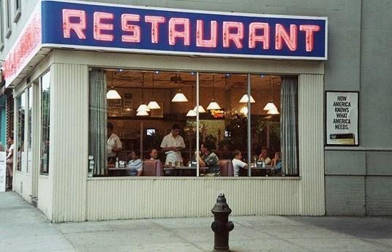
Food Service (Restaurant) Sector
Read et al. 2020: https://doi.org/10.1016/j.scitotenv.2019.136255
  The food service (restaurant) sector:
  Has a high, direct impact of food loss & waste (FLW) on GHG
  Is a final downstream point of the food supply chain, where the food meets the consumer
  Has large portion sizes contributing to waste
Potential solutions include:
  Introducing better inventory-management systems
  Using analytics to optimize quantity of purchases and batch sizes
  Reassessing the restaurant model that provides large portions to justify higher prices.
Tom’s Restaurant in NYC. Unaltered photo by Rick Dikeman via Wikimedia Commons, 3.0
Notes:
Notes for Instructor: Ask learners: At a restaurant, how do you measure the value of your meal? Is it related to quantity, quality, or some combination (plus service quality, dining ambiance)? What are some ways to reduce the pressure on restaurants to provide huge portions as a (mis)measure of quality? How could we implement composting solutions for restaurants?

Slide 4
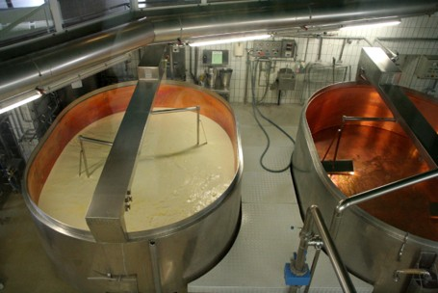
Food-Processing Sector
Read et al. 2020: https://doi.org/10.1016/j.scitotenv.2019.136255
  The food processing sector:
  Wants to maximize profit, which will drive gains in efficiency
  Faces challenges of calculating production quantity and cold chain management
  Involves a “Middleman” processing delay, which can spoil food.
Potential solutions include:
  Using better technology to improve logistics and forecasting ability to guide production quantity
  Improving cold chain management
  Shipping directly from manufacturers to retailers.
Cheese production facility. Unaltered photo by MatthiasKabel via Wikimedia Commons, Share-Alike 3.0.
Notes:
Notes for Instructor: Cold supply chains, a sequence of refrigerated stages along the food distribution chain from the farm to the table, are a major challenge for developing nations in hot climates; building cold chain infrastructure is critical to reducing food spoilage for populations most acutely in danger of malnutrition.
“Middlemen” in the food industry occupy the intermediary stages of food processing, packaging, and transportation. Are there any benefits to “middlemen” ? Why do they exist?
Remind learners about the high impacts of “food miles”: our food is transported vast distances from farms to manufacturers and processors, then to retailers, and finally to our homes. How could we reorganize the food processing industry to reduce food miles? Would eating more whole foods and less processed and manufactured foods effectively reduce food miles and spoilage?

Slide 5
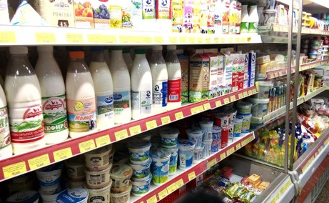
Household Consumption
Read et al. 2020: https://doi.org/10.1016/j.scitotenv.2019.136255
  Household consumption:
  Involves millions of individual consumer decisions—hard to regulate or standardize
  Has inconsistent date labeling, which may contribute to waste
  Includes consumer bulk purchasing, which may cause waste.
Potential solutions include:
  Optimizing package sizes to reduce spoilage
  Developing smart labels that change color
  Investing in consumer education, reminders, and access to composting.
A grocery store shelf with dairy products. Rakoon, via Wikimedia Commons, Public Domain.
Notes:
Notes for Instructor: Ask learners to contemplate which features of store-bought food makes it most attractive for purchase: packaging, size, quality, price, etc.? Do “bulk-buy” clubs like Costco and Sam’s Club cause more food waste than standard retail outlets? How often do learners throw out food that has past the date on the label (e.g., expiration, best-by, use-by, etc.) regardless of its condition? Do learners have access to household or municipal compost? What roles do farm stands, farmer’s markets, and community-supported agriculture (CSAs) play in increasing the quality, freshness, and compensation for farm workers (by avoiding “middlemen”)? How might direct to consumer sales affect “food miles?”

Slide 6
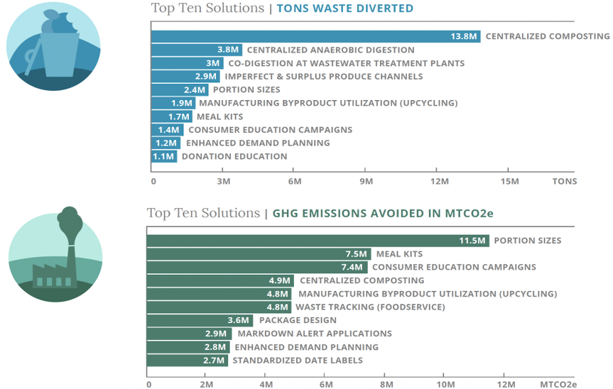
ReFED Roadmap: Solutions Analysis
Source: ReFED: Roadmap to 2030 – Reducing U.S. Food Waste by 50%:
https://refed.org/downloads/roadmap-to-2030-reducing-u-s--food-waste-by-50/
Notes:
Notes for Instructor: Discuss reactions to these graphs. How easy or difficult do participants envision different solutions might be?

