Slide 1

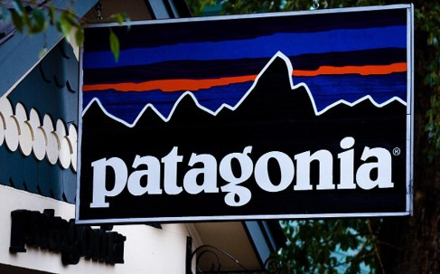
Greenwashing in the Fashion and Apparel Industry
The outdoor apparel company Patagonia has long led the industry in innovative sustainable production. But all clothing has impacts, and Patagonia products are more expensive than most, which limits who can buy them.
Photo by Dave Dugale via Wikimedia Commons, 2.0.
Notes:
Notes for Instructor: Ask learners the prompt from the Hook: Who are you wearing today? Does the brand itself matter to you, and why? How many times have your worn this garment?

Slide 2

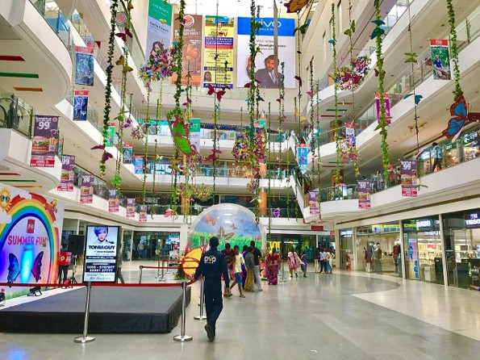
What Is Greenwashing?
Greenwashing takes many different specific forms, but they all aim toward one goal:
to make consumers believe that a product or company’s operations are sustainable.
Greenwashing tactics are applied to:
Consumer goods
Energy sourcing
Restoration of degraded landscapes
Corporate environmental philanthropy
This retail mall’s interior is decorated with fake vines and butterflies. Would you consider this a form of greenwashing? If so, which one? If not, why not?
Unaltered photo by IM3847 via Wikimedia Commons, 4.0.
Notes:
Notes for Instructor: Ask learners: Could interior design choices be considered a form of greenwashing? If so, why and which form? If not, why not? Is it possible that both perspectives—yes and no, could be true? How? Since learners may not yet be familiar with all forms of greenwashing, they might consider “executional” greenwashing in this case – slide 6.

Slide 3
Concepts and Forms of Greenwashing:
A Systematic Review
de Freitas Netto et al. 2020: https://doi.org/10.1186/s12302-020-0300-3
Researchers have compiled a list of 19 distinct forms of greenwashing:
The hidden trade-off: claims suggest that a product is ‘green’ based on a narrow set of attributes without attention to other important environmental issues (8).
No proof: environmental claims that cannot be verified by supporting information or by a reliable third-party certification (8).
Vagueness: claims that are so poorly defined or broad that their real meaning is likely to be misunderstood by the consumer (9).
Worshiping false labels: misleading consumers into thinking products have been through a legitimate green certification process, by using a false suggestion or certification-like image (9).

Slide 4
Forms of Greenwashing
#s 5–9
de Freitas Netto et al. 2020: https://doi.org/10.1186/s12302-020-0300-3
Irrelevance: environmental claims that may be truthful but are irrelevant for consumers seeking specific sustainable products (9).
The lesser of two evils: claims that may be true within a product category but distract the consumer from the greater environmental impacts of the category as a whole (9).
Fibbing: environmental claims that are simply false (9).
False hopes: claims that reinforce a false hope of sustainability in a product category that is not sustainable (9).
Fearmongering: claims that fabricate consumer insecurity for not “buying-in” to an organization practice, like hydraulic fracking (9).

Slide 5
Forms of Greenwashing
#s 10–13
de Freitas Netto et al. 2020: https://doi.org/10.1186/s12302-020-0300-3
Broken promises: claims promising that extraction will lift-up poor, rural communities with riches from mineral rights and economic development, but when evidence shows the contrary, communities are left with irreversible impacts (9).
Injustice: environmental communication does not speak directly to communities most affected by production and disposal, it focuses on a segment of the population that benefits from the industry but do not suffer its consequences (9).
Hazardous consequences: greenwashing hides the reality of inequality and distracts the public from the dangers of the risk (9).
Profits over people and the environment: to place profit margins over people and the environment—potentially the greatest greenwashing tactic of all (9).

Slide 6
Forms of Greenwashing
#s 14–18
de Freitas Netto et al. 2020: https://doi.org/10.1186/s12302-020-0300-3
Dirty business: belonging to an inherently unsustainable business but promoting sustainable practices or products that are not representative of the business or the society (9)
Ad bluster: Using ads to divert attention from sustainability issues. Exaggerating achievements or presenting alternative programs that are not related to the main sustainability concern (9).
Political spin: influencing regulations or governments in order to obtain business benefits that negatively affect sustainability (10).
It’s the law, stupid!: touting sustainability accomplishments or commitments that are already required by existing laws or regulations (10).

Slide 7
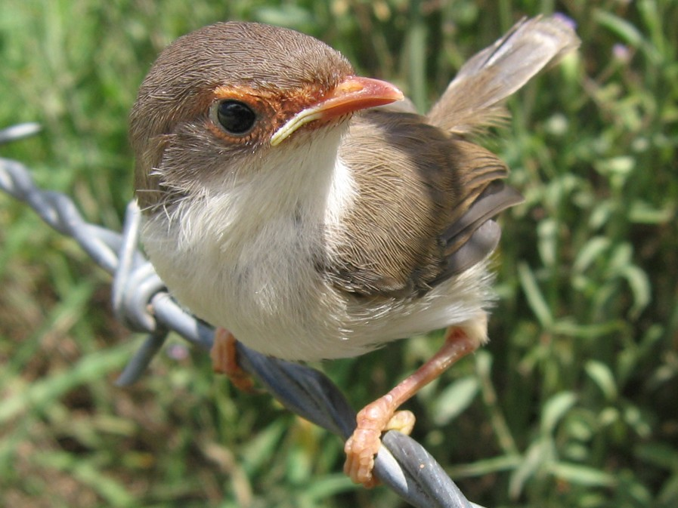
Forms of Greenwashing
#s 18–19
de Freitas Netto et al. 2020: https://doi.org/10.1186/s12302-020-0300-3
Fuzzy reporting: taking advantage of sustainability reports and their one-way communication channel, to twist the truth or project a positive image in terms of corporate practices (10).
Executional Greenwashing: Using elements such as naturalistic colors and sounds. Website backgrounds that represent natural landscapes or pictures of endangered animal species or renewable sources of energy are using executional greenwashing (10).
This Superb Fairy Wren did not
agree to help corporations sell
their products.

Slide 8
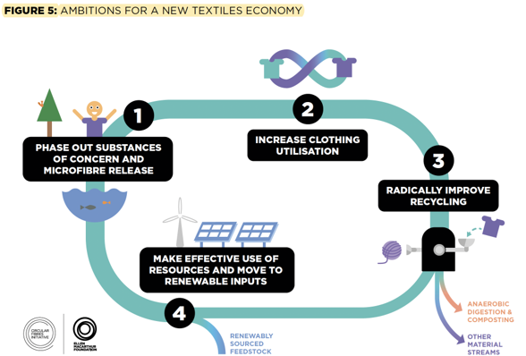
A New Textiles Economy:
Redesigning Fashion’s Future
Ellen MacArthur Foundation 2017:
https://www.ellenmacarthurfoundation.org/a-new-textiles-economy
Researchers have identified four initiatives for achieving greater sustainability in the garment industry:
Reduce and phase out toxics and plastic microfibers
Use garments more often
Design around recyclability
Convert production and retailing to renewable materials and energy.
Notes:
Notes for Instructor: Ask learners: What are some fundamental structural barriers to easy adoption of a circular economy?
For example: Growth economics, cheap petroleum-sourced raw materials, and poor labor practices all support unsustainable fast fashion practices. What are some policy and regulatory initiatives that could spur change toward circularity?

Slide 9
A New Textiles Economy:
Area of Action – Creating an Evidence Base for Planning
Areas of Action:
Create a Robust Evidence Base for Planning Industry-Wide Action (p.30–31) :
      Investigate consumer motives for buying and disposing clothing.
      Research the optimal balance of collection and recycling before disposal.
      Coordinate various stakeholder needs to create industry-wide change.
      Research economic, ecological, and social impacts of released microfibers.
      Seek ways to create cross-sector material flows to serve different industries.

Slide 10
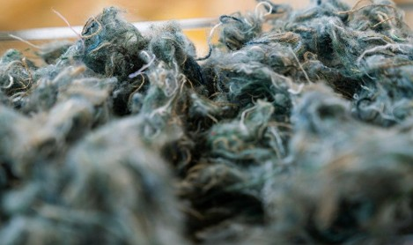
A New Textiles Economy:
Area of Action – Innovation
Innovation (p.31) :
      Create and finance a common vision for the textile industry’s best practices.
      Support and reward innovation moonshots that would revolutionize production.
Textile fiber made from recycled clothing and linens, ready for processing into insulation and absorbents.
Photo by Tony Webster via Wikimedia Commons, 2.0.

Slide 11
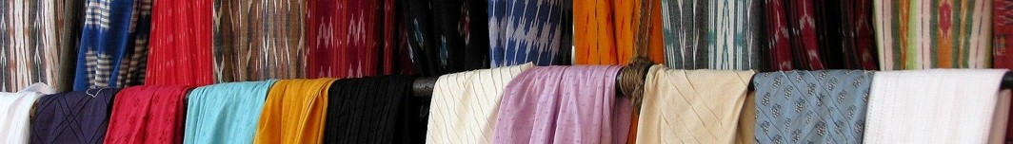
A New Textiles Economy:
Area of Action – Policy
Policy (p. 32) :
      Create policies that set systematic direction and show company commitment.
      Analyze regulatory frameworks to remove unintended barriers and set achievable targets with policy incentives.
      Increase government-led public procurement and support infrastructure investments required to implement circular business models for textiles.
Colorful textiles at a market in Chennai, India.
Photo by McKay Savage via Wikimedia Commons, 2.0.

Slide 12

A New Textiles Economy:
Area of Action – Transparency, Marketing & Adoption of Strategies
4. Transparency, Marketing, and Internal Adoption of Circular Strategies (p. 33) :
      Provide clear information on production methods, product content, and reuse and recycling options; the Higg Index is referenced but note that it has come under scrutiny for greenwashing itself.
    Develop honest and enticing marketing methods to attract consumers to closed loop and sustainable products—with no greenwashing.
    Promote corporate decision-makers who appreciate the values of the circular textiles economy and deeply understand its incentives and advantages.
Cropped photo of Perito Moreno Glacier by Murray Foubister via Wikimedia Commons, 2.0.
Notes:
Notes for Instructor: See the first bullet under the optional extension of the lesson if you would like to expand on the Higg Index as well as its critiques.

