Slide 1
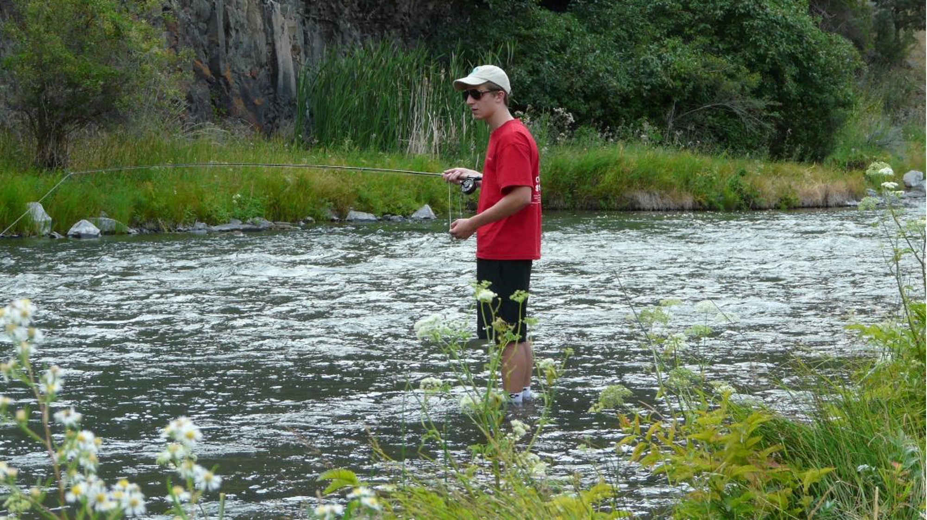

Ecosystem Services Part 1: Defining and Valuing Nature
Notes:
Notes for Instructor: On the following slides, query learners using the questions in blue.

Slide 2

What Is Value?
Question 1.
How can you describe the value you place on something?
How would you compare something you value to something different that another person values (e.g., soil health vs. swimming in a clean lake)?
Would that value change if you lived in a different part of the world or had less money?
Notes:
Notes for Instructor: The last part of this question is getting at the fact that ecosystem services are place-based and contextual and that some of them are personal (i.e., if you have less money, obtaining water that has a cost becomes more valued).

Slide 3

What Are Ecosystem Services (ES)?
Ecosystem services are the benefits that humans receive from nature, sometimes called natural capital.
Examples include clean air and water; flood control; arboreal shade and cooling; pollination from birds and insects; raw materials and wild food; and fertile soil for farming.
In theory, these ES can be valued using standard methods developed by economists that can be in monetary or indirect non-monetary terms.

Slide 4

Value from an ES Perspective
Value is what something that’s associated with nature is worth to people.
What an ES costs and the value or benefits it delivers are not necessarily equal.
Nature’s values need not be revealed in markets.
The value of foregone activities (“opportunity cost”) must be considered.

Slide 5
How Ecologists Have Categorized ES
Question 2. Which of the following are not ecosystem services?
Supportive Services
Nutrient Cycling
Net Primary Production
Pollination and Seed Dispersal
Habitat
Hydrological Cycle
Regulating Services
Climate Regulation
Hazard Protection
Disturbance Regulation
Water Regulation
Soil Retention
Waste Regulation
Nutrient Regulation
Provisioning Services
Water Supply
Food
Raw Materials
Genetic Resources
Medicinal Resources
Ornamental Resources
Cultural Services
Recreation
Aesthetics
Science and Education
Spiritual and Historic
Notes:
Notes for Instructor: This is a bit of a trick question; however, the point is that learners need to understand that the entity must be of value to people. For most of the provisioning services in the table (water supply, food, medicinal resources, ornamental resources) people will tell you they value them either monetarily or non-monetarily. Most of the others are biophysical/ecological attributes or processes that help in the provisioning of ecosystem services, but they are not services because people will rarely express that they value them. Indeed, people don’t even understand what many of them mean. (Exception: scientifically educated people may).

Slide 6
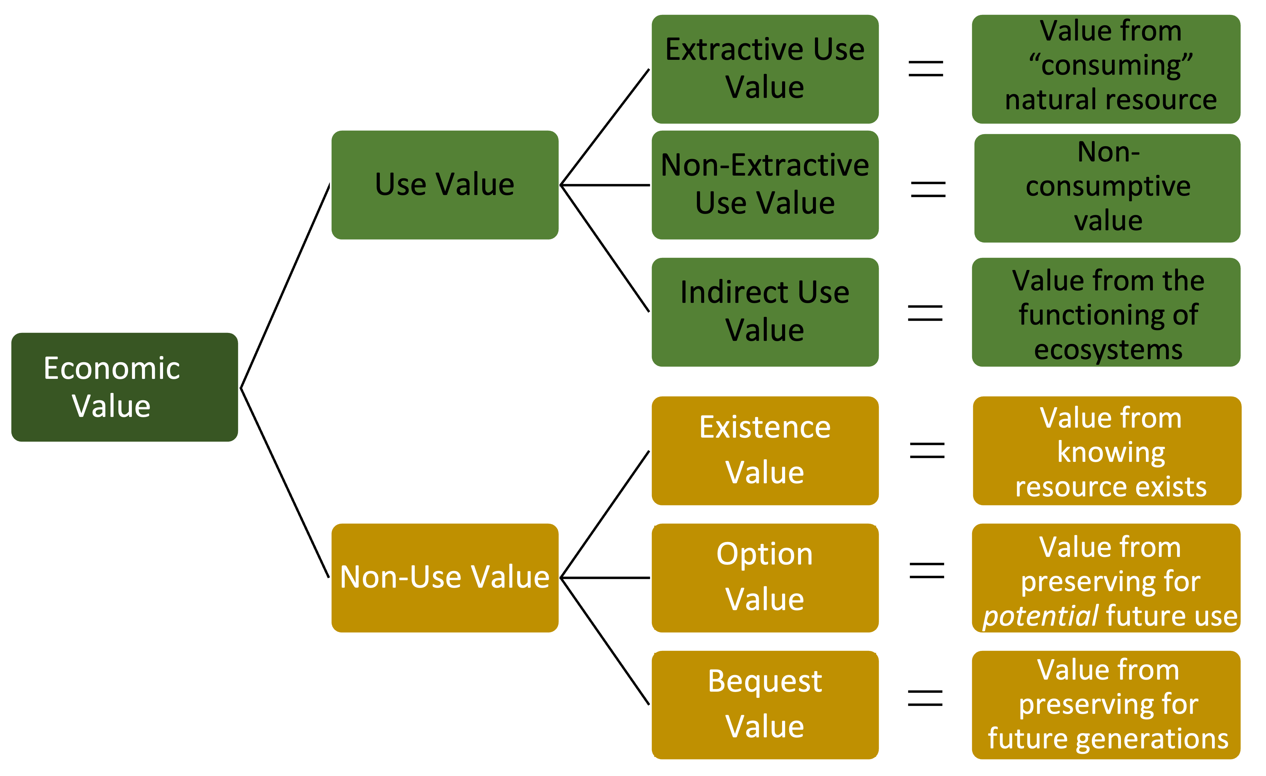
Types of ES Value
Question 3. Can you list natural resource examples related for each of the six types of values?
Note: This is only one way to categorize types of ES value.
Notes:
Notes for Instructor: Non-use values are sometimes called passive-use values. Ask learners to provide examples for each of these. Here are some:
Extractive use value: e.g., coal, water, timber
Non-extractive use value: e.g., seascape views, land
Indirect use value: Value of ecosystems and biophysical processes necessary for an ecosystem service; e.g., wind for energy production; nutrient processing for healthy soil; forage food (plankton, etc.) of fisheries
Existence value: The value of knowing something exists—usually expressed as a sense of well-being; e.g., a mountain, knowing marine life is diverse
Option value: Value of preserving a natural resource in case you wish to use it (key here is potential use by the individual valuing it; the value of having an option) e.g., parks, substitutable species
Bequest value: The value of knowing biodiversity will be available to future generations (key here: is future use by others)

Slide 7
Types of ES Value (continued)
This Lesson 1 will
focus primarily on
Use Valuation like
market &
non-market
valuation.
Lesson 3 will
delve into
Non-Use Valuation
like intrinsic and cultural value.

Slide 8
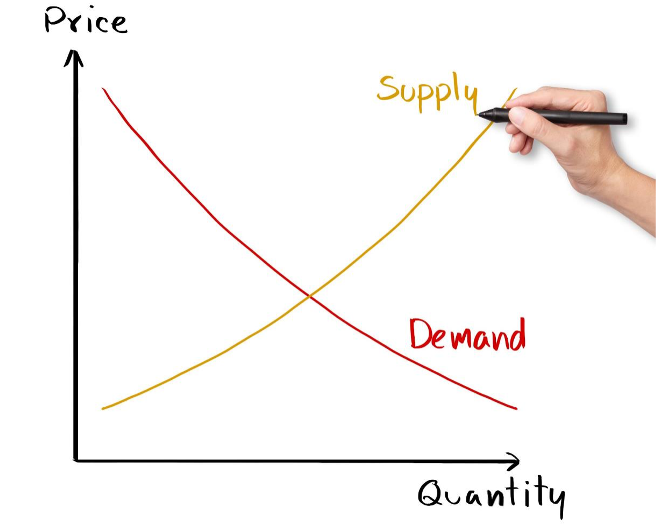
Supply and Demand
Notes:
Notes for Instructor: This is a classic supply-demand curve. The price something garners on the market (i.e., what a person is willing to pay) is closely tied to the supply (i.e., how much people have).

Slide 9

Valuation Methods: Market-Based Price
Market-based price is:
A type of use value
Sold commercially so data are available in monetary units
Easiest for determining value and creating policies, but most ecosystem services do not have markets
Assumed to represent the social benefits
that an additional unit confers
Question 4. Why do you think the method is linked to getting more or having less? i.e., rather than a fixed amount of the service
8
Notes:
Notes for Instructor: Answer to question: How much people will pay is closely tied to what they already have. If they have plenty of “x”, they are unlikely to pay much for more, and they are also are more likely to accept a lower price if they sell a unit of what they have plenty of. See next slide for graph of supply vs. demand and price.

Slide 10
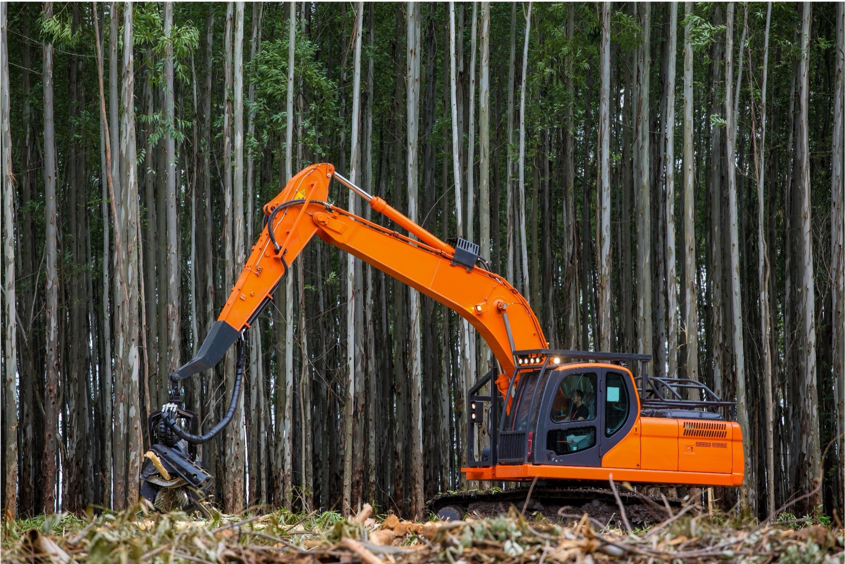
Valuation Methods: Market-Based Price (continued)
Market-based price is:
A type of use value
Sold commercially so data are available in monetary units
Easiest for determining value and creating policies, but most ecosystem services do
not have markets
Assumed to represent the social benefits
that an additional unit confers
Question 5. What is an example of something in nature that can be monetized based on markets (i.e., has commercial value)?
9
Notes:
Notes for Instructor: Answer to questions: Examples of market-based natural benefits include timber, commercial fisheries, or other entities in which prices are clear, such as the cost of salmon or the cost of a unit of water in countries that use water markets (Note: There are some emerging markets, including those for U.S. water out west. The carbon market has also been struggling to be successful because it still largely depends on someone covering the initial costs of what is sold on the market. It could work if regulations put a cap on carbon losses/CO₂ release and then trading could occur; currently, this is working for SO₂ emissions in the U.S.)

Slide 11
Valuation Methods: Market-Based Cost Avoidance
Market-based cost avoidance is:
A type of indirect use value
Nature provides the service, but it could be replaced through commercial markets
Could refer to the value of preserving nature to avoid future costs
Question 6. What is an example of something that could be valued based on what it would cost to get it if nature did not provide it?
Notes:
Notes for Instructor: Answer to question: Cooling services of forest and trees—the cost of extra air conditioning; flood protection with seawalls if wetlands were not on the coastline; clean drinking water—filtration structures. Note this depends on having markets for whatever is used to replace the lost ecosystem process or structure.

Slide 12
Assigning Valuation Methods
Question 7. How might you go about assigning value to each of the six types of ecosystem services? (i.e., what method would you use?)
Notes:
Notes for Instructor: Have the learners first take a stab at how they might do this. Perhaps break up learners into groups. The next slide identifies the economic method and after that goes into a bit more detail.

Slide 13
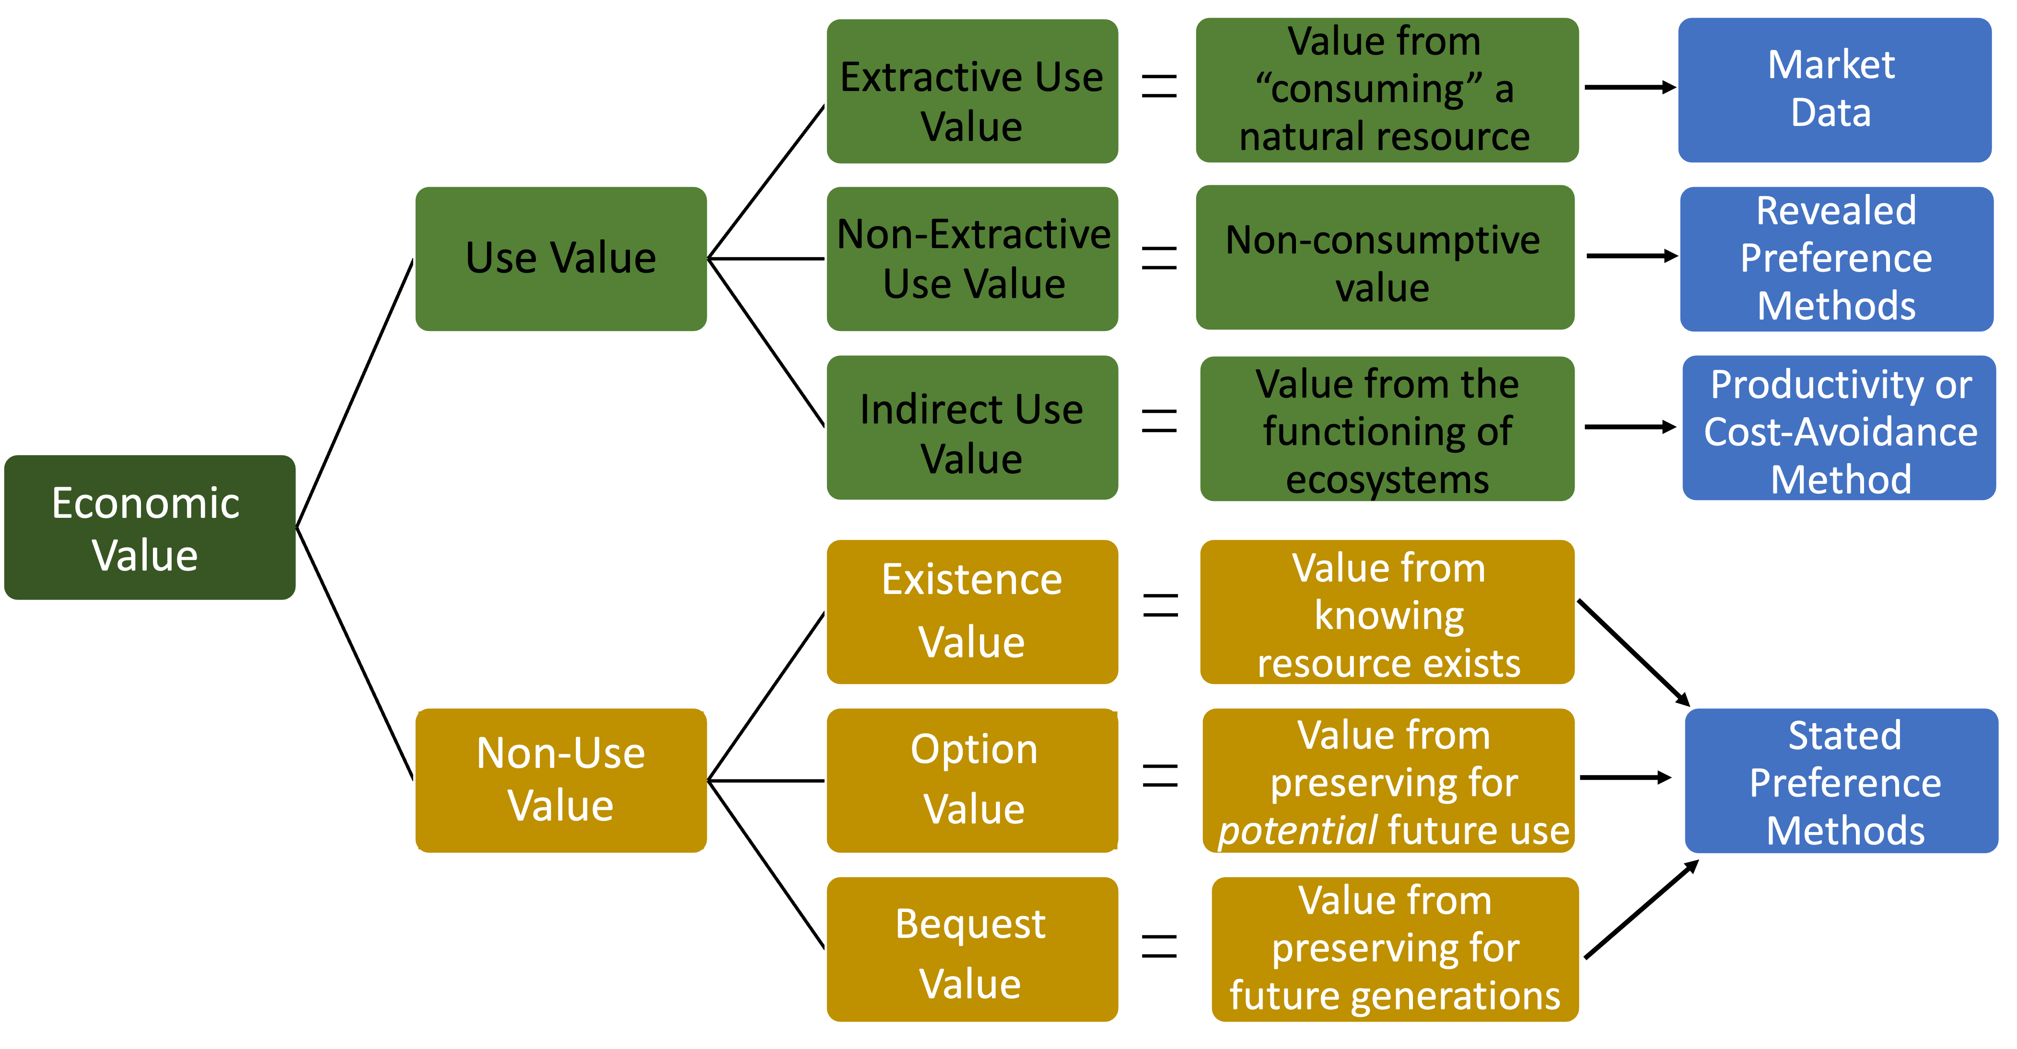
Valuation Method for Each Type of ES Value
Notes:
Notes for Instructor: Be sure learners note that market data are the easiest to value (i.e., cost per extra unit exists in $). The other methods all require different ways to evaluate value and what is found may or may not be expressed in currencies ($).

Slide 14
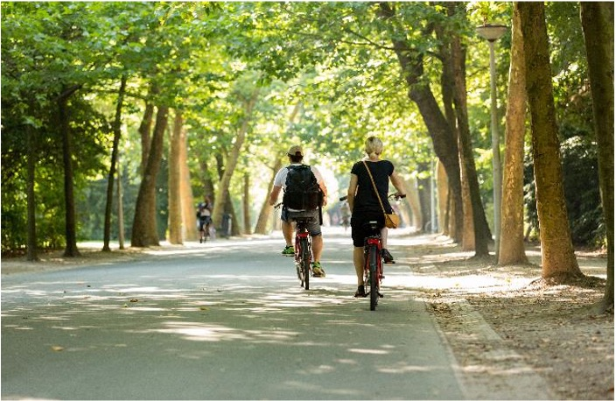

Valuation Methods: Non-Market
They are not estimated based on market prices (i.e., not commercial).
They can observe choices, but not prices.
Most ecosystem services must be valued using non-monetary economic methods.
They require that a link be established between changes in the quantity or quality of the resource and changes in the stated or observed behavior of people.
  E.g., changes in air quality may result in people moving to another area.
Notes:
Notes for Instructor: Make sure the learners understand that “economists” are trained in mathematics and statistical methods to help identify how people value things…so economics does not just mean money and markets.

Slide 15
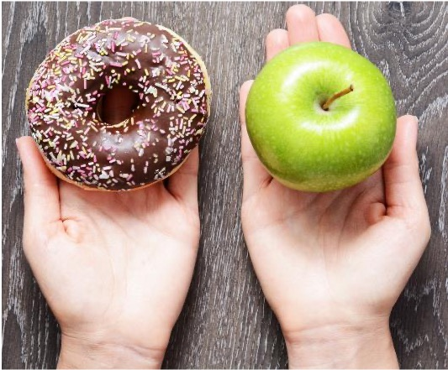
Valuation Methods: Non-Market (continued)
Methods involve discovering preferences:
        revealed preferences – based on choices/decisions people make
        stated preferences – based on what people say their preferences are
Once preferences are determined, they can sometimes be monetized.
(e.g., by stating their willingness to pay for something)
Question 8. How might you implement these two methods to determine the value of a natural resource or natural process?
Notes:
Notes for Instructor: The next few slides provide the answers but for you, but for now: revealed preferences are when economists look at markets to see what people pay or what people actually do, not what they say; stated preferences are what people say when given choices (in writing, with images, scenarios) and are asked to state their preferences or indicate how much more they would pay for one over another.

Slide 16
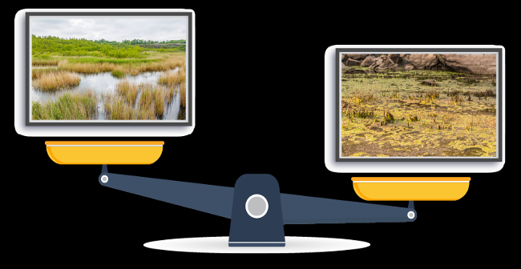
Stated Preference Method Example
Question 9. If you are shown the below two images on computer screens, which one do you prefer? By how much (more)? Why?

Slide 17
Stated Preference Method Example (continued)
Question 10. What factors other than what appears to be the health of the wetland on the left might apply to your preferences?
Hint: Think about the multi-dimensional nature of ecosystem services.
Notes:
Notes for Instructor: The goal of this question is for learners to recognize that many factors influence the extent to which an ecosystem service is valued. So, the left wetland may be more aesthetically pleasing, but perhaps the wetland on the right might store more water and protect areas from storms. Or perhaps the one on the right is closer to population centers, and so the opportunity to visit it for birdwatching is greater.

Slide 18
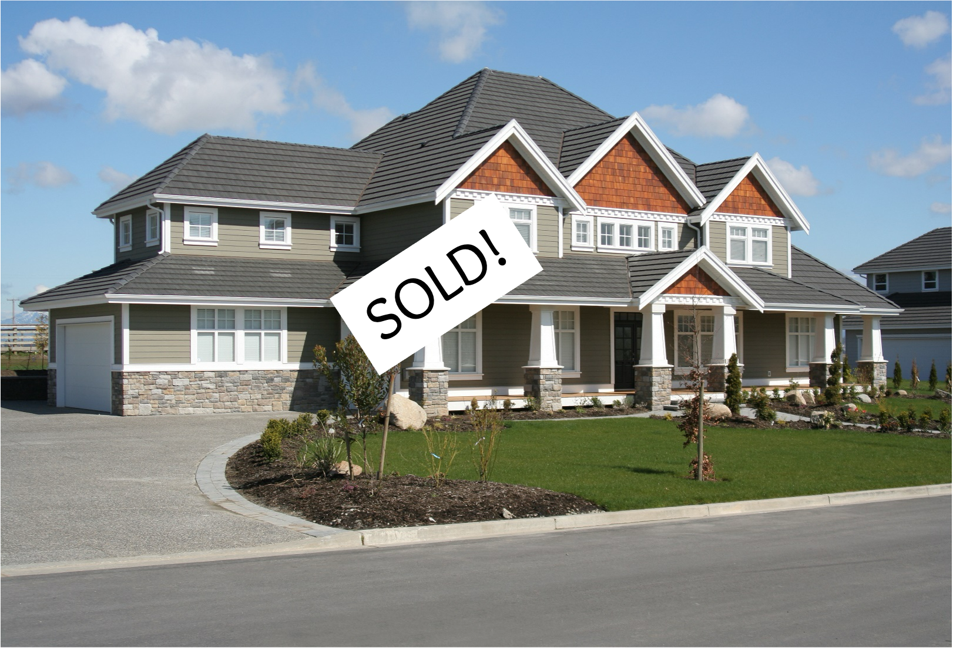
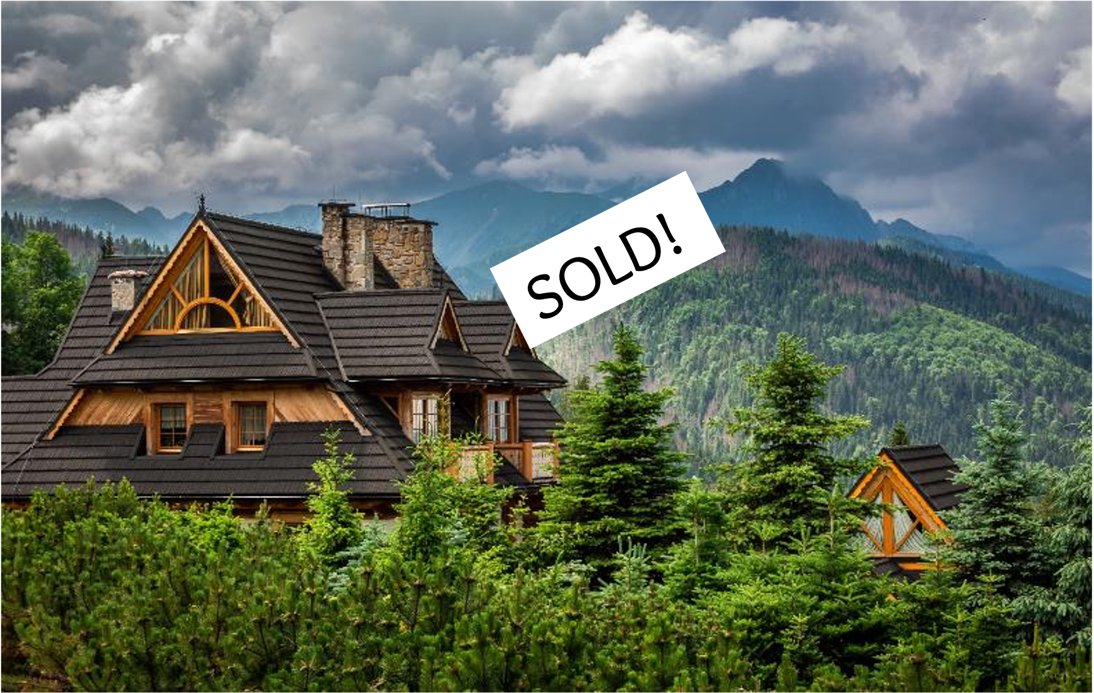
Revealed Preference Method Example
Question 11. How might these two properties differ in terms of how much they sold for? What do you think the ecosystem service is in this example?
Question 12. What are some other examples in which preferences can be revealed that cannot be easily linked to a $ number?
Notes:
Notes for Instructor:
11. The house on the right is likely to be MUCH more expensive. The difference is the view, location, and ability to go to beautiful forest. It is difficult to place a $ on this unless you look at markets and see what people actually paid for the two homes (i.e., revealing their preferences).
12. Other examples: the influence of soil properties on agricultural land or how travel costs may be used as a proxy for recreational value of an entity.

Slide 19

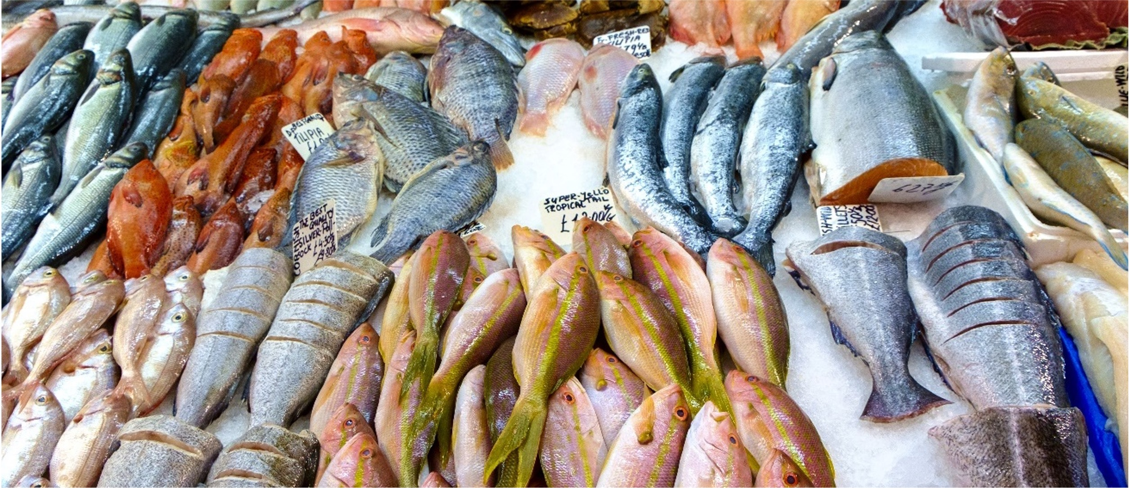

Why Is Valuation of ES Useful?
Question 13. What are several reasons that valuation of ecosystem services is useful?
Notes:
Notes for Instructor: Ask learners to come up with at least three reasons. The next slide provides some answers that have been written about extensively.

Slide 20
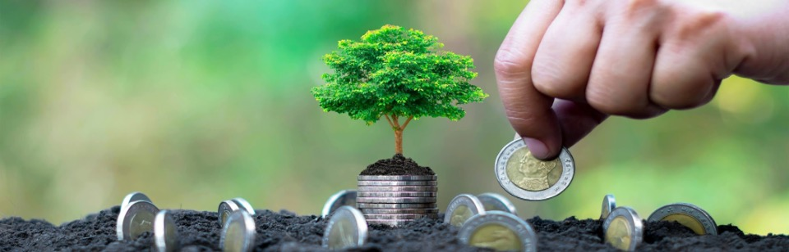
Why Is Valuation of ES Useful? (continued)
Provides a common unit of measure
Uses of natural resources create a range of impacts, usually not in comparable units (generated revenues, changes in fish stocks, loss of tourists, water quality changes, reef degradation).
Facilitates decision making
Benefit-Cost Analysis (BCA) is a systematic
enumeration of the gains (benefits) and losses
(costs) of particular decisions in common units, for comparison purposes.
Serves as a good public communication tool
Uses of natural resources create a range of impacts, usually not in comparable units (generated revenues, changes in fish stocks, loss of tourists, water quality changes, reef degradation).
Notes:
Notes for Instructor: Point out to learners that objective decision making is fostered when all potential impacts are expressed in the same units.

