Slide 1

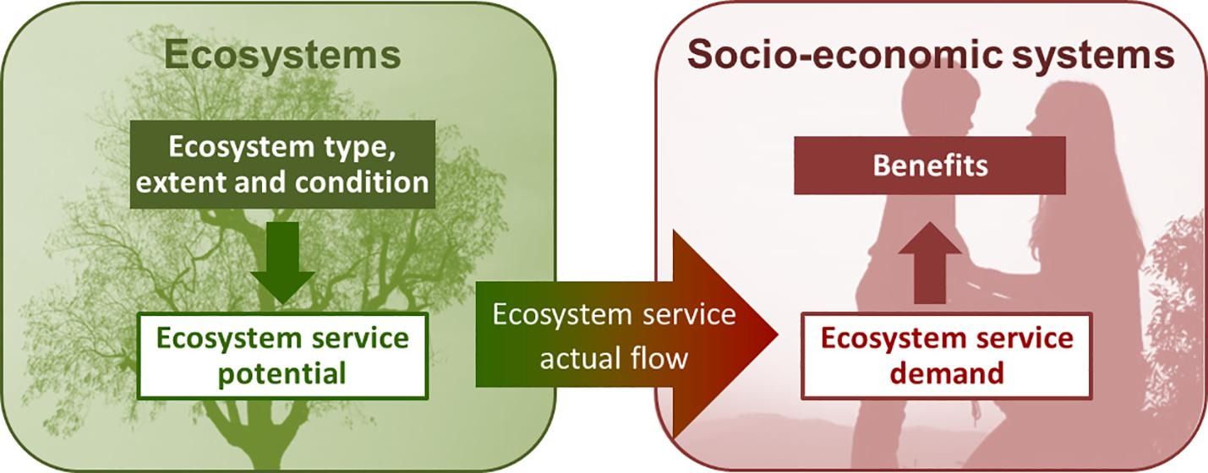
The Spatial Nature of
Ecosystem Services
Image credit: Vallecillo et al. 2019 https://doi.org/10.1016/j.ecoser.2019.101044
Notes:
Notes for Instructor: The slides have animations so that you can bring up the parts separately. This PPT starts with two background (definition) slides then provides two specific examples from a research paper; each example includes a map in its first slide and questions to prompt discussion in the next slide. You may wish to distribute the slide with the map for participants to look at while pondering the questions.

Slide 2

Background: Ecosystem Service (ES) Flows
Ecosystems that supply benefits (e.g., rivers as water sources)
may be distant from where their benefits are received or desired (i.e., ES supply and demand often do not overlap spatially)
Ecosystem service flows:
  The spatial and temporal connections between a service providing area and a service benefitting area
  May be mediated by nature (wind, organismal dispersal) or by the actions of actors*
*actors = people, institutions, governments, communities, etc.
Notes:
Notes for Instructor: You may wish to prompt this slide by first asking participants what is meant by supply and demand of ES.

Slide 3
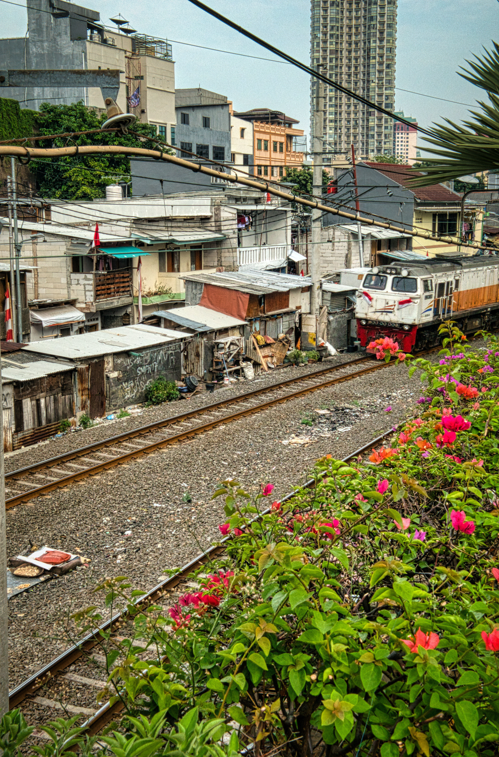
Background: Spatial Resilience
A subset of resilience theory
Integrates concepts from landscape/spatial ecology, ecosystem services, and sustainability
Recognizes that:
These are all spatially distributed: ecological entities & processes; people, communities, & institutions; and social resources
The equitable flow of ecosystem services requires ecological and social connectivity
Space can generate or alleviate vulnerability depending on connectivity
Notes:
Notes for Instructor: Before bringing in the text (animation 1) that lists the three important facts that spatial resilience integrates, try probing the participants for what they think spatial resilience is based on.

Slide 4
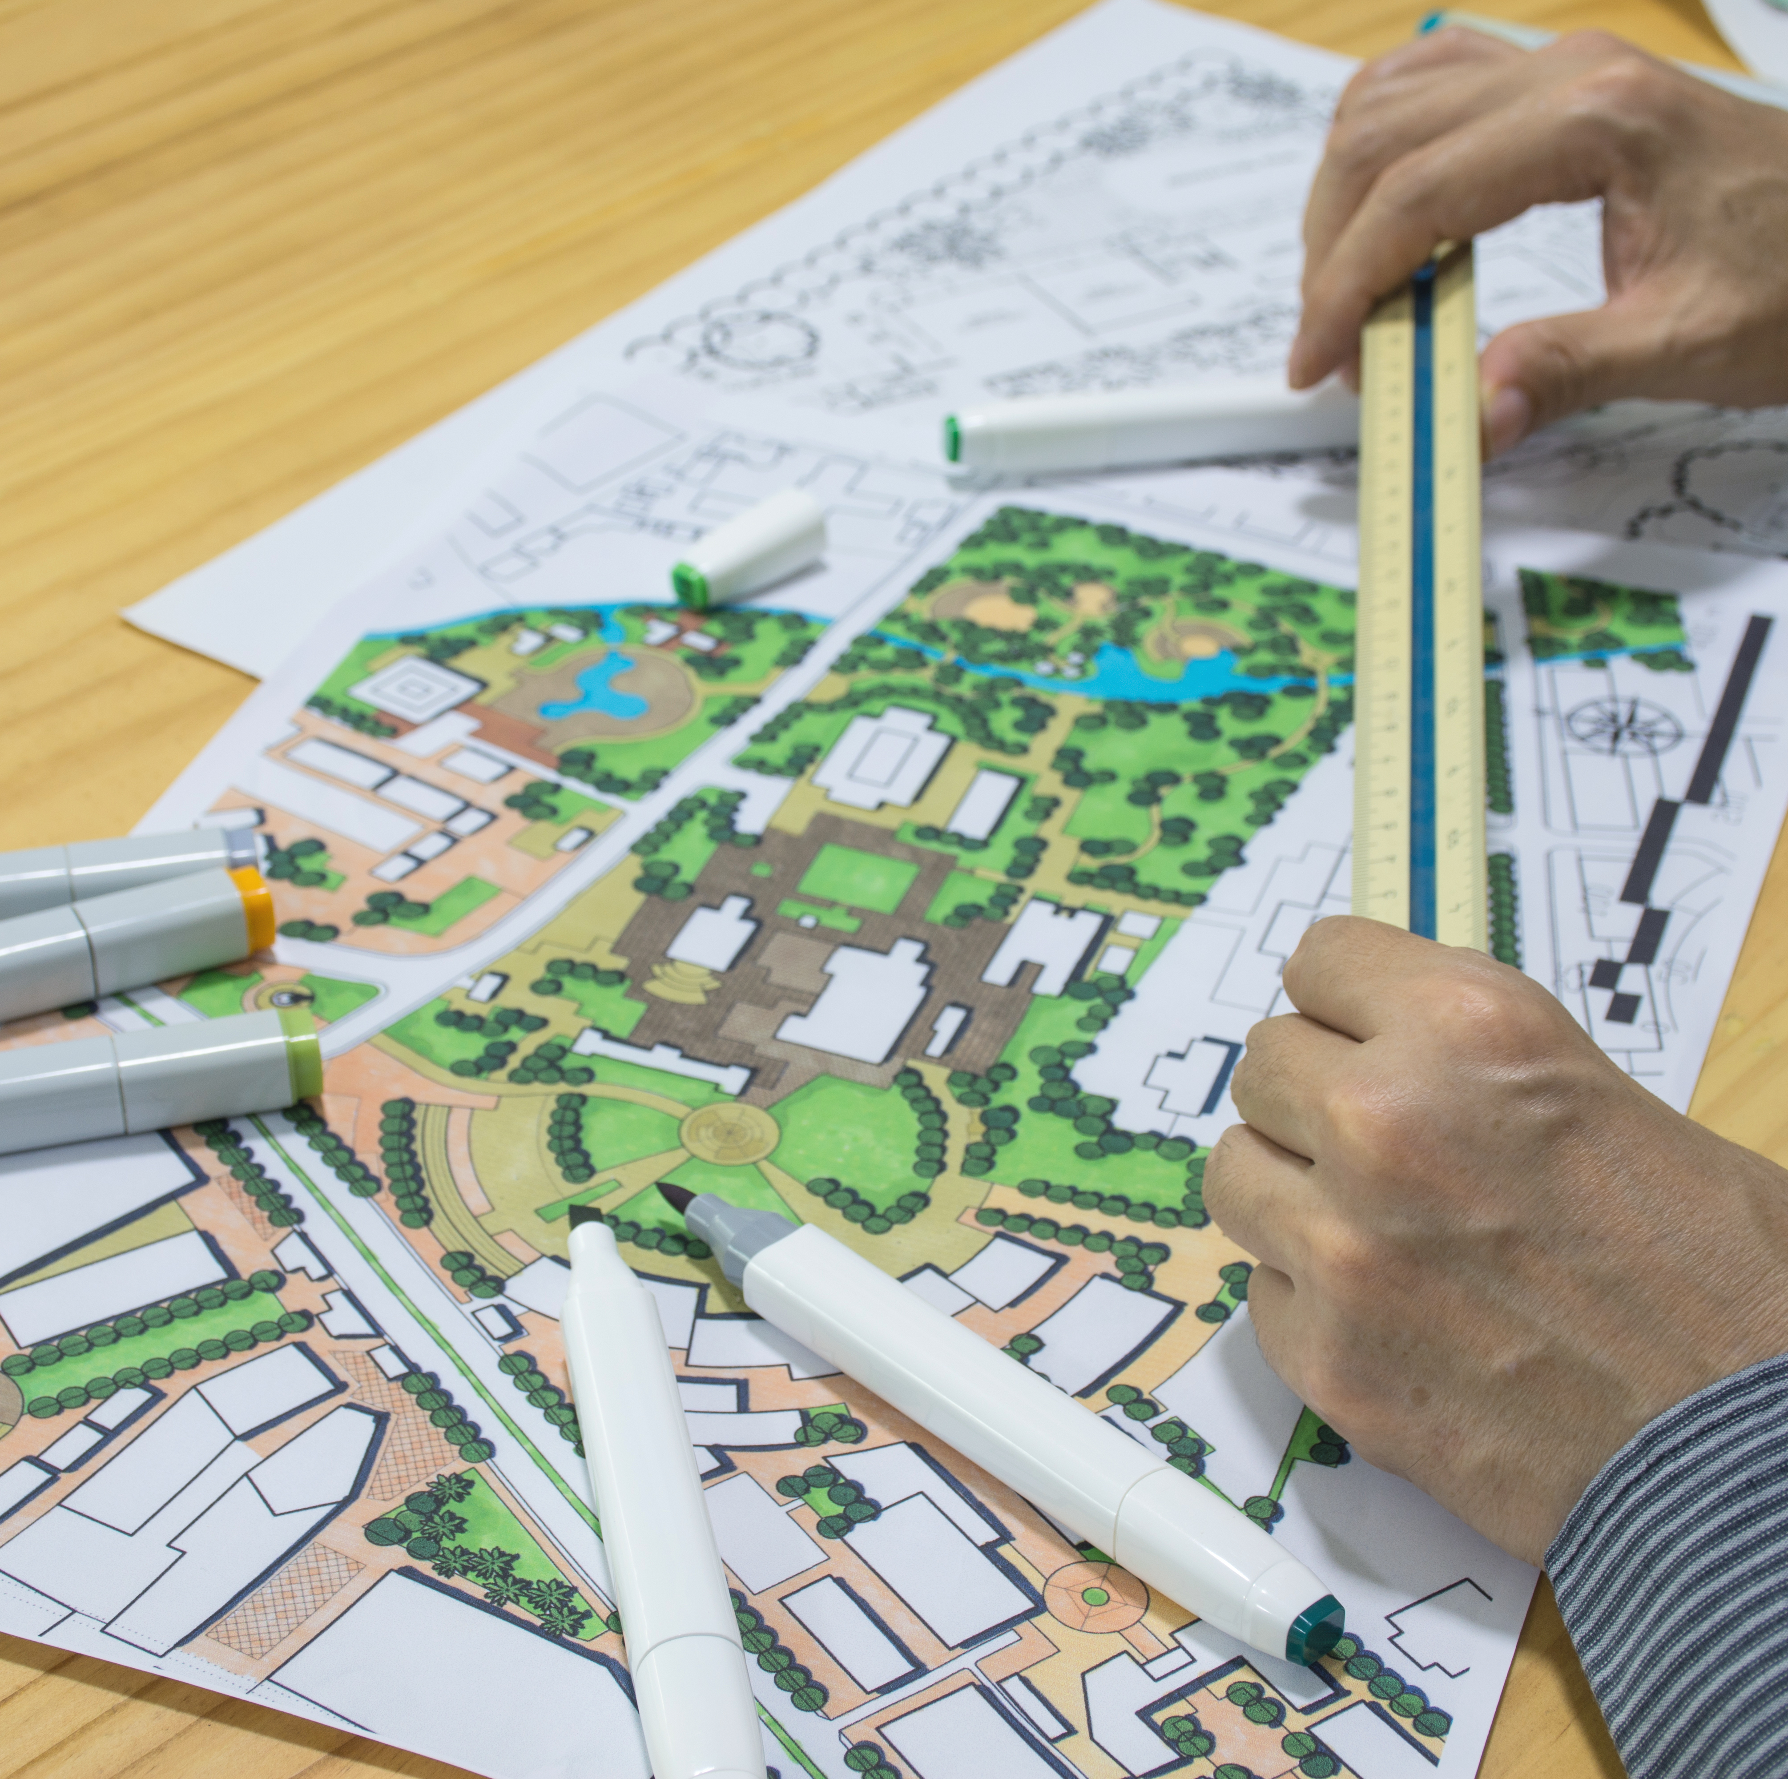
Background: Spatial
Resilience (continued)
A spatially resilient socio-ecological system can:
Resist, adapt, or recover from a pressure or disturbance if there is some flexibility in spatial plans, policies, and practices that influence connectivity.
Notes:
Notes for Instructor: For this slide, first ask the students to complete the sentence “spatially resilient S-E system can/is…”

Slide 5
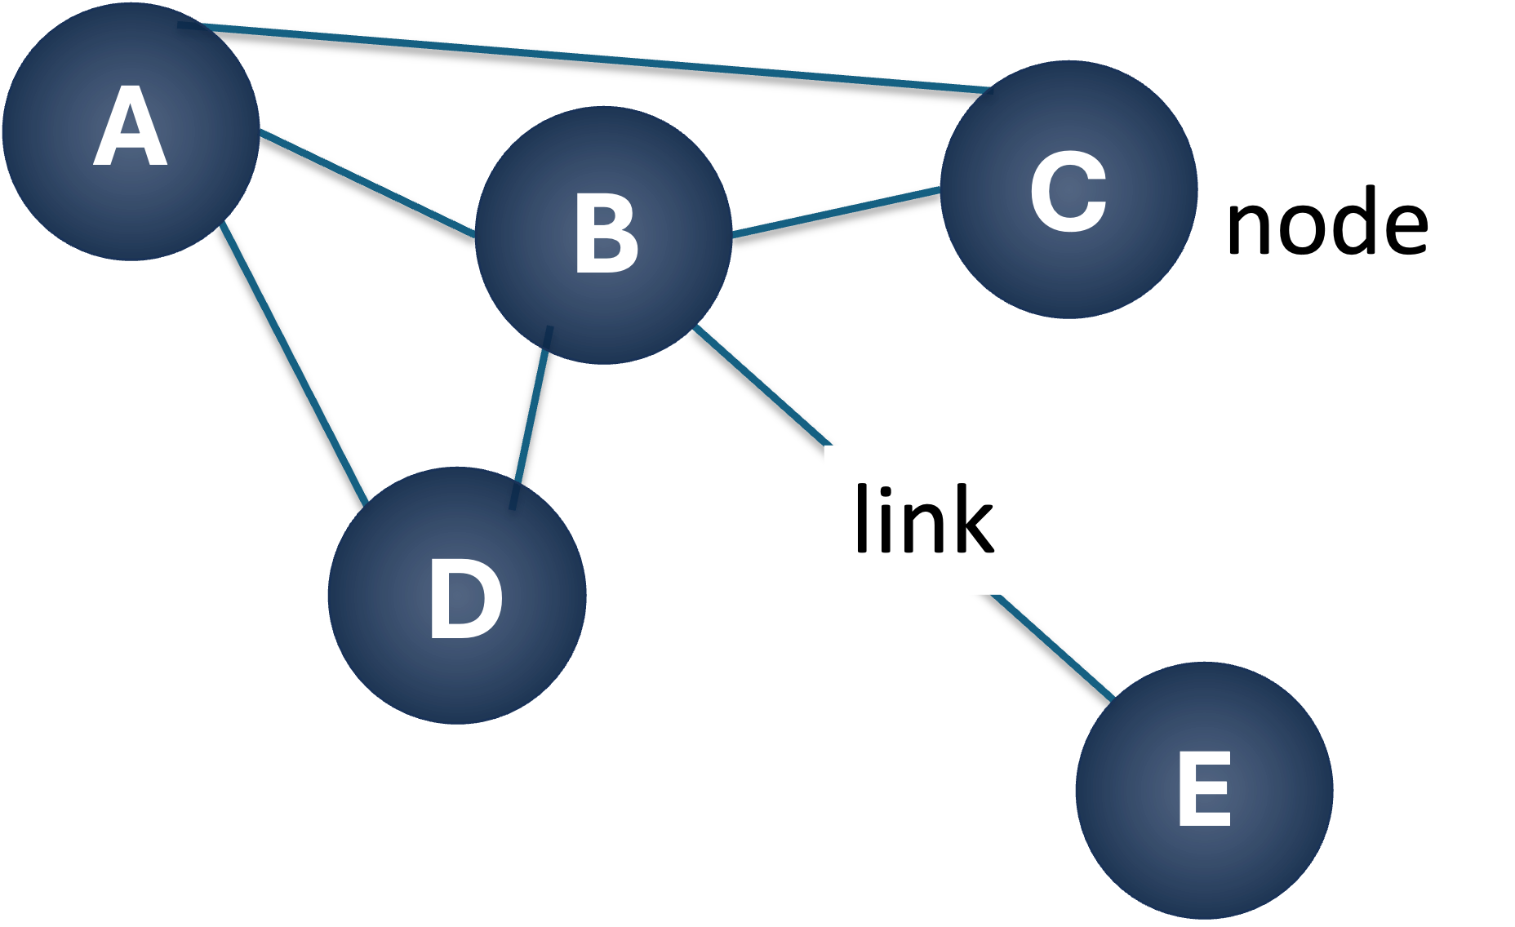
Background: Networks
May be social, ecological, or socio-ecological
Are represented in diagrams with nodes that vary in their connectivity (nodes may be agents, resources, or other features)
These diagrams are used to describe many characteristics of networks that can be quantified with a variety of metrics
In this network, node B is very important because it is connected to all others; E has very little influence (connectivity) on others because it is only linked to one other node and the connection is weak as indicated by the length of the linking line.
Notes:
Notes for Instructor: The concept of networks is relevant to the papers discussed in the lesson. Ask participants what they can say about the 5-node diagram just by looking at the image. Then bring in the 1st animation which is some explanation in the box. You may want to mention a few of the simpler metrics like those that describe the importance of a node in different ways:
Degree centrality – Indicates the number of relationships an individual or species has
Closeness centrality – Indicates importance based on position in the network, e.g., how many nodes “away” from other nodes it is on average; the node with the shortest average distance (# of links between it and each node) can indicate that information can move from this node throughout the network quickly so perhaps they are more influential even if they have fewer relationships

Slide 6
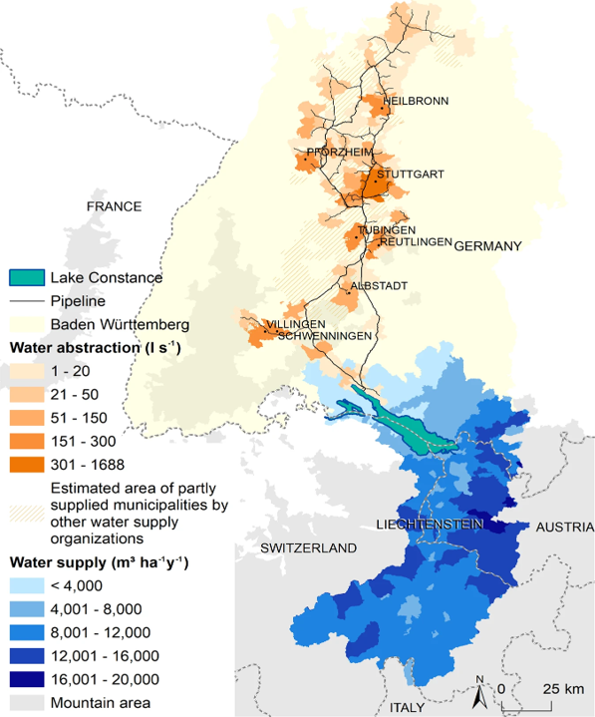
Example 1:
Water from the Alps to Lowlands and Beyond
Image from: Schirpke et al. 2019: https://doi.org/10.1038/s41598-019-43229-z
Notes:
Notes for Instructor: For explaining this map: Blue = supply of water. Orange = use in lowland. Black lines are connecting pipelines. This image is from work by Uta Schirpke, Ulrike Tappeiner and Erich Tasser—researchers in Austria and Italy. It illustrates where water ecosystem services are produced—largely in the mountainous Alps, with flows to Lake Constance where it is stored and used. Beneficiaries are mostly in the adjacent lowlands where water is moved via pipelines, especially to cities. Ecosystem services produced in the Alps are also enjoyed by tourists from all over the world who visit the Alps. Make sure the learners note that the darkness of the colors indicates the level of service (i.e., the flow).

Slide 7
Example 1: Water from the Alps to
Lowlands and Beyond, Continued
Social actors and processes facilitating connectivity:
Water utilities or other entities building pipelines
Institutions governing water utilities and making decisions on where to create pipelines
Flow of funds to cover costs of pipeline (where does it come from? does $ source determine locations of pipelines?)
People traveling to the Alps
Tourism industry
What/who else?
Notes:
Notes for Instructor: Be sure participants understand that both the actions of actors and social processes (e.g., flow of $, who knows who, etc.) affect connectivity. Also, have them speculate on:
How these actors and social processes may determine who gets water access
How these actors and flows may be connected as part of a network

Slide 8
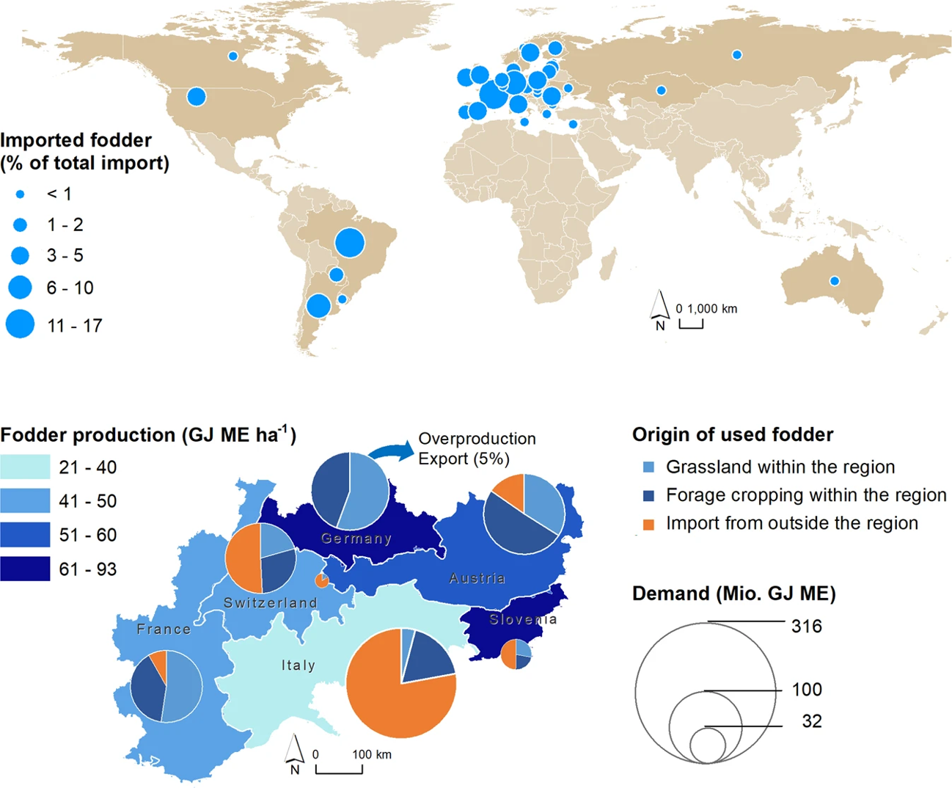
Example 2: Pasture Fodder to the Alps
Schirpke et al. 2019: https://doi.org/10.1038/s41598-019-43229-z
Notes:
Notes for Instructor: This figure is from the same paper by Schirpke et al. It illustrates a different ecosystem service: fodder for livestock on pastureland in the Alps. In this case, the flow of fodder comes from multiple countries in Europe and even from Australia, the U.S., South America and beyond.
Pay attention to the size of the circles in top image and the colors in the bottom image.

Slide 9
Example 2: Pasture Fodder to the Alps, Continued
Social actors and processes facilitating connectivity
Agricultural producers/industry
Transport industry & associated supply chain
Movement of materials through water or on land
Government regulation of importing/exporting
Port authorities
Owners of pasture lands
Who/what else?
Notes:
Notes for Instructor: Ask participants which of those listed in this slide is an example of a social process that relies partially on biophysical connectivity (answer: the movement of materials during transport can be impeded by impassable mountain terrain or facilitated by connecting water bodies if moved via ships)
Again, have them speculate on:
How these actors and social processes may determine who gets access to the fodder
How these actors and flows may be connected as part of a network

Slide 10
Socio-Ecological Networks & Spatial Resilience
To what extent does the spatial network of ecosystem services (water or fodder) overlap with the spatial network of beneficiaries?
How might one evaluate the spatial resilience of these networks from an ecological and a social perspective?
Notes:
Notes for Instructor: Consider distributing hard copies of the images in slides 4 and 6 and pose these questions. Ask participant to draw network diagrams of the services and beneficiaries then discuss where and why there may be fragilities in this system from a resilience perspective.

