Slide 1

Ecosystem Services – Part 3:
Ecosystem Services vs. Intrinsic Value

Slide 2
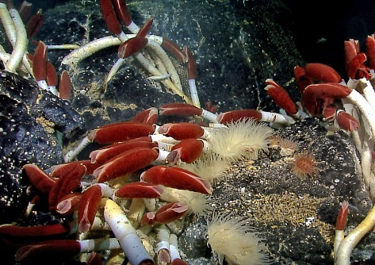
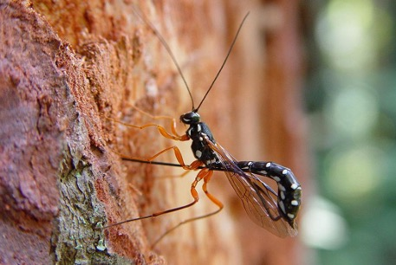
Do These Have Intrinsic Value?
Notes:
Notes for Instructor: Be sure to ask learners to consider what assumptions they believe are influencing their response.

Slide 3
Values – How
Do the Following
Differ?
Instrumental Value
Intrinsic Value
Subjective
Objective
Define each and provide some potential examples.
Relational Value
Notes:
Notes for Instructor: Many people believe that in reality these three are not totally separable. They may represent a continuum, or the learners may feel that some of them are not really separable. For example, some ethicists and scholars believe the relational values are no different from instrumental in that the viewer “gets” something from the natural feature even it is not monetary.

Slide 4
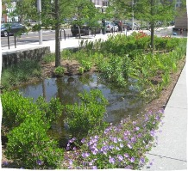
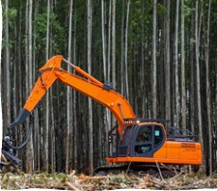
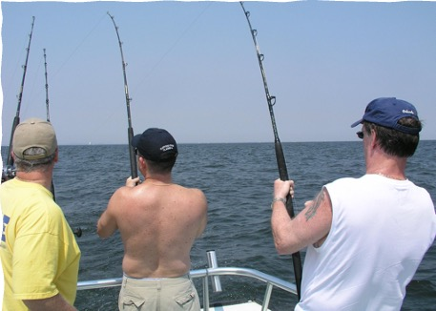
Instrumental Value
Is a derivative value
Has its value lie in what someone gets from it or what it does
Is substitutable, replaceable, and compensable
Notes:
Notes for Instructor: The direct use of nature with obvious economic value includes fishing and timber extraction. The image at the top left of the created wetland is valued because of it stores water and minimizes flooding in urban areas. It is worth pointing out to the learners that this created wetland (i.e., human-constructed) is a substitution for a natural wetland, and its creation is also a source of income for many environmental consulting firms.

Slide 5
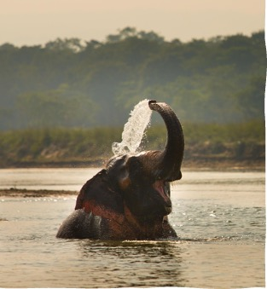
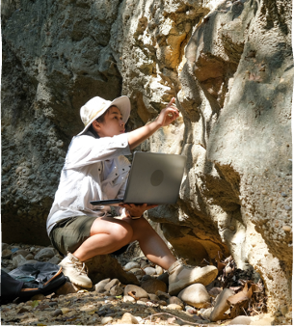
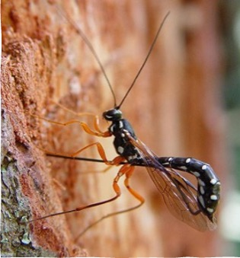
Subjective Intrinsic Value
Is a value for something on its own rather than what it “does”
Is created by people through their individual judgements & attitudes
Is reason-oriented
Notes:
Notes for Instructor: These images may not be construed by some to be reflective of subjective intrinsic. The elephant in water was selected as an example on the left because its value could depend on where people live. For example, for some people in Africa, elephants may be dangerous, while people on safaris may view them as having intrinsic value. In the center, the scientist studying the rock formation may view the rock as being intrinsically valuable, but she may be basing this value on her understanding of geologic history. Similarly, the parasitic wasp on the right may have intrinsic value to those who understand that it parasitizes crop and garden pests.

Slide 6
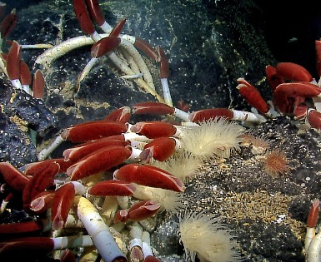
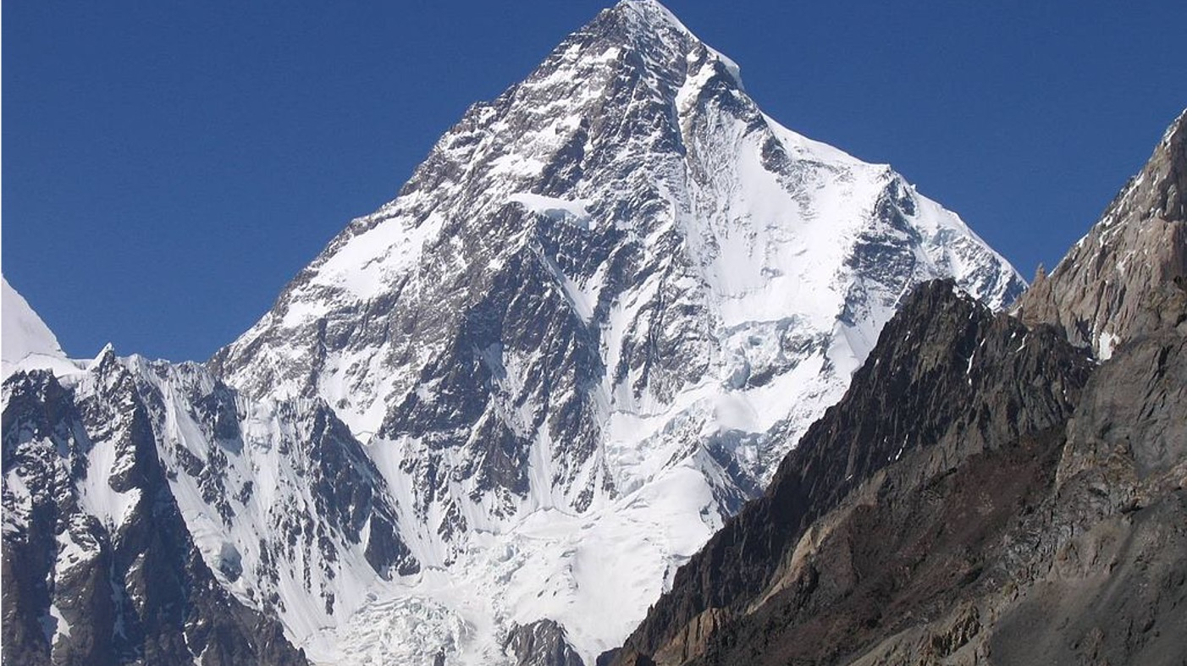
Objective
Intrinsic Value
Has inherent value independent of peoples’ judgements or views
Is not a created value
May even apply to nature’s rights
Notes:
Notes for Instructor: Many images could be used to illustrate intrinsic value. A few beautiful images were selected as examples, but for many people/cultures, nature need not convey beauty to be viewed as inherently valuable.

Slide 7
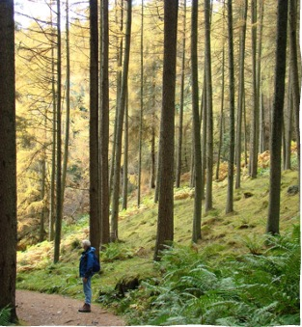
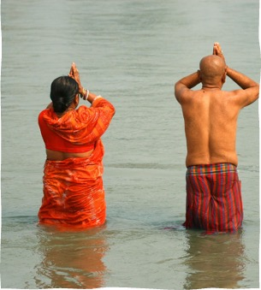
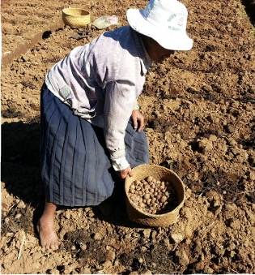
Relational Values
Are determined by a person’s interactions with and responsibility to nature
Are prominent across many cultures and times
Notes:
Notes for Instructor (Useful background): Buddhists believe it is critical to be mindful of nature, to live simply, and to respect the cycle and balance of nature so that everything can continue for future generations—to be positive forces in conservation. Farmers engage with nature and often reflect on the soils value to them or how they “know the soil.” People walking in nature may value it for spiritual or mental wellness.

