Slide 1

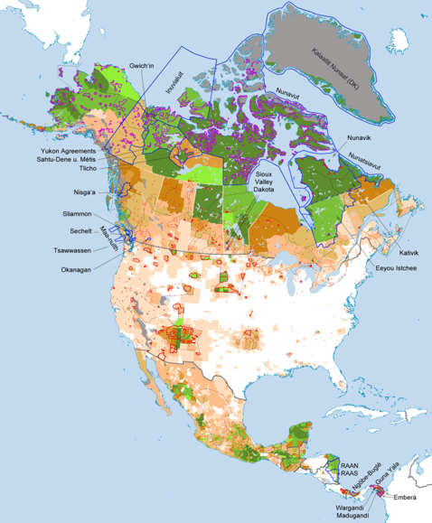
Co-Evolutions:
Indigenous Knowledge (IK) and Scientific Research
Map of the population density and territories of Indigenous peoples of North America at the beginning of the 21st century. Image by Fährtenleser, 4.0.
Notes:
Notes for Instructor: The deeper green areas on the map represent higher demographic populations of Indigenous peoples. For Western scientists working in the white zone (very little Indigenous citizenry), what could be some approaches to integrating and learning from IK pathways?

Slide 2

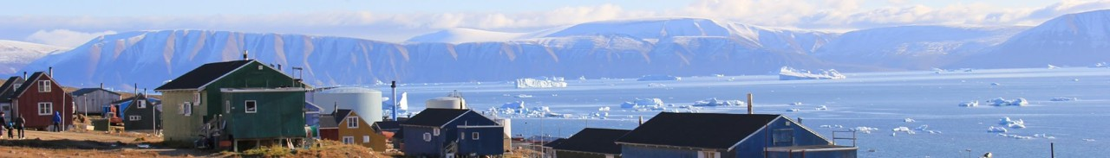
What Is Indigenous Knowledge (IK)?
A distinct and complex body of knowledge based on millennia of Indigenous land stewardship, holistic cultural values, close observation, and evolving contemporary perspectives.
An epistemology distinct from Western Science (WS) in that it emphasizes: inherent values rather than economic or utilitarian ones, whole systems perception rather than reductionism, and ethics based on sustainable human dwelling rather than extraction for profit or protection from humans (i.e., National Parks that exclude human habitation).
IK is owned by its knowledge-makers and must not be appropriated by Western science to achieve Western goals; instead, the practice of IK supports Indigenous values and governance.
Houses in Quaanaac, Greenland. Unaltered photo by Helene Brochmann via Wikimedia, 4.0.
Notes:
Notes for Instructor: It’s important to emphasize that WS, which originates from Euro-colonial cultures, should not reinscribe abusive histories of colonization, appropriation, and erasure that are inherent in the histories of Western-Indigenous contact. Therefore, this co-evolution is as much about designing research around IK values systems as it is about specific approaches to observation, data gathering, and interpretation. In IK, the “data” cannot be extracted from its context, it cannot be commodified, and it cannot be used to promote Western values of profit, privatization, and individualism.

Slide 3
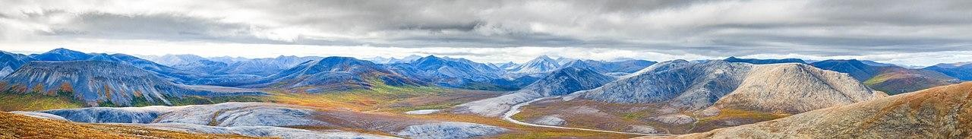
IK and WS in Relationship
Houde et al. 2022: https://doi.org/10.1016/j.scitotenv.2022.156566
IK is not a new “tool” in scientific epistemology. It is a sovereign and distinct approach to knowing that can be complementary to Western science and enhanced by modern technology.
Co-created knowledge that does not appropriate or colonize IK should:
Empower the Indigenous community to determine the reason to conduct research
Address a community-identified issue based on their needs, priorities, and interests
Involve the community at all stages: planning, implementing, monitoring, interpreting, communicating, governing, and decision-making.
Western Arctic National Parklands. Unaltered photo via Wikimedia, 2.0.
Notes:
Notes for Instructor: Learners may find it interesting to consider how these guidelines relate to conversations about “consent.” When WS desires access to Indigenous lands to conduct research, scientists must not only ask consent for their inquiry, but must co-design their research approach around Indigenous practices, priorities, and future benefit.

Slide 4
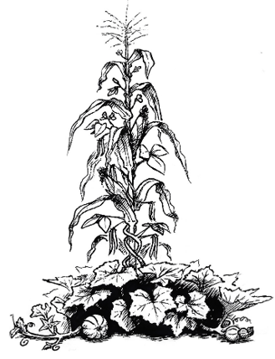
How Can Indigenous Knowledge and Science Co-Evolve? (Kimmerer)
Writer, Biologist, and Potawatomi tribal member Robin Wall Kimmerer uses the Three Sisters Garden* to describe IK and Science co-evolution:
Corn: Indigenous values, ethics, and procedures: the “physical and spiritual framework” for ethical inquiry
Beans: Western Science methods, tools, energy: a “double helix” of inquiry
Squash: “ethical habitat for coexistence and mutual flourishing”: respect, communication, and reciprocity (139)
(Kimmerer, R. W. (2015). Braiding Sweetgrass. Milkweed Editions.)
*The phrase “Three Sisters Garden” is the native legend of how the crops corn, beans, and squash came to be grown together in many native cultures.
Graphic by Garlan Miles, 4.0.
Notes:
Notes for Instructor: Learners may find this metaphor accessible and appealing. Consider analyzing it from multiple perspectives, while utilizing possible past knowledge. How do the plants benefit from one another’s physical and chemical properties? (Hint to instructor: the height of the corn both enables light penetration and protection from predators of the beans; the beans provide an anoxic environment for bacteria that fix nitrogen and enable its uptake to all three plants; and the squash provides protection from pests, as well as moisture retention for the soil.) How do the consumers of these plants benefit from eating them in tandem? (Hint to instructor: the complementary amino acid profiles of these plants create complete proteins.) How do these biophysical benefits to both plants and people contribute to the metaphor?

Slide 5
How Can Indigenous Knowledge and Science Co-Evolve? (Schott)
Schott et al. 2020: https://doi.org/10.1139/as-2019-0011
Schott et al. describe a framework based on the following guiding principles:
1. The delineation of common objectives that could change throughout the process.
The creation of a governance structure and steering committee for the research and learning process.
3. An acknowledgement that capacity building is important for both sides: IK, such as elder-youth knowledge transfer, as well as WS [Western Science].
4. The effective sharing and collective interpretation of knowledge and data analysis.
The mutual co-existence of both knowledge systems, with neither one dominating.
6. Beneficial outcomes that empower IK holders in the decision-making process and advance their prosperity.
7. The enhancement of collective learning, governance, and management practices including the implications of the research process and findings on Indigenous and non-Indigenous governance and relationship with the resource.

Slide 6
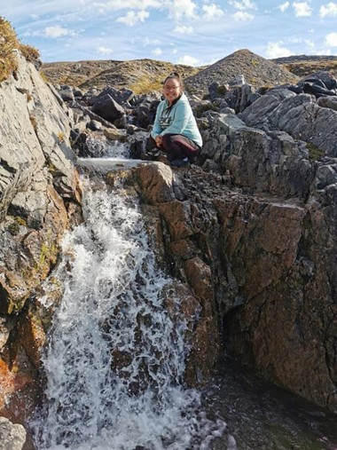
How Can Indigenous Knowledge and Science Co-Evolve? (Schott cont’d)
Schott et al. 2020: https://doi.org/10.1139/as-2019-0011
Schott et al. (2020) describe six stages to knowledge co-evolution:
Origination of the collaboration and defining collective research
A governance structure that guides the research, the findings, and potential implementations
Knowledge sharing between IK practitioners and Western scientists
Formulation of research objectives
Knowledge gathering
Knowledge unification
Image from ArctiConnexion, Taloyoak Climate & Fish Project
Notes:
Notes for Instructor: Observe how the action period (knowledge gathering) of the IK-Science co-evolution is stage #5 out of 6. This late entry shows how important it is for Indigenous communities to lead the way in the early stages of definition, governance, design, and sharing. Note also that this 1-6 is not terminal, but iterative: after gathering and unification, there will be repeated cycles of research design innovation, sharing, and re-formulation of objectives. That is the essence of co-evolution: external conditions affect the research design and thus allow for the evolution of the collaboration throughout time.

