Slide 1

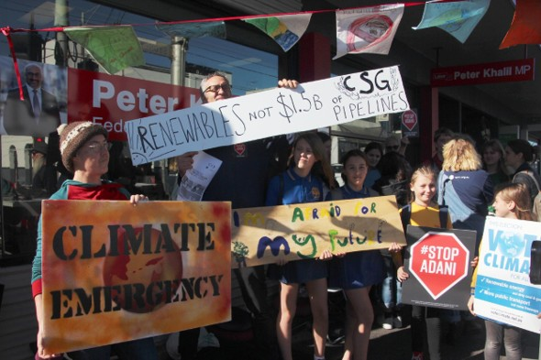
Climate Change and Choices:
Change Behavior, Mitigate, or Adapt
Source: Wikimedia Commons

Slide 2
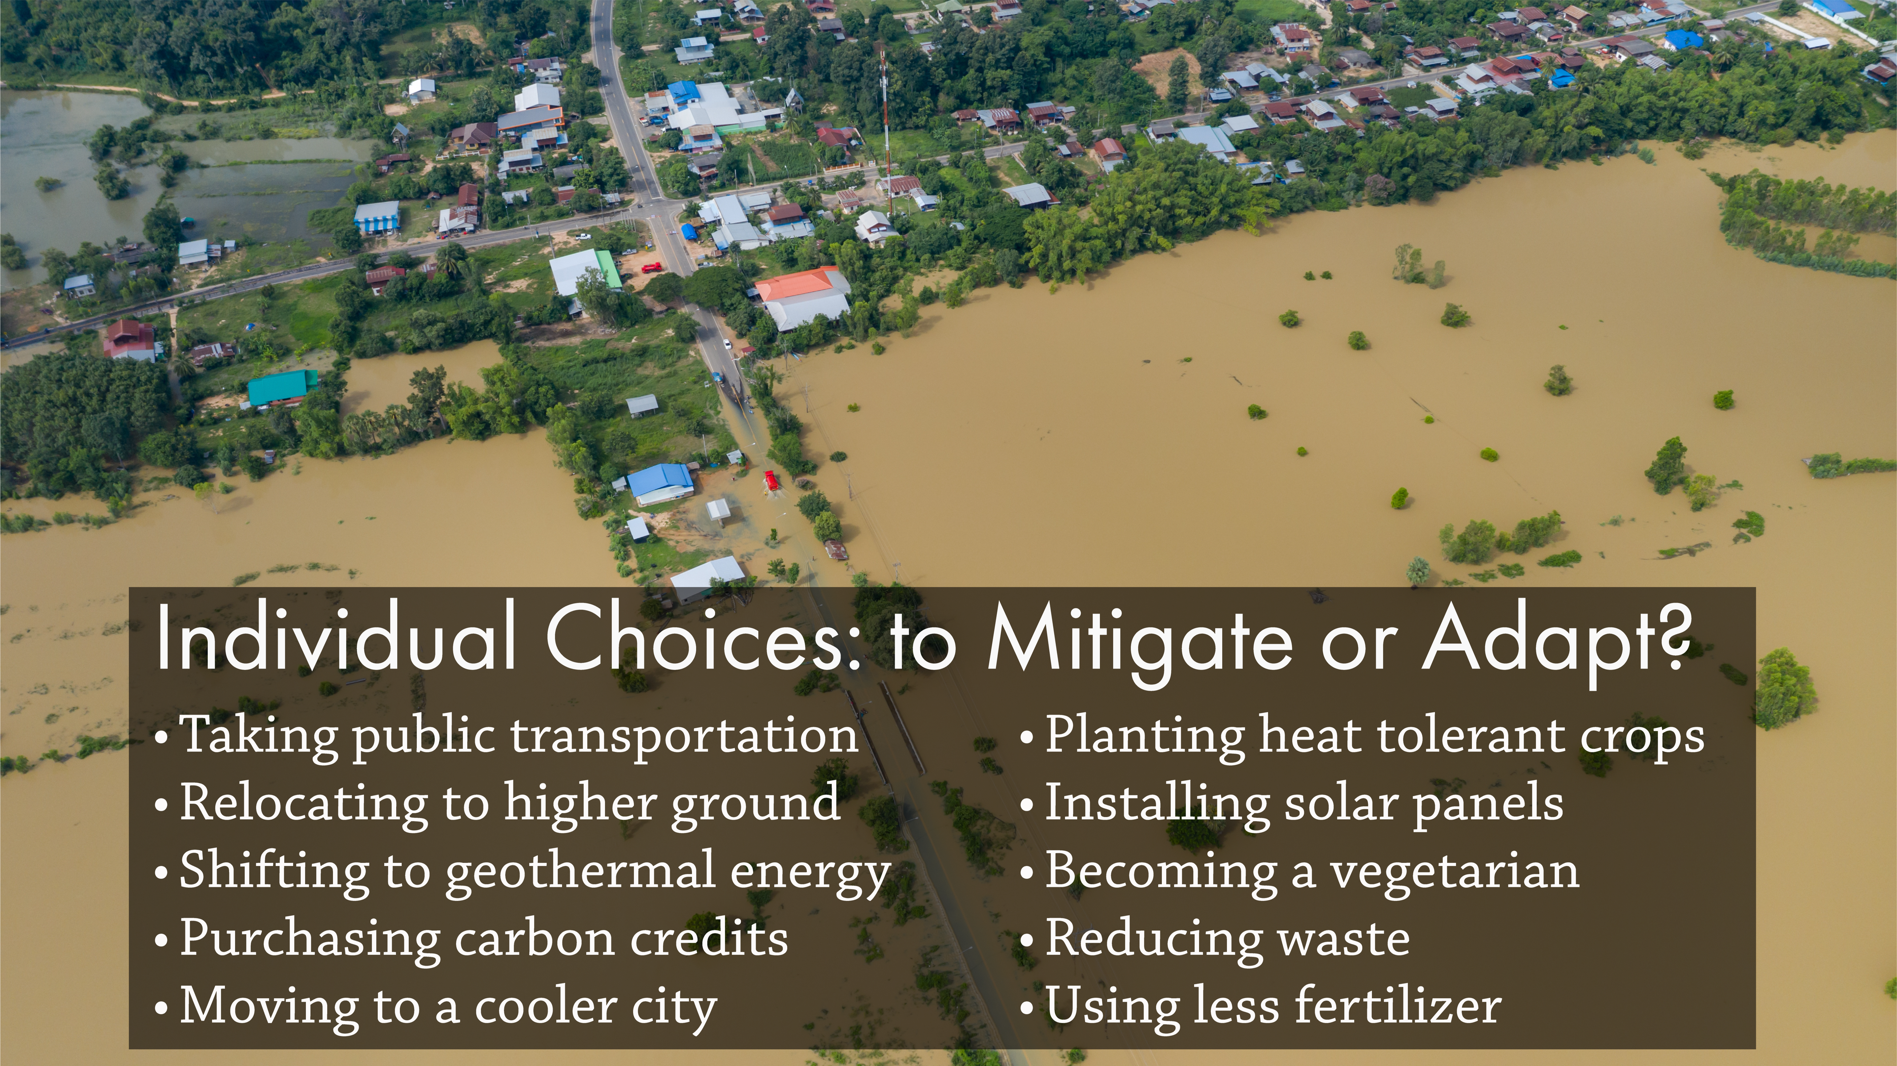
1
Notes:
Notes for Instructor: This slide is for prompting learners the to complete Hook (step 2 in the lesson). Have the learners jot down how they would categorize each of these 10 choices. Note: For some of these choices, it will be unclear which category they fall into or if they are effective. These categories will be discussed toward the end of the session.

Slide 3
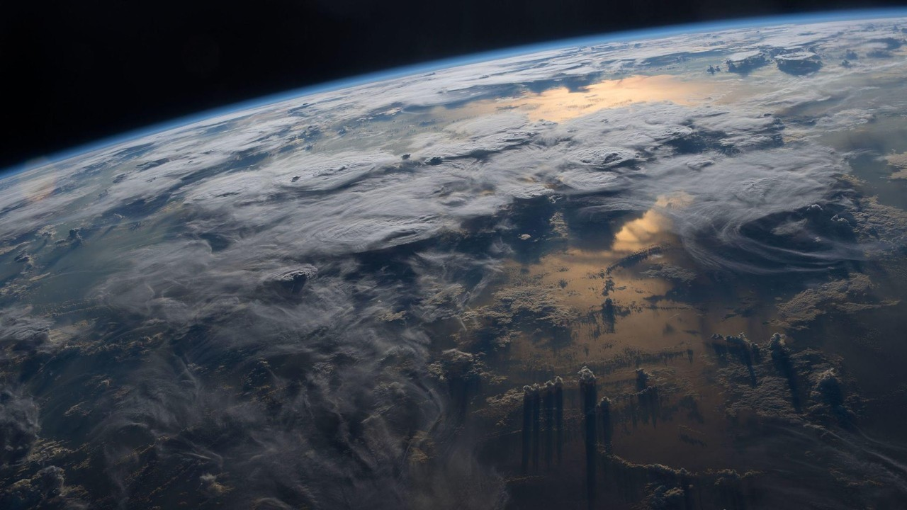
What is the physical process behind the warming effect of greenhouse gases (GHGs)?
Source: NASA.gov
Notes:
Notes for Instructor: See next slide for the answer.

Slide 4
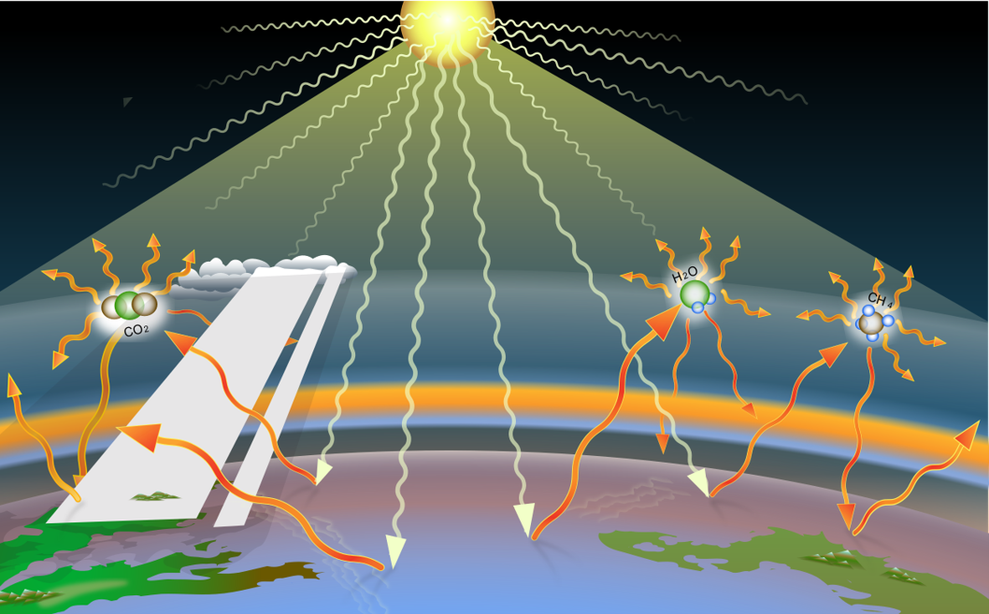
Warming Effect
Molecules of greenhouse gasses—carbon dioxide (CO₂), methane (CH₄), nitrous oxide (N₂O)—trap infrared radiation from the sun.
Steps of the effect:
Solar radiation (heat) is absorbed by the atmosphere and the earth’s surface.
The heat is re-radiated as infrared waves.
When GHGs are present, molecules are excited, and they trap heat that warms the earth.
Source: Wikipedia, creative commons
Notes:
Notes for Instructor: Background: Other gases, like oxygen and nitrogen, don’t interfere with infrared waves in the atmosphere because molecules are picky about the range of wavelengths that they interact with. For example, in gaseous forms oxygen (O₂) and nitrogen (N₂) absorb energy that has tightly packed wavelengths of around 200 nanometers (nm) or less, whereas infrared energy travels at wider and lazier wavelengths of 700 to 1,000,000 nanometers. Those ranges don’t overlap, so to oxygen and nitrogen, it’s as if the infrared waves don’t even exist; they let the waves (and heat) pass freely through the atmosphere. But GHG molecules absorb the infrared waves at wavelengths of 2,000 to 15,000 nm.

Slide 5


Most global warming emissions come from which GHGs?
Source: Adobe Images
Notes:
Notes for Instructors: See the next slide for answer.

Slide 6
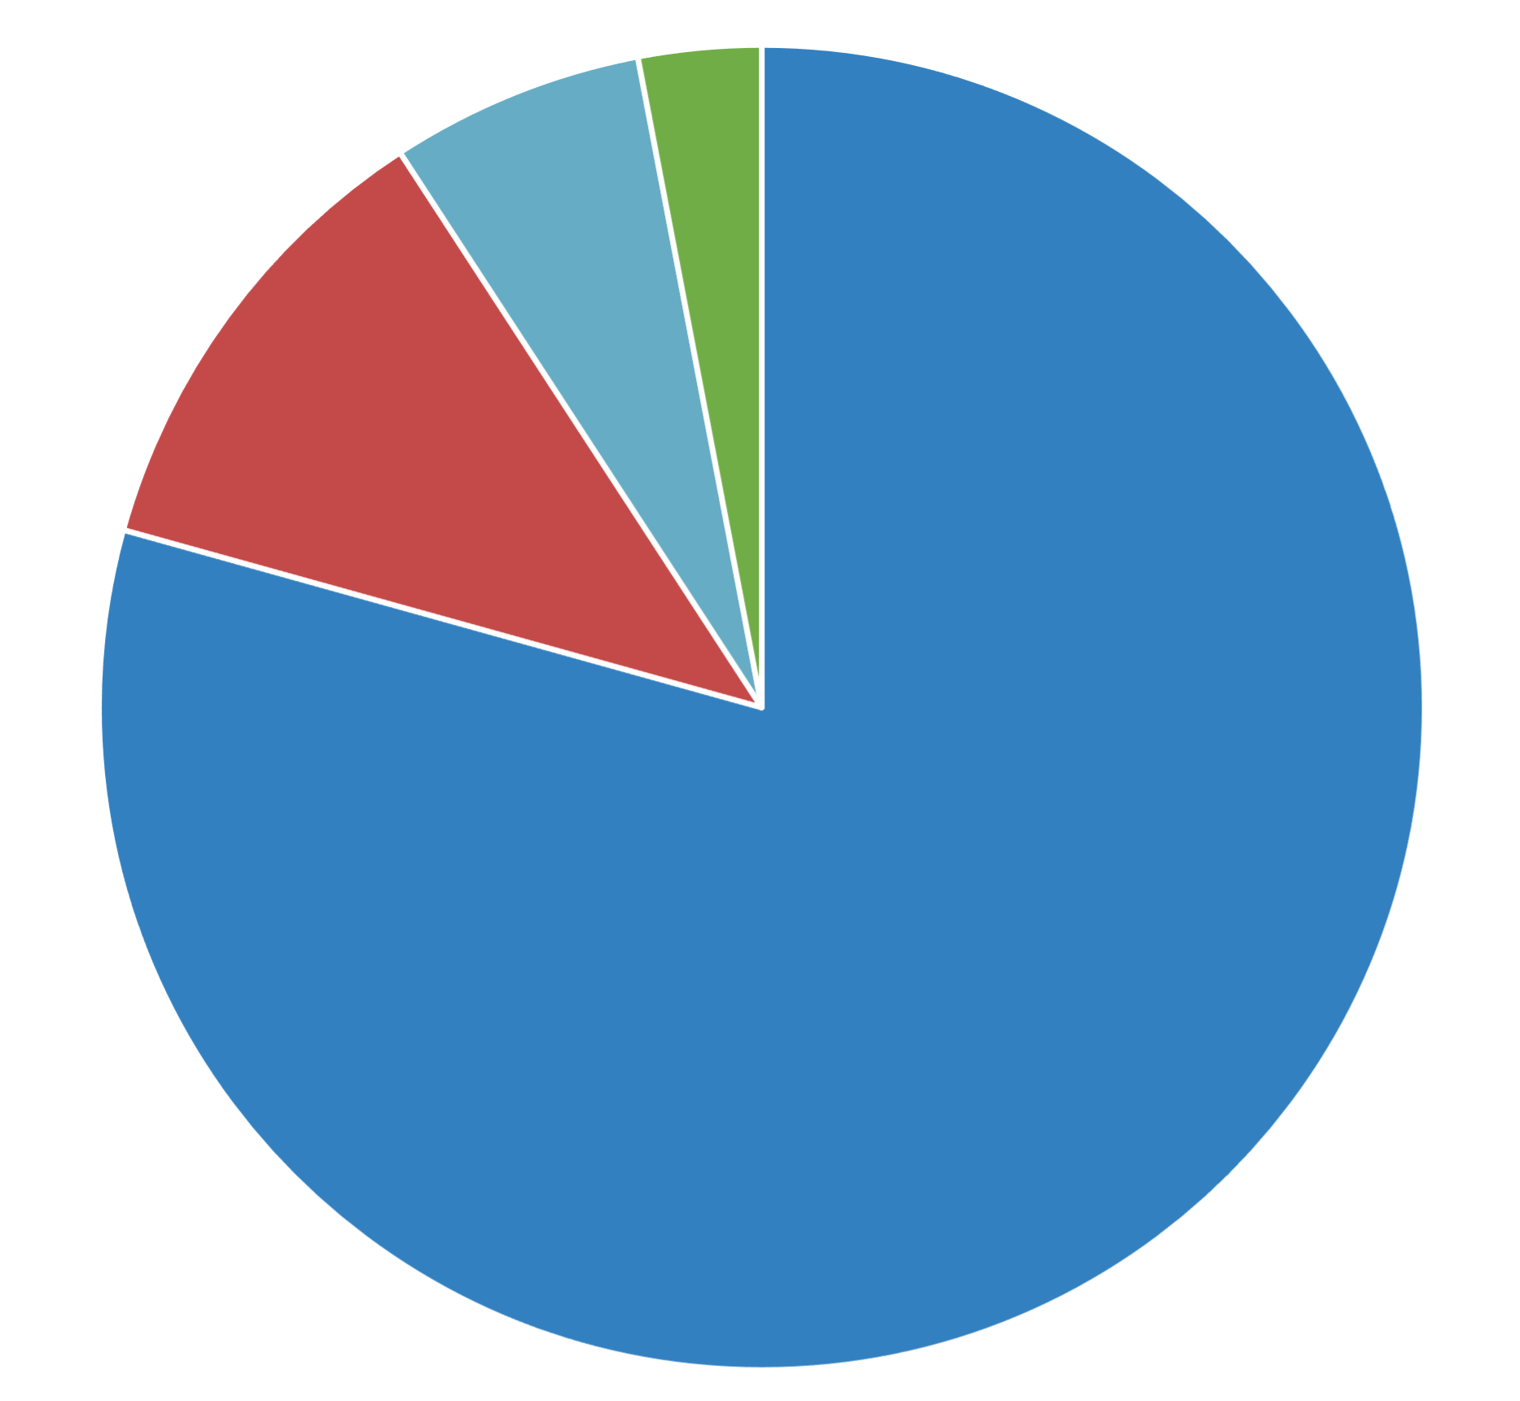
What are the sources & sinks of these dominant GHGs?
3.0% HFCs, PFCs, SF₆, and NF₃
6.2%
N₂O
U.S. emissions after being offset by GHG sinks
Source: EPA.gov 2021
11.5%
CH₄
79.4%
CO₂
CO₂ = carbon dioxide; CH₄ = methane; N₂O = nitrous oxide; HFCs = hydrofluorocarbons; PFCs = perfluorochemicals; SF₆ = sulfur hexafluoride; NF₃ = nitrogen trifluoride
Notes:
Notes for Instructors: Learners who are new to the topic tend to forget that many of the gases are taken up naturally by ecosystems. For CO₂, this take-up includes by soils, oceans, plants photosynthesizing, etc. These processes are the basis for natural sources of mitigation. For CH4, this includes soils and the atmosphere by Cl and hydroxyl [OH] ions. The next slide indicates the relative contributions from different sources.

Slide 7
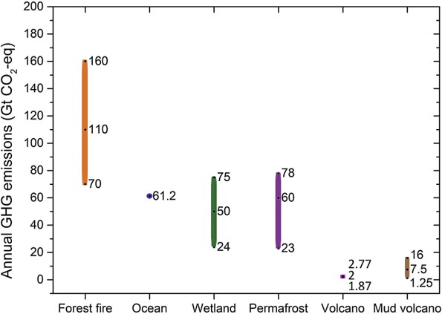
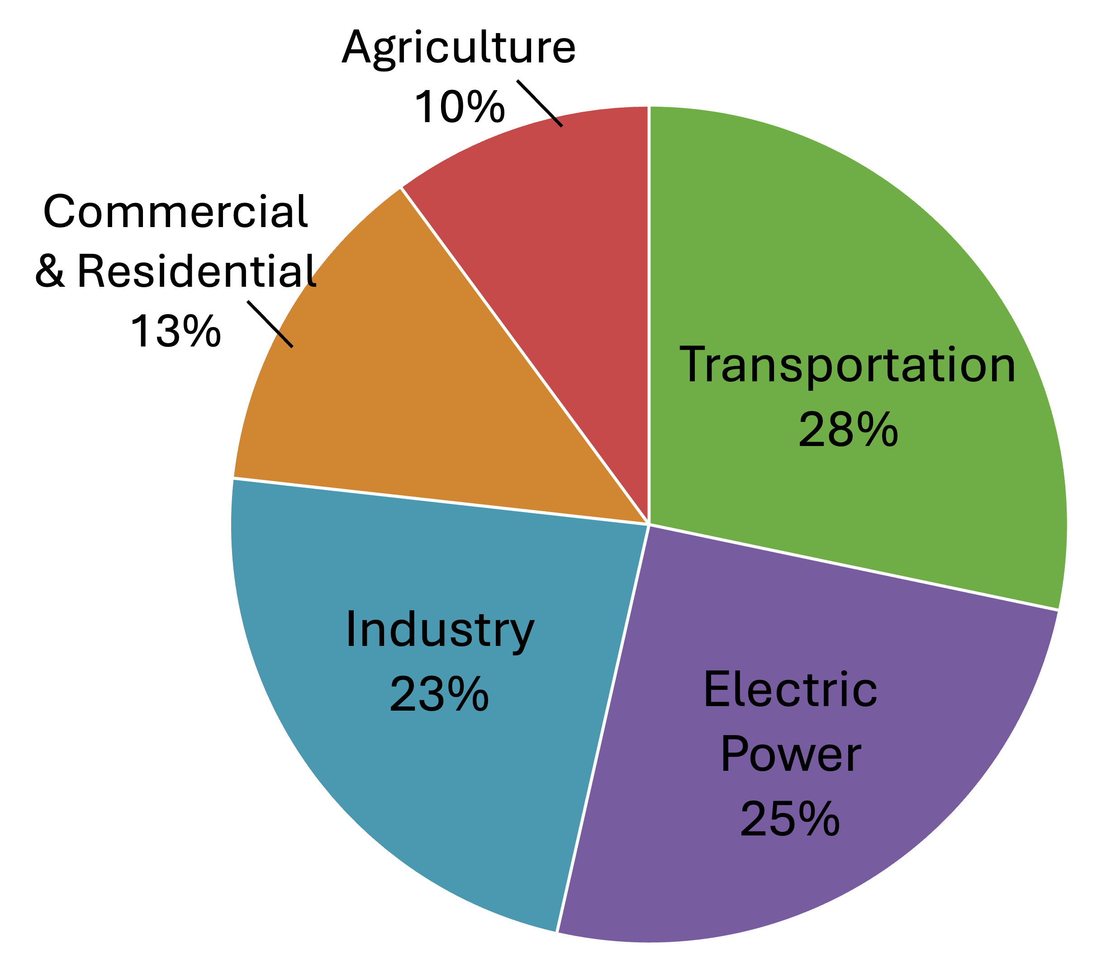
Relative Importance of Different Anthropogenic and
Natural Sources of GHGs
Anthropogenic Sources
Natural Sources
Source: EPA.gov 2021
Source: Yue & Gao 2018, Advances in Climate Change Research, https://doi.org/10.1016/j.accre.2018.12.003
6
Notes:
Notes for Instructor: Both figures provide information for all GHGs combined in CO₂-equivalents i.e., their global warming potentials (GWP). GWP is a gas’s potency, molecule for molecule, considering how long it remains active in the atmosphere. So, for example, CH₄ is a stronger GHG than CO₂, but it doesn’t persist in the atmosphere as long.

Slide 8
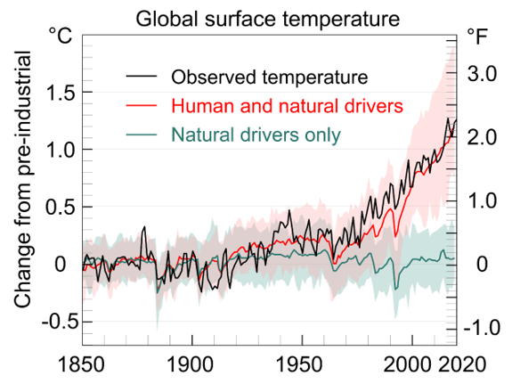
Natural vs. Human-Caused
Temperature Change
Source: IPCC AR6 WGI, Figure SPM.1b, p. SPM-7.
Notes:
Notes for Instructor: It is important for learners to recognize that natural sources have changed little since 1850, so the increase in temperature is almost entirely due to anthropogenic sources.

Slide 9
Why does warming keep accelerating?
Notes:
Notes for Instructor: See the next slide for the answer.

Slide 10
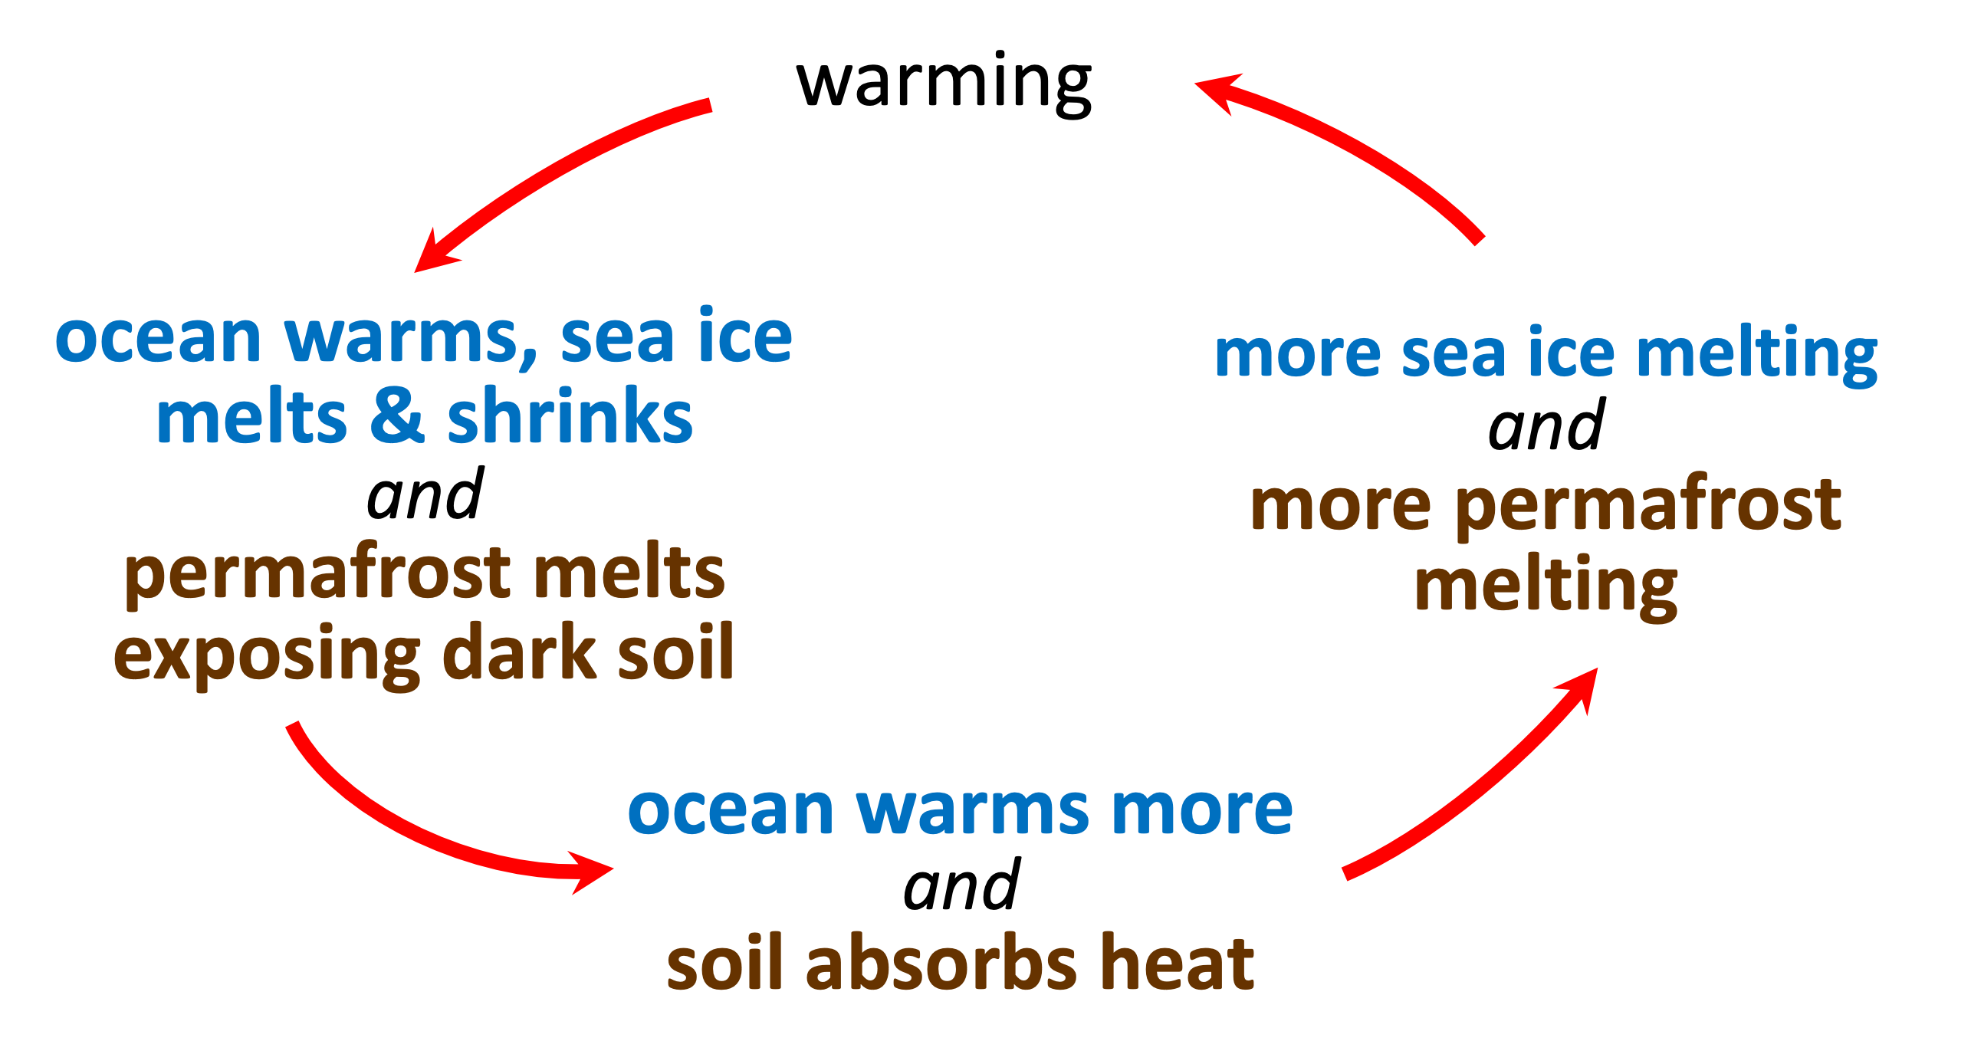
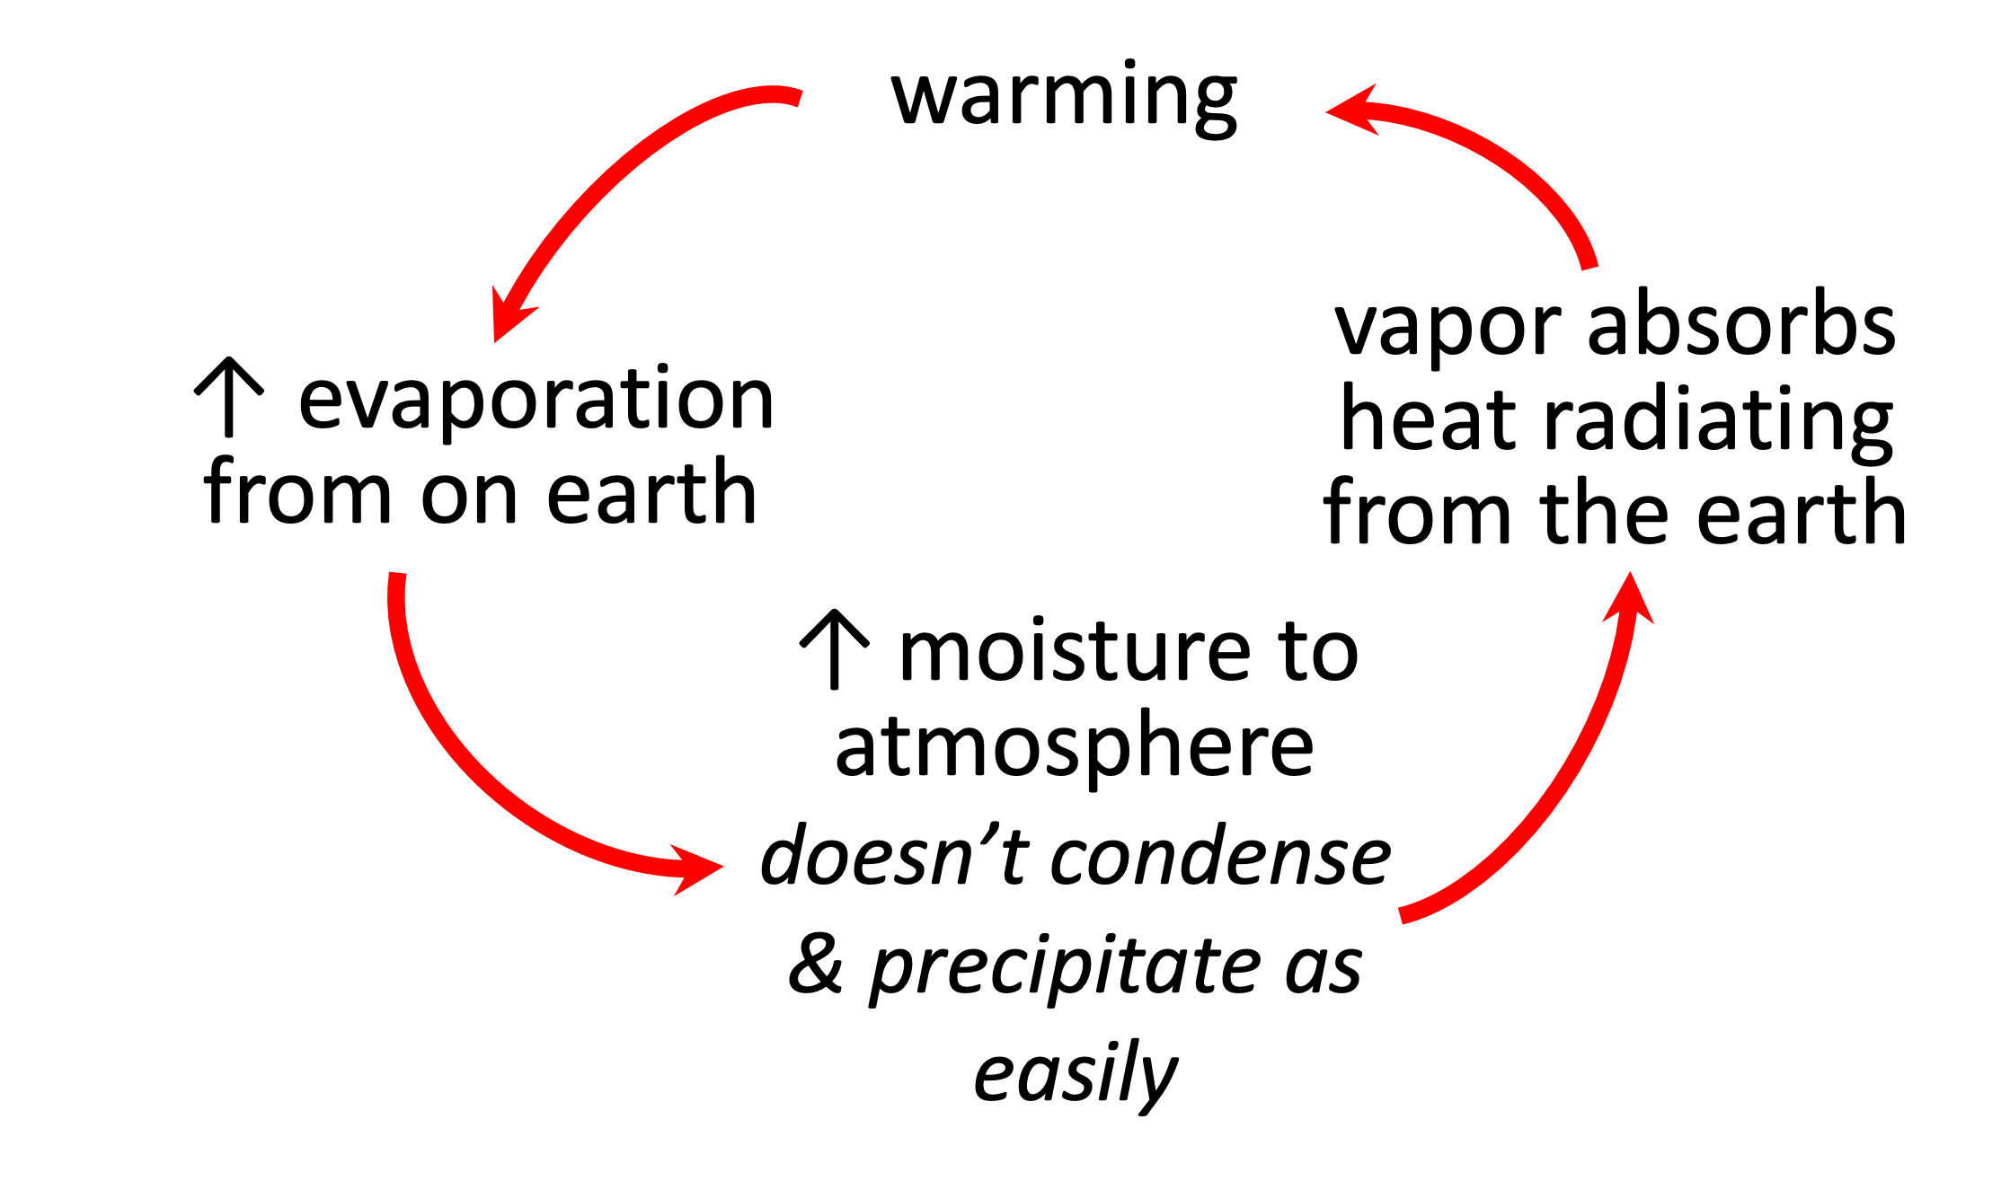
Positive Feedback Loops
Feedback loops are circular processes in which a system’s output serves as input to that same system.
Positive feedbacks are reinforcing.
Notes:
Notes for Instructor: You may wish to ask participants to come up with something that will stabilize these positive feedbacks (i.e., introduce the idea of negative feedback loops). Examples include increased cloudiness, cloud seeding in order to cause precipitation, an increase in net primary production, and increases in CO₂ storage in the ocean. ALL are very complicated with unintended consequences being likely, which participants should consider when evaluating many proposed mitigation options.

Slide 11
Which countries are emitting the most GHGs – total and per capita?
Notes:
Notes for Instructor: Query the students based on total emissions by country, as well as per capita.

Slide 12
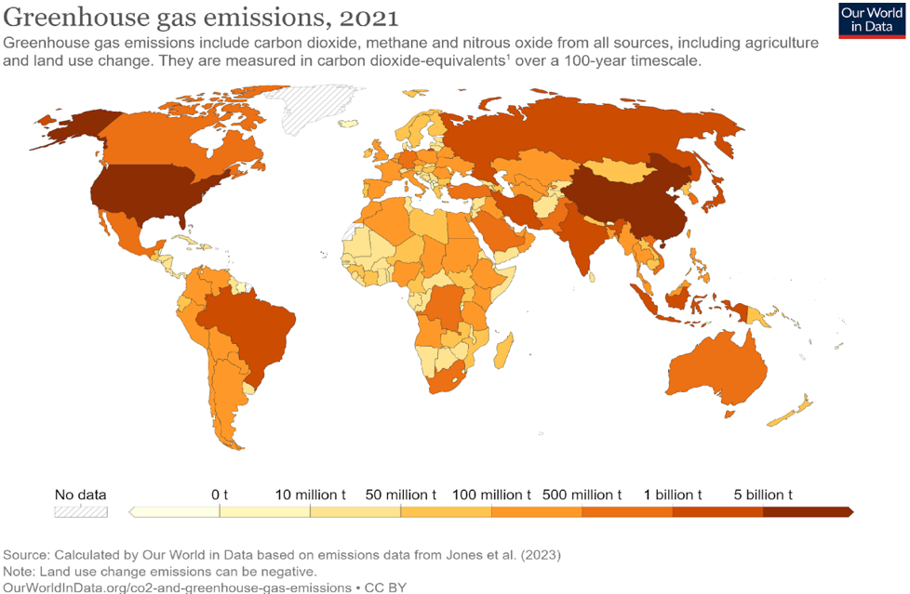
Total
Emissions
Notes:
Notes for Instructor: These data show total CO₂ emissions in millions of tons by country. In general, developed nations have the highest emissions, mostly due to energy industries that burn fossil fuels for electricity. The data and map developed (open access) by Our World in Data are from Jones et al. (2023) and are documented here: https://ourworldindata.org/greenhouse-gas-emissions. Make sure learners note not only that the U.S. is high but so is China so that on the per capita slide (next one) learners see that China changes (less per capita) as does the tiny country to the southeast of Saudi Arabia (Qatar more per capita) and Libya (more per capita).

Slide 13
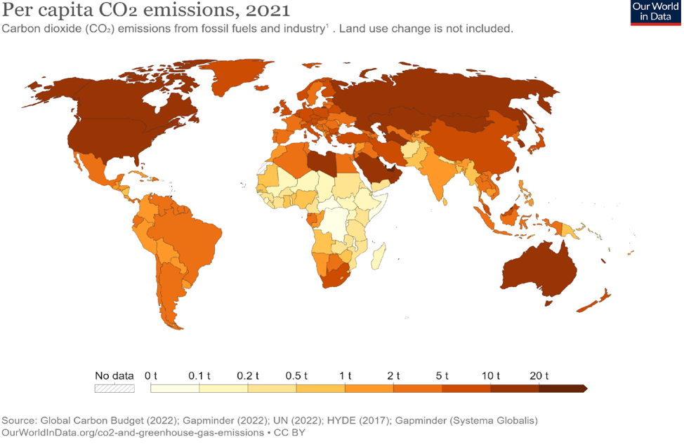
Per Capita
Emissions
Notes:
Notes for Instructor: These data show total CO₂ emissions in millions of tons by country. In general, developed nations have the highest emissions, mostly due to energy industries that burn fossil fuels for electricity. The data and map (open access) produced by Our World in Data and their sources are provided here: https://ourworldindata.org/grapher/co-emissions-per-capita.
Note on high-emitting countries: Emissions are strongly tied to wealth! Qatar, which is very wealthy (but has high inequality), has started cooling outdoor spaces!

Slide 14
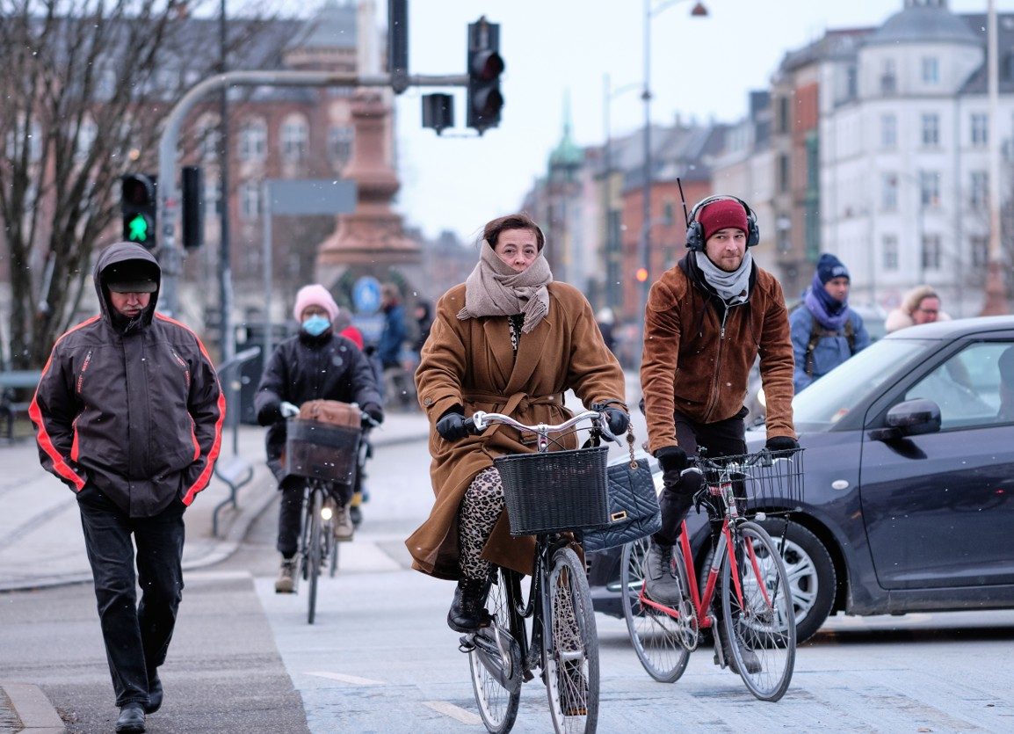

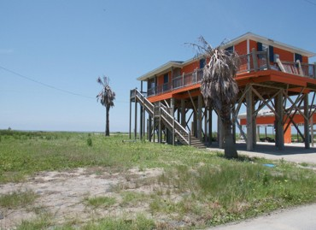
What are the choices?
How does mitigation differ from adaptation?
Change behaviors to reduce GHGs
Mitigate to reduce GHGs
Adapt to reduce the impacts
Sources: Wikipedia & Wikimedia Creative Commons
Notes:
Notes for Instructor: Ask the learner to describe what is meant by these three choices. Then go over the choices that were presented in the Hook (step

Slide 15
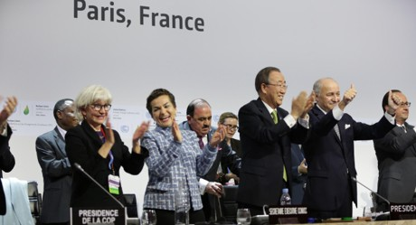
International Policy
Features of the Paris Agreement:
It is a legally binding, international treaty on climate change.
It was adopted by 196 Parties at the UN Climate Change Conference (COP21) in Paris on 12 December 2015; it entered into force on 4 November 2016.
Source: Wikipedia Commons
Its overarching goal is to hold “the increase in the global average temperature to well below 2°C above pre-industrial levels” and pursue efforts “to limit the temperature increase to 1.5°C above pre-industrial levels.”
Countries regularly submit national action plans (“nationally determined contributions” [NDCs] to meet accord agreements).
The U.S. re-signed the agreement in 2021.
Notes:
Notes for Instructors: Countries agreed that developed countries should take the lead in financing changes; the above list is from the UN Climate Change site: https://unfccc.int/process-and-meetings/the-paris-agreement; the Council of the Parties is an official decision-making body of the United Nations. It is worth letting the participants know that leaders—particularly scientific ones—have more recently stressed the need to reduce warming to 1.5 degrees Celsius by the end of this century; however, achieving that is unlikely.

Slide 16
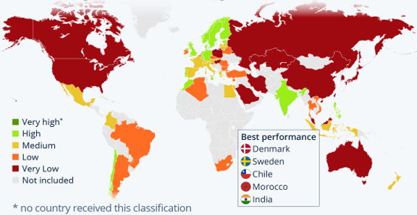
Climate Change
Performance Index (CCPI)
The index estimates “climate change performance” of countries that together account for 92% of global GHG emissions.
Performance is assessed in four categories: GHG Emissions, Renewable Energy, Energy Use, and Climate Policy.
Source: https://www.statista.com/chart/28816/climate-change-performance-index/
Notes:
Notes for Instructor: The index is calculated regularly by work between three non-profits: Germanwatch, the NewClimate Institute, and the Climate Action Network.

Slide 17
Group Project Assignment:
Regional and Country–Level Strategies for Mitigation and Adaptation
Describe the causes (ultimate/proximate), environmental impacts, and social or economic impacts associated with an environmental topic.
Propose two mitigation strategies that could be deployed to reduce or eliminate impacts.
Propose two adaptation strategies that would foster coping with or being resilient to the impacts associated with your topic
For each of the two types of strategies:
Avoid strategies that were discussed during the session.
Focus on regional or country scales.
List at least two citable sources that informed the two types of strategies.

Slide 18
Group Project Assignment – Topics
Sea rise and coastal flooding
Saltwater intrusion
Melting Arctic ice
Food-production systems
Pests and agriculture
Pastoral production systems
Water security – drought and/or rainfall timing
Water security – flooding
Desertification
Wildfire
11. Hurricanes
12. Urban heat
13. Air quality
14. Infectious disease
15. Human migration
16. Tropical biodiversity loss
17. Plant phenological shifts (e.g., timing of flowering)
18. Subsistence or artisanal fishing
19. Ocean acidification
20. Harmful algal blooms

