Slide 1

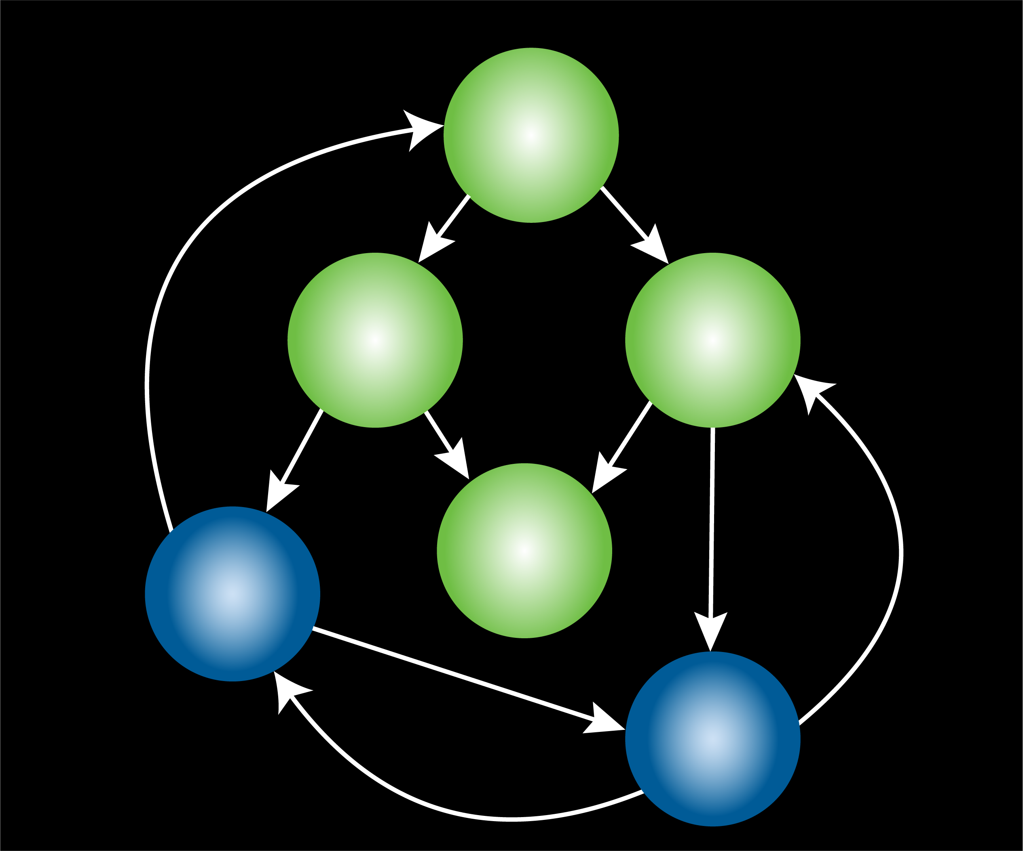
Cascading Effects in Complex Systems Part 3: Socio-Environmental

Slide 2
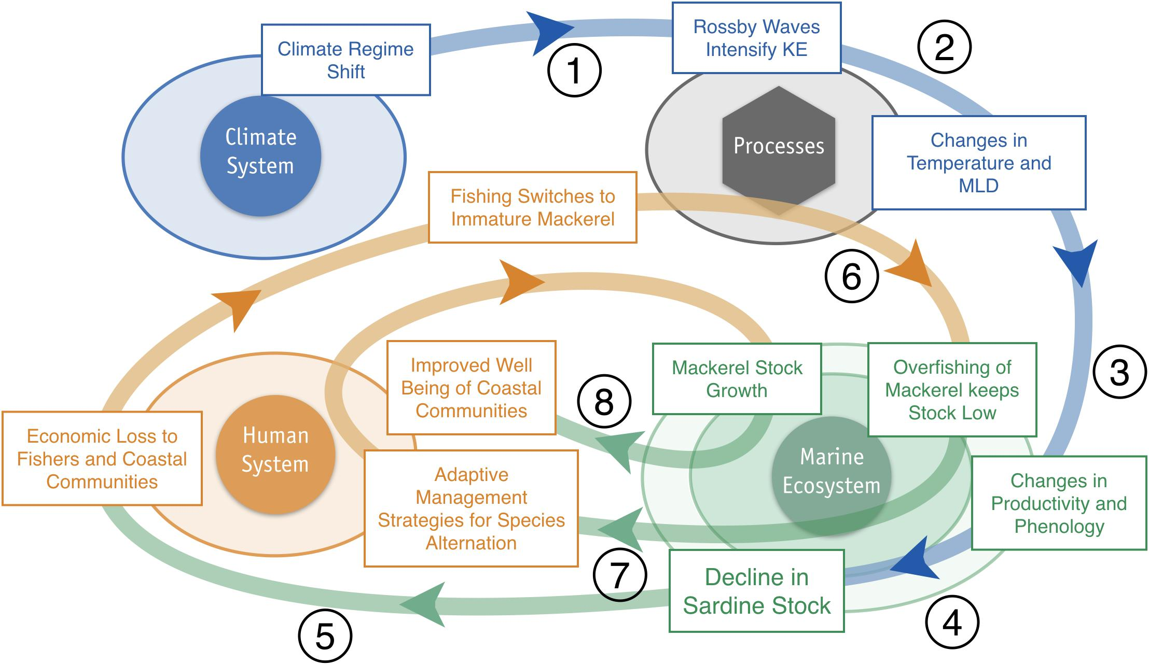
Climate Change-Enabled Cascade in the North Pacific
Bograd et al. 2019: https://doi.org/10.3389/fmars.2019.00333

Slide 3


Cascading Effects
A cascading effect propagates through a complex system sequentially (i.e., moves in one direction).
It is common for cascades to occur ecologically, socially, and socio-environmentally.
Cascades gain momentum through enabling conditions, which are typically:
  Human impacts, in ecological systems
  Human agency or technological innovations, in social systems
  Human impacts and social or technical innovations, in socio-environmental systems.
Cascades can result in tipping points (regime changes).

Slide 4
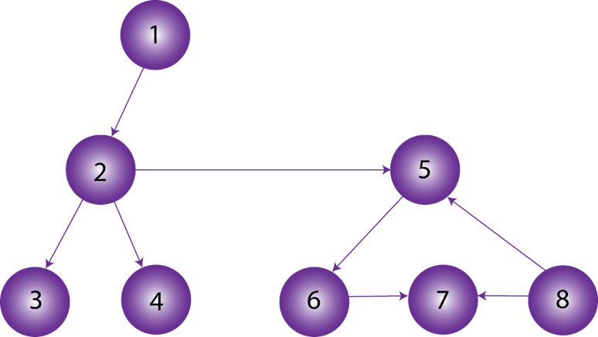


Cascades Represented as Networks
Cascades occur in directed networks.
Node (agent, species, etc.)
Interaction
1. Which nodes in this network will be impacted if node 2 changes?
2. What if the arrow from 8 to 7 was a two-way arrow instead?
Notes:
Notes for Instructor: Answers: Question #1 – Nodes 3, 4, 5, 6, and 7 will be impacted. Question #2 – All nodes would be impacted.

Slide 5
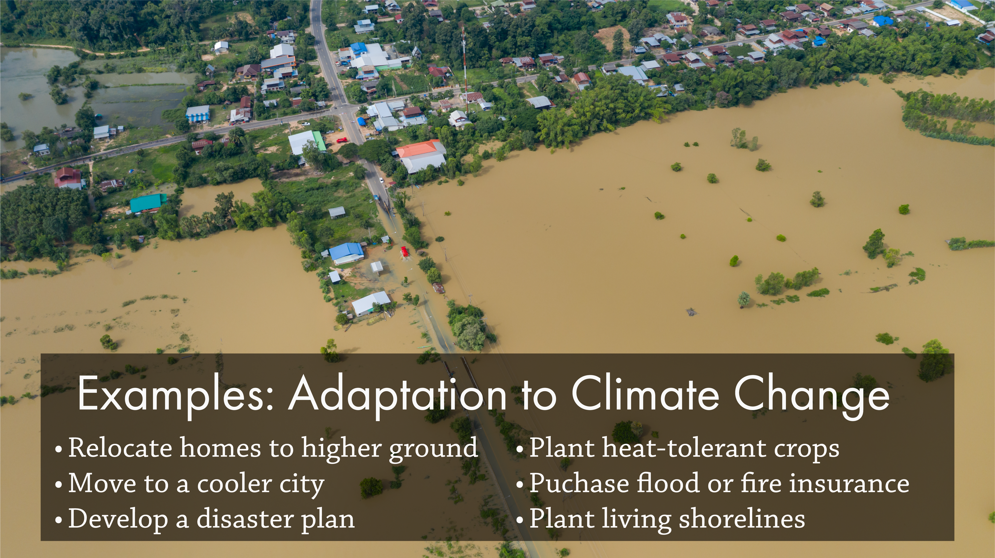
Adaptation Planning
Prepares people for hazards associated with climate change
Protects people or helps them adjust/recover
Does not stop climate change nor slow it down
Increases adaptive capacity and, thus, resilience
Notes:
Notes for Instructor: Consider asking learners how adaptation to climate change differs from mitigation? Answer: Mitigation is some action/decision/behavior that reduces climate change while adaptation is simply coping with it but protecting oneself to the extent possible.

Slide 6
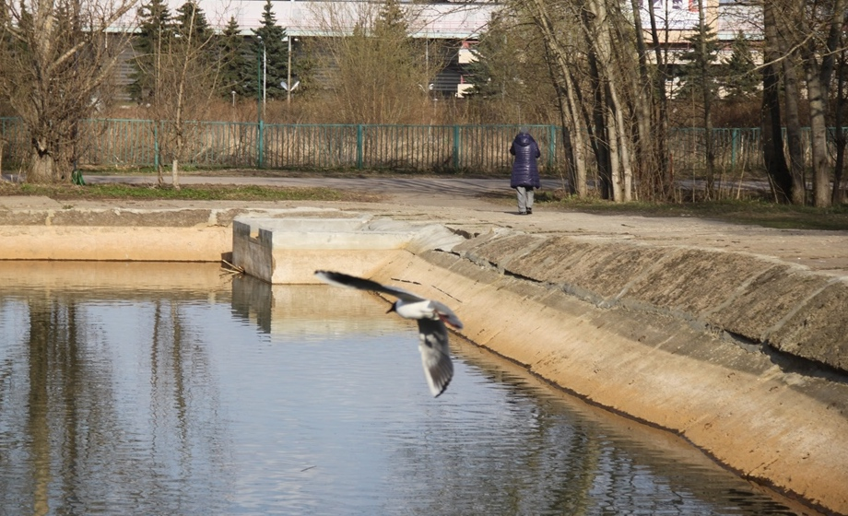
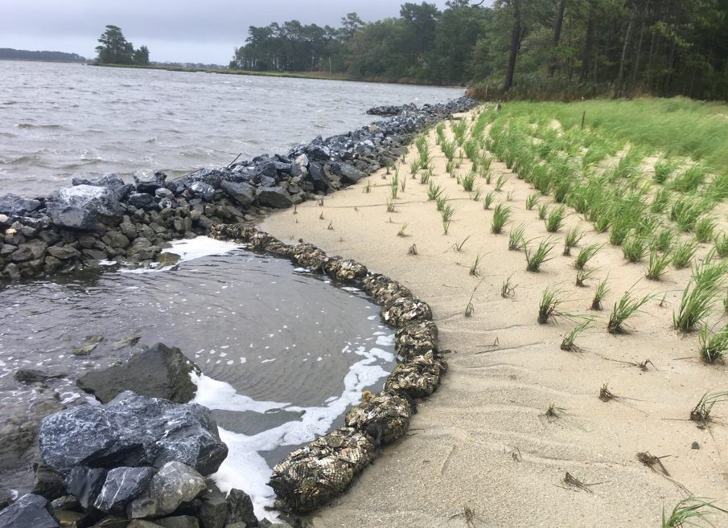
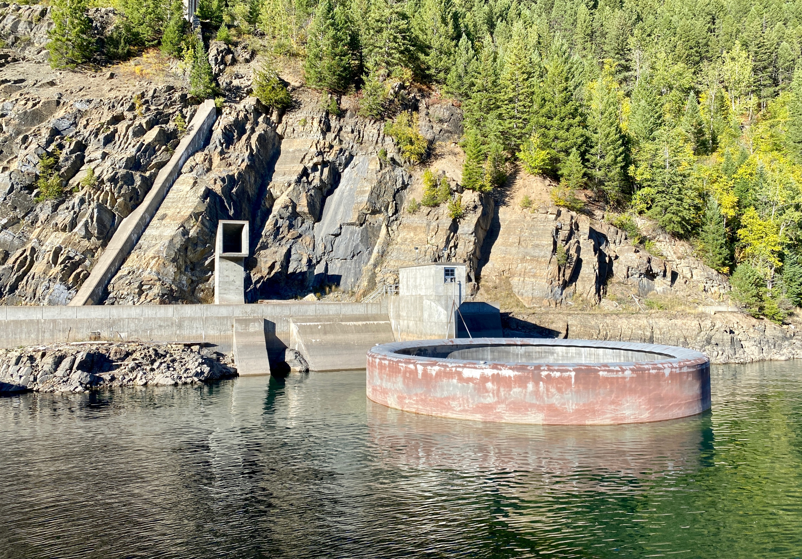
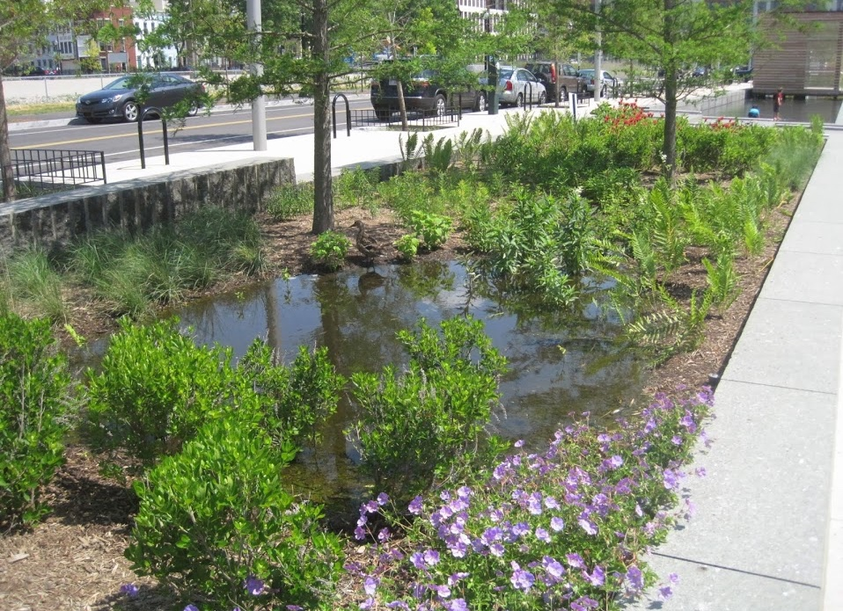
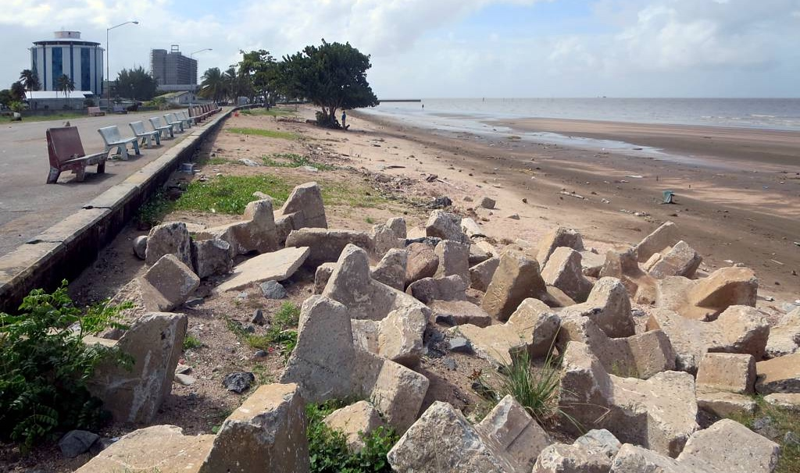
Urban Infrastructure
Comprises built or engineered systems
In the context of this lesson, is designed to protect from flooding, storms, droughts
Usually includes hard structures, but ideally includes green infrastructure
Photos: Wikimedia unless otherwise indicated
Credit: Delaware.gov
Credit: David Stanley
Notes:
Notes for Instructor: The images in the left panel are examples of “hard” urban infrastructure—a concrete pond that stores urban run-off; a dam that stores water for a city downstream to ensure adequate water during droughts; and rocks and a seawall to protect a coastal city from storm surges. The images on the right are “soft” but still engineered examples of urban infrastructure—a living shoreline on a beach and a rain garden along a highway.

Slide 7
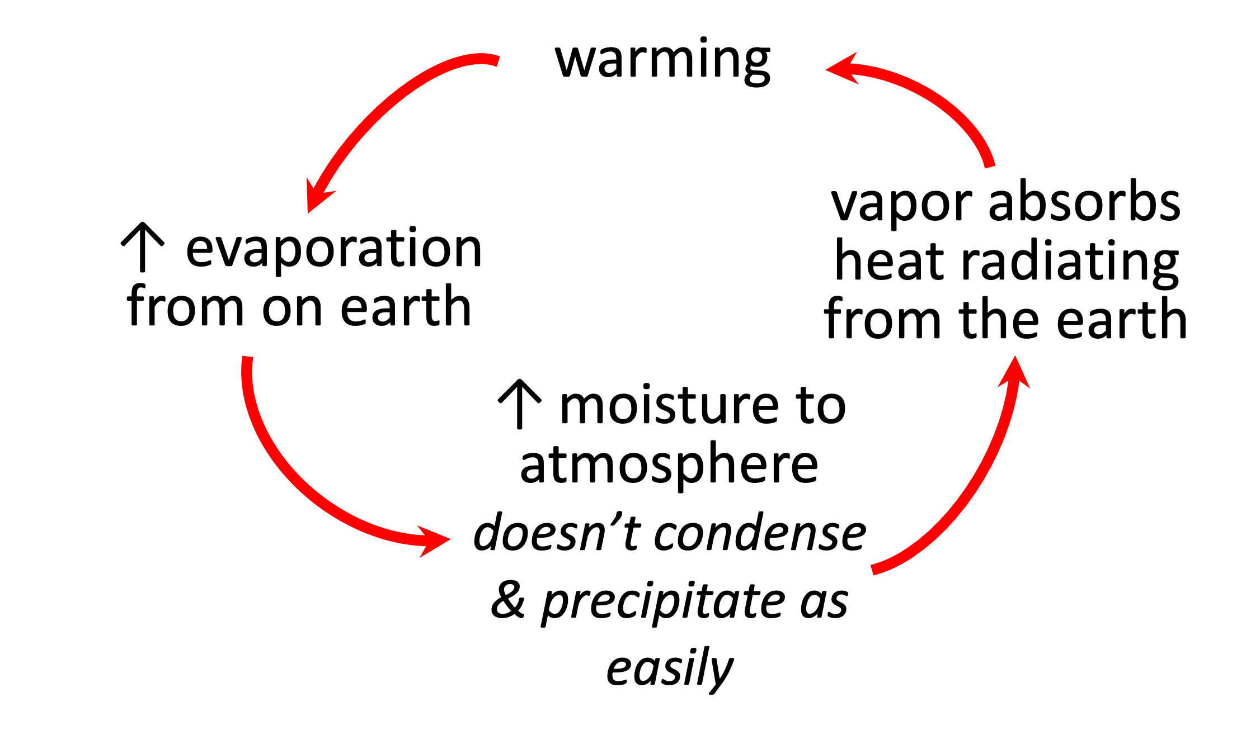
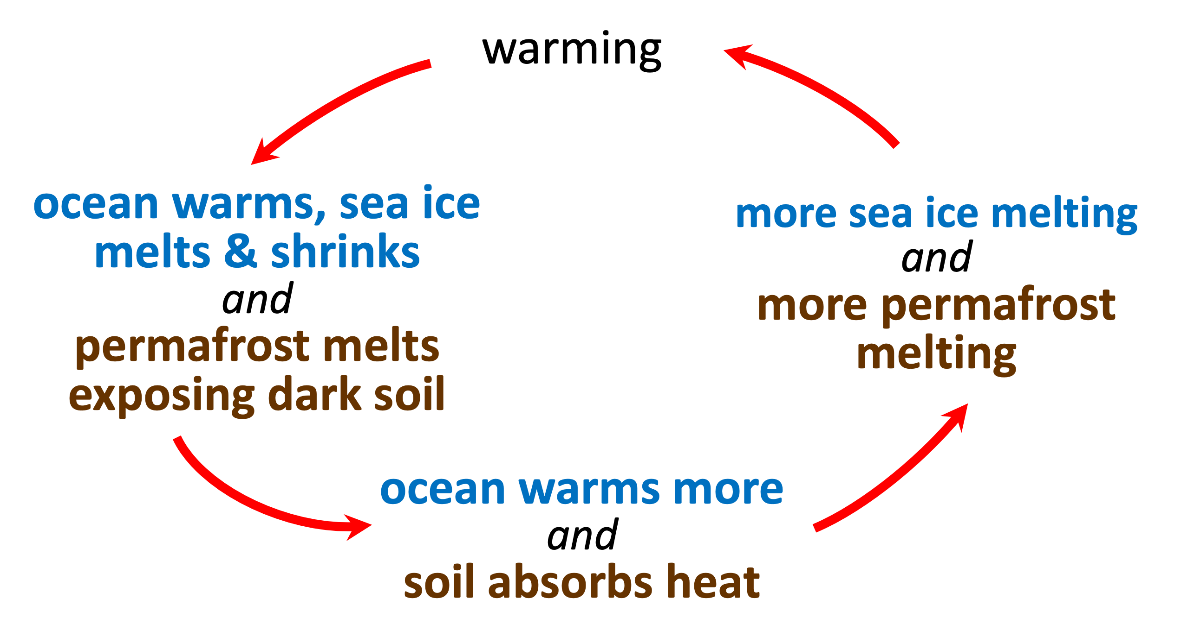
Feedback Loops
Feedback loops are circular processes in which a system’s output serves as input to that same system.
Positive feedbacks are reinforcing (not just feedbacks that are good socially!).
Notes:
Notes for Instructor: Ask learners what positive feedbacks are called in the Lawrence paper. (Answer: Opposite or reinforcing feedbacks). Then ask them what negative feedbacks are.

Slide 8
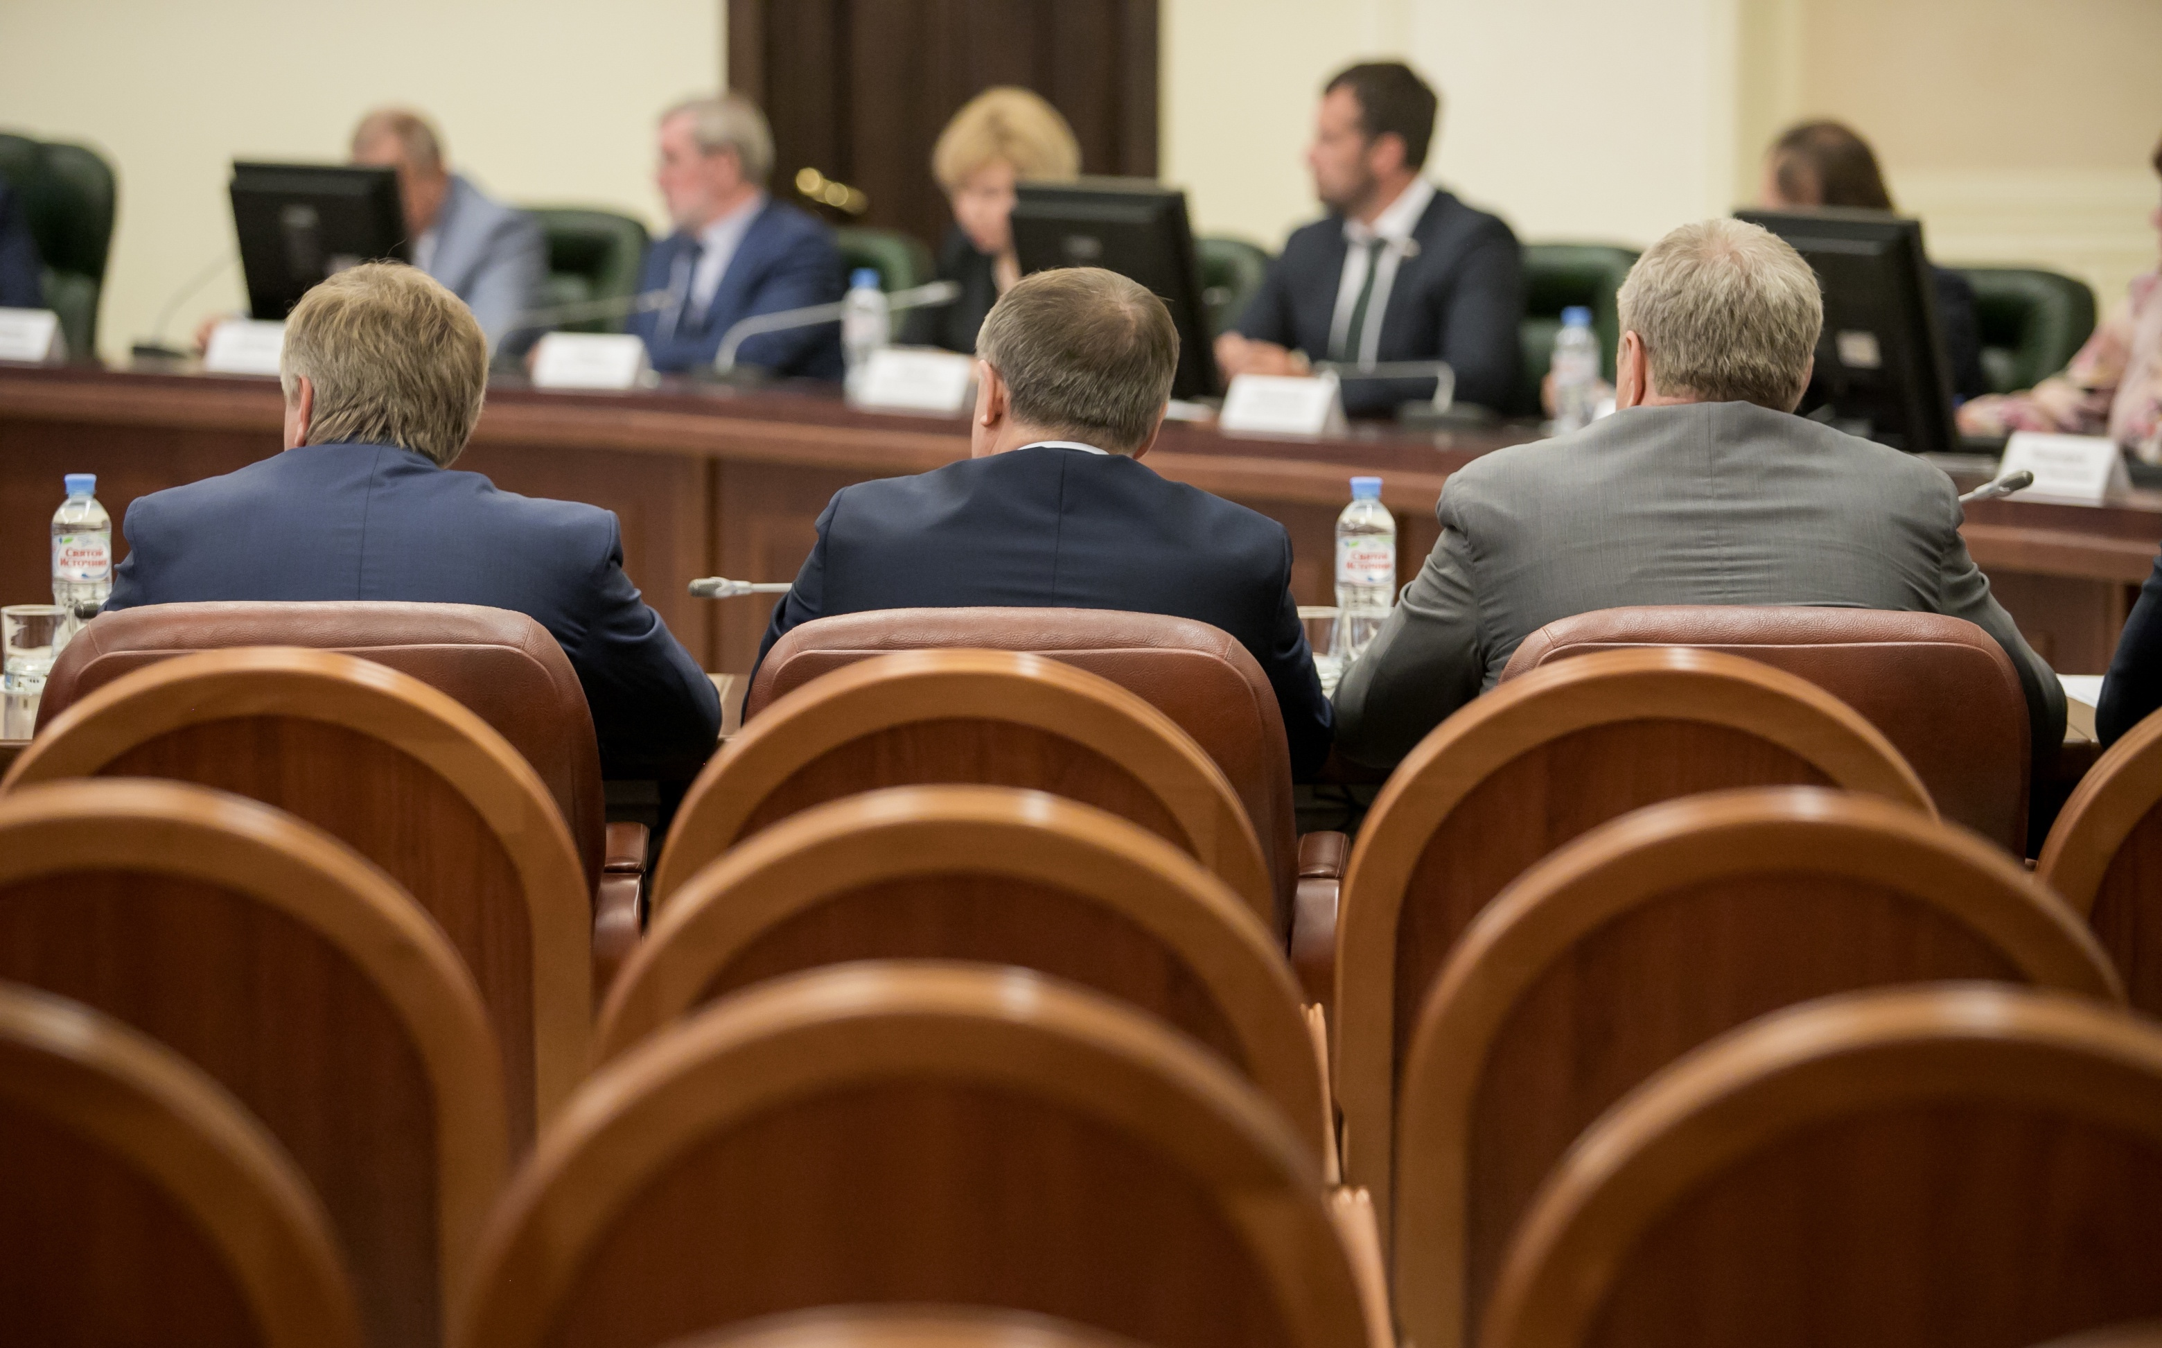
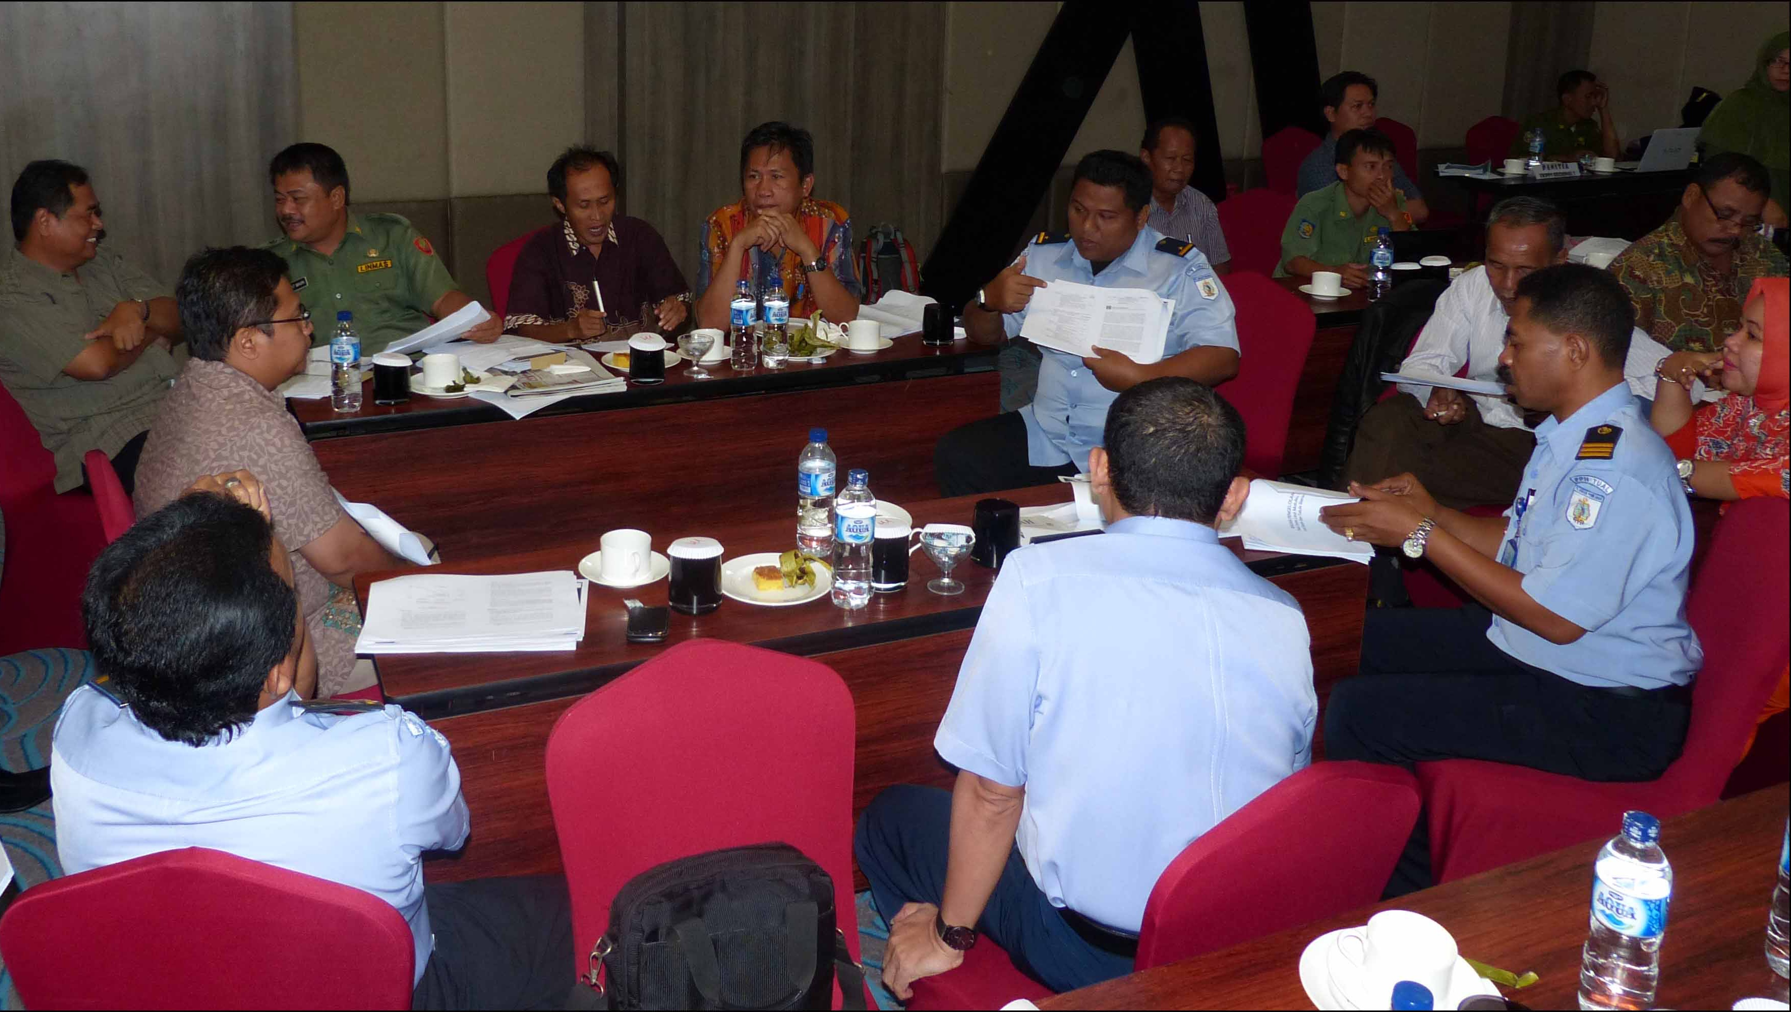

What Is Governance?
It is a system or set of rules to facilitate collective action.
It can occur in a political, social, economic, business, environmental or other context
In the study of S-E systems, it is a used as a framework for analysis, typically of institutions within which actors and rules play out.
Adobe Stock
NOAA.gov
Shutterstock
7
Notes:
Notes for Instructor: Ask learners to provide examples of some types of governance that they are familiar with.

Slide 9
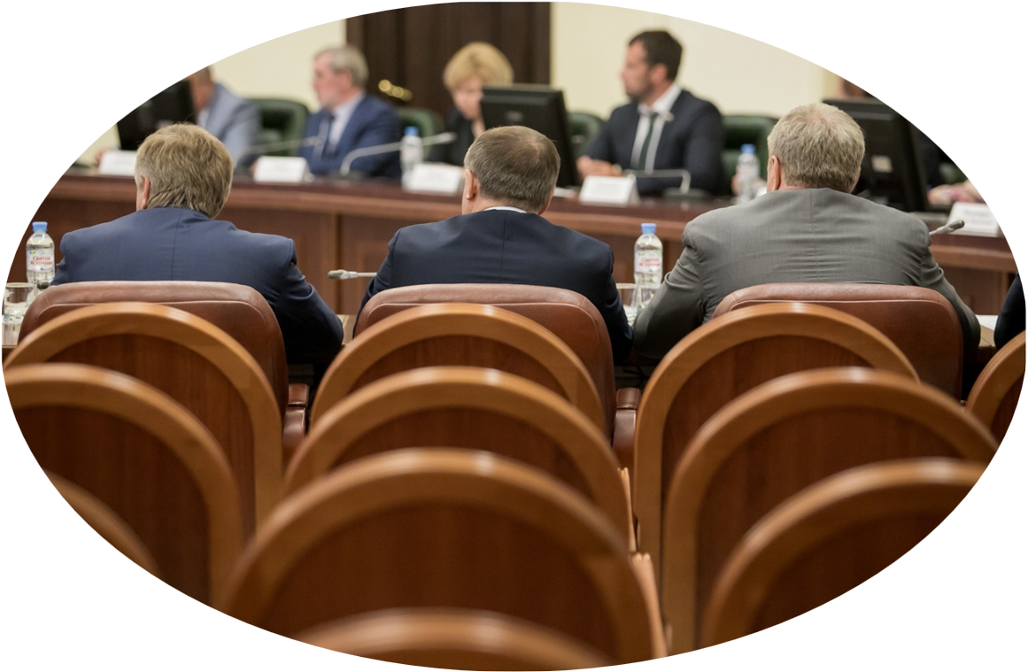

Types of Governance
Formal Governance
Laws, rules, and policies that dictate management and decisions
usually set by “institutions”
usually, some enforcement
Informal Governance
Norms, practices, and informal agreements that dictate management and decisions
usually emerges from groups
informal “enforcement” (e.g., shame)
Typically, involves state actors:
Government representatives
Court officials
Police
Typically, involves non-state actors:
Civil society groups
NGOs
Media
businesses,
markets,
etc.
Adobe Stock
Shutterstock
Notes:
Notes for Instructor: Consider asking learners why and how the media influences governance.

Slide 10
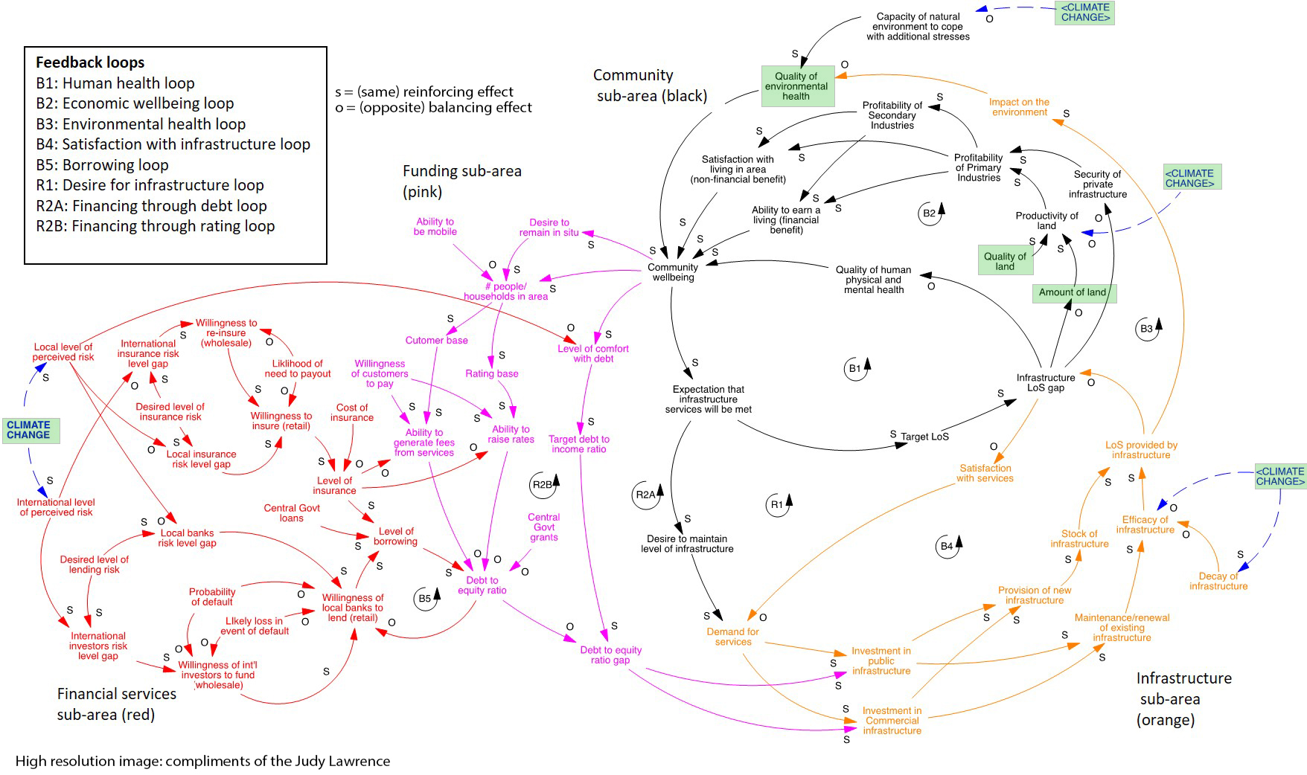
Systems Map Showing Cascading Impacts across Multiple Domains
Lawrence et al. 2020
https://doi.org/10.1016/j.crm.2020.100234
9

Slide 11
Narratives & Assignment
Wastewater systems (Sea level rise and rising groundwater tables cascade)
Water supply systems (Drought cascade)
Stormwater systems (Heavy rainfall cascade)
Stopbank breach (Extreme flood event cascade)
Power/gas/internet (Storm event cascade)
Identify the environmental change associated with climate change that causes the infrastructure problem; these differ among the narratives.
b. Using the peer-reviewed literature in your university’s online library resources, find at least one
case study where the narrative you are assigned has actually played out, e.g., a time in the
last 5 years when a major storm led to power outages with cascading social impacts.
Identify potential shortfalls in governance that may have facilitated the cascade in your narrative and suggest a change in governance that could reduce the chance of such cascades.

