Slide 1

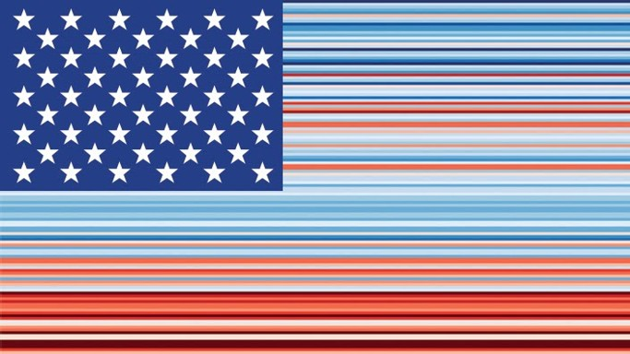
Critical Discourse Analysis:
Climate Visualization
Climate Change Stripes laid over the American Flag. The stripe colors show divergence from average USA temperatures from 1895-2020, top to bottom.
Graphic by Professor Ed Hawkins, University of Reading, and the UK Climate Lab, 4.0.
Notes:
Notes for Instructor: Climate change (CC) visualization often goes beyond simple conversions of datasets into graphs and charts. The next generation of rhetorical visuals integrates data with artistic elements that personalize the impact of the data, such as this provocative version of the American Flag. Ask learners to consider how the manipulation of identity-linked visuals like a national flag enhances the emotions of the viewer in a way that sheer data projections cannot.

Slide 2

What Are Some Forms of CDA?
Visual Discourse Analysis (VDA):
Reveals how images mediate themes like time, truth, and power. Visuals include photos, films, advertisements, and scientific charts and graphs. VDA can be applied to the discourse surrounding human landscape use, climate change, and greenwashing.
Narrative Discourse Analysis (NDA):
Narratives have surface, denotative values, they also have implied connotative values, and can be used to uphold myths that have a range of environmental effects. NDAs are direct reader responses to texts that question the truth of narratives and examine how they may be the construct of particular stakeholders, often with submerged agendas.
Qualitative Content Analysis (QCA):
Data processing software allows analysts to compile thematic and lexical trends across hundreds of documents. QCA is a technological evolution that employs narrative analysis on a larger scale in order to handle the big data of public discourse and policy.
Image courtesy of the UK’s Advertising
Standards Authority
Notes:
Notes for Instructor: Each of these forms of discourse analysis has a SESYNC Explainer dedicated to it:
CDA: What Is It? https://www.sesync.org/resources/critical-discourse-analysis-visual-approach
CDA: Visual Discourse Analysis: https://www.sesync.org/resources/critical-discourse-analysis-visual-approach
CDA: Narrative Discourse Analysis: https://www.sesync.org/resources/critical-discourse-analysis-narrative-approach
CDA: Qualitative Content Approach: https://www.sesync.org/resources/critical-discourse-analysis-qualitative-content-approach
CDA: Artificial Intelligence, Social Network, & Social Media Analysis: https://www.sesync.org/resources/critical-discourse-analysis-artificial-intelligence-social-network-social-media-analysis

Slide 3

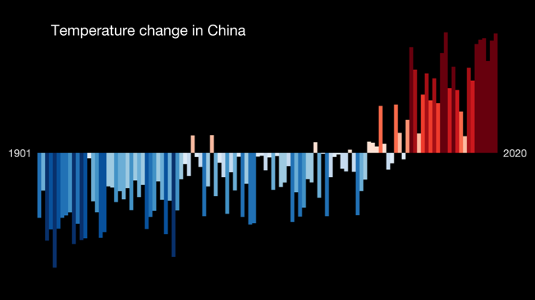
What Is Visual Discourse Analysis (VDA)?
VDA represents a variety of approaches to analyzing visuals in order to show their rhetorical aims, connotations, aesthetics, erasures, and social context.
VDA may be applied to:
          scientific graphics
archival and historical charts
            films, images, maps, and creative media
climate change visualization
Bar Graph by Ed Hawkins, University of Reading, via Wikimedia Commons, 4.0.
Notes:
Notes for Instructor: Ask learners to scrutinize this visual for its factual content (logos) versus emotional content (pathos). How might they critique this image as a “scientific” tool? (They might note that the Y axis is not defined nor are the significance of the shades of blue/red. They might also wish to know the source of the data about China’s temperature measurements.) How might they appraise the image’s impact on emotion – do they “feel” its message, or is this just another visual that flows past in a sea of visual saturation on the internet?

Slide 4
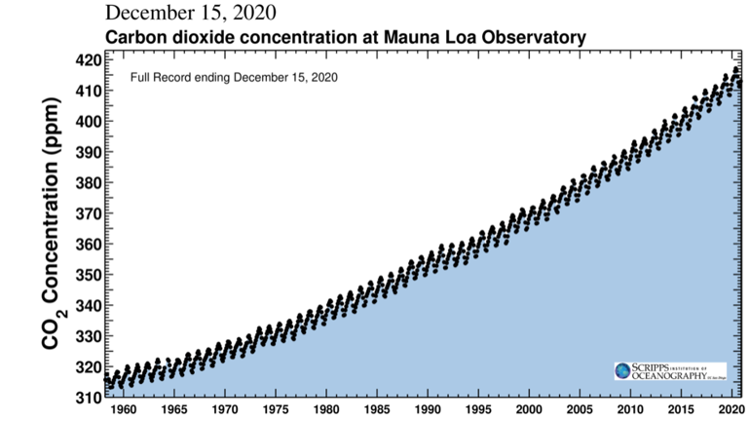
What Is Climate Visualization?
Climate Visualizations take many forms, both static and dynamic, based on facts and/or emotions.
          This graph, known as the Keeling
          Curve, is the most famous and
          possibly the most impactful climate change visualization in history.
          What does it denote? Why are there annual zig-zags? What does the
          X-Y trend show?
          Is this original visual now
          inadequate to communicate the full impact, complexity, and socio-environmental nature of climate change?
Image courtesy of the Scripps Institution of Oceanography
Notes:
Notes for Instructor: Denotes: CO₂ in the atmosphere through time; Zig-zags: Northern Hemisphere’s summer (low) and winter (high); trend: inexorable rise past historical baselines due to anthropogenic carbon emissions. Ask learners: how might we update this classic visual using software visualization tools, graphic design approaches, and dynamic presentation (GIFs and videos)?

Slide 5
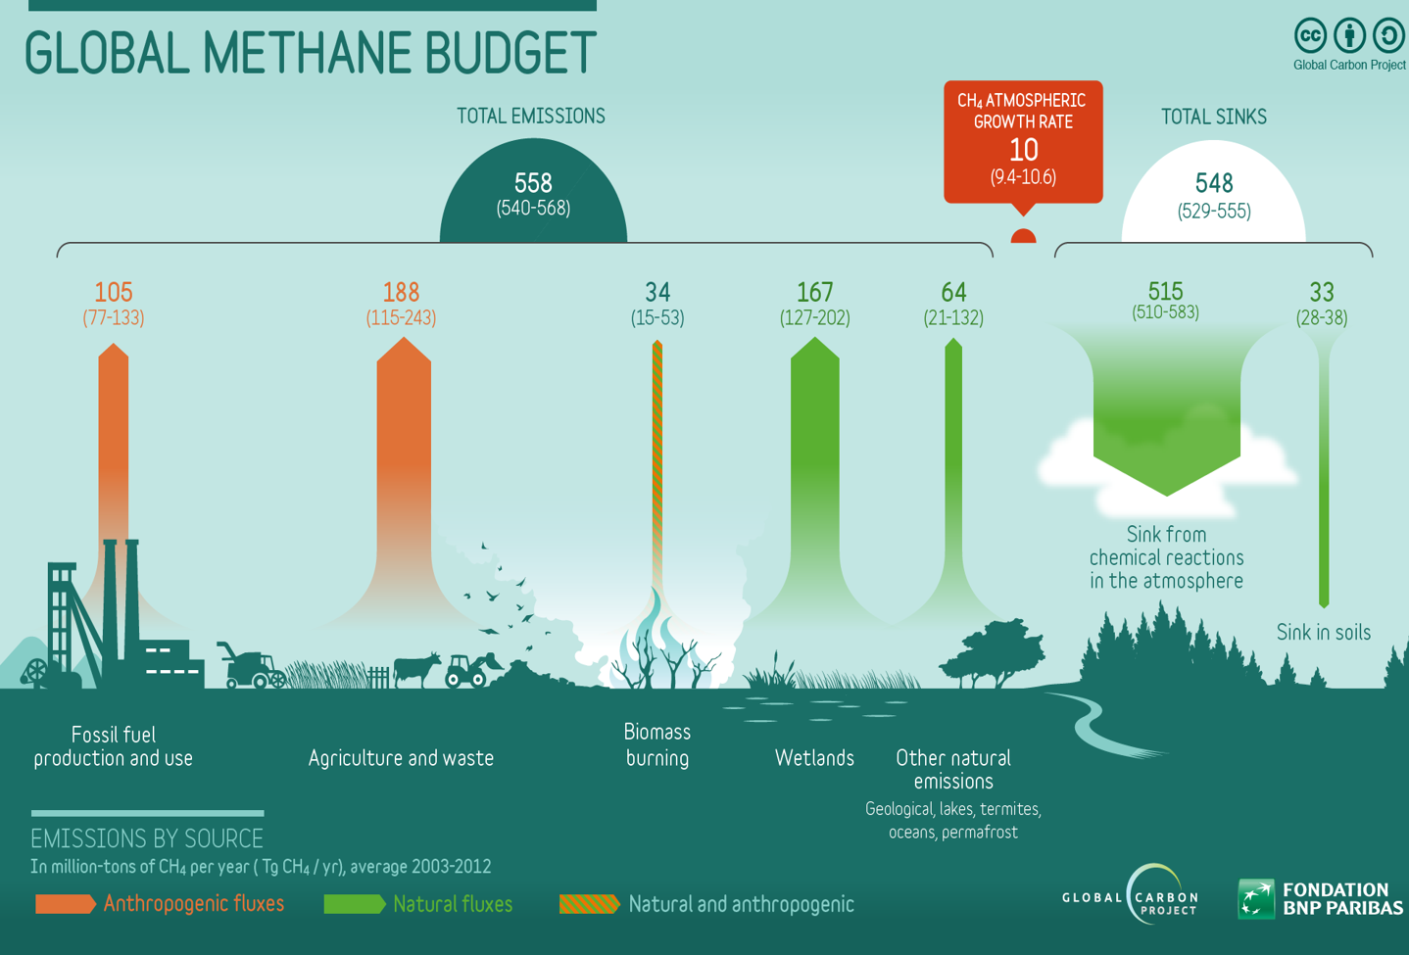
What Is Climate Visualization? (Continued)
          Climate Visualizations take many forms, both static and dynamic, based on facts and/or emotions.
          This infographic shows a
          popular way to present data
          in a visually engaging
          or aesthetic medium.
          How do the colors help
          differentiate between
          methane sources?
          How do the images
          and flows help engage
          the viewer with various actors in methane emissions?
Notes:
Notes for Instructor: Ask learners: How might we go beyond static visuals using dynamic presentation forms (GIFs and videos)? How much do climate facts (logos) matter in relation to other factors like identity (race, gender, nationality, sexuality, political orientation), affiliations, socio-economic status? Can learners suggest innovative ways to engage various sub-groups who may not identify as “environmentalists”? For example, how would they approach climate change visual discourse for a group of American cattle ranchers? (Focus on drought, economic futures, methane recapture as a resource, etc.)

Slide 6
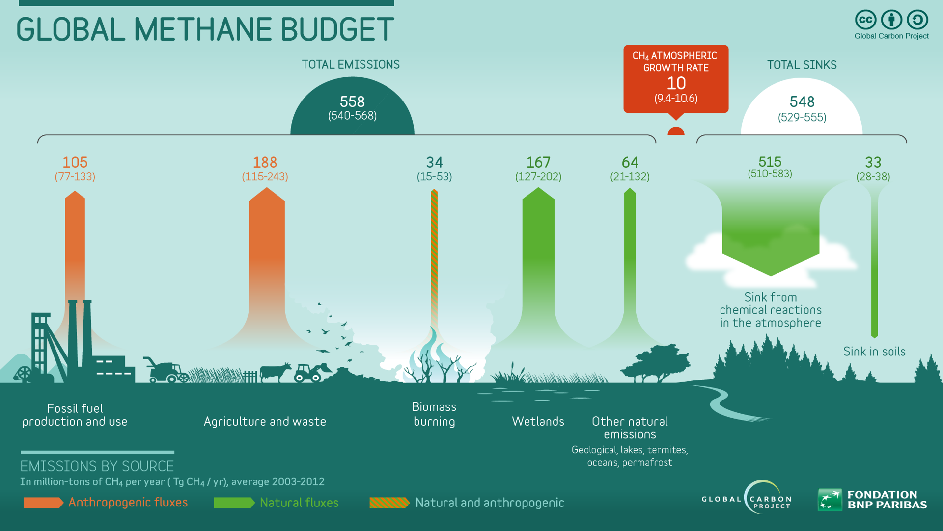
Image courtesy of the Global Carbon Project via Wikimedia Commons, 4.0.
Notes:
Notes for Instructor: Full graphic is available here for easier viewing.

