Slide 1

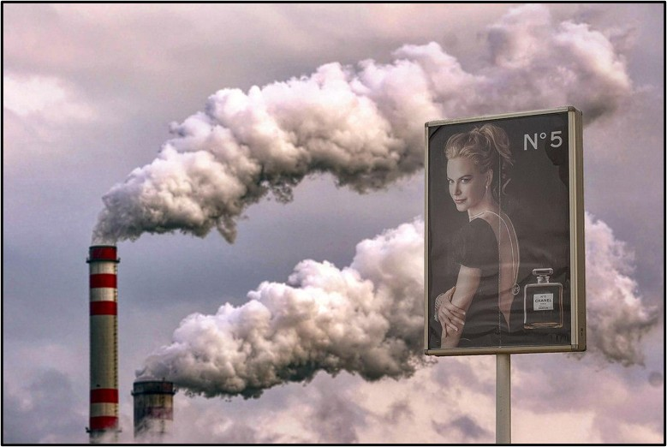
Critical Discourse Analysis:
The Power of Visuals
Image by Irwin Bosman via Wikimedia Commons, Public Domain
Notes:
Notes for Instructor: This image has a lot going on, and learners will immediately perceive that. Start with denotation: What two physical objects does it depict? Does denotation alone reveal all the dynamics in play here? No. So, move on to connotation: How are the two denoted objects drawn into a juxtaposition that is rhetorical? What cultural values or hegemonies do they display together? Does their contrast imply irony, hypocrisy, or another form of cultural judgment? Now, consider Barthes’ third stage of myth. Does this image reinforce or deconstruct a myth about beauty and luxury consumption (a movie star with expensive perfume)? And how is that cultural value linked to energy generation and pollution? Learners might also observe the conflicting sensory and aesthetic elements of the image. It is inherently satirical. These visual energies have been put into motion by the photographer’s choice of framing (two distinct causes of climate change [CC]) and image composition.

Slide 2

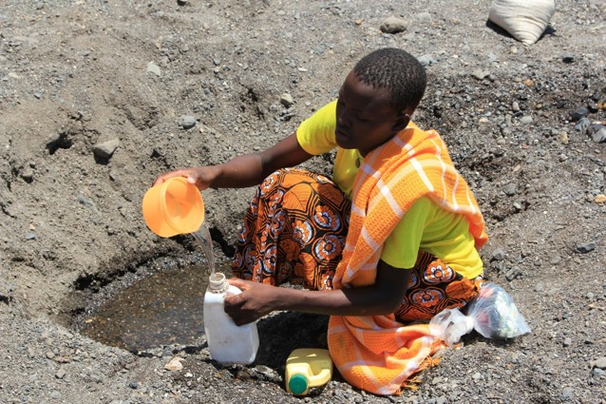
What Is Critical Discourse Analysis (CDA)?
CDA represents a variety of quantitative, qualitative, and comparative approaches to analyzing texts in order to uncover their connotations, framing, biases, erasures, and social context.
CDA may be applied to:
          scientific publications
policy documents
archival and historical materials
            films, images, and other creative media
Journalism
A woman seeks water in a dry riverbed near Kataboi village in northern Kenya. Public Domain.
Notes:
Notes for Instructor: The ethics of journalism require a balanced presentation of information—for example, representing both sides of an argument in public discourse. But ask learners about some ways that journalists can employ creative tactics, like lexicon (words used), metaphors, facts and statistics (logos), and emotion (pathos) to present a story weighted with particular values. Then consider what tactics photojournalists may use to enrich the connotations of their images: subject framing, colors, composition, and the photo’s dynamic with the story piece it accompanies.
The photo is open source via Wikimedia, with this caption: “A woman seeks water in a dry riverbed near Kataboi village in remote Turkana in northern Kenya. In 40-degree heat and no access to clean water, she resorts to collecting unfiltered water for her family in containers.”

Slide 3

What Are Some Forms of CDA?
Visual Discourse Analysis (VDA):
VDA reveals how images mediate themes like time, truth, and power. Visuals include photos, films, advertisements, and scientific charts and graphs. VDA can be applied to the discourse surrounding human landscape use, climate change, and greenwashing.
Narrative Discourse Analysis (NDA):
Narratives have surface, denotative values, they also have implied connotative values and can be used to uphold myths that have a range of environmental effects. NDAs are direct reader responses to texts that question the truth of narratives and examine how they may be the construct of particular stakeholders, often with submerged agendas.
Qualitative Content Analysis:
Data processing software allows analysts to compile thematic and lexical trends across hundreds of documents. QCA is a technological evolution that employs narrative analysis on a larger scale in order to handle the big data of public discourse and policy.
Image courtesy of the UK’s Advertising
Standards Authority
Notes:
Notes for Instructor: Each of these forms of discourse analysis has a SESYNC Explainer dedicated to it:
CDA: What Is It? https://www.sesync.org/resources/critical-discourse-analysis-visual-approach
CDA: Visual Discourse Analysis: https://www.sesync.org/resources/critical-discourse-analysis-visual-approach
CDA: Narrative Discourse Analysis: https://www.sesync.org/resources/critical-discourse-analysis-narrative-approach
CDA: Qualitative Content Approach: https://www.sesync.org/resources/critical-discourse-analysis-qualitative-content-approach
CDA: Artificial Intelligence, Social Network, & Social Media Analysis: https://www.sesync.org/resources/critical-discourse-analysis-artificial-intelligence-social-network-social-media-analysis

Slide 4
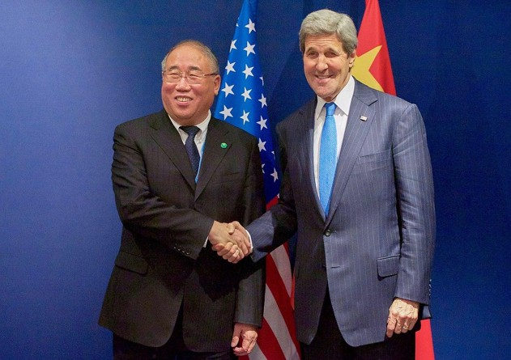
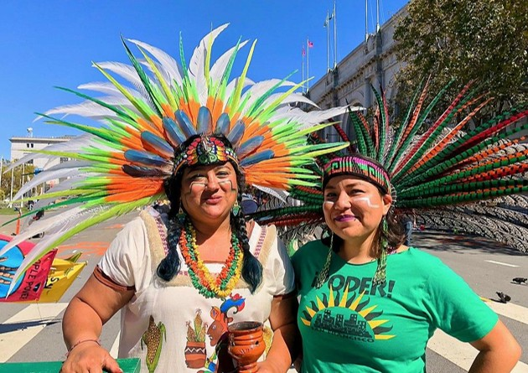
Visual Discourse Analysis: The Subject
U.S. Secretary of State John Kerry shakes hands with Chinese Special Envoy for Climate Change Xie at the COP21 Conference in Paris, 2015, Public Domain.
U.S. Secretary of State John Kerry shakes hands with Chinese Special Envoy for Climate Change Xie at the COP21 Conference in Paris, 2015. Public Domain.
Notes:
Notes for Instructor: Though climate change solutions are the common framing in these two images, the subjects they depict are very different. What does the Kerry/Xie meeting denote, and what does it connote? How do their identity, dress, and pose in a handshake in front of the flags of Earth’s two highest-emitting countries affect the image’s rhetorical power? Likewise, consider the exuberant pair of climate protesters. How do their identity, dress, pose, and context present a contrasting view of climate policy action and activism? Are there elements of connotation, tension, or hypocrisy in the image that might be perceived differently depending on the viewer?

Slide 5
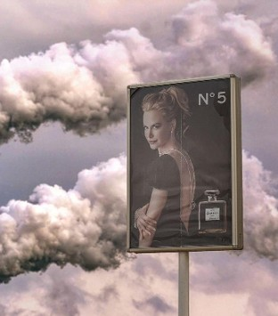
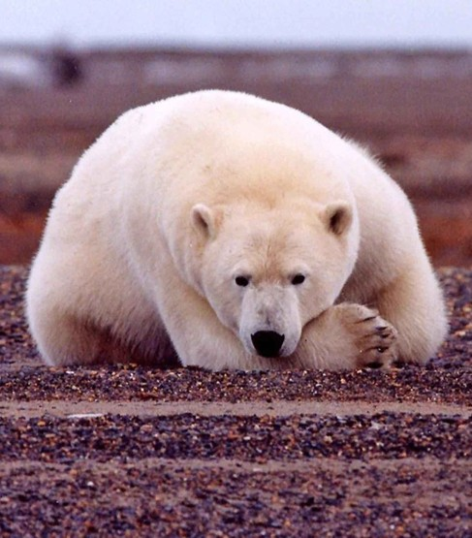
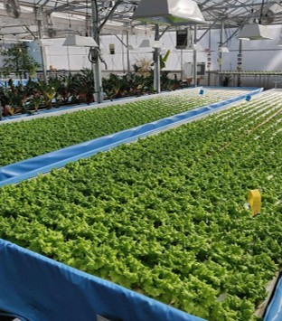
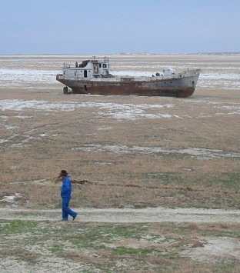
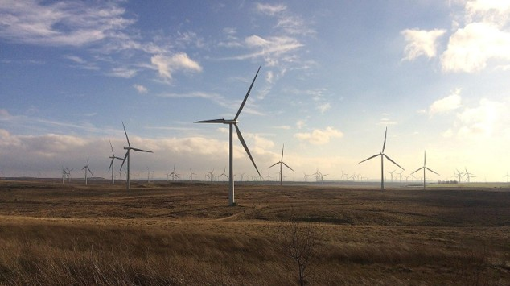
Visual Discourse Analysis: Framing
Climate change (CC) theorists use a frame typology of CC imagery as depicting causes, impacts, or solutions. How would you classify each image?
Notes:
Notes for Instructor: While causes versus impacts may be clear to all, the category of ”solutions” can be ambiguous. For example, the solutions of wind turbines and hydroponics may not universally be hailed as solutions to climate change, and they may cause other problems. Some may see them as pure solutions-oriented progress and others as a visual blight or inadequate response to the challenges CC poses to energy and food sourcing. Instructors might also look back on the Kerry/Xie COP handshake photo. Is this a framing of a promising solution (diplomacy and co-created policy), or a depiction of business as usual by two powerful men representing highly impactful nations? Learners may adopt frame awareness to perceive how an image relates to CC ur-narratives of causes, impacts, and solutions. For more useful discussion, see Culloty et al. (2019): Researching Visual Representations of Climate Change.

Slide 6
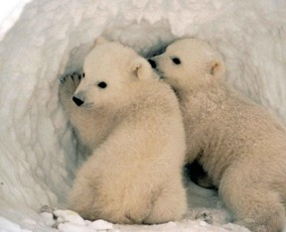
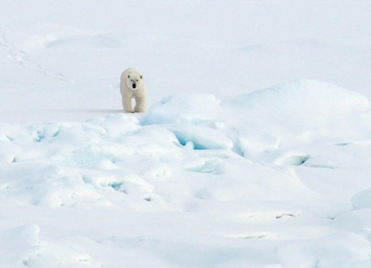
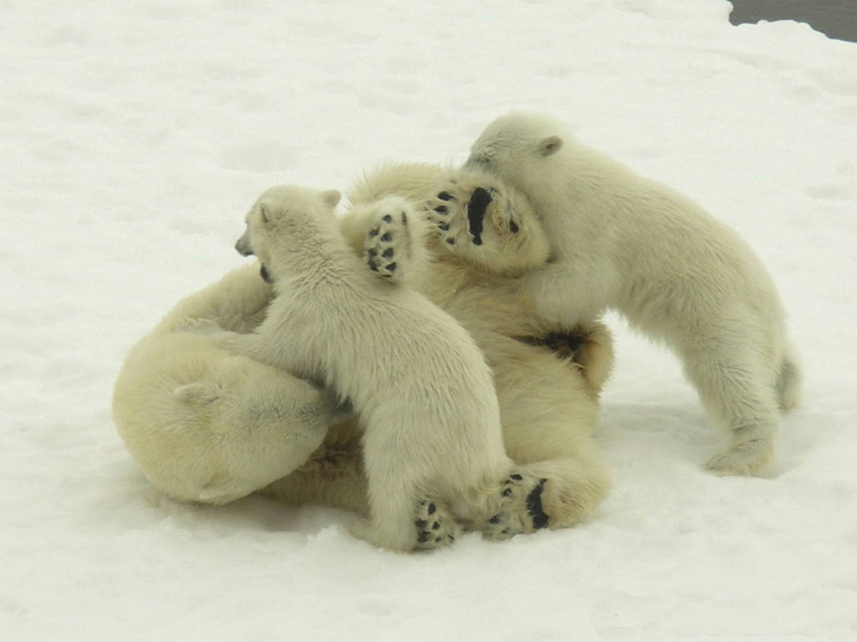
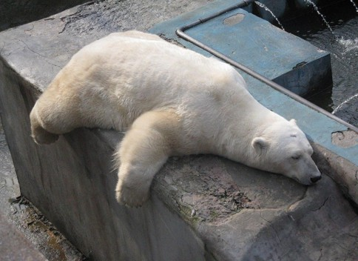
Visual Discourse Analysis: Composition
Notes:
Notes for Instructor: These images all denote the same thing: a polar bear. Variations of denotation exist: some photos are of single adult bears, some are of cubs, and one is of a family. Each image also has a denoted setting: snow/ice, brown gravel, or concrete. How do these various denotations carry different connotations about the bears’ behavior, habitat, health, and mood?
Next, ask learners to think about photographic composition: telephoto vs. closeup range, camera angle, subject awareness (is the bear looking at us?), colors, and the moods and relational dynamics these compositional elements imply to the viewer. Which image do learners think is the most effective in conveying the CC peril faced by polar bears? Hint: it may not be the image that makes us feel the worst (concrete slab, brown habitat), but instead the one that implies the most inherent value and appeal of these charismatic megafauna (family play). Ask learners to consider how CC messaging may better use positive moods (hope, joy, fun) rather than the common reversion to negative moods (anger, despair, guilt).

Slide 7

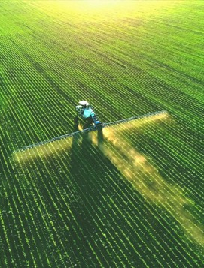

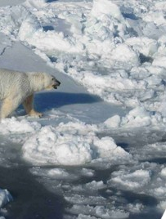
Visual Discourse Analysis: Pathos and Mood
Notes:
Notes for Instructor: Ask learners to consider how each of these diverse images affects their mood or emotions. Visual rhetoric can cause very strong emotions (pathos) that may be interpreted as simply factual (logos). Once viewers are trained to critically appraise gaps between denotation and connotation, they may appreciate that different viewers may perceive very different values or outcomes in the same image (the two agriculture images at the top left and bottom right are a good example). Evidence points to a greater effectiveness of engaging general audiences by sparking positive emotions rather than negative ones, especially negative ones that approach cliché (the polar bear on broken ice). Ask the whole group to vote: Which is the most hopeful or positive image of this group? Does it denote something that is actually a valid CC solution, or is the positive appeal based more on aesthetics and mood cues?

