Slide 1

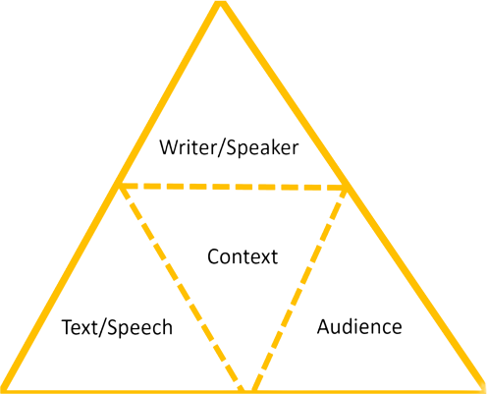
Critical Discourse Analysis: African Pastoralism
This Rhetorical Tetrahedron elaborates on the triad of ethos, pathos, and logos to show how writing’s context affects its design and impact.
Graph by ChloeGui via Wikimedia Commons, 4.0
Notes:
Notes for Instructor: The rhetorical triad may be new to learners, but it is old to the practice of discourse analysis. Ethos is the authority or reputation of the writer or other individuals quoted; pathos is the rhetorical use of emotion; logos is the deployment of facts and statistics in support of an argument. Ask learners: Based on postcolonial and capitalist values, what forms of prejudice may unfairly accompany newspaper coverage of these peoples? What journalistic standards might provide fair coverage of African pastoralists, considering that these groups often lack political representation, and can be poorer and more itinerant than their farming and urban counterparts?

Slide 2

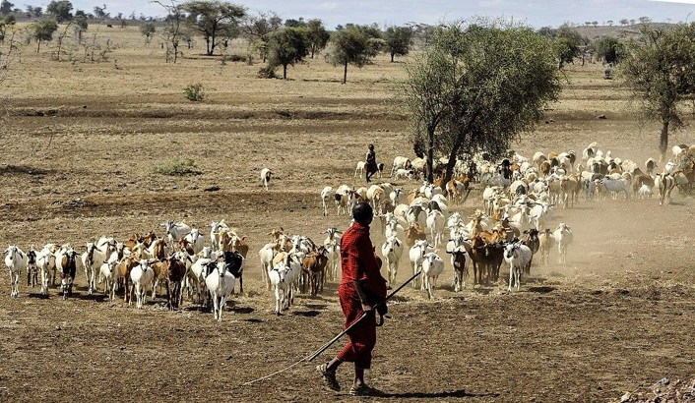
What Is Critical Discourse Analysis (CDA)?
CDA represents a variety of quantitative, qualitative, and comparative approaches to analyzing texts to uncover texts’ connotations, biases, erasures, and social context.
CDA may be applied to:
          scientific publications
policy documents
archival and historical materials
            films, images, and other creative media
journalism
Maasai herdsman with goats.
Public Domain via Wikimedia Commons.
Notes:
Notes for Instructor: The ethics of journalism require a balanced presentation of information, that is, representing all sides of an argument in public discourse. But ask learners about some ways that journalists can employ creative tactics, like selected interviewees, lexicon (words used), metaphors, facts and statistics (logos), and emotion (pathos) to present a story weighted with particular values.

Slide 3
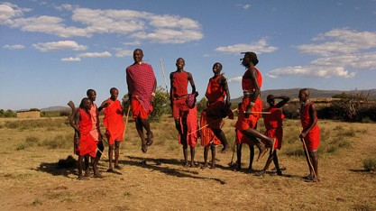
How Will You Use CDA in This Lesson?
Narrative analysis can help readers evaluate multiple news sources to compare and to contrast vying discourses about African pastoralism.
        Who is depicted in what framing (hero, villain, victim?) and what are they doing in nature?
        What keywords capture the article’s subjects and the qualities or connotations assigned to subjects?
        How do keyword quantities show rhetorical emphasis and choices?
        How does the lack of discourse or absence of keywords demonstrate disinterest or erasure?
The Maasai Adumu jumping dance.
Public Domain via Wikimedia Commons.
Notes:
Notes for Instructor: Point out to learners how this analysis requires a combination of quantitative and qualitative methods. Quantitative includes number of articles on a subject and keyword usage. Qualitative measures include rhetorical tone, depiction of subjects and authority figures, and use of creative elements like metaphors.

Slide 4
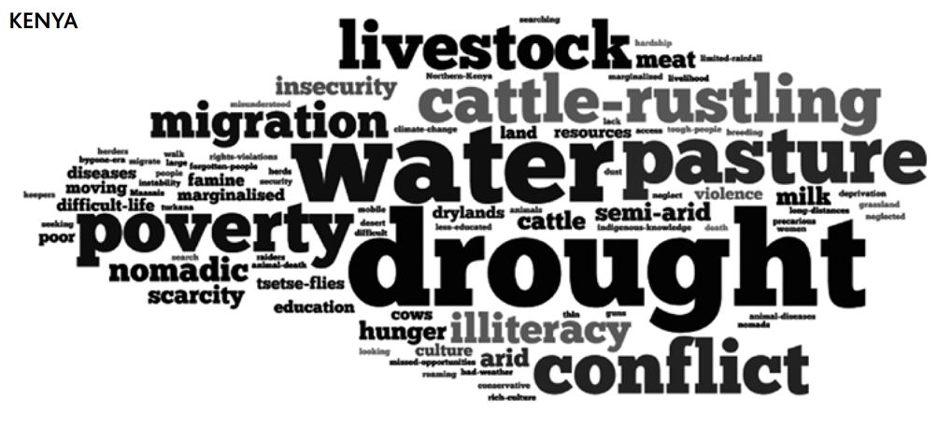
Media Perceptions and Portrayals of
Pastoralists in Kenya, India, and China
Shanahan 2013: https://www.iied.org/sites/default/files/pdfs/migrate/14623IIED.pdf
Shanahan focuses on newspaper coverage of pastoralists to assess how their discourse depicts the social and environmental effects of herding.
Figure 1 Excerpt: Word cloud created by keyword frequency (p. 15).
Notes:
Notes for Instructor: Ask learners to scrutinize the word cloud to find the largest “positive” term here. They will find it challenging. Yet, pastoralism in Kenya has existed for millennia, and for many peoples, it is the only way to generate food and income on these arid grasslands. This list also provides ideas for keywords that learners can use to search articles using the Ctrl + F function.

Slide 5
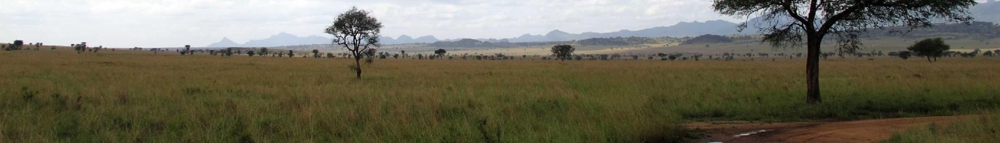
Media Perceptions and Portrayals of
Pastoralists in Kenya, India, and China
Shanahan 2013: https://www.iied.org/sites/default/files/pdfs/migrate/14623IIED.pdf
Shanahan concludes that 93% of the articles on Kenyan pastoralists are negative, and focus on conflict, drought, and banditry (6).
News coverage rarely mentions government policies that affect pastoralists, nor ideas for positive reforms and sustainable development of this livelihood (7).
This analysis is 10 years old: has the tone and content toward pastoralists changed?
Has climate change been integrated into the depiction of their needs and futures?
The Narus Valley savanna in Uganda, Africa. Unaltered image by Keitsist via Wikimedia Commons, 3.0.
Notes:
Notes for Instructor: This slide is not meant to be a “spoiler” on the outcomes of the learners’ discourse analysis, but it should pique their awareness of how a comprehensive survey of Kenyan pastoralism shows a bias toward negative framing. Learners may wish to use this biased frame as a challenge that inspires them to identify the minority of coverage that is positive or neutral and to take an interest in how those articles depict pastoralists, their ecosystem, and concepts like resilience or Indigenous knowledge. By observing positive portrayals, learners may discover how to craft their own socio-environmental writing with the support of positive authorities, facts, and emotions.

Slide 6
Table 2. Variables Considered during Detailed Textual Analysis
Variable | Description
Main goal | Is the main goal of the article (a) to describe natural history; (b) to report on policy, planning, or governance; (c) to discuss environmental changes in the region; (d) to report and explain scientific results; (e) to explain the relevance of environmental science to policy questions; (f) to explain the relevance of environmental science to individuals or landowners; (g) public reflections about environmental issues?
Emotional tone | Does the article convey a sense that the environment is threatened, cherished, homey, etc.?
People | Does the article represent people as disturbers, users, protectors, investigators, etc.? Does it represent them as collectively interested in the environment (we/our) or individually so (me/ my)? How does it represent relationships within the community (especially between insiders and outsiders)?
Everyday life | How does the article represent the relationship between the environment and people’s everyday lives, actions, and concerns?
Spatial scale | At what scale does the article consider environmental issues or concerns: individual, sub-set of community, local community, regional, national, global? If human intervention in the environment is discussed, what scale of intervention is privileged?
Temporal scale | What time scale does the article discuss: how far into the past and how far into the future? If human intervention in the environment is discussed, at what temporal scale is it presumed to function?
Environmental politics | How does the article convey the relationship of the environment to formal politics (government, policies, regulations) and informal politics (civic action, public debate)? What types of intervention are described? What types of intervention are ignored despite being commonly discussed elsewhere?
Valuing the environment | What does the article suggest about why the environment is valuable (intrinsic value, ecological value, spiritual value, relationship to economic growth, human health, climate resilience, etc.)?
Risks | Does the article use a risk frame? If so, what types of risks or costs does it discuss (economic, health, legal, environmental, etc.) and to what extent does it discuss the probability of those risks or costs?
Change | Does the article represent the environment as static or changing? If changing, how does it evaluate those changes (unavoidable, primarily positive, primarily negative, neutral)?
Burke et al. 2015 identified a series of variables to standardize their textual analysis across 53 articles.
Notes:
Notes to Instructor: Make this slide or table handy for learners as they decide on the terms of the CDA analysis during the lesson. They may find these variables and themes useful in guiding their keyword selection and tonal analysis.

Slide 7
How Will You Use CDA in This Lesson?
(continued)
Excerpt: “The Feds Crack Down on Feral Cattle”
by Jonathan Thompson of High Country News:
It may be the most consequential action the federal government has taken in at least two decades to mitigate the impacts of overgrazing on public lands. It might even look like the start of real grazing policy reform, something conservationists have been pushing for since the 1970s. But there’s a catch: The only reason the Forest Service did something this time is that the bovines in question are feral — descendants of cattle abandoned by a belly-up livestock operator in the 1970s. Think of them as the bovine version of “orphaned” oil and gas wells, similarly sullying land and water and continuously belching methane.
By highlighting different aspects of narrative, including actors, settings, and characterizations, the levers of rhetorical discourse emerge. This exercise also provides keywords that may be searched within and across articles and journals using the [ctrl-f] function.
https://www.hcn.org/articles/south-landline-the-feds-crack-down-on-feral-cattle
Notes:
Notes for Instructor: Each highlight color brings out a different level of discourse in this text. Green highlights refer to government policy; Yellow to environmental degradation; Blue to environmental actors (+/-); and Gray is a metaphor that constructs these feral cattle in a particularly negative light. From this brief excerpt, learners see how texts work on multiple levels by presenting an environmental case through a particular framing (here, a conservationist worldview); and deploying connotations (“belly-up livestock operator” sounds like a lazy, dead failure); emotions or pathos (gross lexicon of “sullying” and “belching”); and metaphor (feral cattle are abandoned oil wells). The most useful keywords to search across articles may be the following: government (Forest Service), conservationists, overgrazing, sullying (polluting, dirtying, ruining), public lands, and policy.

