Slide 1

Introduction to Sociology
By: Dr. Lori Peek

Slide 2

Major Theoretical Approaches
Perspective | Level of Analysis | View of Society
Functionalist | Macro | Society is composed of interrelated parts that work together to maintain stability within society. The stability is threatened by dysfunctional acts and institutions.
Conflict | Macro | Society is characterized by social inequality; social life is a struggle for scarce resources. Social arrangements benefit some groups at the expense of others.
Symbolic Interactionist | Micro | Society is a sum of interactions of people and groups. Behavior is learned in interaction with other people; how people define a situation becomes the foundation for how they behave.

Slide 3
Comparing Major Theoretical Paradigms
 | Functionalism | Conflict Theory | Symbolic Interactionism
Level of Analysis | Macro | Macro | Micro
Core Questions | What keeps society functioning smoothly? What are the parts of society and how do they relate? What are the intended and unintended outcomes of an event? | How are wealth and power distributed in society? How do people with wealth and power keep them? Are there groups that get ahead in this society and why? How are society's resources and opportunities divided? | How do people co­ create the society? How does social interaction influence, create, and sustain human relationships? Do people change behavior from one setting to another, and if so, why?

Slide 4
Methodological Approaches
Quantitative Research
Based on the goal of scientific objectivity and focused on data that can be measured numerically
Qualitative Research
Uses interpretive description rather than statistics to analyze underlying meanings and patterns of social relationships

Slide 5



Research Methods
Surveys
Secondary data analysis
Content analysis
Field research
  Interviews
  Participant observation
  Focus groups
  Photovoice
Experiments
Spatial Analysis/GIS

Slide 6

Structure/Agency
Structure vs. agency is an important debate in sociology that highlights to what extent an individual’s life is determined by social forces
Agency – The ability to act independent of structure
Structure – Pre-existing social arrangements that shape and constrain behavior

Slide 7

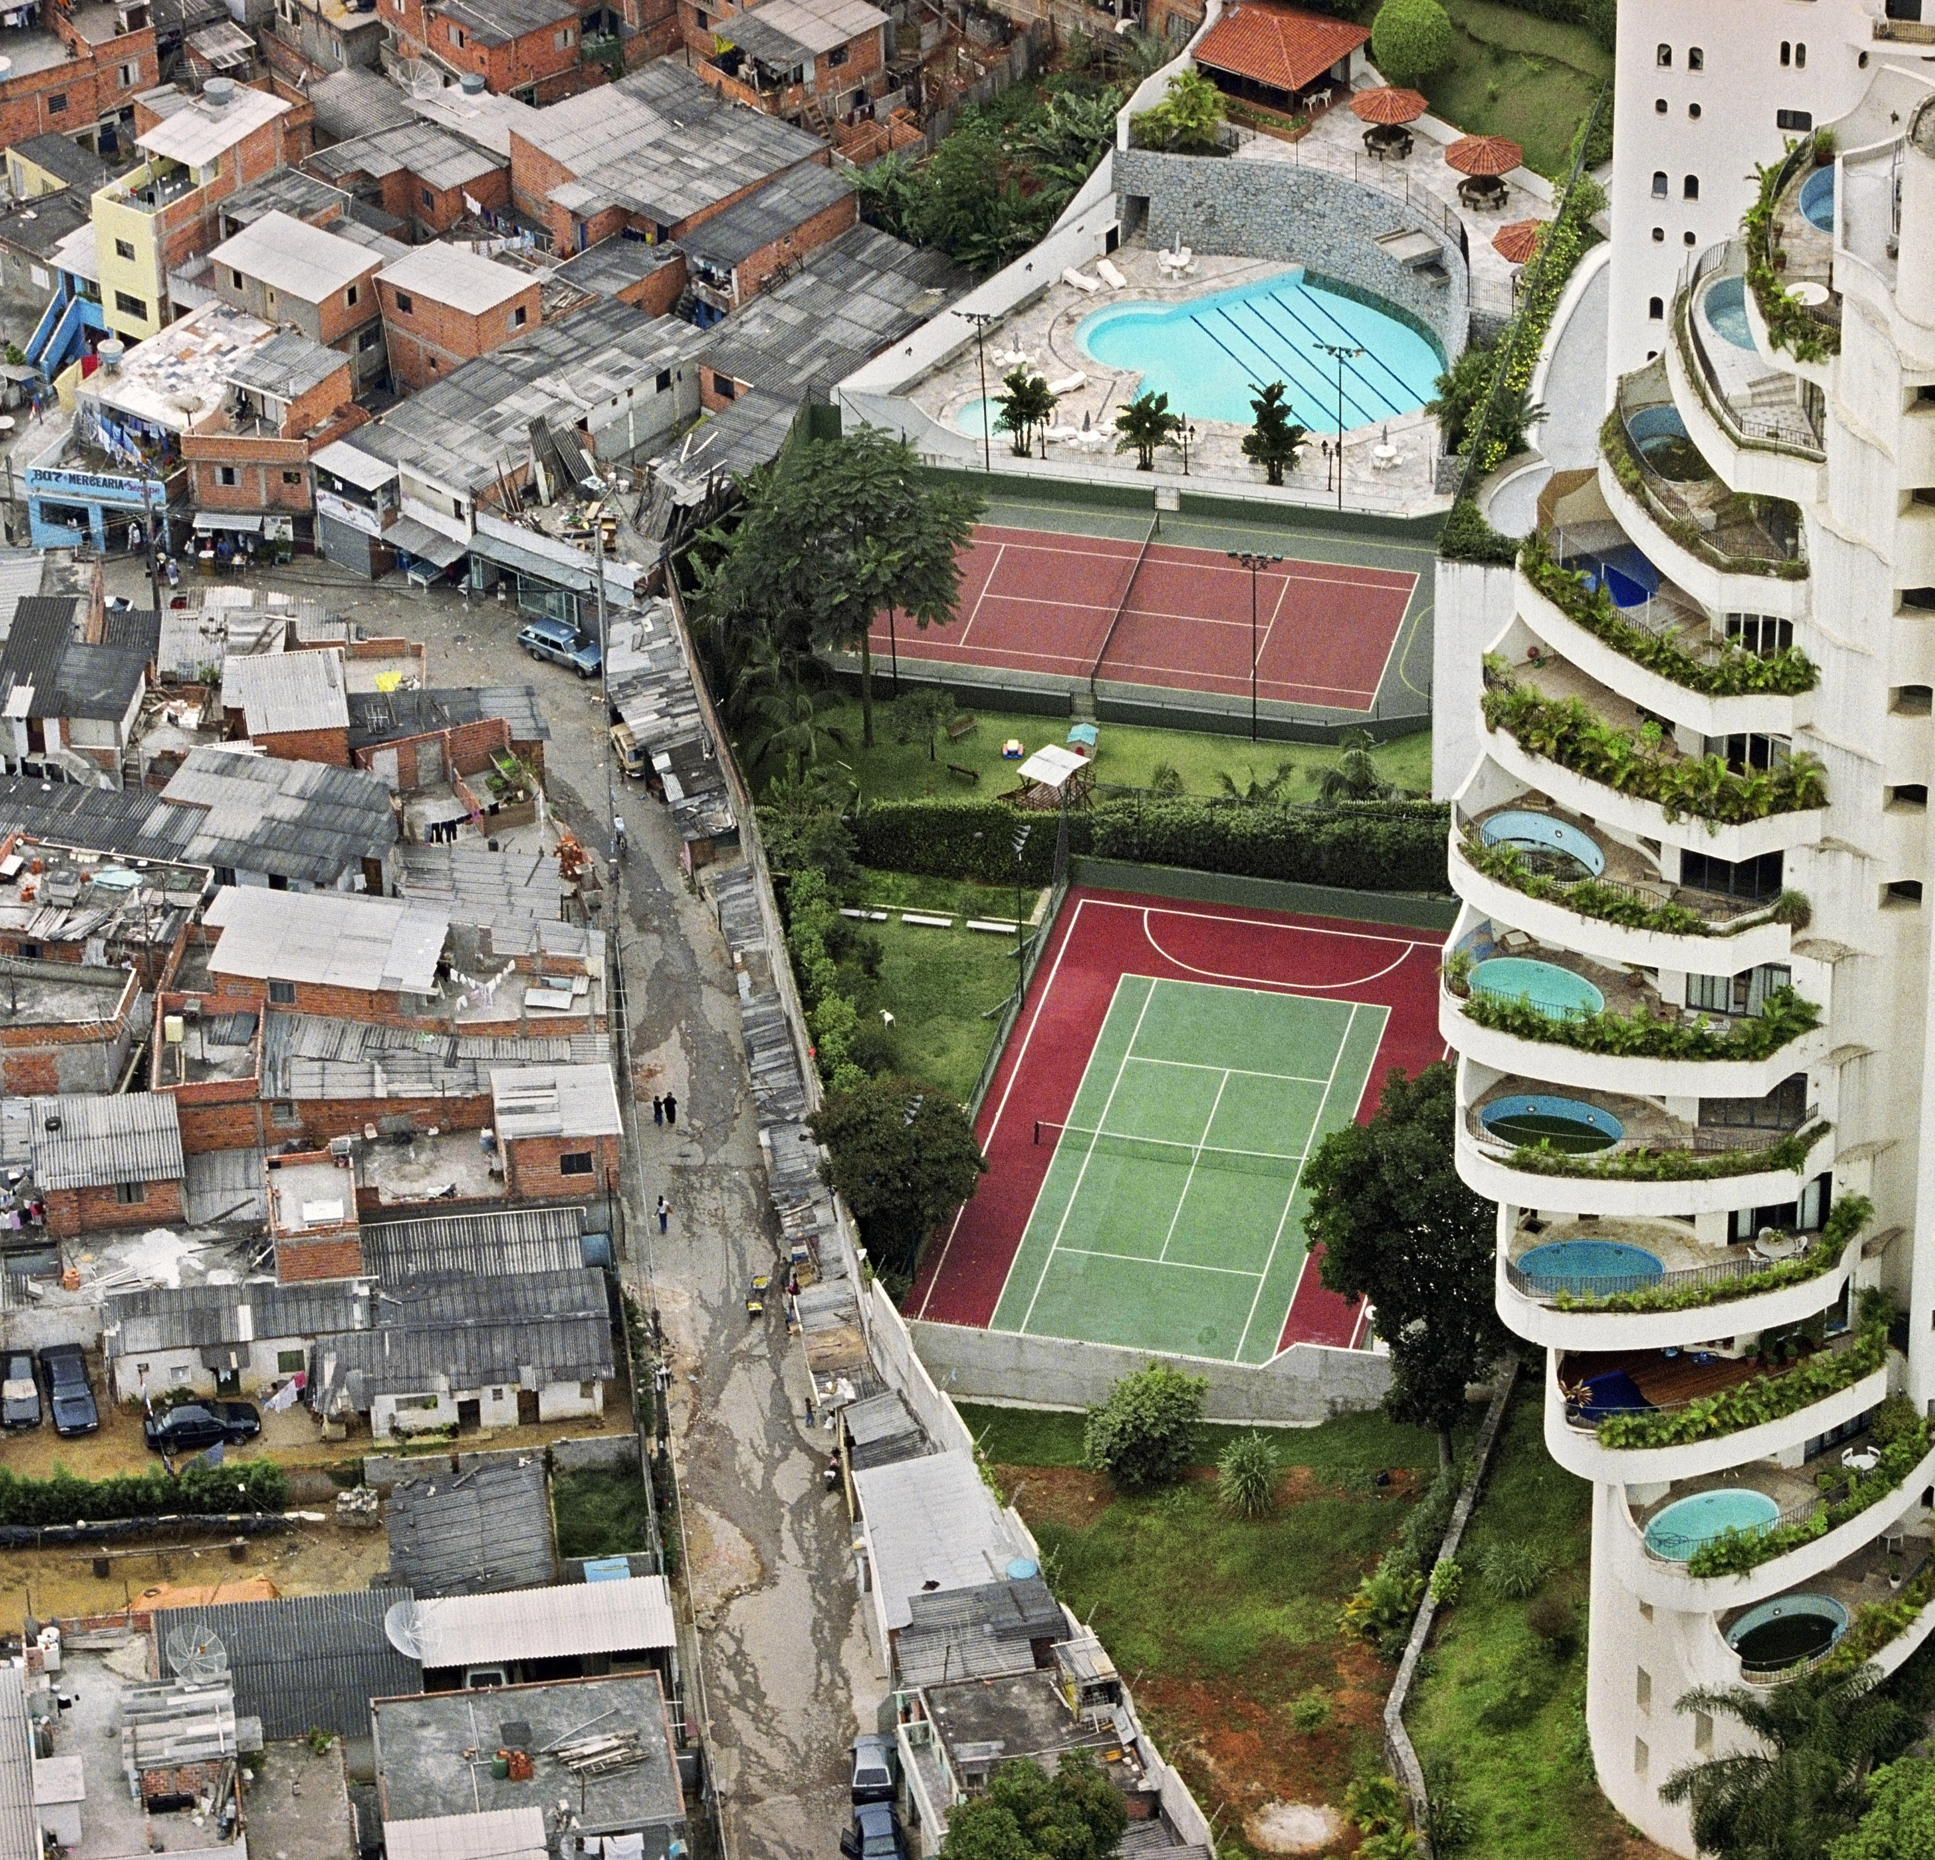
Social Stratification
The hierarchical arrangement of large social groups based on their control over basic resources (Feagin and Feagin 2003).
Social structural inequality is often based on class, race, gender, age, and other attributes on which society places value.

Slide 8
The Social Causation of Disasters
Natural Environment
Spatially varied, with unequal distribution of opportunities and hazards
Opportunities, locations, and resources for human activities (agricultural land, water, minerals, energy sources, sites for construction, places to live and work
Hazards affecting human activities (drought, floods, earthquakes, hurricanes, volcanic eruptions, diseases)
Social processes determine unequal access to opportunities and exposure to hazards
Class, gender , ethnicity, age, disability, immigration status
Social systems and power relations
Political and economic systems at national and international scales

