Slide 1


Understanding Disease and Illness as a
Socio-Environmental Problem

Slide 2
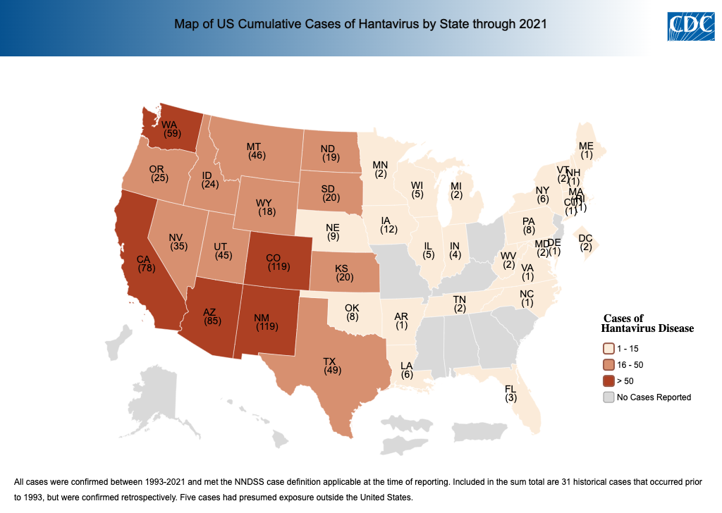

Slide 3

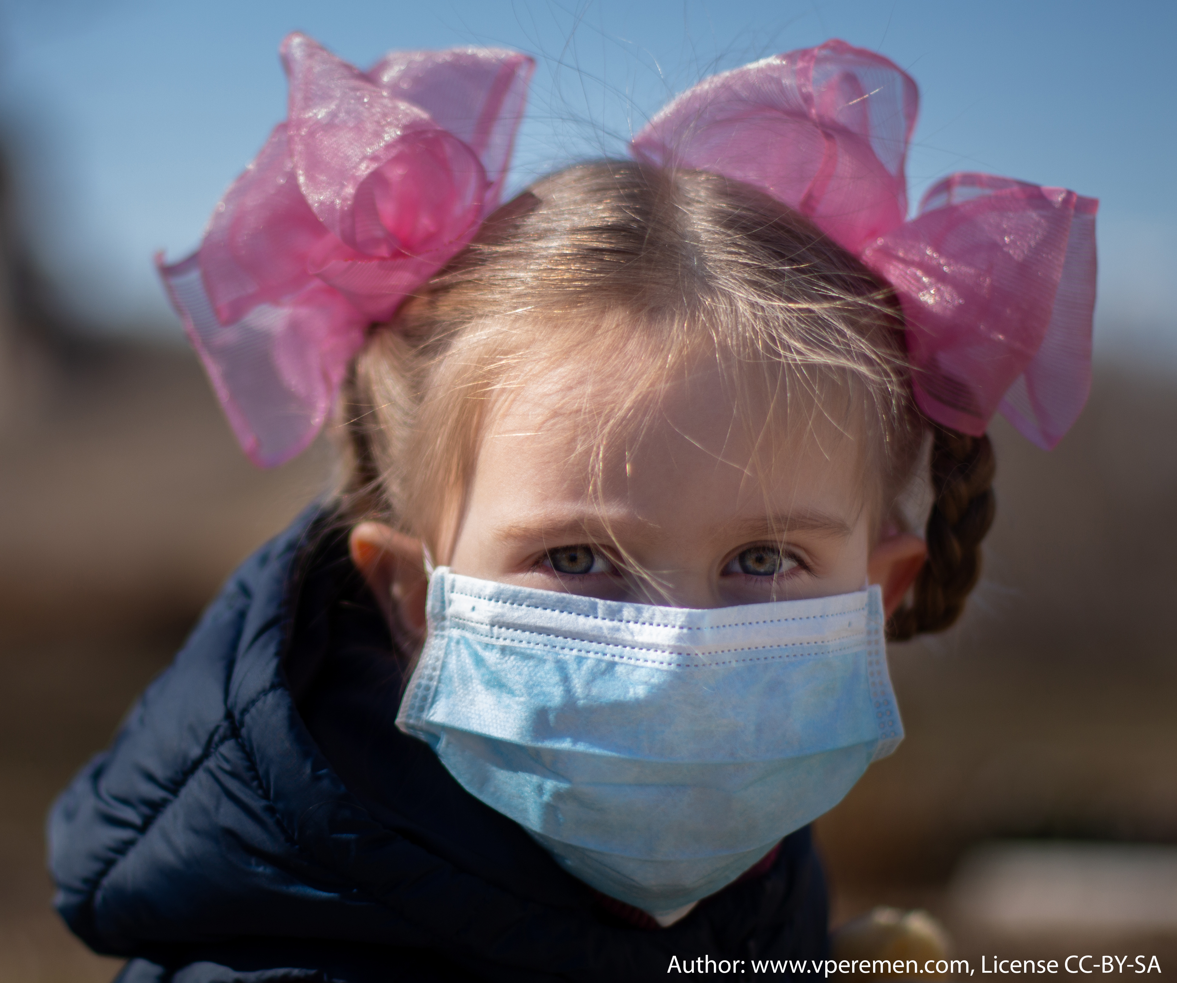
Strong Linkages Between Human Health, Social Dynamics, & the Environment
Recent Example: COVID-19
Zoonotic (animal in origin)
Environmental aspects: pollution, climate, and urbanization influenced risk and severity.
Social aspects: controversy existed about how it spread to humans; a lack of trust in government, vaccines, and policies spread.
maintaining natural infection
viral amplification
probable COVID-19 transmission path
human
primary host (bat)
human
secondary (pangolin)
intermediate hosts
(yet to be determined)
From: Ray, A.S., & Bhattacharya, K. (2023). An Overview on the Zoonotic Aspects of COVID-19. Proceedings of the National Academy of Sciences, India, Section B Biological Sciences. https://doi.org/10.1007/s40011-023-01445-8

Slide 4
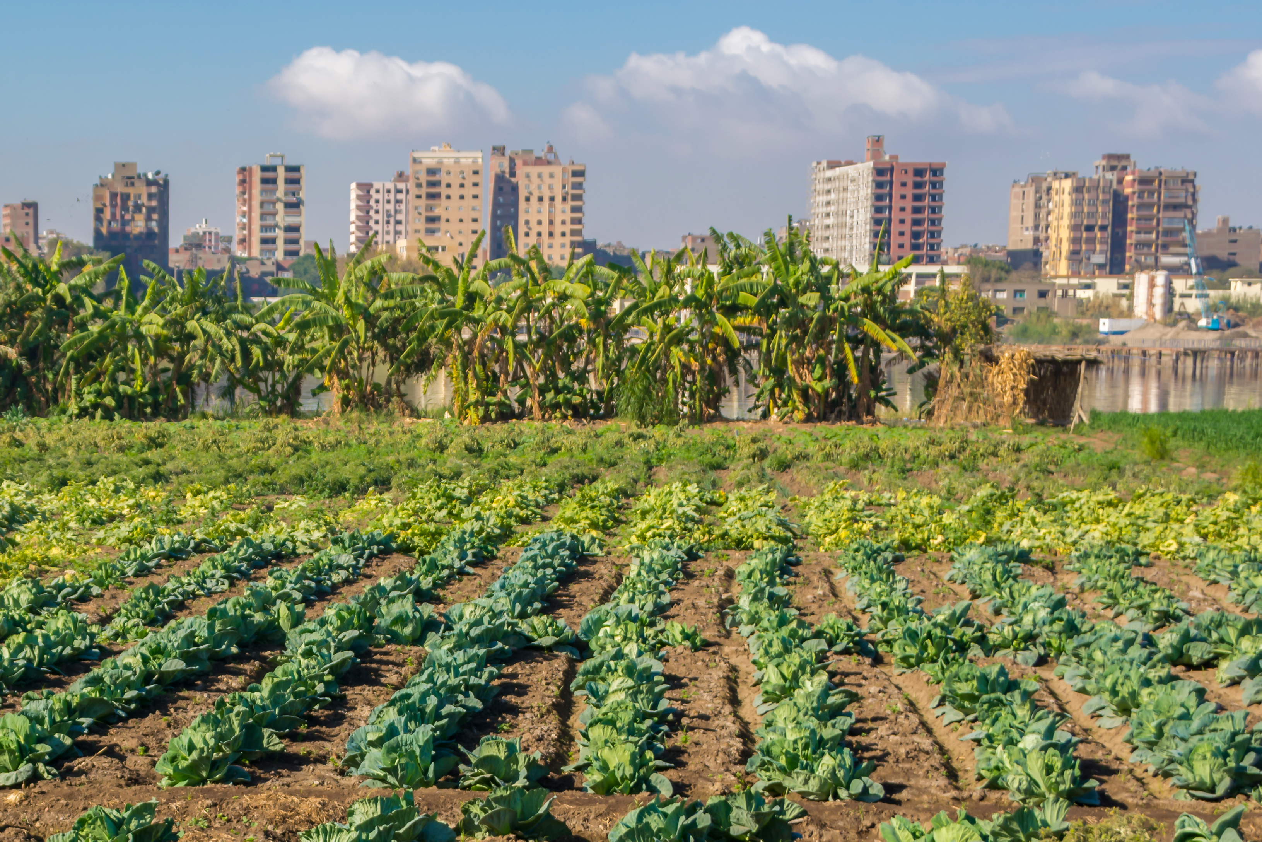
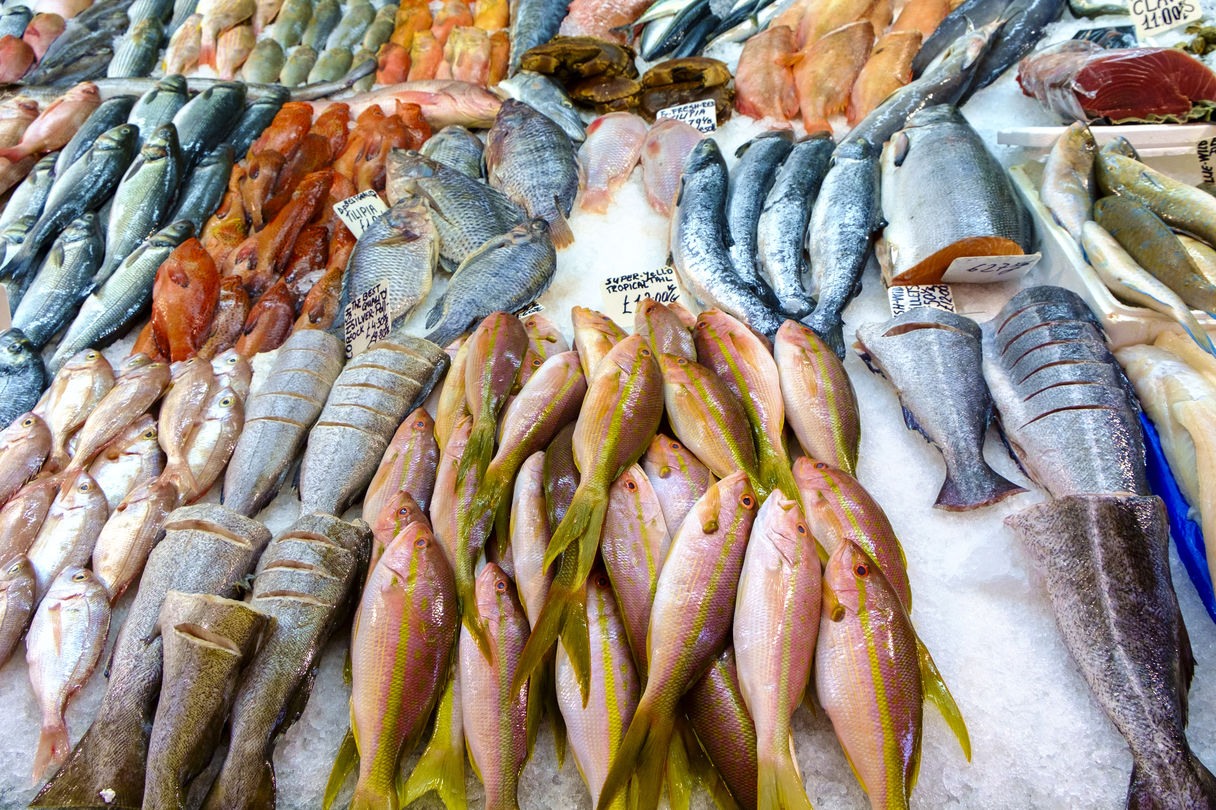

The Most-Influential Environmental
Factors Affecting Zoonotic Illnesses
land use change
biodiversity loss
climate change
built environment
habitat degradation
agricultural intensification
deforestation
microclimatic changes
Example Mechanisms
Viral hosts (“reservoirs” of virus) often proliferate in modified habitats where predators may be excluded; altered temperatures from land cover simplification are often beneficial.
Loss of species may open niches and/or result in higher resources for viral hosts; in some more cases, biodiverse areas have more mammals that are viral hosts.
Altered temperatures and increased natural hazards may benefit viral hosts or make people more susceptible to disease.
Allen et al. (2017); White and Razgour (2020)
Notes:
Notes to Instructor: You may need to define “reservoir”; it refers the viral “load” (amount) in its animal hosts. The three most commonly reported environmental factors that influence risk of zoonotic illnesses are land use change, biodiversity loss, and climate change. These three factors, of course, can interact in complex ways.

Slide 5
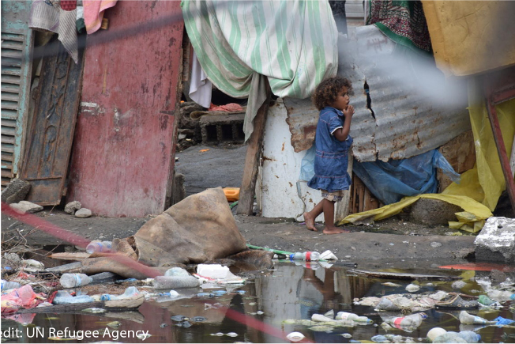

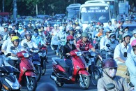

The Most-Influential Social
Factors Affecting Zoonotic Illnesses
POVERTY
Globalization
EXPANDING POPULATIONS
cONFLICT
racial and ethnic disparities
trade, travel
Example Mechanisms
Typically, less access to health care, poorer health in general, and an inability to isolate all increase a population’s susceptibility and rates of morbidity/mortality.
Increased trade and travel lead to higher rates of transmission.
More human-to-human contact and/or the movement of people to regions where they are more likely to encounter hosts are factors.
Troops may spread disease; its occurrence often has feedbacks to poverty and poor health.
Allen et al. (2017); White and Razgour (2020)

Slide 6
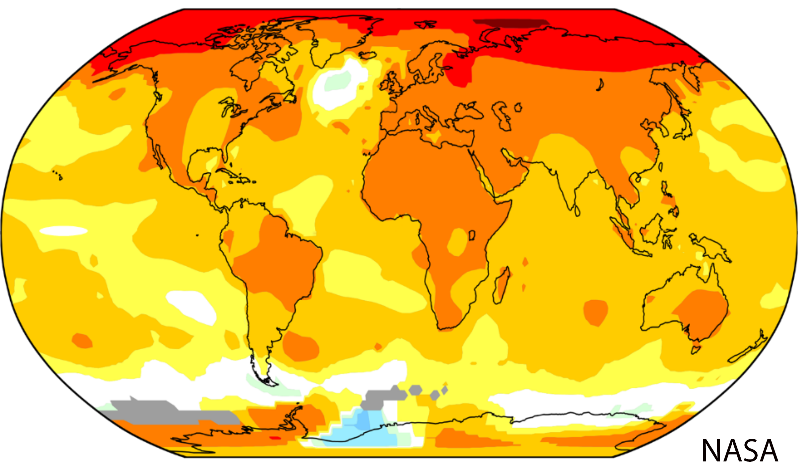
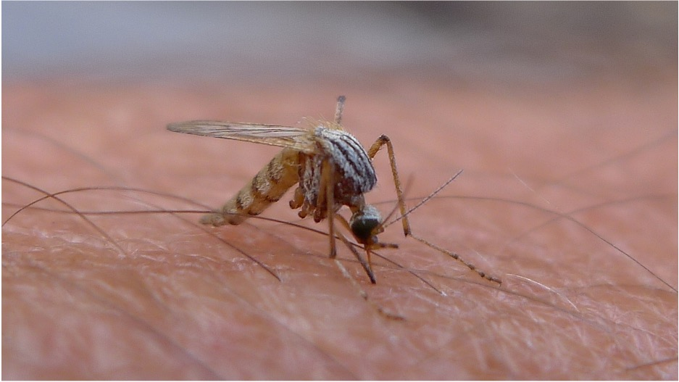
Worldwide Effects on Disease:
Climate Change
Diseases are getting much worse.
Many are carried by vectors whose habitat is more suitable under warmer climates (e.g., malaria, dengue, Zika, chikungunya).
The geographic range for these vectors is expanding.
Transmission seasons are becoming longer.
From: Semenza, J.C., Rocklöv, J., & Ebi, K.L. (2022). Climate change and cascading risks from infectious diseases. Infectious Diseases and Therapy, 11(4): 1371-1390. https://doi.org/10.1007/s40121-022-00647-3
Notes:
Notes to Instructor: Instead of you going over these slides, the article by Semenza should be summarized by advanced learners if it was assigned to them; they should do a more in-depth coverage than these slides here and next. The article is worth reviewing because climate change will only get worse over time, and it is impacting disease burden everywhere.

Slide 7
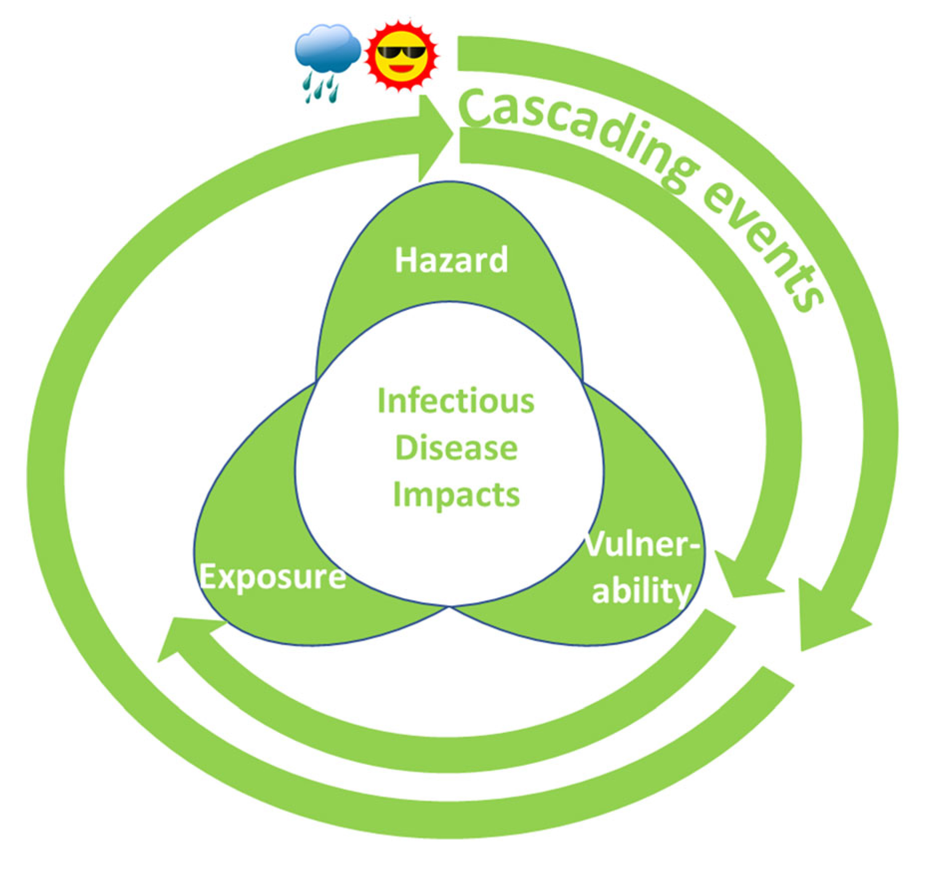
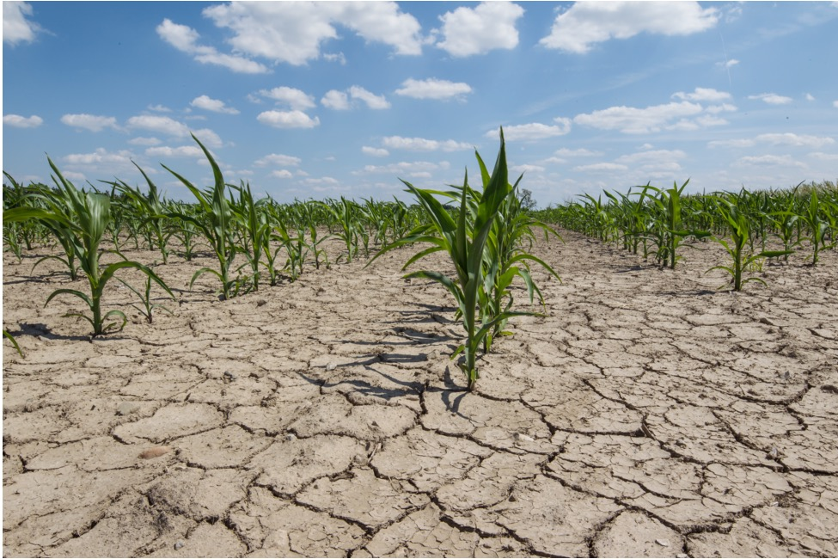
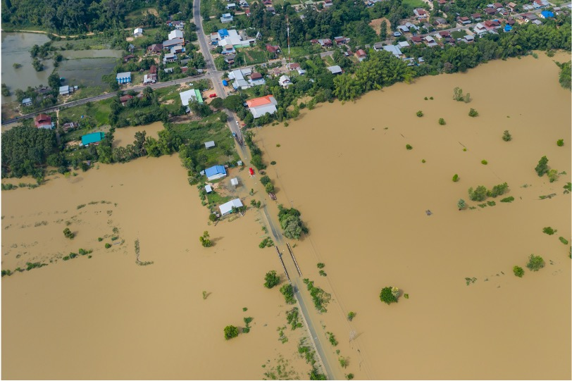
Worldwide Effects on Disease:
Climate Change
Risk of disease is compounded by cascading effects of hazards, such as:
Extreme precipitation and flooding
(e.g., Malaria increases due to more stagnant water where mosquitoes breed.)
Drought
(e.g., Cholera spreads in association with malnutrition and displacement.)
Elevated temperature
(e.g., Legionella spreads as bacteria replicate faster.)
Sea level rise
  (e.g., Schistosomiasis increases due to the parasite’s salinity
  tolerance.)
From: Semenza, J.C., Rocklöv, J., & Ebi, K.L. (2022). Climate change and cascading risks from infectious diseases. Infectious Diseases and Therapy, 11(4): 1371-1390. https://doi.org/10.1007/s40121-022-00647-3

Slide 8
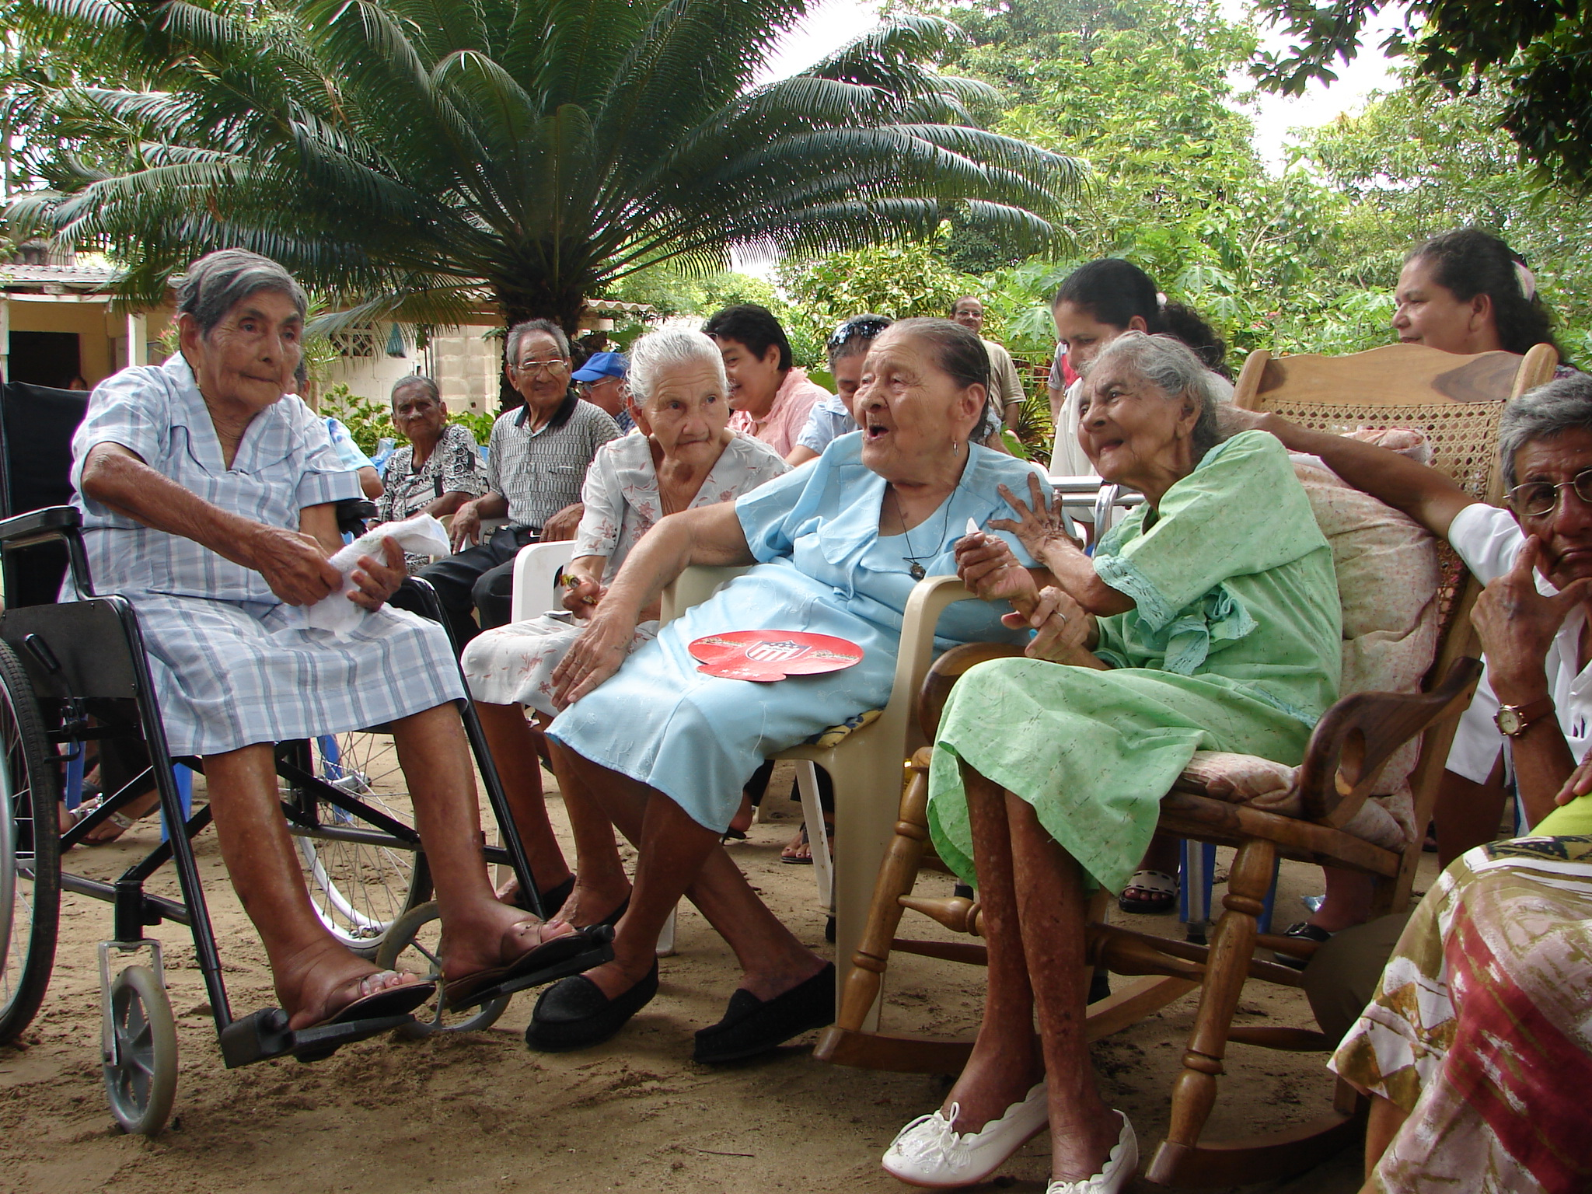
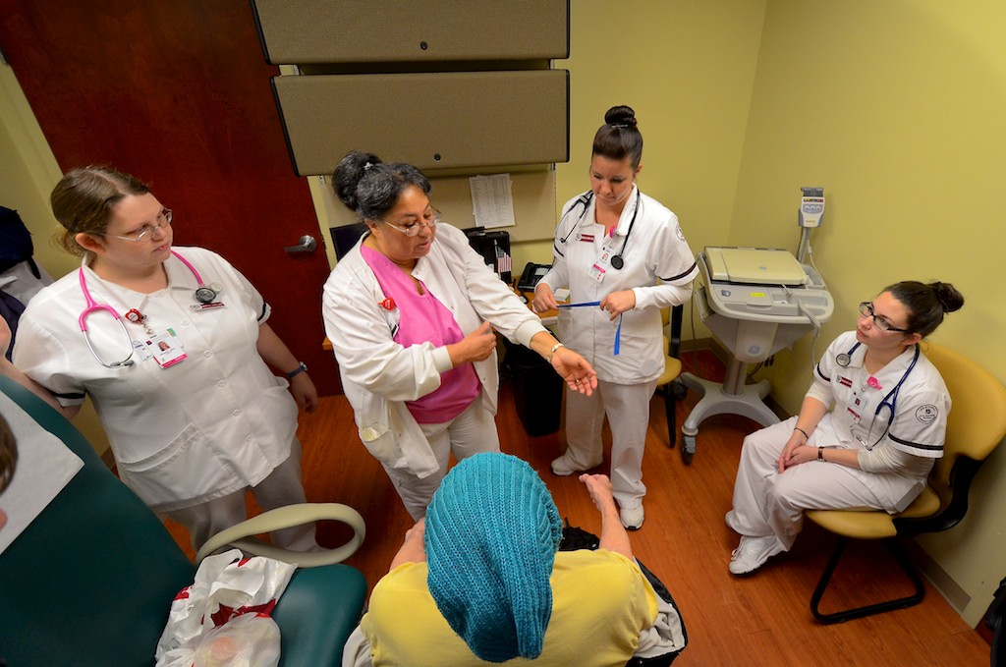
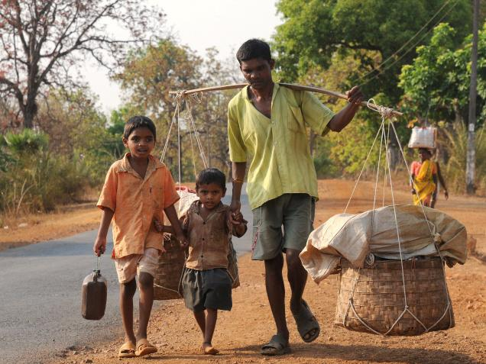
Dimensions of Risk Often
Determine Impacts on Humans
Risk of disease is also compounded by cascading effects of vulnerability for those,
for example, who:
Have little social support
or financial resources
Work in service jobs or live
in crowded conditions
Face displacement from their homes
Notes:
Notes to Instructor: Hazard: People who, for example, work in mining jobs or more generally those in pollution-heavy or dangerous jobs are more likely to be poor, and thus, they can’t take leave and isolate during an outbreak. Those living in polluted urban areas or near hazardous zones climatically may experience disasters more frequently, and thus, they are less able to cope when a new one comes along. They also tend to have poorer health in general, meaning they are more susceptible to illness and to have poorer outcomes. Vulnerability: As covered in previous slides, vulnerable individuals include those who have a small social network, those who are experiencing poverty, or those who have poor health. Exposure: Examples of people who are more exposed are those living or working in close quarters or interacting with many people every day.
NOTE: SESYNC has an extensive resource focused on the three dimensions of risk and how they together determine socio-environmental resistance and resilience
Explainer - https://www.sesync.org/resources/sustainability-resilience-and-dimensions-risk-hazard-exposure-vulnerability
Lesson - https://www.sesync.org/resources/lesson-introduction-resilience-and-sustainability-ecological-social-socio-environmental

