Slide 1

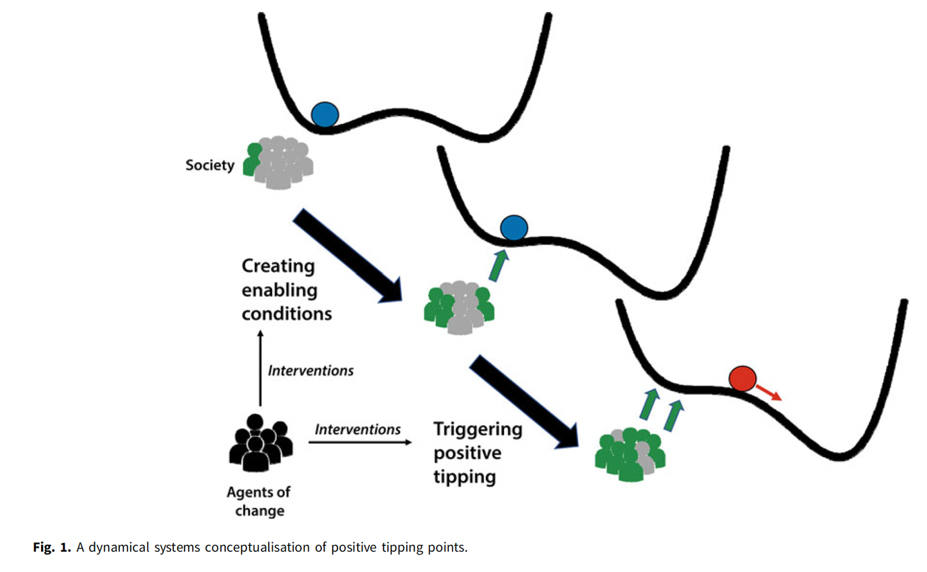
Cascades of Social Behavior in S-E Systems
Figure 1 from Lenton et al. (2022) theorizes how agents of change with a particular intent (here, achieving greater sustainability) can affect tipping points in collective societal behavior.
Notes:
Notes to Instructor: Observe how a small minority of people, described here as “agents of change,” may act as a critical mass that effectively nudges a social system into a tipping point that results in a new norm for group behavior. It might be engaging for learners to briefly think back on normative behaviors from the past and see how social change has made those behaviors unacceptable. For example, glamorous cigarette smoking and the “three martini lunch” are relics of a past mid-century American culture. Trophy hunting for exotic animals, such as the African safaris taken by elites from Europe and the United States, is another example of past norms that have become unacceptable, or at least rare, due to social evolution coupled with changes in policy. One day soon, burning fossil fuels may entail a similar stigma and social risk to the user.

Slide 2


Overview of Behavioral Cascades
from Lenton et al. (2022); https://doi.org/10.1017/sus.2021.30
        How do we approach a wicked problem like climate change without feeling paralyzed by its inherent socio-environmental complexity?
                Enable a critical mass of trendsetters, which may be a small minority (~2%) of the population.
                Reduce the complexity of the big problem into clear arenas in which the critical mass may take action:
                Transportation
                Food production and consumption
                Electricity generation.
                Note: Reducing complexity should not result in “silos” or artificial divisions among issues when there may be inter-sector synergies, such as the food-energy-water nexus, that work to resolve multiple problems at once.
The familiar frustration of being stuck in a traffic jam may be a useful socio-psychological starting point for implementing public transportation and microtransportation systems.
Photo is public domain via Wikimedia Commons.
Notes:
Notes to Instructor: So much of the resistance to move past the fossil fuel regime is based on fossil fuels’ spectacular affordability, convenience, and energy density. But how can changemakers flip the script on the wonder of fossil fuels to communicate their multilevel problems (including but not limited to climate change)? Now that the regime has manifested steep downsides, the benefits of shifting to a renewable energy regime become much more apparent and appealing. Part of the social and psychological challenge for changemakers is to communicate that the normative culture of fossil fuel overuse is an aberration or stark counter-norm that will be viewed by future generations with a range of negative emotions—long-term thinking.

Slide 3

Enabling Conditions
from Lenton et al. (2022); https://doi.org/10.1017/sus.2021.30
                Identify enabling conditions that allow the critical mass to work effectively among peers:
                Target small populations
                Alter social network structure
                Provide relevant information
                Reduce price
                Improve quality or performance
                Increase desirability
                Increase accessibility
                Coordinate complementary technologies
Graphic is public domain via Wikimedia Commons.
Notes:
Notes to Instructor: Learners may enjoy quickly running through examples of these enabling conditions in action. Ask for volunteers to contribute examples for each one.

Slide 4
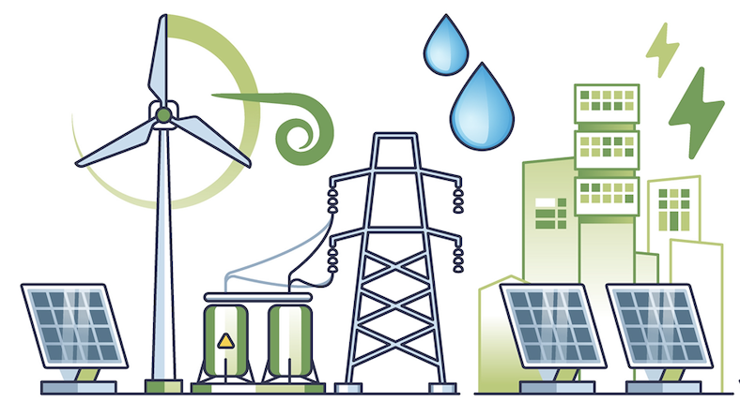
Reinforcing Mechanisms
from Lenton et al. (2022); https://doi.org/10.1017/sus.2021.30
                Identify reinforcing mechanisms that help to fund, popularize, and sustain behavior change:
                Innovations in social, technological, and ecological systems
                Policy changes
                Private and public investment
                Better communication with the public
                Behavioral nudges, incentives, and “carrots” for positive reinforcement
Graphic by Adobe Stock
Notes:
Notes to Instructor: While sociology and psychology are important aspects of any socio-environmental solution, learners should remember that monetary investment, brainpower, and aggressive policy change fostered by courageous politicians are also essential components to make difficult but necessary changes. What college majors outside of environmental science need to contribute to behavioral cascades?

Slide 5
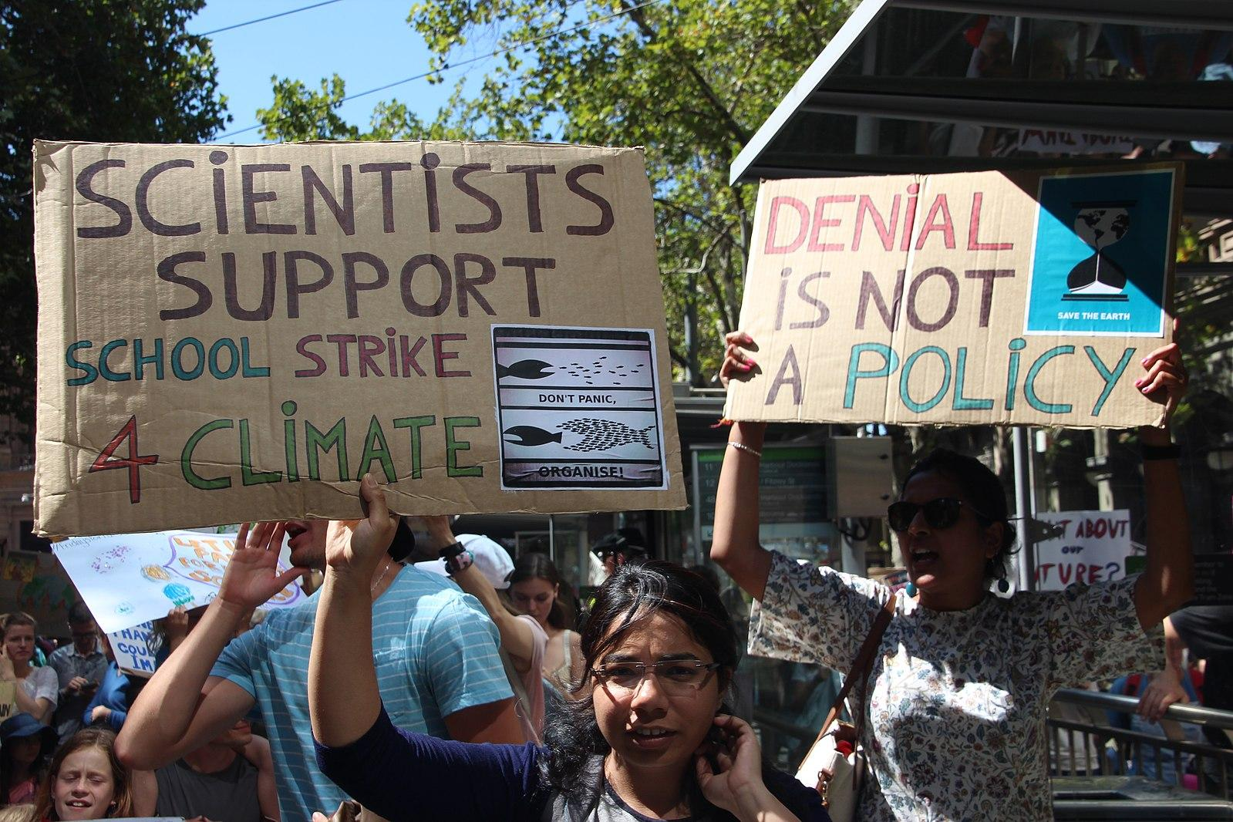
How to Start a Revolution
from Wilson et al. (2016), DOI: 10.1111/cobi.12632
Behavioral economics can help changemakers craft the most effective approaches by integrating human thought processes:
                Recognize bias and myopia in our perceptions of the right behavior
                Use emotion and social feedback to encourage pro-environmental choices
                Communicate long-term effects to overcome the short-term thought bias
                Appeal to self-interest in economics, social acceptance, benefits to kin and society, and personal legacy in the long term.
Students in Melbourne, Australia protest climate inaction with a school strike. Unaltered photo by Takver via Wikimedia 2.0.
Notes:
Notes to Instructor: The SESYNC explainer on classical vs. behavioral economics may resonate with this lesson. It can be accessed here: https://www.sesync.org/resources/classical-versus-behavioral-economics-environmental-applications

