Slide 1

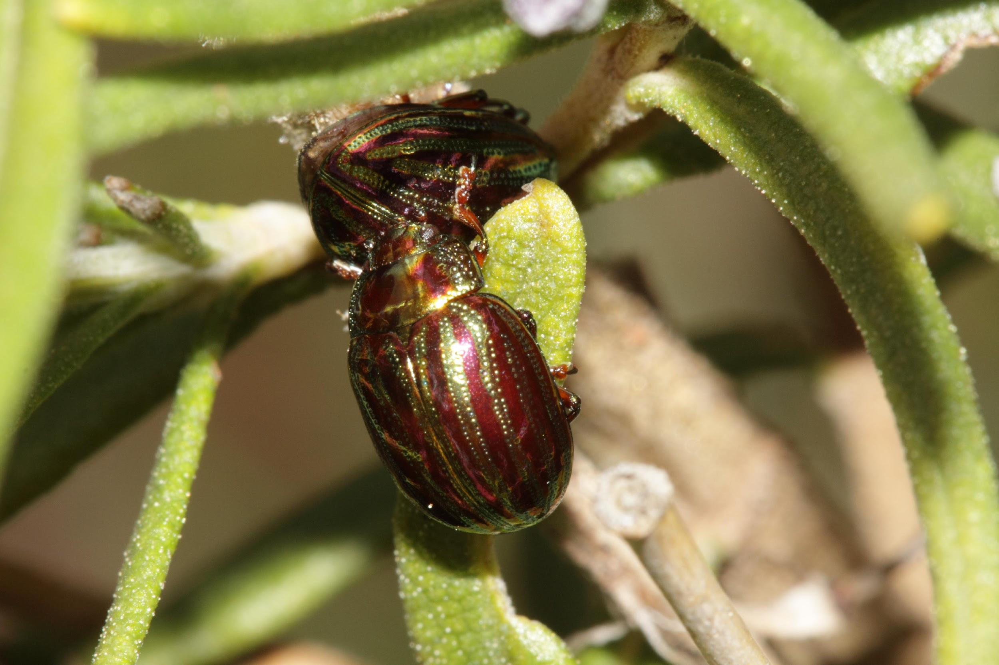
Cascading Effects in Complex Systems Part 1:
Species Interactions Lead to Regime Shift
An invasive beetle
Credit: Wikimedia Commons

Slide 2


Cascading Effects
A cascading effect propagates through a complex system sequentially (i.e., moves in one direction).
It is common for cascades to occur ecologically,
socially, and socio-environmentally.
Cascades gain momentum through enabling conditions, which are typically:
  Human impacts, in ecological systems
  Human agency or technological innovations, in social systems
  Human impacts and social or technical innovations, in socio-environmental systems.
Cascades can result in tipping points (regime changes).
Credit: Olelxandr P. (Pexels share)
Notes:
Notes to Instructors:
1) Emphasize that there are important differences between social-ecological cascades that lead to tipping to points, largely due to human agency. Agents in social networks have the ability to purposefully make changes such as adding more agents (nodes) and effects can cascade much more rapidly (https://doi.org/10.1016/j.ecolecon.2021.107242).
2) If you wish to provide good examples now (some are mentioned in Lessons 2 and 3 of this series), they include:
Social cascades – The sequential spread of norms and the adoption of environmental behaviors can lead to social tipping points in which small changes in a social system “push” it into a different state because of reinforcing feedbacks. A clear example of a social cascade is the adoption of the domestication of crops, which led to an agricultural revolution with massive impacts on land use (https://doi.org/10.1038/s41562-022-01388-6).
Ecological cascades – Entire changes occur to food webs when sequential extirpation events occur, e.g., a species is lost and/or an invasive species arrives (https://doi.org/10.1038/s41598-018-23282-w). Social events, such as the development of a new fishing technology that results in overfishing of a top predator, can also enable trophic cascades (https://doi.org/10.1016/j.cub.2019.07.081).
Socio-environmental system cascades – Climate change, which includes environmental cascades, can also trigger economic and social upheavals—each of which can have cascading effects on people and business (https://doi.org/10.1088/1748-9326/ac42fd).

Slide 3
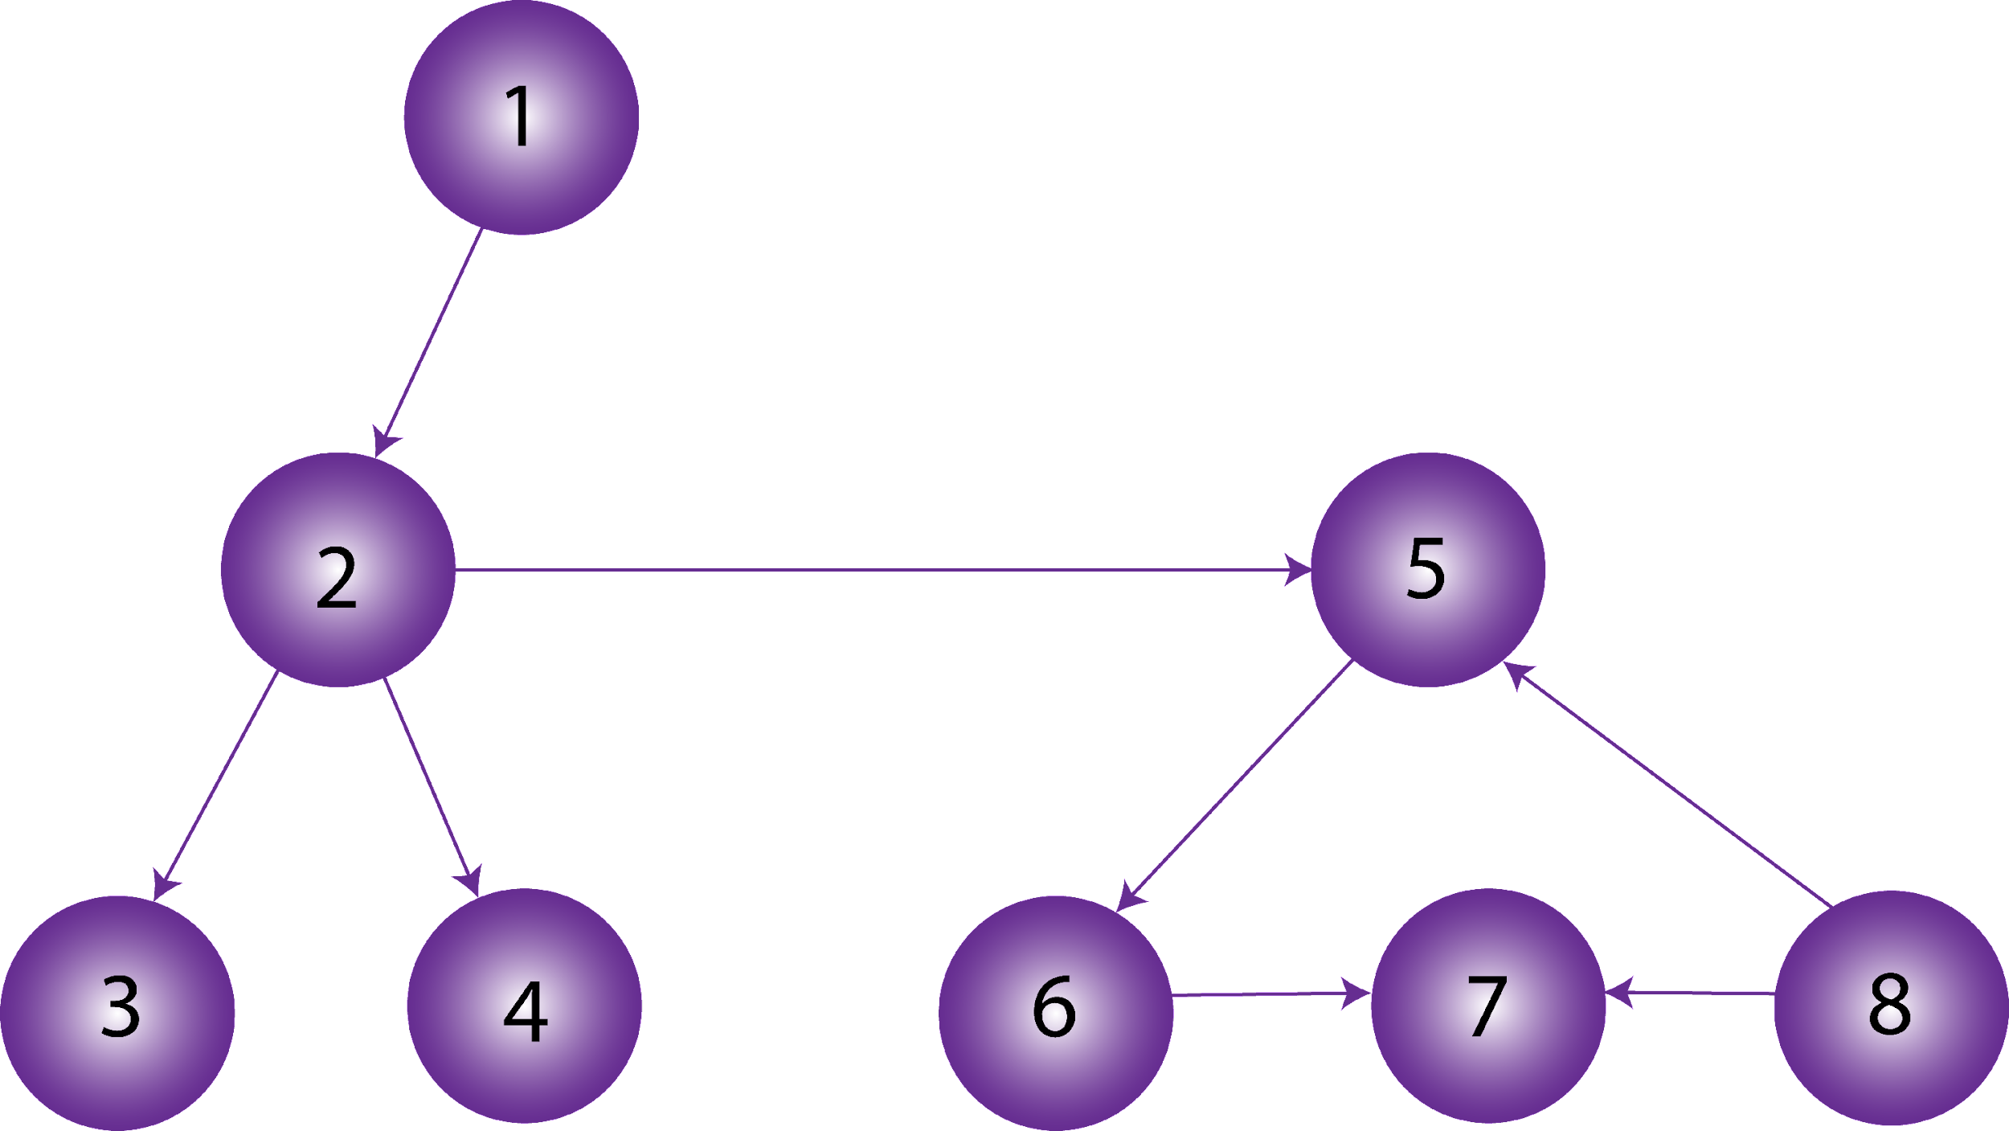
Cascades Represented as Networks
Cascades occur in directed networks.
Node (agent, species, etc.)
Interaction
1. Which nodes in this network will be impacted if node 2 changes?
2. What if the arrow from 8 to 7 was a two-way arrow instead?
Notes:
Notes to Instructor: Question #1 – Nodes 3, 4, 5, 6, and 7 will be impacted. Question #2 – All nodes would be impacted.

Slide 4
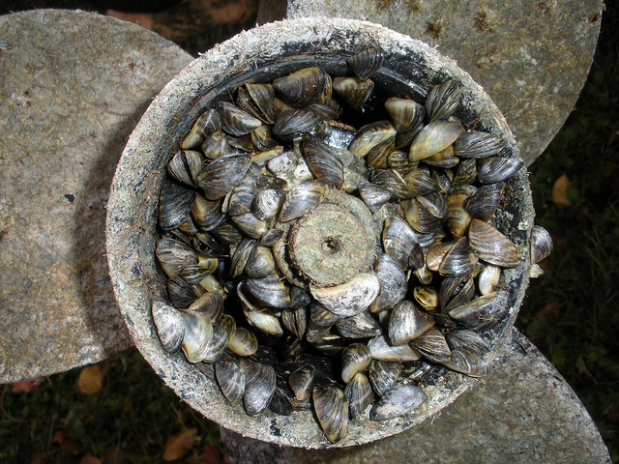
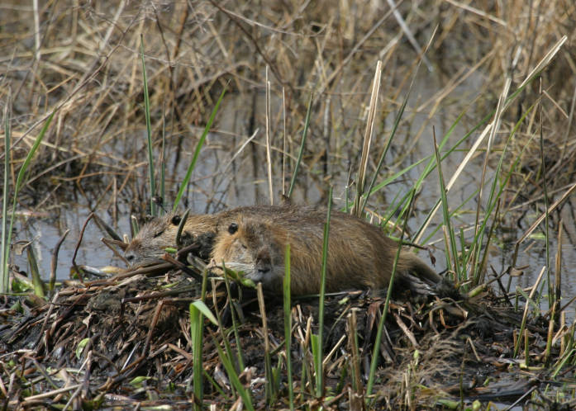
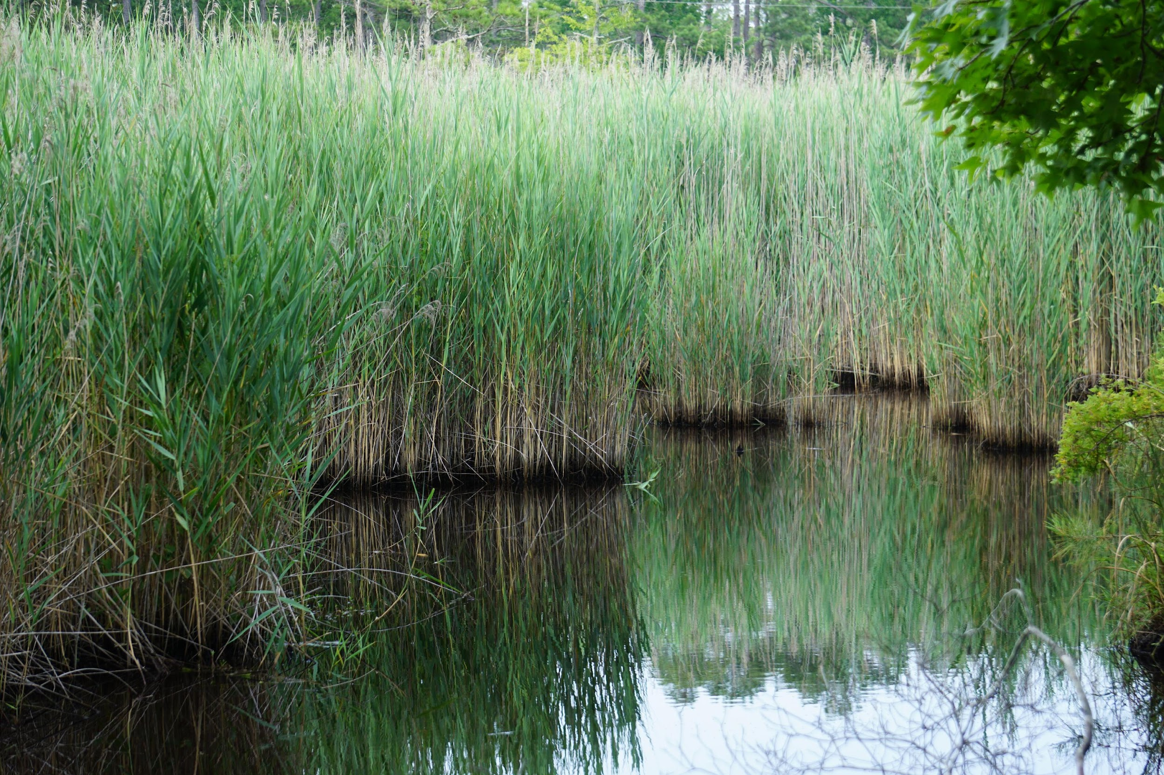
Invasive Species
Invasive species are nonnative species whose expansion can cause economic or environmental harm and/or can have negative effects on public health.
Which conditions allow for the successful establishment of a nonnative species?
Mussels clogging a propeller
Credit: Government of Australia
Nutrias in a Maryland marsh
Credit: U.S. Fish and Wildlife Services
Phragmites replacing Spartina
Credit: Wikimedia
Notes:
Notes to Instructor: Answers are available on the next slide.

Slide 5
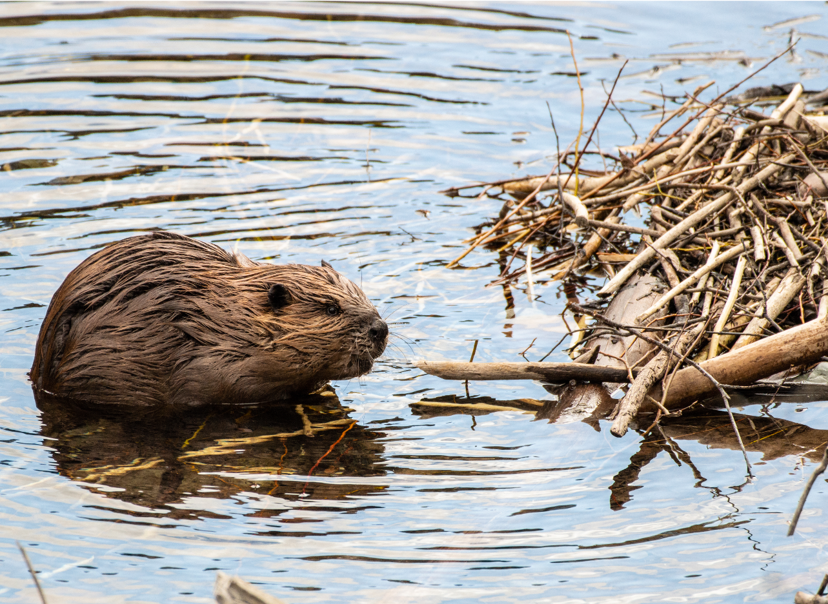
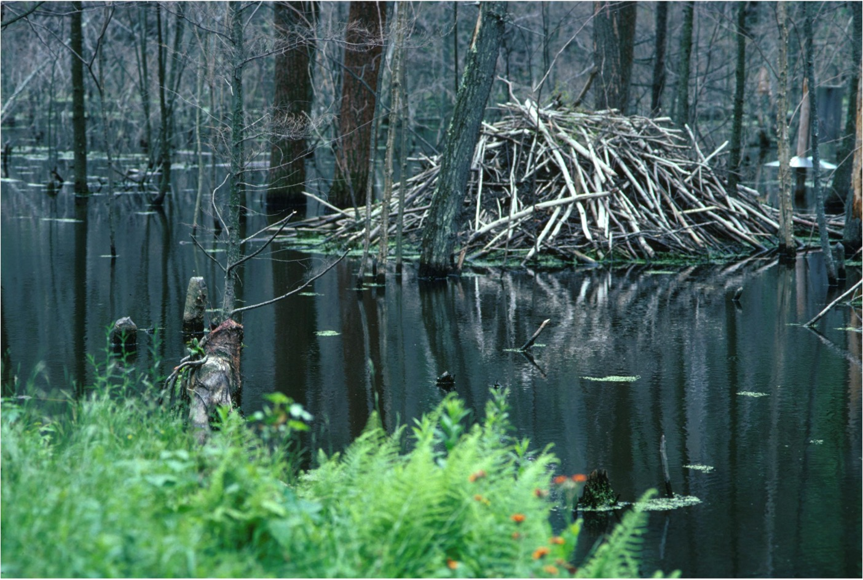
Invasive Species
Which conditions allow for the successful establishment of a nonnative species?
The nonnative species must be suited to endure the environment’s conditions.
Niches are open for non-natives to occupy.
Prey are inexperienced with a nonnative predator.
Disturbances occur that disrupt the native
community.
The invader is a keystone species or an
ecosystem engineer.
The beaver is native to the United States but was introduced in South America and parts of Europe.
Notes:
Note to Instructor: You may want to point out that beavers are an example of a keystone species that also engineers their environment. They can change a forested stream to a wetland as they take trees down and create dams.

Slide 6
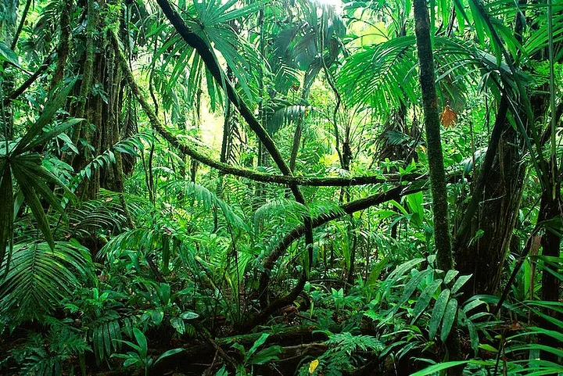
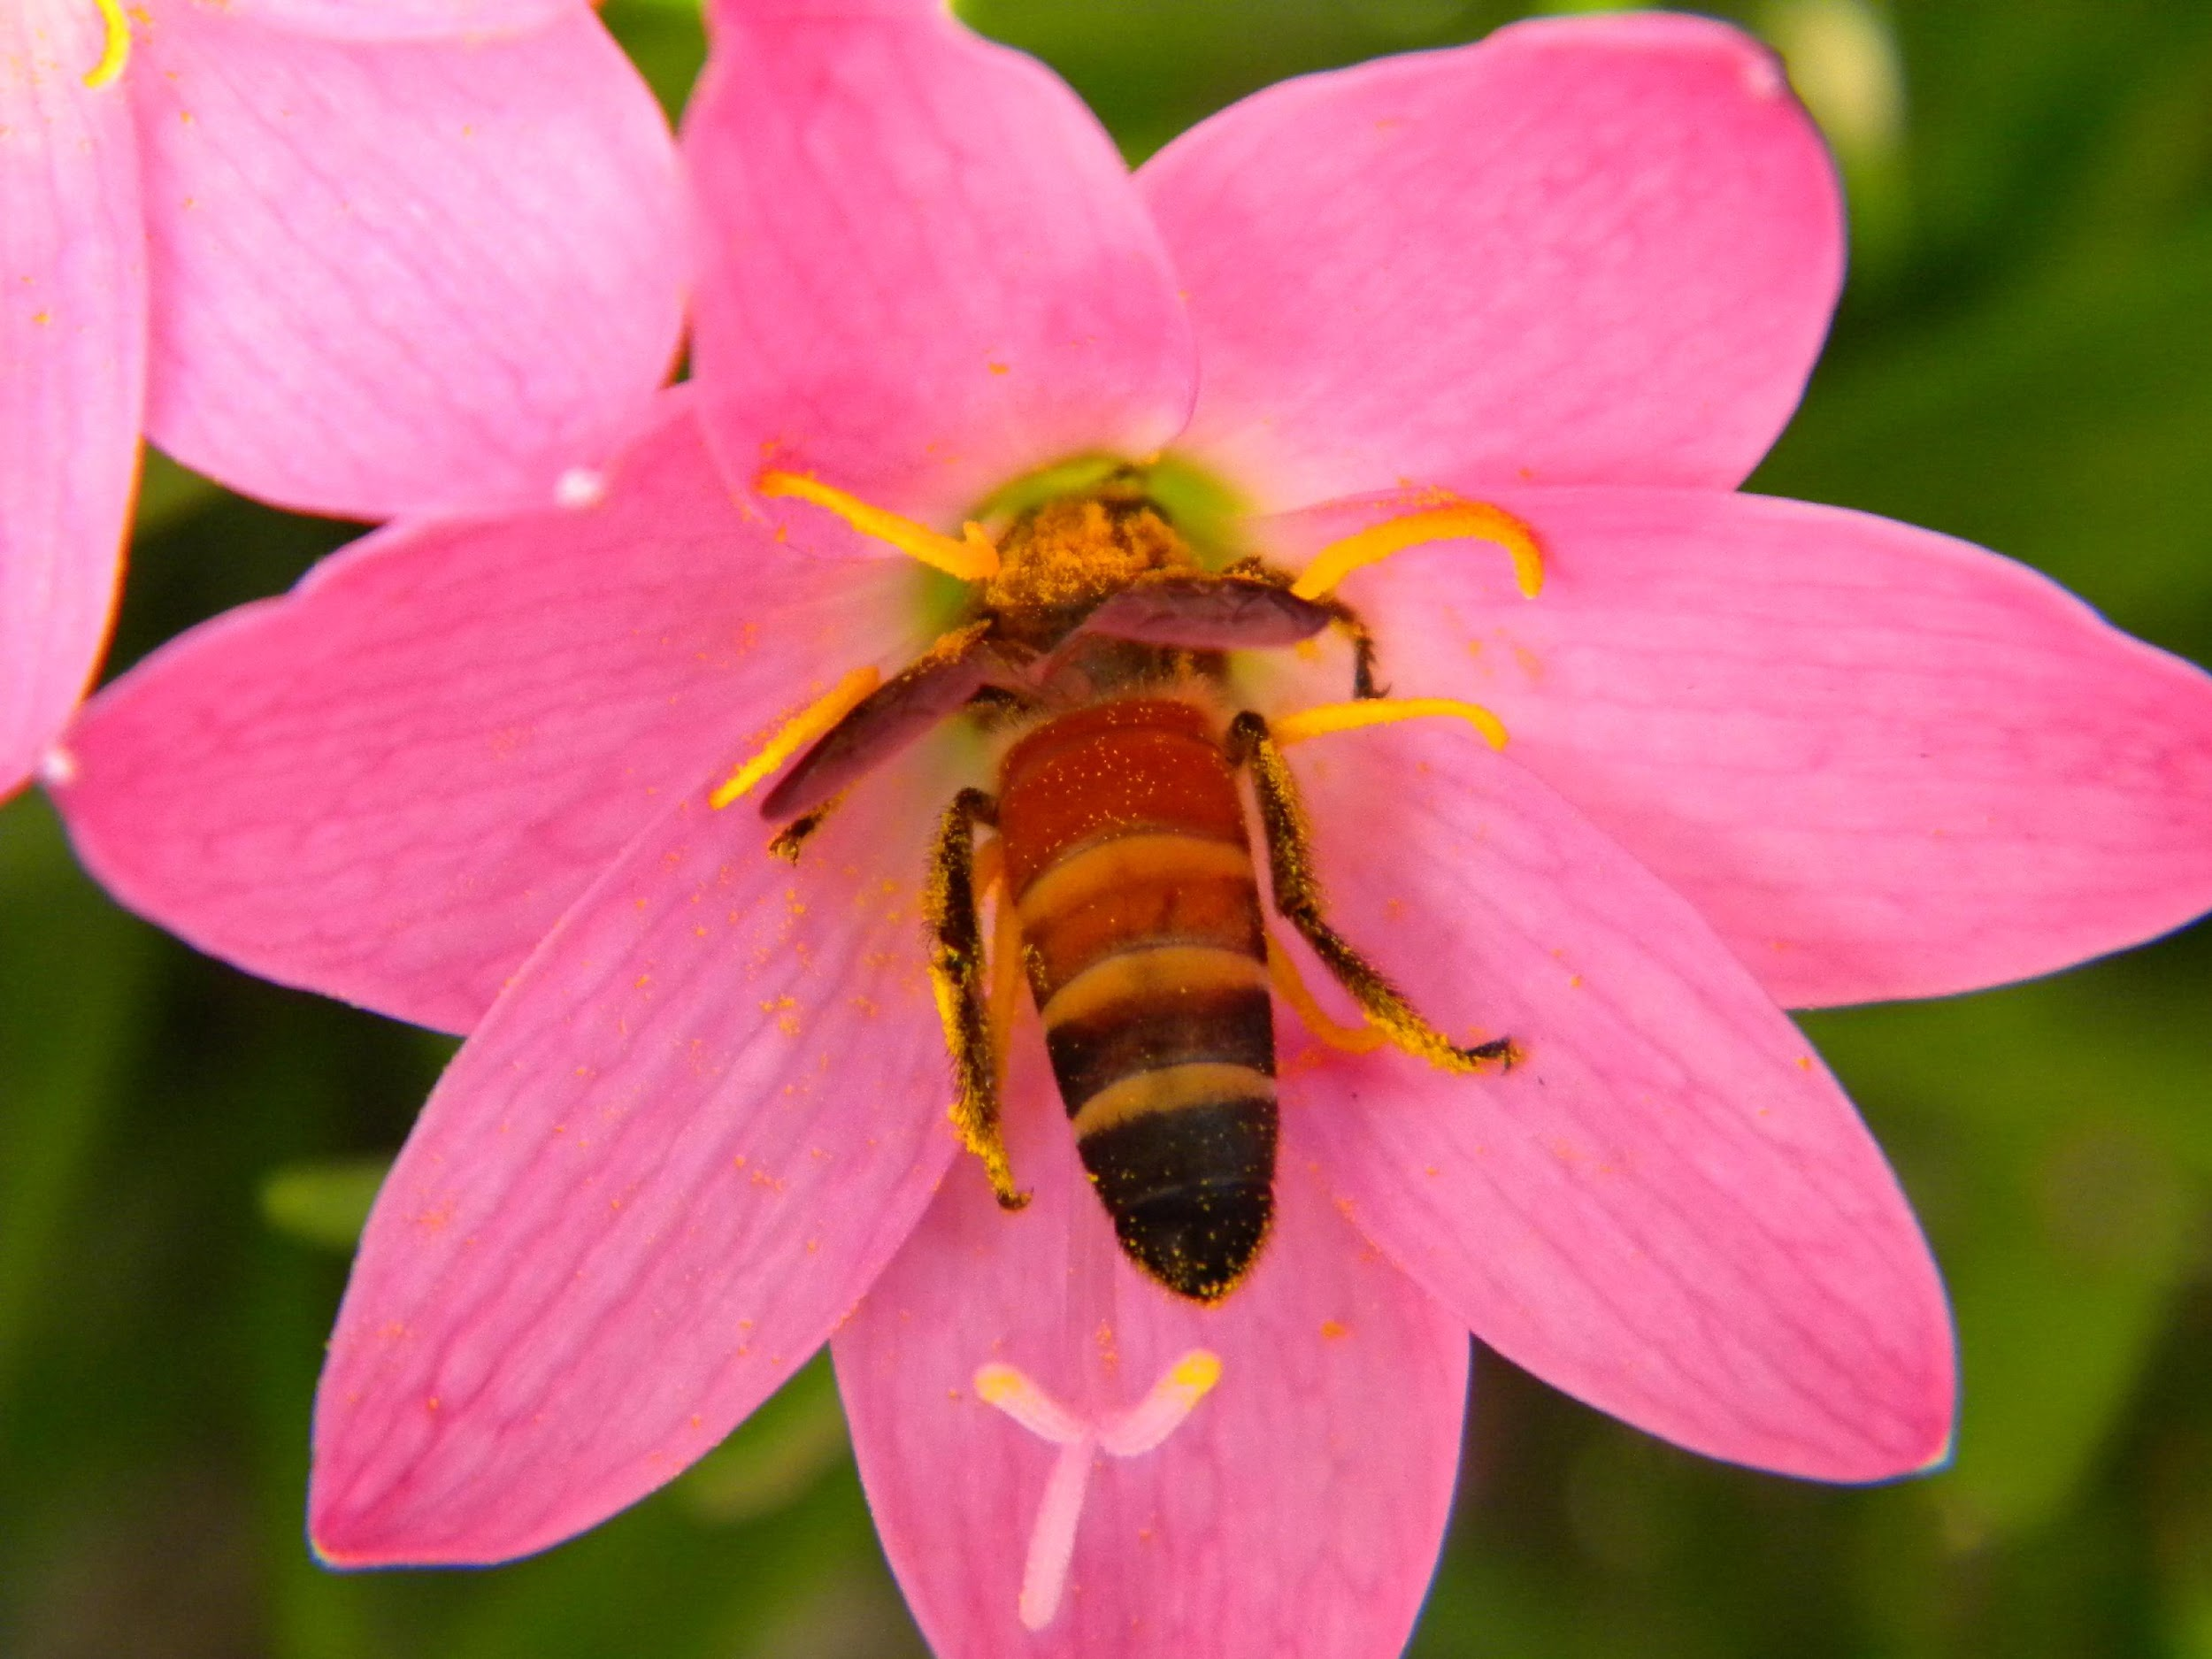
Networks Resistant to Invasion
What properties of communities make them more robust against invasion?
Rain forest
Credit: Medium
Bee Pollinator
Credit: Wikimedia Commons
Notes:
Note to Instructor: Answers are on the next slide.

Slide 7
Networks Resistant to Invasion
What properties of communities make them more robust against invasion?
They are diverse (there are many species or functional groups).
They are modular networks.
They are nested networks.
Rain forest
Credit: Medium
Bee Pollinator
Credit: Wikimedia Commons
Rain forests are among the most diverse ecosystems globally.
Many plant pollinator network are modular.
Notes:
Note to Instructor: Best answer: high diversity of species. Most other factors are related to diversity, e.g., communities that are older evolutionarily are resistant, but they are usually more diverse.

Slide 8
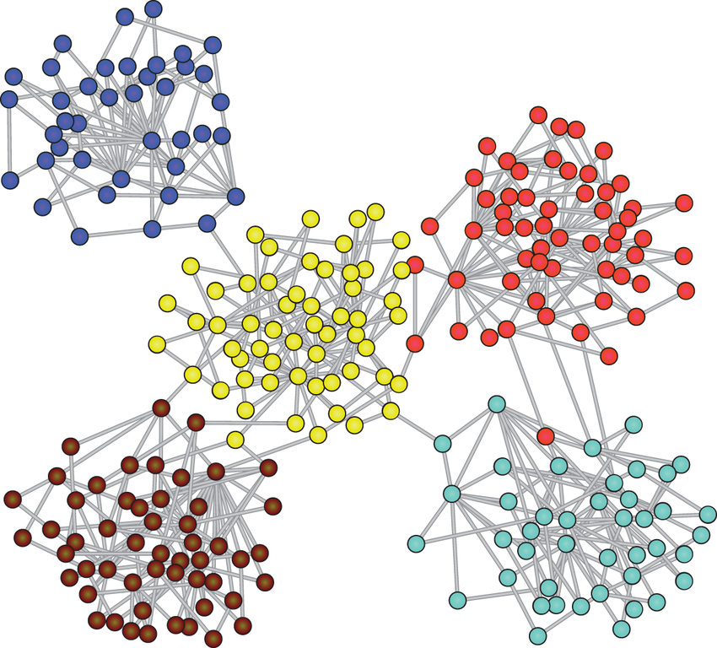
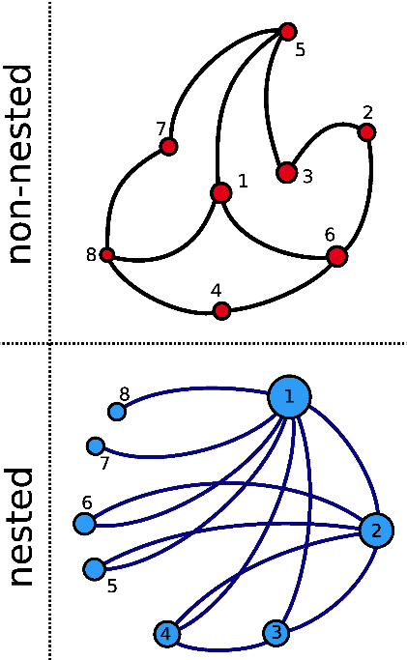
Modularity and Nested Networks
Which of the below networks are modular or nested?
Notes:
Note to Instructor: Answers are on the next slide.

Slide 9
Modularity and Nested Networks
Which of the below networks are modular or nested?
A modular network with five subnetworks
Notes:
Note to Instructor: Answer: Top left network (red) is NOT nested; Bottom left is nested – Note that node 2’s neighborhood is within node 1’s neighborhood; Right – a modular network with 5 subnetworks

Slide 10
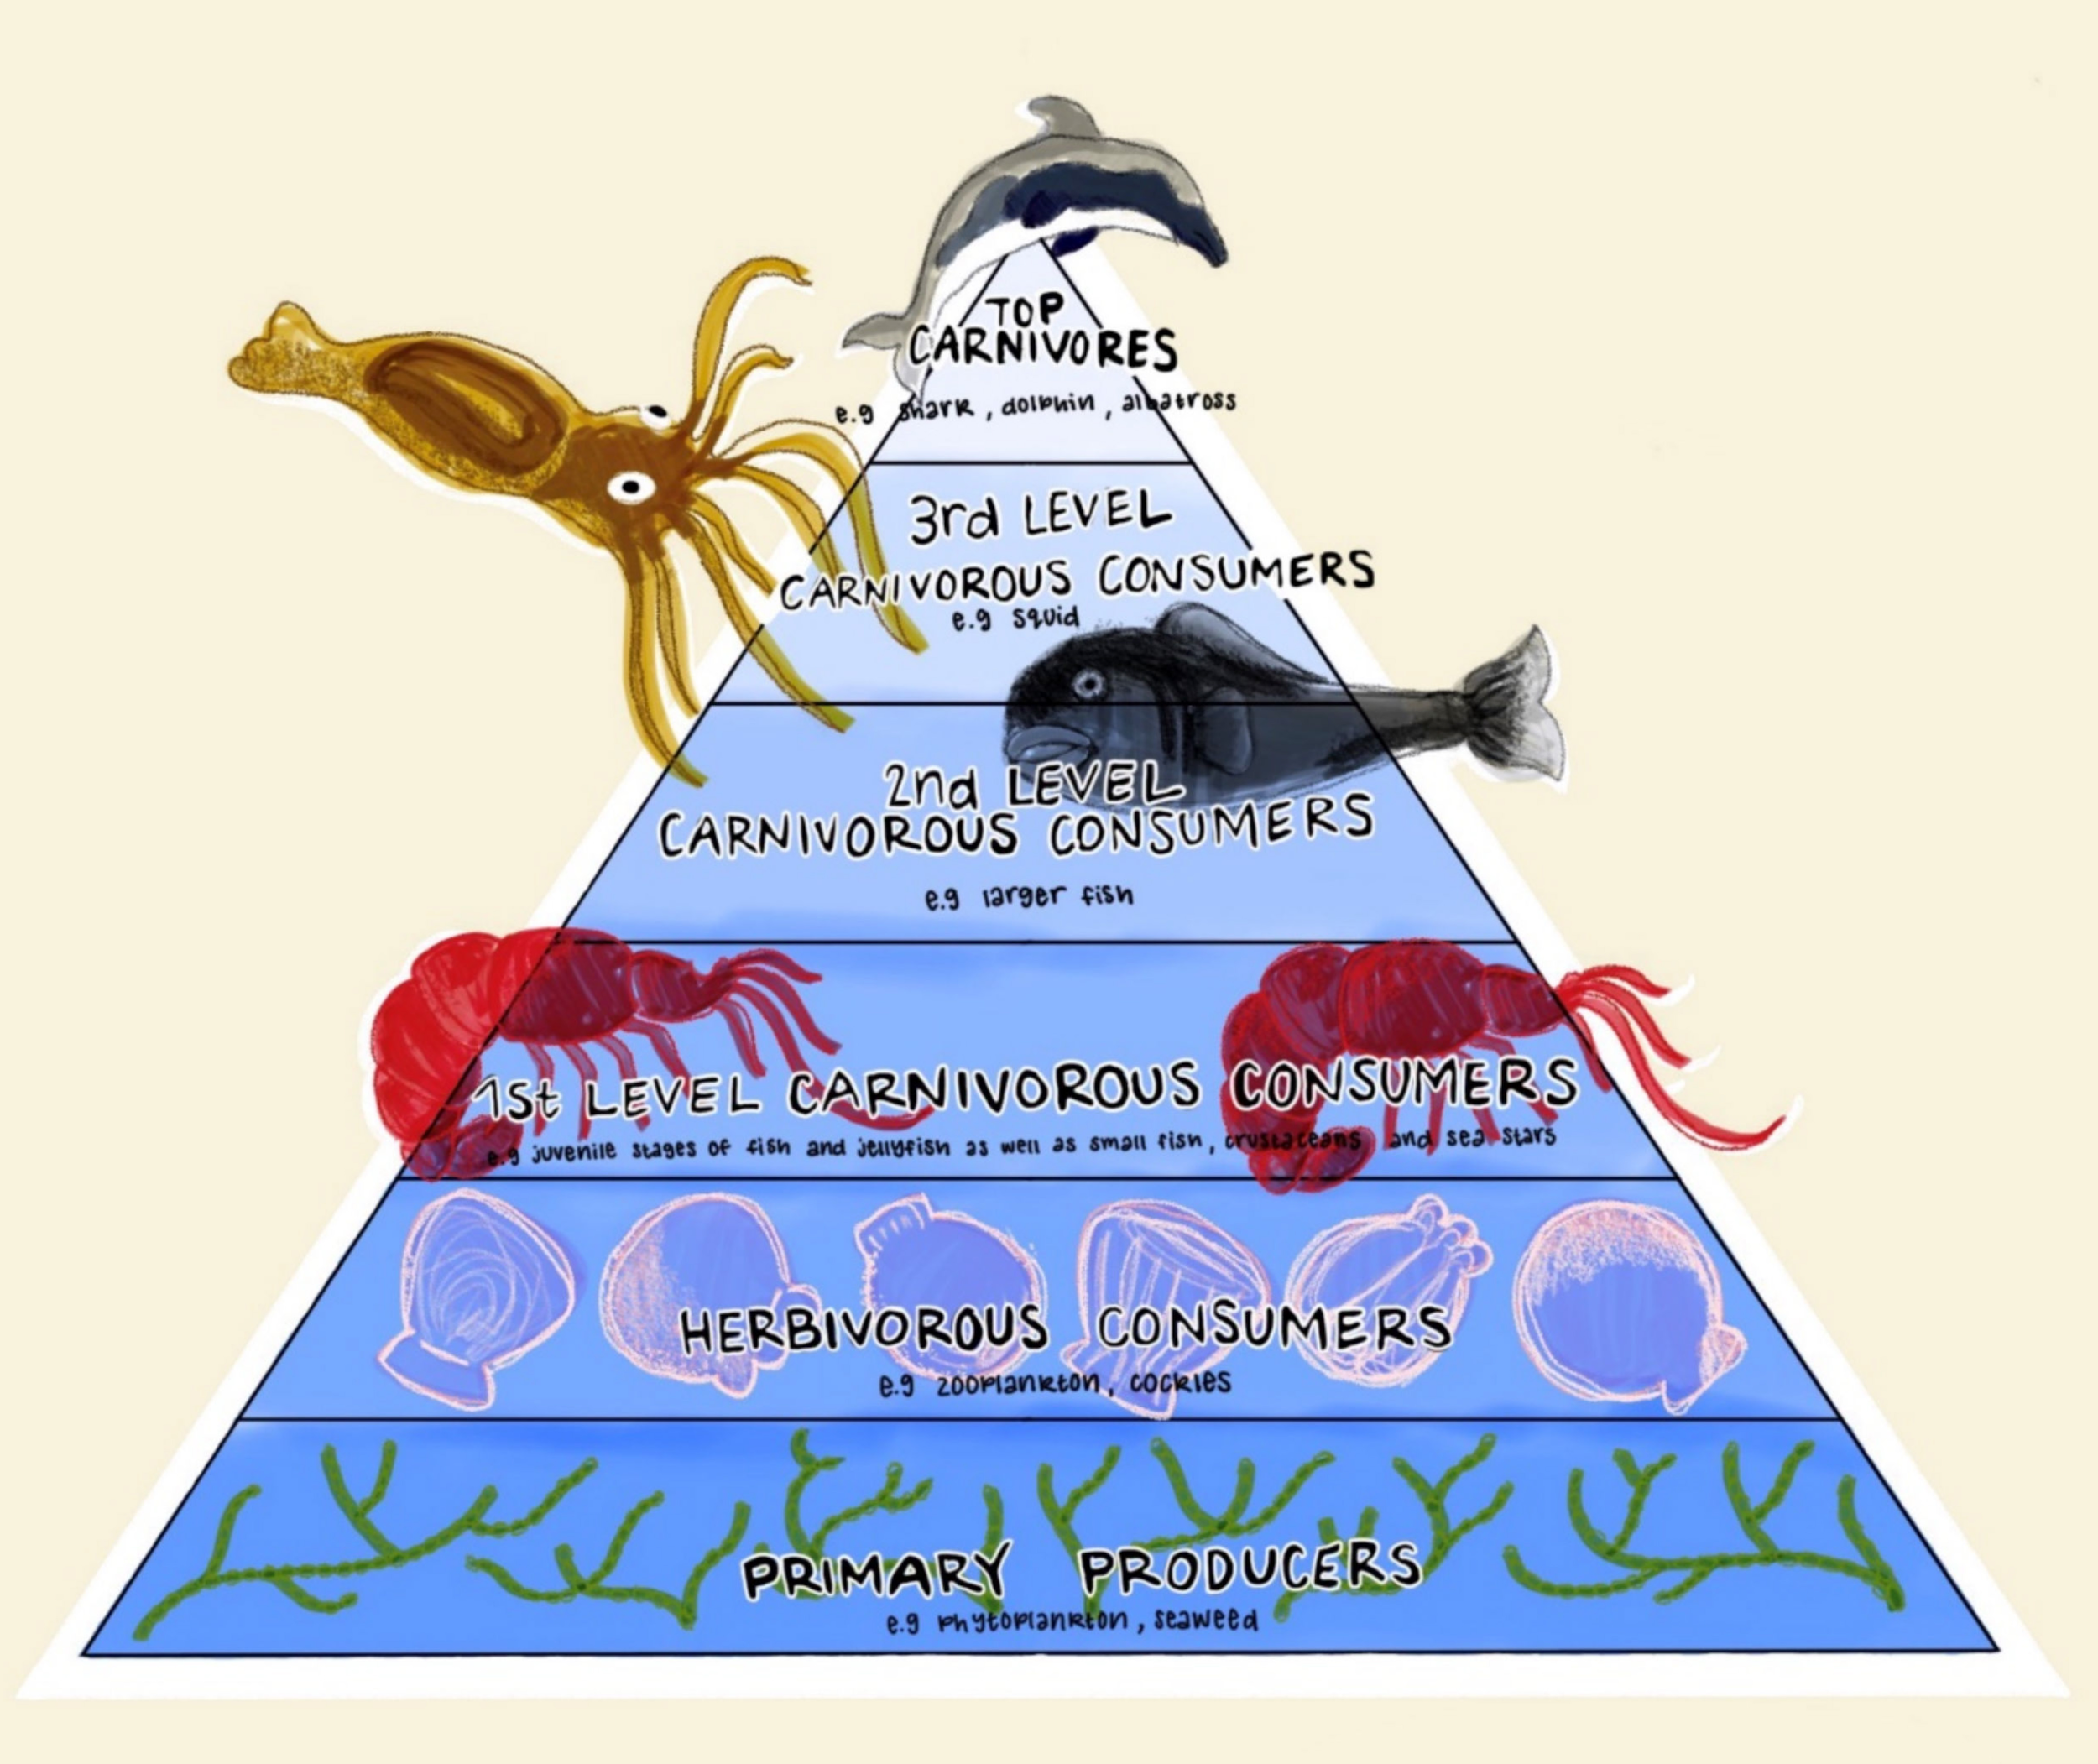
Trophic Cascades
Trophic levels and food webs (such as in the image) are depicted in an over-simplified
way; food webs are more complex and convoluted, with some species feeding on multiple levels or even within their own level.
Assuming webs are this simple, what is meant by a top-down vs. bottom-up effect?
What might a keystone species be in the context of cascades?
What is an indirect effect?
Illustration Camilla Neema Haule In: Poto and Morel 2021
doi: 10.3390/su13095065
9
Notes:
Notes to Instructor: Answers – top down is when the organism that is at the top of the food web changes in abundance or diet and that influences all species below it; bottom up is almost always a photosynthesizing species such as a seagrass upon which herbivores feed; if it is lost or replaced then species above it in the food web can change or also be lost.

Slide 11
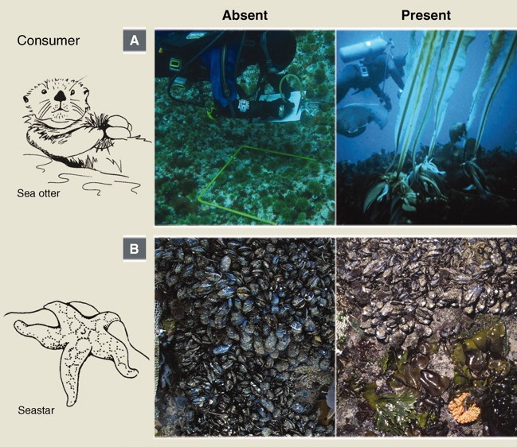
Ecological Significance of Trophic Cascades
Biodiversity Effects
Example: Sea stars prey on mussels, which outcompete other sedentary species for space, which results in higher biodiversity in intertidal zones.
Productivity Effects
Example: Sea otter declines released urchin populations from predation, which resulted in
kelp declining as large urchin populations consumed the kelp.
Regime Shift Effects
Example: The effect of the sea otters’ decline resulted in an alternate stable state in which the sea floor was kelp barren.
10
Source: Estes et al. 2011 doi: 10.1126/science.1205106
Notes:
Notes to Instructor: All of these are classic examples of ecological trophic cascades. Removal of some of the mussels by sea stars allowed other bottom-dwelling species such as barnacles and limpets to thrive and thus diversify the rocky intertidal community. Sea otters normally eat a lot of urchins, which allows kelp to proliferate because the urchins are no longer eating it all. When sea otters decline, urchin populations increase, and kelp is reduced, so the usual, plush kelp forest is gone, leaving the seafloor empty.

Slide 12
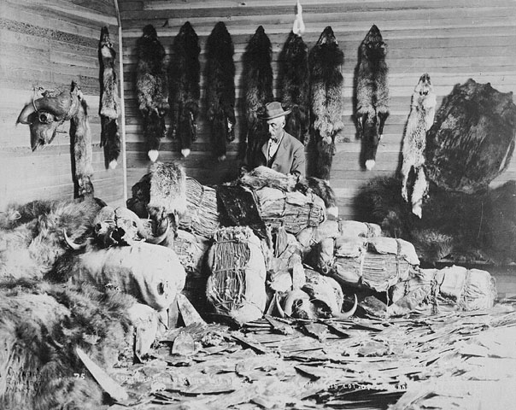
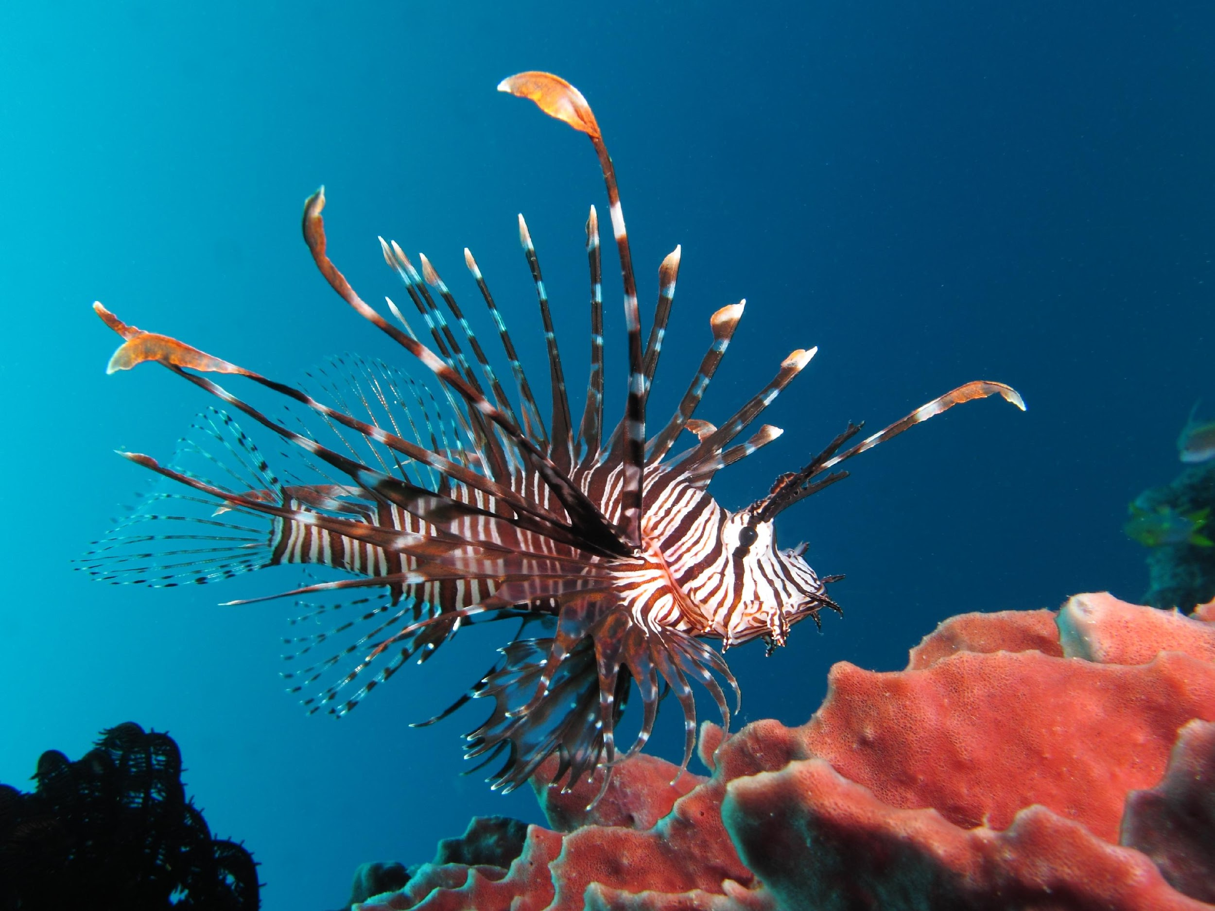
Human Influences on Trophic
Cascades
Predator Removal
The fur trade led to a decline in sea otters along the U.S. Pacific Coast.
Introduced Species
Lionfish introduced in the Caribbean have been linked to regime shifts in coral reefs.
Nutrient Pollution
Eutrophication in the Baltic Sea increased the vulnerability of cod to overfishing.
Climate Change
Ocean warming and acidification have altered planktonic food webs.
Credit: Library and Archives Canada/C-001229 (copyright expired)
Credit: Alexander Vasenin via Wikimedia Commons
11

