Slide 1

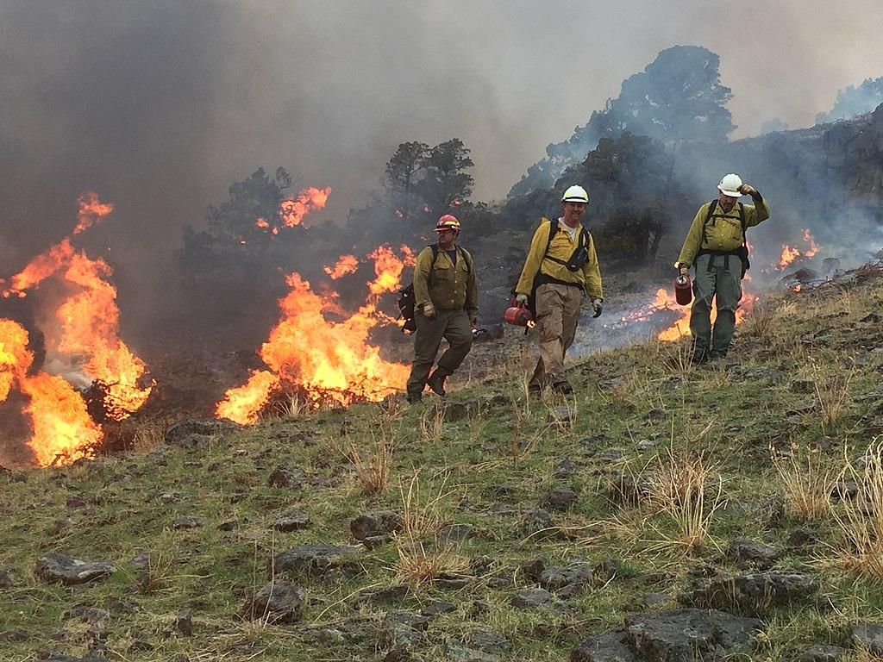
Behavioral
Economics (BE) and Timescale
Mismatches
Prescribed burning in eastern Oregon, USA. Open source photo by Justin Robinson, Bureau of Land Management, via Wikimedia.
.
Notes:
Notes to Instructor: Though prescribed burns are an accepted necessary tool of wildland management, they can be unpopular and even feared by local residents. What tools of BE will help managers create messages that inform the public with better knowledge of this management strategy as a solution to uncontrolled wildfires?

Slide 2

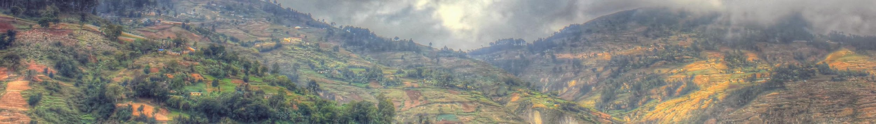
A Framework of Timescale Mismatches
from Wilson et al. (2016), DOI: 10.1111/cobi.12632
Domain 1: Mismatch between the manager’s objectives, actions, and learning
Example: An ocean fisheries management team needs to set a harvest rate for fish species that balances short-term priorities while maintaining long-term ecosystem and fish population resilience.
Domain 2: Mismatch between the manager’s realm and individual actors in the social system
    Example: A state forest manager must choose how much and where to use fire as a proactive tool in the wildland-urban interface while maintaining the safety and support of local residents and businesses.
    Domain 3: Mismatch between the manager’s domain and ecosystem dynamics
        Example: A state forest manager is tasked with removing an invasive species and restoring the ecosystem to its previous state within a 2-year budget allotment.
Notes:
Notes to Instructor: Though the Wilson et al. paper discusses six domains of mismatches, this lesson focuses on the first three, which are crucial areas for interrogating BE theories’ application to environmental management. Ask learners to name at least one more example for each of these categories, so that they go into the lesson with ample ideas for case studies. (The lesson itself has two examples per domain.)

Slide 3



Three Levels of Solutions Based on BE
from Wilson et al. (2016), DOI: 10.1111/cobi.12632
Technological: Technological tools adjust ecosystem timescales to human ones. They provide short-term solutions but may have unanticipated consequences.
Example: Implement carbon recapture and sequestration
Cognitive: Cognitive tools use messaging, framing, and social cues to change the way the public processes and uses information in decision making. Cognitive tools aim to reduce judgment errors in how individuals perceive and value time. Tactics include appealing to existing environmental values, emphasizing social cues of good behavior, or making the intended behavior easy to perform.
Example: Communicate the anticipated total biodiversity loss across a century due to climate change, rather than within a shorter time frame like a year or even a decade
Structural: Structural tools change the consequences of an action through regulatory carrots and sticks. Structural tools incentivize individuals to match the timescale of the ecological system.
Example: Provide tax breaks for conservation easements and reduce runoff through agricultural best practices (cover crops, buffers, reduced fertilizer use)
Notes:
Notes to Instructor: Learners will perceive how these solutions involve a complex balance between enticement and punishment. Have learners quickly reflect on how framing a message and providing the right information in the right tone for a given audience is not something environmental managers are usually trained to do. What kind of expertise may help managers be more effective communicators? How do other considerations, like framing messages and finding communication outlets for different generations (Baby Boomers versus Gen Z), or for different political identities (Libertarians versus Republicans), or for different regions (urban vs. rural) affect the outcome of these solutions? Finally, how can these three levels be more effective if used together? For example, can managers motivate individuals to control invasive species on their lands by previewing the legacy they want to leave for their family and community and pairing this future vision with technical assistance and subsidies that make the choice to conserve easier?

