Slide 1

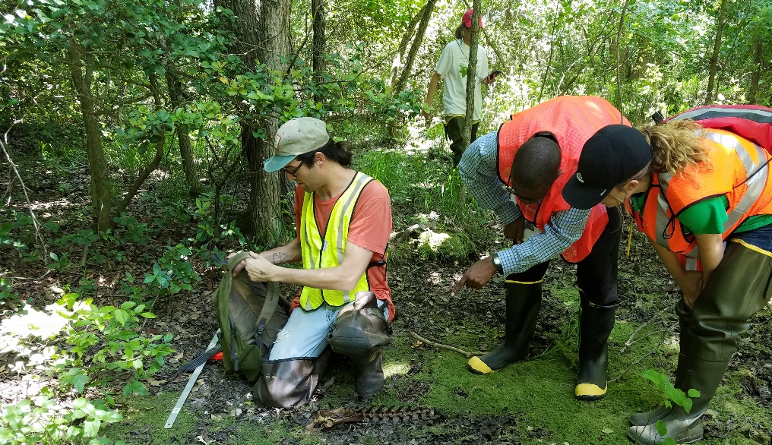
What Types of Methods Are Used to Study Sustainability Problems?
Exploring Disciplinary and Interdisciplinary Methods
Notes:
Notes to Instructor: There are many methods used to solve sustainability problems. This PPT is focused on the collection and analysis of information for research. It is impossible to be comprehensive in a short overview, so note that this PPT does not include methods of co-production; stakeholder engagement; or modeling, including futures and scenario analysis, network analysis, causal analysis, archetypes analysis, and a few others; however, these topics are all covered in other SESYNC resources (Lessons, Learning Materials, or Explainers) and can be found by searching for keywords on the SESYNC website. The most efficient way to search is to check off the types of resources in the search menu (again – Lessons, Learning Materials, Explainers).

Slide 2
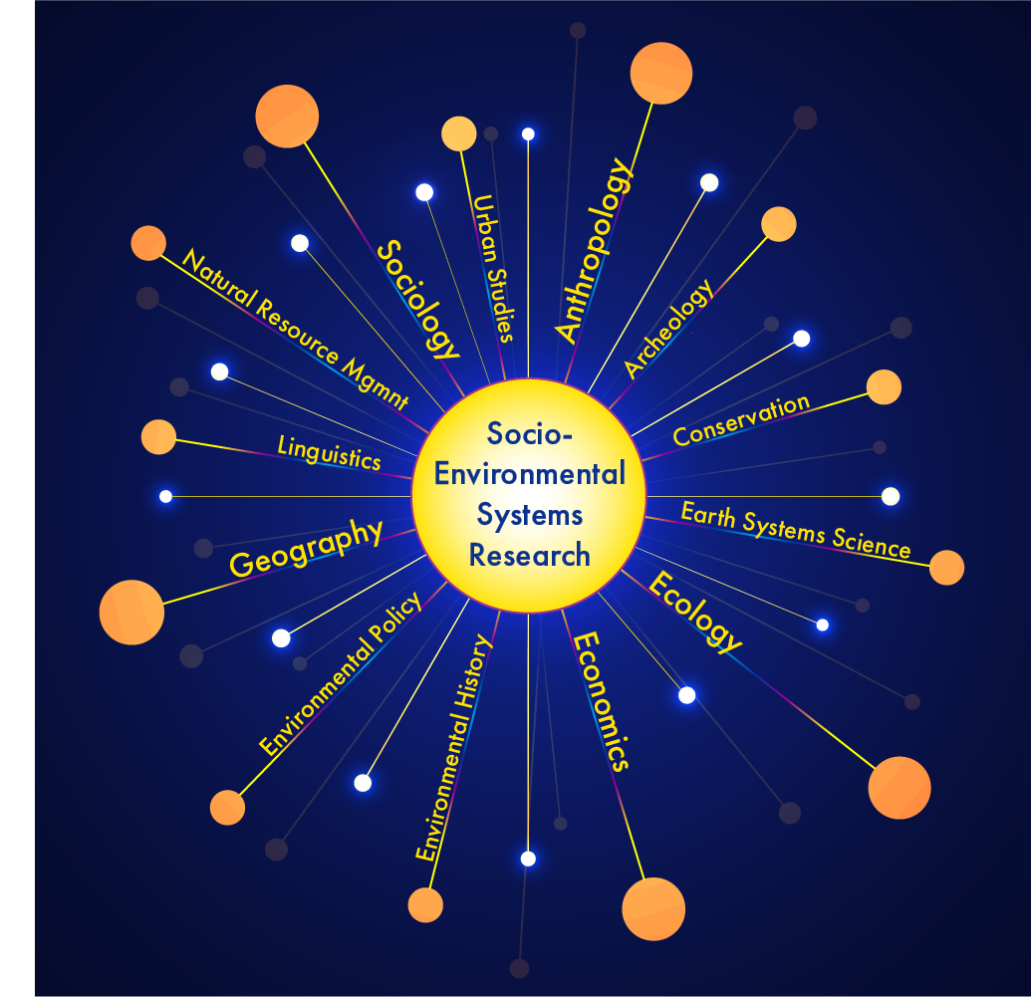
Many Problems, Many Disciplines
Many disciplines contribute to sustainability research.
Notes:
Notes to Instructor: It is important to note that these are just examples of disciplines that in various combinations focus on the same or similar problems, such as food security. Also indicate to learners that the lesson is not meant to suggest that everyone within a discipline adopts the same theories, approaches, and methods; indeed, some disciplines themselves are very diverse when it comes to those. Additionally, perhaps, you’ll want to emphasize that this lesson focuses on disciplinary diversity in approaches and methods but that the inclusion of stakeholders in studying or solving sustainability problems can bring very different understandings and approaches. Source of image: SESYNC

Slide 3


Dimensions of Scholarship
Epistemology: The theory of knowledge – What is knowledge? What are acceptable forms?
Theoretical Perspective: The philosophical stance that informs the methodology; analytical tools for understanding or explaining something
Methodology: Rationale for an approach or strategy of study; influences the choice and use of specific methods; influenced by the type of desired outcome
Methods: The techniques or procedures for gathering and analyzing data
Influenced by: Al-Ababneh, M.M. (2020). Linking ontology, epistemology and research methodology. Science & Philosophy, 8(1), 75-91.
Source: AdobStock - SESYNC
Notes:
Notes to Instructor: Explain to the learners that the assignment really focuses on a mix of these dimensions. Some disciplines have similar epistemological perspectives on what constitutes value knowledge (e.g., empiricists that rely heavily on numeric data from the field or lab can be found in chemistry, physics, biology, and anthropology). Additionally, explain to them that these are difficult to separate because they are so linked/interconnected.

Slide 4
Example: Cultural Anthropologist
Epistemology – Knowledge can be understood qualitatively and quantitatively.
Theoretical Perspectives – Examples:
  “Historical particularism” – Each society has its own unique historical development and must
  be understood based on its own specific cultural and environmental context, especially its
  historical process.
  “Functionalism” – Different aspects of culture (e.g., institutions, norms) play particular functions
  in maintaining a society.
Methodology – Examples:
  A full understanding requires at least some use of field approaches to learn from subjects and societies, especially by using ethnographic methods.
Methods – Examples:
  Field methods include interviews, surveys, and observations.
Notes:
Notes to Instructor: Mention to the learners that they may get different responses than what is shown above in each bullet, depending on the anthropologist questioned., i.e., it is a very diverse field in perspectives, approaches, and views. Anthropologist Dr. Paige West provides a nice lecture on the history of the field of anthropology and how it was born through colonialism and over time moved away from it. See: https://www.sesync.org/resources/foundations-and-debates-anthropology. Dr. Michael Paolisso discusses the methods of anthropology, especially cultural anthropology, here: https://www.sesync.org/resources/anthropological-research-methods.

Slide 5
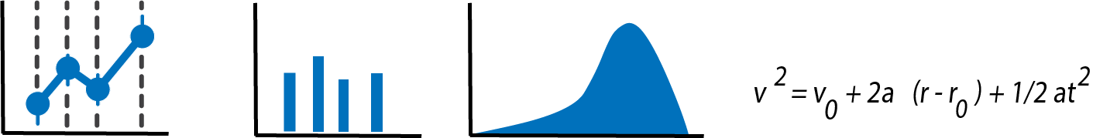
Quantitative Research
Data are gathered from observations, experiments, surveys, or a synthesis of existing databases.
Data are usually numerical.
Researchers most commonly analyze quantitative data statistically (e.g., econometrics, frequentist/Bayesian methods).
Quantitative research is considered the hallmark of “objective research.”
It is useful for testing hypotheses, quantifying uncertainty, or saying “how much.”
Source: SESYNC
Notes:
Notes to Instructor: This description is highly generalized and simplified as there are many methods that could be listed e.g., meta-analyses and systematic reviews (see: https://www.sesync.org/resources/quantitative-synthesis-methods-literature-reviews-systematic-and-meta-analyses-expert), conversion of qualitative to quantitative data (e.g., using fuzzy set methods or Likert scales) would fall into the category of mixed methods perhaps).

Slide 6
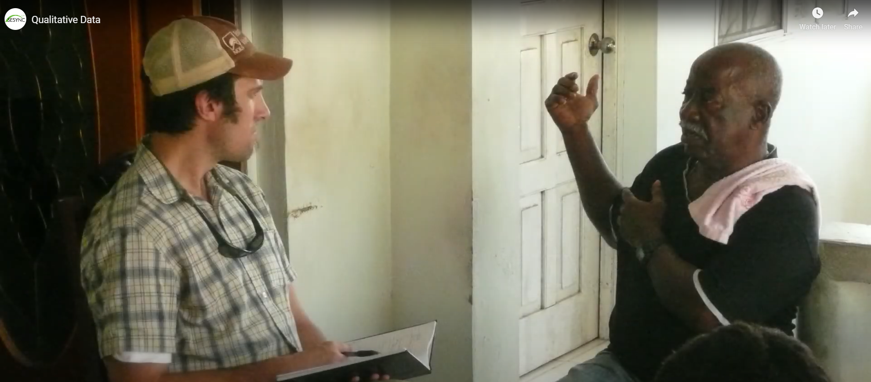
Qualitative Research
Qualitative research involves non-numeric data, including words, sounds, images, etc.
It often focuses on subjective experiences, opinions, and attitudes.
Qualitative research is useful for describing phenomena and explaining patterns or context-specific results.
It is useful for answering questions about why something is (not) observed.
Examples:
Observations
Interviews
Focus groups
Photographs
Credit: Steven Alexander
Notes:
Notes to Instructor: The next several slides provide more examples of qualitative methods that learners tend to know less about (than quantitative approaches), unless they are social science researchers.

Slide 7
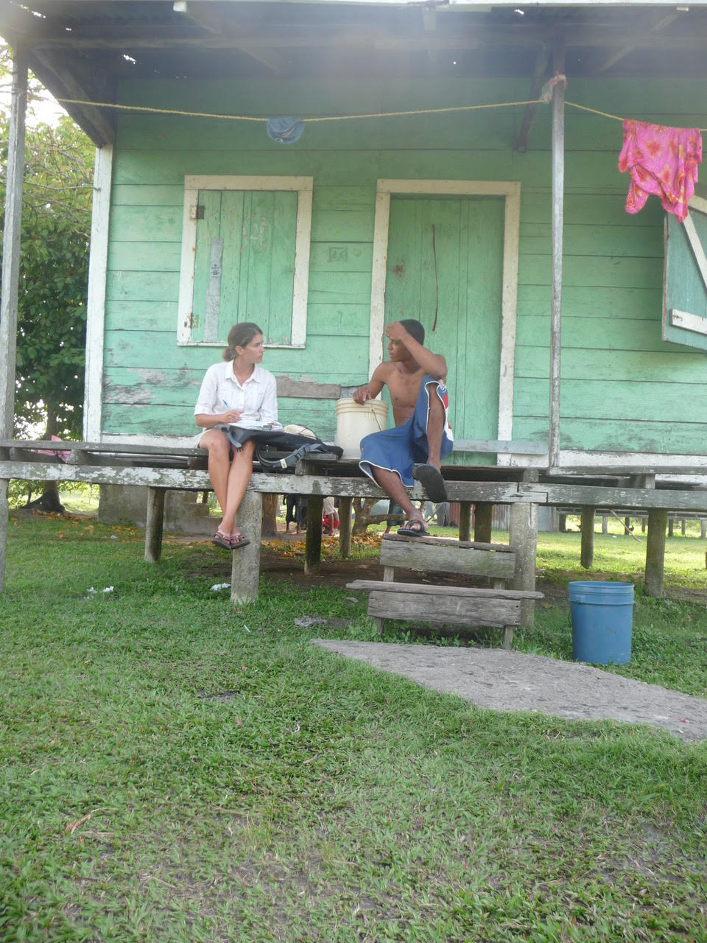
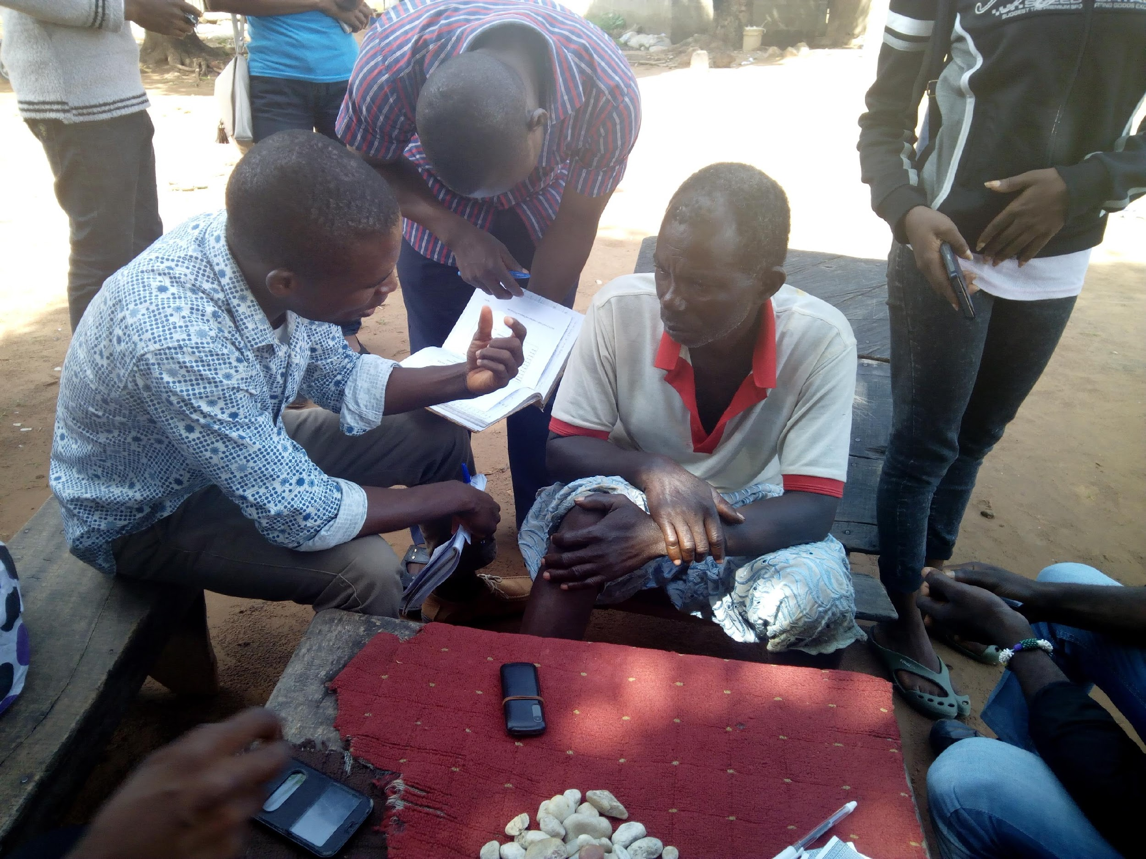
Ethnography
Is the in-depth study of everyday practices and lives of a people(s)
Is primarily qualitative but is not exclusively so
Involves the researcher immersing themselves in a subject’s environment
Uses a variety of approaches, such as the examples below
Examples:
Fieldwork gathering artifacts
Notes taken during discussions
Observations of activities of interest
Recorded observations
Source: Daniel Kramer
Source: Wikimedia Commons
Source: Wikimedia Commons
Notes:
Notes to Instructor: Ethnographic work has historically been the hallmark of anthropologists, but today, sociologists, human geographers, and others also use it.

Slide 8
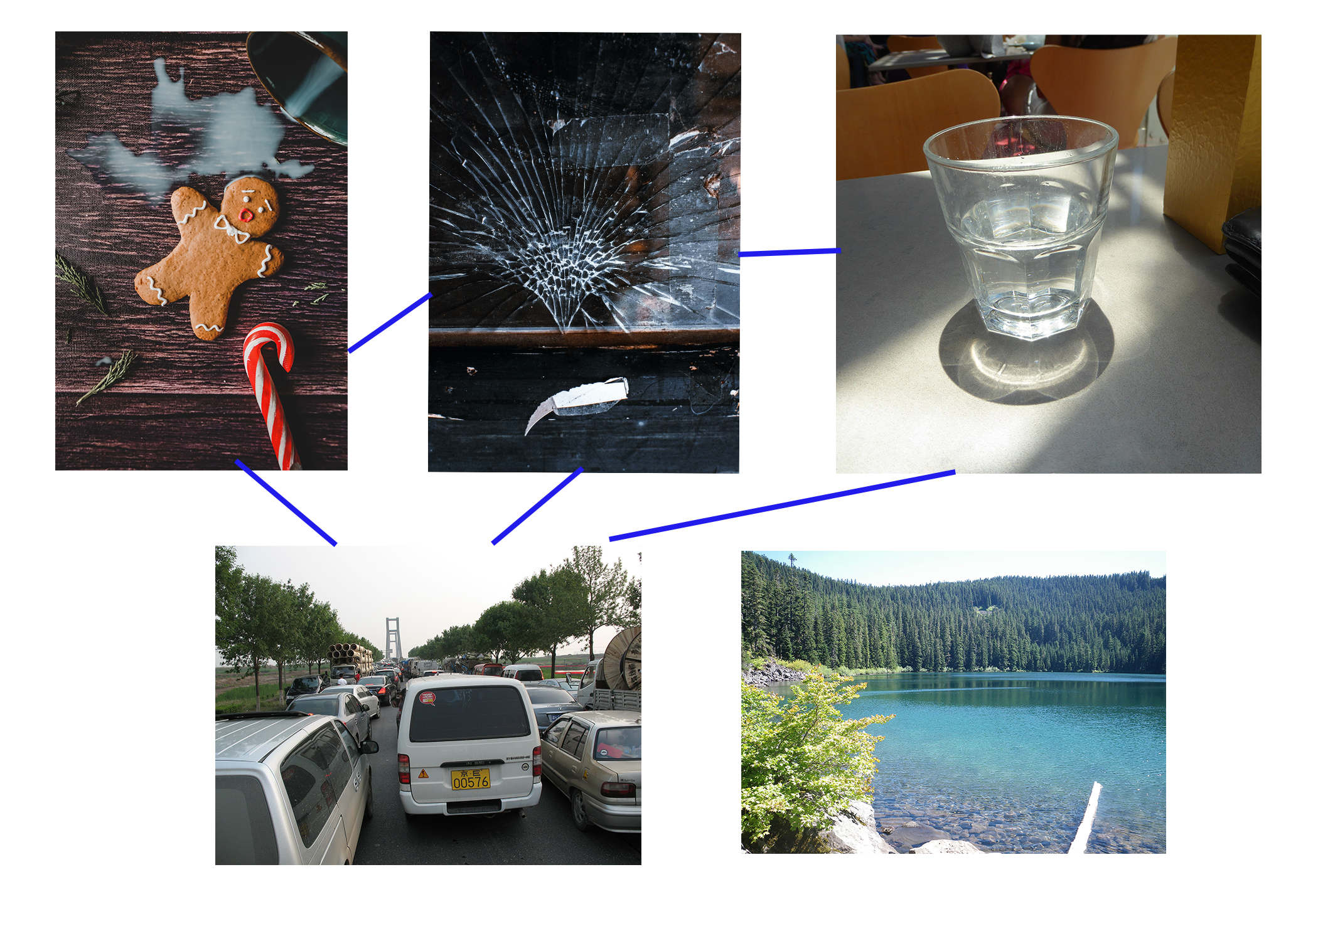

Content Analysis
Content analysis examines social media posts, tweets, or images to understand meaning, sentiment, attitudes, or emotions.
It uses searches to detect patterns (themes).
The initial stages may involve reading or using natural language processing (NLP) software to detect repeated words or phrases with similar meanings.
It requires judgment or defined
input by the researcher.
Source: SESYNC
Source: Pexels Commons
Notes:
Notes to Instructor: The most common type of content analysis is of textual material; however, with the growth of social media, analysis of tweets, Flickr images, etc. that are also geolocated has become common. The next slide provides a detailed example.

Slide 9

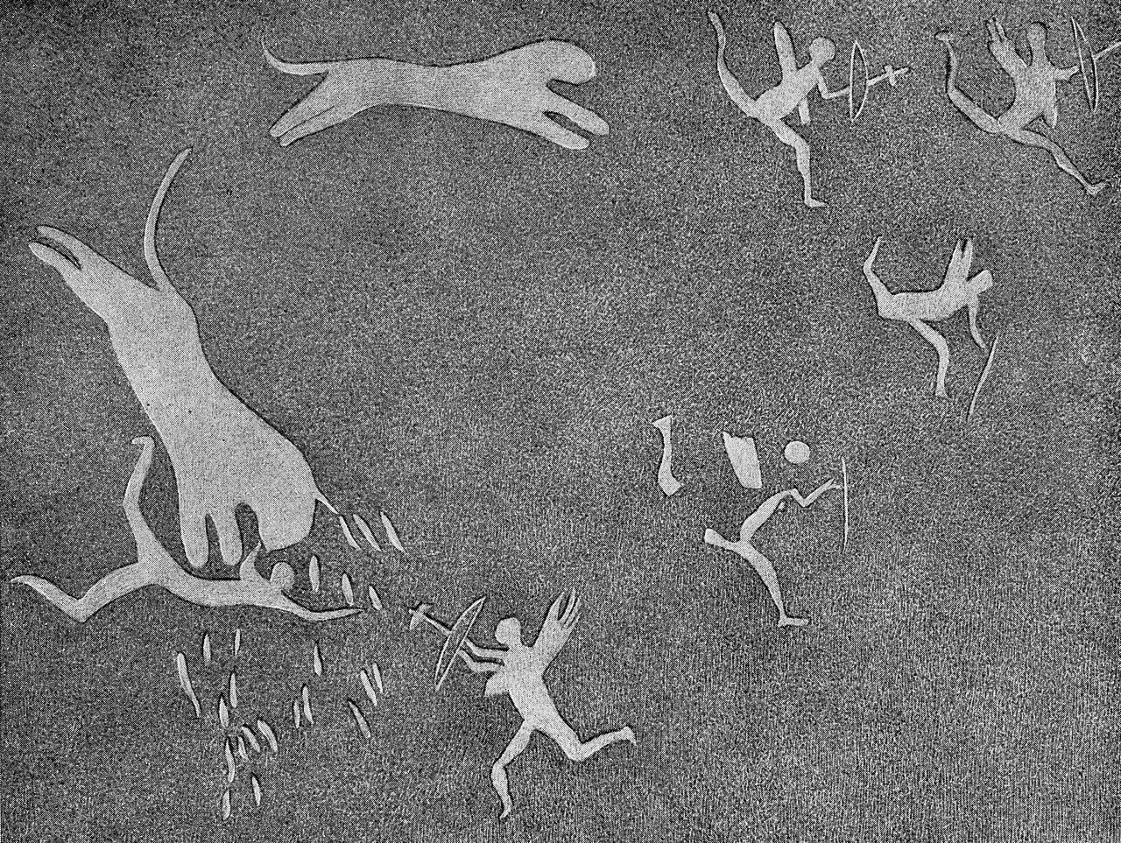
Critical Discourse Analysis (CDA)
CDA involves a series of approaches for critically analyzing texts & cultural artifacts (e.g., images).
CDA focuses on the suggested or implied meaning or context in which it was created.
Its goal is to reveal connotations and draw out the larger cultural narratives
that these connotations support. I.e., What was the social context that led
to this depiction?
It often focuses on revealing power structures.
Examples
Sentiment analysis
Opinion or emotion analysis
Thematic analysis
Narrative analysis
Psychosocial analysis
Visual discourse analysis
Ecolinguistics
Source: Wellcome Collection
Source: U.S. Post Office via Picryl open access
Notes:
Notes to Instructors: One can apply CDA to texts, images, advertisements, and other entities. It is used extensively by humanists and some social scientists.
SESYNC has five explainers on CDA:
https://www.sesync.org/resources/critical-discourse-analysis-what-it
https://www.sesync.org/resources/critical-discourse-analysis-narrative-approach
https://www.sesync.org/resources/critical-discourse-analysis-qualitative-content-approach
https://www.sesync.org/resources/critical-discourse-analysis-artificial-intelligence-social-network-social-media-analysis
https://www.sesync.org/resources/critical-discourse-analysis-visual-approach

Slide 10
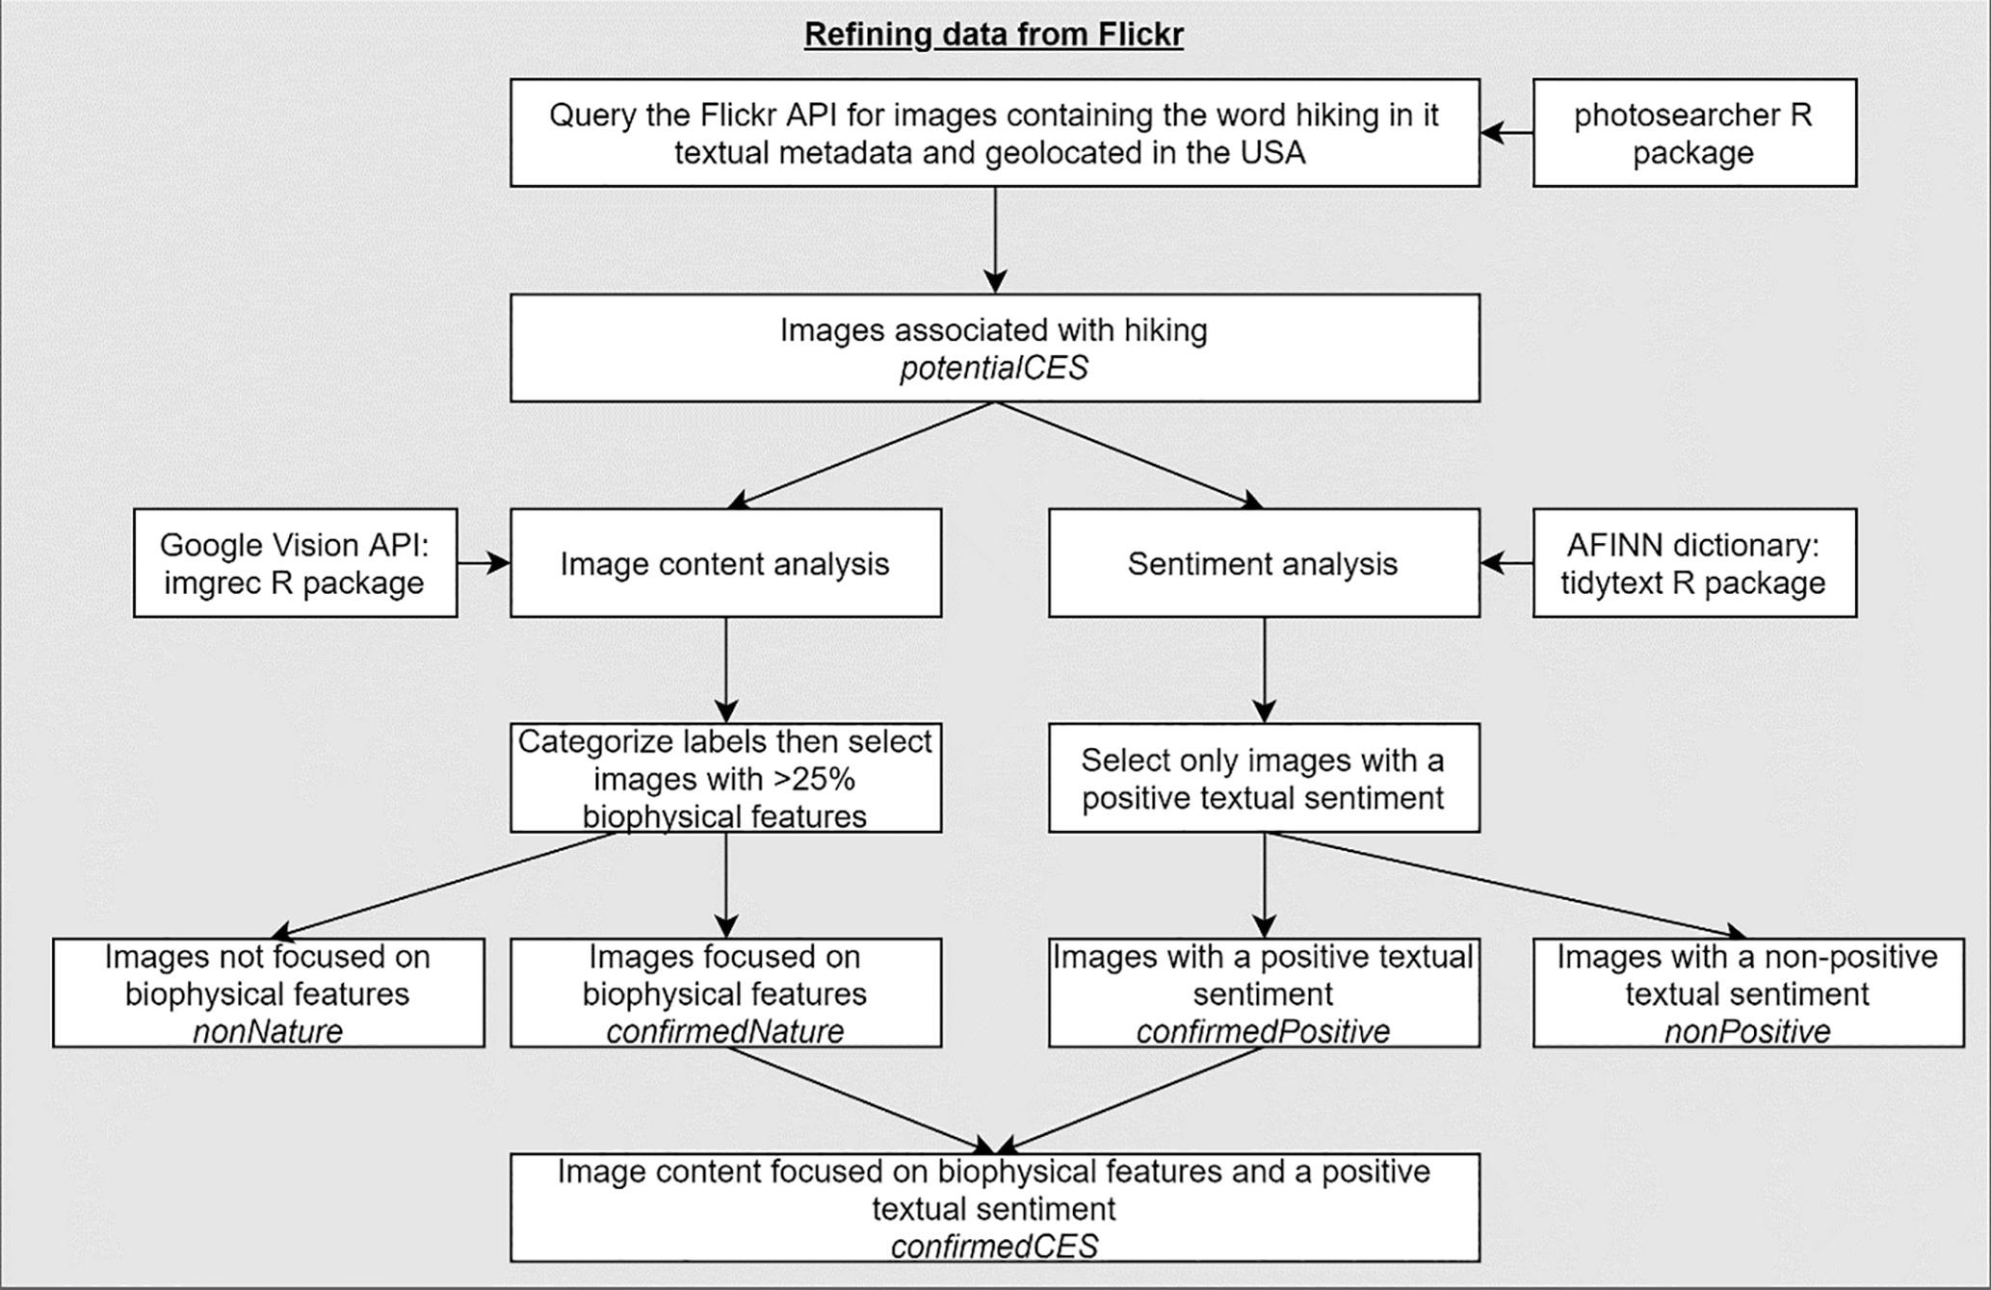
Sentiment
Analysis
Machine Learning Automated
Increasingly, the social
sciences use computational approaches.
Source: modified from Fox et al. 2021 Ecosystem Services 50: 101328.
Notes:
Notes to Instructor: This figure comes from a study in the journal Ecosystem Services in which the authors used Flickr images and associated textual metadata to try to understand the drivers and distributions of cultural ecosystem services. They wrote: “We classified the contents of these hiking images and, using latent semantic analysis, clustered the images into 10 groups based on the similarity of their content. The groups provide rich information, such as the importance of geodiversity and biodiversity in supporting a positive hiking experience.”

Slide 11
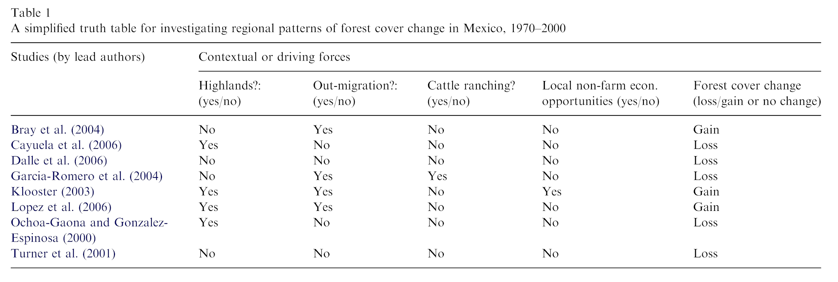
Comparative Case Study Analysis
This analysis uses a number of case studies to search for patterns or general insights on issues in different contexts.
It groups cases and identifies variables explaining outcomes
They’re often used to test socio-environmental theories (e.g., how social variables influence ecological variables).
Sometimes, quantitative approaches are used to analyze results from tables, etc. (using algorithms from Boolean (binary) algebra)
It requires that the researcher “thinks” and draws conclusions.
Table from study by Tom Rudel 2008 Global Env Change 18: 18-25.
Notes:
Notes to Instructor: Other approaches are sometimes listed under the rubric of comparative case study analysis, including archetype analysis (see: https://www.sesync.org/resources/system-archetypes-understanding-and-solving-sustainability-problems). In the best work, many cases (10–50) are compared so that there is substantial data to draw inference from. A series of ‘yes/no’ type questions are asked of each e.g., do the explanatory variables in the study include land use?
Boolean algebra – results coded at 0 or 1 or true/false. It simplifies analysis, grouping cases into similar bins.
Rudel table: Using CDA, Rudel identified sets of conditions for deforestation around the world and concluded, among other things, that deforestation has shifted from a state-initiated to an enterprise-driven process in the last decades.

Slide 12
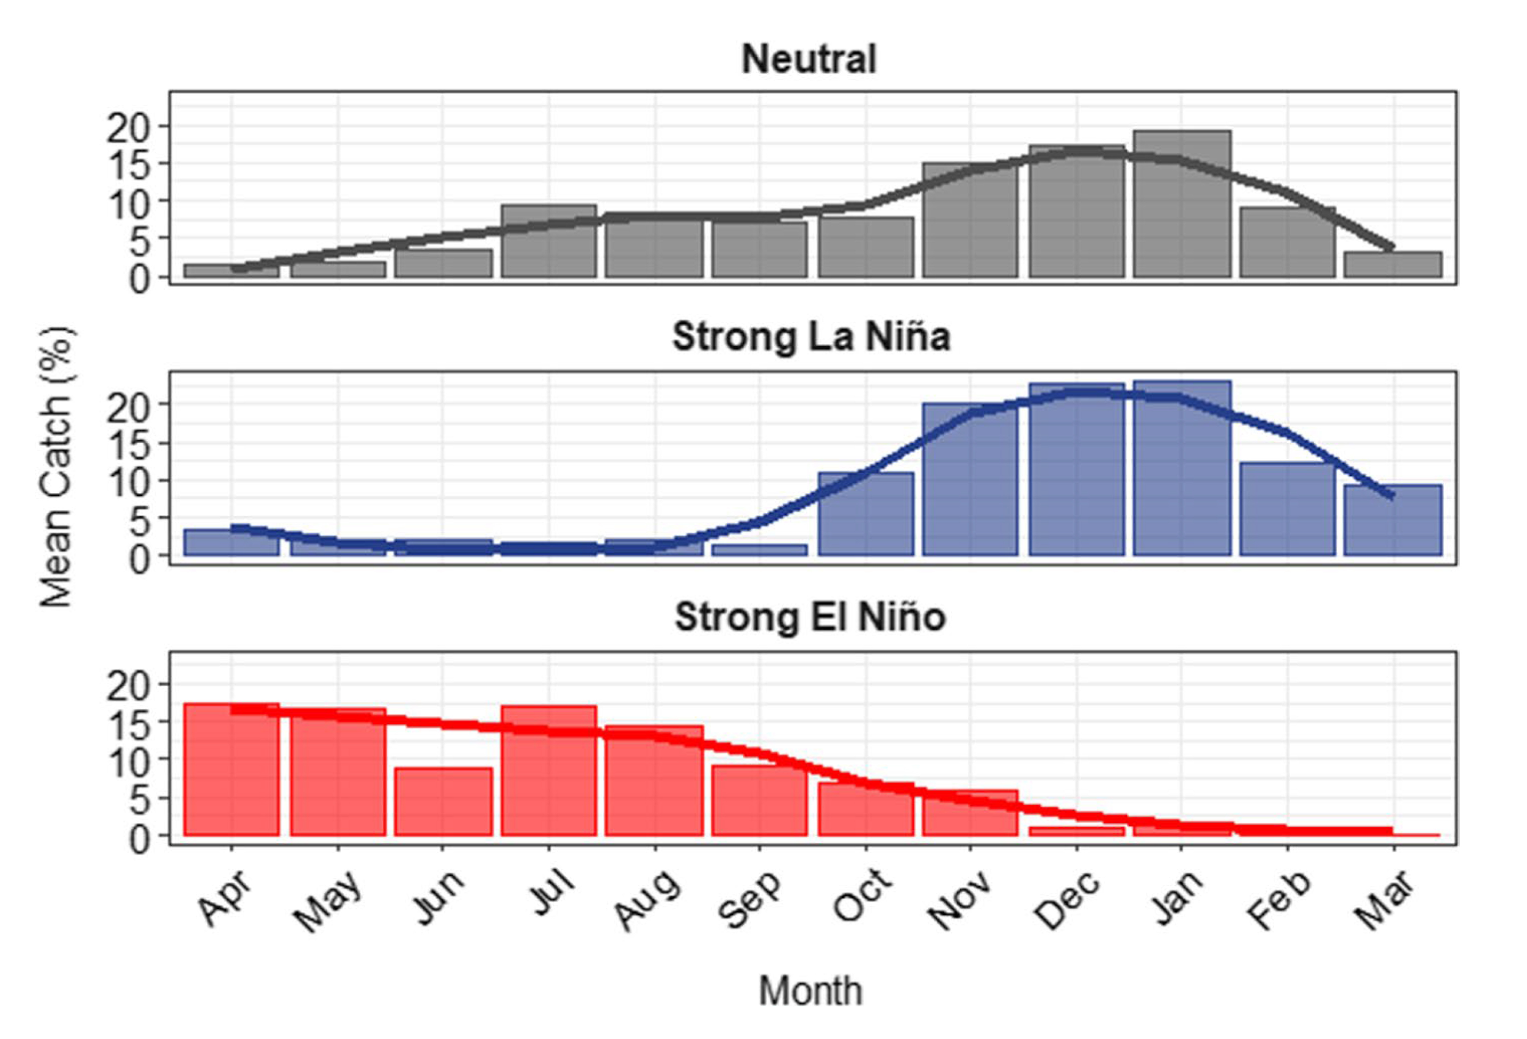
Mixed Methods Analysis
It brings together qualitative and quantitative approaches.
It can take advantage of inductive (specific observations to generalization) and deductive (moves from general to specific) approaches.
Qualitative components are often used to help explain statistical results.
Research Example
Question: How do fishermen who catch market squid respond to high seasonal and interannual climate variability?
  Quantitative data: historic fishery landings, climate records – to show fishery had responded to climate
  Qualitative data: fishermen survey – to determine how they altered fishing and if they would if more variability is likely
Powell et al. 2022 Climatic Change 173: 1
Notes:
Notes to Instructor:
Inductive example: case study analysis, ethnography, etc.
Deductive example: testing a theory in a specific context
In the Powell et al. (2022)‘ study in southern California, the authors report: “Nearly half of fishermen stated that they would switch fisheries if market squid decreased dramatically in abundance, although fishermen who were older, had been in the fishery longer, were highly dependent on squid for income, and held only squid and/or coastal pelagic finfish permits were less likely to switch to another fishery in a scenario of” lower abundance. While market squid fishermen have exhibited highly adaptive behavior in the face of past climate variability, recent (and likely future) range shifts across state boundaries, as well as closures of other fisheries, constrain fishermen’s choices and emphasize the need for flexibility in management systems”

Slide 13
Topic and Journal Assignments
Group 1: Drought Journal of Ecological Anthropology
American Anthropologist
Ecological Applications
Journal of Ecology
Group 2: Drought Environmental Sociology
American Journal of Sociology Journal of Environmental Economics & Management
Group 3: Urbanization Journal of Ecological Anthropology
American Anthropologist
Ecological Applications
Journal of Ecology
Group 4: Urbanization Environmental Sociology
American Journal of Sociology Journal of Environmental Economics & Management

