Slide 1

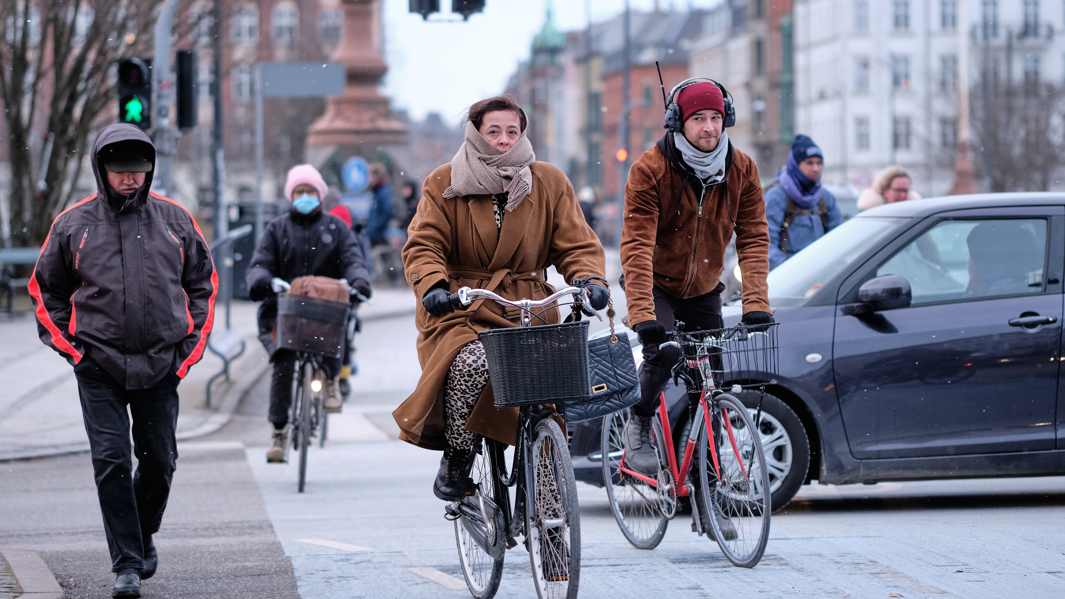
What Influences Pro-Environmental Behavior?
Climate Change Case Study
Photo via Wikimedia Commons

Slide 2
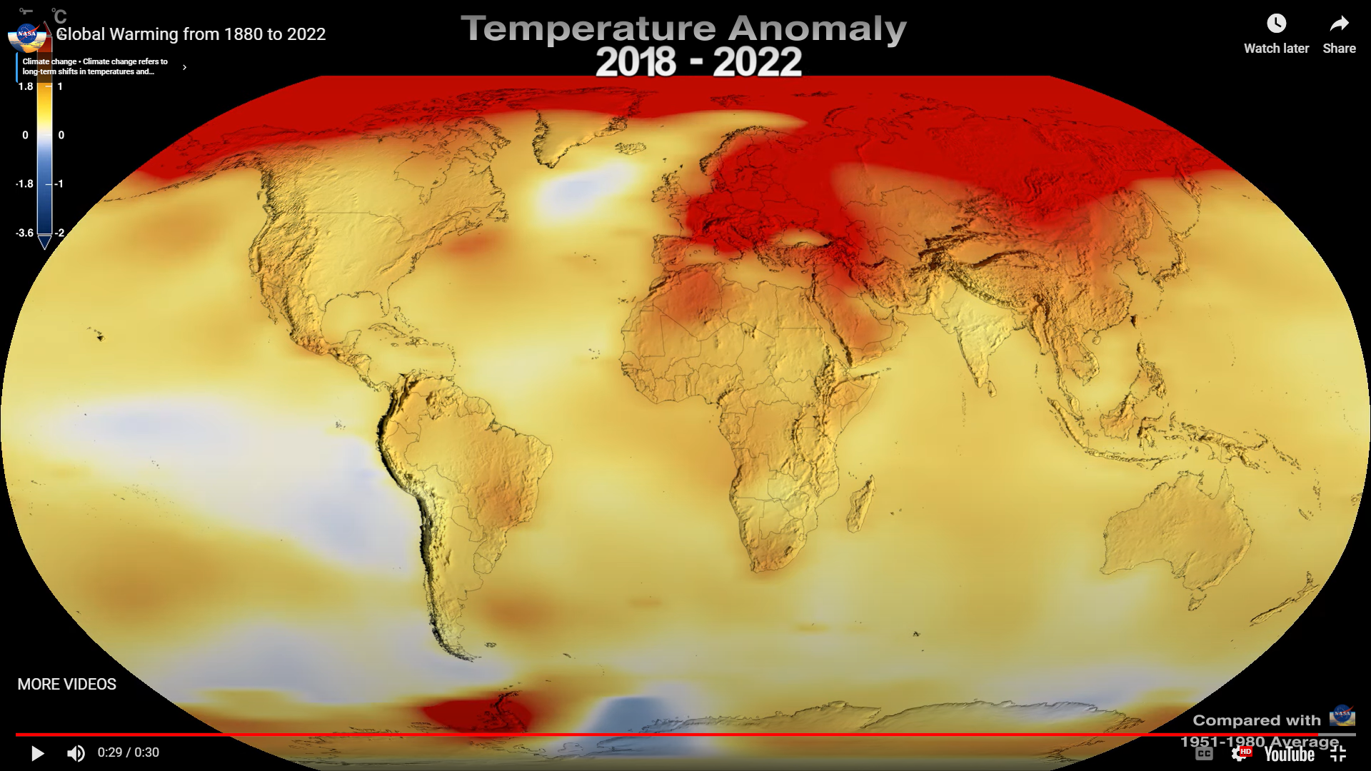
Image from NASA video:
Global Warming from 1880–2020

Slide 3

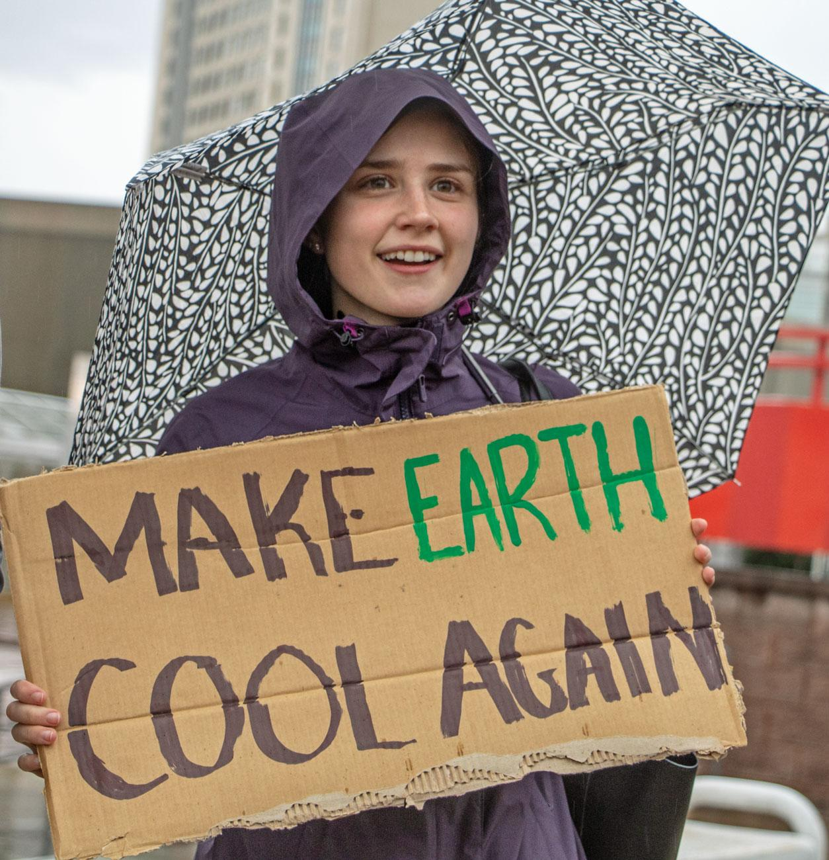
Belief in Climate Change
…is quite widespread today.
A belief in climate change is associated with:
Acknowledgment that humans are the cause of climate change
A stronger perception of impacts/risks resulting from climate change
An increased intent to act on climate change
Notes:
Notes to Instructor: While climate denial often gets a great deal of media attention, today, the majority of people believe global warming is real. In addition to looking at the graphic on the next slide and its source, see for e.g., https://climatecommunication.yale.edu/visualizations-data/ycom-us/

Slide 4
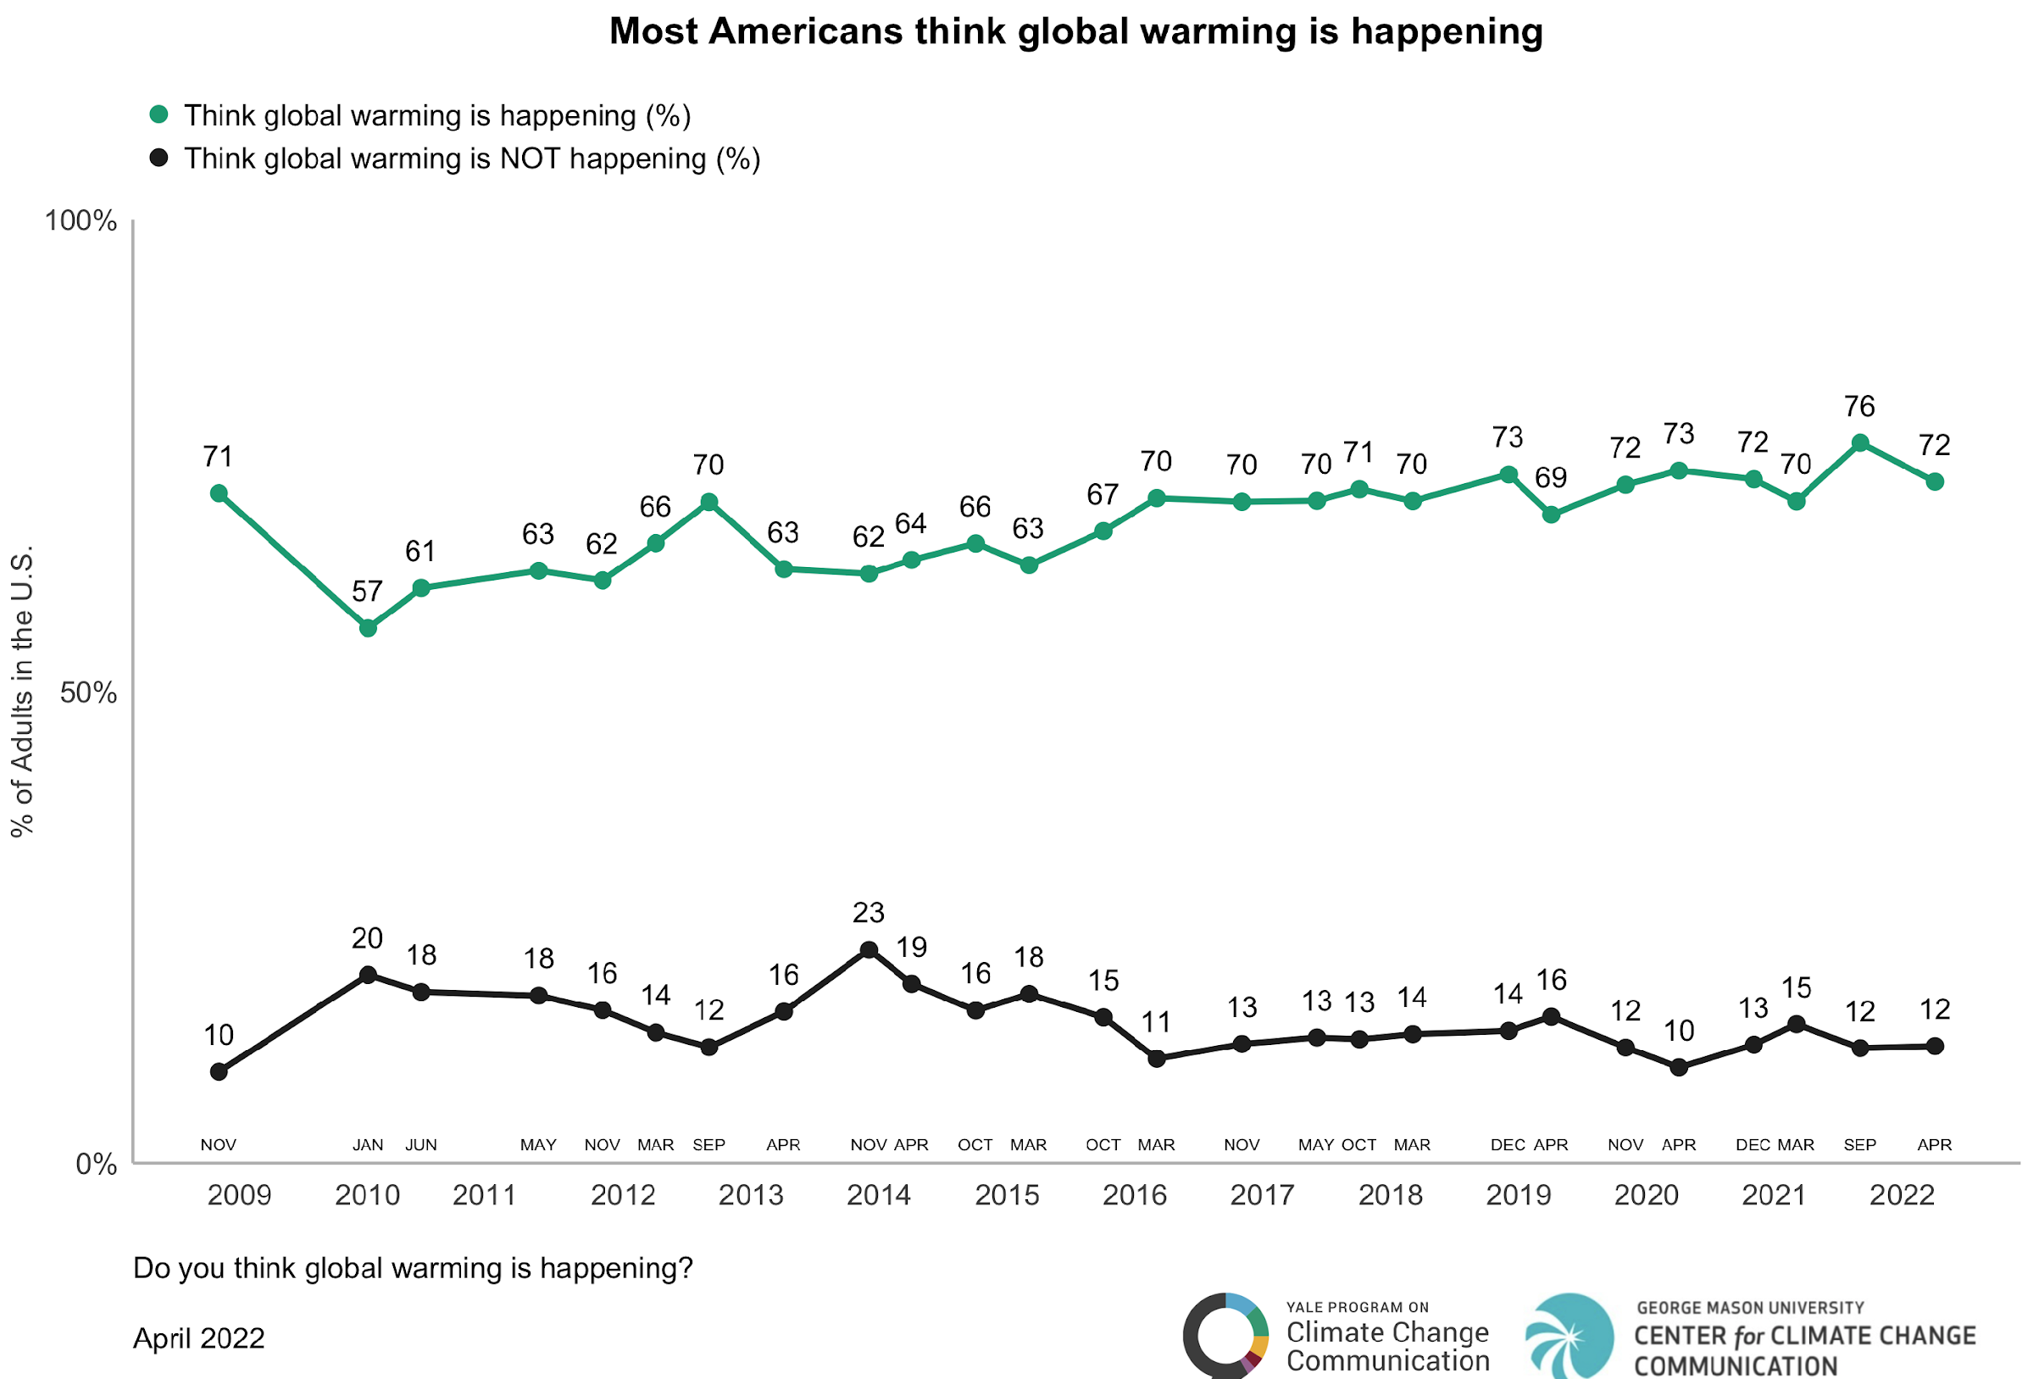
Source: Center for Climate Change Communication
https://www.climatechangecommunication.org/all/climate-change-american-mind-april-2022-1/

Slide 5

The following slides are based on an article by Linda Steg:
“Psychology of Climate Change”
Annual Review of Psychology (2023)
https://doi.org/10.1146/annurev-psych-032720-042905
Professor Steg is an environmental psychologist at the University of Groningen and a Fellow of the Royal Netherlands Academy of Arts and Sciences. Her research focuses on the interaction between people and their environment: How does the environment influence people’s behavior and well-being? How do people influence the quality of nature and the environment? How can environmentally friendly behavior be promoted?
Notes:
Notes to Instructor: The slides that follow are from Steg’s article that learners read in advance. In the Lesson, see “Background Information for Instructor” for another excellent paper she helped lead; however, it is not open access.

Slide 6

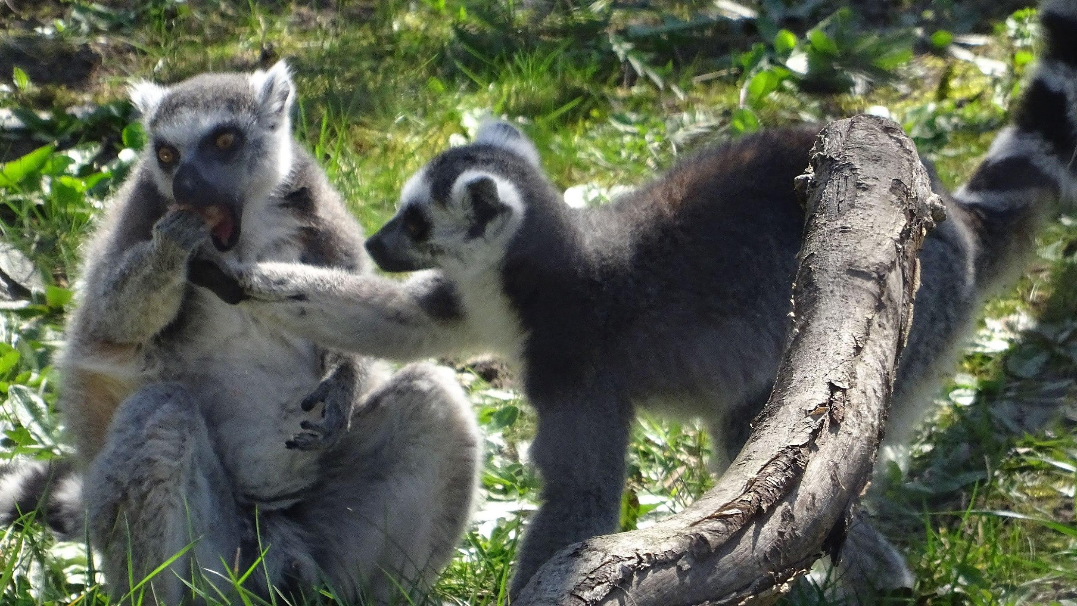

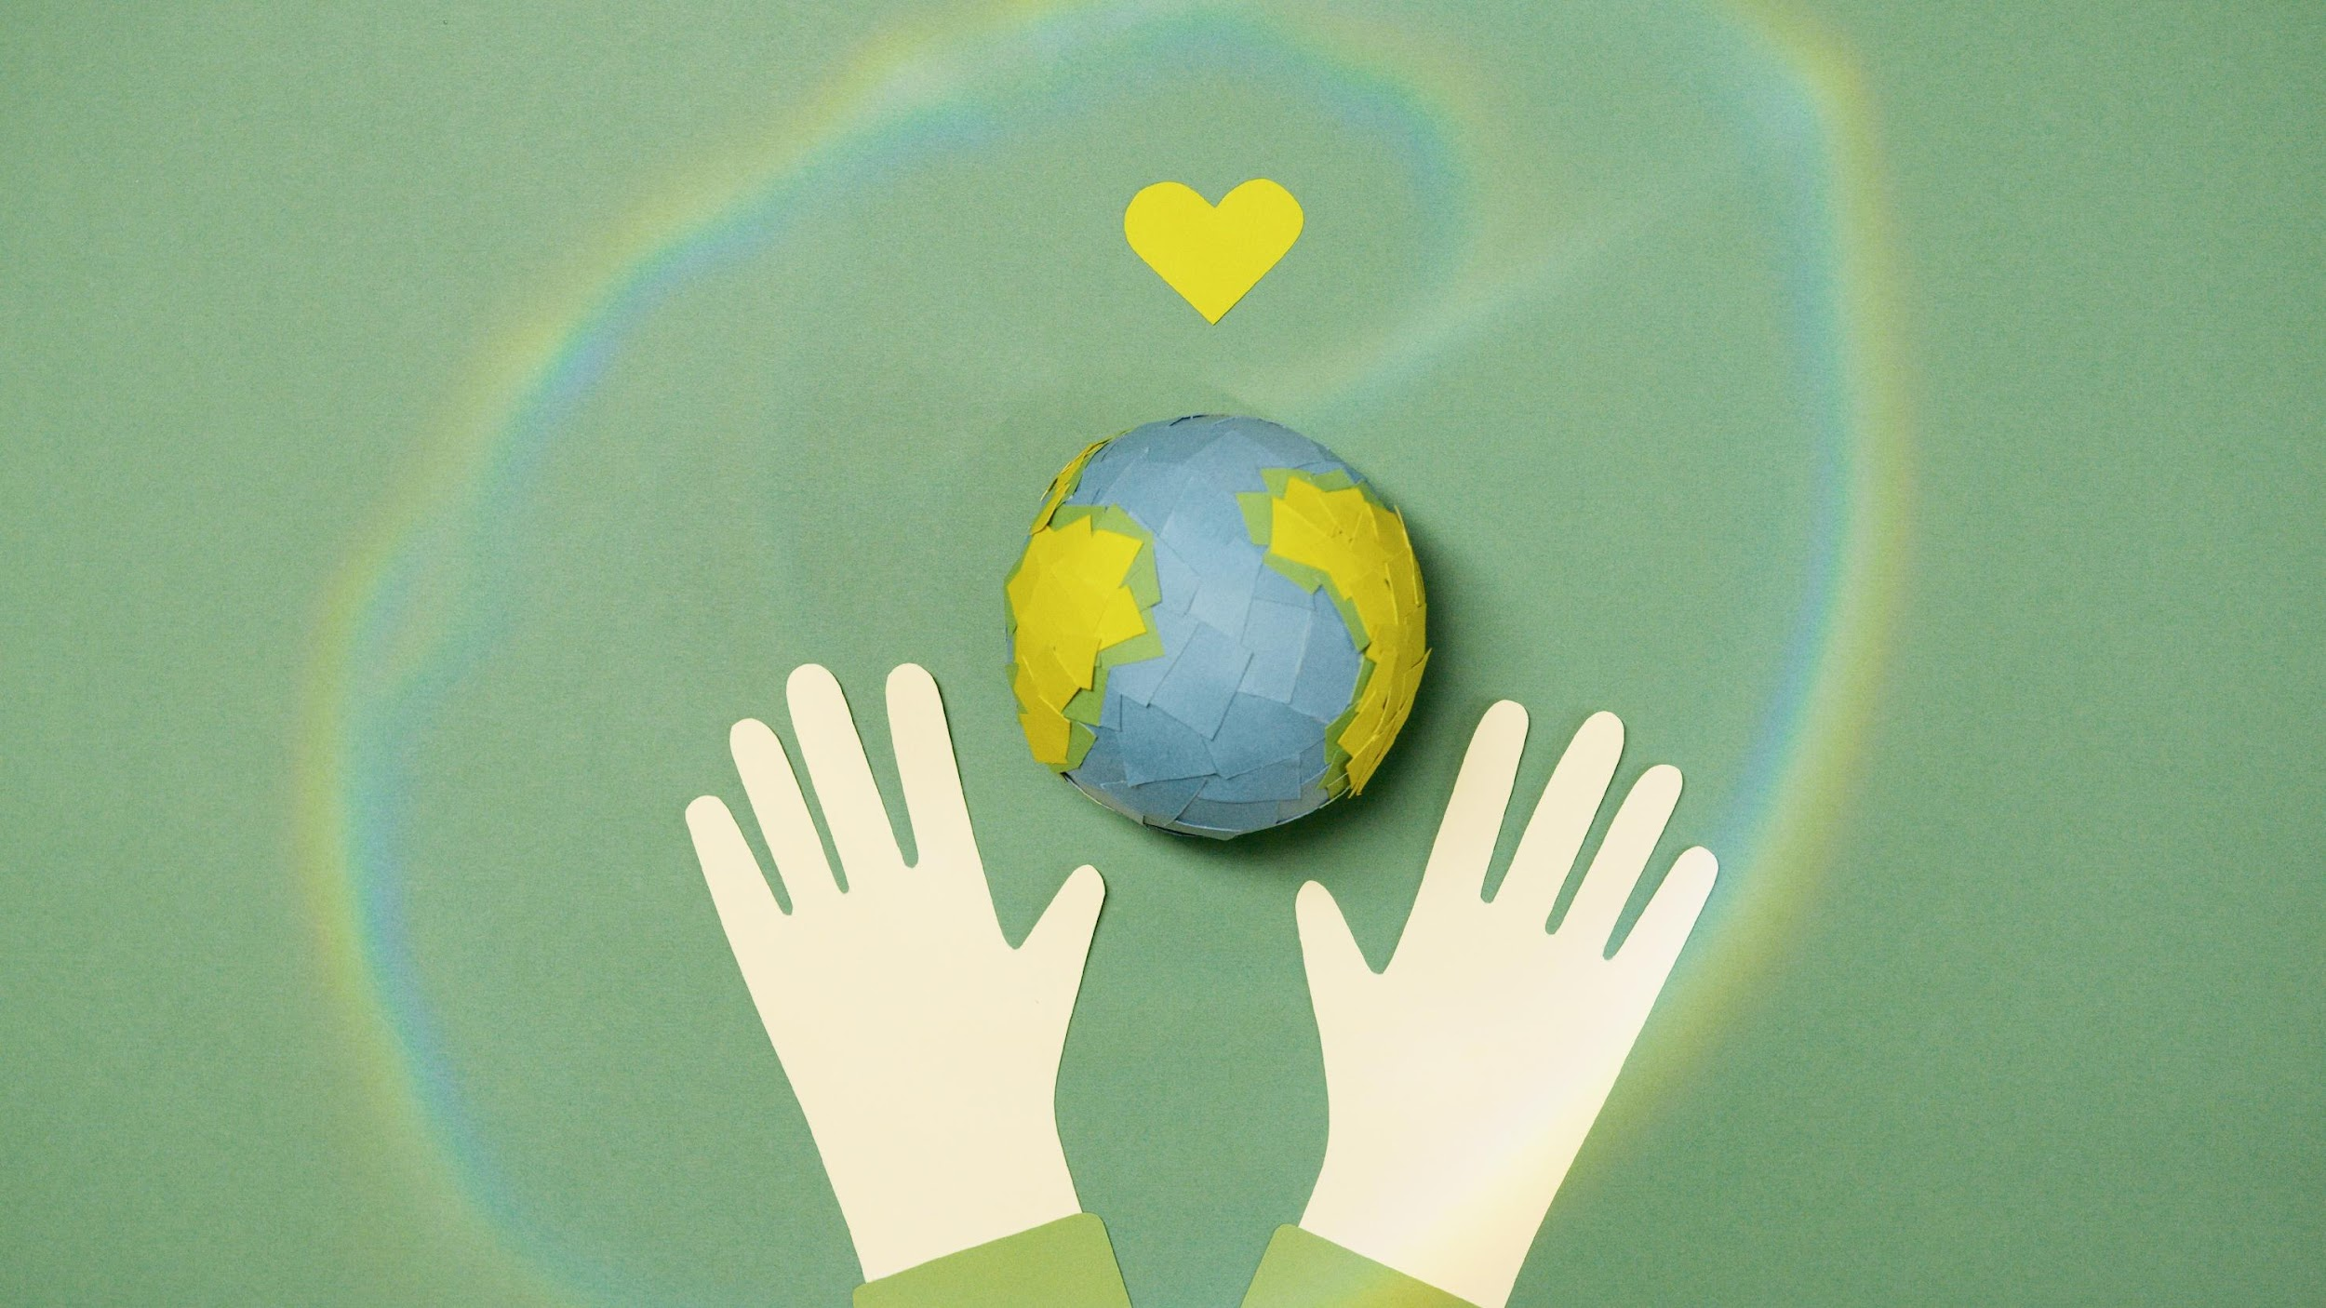
Factors Influencing Pro-Environmental
Behaviors
Values reflect the goals that people strive for.
Individual Values
Make people focus on personal consequences of actions
Hedonic Values
– strive to improve feelings & reduce effort
Egoistic Values
– strive to enhance resources
Collective Values
Make people focus on collective costs and benefits of actions
Altruistic Values
– strive to benefit others
Biospheric Values
– strive to enhance nature

Slide 7
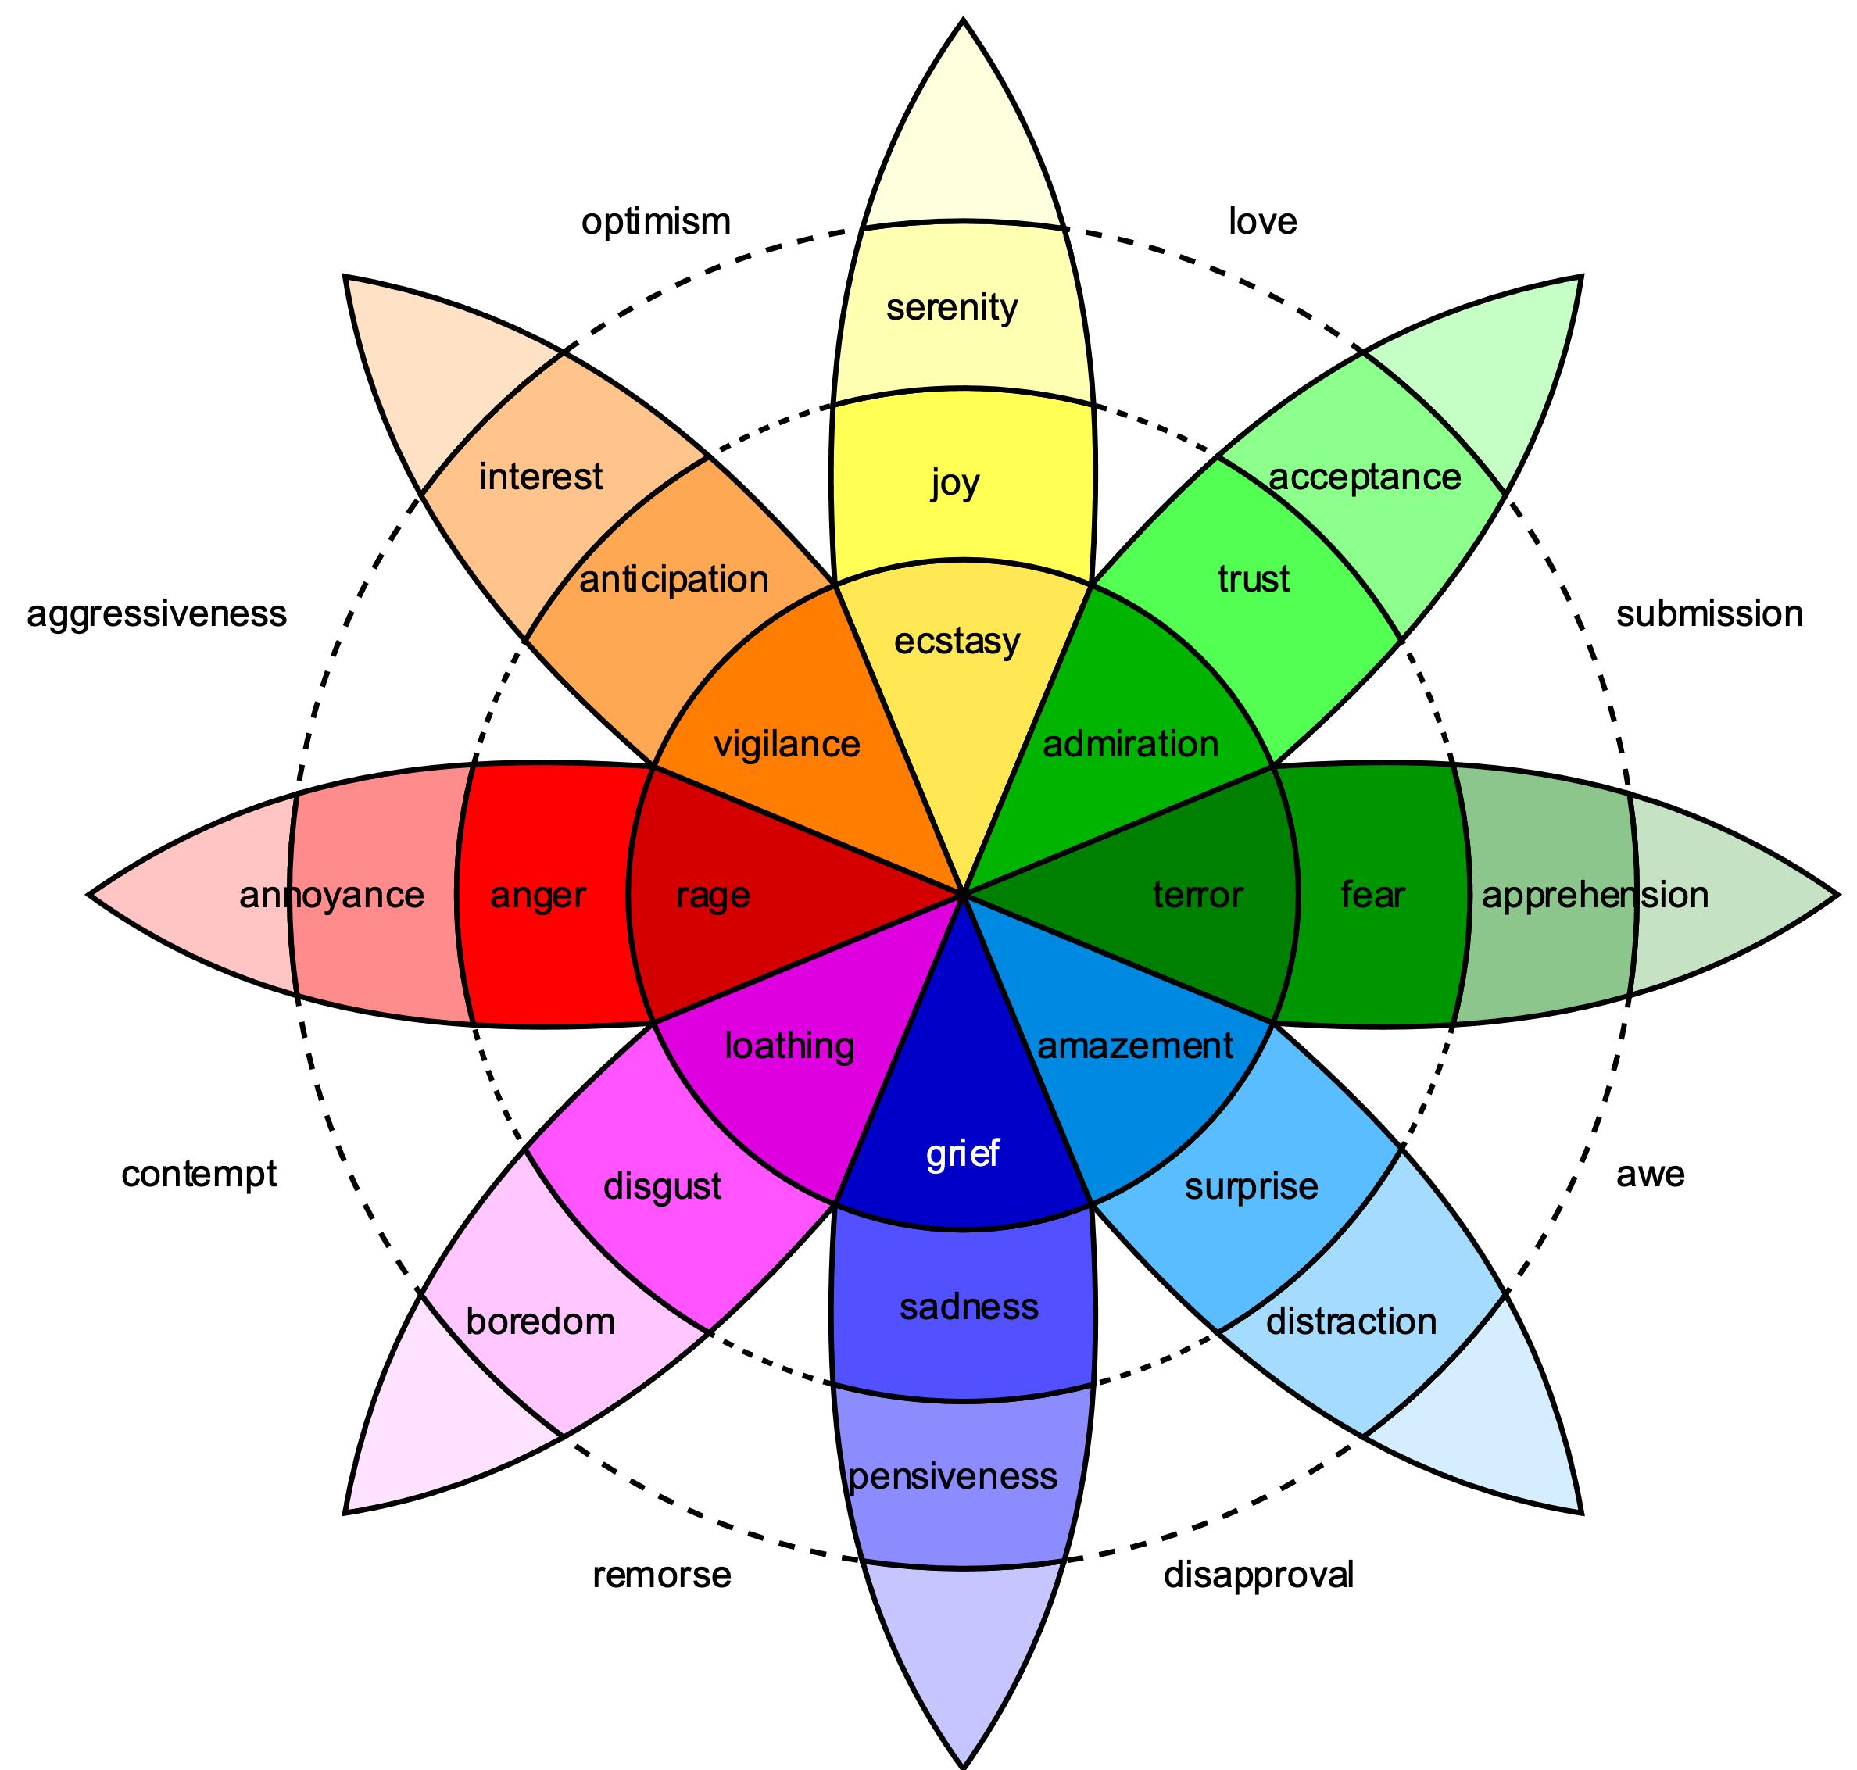
How do Values Influence Actions?
Indirectly by affecting emotions
Emotions can include guilt, fear, pleasure, sadness, etc.
Emotions signal values that are threatened or supported.
Anticipating emotions can motivate actions.
Source: Wikimedia Commons

Slide 8


How Do Values Influence Actions?
Indirectly by affecting cognition.
Values:
Influence how we think—our evaluations, beliefs, norms
Influence what consequences we consider
Influence how we perceive consequences
(e.g., as good, bad, effective, acceptable …)
Influence how we view information and
whether that influences our intention to act.
Notes:
Notes to Instructor: Note that intention to act can include one’s willingness to support policies. How we “think” means how we evaluate and interpret information, how we process it in our mind, what we pay attention to, etc. It would be good to ask learners why the word “intention” is included in the last bullet. There is a great deal of research showing that intentions change much more readily than actions/behavior. The Theory of Planned Behavior posits that attitudes (e.g., knowledge, values, beliefs); subjective norms (e.g., social pressure, perceived expectations); and perceived behavior control (e.g., do their actions really influence anything?) influence intention. Intention is predictive of action but not fully determinant. Many things can intervene.

Slide 9
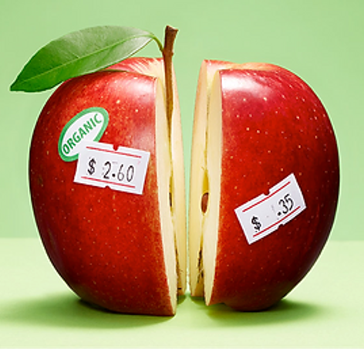
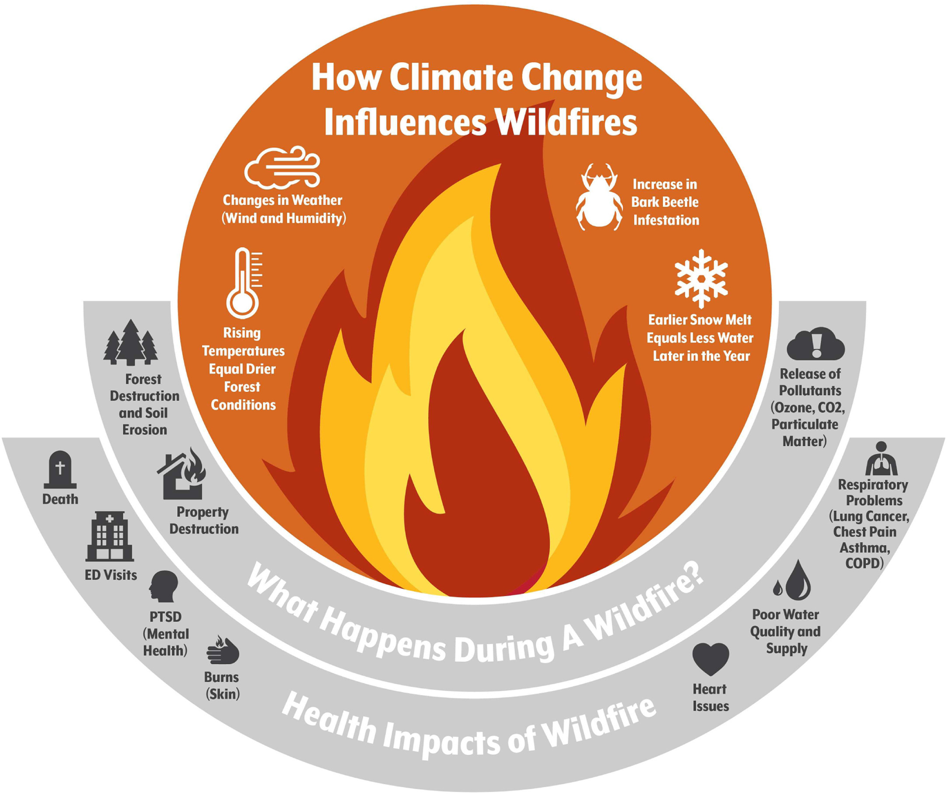
What factors lead to not acting in line with biospheric values or not supporting policies for climate action?
A lack of awareness of consequences
or benefits (e.g., climate change, energy use…)
A lack of salience (when values are activated)
High costs (socially, materially, effort, etc.)
Questions about the fairness of a policy & likelihood that it will benefit them
Lack of trust in those proposing or supporting the policy
8
Source: Hwang et al. 2023. DOI: 10.1016/j.lana.2023.100482
Notes:
Notes to Instructors: With respect to salience, it may be useful to ask learners to speculate on how to activate values. Many examples could be given, such as showing images that evoke relevant emotions,

Slide 10


What can influence people who are not acting on their biospheric values?
Factors that may encourage people to act
on their biospheric values:
Experiencing challenging situations
Strengthening their environmental self-identity
Believing those whom they identify with are more pro-environmental
Strengthening their injunctive norms.
Notes:
Notes to Instructor: Note: this slide is referring to why people who HAVE biospheric values do not always act on them. Norms can be categorized as descriptive (how people act, think, and feel in a situation) or injunctive (how people think they should act based on their perception of what others believe)

