Slide 1
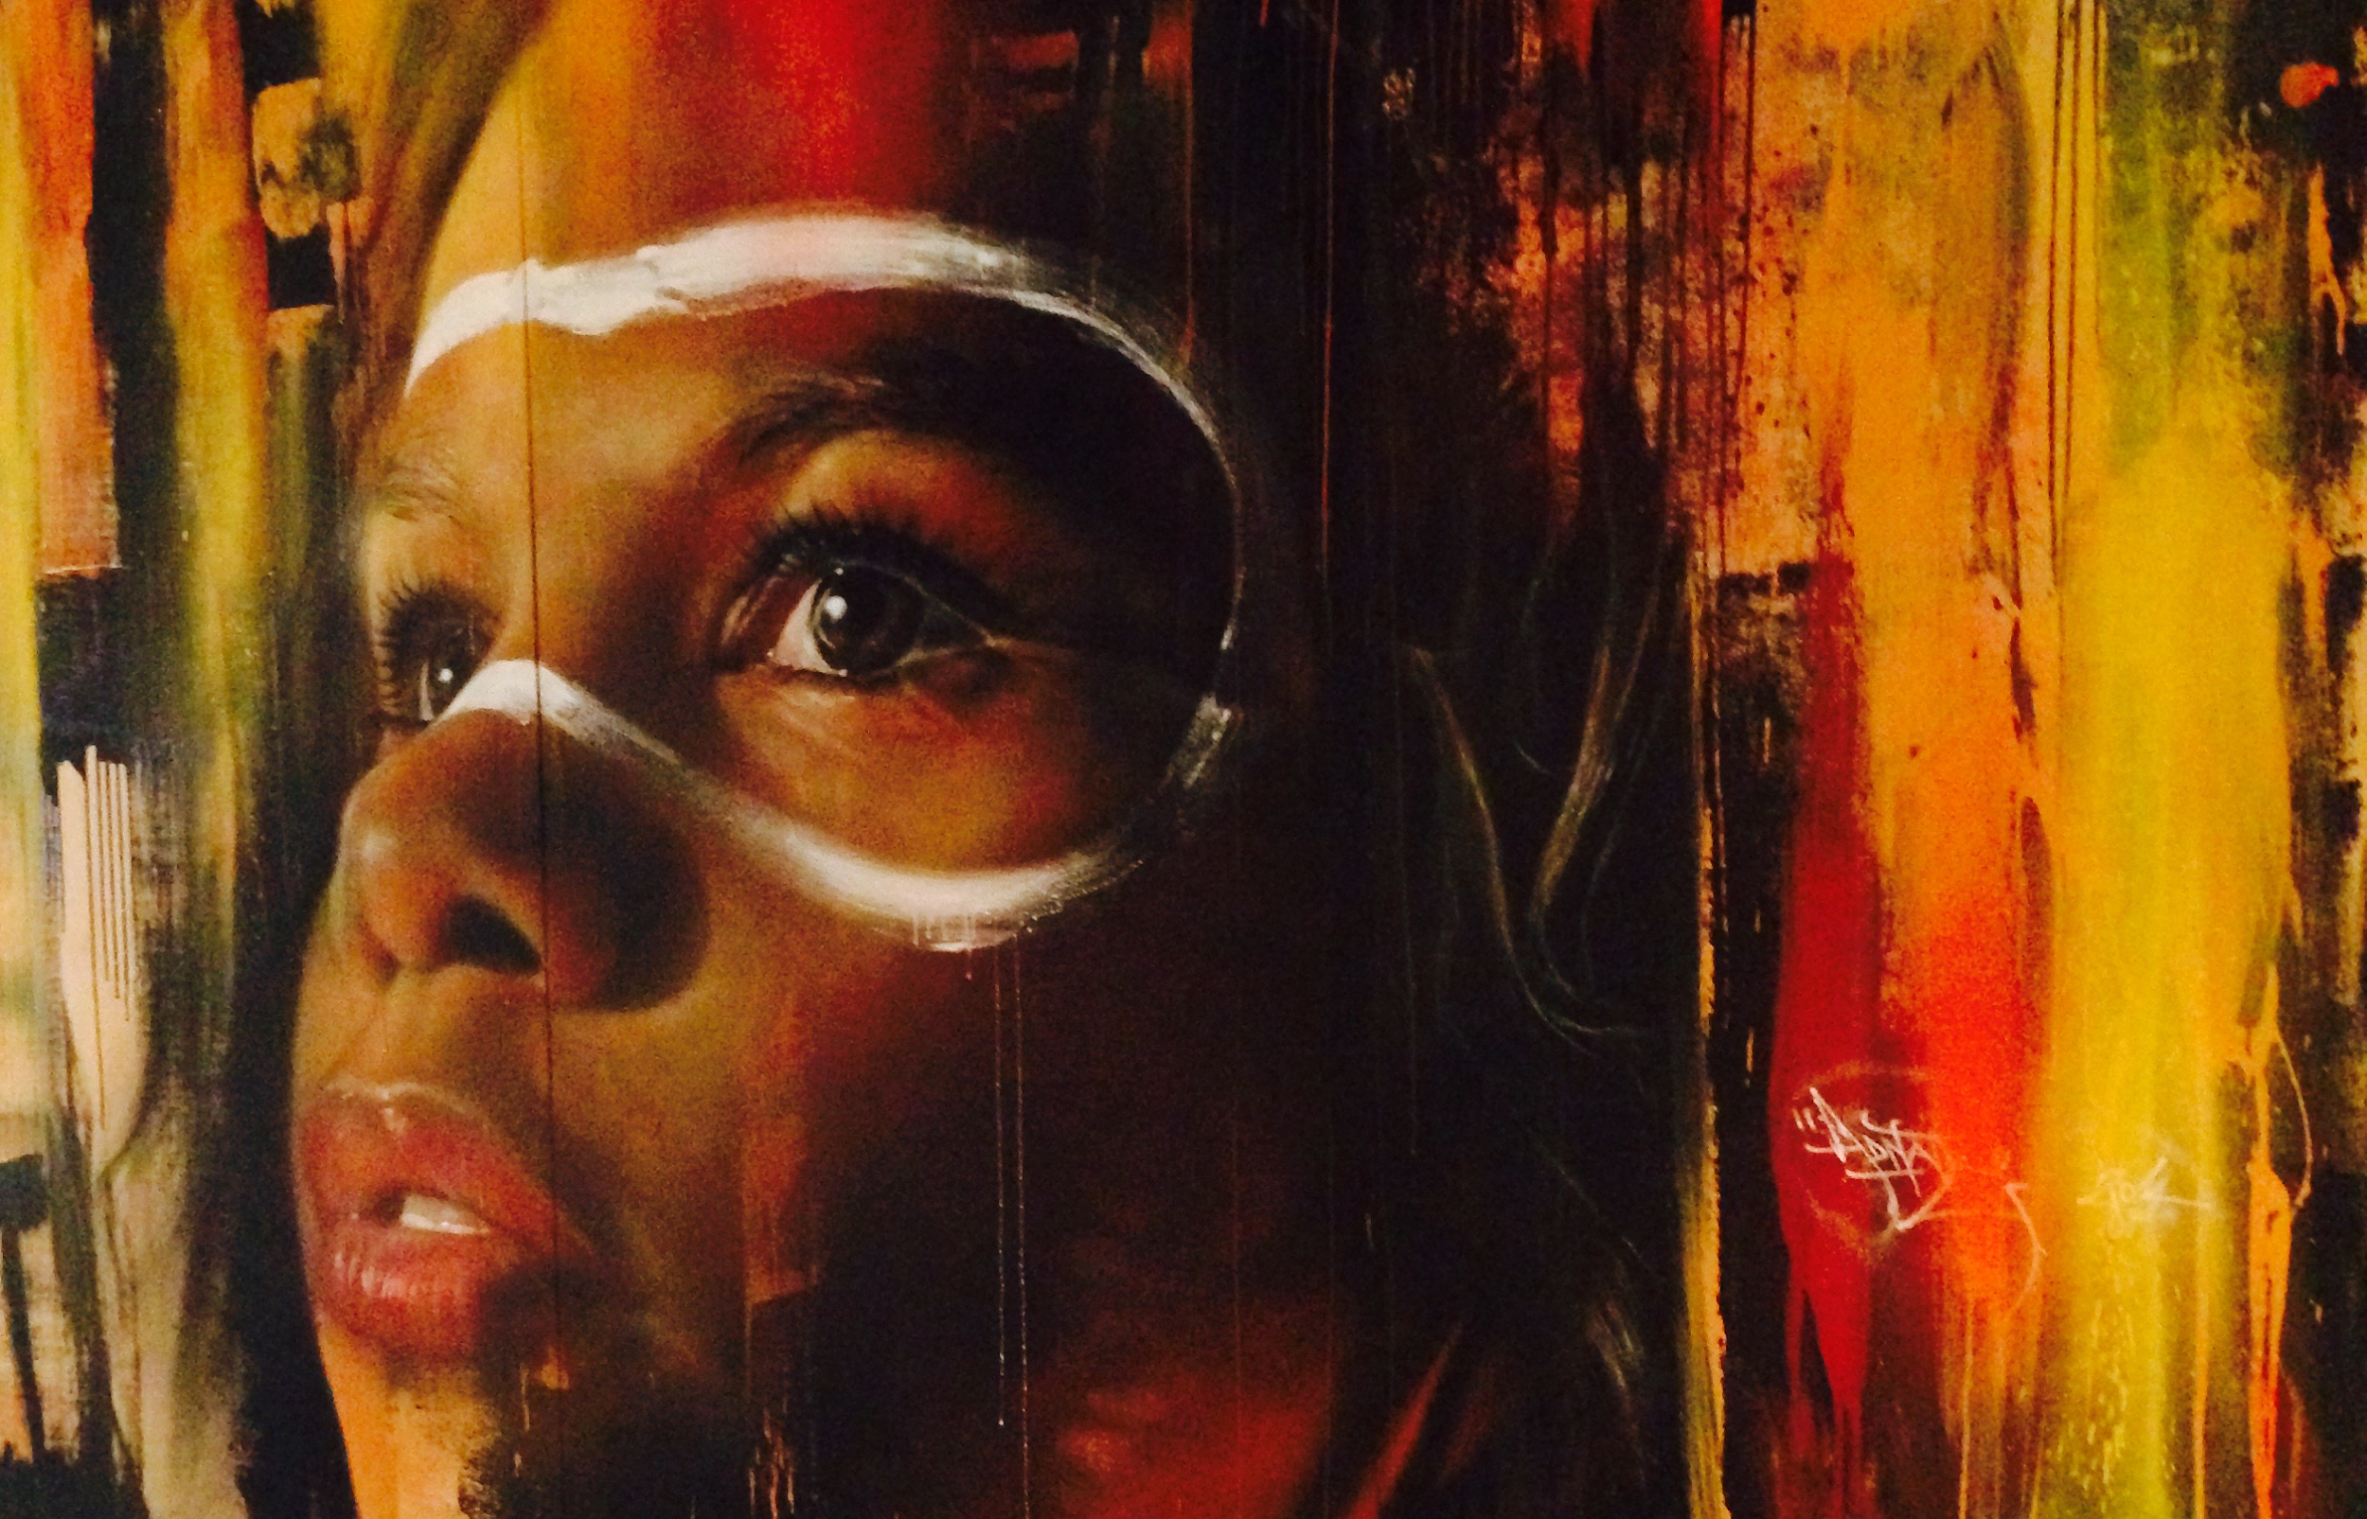
Practicing Reflexivity and Appreciating Diverse Perspectives
Wikimedia Commons “Mural in Thoughtworks Melbourne Office”

Slide 2
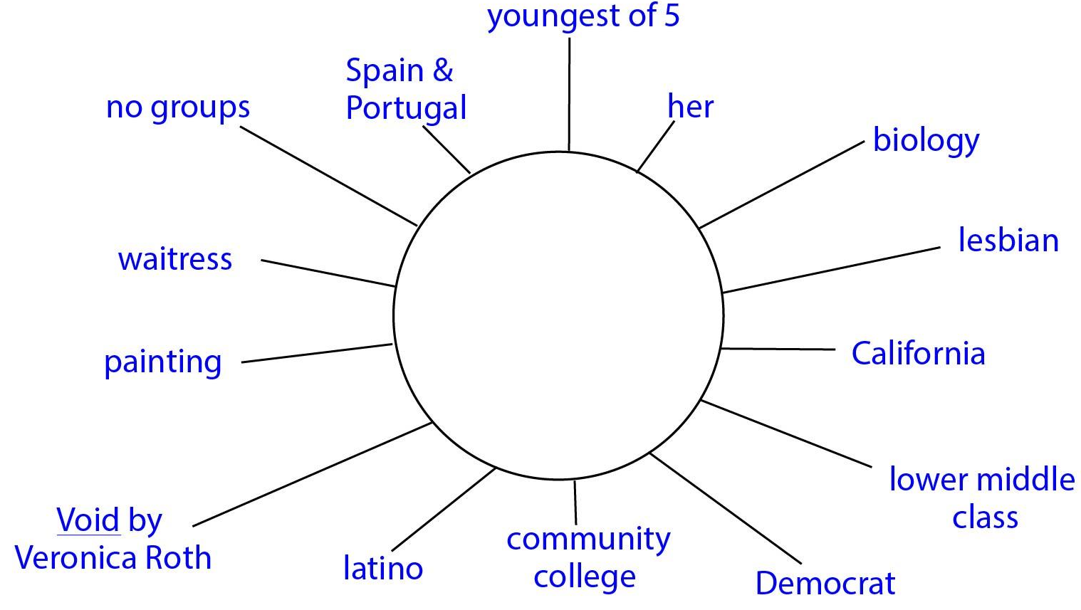
Categories for Self Identities Diagrams
Number in family and birth order
Political leaning
Religion
Potential college major
Any group(s) belonged to
Last book read that was not assigned
Travel experience (e.g., international, local)
Where they grew up
Introvert/extrovert
Past jobs
Talents
Race/ethnicity
Citizenship
Sexual orientation
Gender identity
16. Physical or mental limitations
17. Family social class
18. Education level of parents
19. Hobby
20. Body image (+/-)

Slide 3
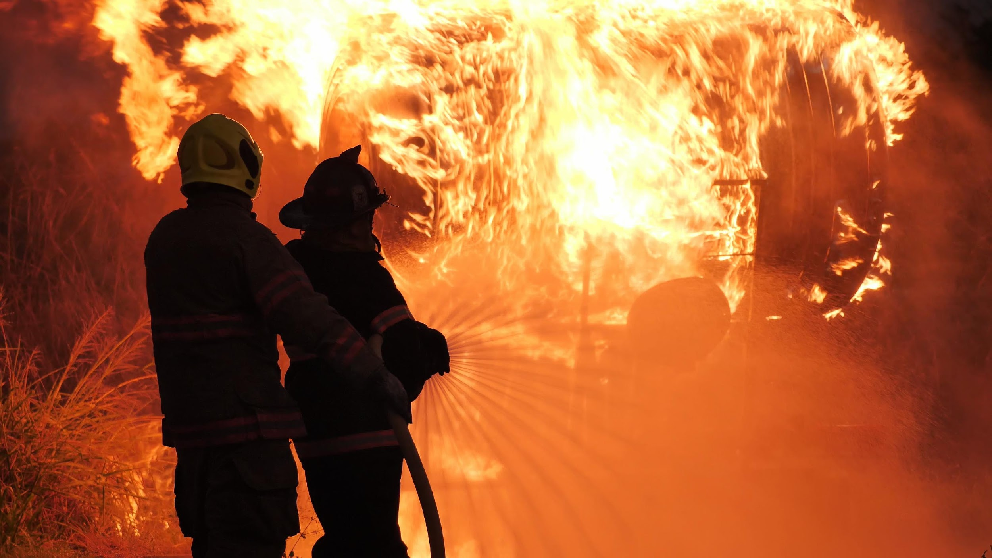
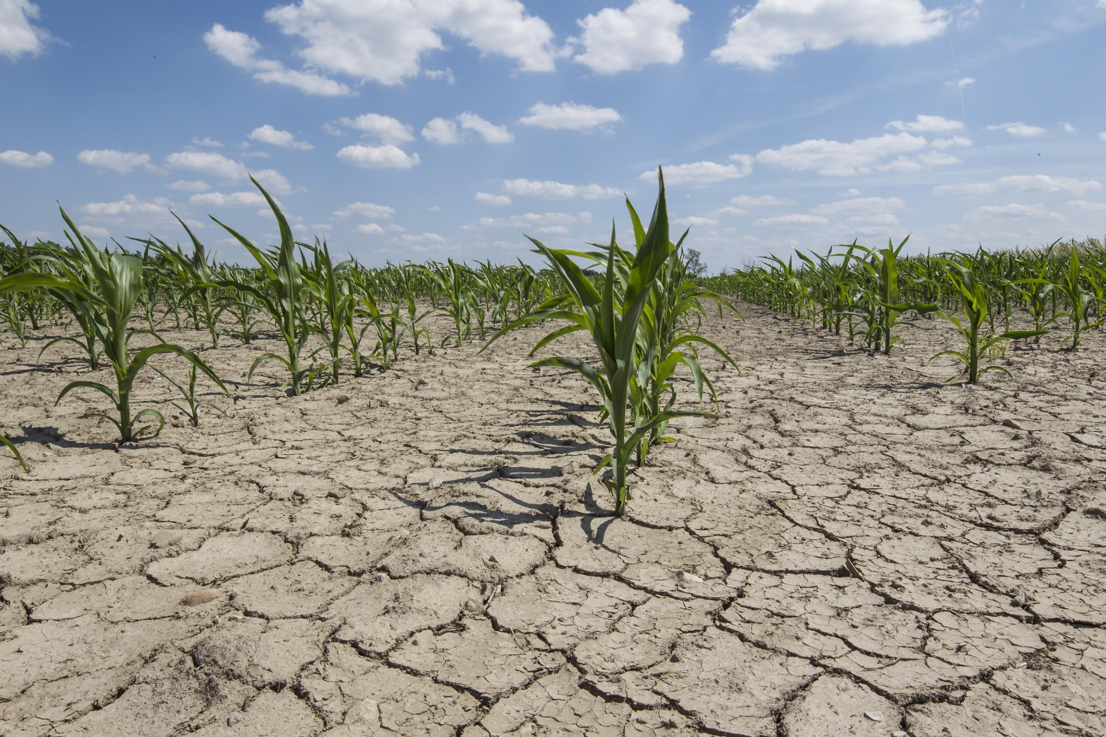
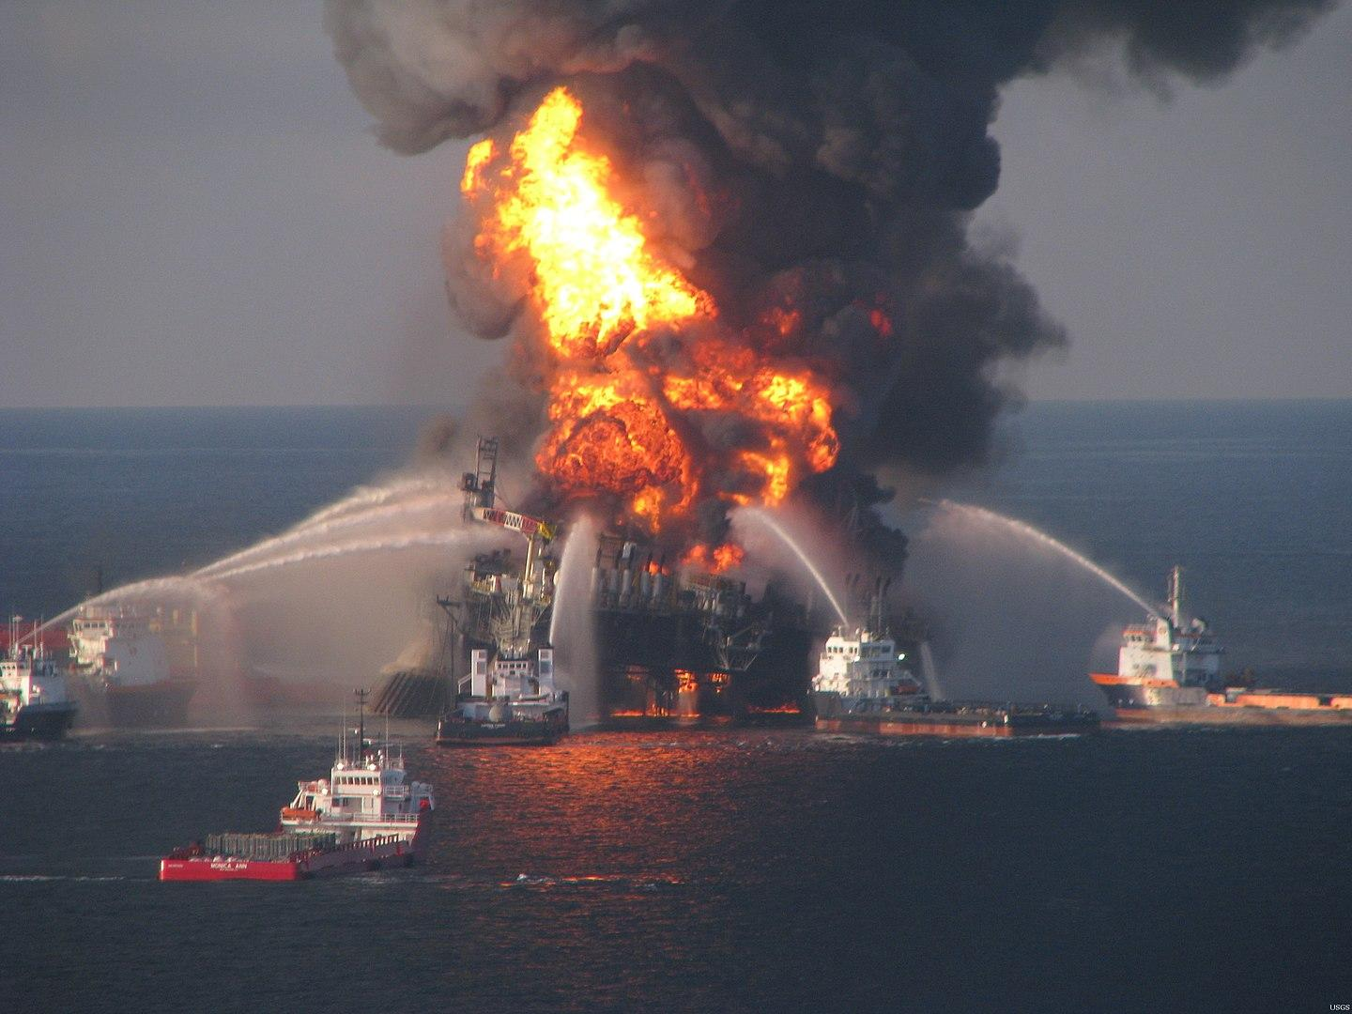
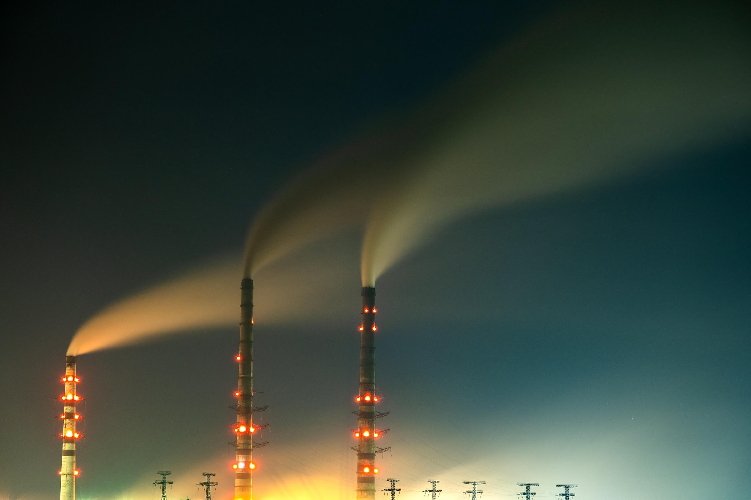
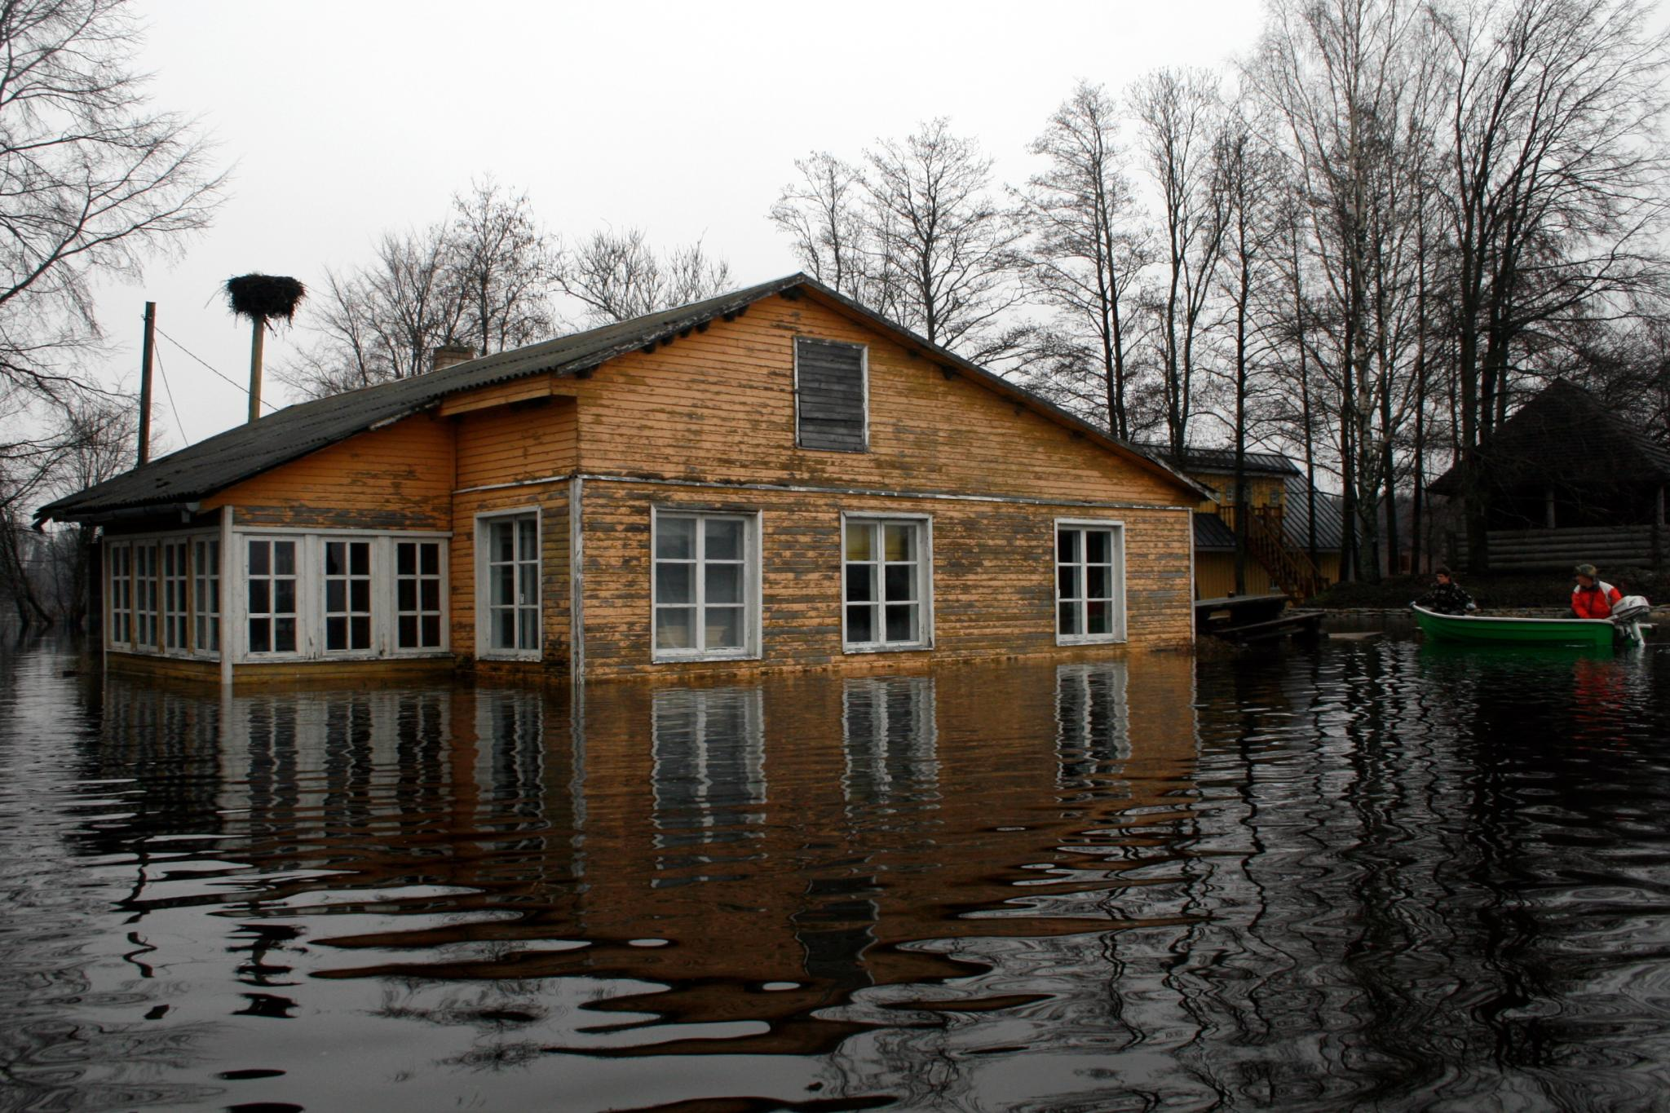
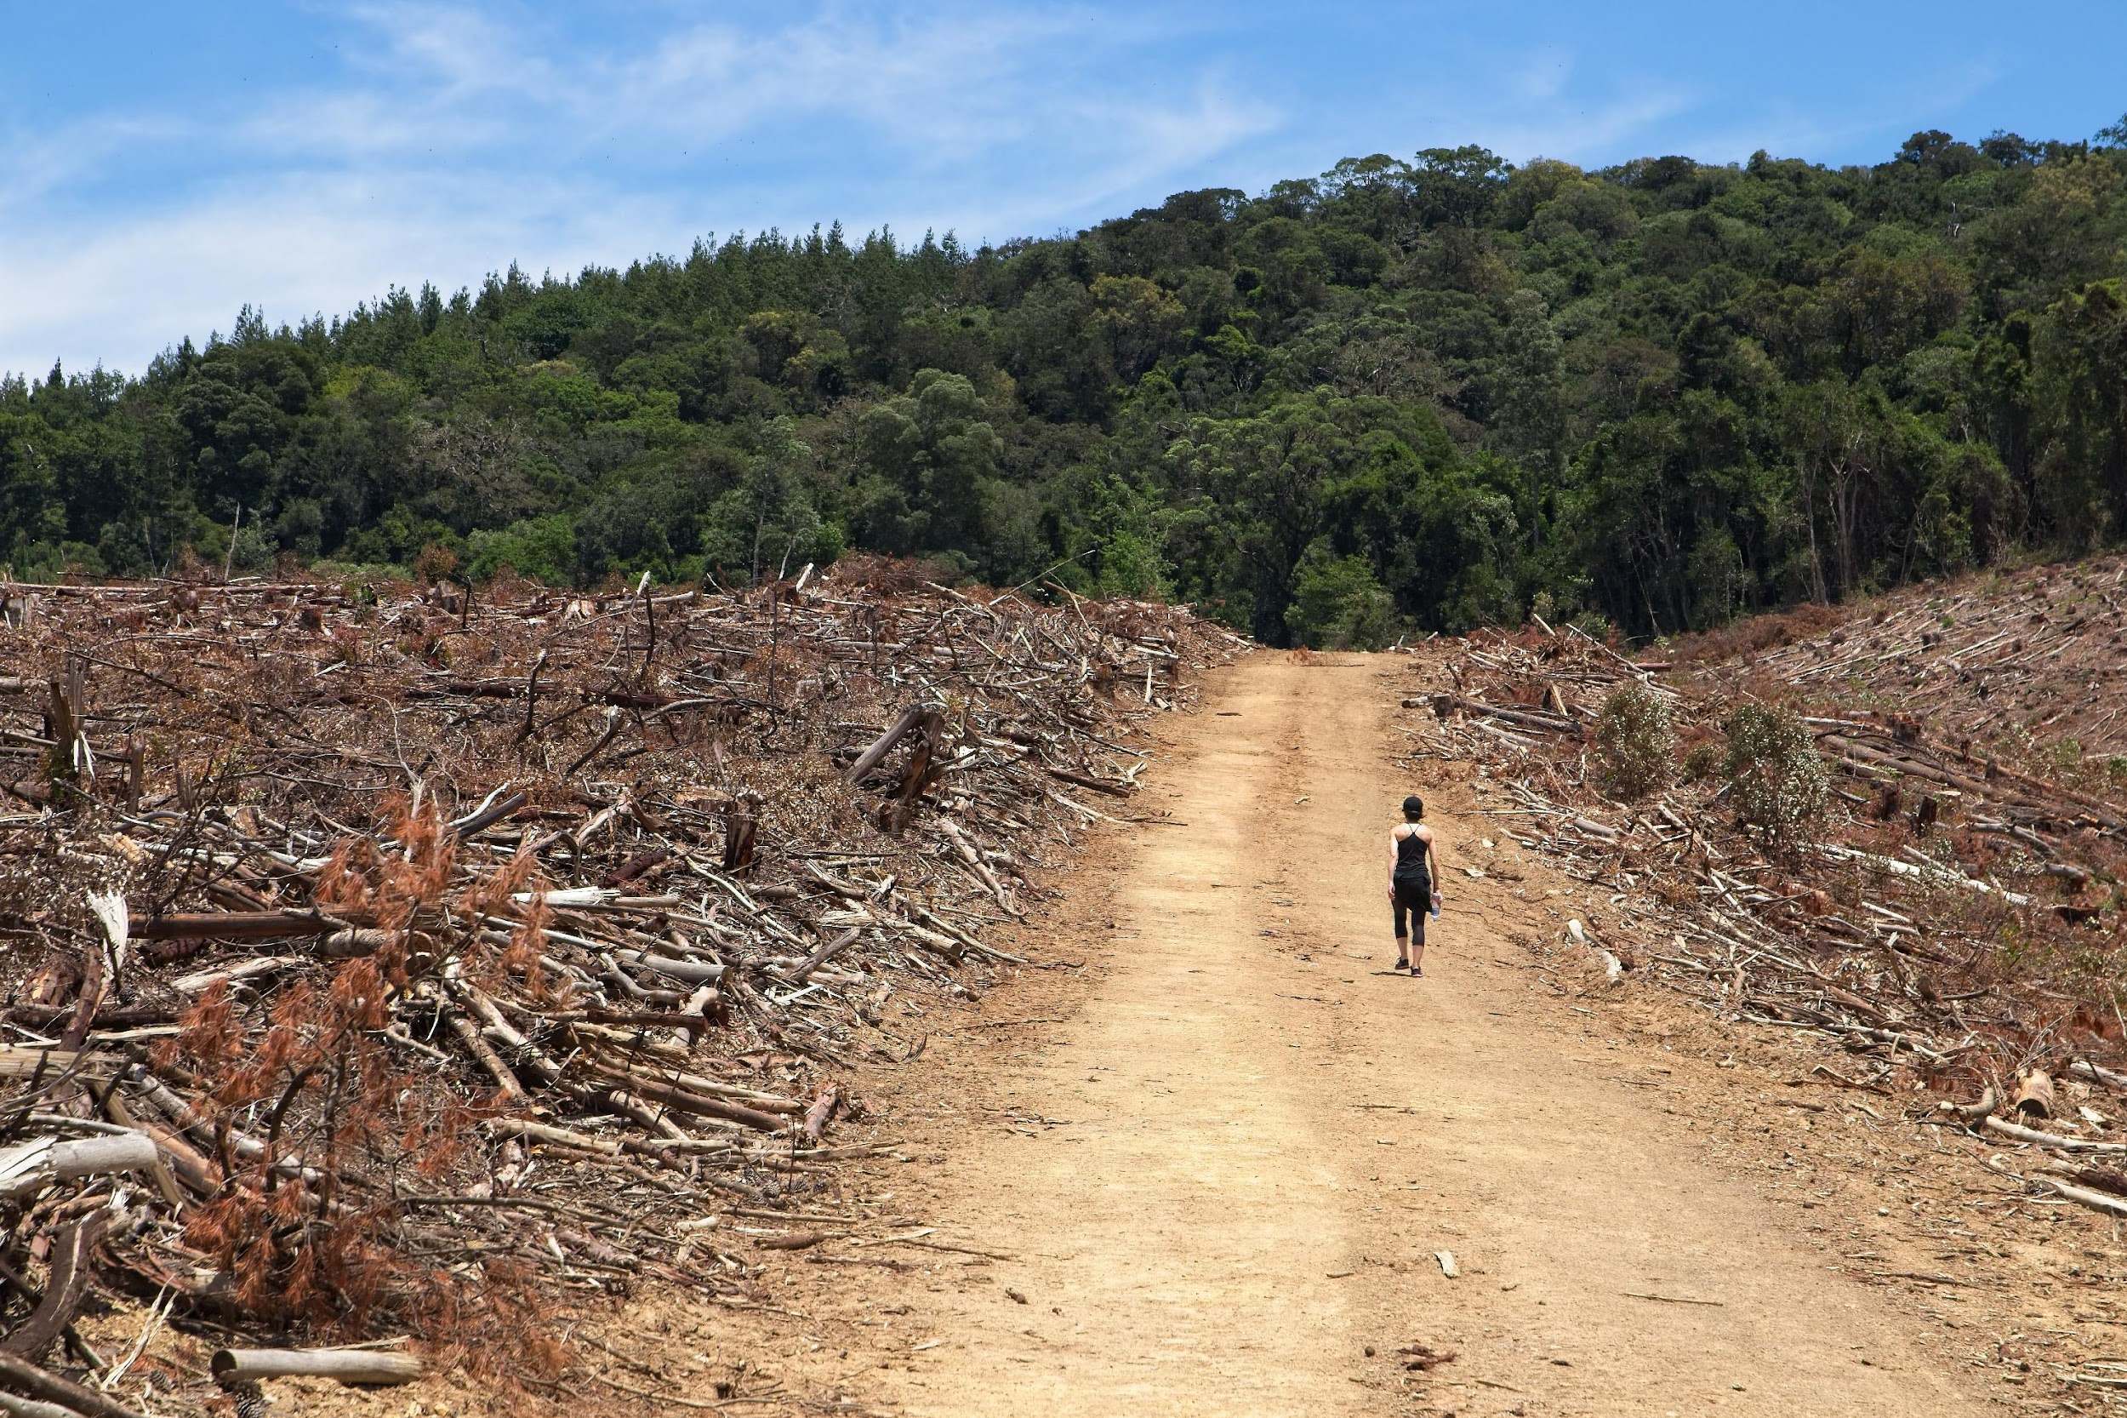
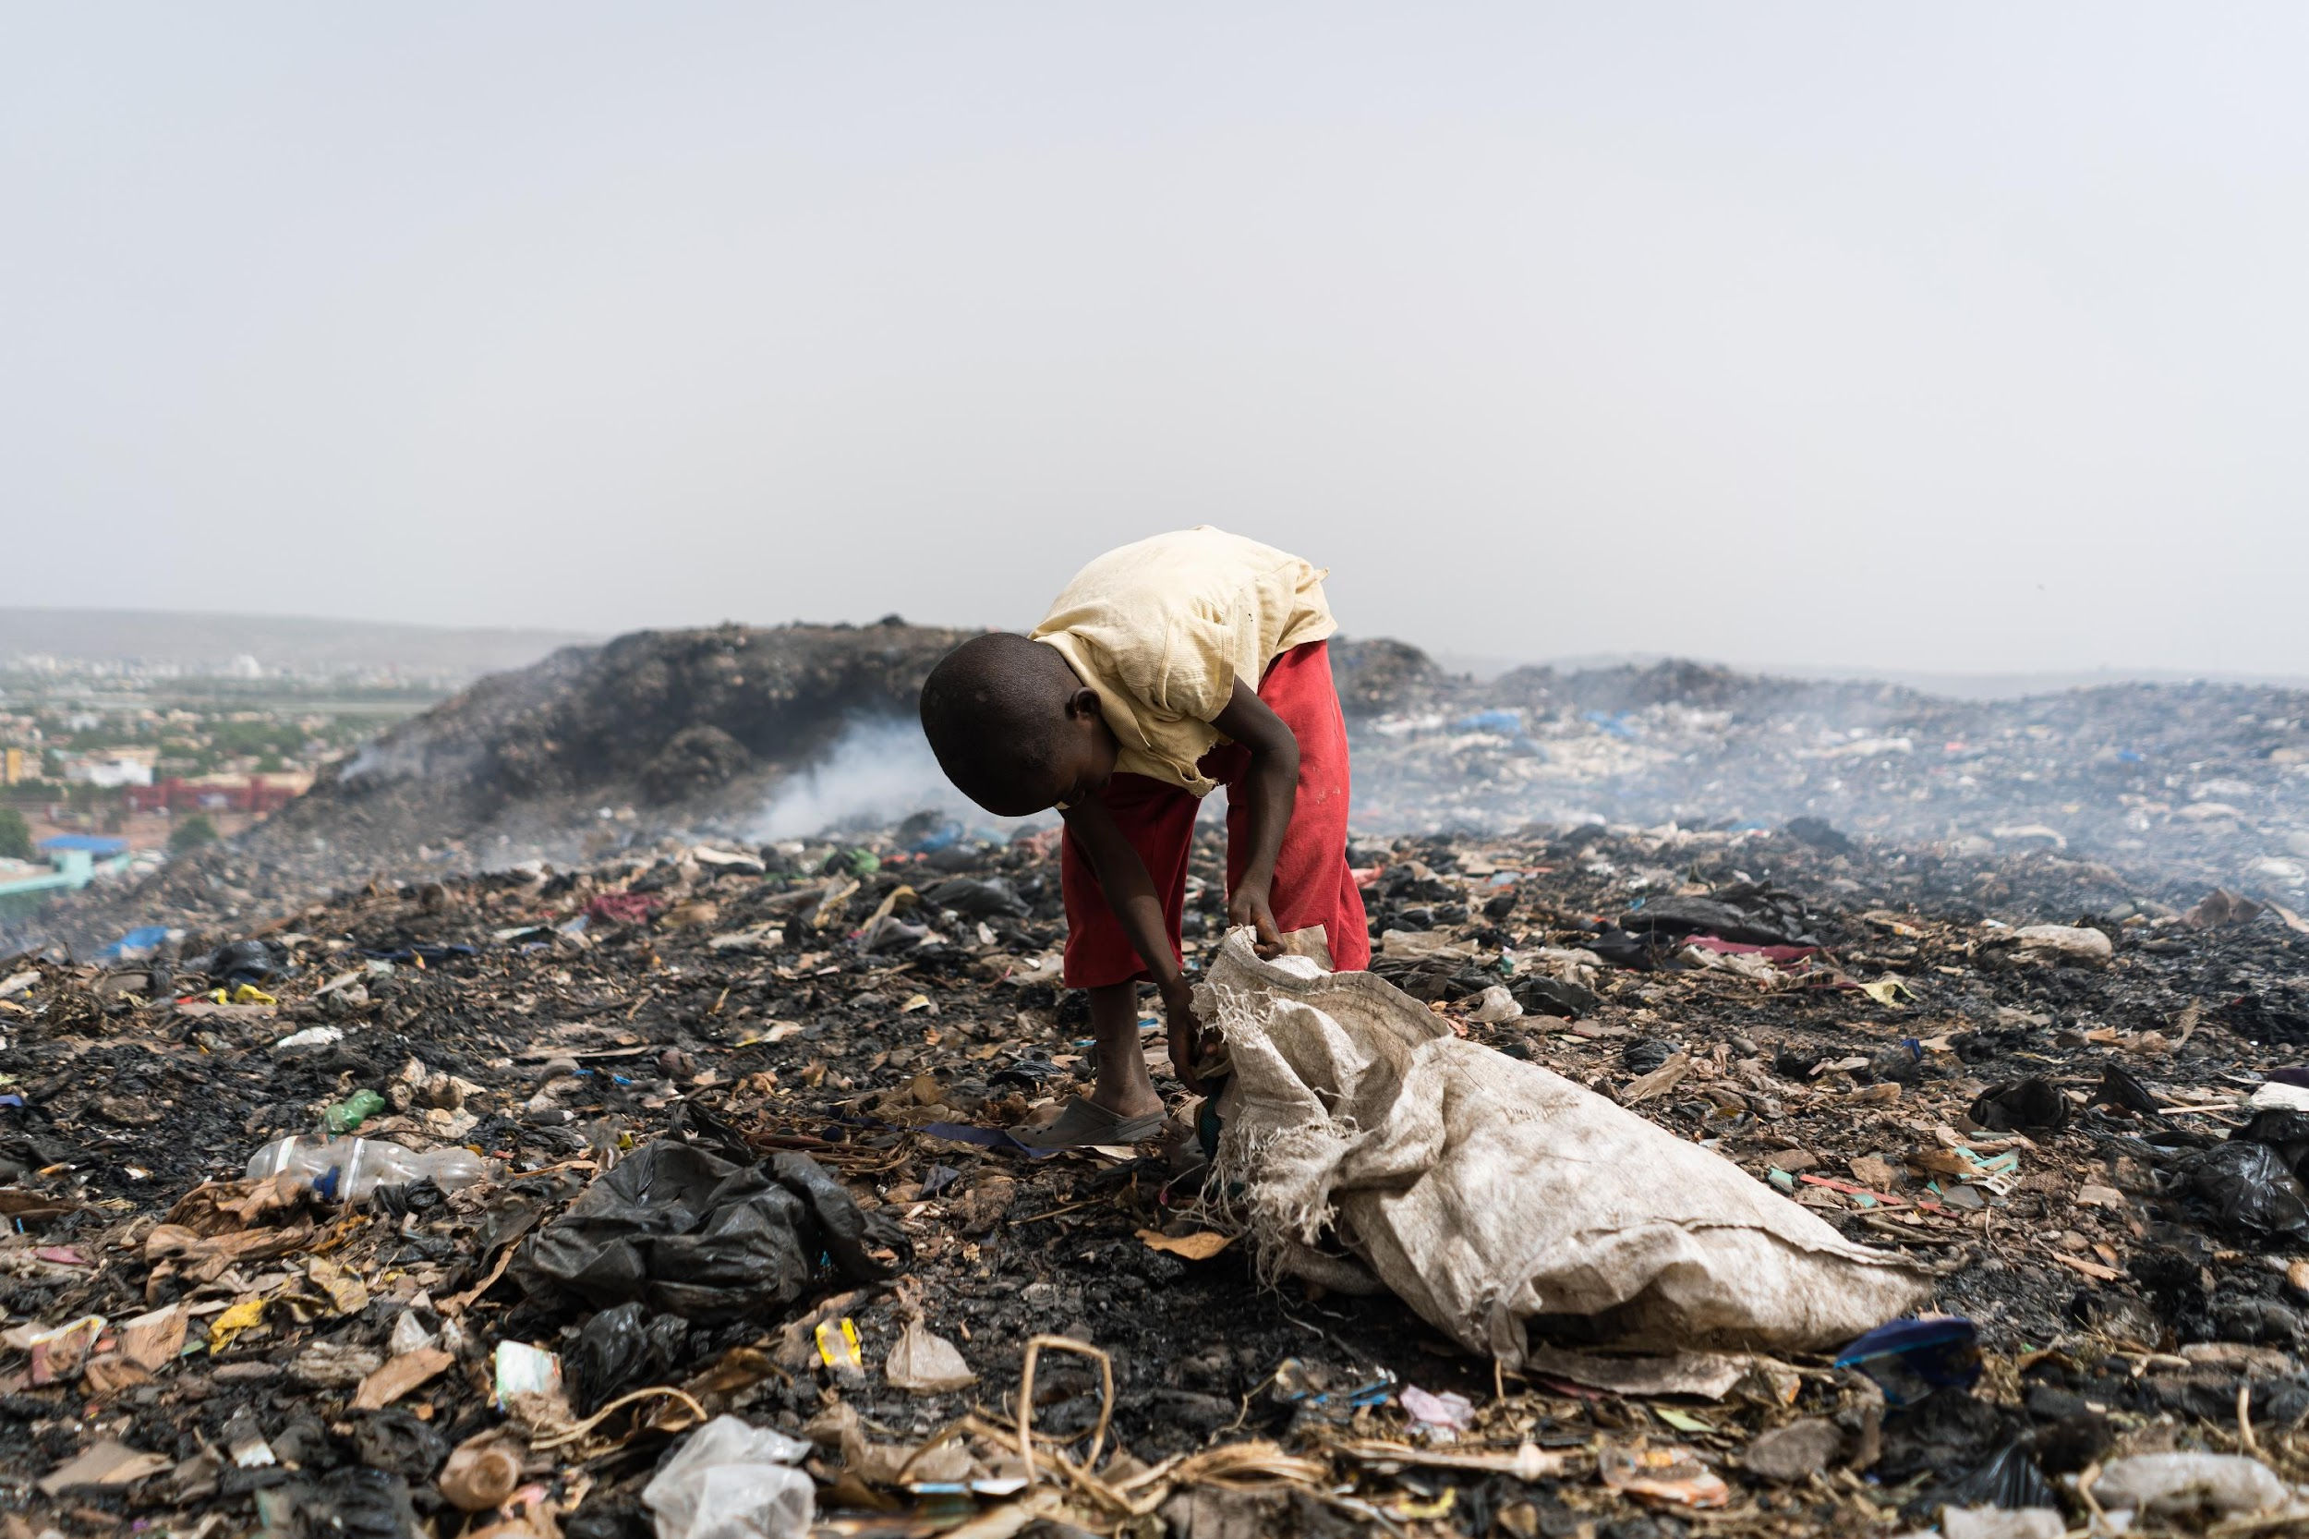
Complete the following sentences
Reducing [list one environmental problem] requires [list at least two actions].
The biggest social issue associated with this problem is [list one social issue].
This social problem is largely due to [list two responses].

