Slide 1
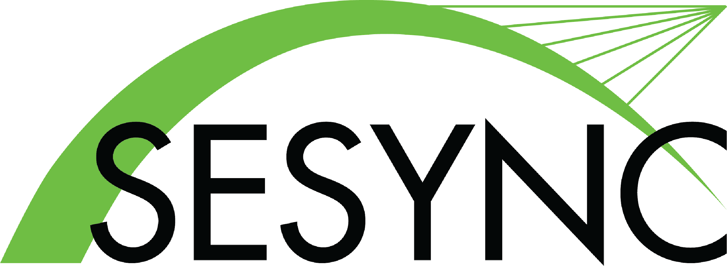

Participatory Futures
Planning:
Reducing Inequality
Notes:
Notes to Instructor: Ask learners about their sense of who is most affected by environmental injustice and inequality. In your country, who are the most vulnerable and underrepresented groups in governance, policy, and social influence? How do identity and intersectionality relate to marginal living environments?

Slide 2

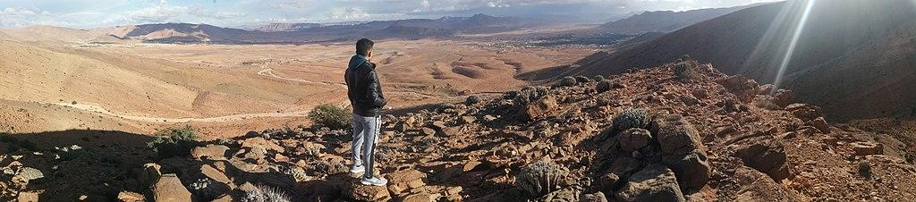
What Is Participatory Futures Planning?
Johansson 2021
Image by Afraoui0 via Wikimedia, 4.0.
Predicting socio-environmental conditions involves scenarios that outline pathways to the future—it is exploratory narrative building.
Scenarios depend on societal choices and public will, so futures planning includes voices from many stakeholders, not just powerful actors.
Participatory futures planning facilitates knowledge co-production among stakeholders and usually aims for consensus and compromise about which futures we wish to achieve.
https://doi.org/10.5751/ES-12617-260403
Notes:
Notes for Instructor: Learners may be interested to reflect on how scenarios can be highly quantitative (i.e. computer modeling) and qualitative (i.e. visionary and idealistic story-telling) and have both objective and subjective elements. How have planners used climate models and variable scenarios as starting points to energize more creative narrative-building processes? The game “Survive the Century” is a good example of blending data with stories to envision and plan for a better future. SESYNC offers a 2-lesson sequence that uses this game to develop futures scenarios.

Slide 3
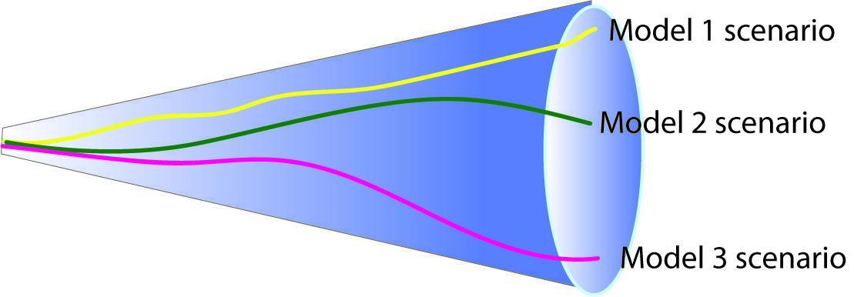
Types of Participatory Futures Planning
Johansson 2021
Predictive
Explores the most likely future developments through social trend scenario-building and climate change modeling.
Often privileged over other approaches because it is rational and instrumental (uses analytical tools).
Predictive planning is based on
regressions, cross-impact
analysis, and model-based
simulations.
Notes:
Notes to Instructor: Many hard science learners will find this the most familiar and comfortable method of developing futures planning. It presumes objectivity because it is based on data, and allows for multiple simulations of futures by running the model with manipulated variables. Ask learners to reflect on the shortcomings of this method in relation to stakeholder engagement.

Slide 4
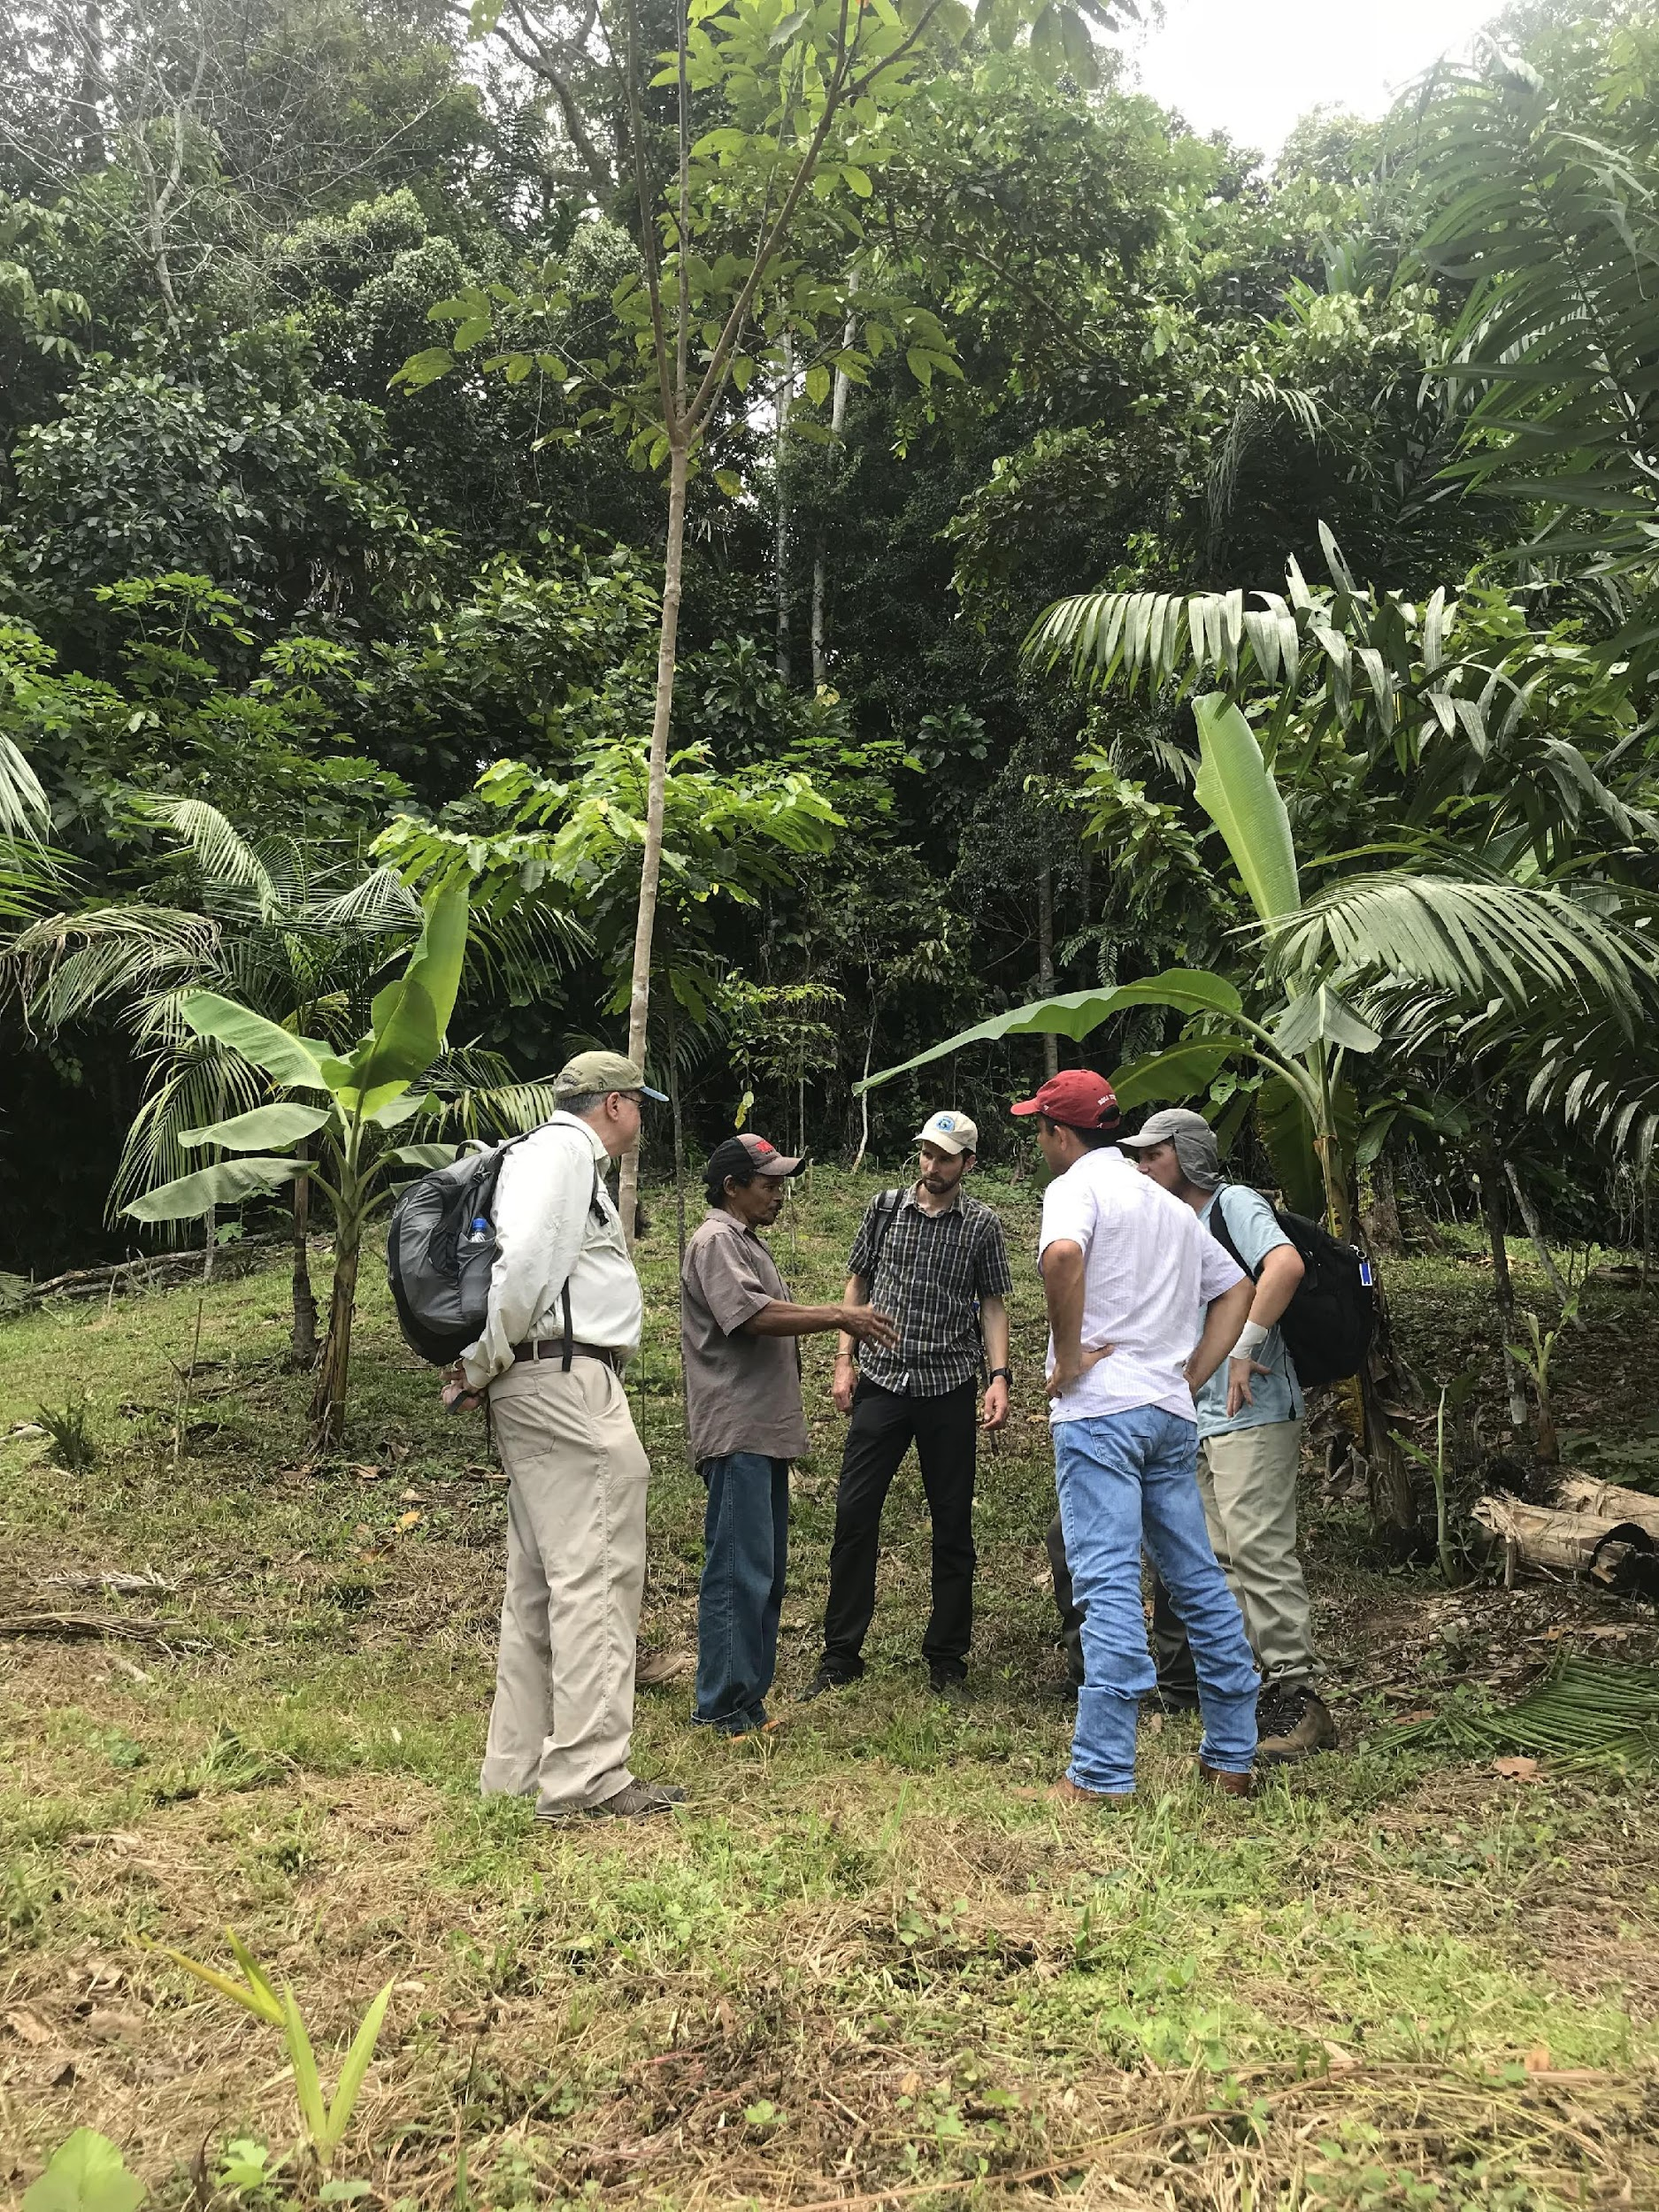
Types of Participatory Futures Planning
Johansson 2021
Explorative
Develops narratives that accommodate high levels of uncertainty and ambiguity.
Challenges conventional assumptions and imagines creative narratives based on a wide variety of variables.
Most widely-used approach: investigates many driving forces and pathways and ranks scenarios from less to more desirable.
Fosters reflexivity, learning, and risk reduction.
Notes:
Notes to Instructor: As a middle ground between predictive and normative futures planning, explorative approaches have the virtue of challenging the status quo and encouraging self-reflection in users. However, when disenfranchised groups are suspicious of powerholders, it can be difficult to engage them in good faith with scenarios planning, especially if the outcomes are not binding, tracked for progress, or verified by further analysis.

Slide 5
Types of Participatory Futures Planning
Johansson 2021
Image by Philipp Weigell of the Kazeg range in Georgia, via Wikimedia 3.0.
Normative
The most visionary, radical form of futures planning; it starts with desirable outcomes and works backwards to find pathways there.
Envisions futures beyond our present normative socio-economic and industrial conditions, with emphasis of greater equity.
Links grassroots initiatives to sustainable transformations and defines collective, positive, attainable futures beyond the normative.
Can involve imperative and critical revisions of cultural values, and welcome worldviews that critique the Western, capitalist status quo.
Notes:
Notes to Instructor: Ask learners what is the procedural advantage of starting with a future ideal, and working back to the present to achieve it? What opportunities to plan the specific timeline and critical initiatives of a future path emerge from this technique?

Slide 6
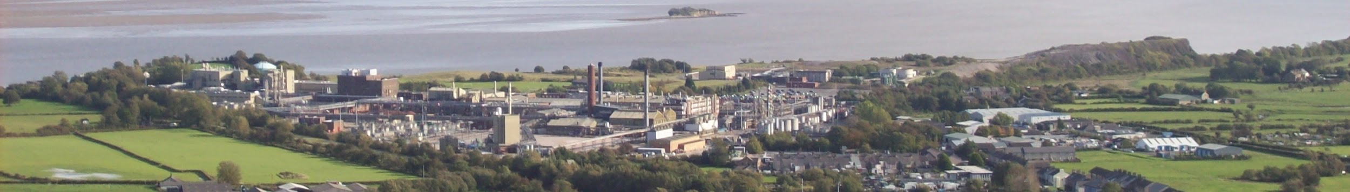
Critical Futures Methods
Johansson 2021
Image of Morecambe Bay in Australia by Yohan euan o4, via Wikimedia 3.0.
Progressive scenario building critically reflects on power structures to reveal the probable beneficiaries of various futures.
Top-down development regimes driven by colonial histories and capitalist ideologies can disenfranchise the most vulnerable groups.
Poverty and social injustice can drive environmental degradation through deforestation and resource extraction (i.e., charcoal).
Western ideals of industrial development mean that governments often fail to regulate profitable agribusiness and large infrastructure projects, which protects the elite from regulation or loss of profit.
Notes:
Notes to Instructor: This use of critical tools to evaluate the environmental impacts that result from a cultural value (private profit from extraction) is obvious in the Global South, which suffers from less development and higher poverty that the global north. Imperial conquest extracted natural resources from colonized lands and disenfranchised native and Indigenous groups. Learners may reflect on how cultural values have environmental impacts both within the global north and across the north/south divide. How do learners see these histories and values in play in the environmental condition of their own region or locality?

