Slide 1


Introduction to Resilience and Sustainability: Ecological, Social, and Socio-Environmental

Slide 2



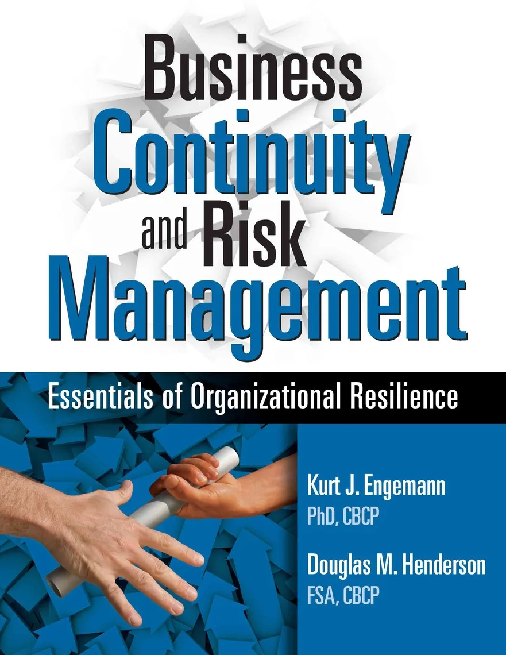

Resilience
Notes:
Notes to Instructor – Hook (Lesson step 1) Slide: These images were from a web search in which the word resilience was used as the search term. It is only meant to illustrate that resilience is a widely used term, even in advertising campaigns such as those for books, products, services, and even women’s stockings. The participants are to define the word resilience based on their own thoughts and experiences. They should be not search online for a definition of the word.

Slide 3
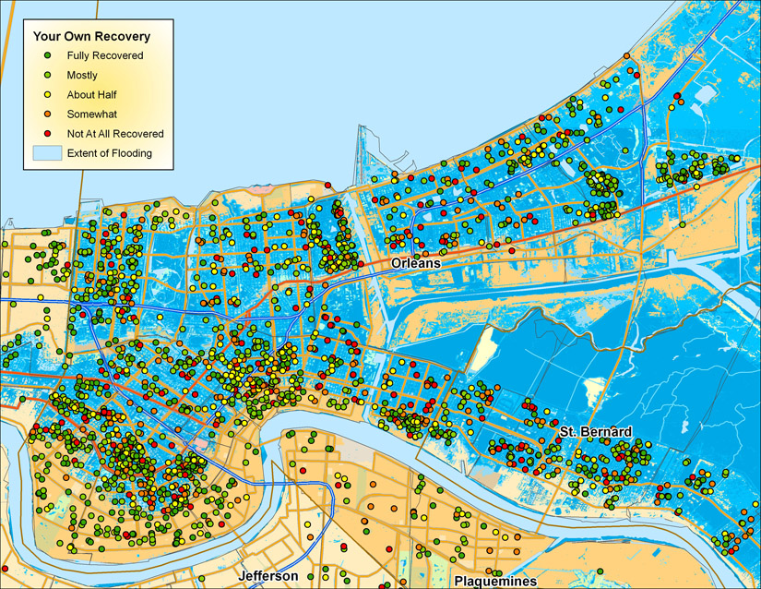
Hurricane Katrina Recovery
Source: Louisiana State University, Post-Katrina Survey results
https://www.lsu.edu/fweil/KatrinaMaps/index.htm
Notes:
Notes to Instructor (Slide for Teaching Assignment Step #2): This image shows the relationship between the extent of flooding (blue areas) and self-reported recovery by individuals based on surveys completed by Louisiana State University researchers, 5 years after the hurricane. Learners are asked to speculate on why recovery (which implies “resilience”) may have varied so much in different flooded regions. They will need to consider both environmental and social factors. (As they will learn after the next step in the lesson—risk and recovery must be considered along multiple dimensions.)

Slide 4
Dimensions of Risk
Hazard
Exposure
RISK
Vulnerability
Notes:
Notes to Instructor (Slide for Teaching Assignment Step #3): Following the bulleted directions in Teaching Assignment Step 3 of the lesson, learners should speculate on the meaning of these words in the context of both the risk of impacts from an environmental event and the recovery potential. Once they have brainstormed and posted their thoughts on the board, discussions should follow. You are trying to get them to think about more than just the physical hazards of an event [i.e., as if the risk from coastal flooding is ONLY associated with the size of a storm (hazard) or ONLY associated with proximity to the coastline (exposure)]. Risk can include both, AS WELL AS how socially vulnerable they are (i.e., do they have a network of people who can help them escape and the monetary means to do so? Similar logic can be applied to recovery—Do they have insurance, funds to buy a new home, or a place to stay during rebuilding and to recover their health if they were injured?

Slide 5
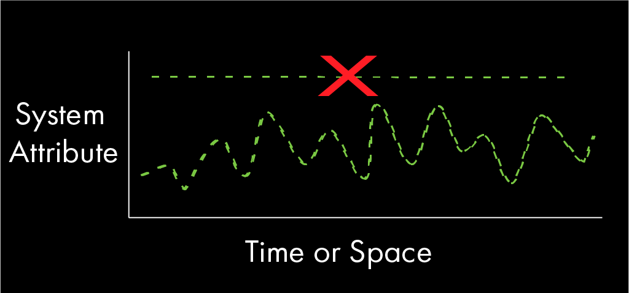

Resilience Background:
Systems vary naturally.
resilience/recovery does not imply stasis
Line-Graph Depiction
system state fluctuates around some
“basin of attraction”
Ball-and-Hill Depiction
Notes:
Notes to Instructor: It will be useful here to mention that resilience was first championed in the field of ecology by Holling in 1973 and was based on an understanding that natural systems vary in time and space and that their ability to absorb change and disturbance allows them to persist. Have the group discuss what is meant by a basin of attraction state, i.e., the system tends to fluctuate in that state, which may be viewed as good or bad—unless some driver pushes it enough to move it to a different state. Often, when an ecosystem becomes very degraded, it is difficult to move it out of that state due to reinforcing feedback loops (i.e., positive feedbacks). The same is true of socio-environmental systems.

Slide 6
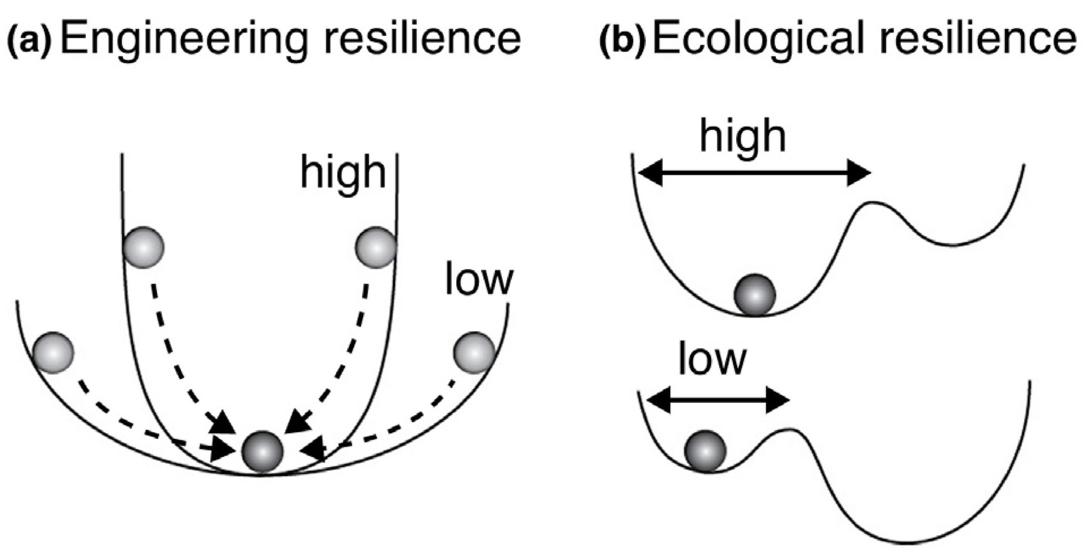

Resilience
Resilience was championed in the 1970s by Canadian ecologist, C.S. Holling, in particular.
Holling drew attention to the difference between ecological and engineering resilience.
Credit: Sterk et al. 2017 COSUST
Notes:
Notes to instructor: 1) C.S. (“Buzz”) Holling was a Canadian ecologist who contributed greatly to systems ecology especially resilience, adaptation, multiple states, and reorganization (described in a later slide). He distinguished engineering resilience from ecological resilience and described them as follows:
Engineering resilience – Involves a system’s resistance to disturbance and speed of return to the equilibrium (specific focus on efficiency, predictability)
Ecological resilience – Involves a “window of natural variability” and assumed multiple states

Slide 7
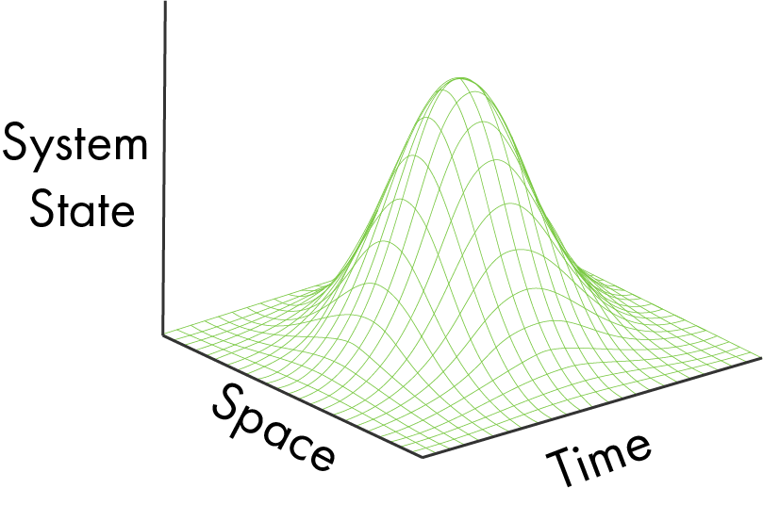
Tenets of Ecological Resilience
System dynamics in time and space are inherent properties of ecosystems.
Only when a system moves outside its range of “natural” variability is it disturbed.
Systems can “flip” to new states when a disturbance exceeds some threshold.
Systems may recover their pre-disturbance function but may not necessarily comprise the same species.
Early emphasis was placed on defining resilience objectively based on a “window of natural variability” over time and space.
Notes:
Notes to Instructor: The ”objectivity” emphasis was associated with assuming ecosystems could recover to their former state (i.e., within a window of “natural” variability); it is worth discussing with the group what “natural” variability means and why it is actually a problematic concept—e.g., When restoring an ecosystem...what is natural? It is the prior (historical) state? How far back?

Slide 8
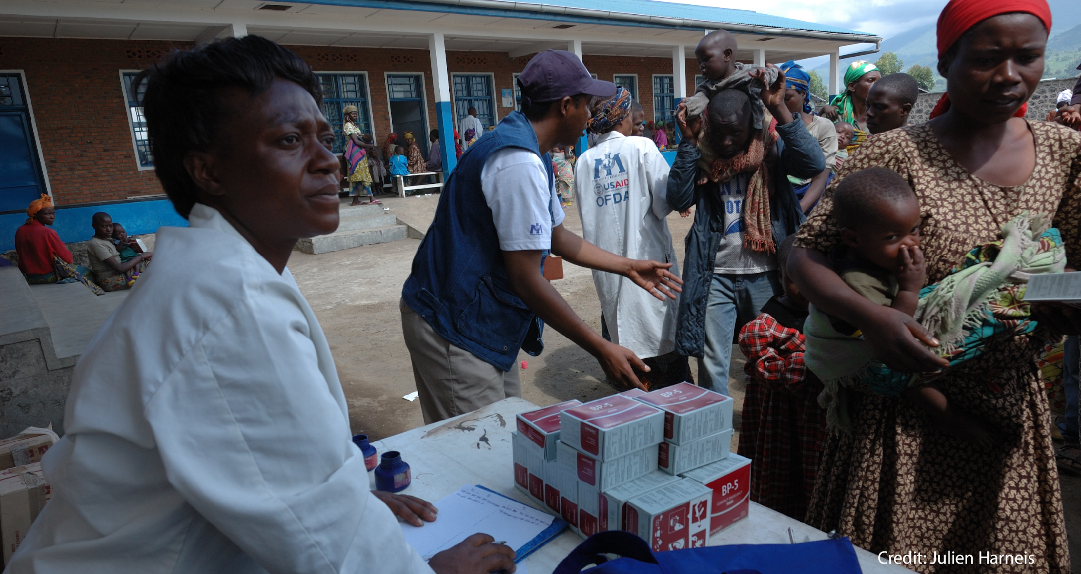
Tenets of Social Resilience
Social Resilience
Resilience is a normative and subjective concept related to maintaining or achieving a generally “desired” state.
Social systems are resilient when they can cope positively with disturbances arising from social, political, and environmental factors, such as those that arise from conflict.
Social resilience varies by group’s economic, racial/ethnic, and social status, largely due to differences in their access to resources.
Social resilience is related to the structural and economic strengths of a community or
society, as well as the social networks and processes
Resilience is a normative and subjective concept related to maintaining or achieving a
generally “desired” state.
Social systems are resilience when they can cope positively with disturbances arising
from social, political, and environmental factors, such as those that arise from conflict.
Social resilience varies by group’s economic, racial/ethnic, and social status, largely due
to differences in their access to resources
Social resilience is related to the structural and economic strengths of a community or
society, as well as the social networks and processes
7
Notes:
Notes to Instructor: The words highlighted in green are for emphasis because they relate to one another, and they are good discussion points to ensure learners understand what is meant.

Slide 9
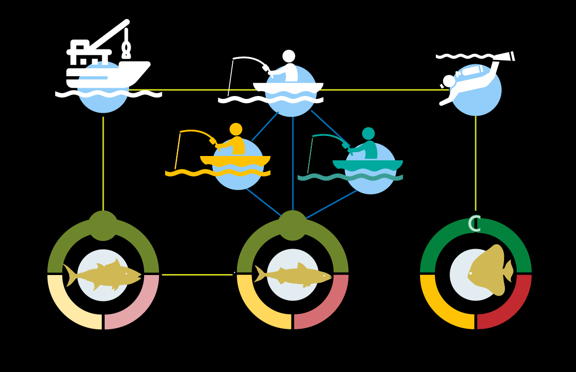
Socio-Ecological (S-E) Resilience
S-E resilience is a normative and subjective
concept.
Resilient S-E systems maintain or achieve
socially and ecologically “desired” states.
S-E resilience, or lack thereof, emerges from
complex interactions and is difficult to
predict.
Disturbance can catalyze innovation in S-E
resilient systems.
Notes:
Notes to Instructor: Describing an S-E system state when it is disturbed and how it has adapted following a disturbance is complicated because it involves multiple factors. The next slide provides an example; however, if you wish to better illustrate this, show ~ 3 minutes (~8:53 – 11:44) of the learning video on S-E Systems as Complex Adaptive Systems https://www.sesync.org/resources/building-basics-part-1-socio-environmental-systems-complex-adaptive-systems. (Narration is a bit slow, so you may want to speed this up to at least 1:25 speed.)

Slide 10
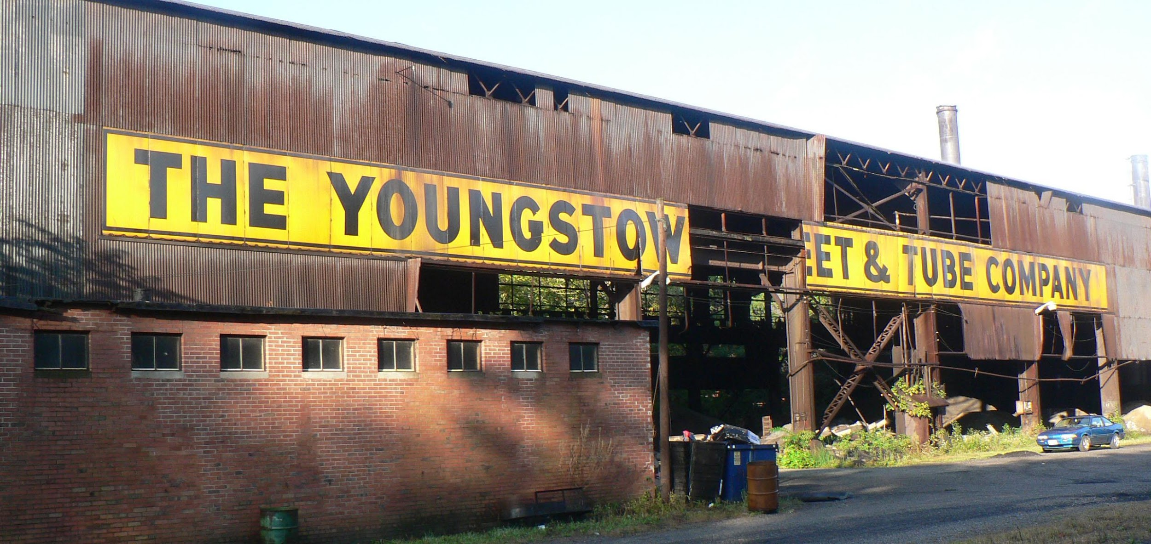
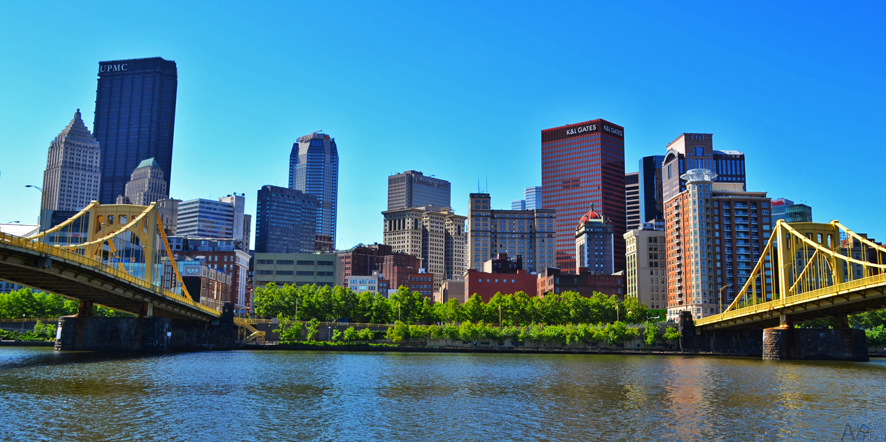
Socio-Environmental Example
Collapse vs. Resilience, Following Disturbance
Disturbance: 1970s collapse of U.S. steel manufacturing in the Midwest
Youngstown, Ohio
S-E collapse
Pittsburgh, Pennsylvania
adaptive resilience
Notes:
Notes to Instructor: The back story on the events depicted are fully described in a SESYNC explainer on “Socio-Environmental System Change and Reorganization” (https://www.sesync.org/resources/socio-environmental-system-change-and-reorganization). In brief: the two images contrast how two cities responded to socioeconomic collapse and environmental degradation following the collapse of steel manufacturing in the midwestern U.S. The initial disturbance that caused the Midwestern steel manufacturing collapse occurred as the market globalized and many plants did not adopt new technologies used internationally. Youngstown, Ohio, (left) was left with extensive abandoned infrastructure and even today faces major environmental and public health crises. In contrast, Pittsburgh, Pennsylvania (right) invested deeply in future growth and innovation, so its people benefited from environmental, social, and infrastructure improvements. Note – the natural resource dependency was iron ore deposits near the Great Lakes and livelihoods and well-being were tied to its use (i.e., the environmental–social link).

Slide 11
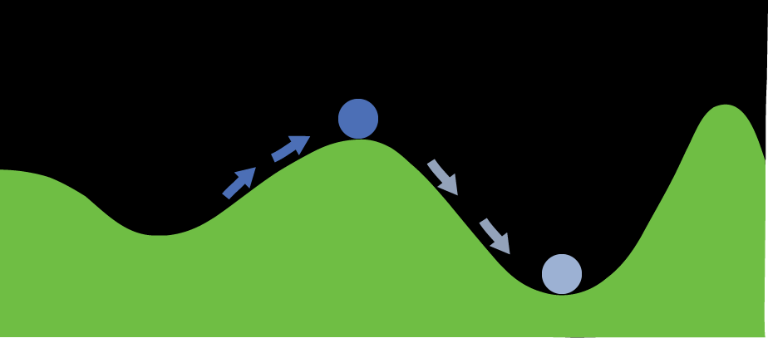
Resilience Theory Across All Systems
Disturbances have the ability to move systems beyond some resilience threshold or tipping point, potentially to a more vulnerable state; this is called a regime shift or a critical transition.
It is more difficult to move a system out of a highly disturbed state due to reinforcing positive feedbacks.
Alternate stable states may persist for a long time; recovery may require massive efforts.
Regime shifts can be identified with sufficient time series of data.
Notes:
Notes to Instructor: The last example of how Youngstown responded to the collapse of the steel industry is an example of crossing a threshold that the S-E system has been “stuck” in. As discussed more fully in the Explainer “Sustainability, Resilience, and the Dimensions of Risk: Hazard, Exposure, Vulnerability,” determining when a system reaches a tipping point is very difficult unless there are clear metrics ecologically and socially for which there are long time series of data. Certainly, highly disturbed ecosystems (e.g., mined with highly simplified plant communities) are easy to recognize as a region with a collapsed economy and/or displaced people who can no longer rely on natural resources such as fisheries or agroecosystems that once sustained them. But most ecological, social, and socio-environmental change is gradual. But the concept of a tipping point or threshold is useful because it suggests the need for management/policies that avoid reaching it. The last bullet is illustrated in the next slide.

Slide 12
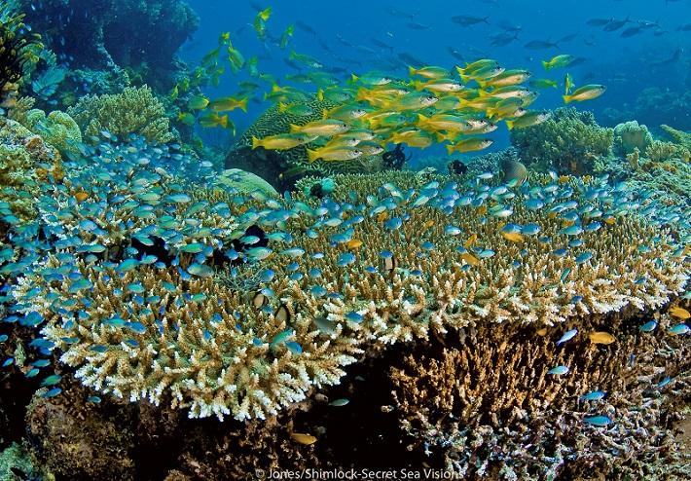
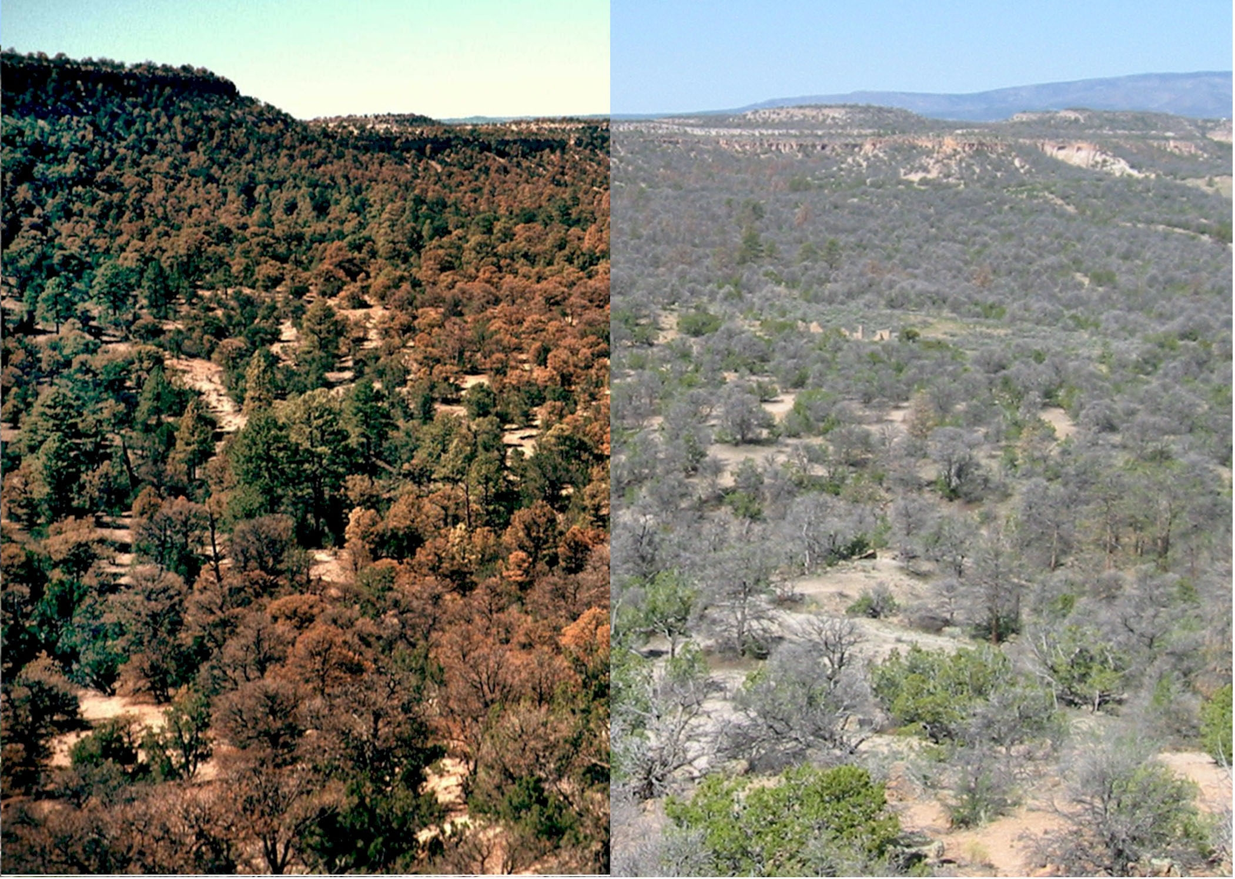
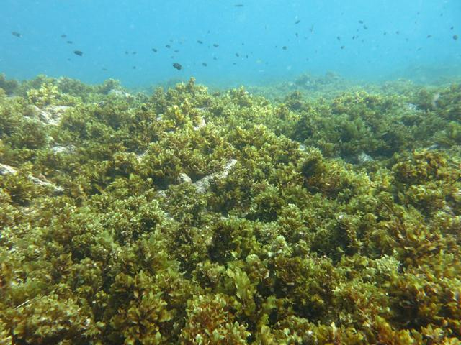
Ecological Regime Shift Examples
Notes:
Notes to Instructor: Left: This shows a region before and after a major drought that was associated with climate change. The semi-desert forest system was pushed beyond its threshold of recovery. Woody shrubs and succulents then encroached on the area and outcompeted other vegetation for water, which then resulted in soil property changes. Positive feedbacks between water use by invasive species and changes in soil prevent recovery especially given ongoing climate change with less rainfall for a shorter time period. Right: Coral reef impacted by pollution and bleaching from warm temperatures resulted in coral die-off and more algal coverage.

Slide 13
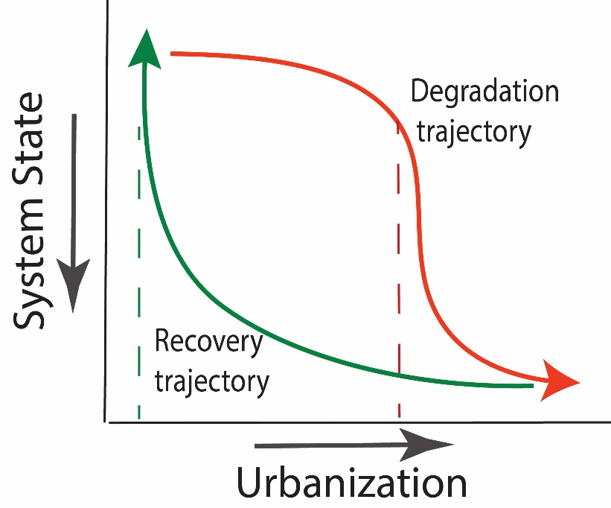
Degraded Traps: Ecological Example
Trajectory to change is not necessarily the same as the recovery trajectory (hysteresis).
The time to recovery can be long (lag).
The recovery response depends on the strength of feedback.
Examples: urban streams, Chesapeake Bay, North Sea
watershed infiltration capacity
Notes:
Notes to Instructor. The effect of urbanization on aquatic ecosystems is often used to illustrate thresholds and resistance to recovery with lag effects. Numerous studies have shown that somewhere between 3–15% impervious cover in a watershed will result in dramatic reductions in aquatic biodiversity. This appears to be related to the lack of rain infiltrating into the ground before it moves to a stream; this causes polluted water. Despite efforts to reverse that effect (e.g., by increasing watershed infiltration via improved stormwater structures and revegetation), biodiversity does not begin to recover until effective infiltration capacity is much lower than it was when the trajectory took a sharp downward decline.

Slide 14
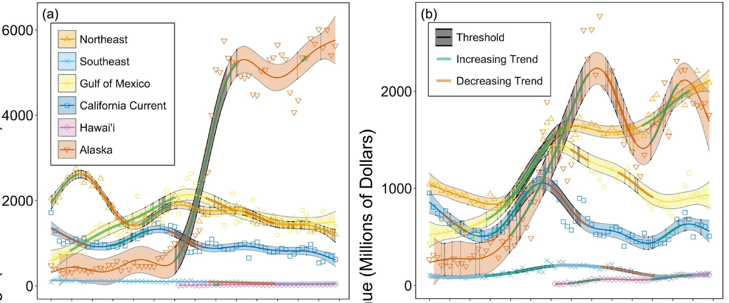
Socio-Ecological Regime Shift: Example 2
The ecological productivity and social benefits of U.S. fisheries undergo regime shifts in response to major technological or policy changes.
The study used indices related to the two parameters in the graphs to calculate an index of S-E status.
Landings (millions pounds)
Revenue (millions dollars)
Perng et al. 2023. https://doi.org/10.1016/j.marpol.2023.105595
Notes:
Notes to Instructor: The steel example was very qualitative. This example comes from a study in which long-time series of fish abundance, ecosystem productivity, fishery catch (commercial & recreational), and economics (number of fishery jobs, incomes, etc.) are available. The authors quantify the ecological “state” or output index based on fish as a function of system production (chlorophyll a) and a social output or index based on the economic indicators per people employable in the sector. Socio-ecological state (an index) was calculated based on the social output compared to that which is ecologically potential.
They identified thresholds using non-linear statistical methods on the time series. They showed that threshold changes occurred after global technological advancements and widespread structural changes in fisheries management (e.g., fisheries management such as the Magnuson-Stevens Fishery Act).

Slide 15
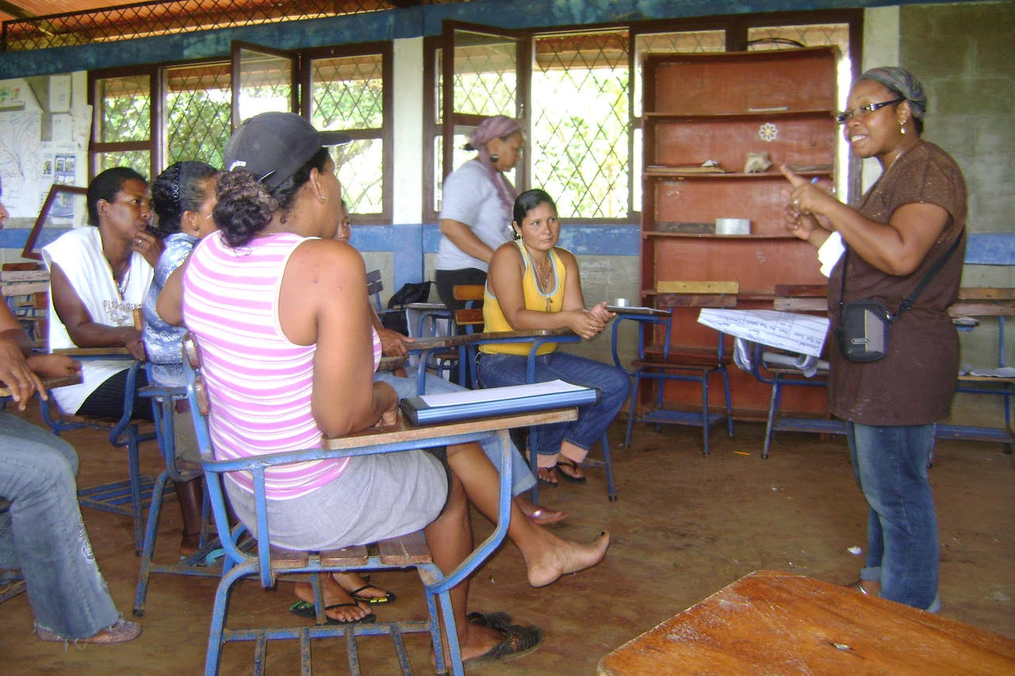
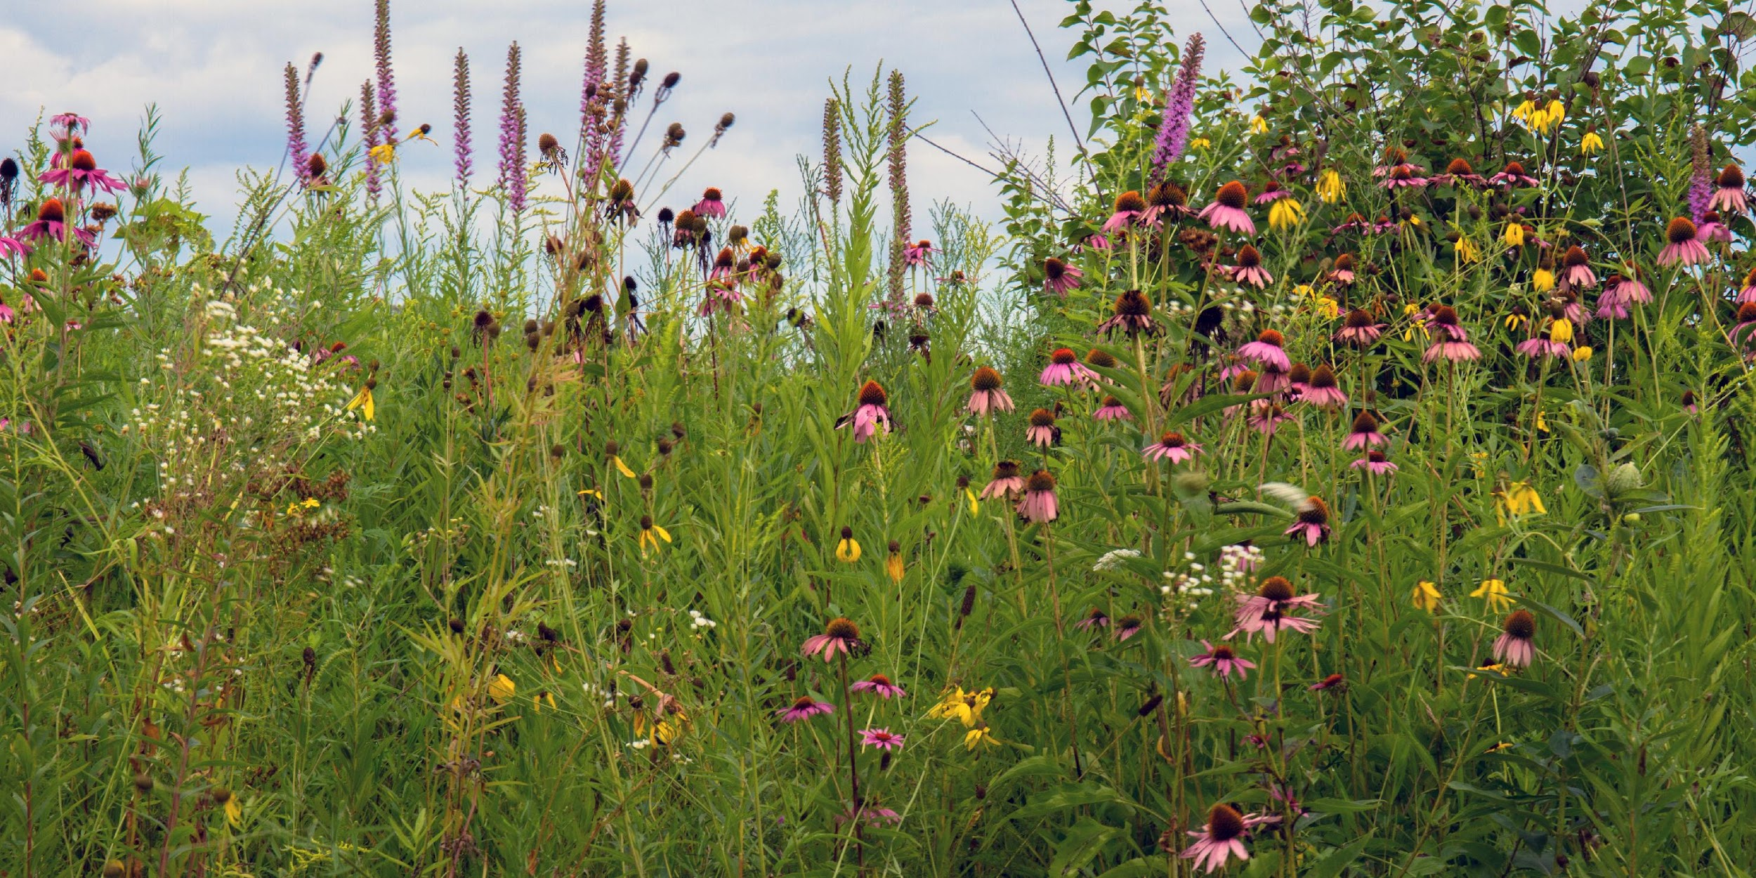
What Promotes S-E Resilience?
Social factors
Strong & diverse networks
  Functional redundancy
  High modularity
  Varying sources of income/assets
  Diverse skills/abilities
  Polycentric governance
  People willing to learn adapt
Ecological factors
Biodiversity (from genes to landscapes)
Presence of keystone species/native ecosystem engineers
Functional redundancy
High modularity
Spatial structure allows “natural” fluxes
Adaptive management
Notes:
Notes to Instructor: It is critical to stress that these factors are generalizations and that scholars from various fields may disagree on them; plus, there will always be exceptions. Though these lists include similar or the same words/concepts: diversity, redundancy, modularity, etc., they do not speak of the interconnection between the two systems. For example, the list of ecological factors ignores the important role of social factors except for the mention of adaptive management. Obviously, anthropogenic impacts that simplify or degrade ecosystems in other ways outweigh most of the other factors listed. Similarly, it does not matter how diverse social networks are and how strong social support is if there are inadequate natural resources to support communities.

Slide 16
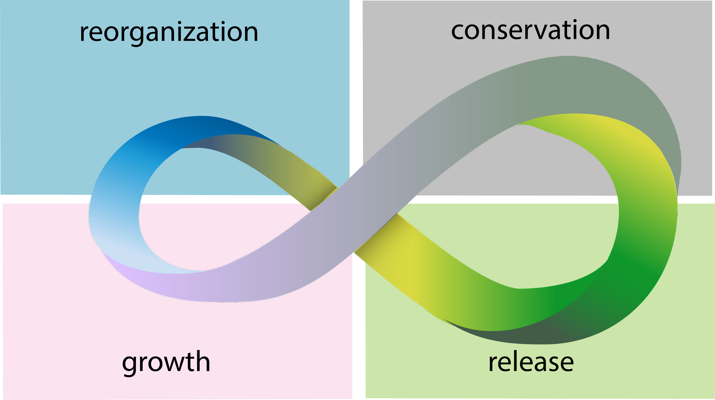
S-E Reorganization
Optional slide
Requires advanced reading*
Gunderson and Holling (2002) described “panarchy” as a four-phase cycle that S-E systems go through as they change and reconfigure following a perturbation.
Panarchy describes how a healthy system can invent & experiment, benefiting from inventions that create opportunity while being kept safe from those that destabilize because of their nature or excessiveness.
re-organizes or renews depending on its resiliency
matures into a stable system as connections and interactions grow
system collapses due to changes in interactions or a perturbation that crossed a threshold
resources are used extensively
Notes:
Notes to Instructor: This is a highly theoretical concept used to help understand the phases that socio-ecological systems can go through although it was developed by ecologists for ecosystems (e.g., see Allen et al. 2014).
DOI: 10.1007/s10021-013-9744-2). It is difficult to operationalize, and most examples are purely ecological or purely governance/institutional. A good exercise for graduate students would be to read the original Gunderson and Holling (2002) article referred to in the lesson as well as Allen et al. and then search for S-E examples in the literature.

