Slide 1
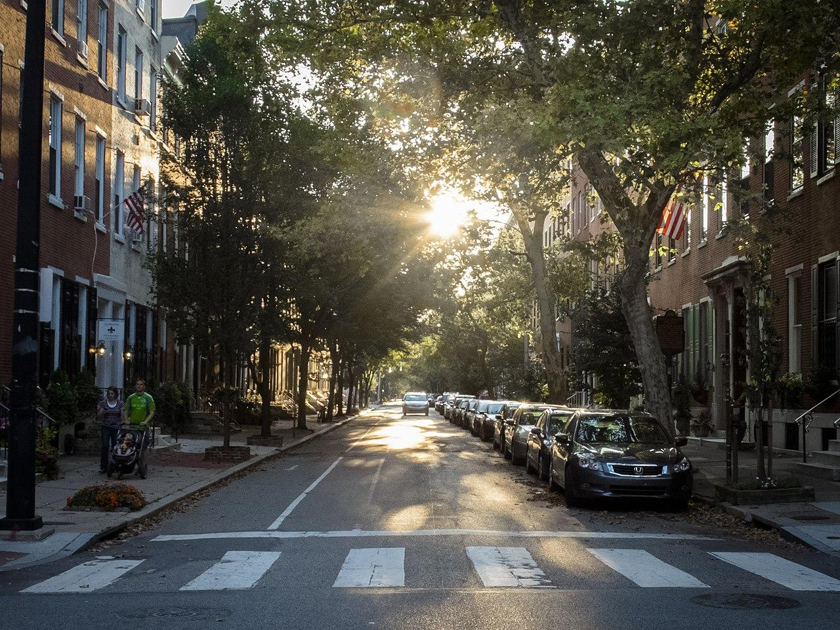
Historic Redlining and Tree Cover: Measuring Environmental Inequality in Baltimore
A tree-lined urban street, Philadelphia, PA, USA.
Unaltered image by William W. Ward via Wikimedia, 2.0.
.
Notes:
Notes to Instructor: Note the tree size disparity between the left and right sides of this street in Philadelphia. What factors or histories might have contributed to this imbalance of tree size (time of planting, tree species, histories of pest disease, city investment, resident desires, etc.)? Even with this disparity, this street represents a high-quality urban habitat for humans and wildlife.

Slide 2
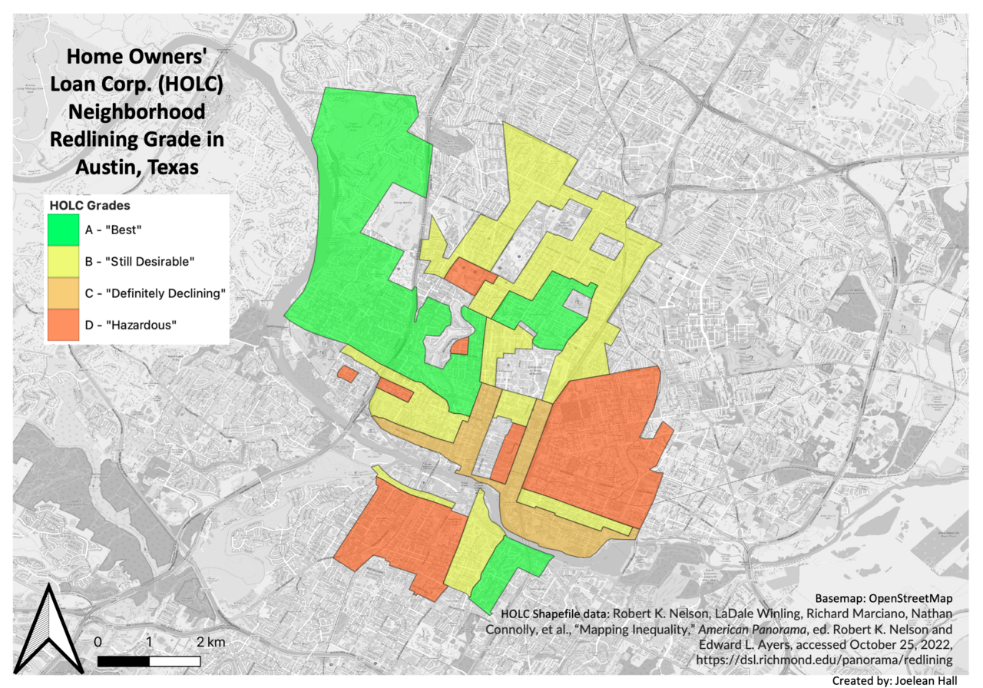
The History of Redlining in the USA
In the 1930s, the Home Owners’ Loan Corporation (HOLC) created maps of investment potential that relied upon racist standards of neighborhood desirability. They targeted Black, Jewish, and immigrant areas as a high risk for mortgages, loans, and investment: redlined neighborhoods.
The maps of 239 cities skewed investment toward wealthier, whiter parts of cities: greenlined neighborhoods.
Residual effects of this practice are visible today in tree cover, proximity to parks and city amenities, and quality of housing and schools.
from Burghardt et al. (2022), https://doi.org/10.1002/ecy.3881
Redlining in the Texas state capitol of Austin.
Image by Joelene Hall via Wikimedia, 4.0, based on HOLC map scans.
Notes:
Notes to Instructor: Ask learners if they have any knowledge of redlining practices in their city, or in the neighborhood where they grew up. What personal anecdotes are learners willing to share about their experience of the residual effects of greenlining (or privilege) and redlining (or marginalization)? As complementary opposites, how have “sacrifice zones” in cities made places of privilege possible? (By concentrating necessary disamenities like waste disposal, industry, highways, railways, and working-class housing in sacrificed places separated from wealthier areas. This oppositional dichotomy is a feature of the Wasteocene: the era in which inequality is stamped on local environments of green amenities versus degraded brownscapes.)

Slide 3
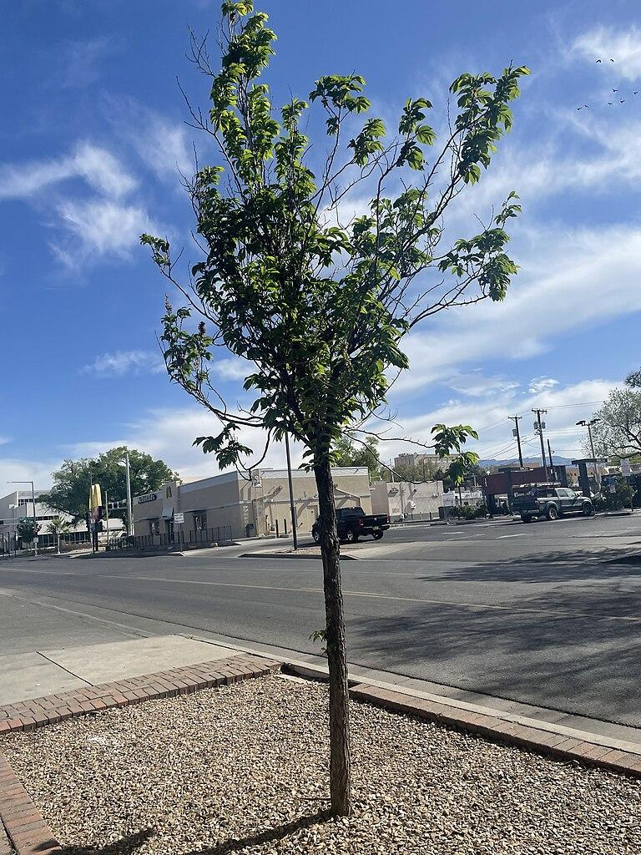
Why Do Street Trees Matter?
from Burghardt et al. (2022), https://doi.org/10.1002/ecy.3881
Street trees provide a canopy that can reduce the urban heat island effect, reduce air pollution, and provide wildlife habitat that is linked to health benefits for residents (i.e., birdsong). Older, larger trees amplify benefits.
Species diversity of trees can create more resilience to pests, diversity of habitat, and aesthetic benefits that increase home values, a sense of community, and green immersion.
Baltimore has an environmental justice program for street tree planting in formerly redlined neighborhoods. This program helps but can result in homogeneous planting by relying on one hardy species (i.e., Red Maple). It takes decades for trees to grow to full size, so early planting is key to building resilience to climate change and redressing habitat loss and lack of green space.
Sapling in a concrete context.
Image by Schavez88 via Wikimedia, 4.0.
Notes:
Notes to Instructor: Why might cities elect to pursue simplified planting schemes that rely on just one for a few species of trees? (Convenience of planting, economics, expedience, species hardiness.) How can environmental planners diversify urban planting without over-complicating these efforts?

Slide 4
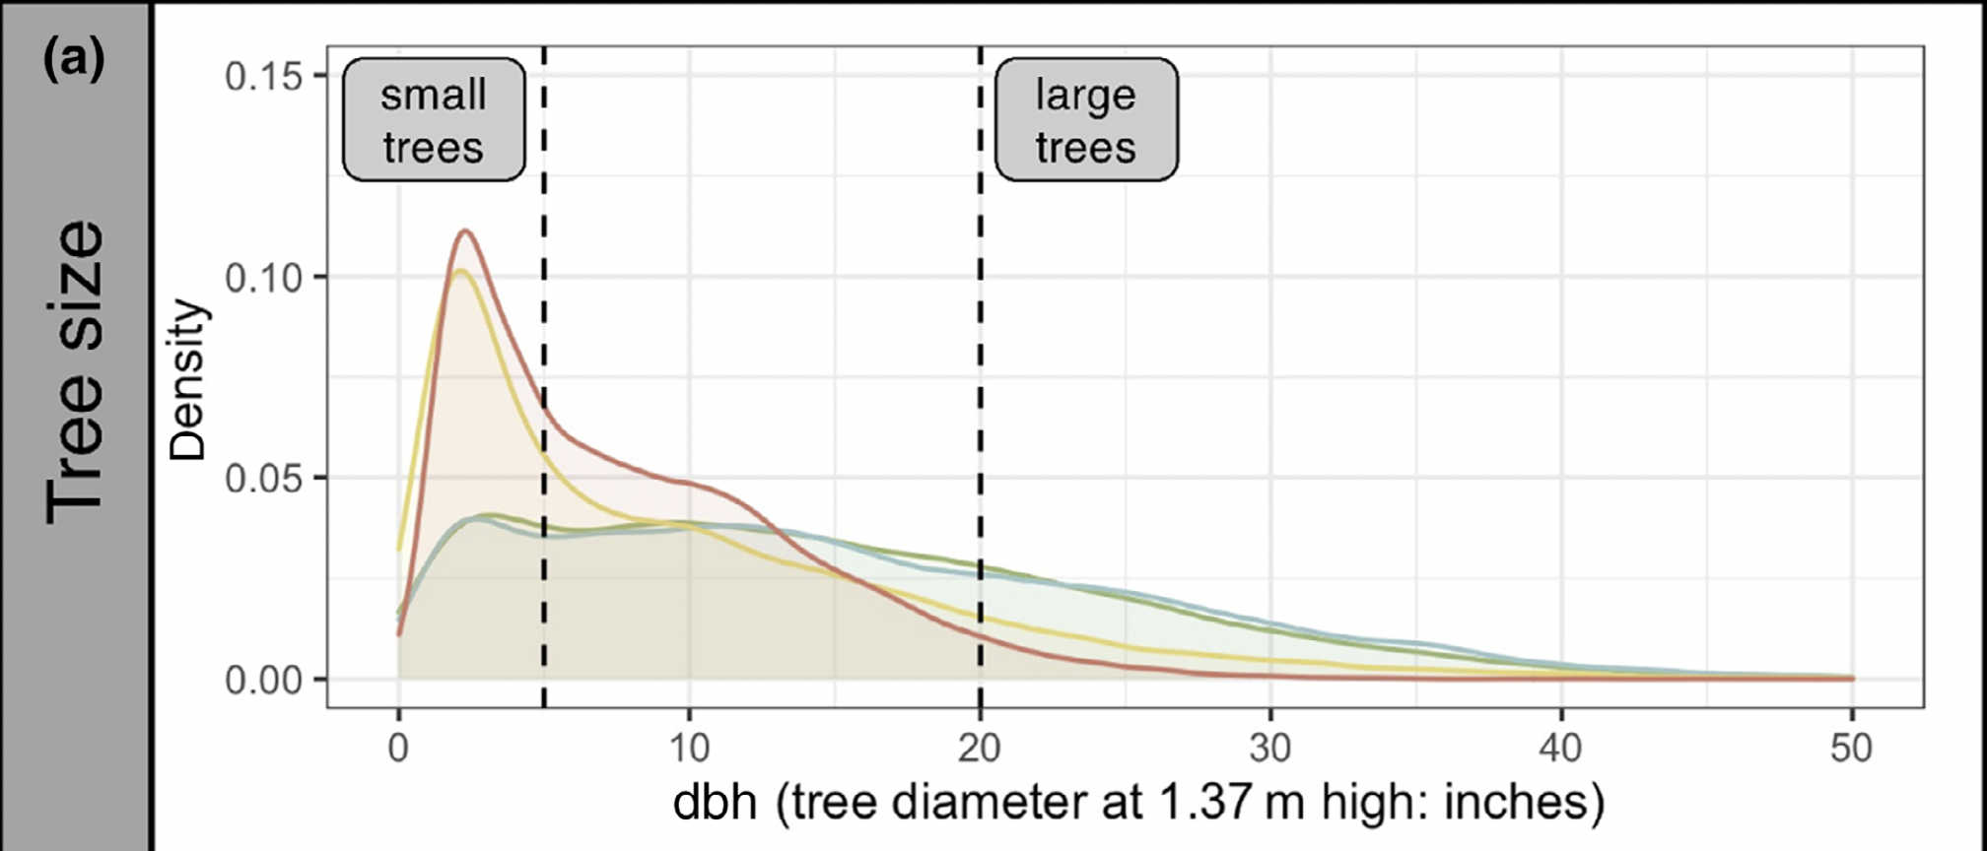
Why Do Street Trees Matter?
Figure 2 excerpt from Burghardt et al. (2022), DOI: 10.1002/ecy.3881
This diagram shows good results of Baltimore’s recent tree planting initiatives in disadvantaged neighborhoods.
Still, the disparity between “green” and “red” neighborhoods in the provision of high-quality, large trees is clear.
Notes:
Notes to Instructor: Observe how the “middle” ranks of blue (Grade B) and yellow (Grade C) neighborhoods nearly follow the patterns of their polar neighbor, so blue looks a lot like green (Grade A) and yellow looks a lot like red (Grade D). Even though the HOLC established four distinct ratings, the history of dis/investment created a clear dichotomy between privilege and neglect in tree cover and presumably other factors, as well.

