Slide 1

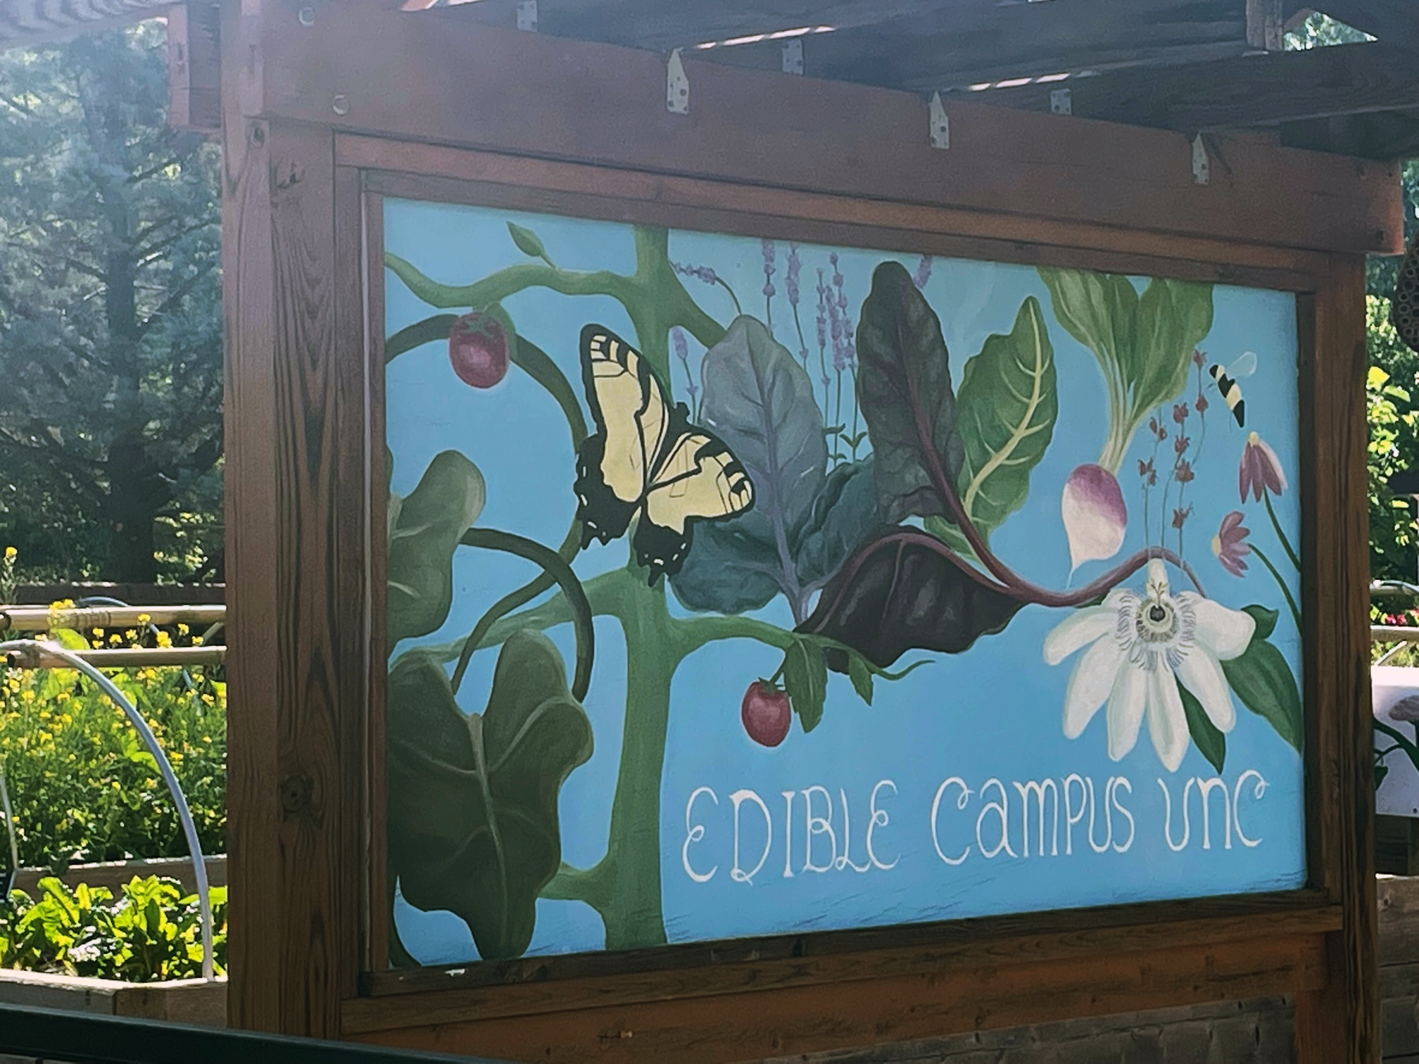
Creating
Actionable
Science on Campus
The University of North Carolina at Chapel Hill’s series of edible gardens complements their Dining Facilities and serves environmental justice and ecosystem health priorities.
Photo by Heidi Scott, 2023.
Notes:
Notes to Instructor: While many solutions begin with perceiving and evaluating problems, university administrators like to celebrate successes and promote them to the broader community. Perceiving the needs of people in positions of power (empathy) is important for gaining their support. So, as learners survey their campus and community, what existing initiatives or features of green infrastructure might be invoked to argue for new investments? That is, where and how has your institution already succeeded in supporting sustainable development and building community?

Slide 2

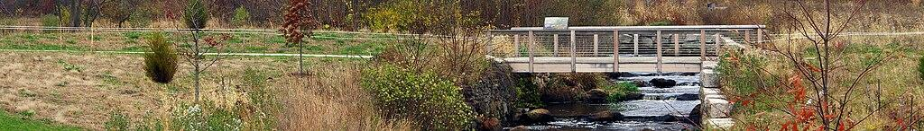
Solutions-Oriented Research
Image by the Massachusetts Department of Environmental Protection via Wikimedia, 2.0.
Actionable socio-environmental (S-E) research depends on moving beyond problem formulation to face the challenge of what can be done to solve or alleviate S-E problems.
The realm of solutions exists at a complex intersection among scientific research, cultural norms, social behaviors, individual psychology, institutional will, policy making, and governance.
This work is interdisciplinary and requires listening to voices outside of academia, including local citizens and tribes, business and industry, policy makers, and environmental managers.
From: What Is Actionable Research? Explainer by Boyd
https://www.sesync.org/resources/what-actionable-research
Notes:
Notes to Instructor: For those inside academia, it can be unfamiliar and disorienting to explain scientific research to non-academics. Learners may enjoy exercising some meta-perception before engaging with outside stakeholders; that is: how does this person or group perceive me? The answer may change radically depending on the stakeholder. (Consider, for example, the different perceptions of industry insiders versus Indigenous groups.) Practicing meta-perception and self-reflexivity can strengthen your ethos when speaking and listening to a variety of stakeholders.

Slide 3
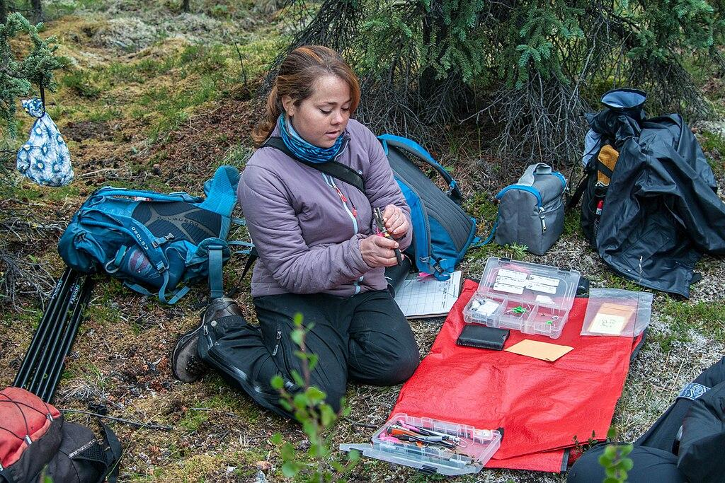
Best Practices for Achieving Actionable Science
Individual Practices
Engage in collaboration
Practice empathy
Build trusting relationships
Use diverse communication methods
Organizational (University) Practices
Reward producers of actionable science
Support early-career researchers
Avian researcher in Denali National Park.
Photo by the National Park Service, public domain
From: Gerber et al. 2020
https://doi.org/10.1111/csp2.295
Notes:
Notes to Instructor: For those learners who are preparing for an academic research career, it will be important to seek out your institution’s supports, both traditional and non-traditional. When choosing among jobs, it may be worthwhile to choose an institution that is open to rewarding actionable research and community impact, not just publication/citation measures. How would this kind of cultural and structural change happen at traditional R1 institutions?

Slide 4
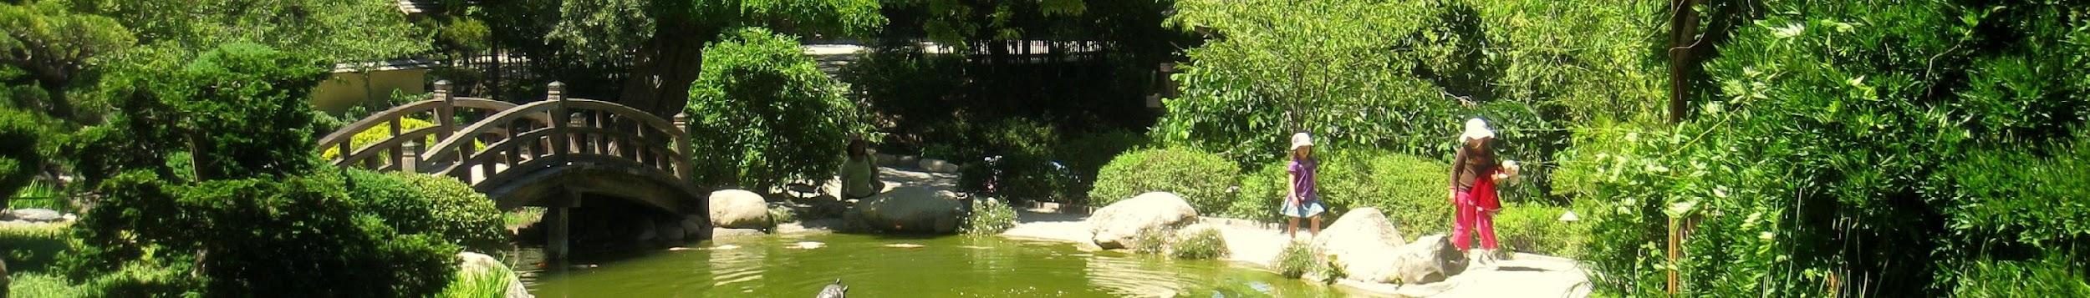
Barriers and Boundary Organizations
Organizational Barriers:
Lack of professional rewards:
Funding
Time
Structural support
Recognition and promotion
Boundary Organizations:
Act as intermediaries and facilitators:
NPOs, sustainability offices, think tanks
Exist between science and policy
Host generalists who unite knowledge
Encourage open dialogues between producers and users
From: Gerber et al. 2020, p. 9, https://doi.org/10.1111/csp2.295
Notes:
Notes to Instructor: This is a good time to ask learners to list the groups on campus and in your community that may serve as facilitators. List them quickly: sustainability office, interdisciplinary centers and faculty, student interest and advocacy groups, community groups, local nonprofits, local businesses, etc.

Slide 5
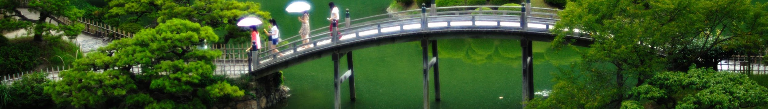
Actionable Science Outcomes
Best practices for organizations and individual researchers cause these desirable outcomes:
Knowledge is adopted by decision-makers.
Programmatic outcomes are accomplished.
The knowledge itself becomes sustainable: it’s regularly and continually used and updated.
From: Gerber et al. 2020, p. 5, https://doi.org/10.1111/csp2.295
Notes:
Notes to Instructor: In the planning stages for a project, leave time to dream and brainstorm best-case scenarios as well as problems. What is your group’s highest aim for the project, and what could its best impacts be in given time frames (3, 5, 10, 50 years)? How could your project work as a seed that sprouts roots and branches far into your community and region?

