Slide 1
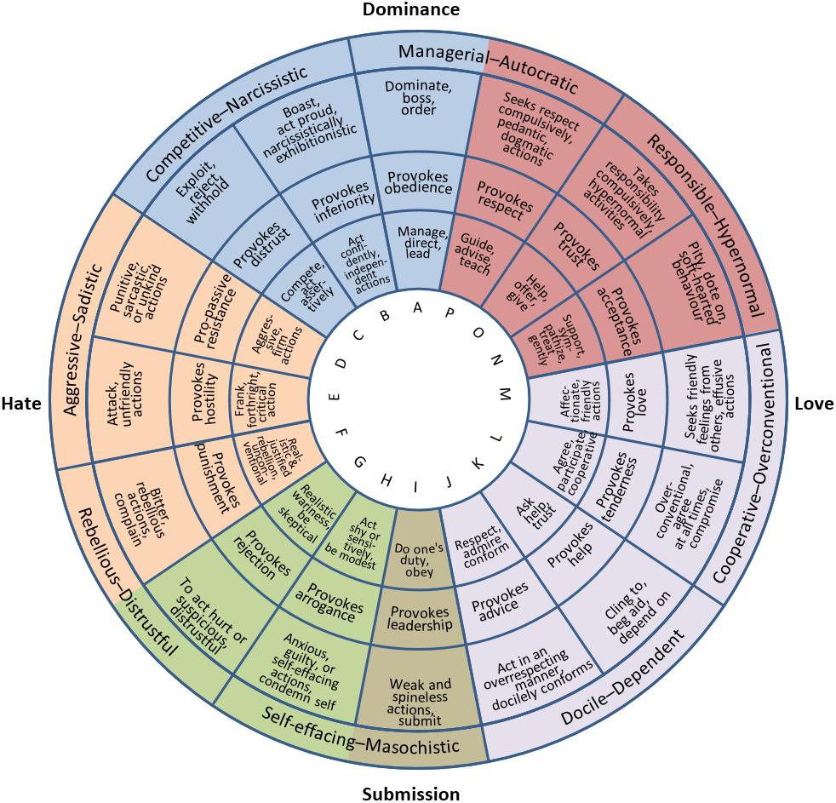

Creating
Interdisciplinary
Research Teams
This diagram of the Interpersonal Circumplex provides a model for conceptualizing interpersonal behavior.
Image by BoH via Wikimedia, 4.0.
Notes:
Notes to Instructor: Learners may consider how various personality types influence interpersonal communication styles, and how a balance of different personalities can both benefit and challenge group trust, synergy, and productivity. Admittedly, this diagram imperfectly captures the complexity of individuals in particular social contexts. For a minute, ask learners to read this chart and identify which letter(s) (A-P) they believe most fully captures their own personality. What can they learn about positive group dynamics from this self-reflection?

Slide 2

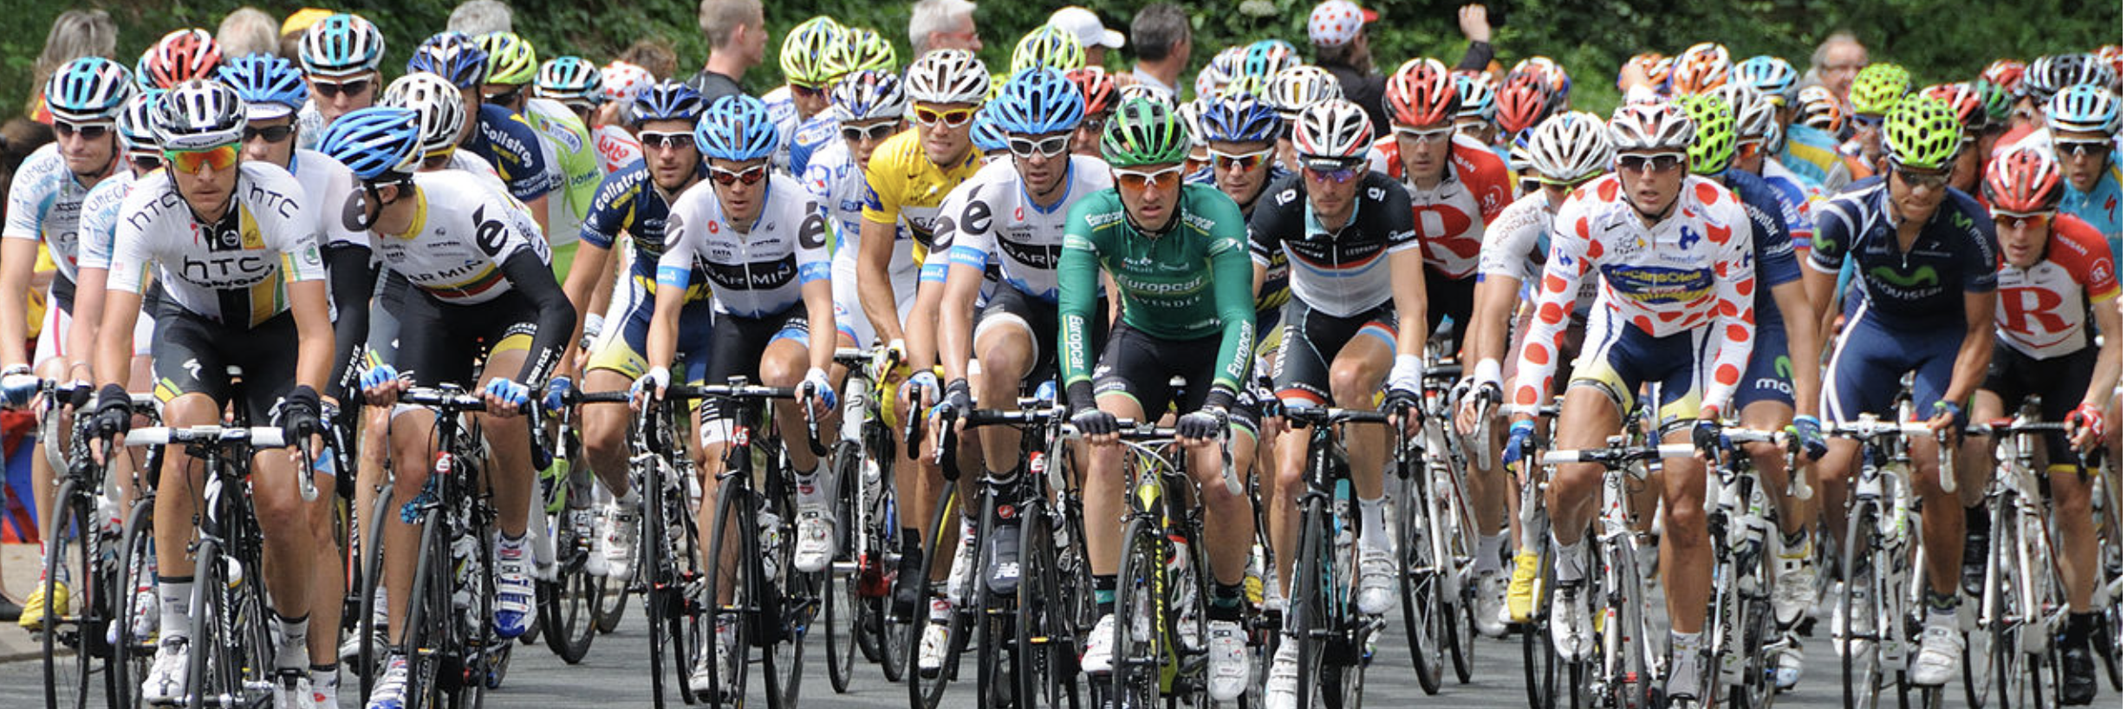
What Is the “Science of Team Science”?
from Cheruvelil et al. (2014) doi:10.1890/130001
Complex socio-environmental research depends upon diverse disciplines across the natural and social sciences, conceptual or mathematical modeling, narratives, policies, and human behavior.
Teamwork training requires knowledge of interpersonal skills such as social sensitivity and emotional engagement, as well as team-functioning skills like communication and delegation.
High-performing teams have common traits: team diversity, positive interdependence, integration of individual skills and talents, and interpersonal communication skills.
Image of a peloton of cyclists by Croquant via Wikimedia, 3.0.
Notes:
Notes to Instructor: Ask learners to imagine an ideal collaborator who is complementary to their skills. Does this collaborator have certain traits, like generalist, broker, empath? How can we move beyond a model that assumes a dynamic of inequality and hierarchy, such as managers and subordinates? Academia can be extremely hierarchical because of the tenure and administrative structures, and this hierarchy can erode group trust, esteem, and involvement in collaborative research, especially in the absence of good communication, social sensitivity, and equitable delegation of tasks.

Slide 3

Defining “Diversity”
from Cheruvelil et al. (2014) doi:10.1890/130001
Five dimensions of diversity are relevant to building well-rounded and equitable teams (p. 32):
      Career stage
      Degree of team member familiarity (~60% is ideal familiarity prior to group formation)
      Preferred interaction mode of individuals
      Types of discipline and number of representatives from each discipline (~2 is ideal)
      Worldviews and perspectives on a relevant issue (can relate to identities such as age, race, gender)
Image by Noj Han via Wikimedia, 2.0.
Notes:
Notes to Instructor: Diversity is important not only because it fosters inclusion and a range of perspectives, but because it integrates a variety of specific disciplinary skills and knowledge as well as different communication styles. Why do you think that a medium degree of familiarity (already knowing ~60% of the group, and not knowing ~40%) is seen as a “sweet spot” in group formation?

Slide 4
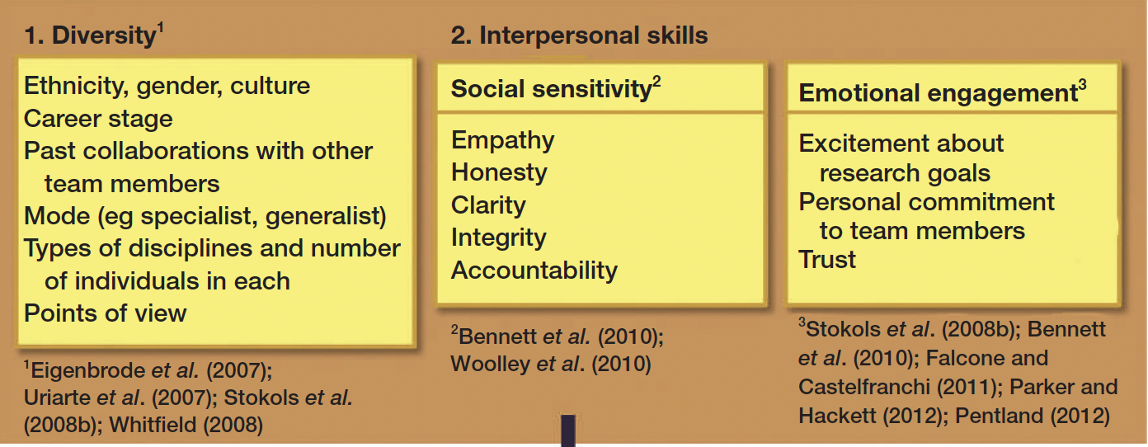
Characteristics of Team Members
Figure 2 (partial) from Cheruvelil et al. (2014) doi:10.1890/130001
Notes:
Notes to Instructor: Ask learners if they’ve ever been a member of a non-functional or “toxic” group. How did they know that it was a poor dynamic? The role of instinct and emotion should not be ignored here; in toxic dynamics, it can be easy to “feel” that things are wrong, and harder to articulate why. This experience is especially prevalent for people with certain identities: younger, female, minority, and junior scholar. Learners should feel empowered by recognizing how their positionality may affect their opportunities (both + and -), and how corrosive hierarchies in which they feel disempowered are not their fault.

Slide 5
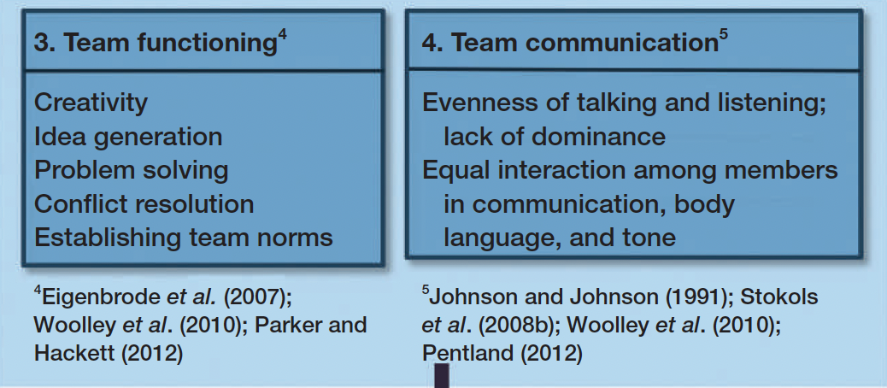
Interactions Within the Team
Figure 2 (partial) from Cheruvelil et al. (2014) doi:10.1890/130001
Notes:
Notes to Instructor: Ask learners to think of some characteristics of people they love to communicate with. Though their answers may be varied, themes will probably emerge that highlight the joy of shared insight, equality, empathy, creativity, and trust.

Slide 6
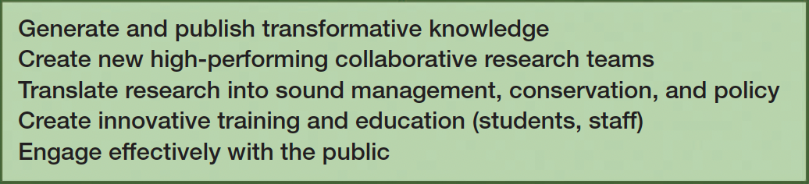
Desirable Research Outcomes
Figure 2 (partial) from Cheruvelil et al. (2014) doi:10.1890/130001
Notes:
Notes to Instructor: Learners should absorb the possibilities for desirable research outcomes far beyond simple “publication.” Though publishing is stressed as an individual career promotion goal, it should be seen as one outcome among many. Others may provide more immediate socio-environmental benefits, including management and policy, education, and public stakeholder engagement.

Slide 7
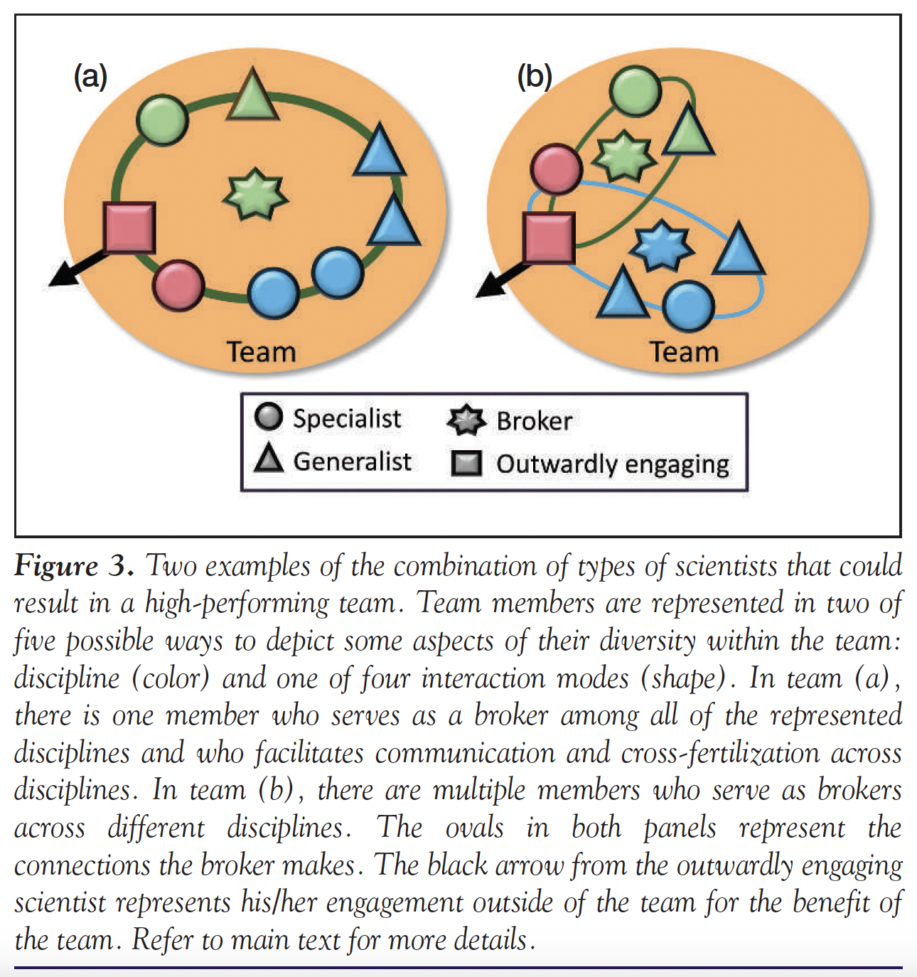
Two Examples of
High-Performing Teams
Figure 3 from Cheruvelil et al. (2014)
doi:10.1890/130001
Notes:
Notes for instructor: Note that this diagram depicts two different possible organizations of similar team structures, which both include specialists, generalists, brokers, and engagers. The difference is that (b) has two brokers, who each support a distinct set of sub-connections within the group. What kind of skills does a broker need to possess?

