Slide 1

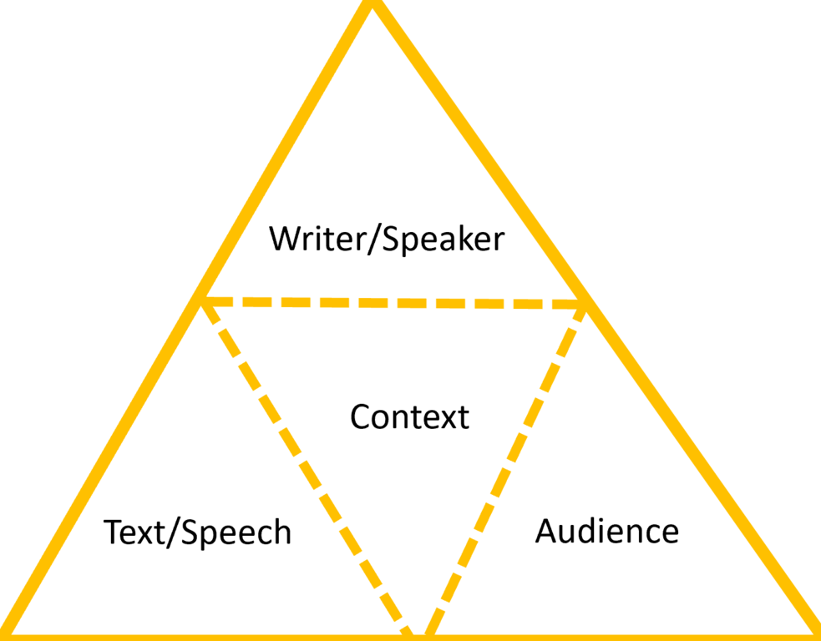
Critical Discourse Analysis:
Environmental Journalism
This Rhetorical Tetrahedron elaborates on the triad of ethos, pathos, and logos to show how writing’s context affects its design and impact.
Graph by ChloeGui via Wikimedia Commons, 4.0
Notes:
Notes to Instructor: The rhetorical triad may be new to learners, but it is old to the practice of discourse analysis. Ethos is the authority or reputation of the writer; pathos is the rhetorical use of emotion; logos is the deployment of facts and statistics in support of an argument. Ask learners: what are some prevailing modes of pathos in environmental writing? (anger, despair, others?) How can the bias toward negative pathos make environmental writing less effective as public discourse? And what are some ways that writers might approach environmental problems with a different tone?

Slide 2


What Is Critical Discourse Analysis (CDA)?
CDA represents a variety of quantitative, qualitative, and comparative approaches to analyzing texts to uncover texts’ connotations, biases, erasures, and social context.
CDA may be applied to:
          scientific publications
policy documents
archival and historical materials
            films, images, and other creative media
journalism
Unaltered photo by Jamain via Wikimedia Commons, 3.0.
Notes:
Notes to Instructor: The ethics of journalism require a balanced presentation of information, for example, representing all sides of an argument in public discourse. But ask learners about some ways that journalists can employ creative tactics, like lexicon (words used), metaphors, facts and statistics (logos), and emotion (pathos) to present a story weighted with particular values.

Slide 3

What Are Some Forms of CDA?
Visual Discourse Analysis (VDA): VDA reveals how images mediate themes like time, truth, and power. Visuals include photos, films, advertisements, and scientific charts and graphs. VDA can be applied to the discourse surrounding human landscape use, climate change, and greenwashing.
Narrative Discourse Analysis (NDA): Narratives have surface-level, denotative values; they also have implied connotative values, and their use can uphold myths that have a range of environmental effects. NDAs are direct reader responses to texts that question the truth of narratives and examine how they may be the construct of particular stakeholders, who may have submerged agendas.
Image courtesy of the UK’s Advertising Standards Authority
Notes:
Notes for instructor: Each of these forms of DA has a SESYNC Explainer dedicated to it. Links to Explainer 1 Overview; Explainer 2 VDA; Explainer 3 Narrative; Explainer 4 QCA.

Slide 4
What Are Some Forms of CDA?
Qualitative Content Analysis (QCA): Data-processing software allows analysts to compile thematic and lexical trends across hundreds of documents. QCA is a technological evolution that employs narrative analysis on a larger scale in order to handle the big data of public discourse and policy.
Image courtesy of the UK’s Advertising Standards Authority
Notes:
Notes to Instructor: Each of these forms of discourse analysis DA has a SESYNC Explainer dedicated to it. Links to Explainer 1 Overview; Explainer 2 VDA; Explainer 3 Narrative; Explainer 4 QCA.
https://www.sesync.org/resources/critical-discourse-analysis-what-it

Slide 5
How Will We Use CDA in This Lesson?
Excerpt: “The Feds Crack Down on Feral Cattle”
by Jonathan Thompson of High Country News:
It may be the most consequential action the federal government has taken in at least two decades to mitigate the impacts of overgrazing on public lands. It might even look like the start of real grazing policy reform, something conservationists have been pushing for since the 1970s. But there’s a catch: The only reason the Forest Service did something this time is that the bovines in question are feral — descendants of cattle abandoned by a belly-up livestock operator in the 1970s. Think of them as the bovine version of “orphaned” oil and gas wells, similarly sullying land and water and continuously belching methane.
This lesson takes a hybrid approach that integrates narrative and qualitative content discourse. Learners may also use visual methods if images are co-present with text.
https://www.hcn.org/articles/south-landline-the-feds-crack-down-on-feral-cattle
Notes:
Notes to Instructor: Ask learners to read this excerpt and name portions that reveal discourse strategies: actors, goals, values, and policy angles that are presented in a rhetorical way to the reader. In the next slide, we provide a sample analysis of the discourse of this narrative.

Slide 6
How Will You Use CDA in This Lesson?
Excerpt: “The Feds Crack Down on Feral Cattle”
by Jonathan Thompson of High Country News:
It may be the most consequential action the federal government has taken in at least two decades to mitigate the impacts of overgrazing on public lands. It might even look like the start of real grazing policy reform, something conservationists have been pushing for since the 1970s. But there’s a catch: The only reason the Forest Service did something this time is that the bovines in question are feral — descendants of cattle abandoned by a belly-up livestock operator in the 1970s. Think of them as the bovine version of “orphaned” oil and gas wells, similarly sullying land and water and continuously belching methane.
By highlighting different aspects of narrative, including actors, settings, and characterizations, the levers of rhetorical discourse emerge. This exercise also provides keywords that may be searched within and across articles and journals using the [ctrl-f] function.
https://www.hcn.org/articles/south-landline-the-feds-crack-down-on-feral-cattle
Notes:
Notes to Instructor: Each highlight color brings out a different level of discourse in this text. Green highlights refer to government policy; Yellow to environmental degradation; Blue to environmental actors (+/-); and Gray is a metaphor that constructs these feral cattle in a particularly negative light. From this brief excerpt, learners see how texts work on multiple levels by presenting an environmental case through a particular framing (here, a conservationist worldview), and deploying connotations (“belly-up livestock operator” sounds like a lazy, dead failure); emotions or pathos (gross lexicon of “sullying” and “belching”); and metaphor (feral cattle are abandoned oil wells). The most useful keywords to search across articles may be: government (Forest Service), conservationists, overgrazing, sullying (polluting, dirtying, ruining), public lands, and policy.

Slide 7
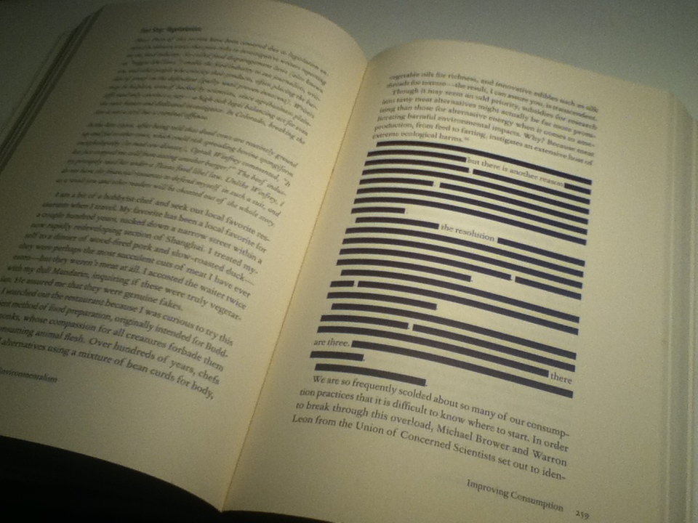
How Will You Use CDA in This Lesson?
Excerpt: “The Feds Crack Down on Feral Cattle” by Jonathan Thompson of High Country News
The analysis from the last slide can be used to evaluate other sources to compare and contrast vying discourses about the environment.
        Who is depicted in what framing (hero, villain, victim?), and what are they doing in relation nature?
        What keywords capture the article’s subjects and the qualities or connotations assigned to subjects?
        How do keyword quantities show rhetorical emphasis and choices?
        How does the lack of discourse or absence of keywords demonstrate disinterest or even erasure?
One of two censored sections of the 2012 environmental book Green Illusions by Ozzie Zehner.
Cropped image by Mutant 669 via Wikimedia Commons, 3.0.

Slide 8
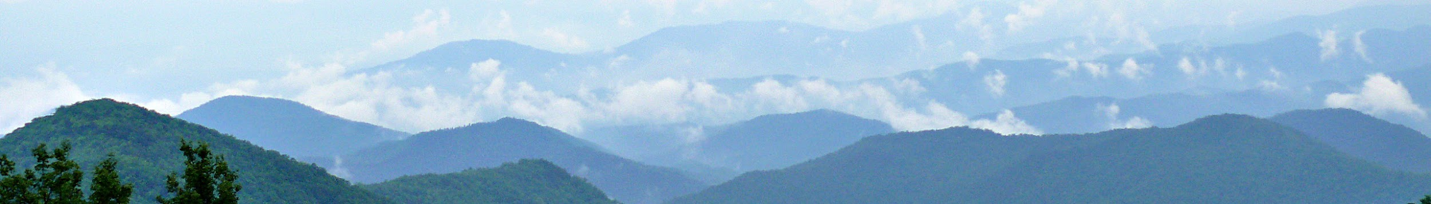
Burke et al. 2015:
Nature Talk in an Appalachian Newspaper: What Environmental Discourse Analysis Reveals about Efforts to Address Exurbanization and Climate Change
Burke et al. focus on a prominent Appalachian newspaper, The Franklin Press,
to asses how its discourse both reflects and constructs
the values of its readership in relation to their natural environment.
The environment is presented as a natural amenity to be consumed and enjoyed,
but rarely does TFP cover human impacts, changes in landscape,
or problems like exurbanization or climate change (186).
Both are affecting the local ecosystems.
Notes:
https://www.jstor.org/stable/44127087

Slide 9
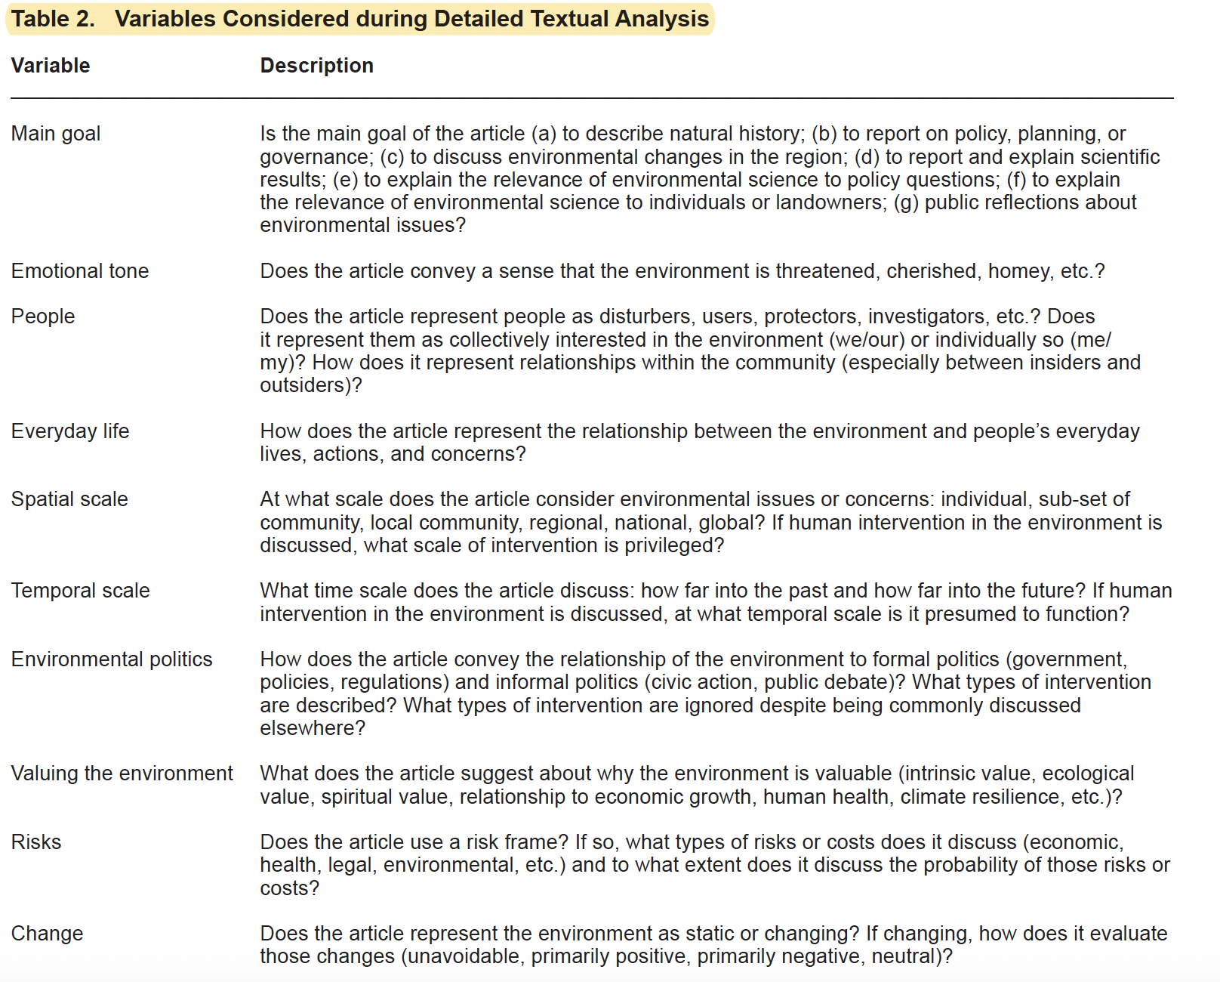
Burke et al. 2015 identified a series of variables to standardize their textual analysis across 53 articles.
Notes:
Notes to Instructor: Make this slide or table handy for learners as they decided on the terms of the CDA analysis during the lesson. They may find these variables and themes useful in guiding their keyword selection and tonal analysis.

Slide 10
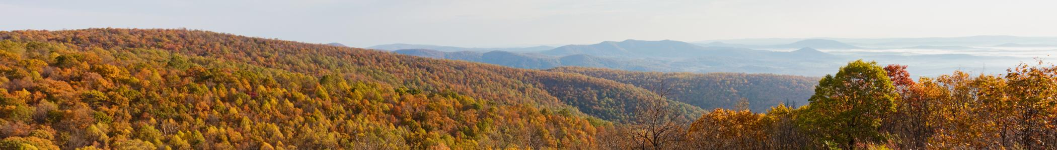
Burke et al. 2015
The Backyard Naturalist is a regular TFP column that yielded CDA insights:
        It reflects a conservative orientation toward the appreciation of natural amenities.
      It shies away from activist discourse that identifies problems and seeks protections.
      It represents “the outdoor life,” by focusing on a single animal or plant species.
      Its goal is to narrate natural history with a bias toward beauty.
      Humans are depicted passively in relation to change or degradation.
      The articles never entertain policy, management, or conservation measures.

Slide 11
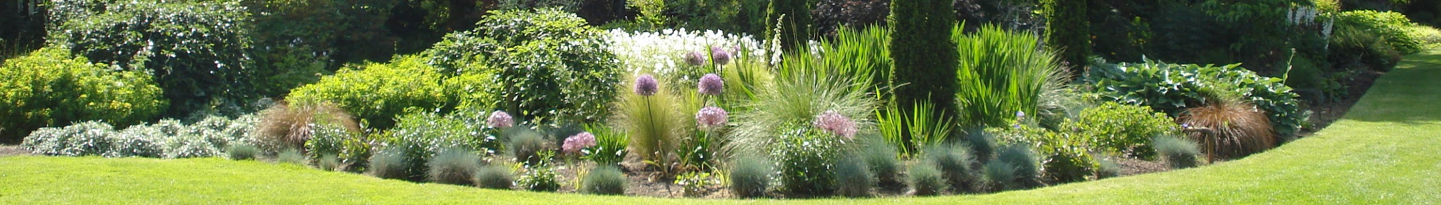
Burke et al. 2015
What insights can we take away from this CDA?
The Franklin Press has a strong ethos with the local residents.
It has a conservative tone of “uncontroversial politeness” over dispute (189).
It privileges domesticated nature (lawns, gardens) over wild or degraded areas.
There is little or no connection between human activities and degradation.
It shows little interest in policy or governance or explaining complexity or trade-offs.
It assumes cultural homogeneity in its readership, and resists a diversity of views.
Unaltered photo by Ikcur via Wikimedia Commons, 4.0.

Slide 12
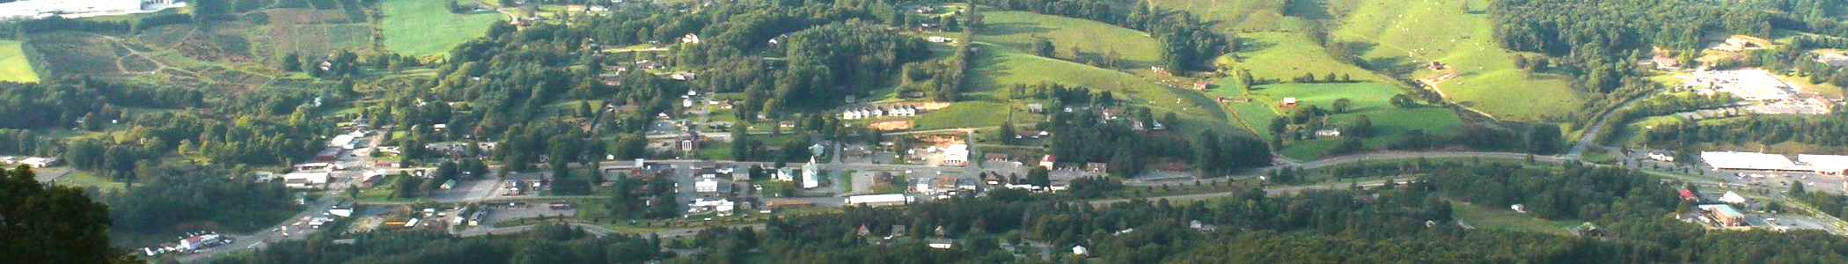
Burke et al. 2015
What insights can we take away from this CDA?
Environmental journalism has the power to energize a sense of collective agency.
It has the breadth to represent a diversity of opinion and views on policy.
It may choose to include heterogeneous populations, not only dominant cultures.
It has a responsibility to depict human drivers of environmental change.
The Franklin Press, a respected source of local news, fails on these fronts.
Brightened photo by Ikcur via Wikimedia Commons, 4.0.

