Slide 1

What’s the Buzz?
Stakeholder Analysis

Slide 2

What is a “stakeholder”?
Anyone who is affected by, or can influence, a decision or action
    Individual
    Group
Notes:
A stakeholder refers to anyone that has a “stake” or interest in an issue. This means anyone who is affected by – or who can influence – a decision or action. For example, in this classroom, as the instructor, I make many decisions that affect all of you as students – the course design, syllabus, readings, assignments, etc. As students, you are “stakeholders” in this class affected by my decisions. I am a stakeholder as a key decision-maker. And you also make decisions that affect the learning that occurs in this class. But some people outside of this room are “stakeholders” as well. For example, the staff who schedule the room in which this class meets also influence our experience in this class.
Stakeholders can be individuals (e.g., Jen) or groups (e.g., urban gardeners).

Slide 3
Who are stakeholders in pollinator conservation?
Uncommon Ground Site | Rogers Park Neighborhood | Chicago Region
Jen
Notes:
We can think about stakeholders in an issue at various scales. At the scale of the Uncommon Ground garden, Jen is a stakeholder in pollinator conservation. (Pose Q to students:) Who else would be stakeholders at the scale of this specific site? (Discuss)

Slide 4
Who are stakeholders in pollinator conservation?
Uncommon Ground Site | Rogers Park Neighborhood | Chicago Region
Jen
Jen’s boss
Other employees
Customers
Notes:
Other stakeholders at the site could include Jen’s boss (presumably has final approval of garden management decision), other employees (who might play a role in caring for the garden), customers (whose might enjoy seeing bees as they dine or be fearful of bees).
(Optional discussion question: Are bees stakeholders? There is not a right or wrong answer; typically the term refers to humans, although one can argue that non-human actors also be considered stakeholders.)
In a few minutes, within your small groups, I’ll ask you to identify additional stakeholders at two more scales: the Rogers Park neighborhood and the entire Chicago region. But first let me describe a procedure for taking your analysis beyond a simple list of individuals or groups with a stake in this issue.

Slide 5
Stakeholder Analysis
A technique to assist in making decisions about who to involve and how to involve them
Source: Dick, B. (1997) Stakeholder analysis [Online].
http://www.uq.net.au/action_research/arp/stake.html
Notes:
Stakeholder analysis refers to a technique to assist in making decisions about who to involve and how to involve when you want to create change within a system. The specific procedure I’ll describe was developed by consultants in Australia who specialize in community and organizational change. The process can be used by a singe person but works better when done with a small, diverse group.

Slide 6
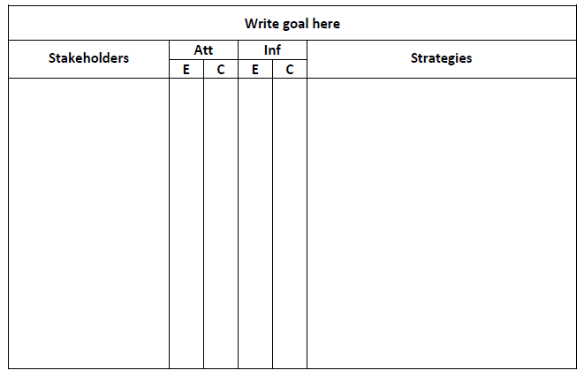
Stakeholder Analysis: Step 1
Draw a chart
Att=attitude Inf=influence E=estimate C=confidence
Notes:
“1. Draw up the chart
Prepare a chart on electronic whiteboard, or perhaps butcher paper, like this:
You will notice that the chart has 6 columns. The four columns in the middle need only be wide enough to contain a three or four letter symbol. You need a little more width in the right-hand column than in the left-hand one.” (Dick 1997)

Slide 7

Stakeholder Analysis: Step 2
Identify & list stakeholders
  Individuals and/or groups
  Brainstorm list on a working sheet of paper
  Then transfer to chart in rough order of importance
Notes:
“2. List stakeholders
Identify and list the stakeholders. These may be individuals, or stakeholder groups, or some combination. If stakeholders can be treated as a group, use groups. The most effective way of doing this is to list as many stakeholders as you can on a working sheet of paper. Then transfer them to the left hand column of the chart. It may help to list them in rough order of importance. (You may change your mind about their importance after this analysis.)” (Dick 1997)

Slide 8
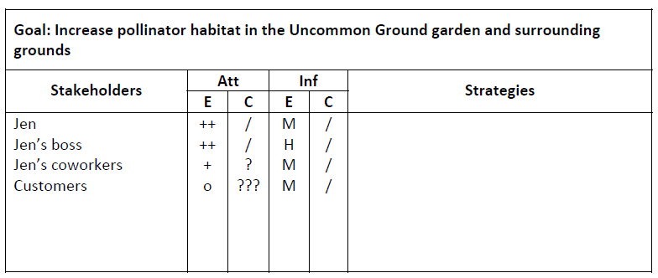
Stakeholder Analysis: Step 3
Estimate attitude and confidence
Notes:
“3. Estimate attitude and confidence
For columns 2 to 5, work across the page. Record your estimates of the following in the columns. In order, they are:
Column 2: Your best estimate of the stakeholder's attitude, from supportive to opposed. I usually find it is adequate to use a 5-category code:
++ strongly in favour, + weakly in favour, 0 indifferent or undecided, - weakly opposed, -- strongly opposed
Column 3: How confident you are about your estimate in column 2. Here you can use:
/ (a tick) for fully confident, ? for reasonably confident (some missing information or some doubts about interpretation), ?? for an informed guess, ??? for wild guess or sheer fantasy
Unless the group achieves immediate agreement, then at least one question mark is warranted.
Column 4: Your best estimate of the influence of the stakeholder. A three-category code is usually enough:
H high (this person or group has power of veto, formally or informally), M medium (you could probably achieve your goals against this person's or group's opposition, but not easily), L this person can do little to influence the outcomes of your intended actions
Column 5: How confident you are about your estimate in column 4. You can use the same codes as in column 2.” (Dick 1997)
Jen herself is a stakeholder. Her attitude toward pollinator conservation is highly positive and she’s confident in that estimate given she knows herself well. However, her influence as garden manager is medium; she makes many decisions about the garden’s management. At the same time, she needs approval for some decisions and relies on other staff to also tend the garden. Jen’s boss and co-workers are also stakeholders… [continue talking through hypothetical example in chart on slide; customers as stakeholders might be supportive of pollinator conservation or opposed to it if they are fearful of or allergic to bees, for instance].

Slide 9
Stakeholder Analysis: Step 4
Plan strategies
  If information insufficient, obtain more
  If information sufficient, involve stakeholder in planning for change
    Especially those with high influence
    For groups, will everyone participate or a representative?
Notes:
“4. Plan strategies
Plan your strategies for approaching and involving each person or group. Your estimates in columns 2 to 5 help you to do this. Your strategy is written in column 6. It usually takes the form of obtaining more information, or of involving the stakeholder in the planning for the change.
In general, question marks indicate a need for more information. The more question marks, and the more influence the person has, the greater the need. On some occasions you will choose to approach the person concerned. On other occasions you may instead approach someone else who can be assumed to know about the person's attitude or influence. (On occasion, you may want to obtain some of this information before completing the analysis.)
In general, high influence indicates a need to involve the person in some way. (Or, if you choose not to do this, and they are opposed, you may choose to find some way to neutralise their influence.) The people or groups who require most attention are those who are influential and opposed.
For involvement, decide the extent. For example:
* involved only as informants
* consulted
* directly involved in decision-making
* involved as co-researchers and co-actors
or some similar categories.
Where the stakeholder is a group rather than an individual, you will probably want to include in your decision the style of participation appropriate: for example, direct participation of everyone or representation.” (Dick 1997)

Slide 10
Stakeholder Analysis: Step 4
Plan strategies
Notes:
(Pose Q to students:) What strategies might Jen use with each of the stakeholders identified to reach her goal?
Example answers:
Jens’ boss – meet to discuss, get approval, ask boss to promote idea to other employees
Jen’s coworkers – discuss at staff meeting, seek other employees inputs about planting, maintenance, etc.
Customers – make small tabletop displays to educate customers about the effort, include brief survey with check to get customer input on level of support, potential concerns

Slide 11

What’s the buzz?
Stakeholder Analysis: Your Turn
Rogers Park neighborhood
Chicago region
Notes:
We’ve got a strong start on the stakeholder analysis at the site scale. Now it’s your turn to conduct a stakeholder analysis another scale.
(Give instructions for small group work – see Teaching Notes.)

