Slide 1
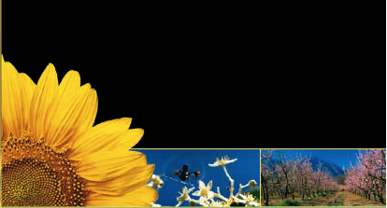
Potential Effect of Climate Change on Pollination

Slide 2
On average, the onset of spring snowmelt in the Rockies now occurs approximately two weeks earlier than in the late 1970s. What may have caused this to occur?

Slide 3
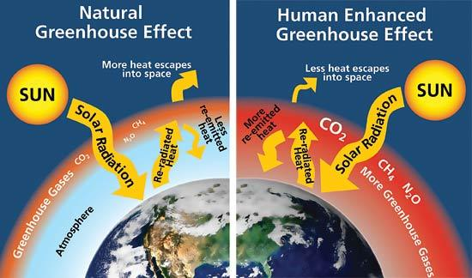

Slide 4
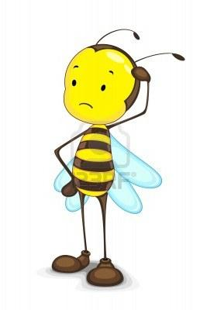
Spring snowmelt is occurring earlier in the Rocky Mountains.
Why would this confuse bees??

Slide 5
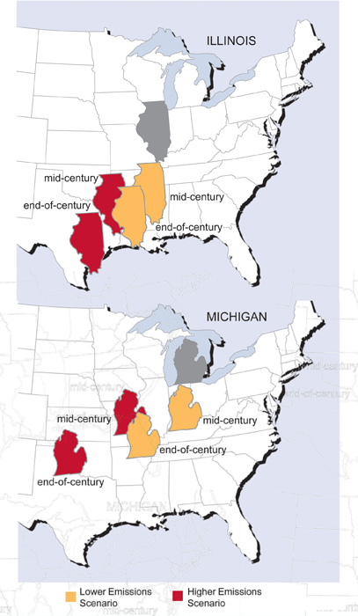
Model projections of average temperature and precipitation changes in Illinois for mid-century (2040-2059) and end-of-century (2080-2099) indicate that summer in Illinois is expected to feel progressively more like summers currently experienced in states south and west.

Slide 6
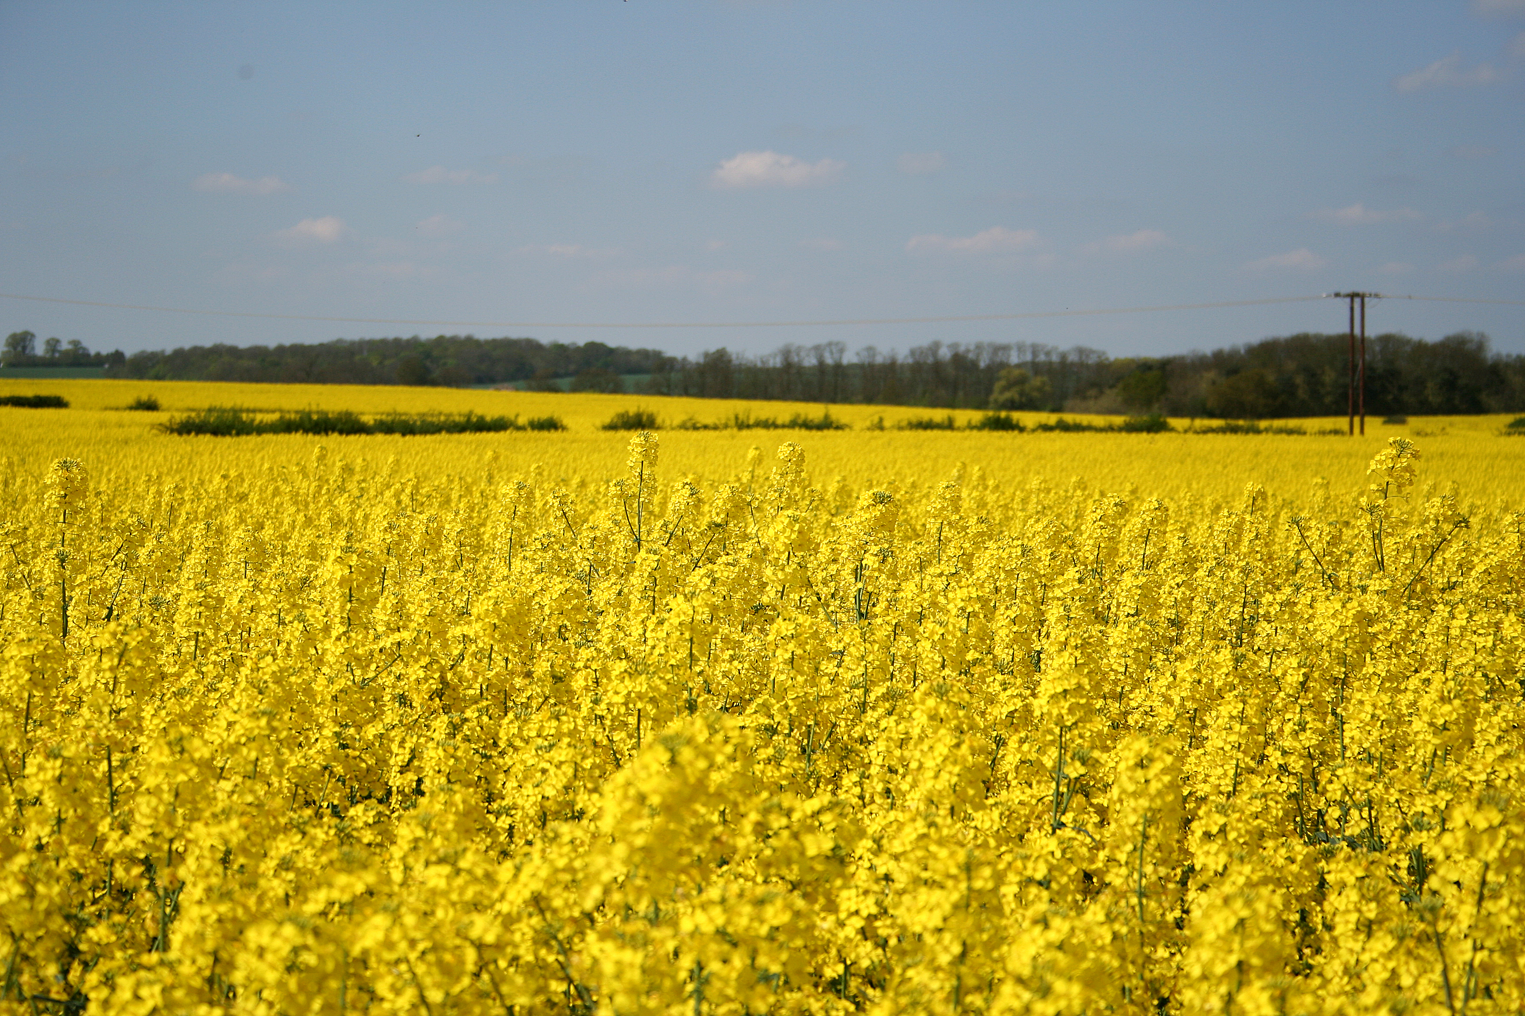
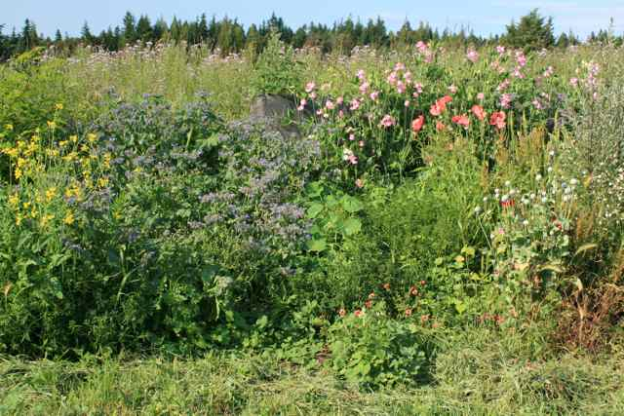
Which may help pollinators to survive climate change?
Monoculture
Vs.
Polyculture

Slide 7
Relevant News Reports
http://www.livescience.com/25232-early-snowmelt-rockies-hummingbirds.html
http://content.usatoday.com/communities/greenhouse/post/2010/09/climate-change-threatens-bees-flowers-food/1#.UfJ6veBDwVQ
http://www.wired.co.uk/news/archive/2010-09/07/pollination-decline-proven
http://www.wired.co.uk/news/archive/2009-05/22/urban-hive-could-save-the-honey-bee

Slide 8
Image Credits
Slide #1 and Slide #4: images of bees
http://www.fao.org/fileadmin/templates/agphome/documents/Biodiversity-pollination/Climate_Pollination_17_web__2_.pdf
Slide #2: image of the Rocky Mountains
http://www.nps.gov/romo/parkmgmt/upload/climate_change_rocky_mountain2.pdf
Slide #3: diagram of the greenhouse effect
http://www.nps.gov/goga/naturescience/images/Greenhouse-effect.jpg
Slide #5: image of the predicted climate change in the Midwest
http://globalchange.gov/HighResImages/12-Midwest-pg-117.jpg
Slide #6: images of monoculture and polyculture
http://farm1.staticflickr.com/45/140859675_bb908eedd4_o.jpg
http://barbolian.com/bfblog/wp-content/uploads/2013/01/IMG_2976.jpg

