Slide 1
Focal Garden: Uncommon Ground
Uncommon Ground is host to the nation's first certified organic rooftop farm, located in Edgewater/Roger’s Park at 1401 W. Devon Ave. Each year the garden team grows a diversity of annual vegetables and herbs. Everything they grow on the roof ends up on the menu at the Uncommon Ground restaurant.
Details, including the rooftop farm report, are available online http://www.uncommonground.com/pages/organic_roof_top_farm_home/200.php
Notes:
Uncommon Ground is host to the nation's first certified organic rooftop farm. Each year we grow a diversity of annual vegetables and herbs. Everything we grow on the roof ends up on the menu! For more information, check out our rooftop farm report and resources pages.
http://www.uncommonground.com/pages/_farm_report_by_farmer_jen/152.php

Slide 2
Guiding Question 1-
What are the biotic and abiotic resources needed for producing food in an urban environment? Do these have management considerations that are similar/different from considerations in rural farms?
Abiotic factors:
--Management considerations for abiotic factors:
Biotic factors:
--Management considerations for biotic factors:
Notes:
Rough draft teaching notes: students should think about the following abiotic factors at a minimum:
Soil, light, water, temperature
Soil and water considerations: soil may need to be collected and transported from another location (especially if we’re talking about created garden beds on a hard surface, such as the rooftop garden in our focal garden). Advanced students may also note that soil formation and nutrient cycling processes are not likely to occur naturally, and must be “engineered” by the managers of the agroecosystem. Water also needs to brought in: main choices are municipal water (e.g., standard hose & sprinklers) and rainwater capture. Rainwater can be a good option, but filtering is often needed and if stored for longer periods of time, limiting growth of bacteria/ potential pathogens is a key consideration.
Light and temp considerations: light intensity and availability will vary seasonally; shade from other buildings is often an important consideration in the city for garden placement (e.g., plants in beds placed in full shade may not thrive). Sun-loving plants like tomatoes, should be placed in beds that get the most light; plants that are tolerant of cooler temps and some shade can be placed elsewhere.
Biotic factors to consider:
Humans, plants we select, all the fauna associated with plants: including beneficial insects, like bees that provide pollination, as well as organisms that can act as pests, including herbivores that graze on plants as well as the web of their natural enemies (e.g., parasites and predators). Humans (and our pets!) can also play the role of pests in an urban environment, if we harvest crops uninvited, or contaminate growing areas with trash or other wastes.

Slide 3
Guiding Question 1-
What are the biotic and abiotic resources needed for producing food in an urban environment? Do these have management considerations that are similar/different from considerations in rural farms?
Abiotic factors:
--Management considerations for abiotic factors:
Biotic factors:
--Management considerations for biotic factors:
Notes:
This slide may be used to fill in student answers, as well as prompt discussion to fill-in gaps as needed.
Abiotic factors: Soil, light, water, temperature
Soil and water considerations: soil may need to be collected and transported from another location (especially if we’re talking about created garden beds on a hard surface, such as the rooftop garden in our focal garden). Advanced students may also note that soil formation and nutrient cycling processes are not likely to occur naturally, and must be “engineered” by the managers of the agroecosystem. Water also needs to brought in: main choices are municipal water (e.g., standard hose & sprinklers) and rainwater capture. Rainwater can be a good option, but filtering is often needed and if stored for longer periods of time, limiting growth of bacteria/ potential pathogens is a key consideration.
Light and temp considerations: light intensity and availability will vary seasonally; shade from other buildings is often an important consideration in the city for garden placement (e.g., plants in beds placed in full shade may not thrive). Sun-loving plants like tomatoes, should be placed in beds that get the most light; plants that are tolerant of cooler temps and some shade can be placed elsewhere.
Biotic factors:
Humans, plants we select, all the fauna associated with plants: including beneficial insects, like bees that provide pollination, as well as organisms that can act as pests, including herbivores that graze on plants as well as the web of their natural enemies (e.g., parasites and predators). Humans (and our pets!) can also play the role of pests in an urban environment, if we harvest crops uninvited, or contaminate growing areas with trash or other wastes.
Transition to more detailed discussion on pollinators: many students noted that pollination is a key aspect of biotic factors in our urban agroecosystems. This potentially leads to a second guiding question:

Slide 4
Guiding Question 2-
Pollinators were among the important biotic factors in our agroecosystem. How do growers determine the importance of pollination on their garden or farm?
Hint: What crops are being grown? Which depend on pollinators?
Notes:
Teaching note: This may be a good time to review some highlights of the pollination chapter from Xerces Society—
Key highlights include that about 70% of our staple crops require insect pollination, and that 1 in every 3 mouthfuls of food and drink is pollinated by bees. Students should have captured that honey bees are an important part of this equation, and that European honey bees are an introduced species that’s placed in hives and managed near crops. There are also a number of bee species that are native to IL.

Slide 5
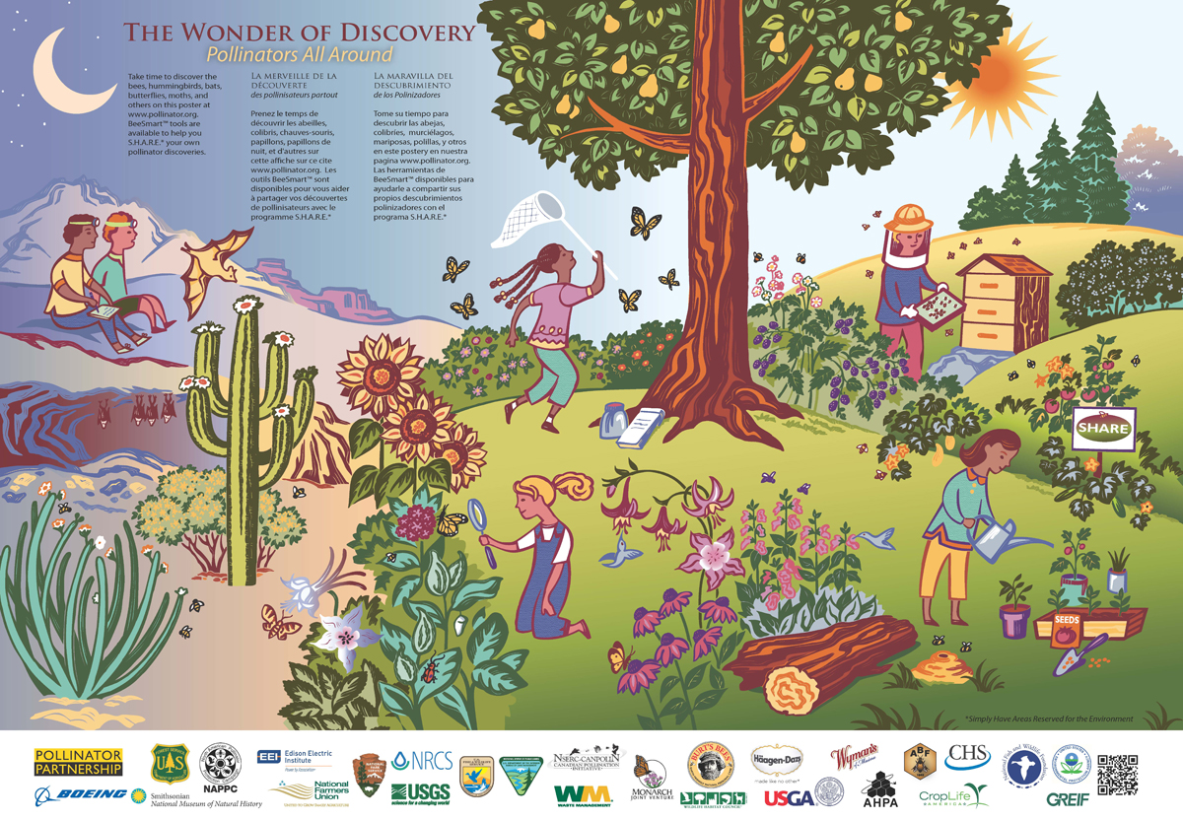
Developing a concept map— Describe the key elements of the social, biological and physical elements in our case study on Chicago pollinators. Create a visual representation on how they fit together, and their key interactions.
Tania will look for a general concept map visual to add here.
Notes:
Teaching notes: We’ve discussed important elements of the social, biological and physical elements in our case study on pollinators in Chicago. Your task is draw out how these elements fit together, as well as key interactions. Make sure your drawing is clear and well-labeled, and includes your name so that you can turn in your concept map at the end of class.
This poster was created by the pollinator partnership, (Pollinator Partnership: www.pollinator.org ) and it has some elements of how social, and biological elements relate to one another (Note: there’s not much going on here for the physical environment). Instructor may want to emphasize that this approach needs more detail to be an appropriate concept map for a class output.

Slide 6
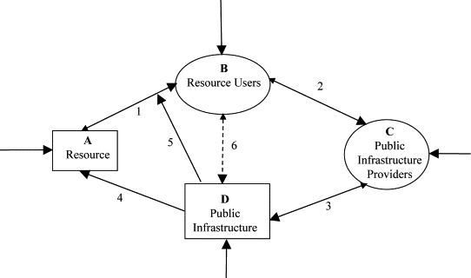
Developing a concept map— Describe the key elements of the social, biological and physical elements in our case study on Chicago pollinators. Create a visual representation on how they fit together, and their key interactions.
Concept map on
Notes:
Teaching notes: We’ve discussed important elements of the social, biological and physical elements in our case study on pollinators in Chicago. Your task is draw out how these elements fit together, as well as key interactions. Make sure your drawing is clear and well-labeled, and includes your name so that you can turn in your concept map at the end of class.
This concept map describes major categories discussed in relation to resource governance in social-ecological systems, found on www.sciencedirect.com . Highlight that students may want to consider including the social, ecological and physical systems as the major categories in their concept maps. Then these categories will need an additional level of detail, that describes the key elements included in each. As the concept map progresses, students should be thinking about how the key elements interact. This can be represented visually with arrows—and students should be able to describe what each of the arrows represents. This is something that students have seen before with food webs.

Slide 7
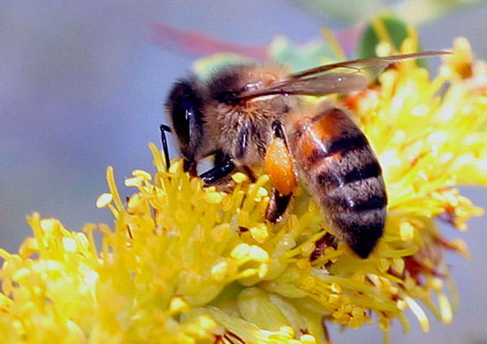
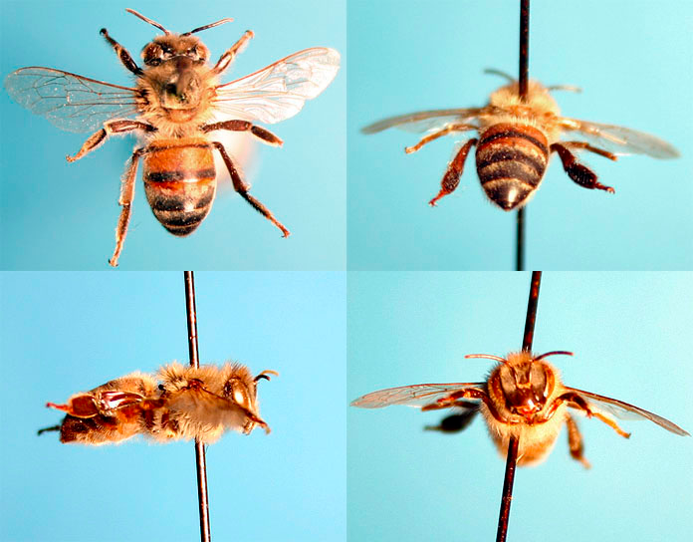
Honey Bee (Apis mellifera)
Native to the Old World.
Often used in managed hives for honey and crop pollination.
Body size: 0.5”, stocky.
Flight period:
Foraging distance:
Habitat preferences:
Floral preferences:
Queens prefer willow, plum, and apple. Workers prefer sweet clover and mint. Males prefer, horsemint, goldenrod, sweet clover, and aster.
Major crops pollinated in the Chicago area: ?
Notes:
http://beespotter.mste.illinois.edu/topics/bio/Apis/index.html
Flight period: Queens appear early in spring, as early as April 21 in Wisconsin (Medler and Carney 1963); colonies are relatively long-lived, lasting until late summer.

Slide 8
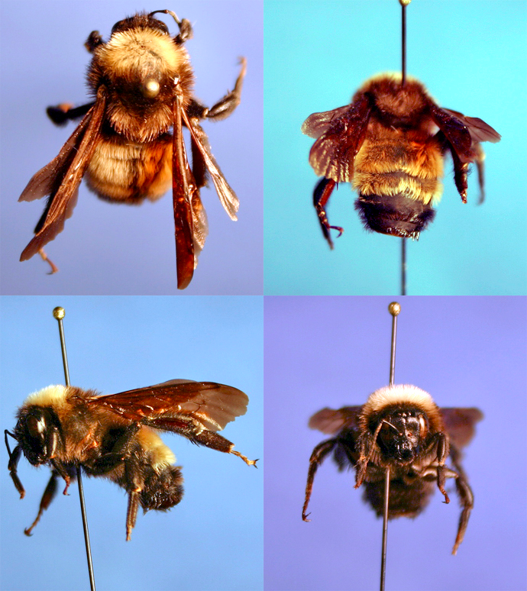
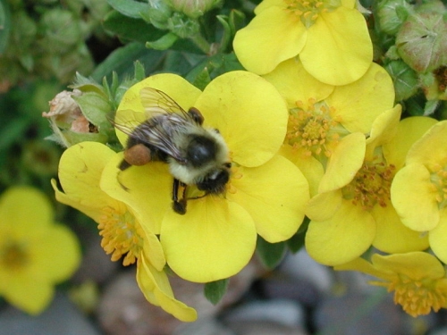
American bumble bee (Bombus pensylvanicus)
Notes:
http://beespotter.mste.illinois.edu/topics/bio/Bombus/pensylvanicus/index.html

Slide 9
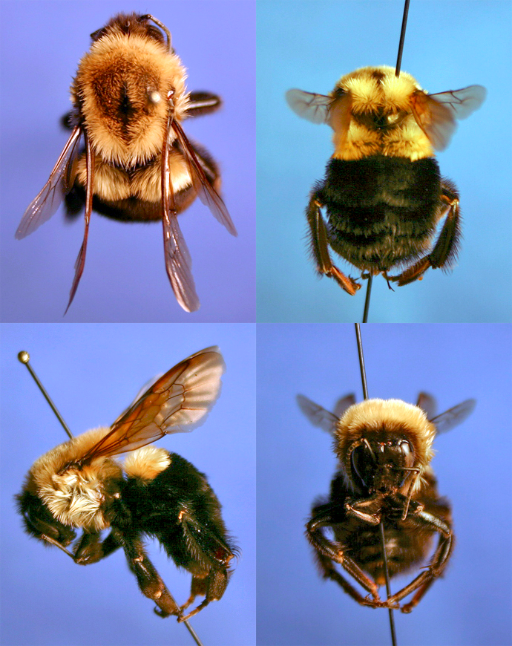
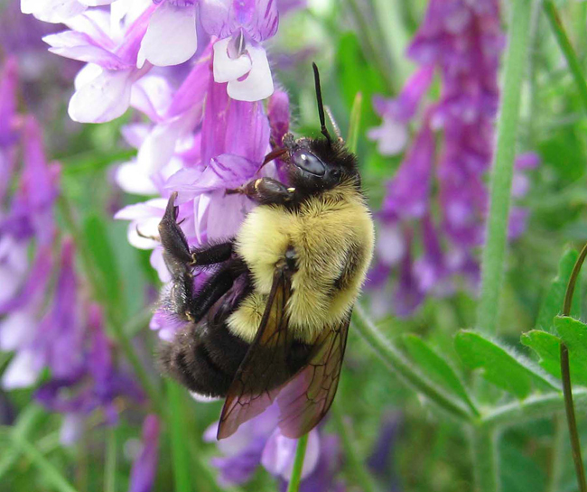
Common eastern bumble bee (Bombus impatiens)
Notes:
http://beespotter.mste.illinois.edu/topics/bio/Bombus/impatiens/index.html

Slide 10
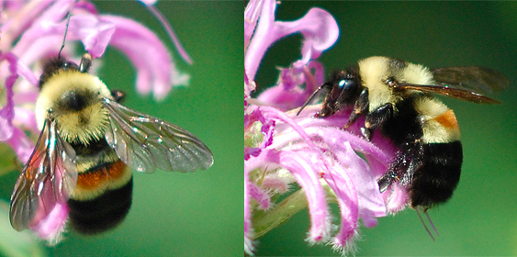
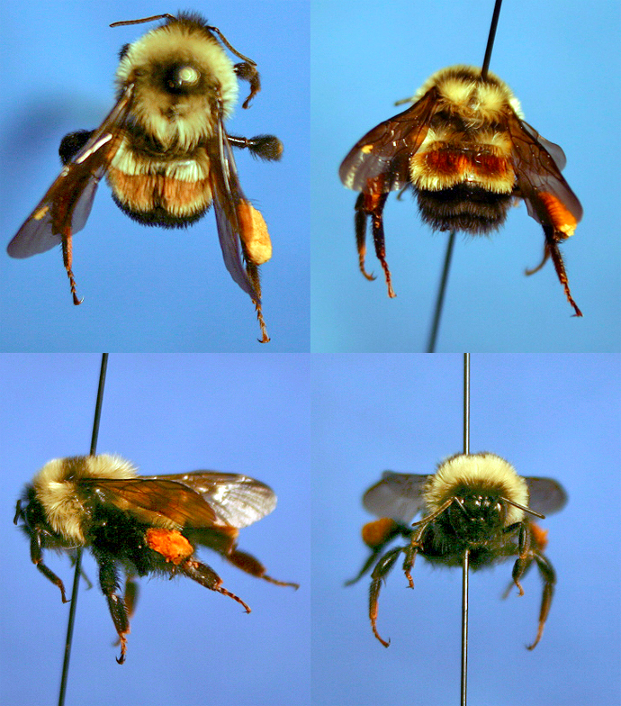
Rusty-patched bumble bee (Bombus affinis)
Notes:
http://beespotter.mste.illinois.edu/topics/bio/Bombus/affinis/index.html

Slide 11
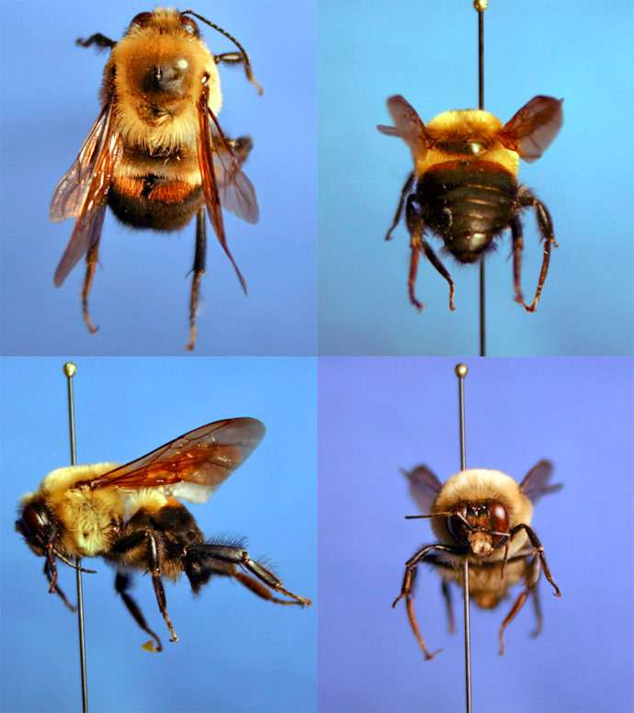
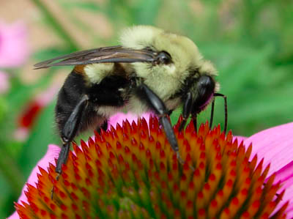
Brown-belted bumble bee (Bombus griseocollis)
Native to
Body size:
Habitat preferences:
Foraging distance:
Notes:
http://beespotter.mste.illinois.edu/topics/bio/Bombus/griseocollis/index.html

Slide 12
Turn in at the end of class:
Turn in your notes on the guiding questions (handout)
Draft Concept map
For next time:
Research on pollinators completed and ready to turn in at the start of class. This includes details for each focal pollinator, as well as recommendations for at least two additional/original resources.

