Slide 1

Payments for Ecosystem Services
Conservation Bridge – Cornell University
APPENDIX VIII-C
A Potential Way Forward for Bhutan’s Human-Wildlife Conflicts
Sean Callahan, Sara Cullen,
Anna Kusler, and Simone Passarelli
Cornell University
Spring Semester, 2012

Slide 2
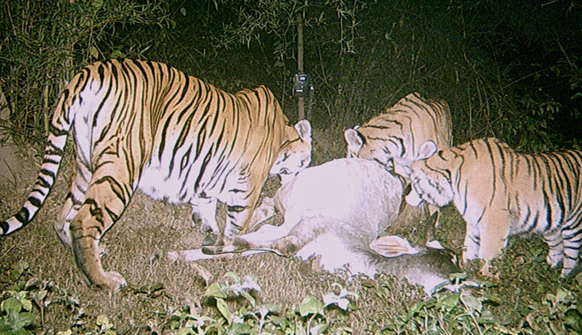
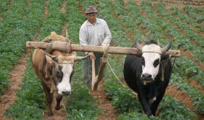
Human-Wildlife Conflicts in Bhutan
The Bhutanese people have derived their livelihoods from the environment for centuries
Buddhist philosophies have led to an attitude of respect towards the environment, aiding recent progress in conservationism
However, these successes have also resulted in increasing damages from wildlife on farmers’ resources
Violent retaliations on wildlife populations threaten to undermine ecological balance and recent progress in conservation

Slide 3
PES:
Payments for Environmental [Ecosystem] Solutions
"Voluntary, conditional agreement between at least "one seller" and "one buyer" over a well defined environmental service–or land use presumed to produce that service."
--Sven Wunder
Notes:
PES is an emerging policy solution, sort of like "polluter pays principle" that realign the direct private benefits with the social benefits that result from decisions related to environmental or ecosystem services. Since diligence to the environment accumulates social benefits for the entire ecosystem and does not directly (monetarily) benefit the individual, like most private markets, individuals are then less incentivized to care for the environment. This market-oriented solution helps to create an incentivized model to hedge against the externalities arising from this market failure.
(SCullen)

Slide 4
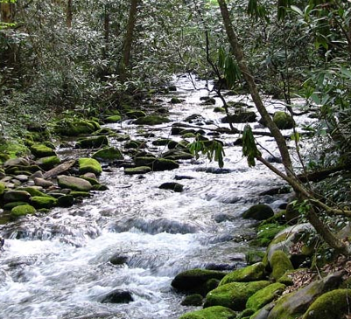
PES: 3 Key Aspects
Ecosystem services
  Provisioning services: fresh water
  Cultural services: ecotourism
  Regulating services: climate regulation
  Supporting services: Nutrient cycling and
  soil formation
Payment arrangements
  Pay-outs
  Insurance
  Credits
  Conditional compensation/monetary incentives
Drivers of the whole PES scheme (buyers/sellers)
  Domestic private sector
  International private/public institutions
  Government agencies
  households, farmers, cooperatives
Notes:
Ecosystem services are whatever nature provides that is valuable to mankind, however note there is a difference between ecosystem services innately provided by nature and those deriving from human husbandry. So you have to be very specific on what you are counting and assessing to make sure you are not double-counting or over-assessing.
Ecosystem services present benefits, opportunities and challenges at every level–local,national, and international
UNEP (2008) "payments for ecosystem services: getting started" Retrieved online 4/24/12: http://www.unep.org/pdf/PaymentsForEcosystemServices_en.pdf

Slide 5
Examples of PES market segments
Ecosystem Service | --------------------------------------------------------Buyer--------------------------------------------------------
 | Public sector | Private, under regulatory requirement | Private, voluntary (business case) | Philanthropic (non-use values) | Consumers of eco-certified products
Carbon sequest-ration | World Bank BioCarbon Fund | Kyoto protocol, CDM | Carbon offset projects by US corporations | Offsets of personal C emissions | --
Water Quantity | Water payments in South Africa | Salinity trading in Australia | Irrigators pay upstream land owners | -- | --
Flood Control | Sloping land program in China | Wetland mitigation banking in US | -- | -- | --
Water Quality | Watershed protection in Catskills, US | Nutrient trading for farm runoff in US | Water bottling companies, dam operators | TNC: farmer conservation easements | Organic certified products
Biodiversity | Europe agri-environment schemes for biodiversity | Habitat banking for endangered species in US | Farmers protect land to maintain pollination services | Conservation concessions | Bird-friendly coffee; Rainforest Alliance products
Landscape beauty & recreation | Europe agri-environment schemes | -- | Ecotourism | Conservation easements in US | --
Complied by Dr. Jeff Milder
Notes:
Ecosystem services present benefits, opportunities and challenges at every level–local,national, and international

Slide 6
Four Main Approaches to PES
Social-Developers
GOAL: Improve livelihood of providers (Bhutanese people)
FOCUS: property rights, social capital, and income needs
Pro-Markets Approach
GOAL: Tap markets' efficiency gains and economic development
FOCUS: Valuation of ecosystem services and market pricing
Conservation Approach:
GOAL: Sustainable funding for conservation
FOCUS: conservation gaims and ecosystem ethics
Governmental Approach:
GOAL: The motivation is mixed between social, pro-markets, and conservation
FOCUS: Ecosystem services but also redistribution and pay-back to constituencies
World Wildlife Fund (WWF)
Notes:
1. Social Developers Approach:
In the broader sense, our motivation in using PES is to help improve the livelihoods of Bhutan people while also saving the wildlife population
Focus on how we can protect their social capital and income needs (how can they manage wildlife better so that they can continue to raise livestock and grow their crops to gain income effectively).
2. Pro-Markets Approach:
A more narrowly defined approach that focuses on using PES to tap market opportunities by looking through the economic and market-oriented gains, rather than the broader social capital gains.
The focus is on market-efficiency tools
3. Conservation Approach:
The motivation is to promote sustainable financing for conservation
They mainly focus on overall conversation and ecosystem gains
4. Governmental Approach:
A mixed motivation combining the other three columns, but their focus may be more towards a national redistribution of pay and how they can benefit their largest constituencies and stakeholders
(SCullen)

Slide 7
Examples of PES in Action:
 | Service | Supplier | Buyer | Instruments | Intended Objective | Payment
Australia: Irrigators Financing of Upstream Reforestation | Reduce Water Salinity | State Forests of New South Whales (government agency) | Irrigation farmers associations (cooperatives) | Water transpiratoin credits earned by the State Forest of NSW agency and sold to farmers asssoc | large-scale reforestation, replanting of desalination plants, trees, and other rooted vegetation | Irrigator's pay 40$ per HA for 10 years to government agency, which then uses $$ to reforest on private and public lands
Pax Natura's PES Project Scope | reduce greenhouse gas emission, protect landowners biodiversity and scenic beauty | National Fund for Festery Finance (government agency) | European private power companies and European governments | Carbon credits | Stop the deconstruction of Costa Rica rainforest and recapture country's land-mass to forest-cover while helping private landowners protect watersheds and biodiversity | International companies pay national government agency for overuse of resources to save globally-valued environemtnal services of Costa Rica
Notes:
http://www.paxnatura.org/CostaRicanPESProgram.htm:
Costa Rica is a country known to implement PES systems to achieve mitigation of greenhouse gas emissions, protection of scenic beauty, biodiversity, water for both rural and urban use
The buyers are European power facilities and governments who are in need to offset their emissions and care about the global social benefits accruing from international offsetting. The program, National Fund for Forestry Finance works as a supplier in Costa Rica to buy the credits (payment is carbon credits) and distribute the valuable carbon sequestration service needed to achieve their goals
Currently this PES scheme has benefited over 7,000 small-medium scale private landowners for environmental services and their property protection in terms of biodiversity and conservation.
(SCullen)

Slide 8

How could this apply to Bhutan?
Desired Outcomes:
Use economic incentives to help attain governmental conservation goals and global social benefits
Use market-based approaches to promote better livestock management practices by farmers
Link conservation with poverty alleviation for mutual buyer/seller benefits
Notes:
Notes for this slide could get more specific on how we can achieve Bhutan's most desired outcomes through an analysis of opportunities, challenges, and available buyers/ sellers.

Slide 9

PES possibilities in Bhutan
Establish a PES system where farmers are the sellers and the government is the buyer
  1) Establish insurance policies for farmers in cases of wildlife losses
  2) Give farmers conditional payouts based on the realization of certain goals, i.e. population levels
  3) Offer payouts or other monetary incentives to farmers who adhere to certain management practices, such as fencing
PES scheme could include one or a combination of these strategies
Notes:
Based on our group's analysis of the project, we're not going to assume that PES is the best way to go since we aren't familiar with the context, and especially since this is supposed to be a participatory management strategy. Rather we're offering an analysis of how PES could be used if it were to be deemed the best management strategy for addressing the human wildlife conflict problem
fencing: providing habitat, forest understory,
report shows that payouts don't work: need conditionality

Slide 10

Plan for Education
Initiate education programs in local communities about the sources of human-wildlife conflicts and the importance of conservation efforts
Advertise the PES plan through literature distribution at the nine model sites
Establish workshops and outreach programs to implement projects and create ongoing access to information
Target community leaders to serve as program specialists and government liaisons
Notes:
As part of our project, we plan to create \presentations for both potential buyers and sellers of ecosystem services

Slide 11

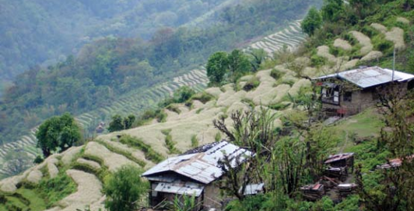
Mutual Benefits
Farmers benefit from:
  Increased income levels
  Improved government networks and experience
  with external business activities
  Increased knowledge of sustainable practices
The government benefits from:
  Maintenance of biodiversity
  Preservation of lucrative ecotourism business
  Protecting their investments in
  national conservation efforts
The environment benefits from:
  Maintenance of population levels
  Regrowth of forest understory

Slide 12

(cont.)
Four Steps to Implementing PES Scheme
Structuring Agreements
  Designing management and
  business plans
  Reducing transaction costs
  Determining equity criteria
  Selecting contract and
  payment plan
Implementing PES Agreements
a. Finalizing the management plan
Verifying service delivery
Monitoring, and evaluating
the system

Slide 13

Four Steps to Implementing PES Scheme
Identifying Service Prospects and Buyers
  Defining, measuring, and assessing the ecosystem.
  Determine the value of the services
  Identify buyers/sellers
  Consider whether service is sold to individual or group
Assessing Institutional & Technical Capacity
  Assessing legal, policy, land ownership rules.
  Survey existing PES rules, markets, support services, and organization
Adapted from UNEP (2008). Payments for Ecosystem Services: Getting Started.
Notes:
These are some of the types of slides we would put in the powerpoint for the potential buyers, which is the government

Slide 14
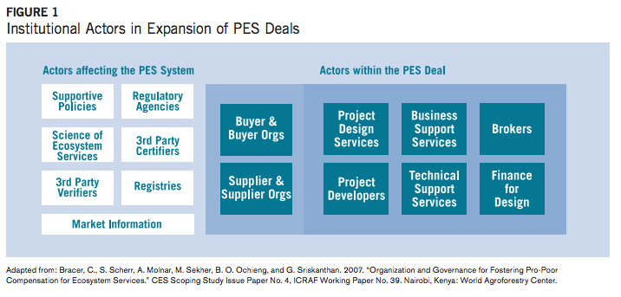
Actors in PES Implementation

Slide 15

Potential Short-Term Challenges to a PES Scheme
Establish brokers to manage programs and exchanges
Obtain funding for start-up and transaction costs
Overcome cultural barriers to convince farmers to participate in long-term conservation benefits
Educate farmers on how PES works and would benefit them
Collect data on HW conflicts and effects
Notes:
Government does not have to be the sole provider, $$ could come from World Wildlife Fund, TNC. Some of sites are corridors,

Slide 16

Potential Long-Term Challenges to a PES Scheme
Create ongoing access to information and resources for farmers
Ensure protection for sellers when external factors influence adverse outcomes for wildlife populations
Establish monitoring and evaluation systems for programs
Conduct environmental impact assessments

Slide 17

Conclusions
Human-wildlife conflicts in Bhutan are increasing due to recent success in government conservation programs
We must find way for farmers and wildlife to peacefully coexist
Payments for ecosystem services (PES) is a tool that could potentially create the proper incentives for farmers to improve management practices
PES is a dynamic scheme that offers mutual environmental and economic gains for both farmers and the government

